Slide 1
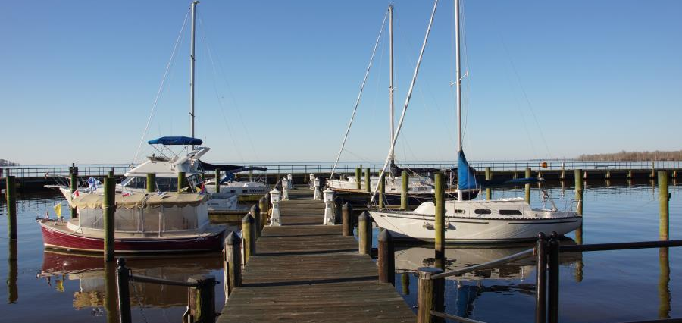
Public-Private Partnership to Provide Water Transportation in the Albemarle Sound
August 28, 2018
Professor Nicholas Didow
4516 McColl Building
Kenan-Flagler Business School
University of North Carolina
Chapel Hill, NC 27599-3490
nick_didow@unc.edu 919.962.3189
HARBOR TOWN PROJECT
Katie Bradshaw, Heather Brutz, Kiara Burroughs, Elisa Elkind, Cindy Frantz, Maria Grimshaw, Taylor Mallard, Susan Sullivan, Brandon Stephenson, Elise Wagner
Notes:
Slide notes:

Slide 2


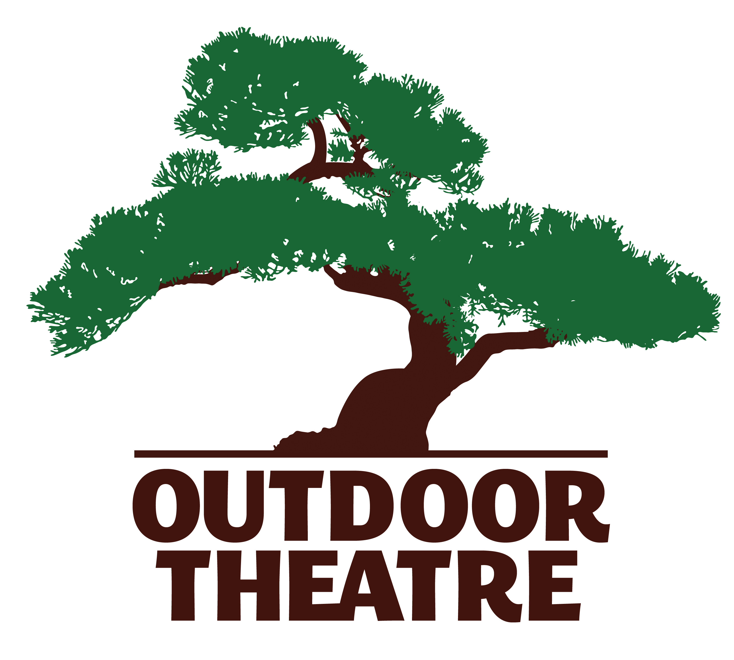
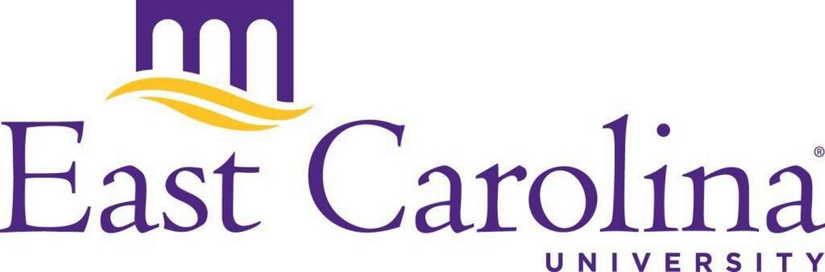

The Harbor Town Project team is a collaborative partnership across the IBX and beyond.
The team also includes Bunny Sanders, Phil McMullan, and Peter Thomson, who developed an earlier version of this strategy in 1993.

Slide 3
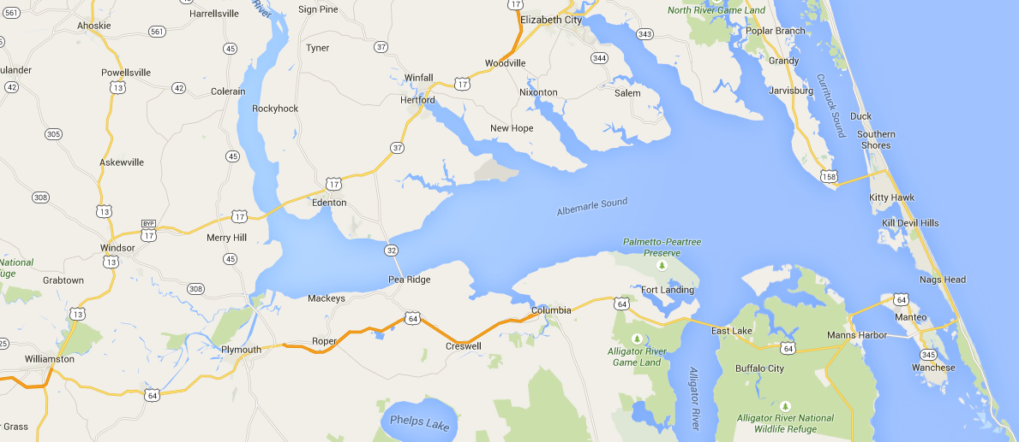
A private ferry system is one of three Phase One initiatives to increase tourism and create sustainable jobs and careers.
Themed Renewal of 5 Communities
Regional Water Ferry Transportation System
Renewal of 25 Existing Regional Eco and Historic Tourism Sites

Slide 4
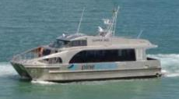
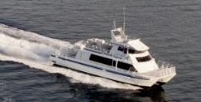
A private passenger ferry system serving the Albemarle Sound is an attractive investment opportunity that can be profitable.
Five Boats
49 seat catamaran
149 seat catamaran
Towns
In phase 1, ferries stop in six towns:
Elizabeth City
Edenton
Hertford
Plymouth
Columbia
Kitty Hawk
Impact
The ferry has the potential to create 94 jobs. Tourism is estimated at $14M.
Cos
t
$13.8M in capital expenditures is required to launch the ferry. Average annual operating expenses are $1.95M.
Return
The ferry has the potential to be profitable in year 1. Year 1 annual ridership is projected to be 107,000.

Slide 5
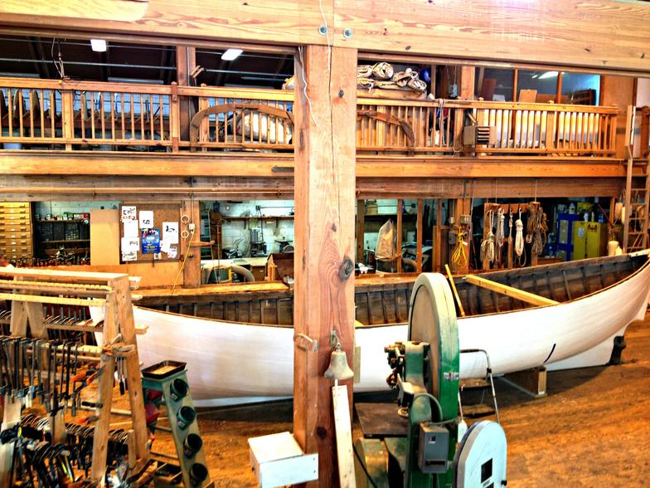

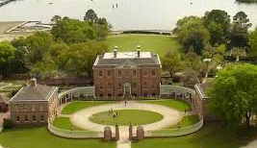
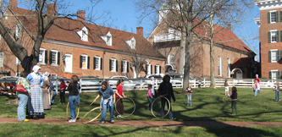
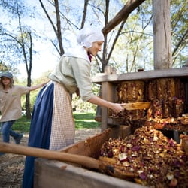
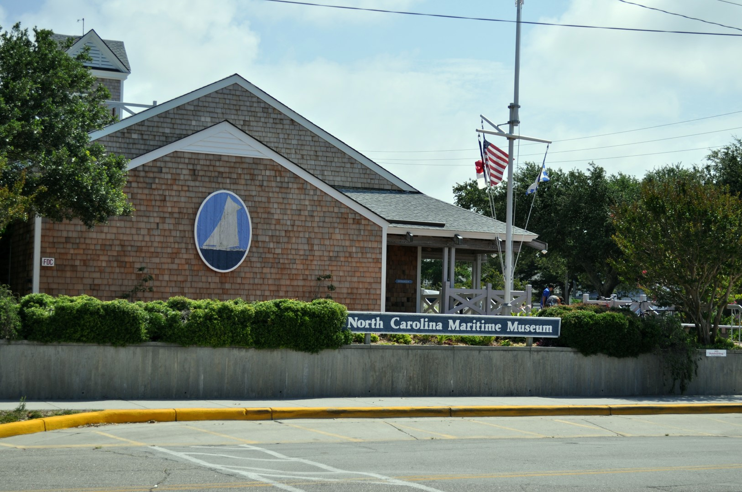
The ferries and coordinated themed renewal of IBX communities and nearby tourism sites could also attract many annual visitors traveling by car.
2017 annual visitors to somewhat comparable tourist attractions
Colonial Williamsburg
568,932 (2016 @ $35+ tk)
Tryon Palace, New Bern
249,233 ($20 adult tk)
Old Salem, Winston-Salem
204,601 ($18 adult tk)
NC Maritime Museum &
Watercraft Center, Beaufort
279,985 (?)
Elizabeth City
Edenton
Hertford
Plymouth
Columbia
Impact
Renewal of the communities and nearby sites could result in 200 to 250 new jobs and new careers across the IBX.
Cos
t
About $8M will be required to renew the towns and sites to make them interesting and engaging for tourists.
Return
200,000 tourists a year traveling to the IBX towns by car would result in about $26,200,000 in additional tourism spending.
Sources: Carolina Publishing and Associates, 2017 NC Museums and Historic Attractions; Colonial Williamsburg 2017 Annual Report; 2013 North Carolina Regional Travel Summary, North Carolina Department of Commerce; IMPLAN; Team Analysis

Slide 6
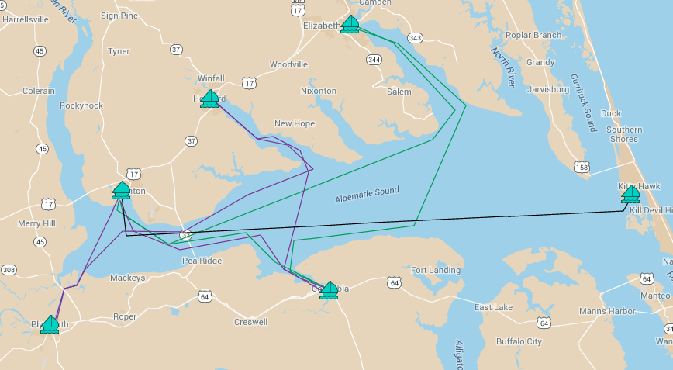
Ferry routes could include Elizabeth City-Columbia-Plymouth-Edenton- Hertford circuits, and a Kitty Hawk-Edenton direct express.
Average trip: 66 min @ 32 mph (28 knots) Plymouth-Edenton: 24 mins
2 Ferries on Kitty Hawk-Edenton Direct Express: 1 hr 45 mins
1 Ferry on Clockwise and 1 Ferry on Counterclockwise 5 town circuits
1 Ferry available for maintenance, charter, or special scheduling
Why These Cities:
Location (accessibility and inter-distance)
Infrastructure and amenities
Vitality, attraction, and potential
Bring more tourists to BOTH the OBX AND the IBX
Generate tourism in the IBX
Complement existing NCDOT ferry service
Elizabeth City
Hertford
Kitty Hawk
Edenton
Plymouth
Columbia
Quick ramp up time & flexible hop on hop off trips
Total operating hours/day per vessel: 10.5 hours
Source: NCDOT GIS Unit
Notes:
Slide 1 Concept

Slide 7
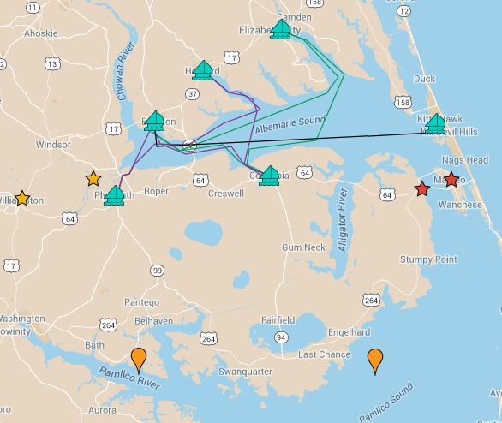
More routes and ferries can be added over time to include other locations on the Albemarle Sound, IBX, OBX, and Pamlico Sound.
Connect to other IBX and OBX cities
Add one-off trips to more cities near the Albemarle Sound and up rivers
Reach towns along the Pamlico Sound and Pamlico River
Complement ferry service provided by NCDOT Ferry Division
Windsor
Manteo
Manns Harbor
Williamston

Slide 8
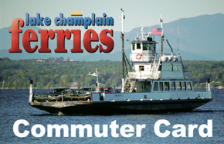
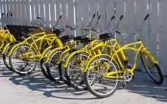
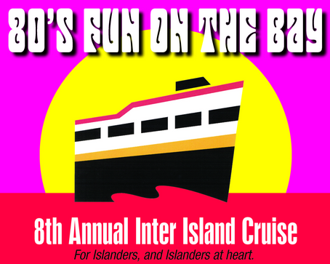
We can apply best practices from other successful public and public-private water transportation systems.
PRICING
PARTNERSHIP
PRODUCTS
Local resident discounts
Commuter/education bulk pass
Hop on/hop off pricing
Family/seasonal passes
Ticket prices vary greatly
Public transportation at docks (bikes rentals, etc.)
Onshore nature walks
Discounts at local businesses
Onboard entertainment
Seasonal schedule
Onboard concessions
Special event charters – nature talk, star gazing, weddings, wine and cheese, sunset dinner and drinks, holiday cruises

Slide 9
Based on benchmark cities and NCDOT Ferry System data, the IBX ferry system will operate 174 days a year with seasonality in ridership demand.
 | Monthly Total | Operating Days | Average Daily Ridership
January | - | - | -
February | - | - | -
March | - | - | -
April | 6,198 | 12 | 516
May | 11,812 | 19 | 622
June | 17,052 | 30 | 568
July | 23,591 | 31 | 761
August | 21,409 | 31 | 691
September | 14,499 | 30 | 483
October | 8,639 | 14 | 617
November | 3,777 | 7 | 540
December | - | - | -
Total | 106,977 | 174 | 615

Slide 10
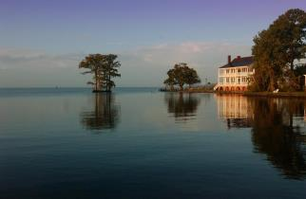
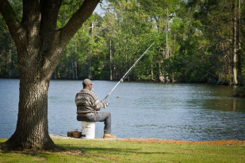
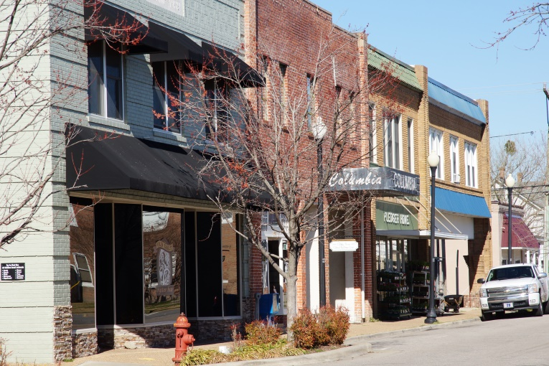
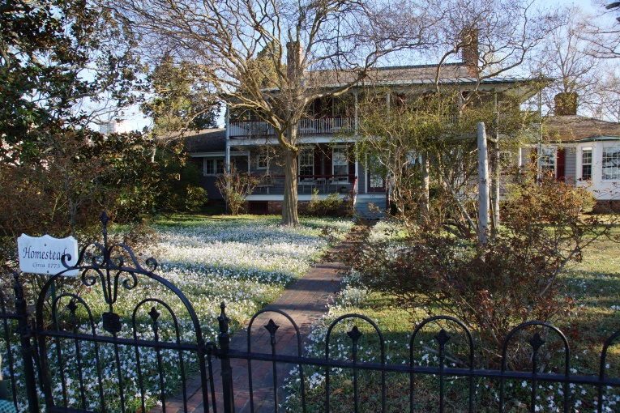
Exploring the IBX is a perfect way for visitors to experience North Carolina.
Idyllic Atmosphere
Outdoor Fun
Charming Villages
Historic Architecture

Slide 11
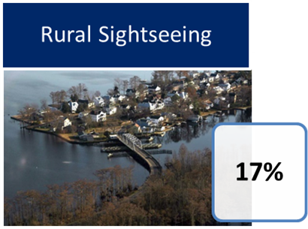
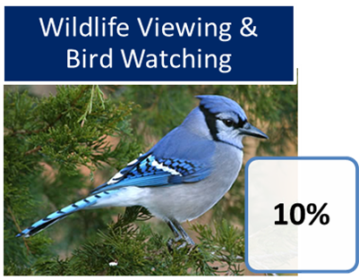
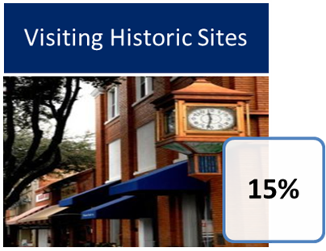
Between 100,000 and 140,000 tourists from the OBX might enjoy riding the ferry and visiting the IBX each year.
8 million
Tourists who visit the Outer Banks annually
17%
Interested in rural sightseeing or historical tours
1.36 million
Outer Banks tourists interested in rural sightseeing
10%
Assumption about how many would take the ferry
Sources: 2013, 2017 North Carolina Regional Travel Summary, NC Department of Commerce; Economic Impact
of Travel on Counties, NC Department of Commerce.

Slide 12


Weekenders or Day Trippers can be attracted from population centers within driving distance of the Albemarle Sound.
4,042,671
2,399,431
3 hours
2 hours
1 hour
728,741
Source: US Census, Social Explorer, Team Analysis

Slide 13
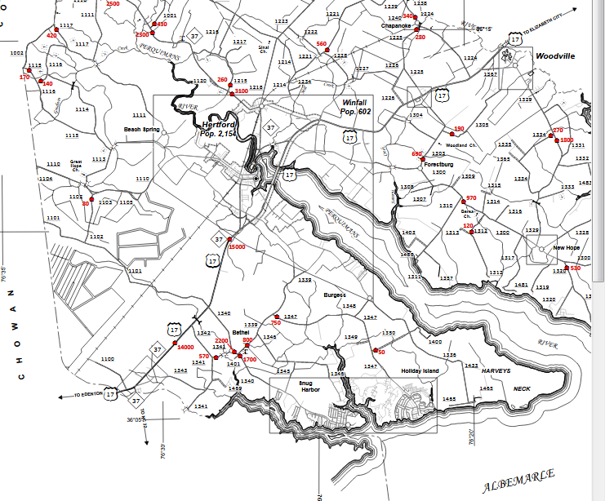
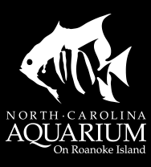
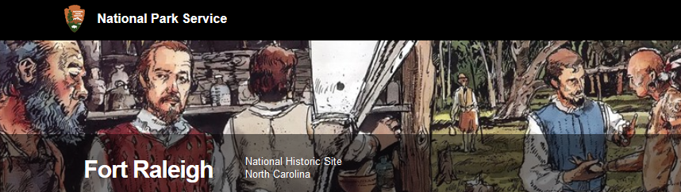
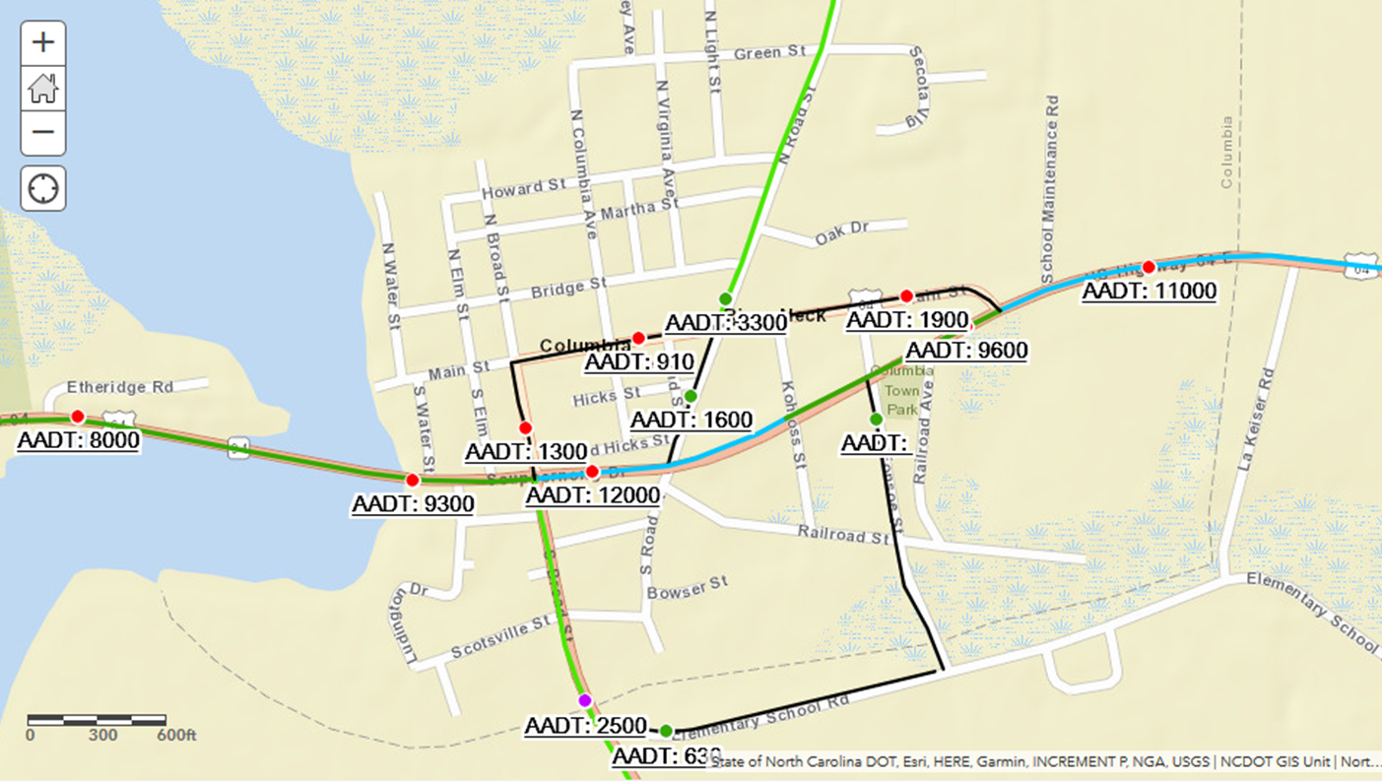
Implementing the Harbor Town Project and establishing the IBX as a regional tourist brand should add additional tourism by nearby Weekenders and Day Trippers, as well as by OBX tourists and visitors.
AADT is 20,000 vehicles on US 17 near Hertford…
8,000,000 OBX summer visitors per year
306,376 visitors to NC Aquarium at Roanoke Island in 2017
… and 12,000 vehicles daily on US 64 in Columbia
274,981 visitors to Fort Raleigh National Historic Site in 2017
50,000 +/- Lost Colony ticket sales
Sources: Carolina Publishing and Associates, 2017 NC Museums and Historic Attractions; The Lost Colony Annual Report; 2016; North Carolina Regional Travel Summary, North Carolina Department of Commerce; US Census Bureau; NC DOT 2016 AADT

Slide 14

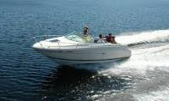
The 200,000 IBX residents are also interested in a wide variety of outdoor activities, adventures, and good times.
Over 40% of the total Inner Banks population makes over $50,000 annually
Average age: ~ 40 years
Outdoor Activities:
  Fishing
  Hunting
  Horseback Riding
  Baseball
  Basketball
  Volleyball
  Golf
  Tennis
  Swimming
  Skiing
  Boating
  Biking
  Camping
  Gardening
Source: http://accessnc.commerce.state.nc.us/docs/

Slide 15
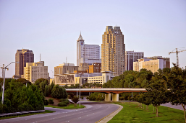
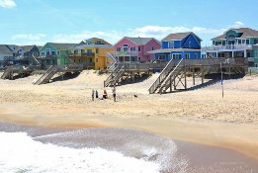
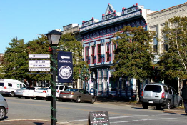
The estimated ferry user market in Year 1 is 107,000 visitors from three different consumer segments.
Projected Visitors:
Weekenders
Coastal Tourists
Inner Banks Residents
To Area:
8,000,000
5,000,000
200,000
13,200,000
To Ferry:
20,000
57,000
30,000
107,000
A projected 107,000 visitors will use the Albemarle Sound Ferry System in Year 1

Slide 16



A ferry service provides an essential part of the infrastructure required for successful economic development of the Albemarle Sound region.
107,000 estimated visitors
in first year
170,000 per year when fully established
With the initial ferry capacity
$14,000,000 estimated initial direct tourism spending year one
at $131 per person per day
94+ estimated direct employment
by ferry system, town docks, and other managerial and
operational personnel,
plus additional employment from econ and historic sites, new
business start ups in the harbor towns, etc.
Source: Team Analysis

Slide 17
More weekenders and day tripper tourists will visit the renewed, engaging communities and nearby upgraded eco and historic sites by car every year.
200,000 estimated additional visitors by car
per year
$26,200,000 estimated additional annual tourism spending
at $131 per person per day
200 to 250 estimated additional new jobs and new careers across the IBX
Source: Team Analysis

Slide 18
Seven reasons why is now the time for the Harbor Town Project
1. It celebrates the beauty, assets, resources, and history of the region and its people.
2. Towns and counties understand the shared benefits of regionalism.
3. Leaders support a major planned, coordinated tourism-based intervention.
4. Other traditional economic development initiatives will also benefit.
5. Public and private funding for capital and start up expenses is available.
6. People understand the benefits and get excited about it!
7. Fosters private entrepreneurship and other creative, thoughtful initiatives.

Slide 19


