Slide 1
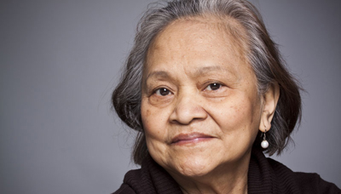
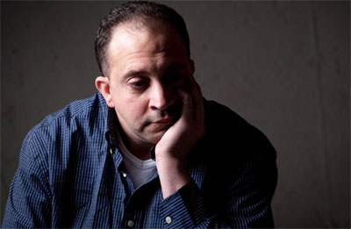
Making Health Care Integration A Reality Rebecca Smith, CIO, Henderson Behavioral Health

Slide 2
Who Is Henderson Behavioral Health?
Oldest/largest not-for-profit behavioral health care system In south Florida
20 locations
650 staff
Serve more than 30,000 clients per year
$38 million annual budget
Inpatient Crisis Stabilization Unit with 23 beds
Residential Treatment with 206 Beds for adults & children
Supported Housing with 702 beds

Slide 3
Adults w/ Mental Health Conditions
Adults w/ Medical Conditions
29% of adults with medical
conditions also have
mental health conditions
68% of adults with mental health conditions also have medical conditions
Robert Wood Johnson, 2011 –Mental Health Comorbidity

Slide 4
Trends
Care management a major core competency
Care and services will be fully integrated
Coordination will be essential with hospital networks and provider networks
Increased emphasis on population data analytics
Sharing of health information through Health Information Exchanges (HIEs)
Capitated payments

Slide 5
Henderson’s 1st Integration Step 2013 Treating “the Whole Person”
Netsmart Primary Care App
Henderson Primary Care Clinics
South PC Clinic
Netsmart myAvatar EHR
New Vistas PC Clinic
Central PC Clinic
Lauderdale Lakes PC Clinic

Slide 6
Henderson’s 2nd Integration Step 2014/2015 HIE Direct Connection
Memorial Health
Administration
CSU
Freedom Project
Treasure Coast
Central Branch
South Branch
Henderson Village
Continuity of Care Document
(CCD) Referrals
Wilson Gardens
Charlee House
CareAnywhere EHR Emergency Department
28 potential additional locations in 2015
Henderson House
West Broward
Crisis Walk In Centers
Lake Worth
Rainbow Village
Summit
SCS
Community Support Services
West Prospect (NV)
Chalet

Slide 7
Coordinated, integrated care between Memorial Health System & Henderson
Refer persons with mental health issues to specialized care in a timely manner
Maintain continuity of care via an electronic referral with all authorized health information
Reduce average stay time in MHS Emergency Dept. (ED)
Open ED beds for more appropriate use
Reduce cost to county and state

Slide 8
Early Stage Results
Much more accurate information
Much less time involved
Data entry reduced in myAvatar by importing the CCD directly into myAvatar
Huge time savings over faxing
Increased client satisfaction scores; and process will feel smoother and more organized for client -- focus on the “client experience”
When shifts change, referral process will be an easier process from one clinician to another. If the referral is still in a pending status, it will save time transitioning the referral

Slide 9
Henderson’s Planned Integration Steps 2015 Replicating the Memorial Direct Connection
Broward Health
Administration
CSU
Freedom Project
Treasure Coast
Central Branch
South Branch
Henderson Village
Continuity of Care Document
(CCD) Referrals
Wilson Gardens
Charlee House
EMR
29 potential
locations 2015
Henderson House
West Broward
Crisis Walk In Centers
Lake Worth
Rainbow Village
Summit
SCS
Community Support Services
West Prospect (NV)
Chalet

Slide 10
Henderson’s Planned Integration Steps 2015/2016
Broward Health
Broward 211 Referrals
NEW!
Memorial Health System

Slide 11
Don’t Forget This Part Of The Why!

Slide 12
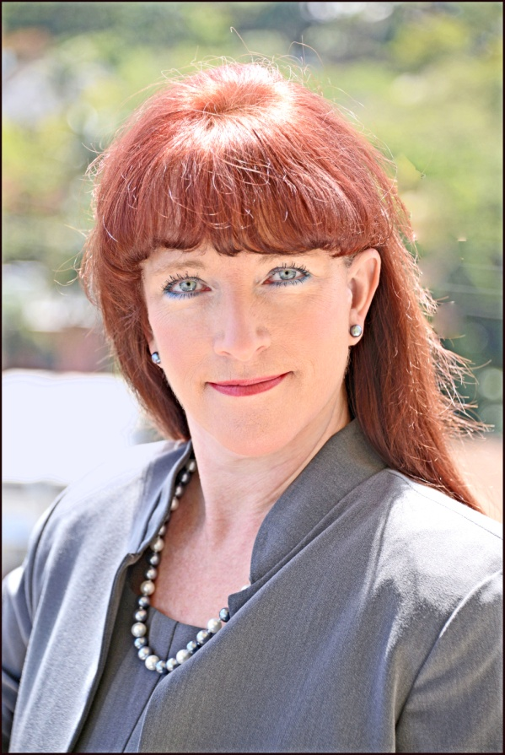
Questions?
Rebecca Smith
Chief Information Officer
Henderson Behavioral Health
rsmith@hendersonbehavioralhealth.org
954-777-1649

