Slide 1
As You Enter...
Fold Here
Fold your cardstock long ways (“hotdog”)
Fill out your Name Tent:
Center: First Name
Upper Left: Favorite Pet
Upper Right: State you were born
Lower Left: Subject You Teach
Lower Right: College
Walk around and look at the activities on the wall.
German Shepherd Florida David Math Erskine/Furman

Slide 2
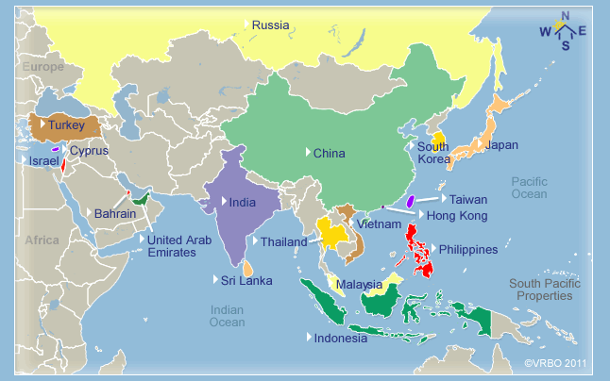
Culturally Relevant and Engaging Classroom
Objectives:
Raise Awareness of Culture in your Classroom
Integrating Culture into your Classroom
Engaging Students in your Classroom

Slide 3
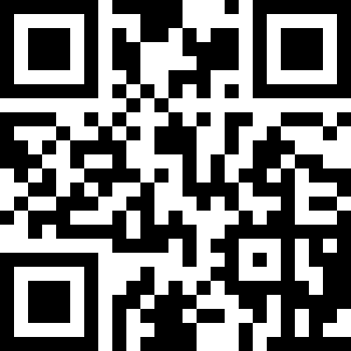
Give a one word that describes “culture”.
Brainstorming:
Quantity over Quality
No Judgement
No Wrong Answers

Slide 4
Give a one word that describes “culture”
https://answergarden.ch/309134
Answers will appear in https://answergarden.ch

Slide 5
What is Culture?
Simple Definition of culture
: the beliefs, customs, arts, etc., of a particular society, group, place, or time
: a particular society that has its own beliefs, ways of life, art, etc.
: a way of thinking, behaving, or working that exists in a place or organization (such as a business)
“Our culture is what we allow.”
“A nation’s culture is in the heart and soul of its people” -Gandhi
“Once you understand and appreciate other people’s cultural backgrounds, then you can also connect with them more.” -Anonymous

Slide 6
Integrating Culture can...
Relationship building through mutual respect - Motivation
Addressing special populations - Relevance
Creating a safe environment for students - Rigor
Make your classroom and your job more interesting - Joy
Notes:
Read excerpt from Motivating Black Males/talk about Hickory

Slide 7
Planning vs. Prejudice
Growth mindset vs. Fixed Mindset:
Carol Dweck is a researcher at Stanford University. Dweck is well–known for her work on “the fixed mindset vs. the growth mindset.” ... In a fixed mindset students believe their basic abilities, their intelligence, their talents, are just fixed traits.
The teacher with a fixed-mindset says, “I’ll try to teach these kids, but they won’t do too well because they probably won’t put their cell phones down long enough to do my homework.”
The teacher with a growth-mindset says, “I can’t wait to get started with these students because I have some strategies that will make them forget all about their cell phone!”
Notes:
Who likes to...

Slide 8
Culturally Relevant Teaching
Definition: Teaching and Learning that builds on and values the cultural experiences and knowledge of all participants, regardless of whether or not they are a member of the dominant culture.
Culture includes race, gender, class, or identity.
CRT practices that help educators build authentic relationships, hold high expectations, empower student voices, engender self-advocacy, respect experiences, and build on assets.
Critical Thinking and Engagement Handbook

Slide 9
“It’s Really About Relationship Building”
Foundations of Relational Capacity:
Inclusive Room Design - based on teacher preferences and student backgrounds and interest.
Purposeful Themes - unit or year-long; help create shared vision.
Whole-Class Interactions - Call and Response or discussions.
Mutual Accountability - Students share in the responsibility for a successful class. (consistent rules and follow through)
Group Events and Traditions - Celebrations, routines,

Slide 10
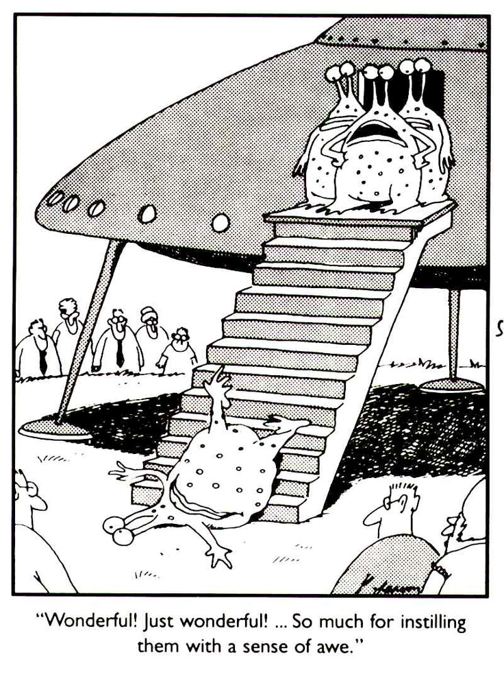
Awareness of Culture in Your Classroom
Use one of several strategies to get to know your audience:
Surveys, Kahoots, etc.
Poster activities and centers.
Name tents or name tags.
Introduction activities.
Writing prompts and journals.

Slide 11
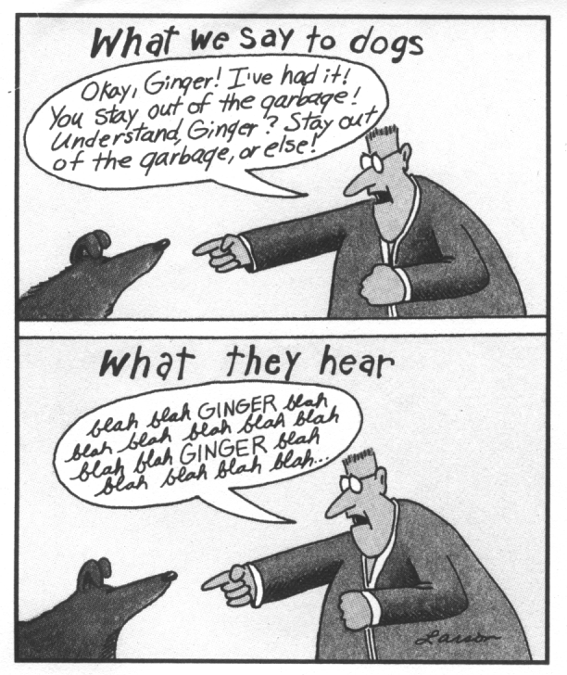
Know the message your classroom is sending...
Pictures
Student work
Seating arrangement
Organization
Music

Slide 12
You can do it!
Black CPA’s
http://www.accountingtoday.com/gallery/photos/black-americans-who-paved-the-way-for-cpas-74664-1.html
Hispanic Authors
http://www.latina.com/entertainment/book-club/our-favorite-latino-authors
Female Engineers
http://www.engineergirl.org/4356.aspx

Slide 13
Resources
Francis Marion Univ. School of Education - Center of Excellence
http://fmucenterofexcellence.org/home
Books/Articles Surveys and Activities
Google Forms
Kahoots
Games/Activities

Slide 14
Engaging Students
K W L
Know-Want-Learn
Notes:
Take out a sheet of paper or use your name tent

Slide 15
Quickwrite
When I am leading an inservice, I like to use a Conga Line to get the teachers up and discussing the topic. Teachers appreciate the movement and the opportunity to share with their colleagues.
Briefly, write a sentence or two about the most engaging activity you use.

Slide 16
Conga Line
Form two lines facing each other.
Share a strategy with the person across from you.
Choose one line to rotate by shifting to the left.
The person at the end of the line dances to the other end.

Slide 17
Engaging Student Learning
Build Relationships and establish routines and expectations
Be passionate about your subject matter
Engage the brain http://www.edutopia.org/blog/strategies-getting-keeping-brains-attention-donna-wilson-marcus-conyers
CRAVE (Curiosity, Relevance, Ask Questions/Inquiry, Variety and Emotions)
Projects that allow for student voice and choice
4 C’s(Collaboration, Critical Thinking, Communication and Creativity)/Natl Career Ready Practices/Profile of the SC Graduate
Have a Plan
Culturally Relevant Lesson Plan
WICOR Lesson Plan
Project-Based Lesson Plans

Slide 18
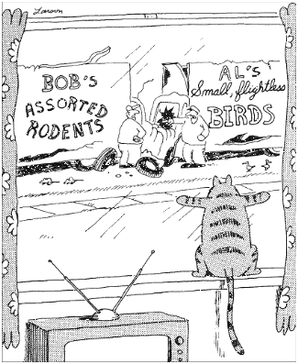
CRAVE*
Curiosity - based on student interest or change of normal routine.
Relevance - by content or frame of reference.
Ask question/Inquiry
Variety - not the same method of delivery.
Emotions - good story telling or current event.
*Edutopia: Donna Wilson, PhD
Notes:
Chart paper brain storming for each letter

Slide 19
Projects
Can include student voice and choice, writing, reading, collaboration, inquiry, relevance, and organizational skills.
Tips:
Have a plan and share your expectations up front (deadlines, rubrics, etc.)
Make the amount of content match the amount of time
Spend time as a class developing the purpose
Develop their interest through relevance and allowing student choice
Help them refine their topic questions with peer involvement
Develop sound assessments and explain them to the students
Use checkpoints to monitor progress and formative assessment

Slide 20
It’s Just Good Teaching...
Writing - Quickwrites, Journaling, Reflection, Essays, Technical Writing...
Inquiry - Think Pair Shares, Levels of Questions (Costa’s or Bloom’s)...
Collaboration - Pair Shares, Group Work, Group Tasks...
Organization - Notebooks, Note-Taking, Calendars, Lockers/Individual Spaces...
Reading - Variety of readings, marking the text…
What is your strength? What is your challenge?
Notes:
Do a conga line with participates on the strengths and weaknesses.

Slide 21
Rigor - Don’t bail them out...
From the Silent Epedemic:
71% recommended making school interesting
81% recommended more “real world” learning opportunities
75% recommeded smaller class sizes to individualize instruction
“Create academic discomfort”

Slide 22
Importance of Note-Taking
Repetition increases retention according to brain research (10-24-7.)
After 10 mins., circle or underline key terms, or concepts.
Within 24 hrs., create sections and add questions for each section.
After 7 days, summarize the notes and answer the questions.
Use marks and color to distinguish different parts or concepts.
Review with students using their notes instead of giving them a study guide.
circle

Slide 23
Noteworthy...
It could even be argued that note quality cannot be assessed by anyone other than the user of the notes, as a specific note format ideal for one person may not be the best quality or way to convey content to someone else (Bui, Myerson, & Hale, 2013). Supporting this claim, Kiewra and colleagues found that reviewing self-produced notes lead to better recall performance than reviewing another student’s notes (Kiewra et al., 1991).
Michael C. Friedman
Harvard Institute of Learning and Teaching

Slide 24
Relationships
https://www.youtube.com/watch?v=iENeK_zZDw4&feature=youtu.be

Slide 25
Culturally Relevant Lesson Plan
Objective:
Essential Question:
WICOR:
Time/Materials:
Cultural Relevant Connection:
Warm Up:
Differentiation/Interactions:
Feedback:
Post Activity:
Notes:

Slide 26
WICOR Lesson Plan
Standard:______________________________________Date:___________
Objective:_____________________________________________________
Method | Strategy | Student will produce...
Writing
Inquiry
Collaboration
Organization
Reading

Slide 27
Content: | Common Core: | Lesson Title:
Topic: Demonstration/Assessment: Level:
Resources:
Anticipatory Set:
Procedure:
W - What activities include writing?
I - What activities include inquiry?
C - What activities include collaboration?
O - How did you address organization?
R - What activities include reading?
Notes:

Slide 28
Project Lesson Plan
Standards:
Launch:
Driving Question:
Grouping Strategy:
Assessment Schedule:
Product:
Notes:

Slide 29
So, In Conclusion...
Name Tents
Brainstorming (Answer Garden)
Brainstorming (Poster version)
Surveys
KWL
Conga Line (Think-Pair-Share)
Planning
Engaging the Brain (CRAVE, WICOR, PBL)
Note Taking
Gallery Walk
Quickwrites
Wall center activities

Slide 30
Thank You...
David Coyne
Blythewood High School
(803) 691-4090 ext. 28009
dcoyne@richland2.org
@DavidPCoyneETAP
Contact me if you have questions or want any of the information.

