Slide 1
POWERLINES COMMUNITY NETWORK
Achievement Schools
Frayser Community Schools
Shelby County Schools
August 2017 – March 2018
Agape Child & Family Services’ 2-Gen initiative is funded under a grant contract with the State of Tennessee Department of Human Services.

Slide 2
THE MISSION
A Christ-centered ministry that is dedicated
to providing children and families with healthy homes
THE VISION
Agape will serve children, families and communities by sharing God’s love throughout the Mid-South. With excellence, we will connect people to God’s mission by:
Uniting children with loving families,
Strengthening homes and communities with intentional relationships, and
Linking servants to service
Vision Approved by Agape Board of Directors
January 25, 2013

Slide 3
Powerlines Community Network is…
…a place-based strategy to
connect at-risk neighborhoods
with the resources they need and want
for children and families to be successful
3
Notes:
Speak to How fit in community plan

Slide 4
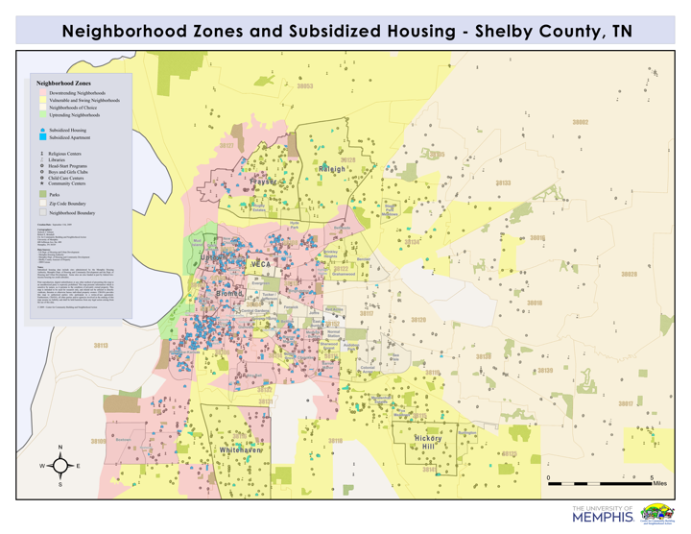
Frayser/Raleigh
(Jamesbridge, Todd Creek and Pershing Park apartments)
FY2017:
Serving in 10 apartments and 9 schools (Stars)
(7,000+ youth and families)
Whitehaven/SW Mphs
Hickory Hill/SE Mphs
Bent Tree, Summit Park & New Horizons Apts Autumn Ridge, Camelot Manor, Wingood Manor, and Cedar Run Apts
Notes:
4

Slide 5
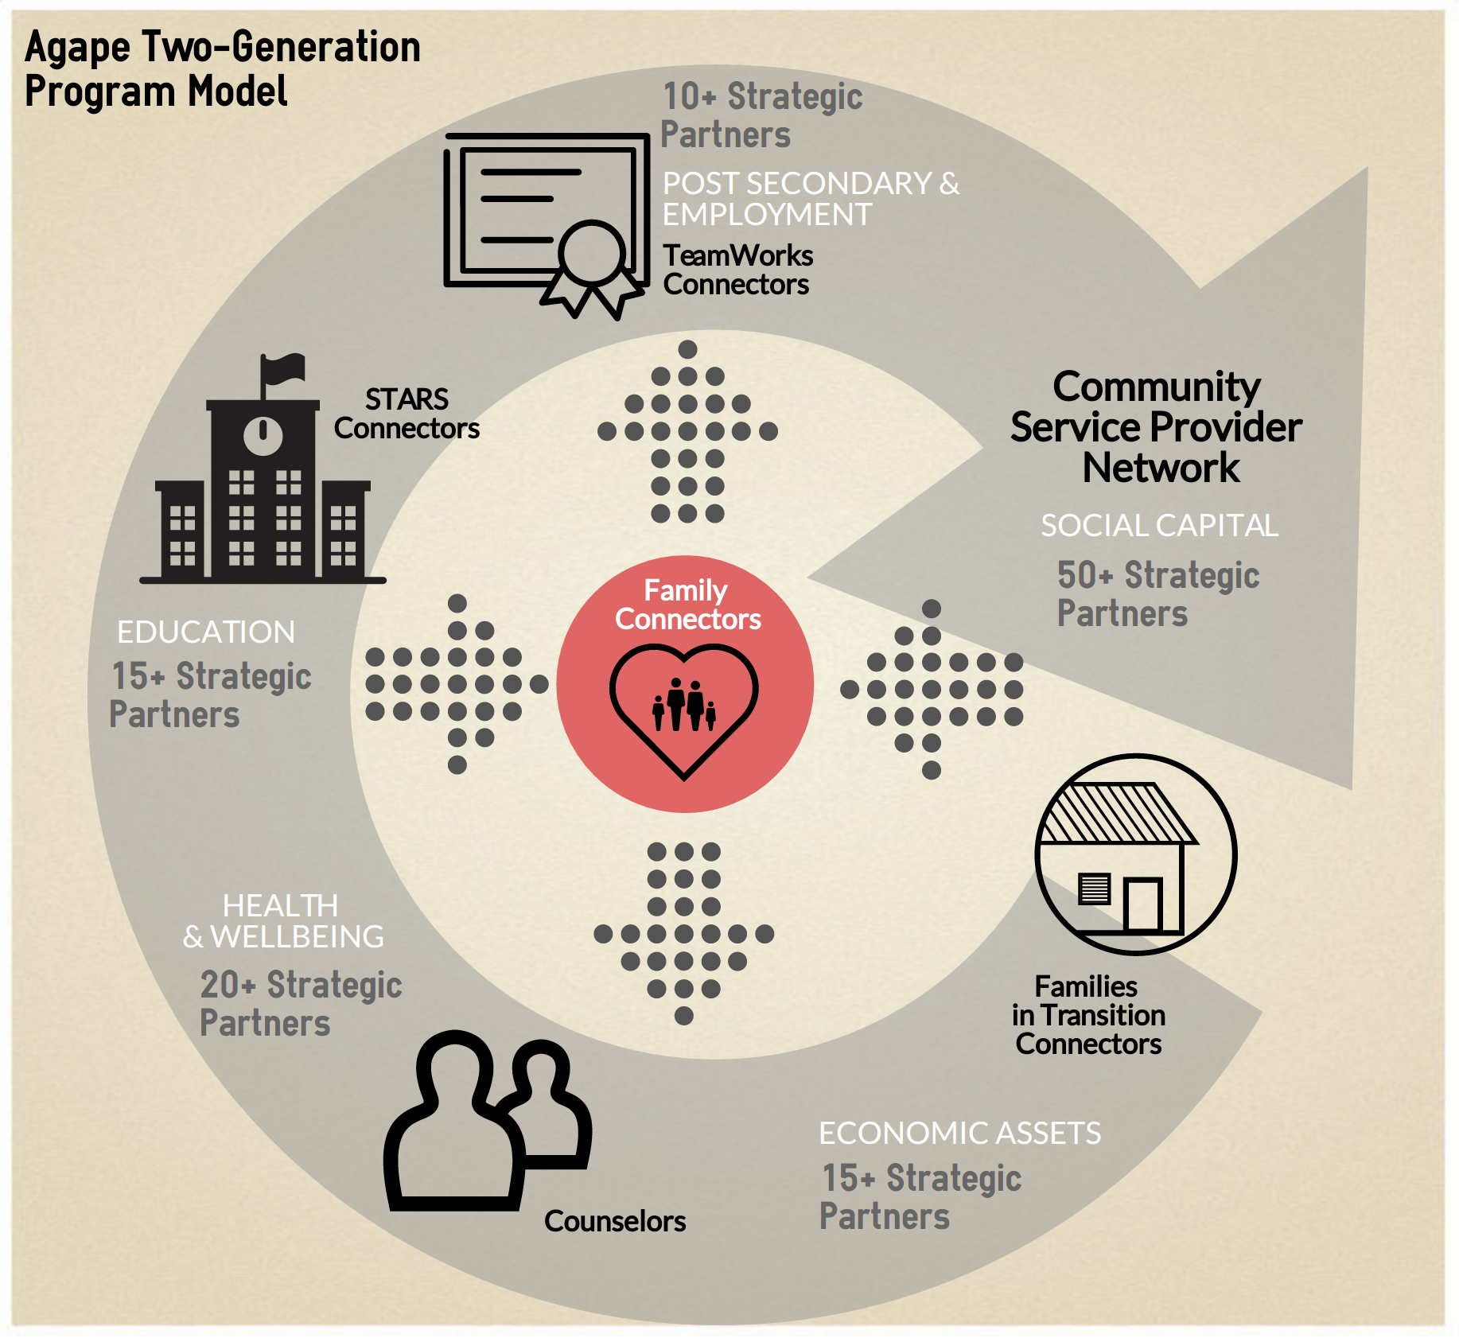

Slide 6
Powerlines Community Network Apartment Communities and School Feeder Pattern Engagement SY17-18 |  | Elementary School | Middle School | High School | Approx. Total Student Body | Other Schools Attended by PCN Youth
Frayser Powerlines Community |  |  |  |  | 2,500 | Georgian Hills Middle
☺ # Pershing Park Apartments |  | Corning, Frayser, Georgian Hills, Whitney | Westside | MLK |  | Georgian Hills Middle
Corning Apartments
Todd Creek Apartments
Total Schools |  | 4 | 1 | 1 | 6 Schools
Hickory Hill Powerlines Community |  |  |  |  | 5,000 | Belle Forrest Community, Evans Elem, Getwell Elem, Lowrance Elem, Ridgeway Middle, Ridgeway High, Sheffield High, Wooddale Middle, Kirby Middle, Kirby High, Knight Arnold Elem, Power Center Academy, SE Prep
☺ # Autumn Ridge Apartments |  | Hickory Ridge | Hickory Ridge* | Wooddale*
☺ # Bella Vista Apartments |  | Hickory Ridge, Winridge
# Wingood Manor Apartments |  | Sheffield | American Way* | Sheffield*
Total Schools |  | 3 | 2 | 2 | 7 Schools
Raleigh Powerlines Community
# Jamesbridge Apartments |  | Scenic Hills, Coleman, Egypt |  | Raleigh Egypt Middle and High
Total Schools |  |  |  |  | 0 Schools
Whitehaven Powerlines Community |  |  |  |  | 3,000 | Fairley High School, John P. Freeman
# Bent Tree Apartments |  | Winchester | A. Maceo Walker* | Hillcrest*
# New Horizon Apartments
☺ # Summit Park Apartments |  | Robert R. Church*
Total Schools |  | 1 | 1 | 1 | 3 Schools
Safeways communities * Stars expansion March 2018 to 30+ Connectors |  |  |  | Total Schools: | 16
# PCN offices Potential Students Served |  | Tier I Engagement (Universal Services): |  |  | 14,500
Student Engagement in Site-based After School Tutoring, Mentoring and Feeding Efforts |  |  |  |  | 120
Student Engagement In-School Mentoring/ Tutoring/ Reading Interventions/RTI Efforts |  |  |  |  | 325
 | Stars - In-School Connector model (Intermediate and Intensive) |  |  |  | 750
Notes:
Julie
On the next page (11), you will see the school feeder pattern as it relates to our efforts within the 4 Powerlines communities.
Currently, we serve more than 100 students with afterschool homework assistance, tutoring, mentoring and feeding efforts
We are onsite in 9 schools, bringing volunteer support (largely in reading intervention)
We are in 6 schools providing Tier 2 and 3 (intermediate and intensive) services through our connector model.
Within the 10 PCN apartment complexes, we work with students attending 27 schools.

Slide 7
Stars Model Growth and Expansion by School Year:
Year 1
Intensive Services (50)
Intensive Services (370)
Year 3
Intensive Services (380)
Schools (6)
Reading Intervention (50)
Connectors (13)
Reading Intervention (83)
Reading Interventions (161)
Connectors (4)
50% Connector Retention Rate
Year 2
Connectors (15)
77% Connector Retention Rate
School (1)
93% Connector Retention Rate
Schools (5)
Year 4
Intensive Services (465)
Reading Intervention (200)
Schools (9)
Connectors (19)
84% Connector Retention Rate
Year 5 (SY17-18)
In School Intensive Services (537)
Summer Reading Intervention (162)
Schools (9)
Connector positions (23)
84% Connector Staff Retention Rate
Data source: CoactionNet; Agape HR; Caseload students in all 10 participating schools in Frayser, Hickory Hill, and Whitehaven

Slide 8
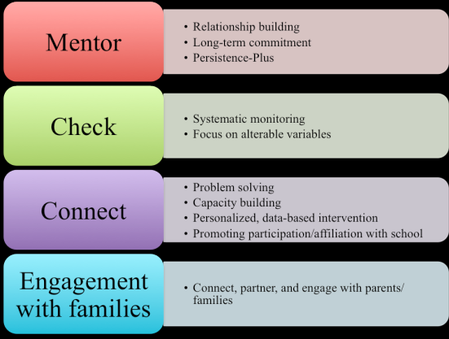
Four Core Components of Check & Connect
(University of Minnesota)
http://checkandconnect.umn.edu/

Slide 9
PERFORMANCE OUTCOMES

Slide 10
Stars Collective Impact: ATTENDANCE – 2017-2018 School Year
ASD, Frayser Community, and Shelby County Schools
Cumulative Summary of Days August 7, 2017 – March 31, 2018
Days Present | Total Students | % of Students | 65% Goal of students with 90% attendance rate
Severe Chronic Absenteeism < 81% | 23 | 4% | 12%
Chronic Absenteeism 81-90% | 42 | 8%
At-risk for chronic Absenteeism 91-95% | 95 | 18% | 88%
Satisfactory attendance: 96%+ | 377 | 70%
Active and Inactive Caseload Total | 537 | 100%
Data source:100% of Active and Inactive Caseload as of first day of school; Not registered and absences divided by the total number of days on caseload; Excludes OSS, ISS, Tardy, and Early Dismissals; Caseload students in all 6 Frayser schools; Data Run Date: 4/18/2018

Slide 11
Data source: CoactionNet from Teacher, Student and Parent data; 100% of Active Caseload students; Caseload students in all 6 Frayser schools; Data Run Date: 4/18/2018
*Reasons for absence to be further investigated

Slide 12
Collective Impact: Acceptable Behavior
Goal #2: Behavior - Less than 40% of participating students will receive office referrals, in-school and out-of-school suspensions or expulsions.
 | SY15-16 (380) 42% | SY16-17 (376) 37% | SY 17-18 (537) 35%
# of Students Received Office Referrals | 159 | 139 | 166
% of Students Receiving Office Referrals | 42% | 38% | 31%
# of Students Received ISS | 64 | 24 | 20
% of Students Receiving ISS | 17% | 6% | 4%
# of Students Received OSS | 128 | 106 | 154
% of Students Receiving OSS | 34% | 28% | 29%
# of Remands/ Expulsions | Not reported | 7 | 7
% of Remands/ Expulsions | Not reported | 2% | 1%
Data source: CoactionNet; 100% of caseload; *Office Referrals uploaded from School Runner for all Frayser schools except MLK; OSS and ISS includes all AS schools; Data Run Date: 4/18/2018

Slide 13
Collective Impact – Parental Engagement for All Schools
Goal #3 - Parental Engagement: 65% of parents will demonstrate an increased investment in their children’s academic outcomes by participating in school meetings/functions.
 | Total Parent Engagements | Total # of Students with Parent Engagements | Total # of Students Served (active and inactive) | % of Students with Parent Engagements
SY15-16 | 753 | 268 | 380 | 71%
SY16-17 | 1021 | 328 | 379 | 87%
SY17-18 | 1574 | 404 | 537 | 75%
Types of Parental Engagements (# of Engagements) | SY15-16 | SY16-17 | Aug 17-18
Agape Parent Meeting | 193 | 716 | 778
Getting Ahead Training | 4 | 0 | 0
IEP Meeting | 6 | 4 | 10
Nurturing Parenting Training | 57 | 1 | 13
Other Parental Engagement (Workshops, Community Fairs, Christmas Gift Pick-Up, Volunteering, Suspension Clearance, Meeting with School Staff) | 126 | 26 | 263
PTA/PTO Meetings | 49 | 122 | 253
School-based program | 283 | 152 | 257
Data source: CoactionNet; 100% of students served; Caseload students in all 6 schools; Data Run Date: 4/18/2018

Slide 14
Meet Stars Student #1…
Ave Intensive Time w/ Connector
2x a month
Parental Engagement
2016 ------
2017
2018 ------
Attendance
Tardiness
Suspensions

Slide 15
Meet Stars Student #2…
Ave Intensive Time w/ Connector
3x a month
Parental Engagement
2016
2017
2018
Attendance
Tardiness
Suspensions

Slide 16
Meet Stars Student #3…
Ave Intensive Time w/ Connector
5x a month
Parental Engagement
2016
2017
2018
Attendance
Tardiness
Suspensions

Slide 17
KEY PARTNERSHIPS: Building Bridges to Combat Delinquency
Seeding Success worked in collaboration with Agape to provide continuous quality improvement and performance analysis. A dosage tracker database resource was provided to monitor summer reading within the PCN communities.
Through a collaborate partnership with Pursuit of God Transformation Center, Pershing Park apartments, Jamesbridge apartments, and MLK Agape was able to afford 97 youth a free, quality summer enrichment camp experience in 2017.
Raleigh Community Church of Christ provided 200 turkeys for Thanksgiving for Agape’s caseload students and families.
City of Memphis, Office of Youth Services provided summer interns who supported efforts with a focus on reading intervention and First Day & Beyond School attendance (PCN communities).
University of Memphis, University of Ole Mississippi, and Union University’s Social Work programs supplied interns this school year who provide clinical support to students and families through individual and group counseling and parent workshops both in school and community settings.
Youth Villages (Anaya) provided intensive behavior intervention support to students at all elementary schools.
Highland Church of Christ Youth and Word of Life Church provided Vacation Bible School activities and snacks at both Pursuit of God and Pershing Park.

Slide 18
KEY PARTNERSHIPS: Building Bridges to Combat Delinquency
Community Alliance for the Homeless Youth Point-in-Time Count is an annual count of sheltered and unsheltered homeless youth between the ages of 18-24. Agape served as a community leader at MATA, Cherokee Library and Benjamin Hooks library providing postsecondary and workforce development resources
United Way-MLGW utility assistance grant 8 Pershing Park caseload families were provided with utility assistance
Memphis 3.0 Facilitate conversations within community meetings to discuss future plans to strengthen the Frayser Community
Agape held its first Hispanic community café in partnership with Latino Memphis and City of Memphis 3.0
Literacy Mid-South provided literacy coaching and books to 100-plus youth during 2017 summer camps (PCN communities).
Agape’s AmeriCorps VISTAs partnered with Memphis Police Department to serve youth and families

Slide 19
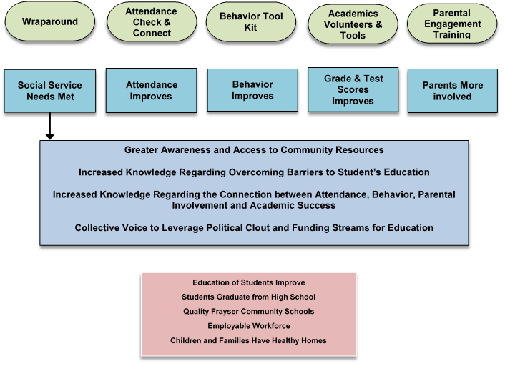
Agape Theory of Change Outcome Map
POWERFUL STRATEGIES
SHORT-TERM OUTCOMES
(Complete Chain from Short-term Outcomes to Community Goal)
LONG-TERM COMMUNITY GOAL

Slide 20
David Jordan, Chief Executive Officer
david.jordan@agapemeanslove.org
Julie Sanon, Chief Operating Officer
julie.sanon@agapemeanslove.org
Benecia Tuthill, PCN Operations Director
benecia.tuthill@agapemeanslove.org
Jim Harbin, Frayser/ Raleigh PCN Site Coordinator
jim.harbin@agapemeanslove.org
Agape Child & Family Services
3160 Directors Row
Memphis, TN 38131
901.323.3600
www. agapemeanslove.org
Agape Child & Family Services’ 2-Gen initiative is funded under a grant contract with the State of Tennessee Department of Human Services.

