Slide 1
The (Florida) Facts Behind the Fiction
Winner
Best Popular Fiction
Florida Book Awards
Richard Wickliffe

Slide 2
About Me
My 25 Year Day Job
A Basis for Crime Fiction

Slide 3
Our Everyday News

Slide 4
“INSPIRED BY…” Facts into Fiction

Slide 5
High-tech burglars target wealthy areas evacuated for approaching hurricanes.”
Winner – Best Popular Fiction
Florida Book Awards

Slide 6
Hurricane Charley

Slide 8
Sanibel-Captiva Island

Slide 12
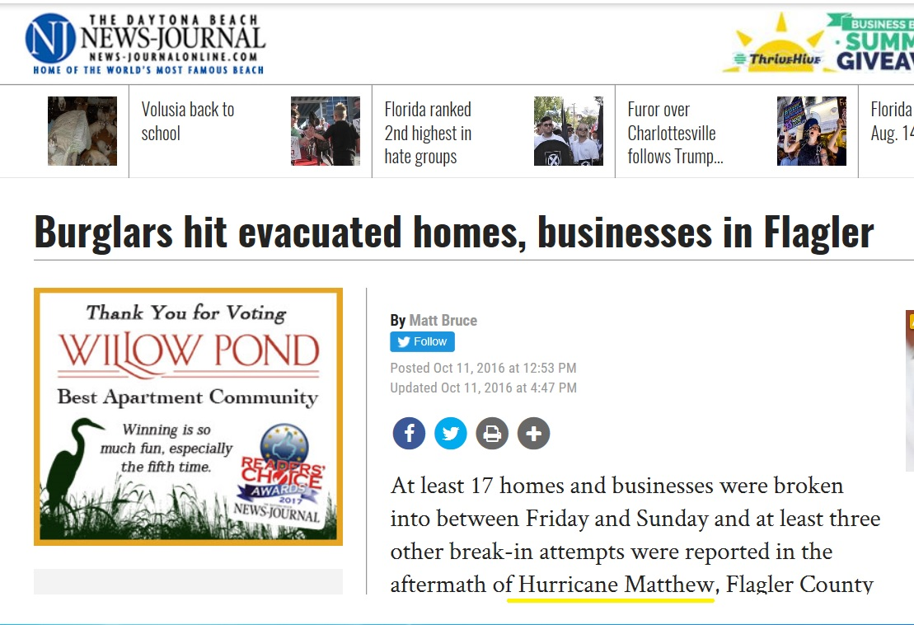

Slide 14
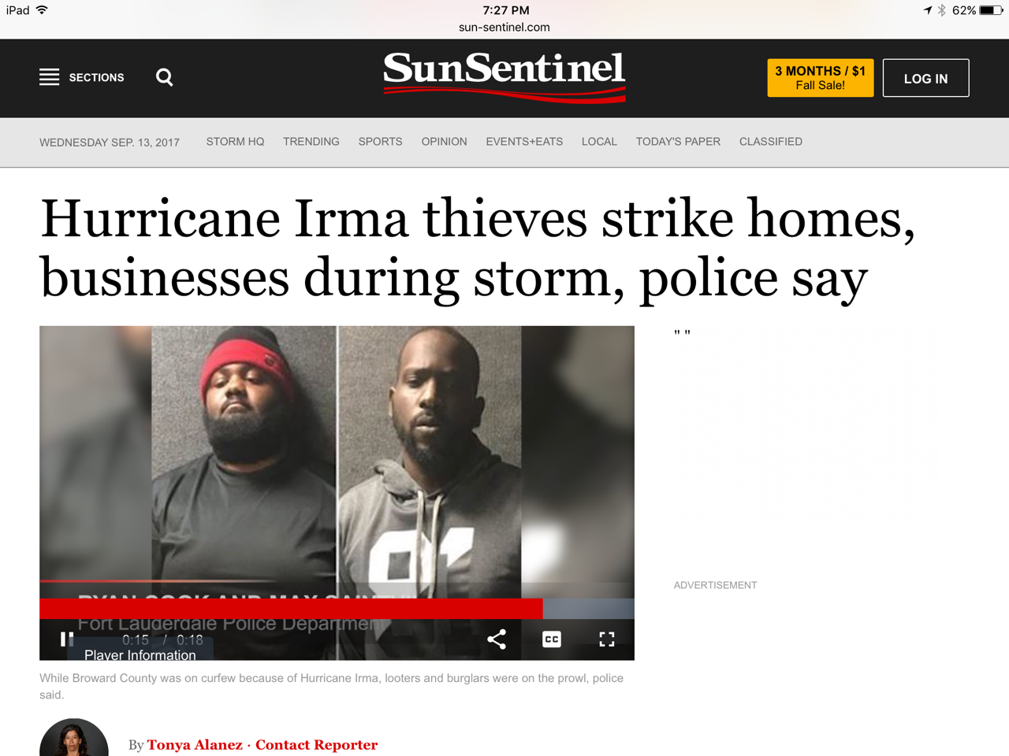

Slide 15
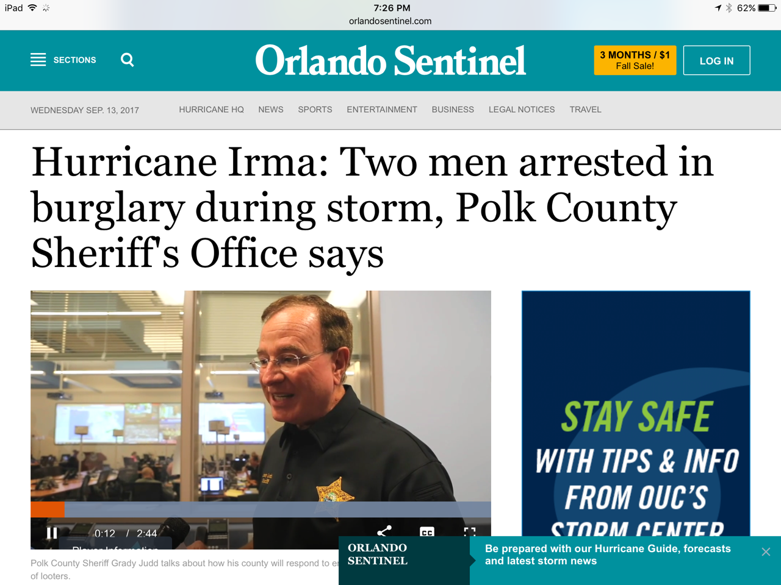

Slide 16
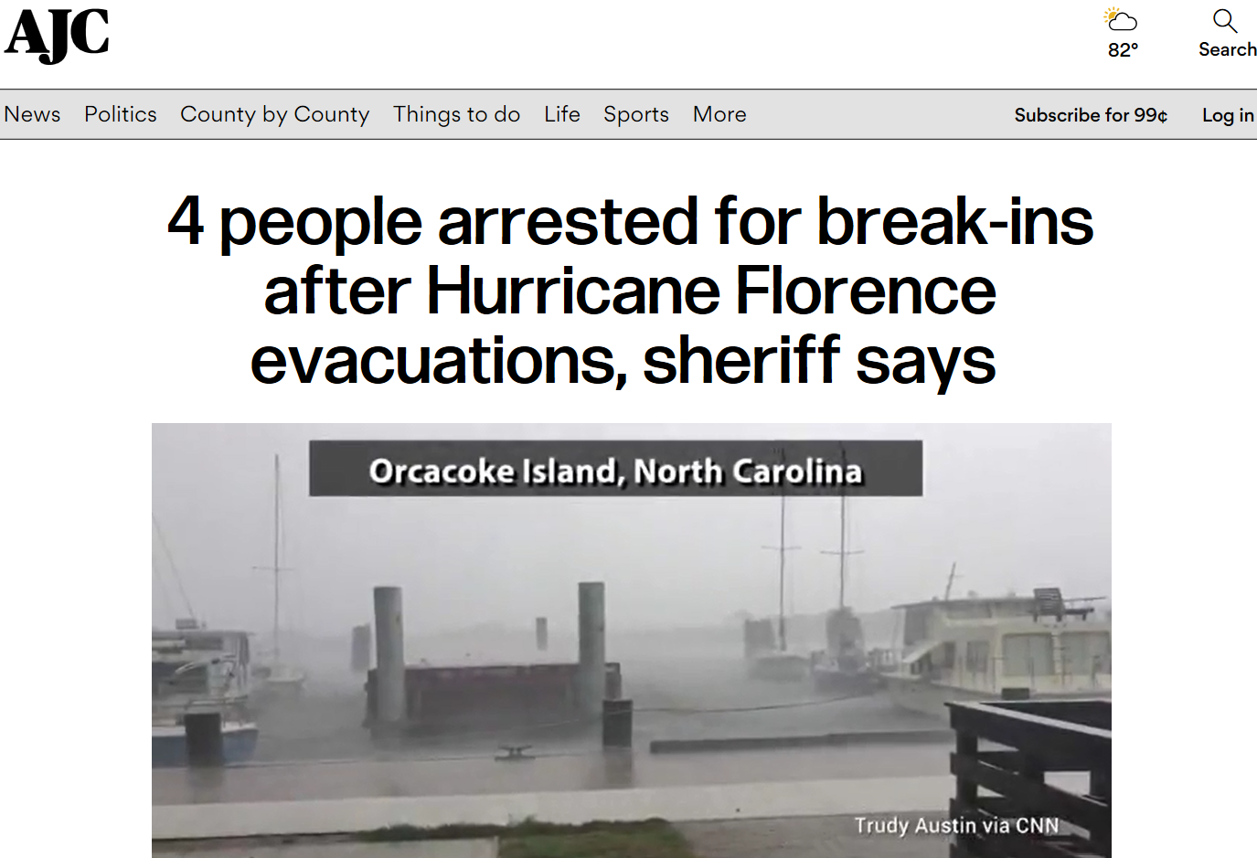

Slide 17
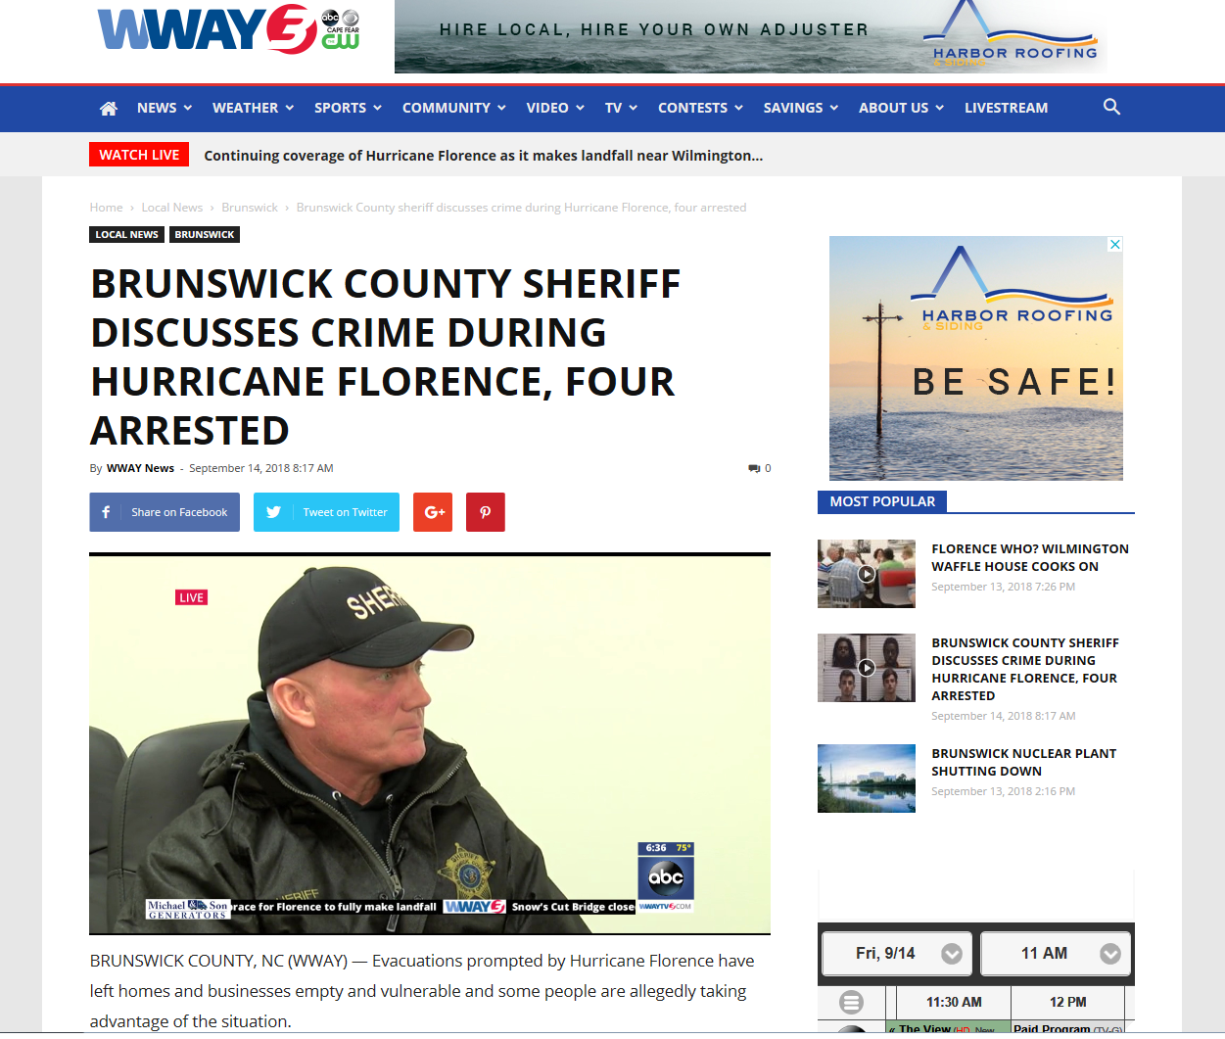

Slide 18
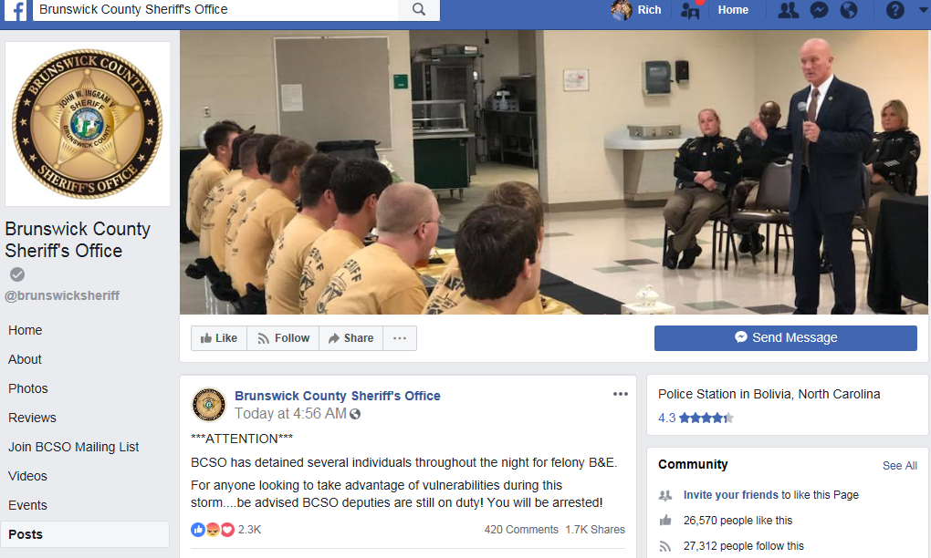

Slide 19
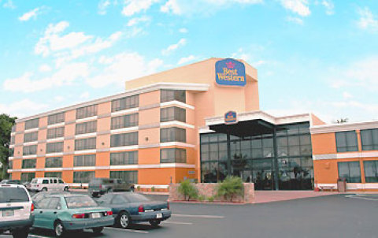

Slide 21
“Bloodline meets Tarantino
in the Keys…”
“A fun and refreshing read that will keep you on the edge of your seat…”
-Top Books Worth Reading

Slide 22
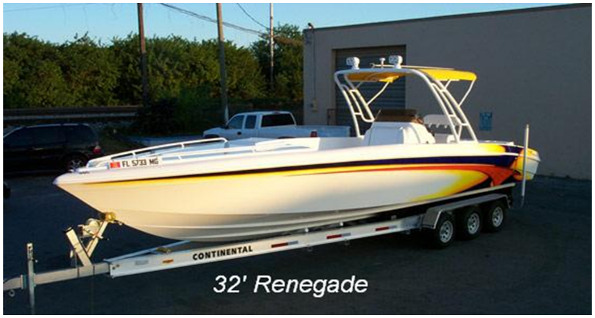
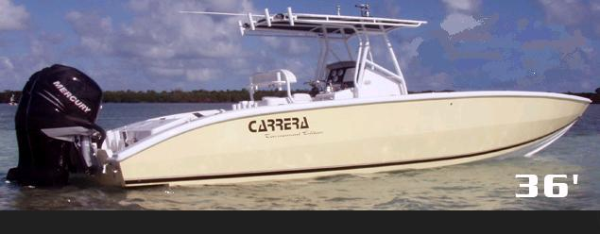
Boats Observed with Smuggling:
-Renegade 29-38 foot (aka Avenger?)
-Carrera 27-36 foot
-Avanti 27-39 foot

Slide 23
How It Works
A “straw owner” with a clean record is given cash down payment for a boat.
Buyer obtains loan and applies for insurance.
Smuggler then “borrows” the boat. The smuggling operation proceeds
The “innocent” owner reports the boat stolen.

Slide 24
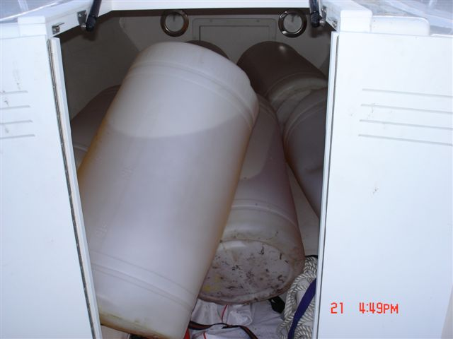
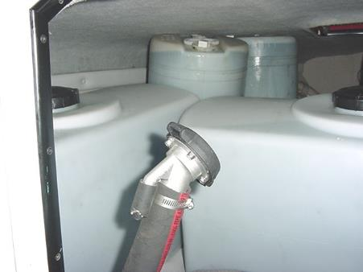
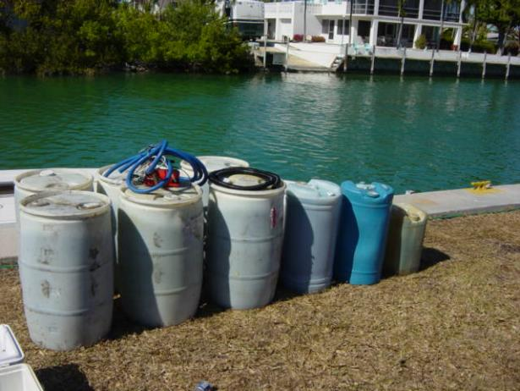
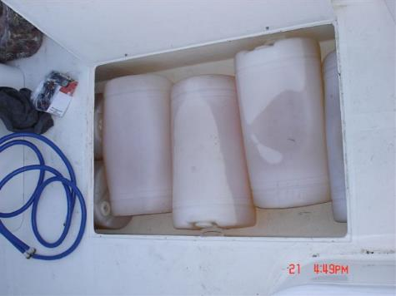
Photos Courtesy Monroe County Sheriffs

Slide 25
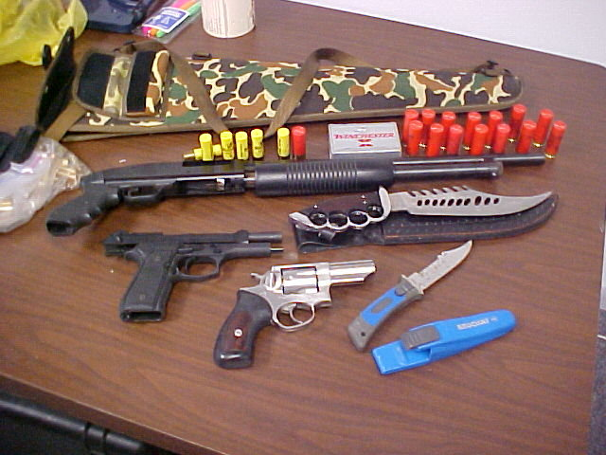
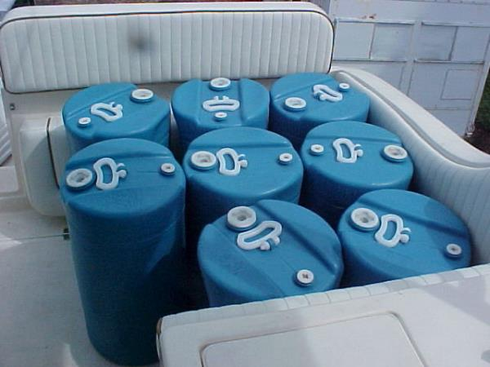

Slide 26
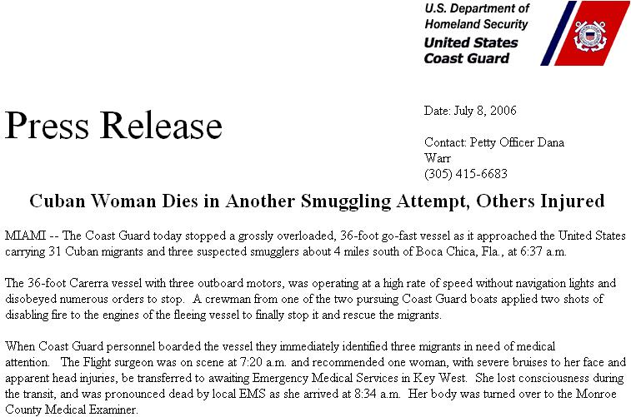

Slide 27
“The Firm meets Gone Girl”
with Russian mob in Miami
FIVE STARS
Reader’s Favorite
Book Reviews

Slide 29
Organized Crime -Russian Mafia-
Organized Eurasian crimes (“Russian Mafia”) have eclipsed Italian organized crime on the FBI’s radar in South Florida, Los Angeles, New York, Las Vegas, and other metro areas.
North Miami Beach = “Little Moscow”

Slide 30
The “B-Girl” Scheme
Perpetrators lease clubs and fly in “B-Girls” from Eastern Europe with 90-day visas, sent to trendy areas.
The girls “hunt” at night to seduce visitors into coming to their “private clubs.”
Customers are drugged; expensive jewelry and cash stolen, credit fraud.
Made easy by embarrassed victims and Innkeeper laws

Slide 31
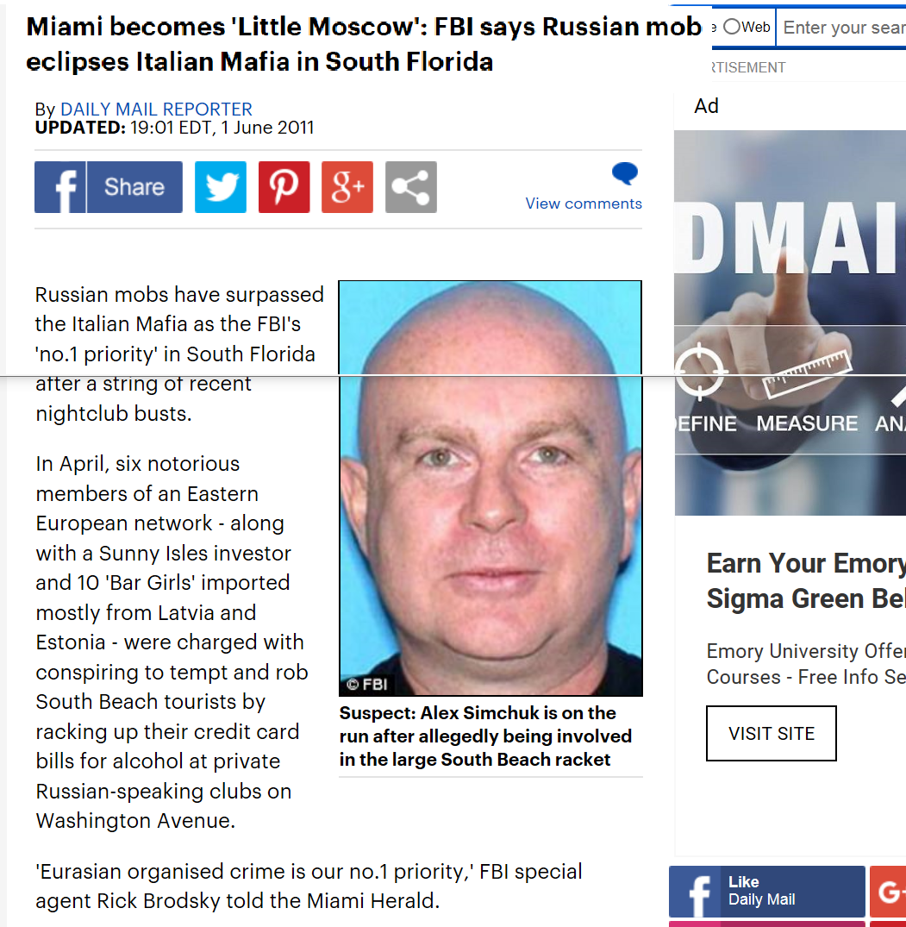

Slide 32
Why an Increase in Russian Activity?
Fast money (insurance) and shorter prison sentences.
They’re moving into injury fraud, using violence in something once considered a white-collar crime.
Can easily net $25,000 a day, risking a modest prison sentence –a drug dealer would need weeks to earn that much, and risk possible life in prison.

Slide 33
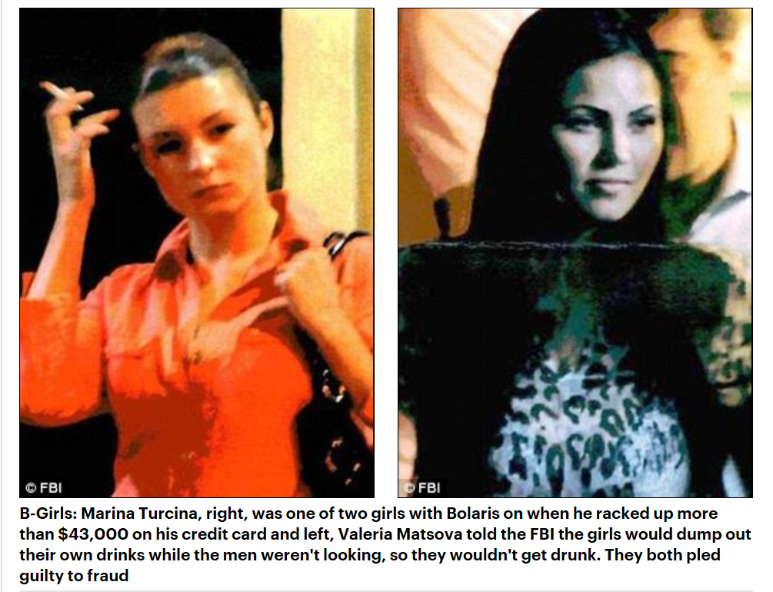

Slide 34
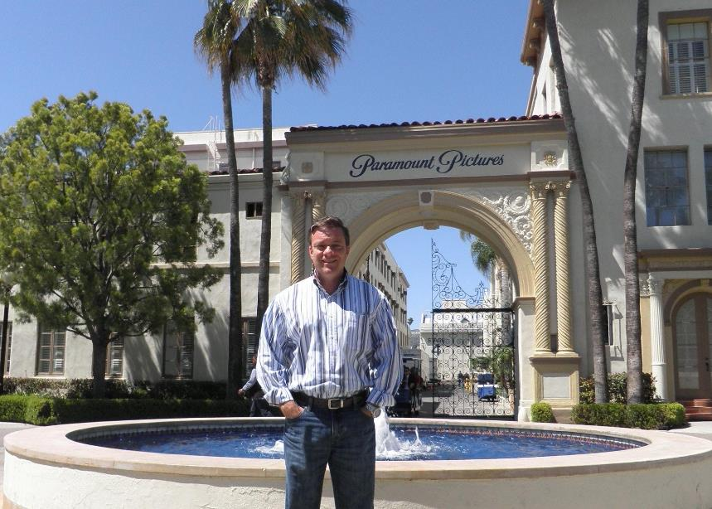
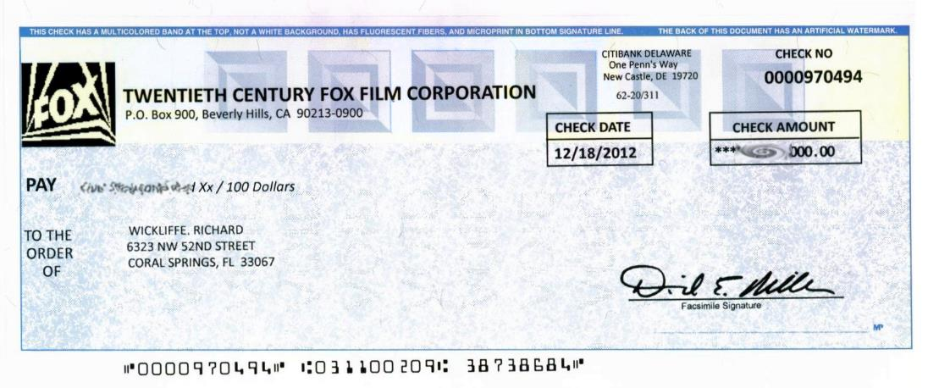
The Hollywood Machine…

Slide 37
Thank You!
“Like” Facebook: “Rich Wickliffe Author Page”
www.RichWickliffe.com
Email: MiamiNovelWriter@yahoo.com

