Slide 1
AEP Texas Energy Efficiency / Demand Response Programs
Russell G. Bego, EE/DR Coordinator
AEP Texas
September 24, 2014

Slide 2
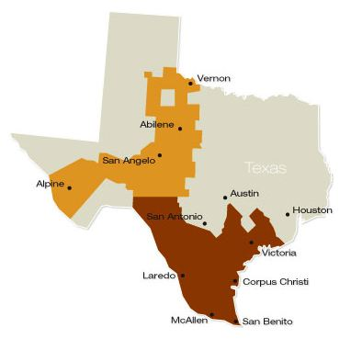
Who is AEP Texas?
AEP Texas is an energy delivery company serving
south and west Texas
AEP Texas Central Company (TCC) delivers
electricity to end-use customers on behalf of
the Retail Electric Providers (REPs) in south Texas
AEP Texas North Company (TNC)delivers
electricity to end-use customers on behalf
of the REPs in west Texas
> 970,000 customers
> 42,000 miles of overhead distribution lines
> 97,000 square miles service area
Notes:
Tip: Add your own speaker notes here.

Slide 3
Demand and Energy Reduction Goals
Demand Reduction Goal (DRG) shall be no less than 30% of annual growth in the demand of residential and commercial customers
If the DRG of 30% equals at least 0.4% of total summer weather-adjusted peak demand for residential and commercial customers, the DRG will be based on the peak demand metric rather than growth in demand
DRG cannot be less than the goal established for the previous program year
Energy reduction goals are calculated from DRG, using a 20% conservation load factor

Slide 4
AEP Texas’ Program Portfolio
Residential Programs | Commercial Programs
A/C Distributor Pilot MTP | Commercial SOP
CoolSaver© AC Tune-Up MTP | Commercial Solutions MTP
Hard-to-Reach SOP | CoolSaver© AC Tune-Up MTP
High Performance New Homes MTP | Irrigation Load Management MTP*
Residential SOP | Load Management SOP**
SMARTSourceSM Solar PV MTP | Open MTP
Targeted Low-Income Weatherization | SCORE/CitySmart MTP
 | SMARTSourceSM Solar PV MTP

Slide 5
Commercial SOP
On-line Application Process
Initial Application
Final Application
Installation Report
Documents to Upload
Process Application Document
Incentives (2014)
$350/kW & $0.090/kWh – HVAC savings
$250/kW & $0.075/kWh – LED Lighting savings
$175/kW & $0.060/kWh – All Other savings
Notes:
2014 Budget - $1,690,000

Slide 6
CoolSaver© AC Tune-Up MTP
Find a participating contractor – website or call
Complete your tune-up
Approve recommended repairs
Clean condenser, Evaporator coil, Blower Assembly
Clean or replace filter
Air flow verified and corrected if needed
Refrigerant charge inspected and corrected if needed
Discount - $75 (2014)
Notes:
2014 Budget - $600,000

Slide 7
Load Management SOP
AEP Texas’ Load Management programs are :
Load control activities that result in a reduction in peak demand, or a shifting of energy usage from a peak to an off-peak period
Designed to cost-effectively reduce demand during summer peak period, defined as weekdays 1-7 P.M. CDT, June through September, excluding Federal holidays
Dispatched using one-hour ahead notices (via email, text and/or phone call)
Limited to 1-4 hours per event, one (1) event per day, no more than four (4) events per month
Must have Interval Data Recorder or AMI meter (> 500 kW demand)
Notes:
2014 Budget - $550,000

Slide 8
SCORE/CitySmart MTP
3rd Party Implementer
Provides resources to identify energy efficiency opportunities and convert them into savings.
Energy Performance Benchmarking
Energy Master Planning Workshops
Technical and Financing Assistance,
Communications Support
Incentives (2014)
$200/kW & $0.02/kWh – Water cooled chillers & LED lighting savings
$150/kW – Lighting, Roofing & HVAC savings
Notes:
2014 Budget - $950,000

Slide 9
SMARTSourceSM Solar PV MTP
Registered Service Providers – list available on website
Solar system will need to be connected to the grid
Incentives - $1.05/watt (2014)
Notes:
2014 Budget - $200,000

Slide 10
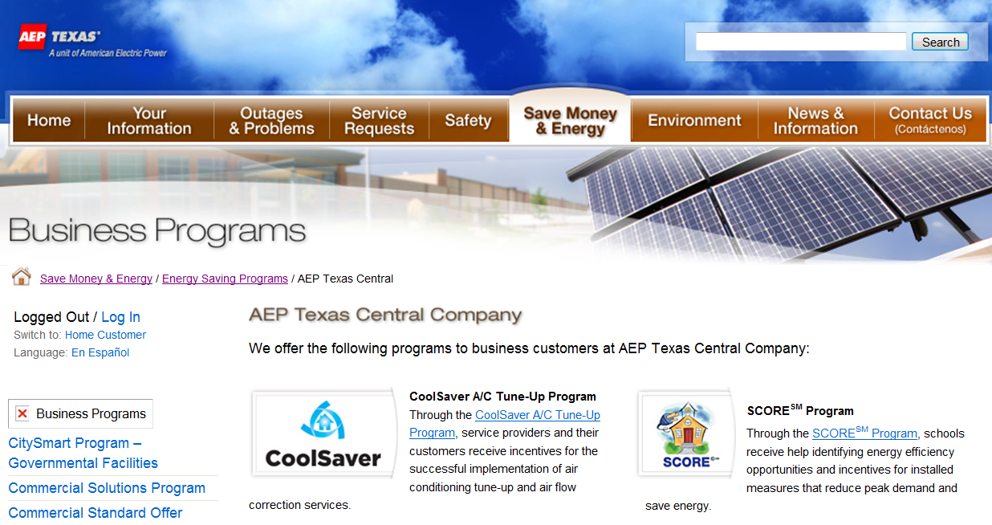
www.AEPTexas.com https://www.aeptexas.com/save/programs/TCCPrograms.aspx
Notes:
Tip: Add your own speaker notes here.

