Slide 1



IN PARTNERSHIP WITH
The payment gateway for every jurisdiction
The perfect solution for you
Easily accessible
Trustworthy
Secure
Reliable

Slide 2

Background
Why FXBit?: Value Preposition
Advantage: Bank-class Risk Control
Advantage: Highly Efficient
Advantage: User-friendly
Target Merchants
Pricing

Slide 3

Background
6+
Currencies
FXBit is an international crypto payment platform.
FXBit is the perfect worldwide remittance and payment solution for both individuals and corporations. The simplicity of our solution ensures efficiency and ease of use.
The FXBit solution includes:
Cash withdrawals,
Cashless crypto transfer service,
All major currencies catered for including HKD, USD, EUR, GBP, RMB and AUD,
All the above is available in more than 200 countries
200+
Countries

Slide 4



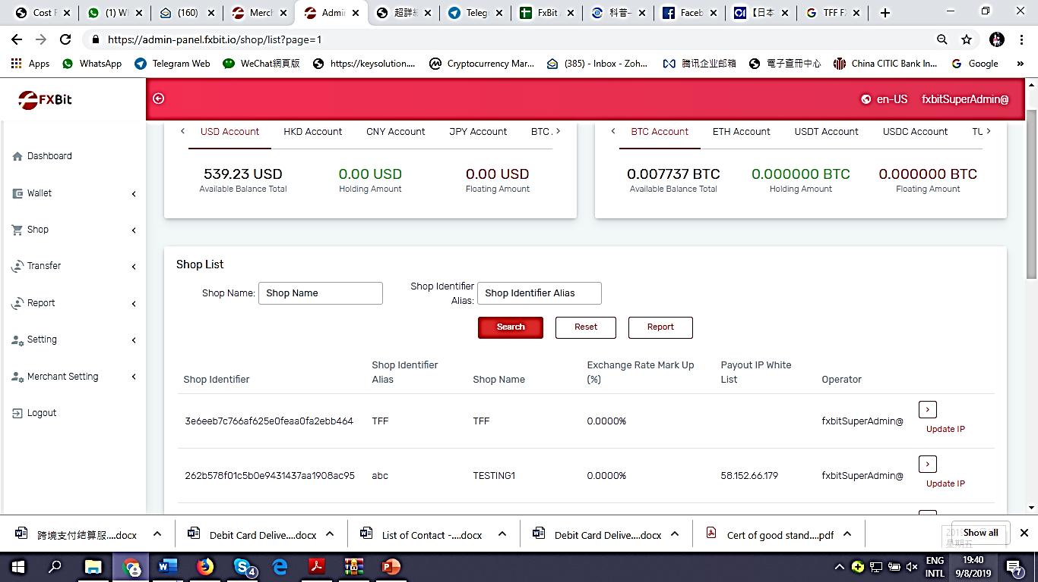
Value Proposition
MERCHANT VALUES
24/7 Rate Lock for Merchant Settlement. No FX mark up. GUARANTEED.
White-list Access control and payout operator: Controlled compliance risk when making fund transfers
Prevent 3^{rd party} payments from multiple clients direct to merchant’s bank account : Decrease bank risk
Instant messaging to merchant support group, IT and processing team: Efficient communication flow
Multi-Currency settlement

Slide 5

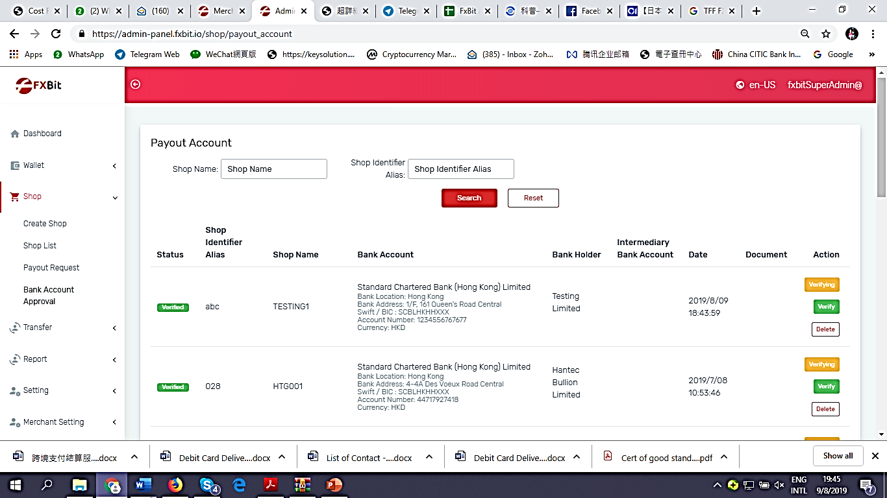
Advantage: Bank-class Risk Control
The FXBit solution ensures ZERO FX risk with a locked currency exchange rate once the payment is confirmed.
Merchants are no longer confronted by a ‘hidden’ FX mark up.
All bank accounts need to be white-listed & approved prior to pay outs.

Slide 6

Advantage: Highly Efficiency
Funds are immediately deposited into the receiver’s bank account in the FXBit wallet.
FXBit’s efficiency saves valuable time.
Transactions are completed on a T+1 basis during the normal working week.

Slide 7


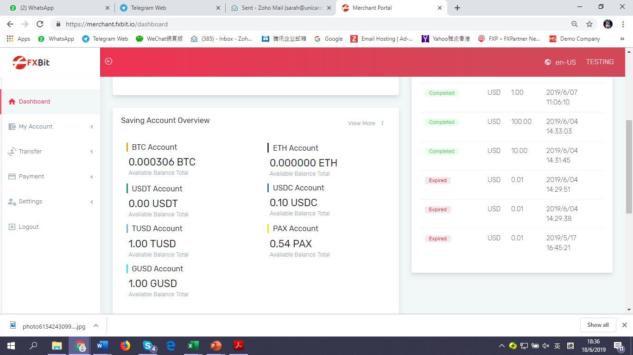
Advantage: User-friendly
The payment gateway is multi-lingual and is designed to be accessible by either mobile or desktop.
The solution is both efficient and easy to use.

Slide 8

Our Target Audience
FX
CFD
BULLION
INVESTMENTS
FXBit is the perfect solution for both remittances and payments.
From individuals and SMEs to international corporations, the FXBit solution seeks to aid merchants who are underserved by the traditional banking sector.
The FX Bit crypto platform is suitable for all merchants who experience a high frequency of international capital flows and transfers.
SME’s
EXPORTERS
GAMING GAMBLING CASINO BINGO LOTTERY

Slide 9




Crypto Wallet Payment Gateway
1
Accept multiple Crypto currencies. Options
include USDT, BTC, ETH amongst others…
2
Only a third of the transaction needs to be successful before…
3
The payment status indicates a successful transaction…
4
The coin is placed in the merchant account for settlement in his currency

Slide 10
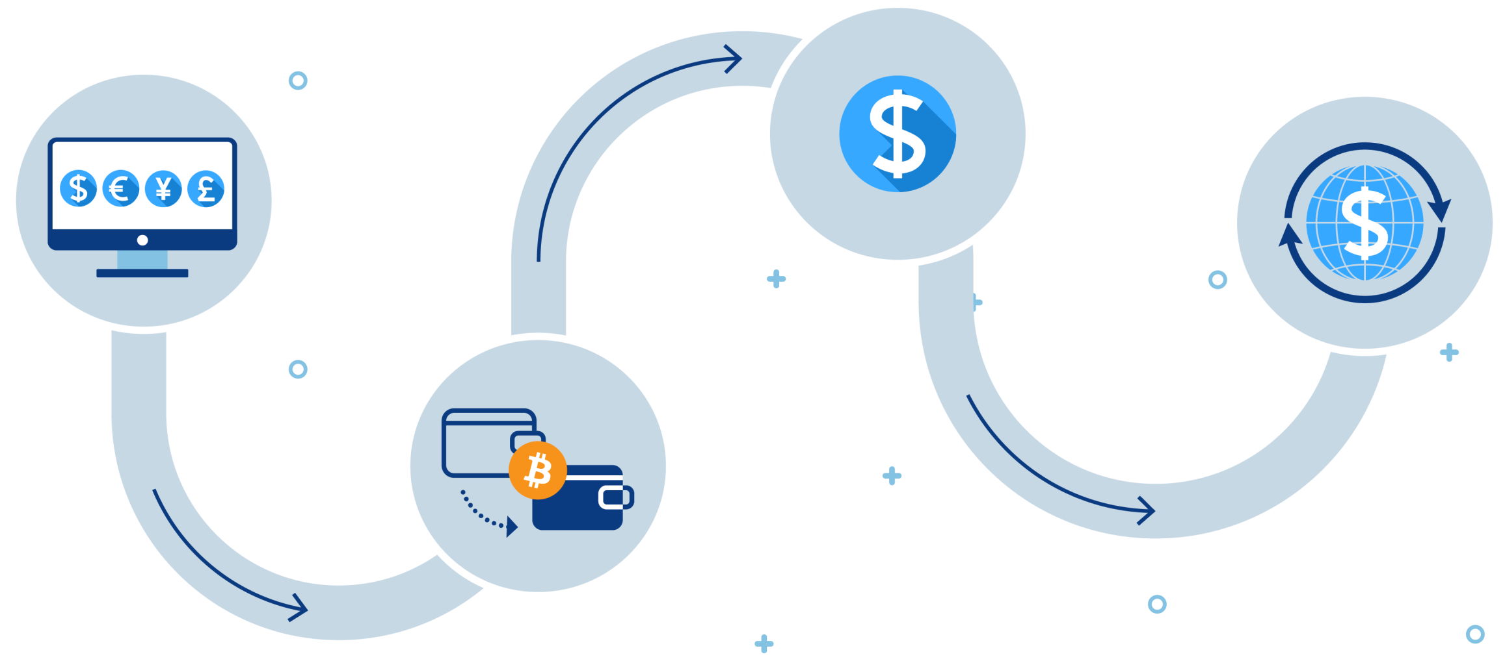
Crypto Exchange
3
1
4
Select designated settlement currency. USD
2
Transfer USDT
USD will be settled by us to the merchant account on the same working day.
Request USDT pay-out

Slide 11

FXBit
The payment gateway
For all countries
THE PERFECT SOLUTION FOR ALL

Slide 12


PLEASE FEEL FREE TO CONTACT US FOR PRICING.
PRICING STARTS FROM 1.50%.
WE ARE HERE TO HELP.
You can also subscribe to our newsletter via email. More information can be found on our websites:
fxbit.io
and
oneroadpayments.com
Telephone
Email
Address
(+852) 2815 0986
sales@fxbit.io
info@oneroadpayments.com
6/F, Kimberley Plaza, 45-47 Kimberley Road,Tsim Sha Tsui , Hong Kong

