Slide 1
Lesson 4: Culture
Robert Wonser
Introduction to Sociology

Slide 2
How Do Biological Humans Become Socialized Humans?
Human beings are biologically homosapien as well as socially human.
We are born homosapiens but not Americans.
Socialization into the ways of those around us, our culture.
How does culture shape us?

Slide 3
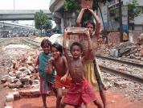
What is Culture?
Culture is the entire way of life for a group of people.
It is hard for us to see our own culture, so we may not recognize the extent to which it shapes and defines who we are.
It is the lens given to us by our ancestors that makes us human, socially, human.

Slide 4
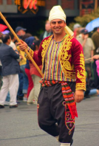
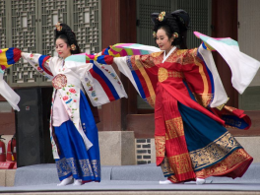
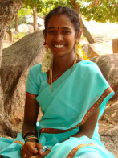
Culture is Learned
Culture includes things such as language, standards of beauty, hand gestures, styles of dress, food, and music.
Culture is learned. It is passed from one generation to the next through communication—not genetics.

Slide 5
Have You met Someone who is Nacirema?
Anthropologist Horace Miner describes the Nacirema as a group living in the territory between the Canadian Cree, the Yaqui and Tarahumare of Mexico, and the Carib and Arawak of the Antilles.
Some of the curious ‘body rituals’ of the Nacirema include:
Medicine men and women, a charm-box, the mouth-rite ritual and a cultural hero known as Notgnihsaw.
These ritual practices are prescribed as how man should comport himself in the presence of sacred things. These sacred aspects are the rituals that the Nacirema part take in throughout their lives.

Slide 6
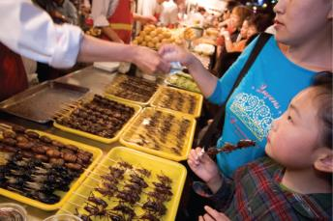
How to look at Cultures
Ethnocentrism is the principle of using one’s own culture as a standard by which to evaluate another group or individual, leading to the view that cultures other than one’s own are abnormal.
Who wants a snack?
Cicadas, grasshoppers, and other insects on skewers
for sale in Donghaumen Night Market in Beijing, China.

Slide 7
Cultural Relativism
Cultural relativism is the process of understanding other cultures on their own terms, rather than judging according to one’s own culture.
When studying any group, it is important to try to employ cultural relativism because it helps sociologists see others more objectively.

Slide 8
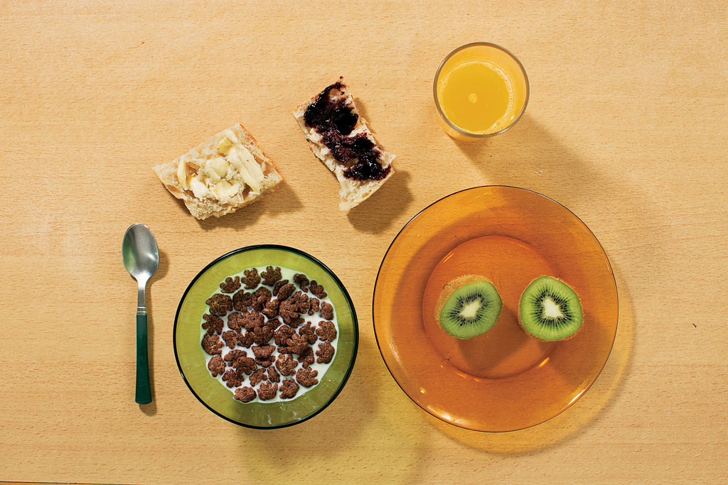
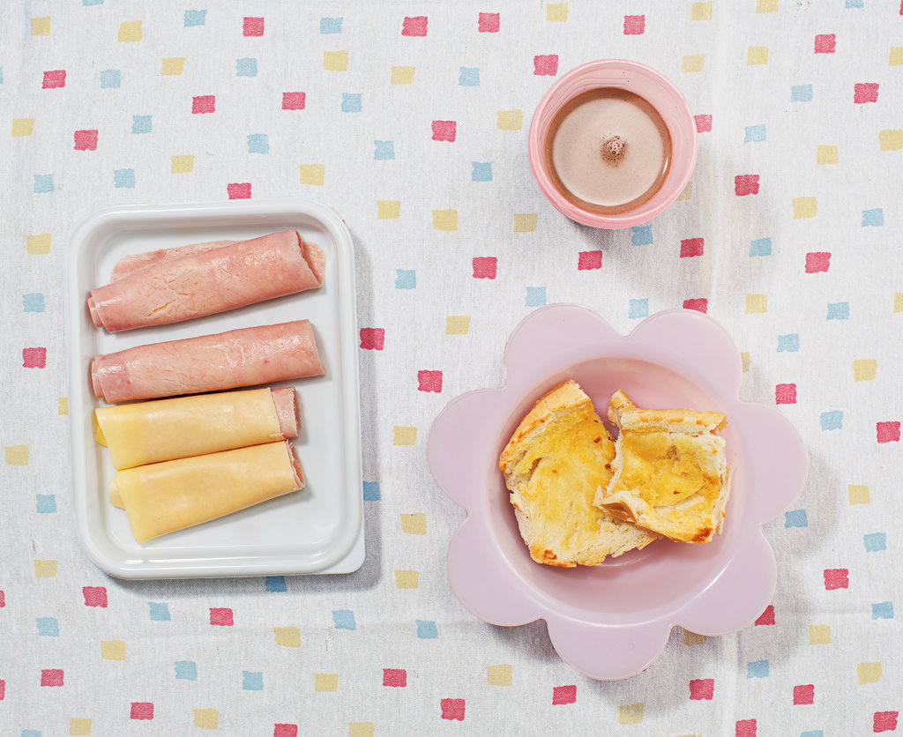
What Does Breakfast Look Like?
Nathanaël Witschi Picard, 6 years old, Paris
Aricia Domenica Ferreira, 4 years old, and
Hakim Jorge Ferreira Gomes, 2 years old, São Paulo, Brazil
Saki Suzuki, 2 ¾ years old, Tokyo
Notes:
http://www.nytimes.com/interactive/2014/10/08/magazine/eaters-all-over.html

Slide 9
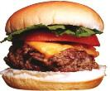
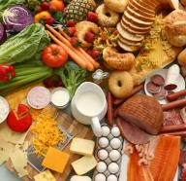
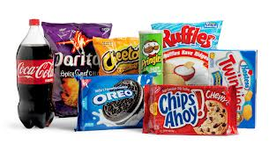
Material Culture
Material culture includes the objects associated with a cultural group, such as tools, machines, utensils, buildings, and artwork.

Slide 10
Symbolic Culture
Symbolic culture includes ways of thinking (beliefs, values, and assumptions) and ways of behaving (norms, interactions, and communication).

Slide 11
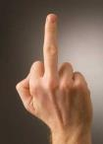
Components of Culture
One of the most important functions of symbolic culture is it allows us to communicate through signs, gestures, and language.
Signs (or symbols), such as a traffic signal or product logo, are used to meaningfully represent something else. Gestures are the signs that we make with our body, such as hand gestures and facial expressions; it is important that these gestures also carry meaning.

Slide 12
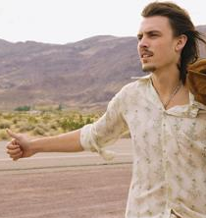
Symbols, Gestures and Signs

Slide 13
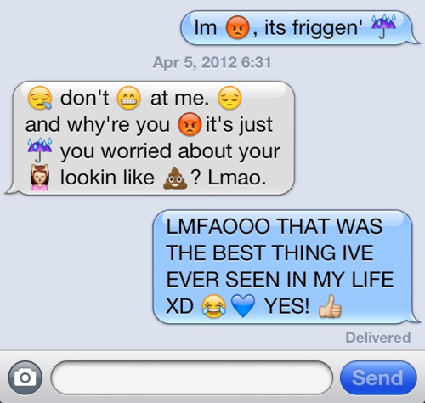
What Do Emojis Mean?

Slide 14
Notes:
https://getpocket.com/a/read/1255243442

Slide 15
Lost in Transmission

Slide 16
A graphic ranking misconstrued emojis across platforms, From left to right, it shows most misconstrued to least misconstrued:

Slide 17
Components of Culture
Finally language, a system of communication using vocal sounds, gestures, and written symbols, is probably is the most significant component of culture because it allows us to communicate.
Language is so important that many have argued that it shapes not only our communication but our perceptions of how we see things as well.

Slide 18
Lagom
lagom (pronounced: law-gum) and it permeates all facets of the Swedish psyche. Often misconstrued as indifference, or the stereotypical Scandinavian "coldness," lagom is loosely translated from Swedish as “just the right amount,” “in moderation,” “appropriate,” and other such synonyms.
For example, a common usage would be: The water is lagom hot, or the coffee is lagom strong.
Notes:
http://www.slate.com/articles/news_and_politics/roads/2013/09/sweden_s_lagom_the_single_word_that_sums_up_the_swedish_psyche.html

Slide 19
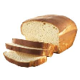
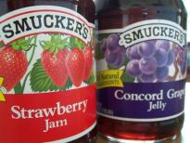
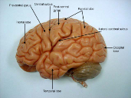
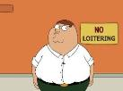
Components of Culture: Language
The Sapir-Whorf hypothesis, which is the idea that language structures thought, and that ways of looking at the world are embedded in language.

Slide 20
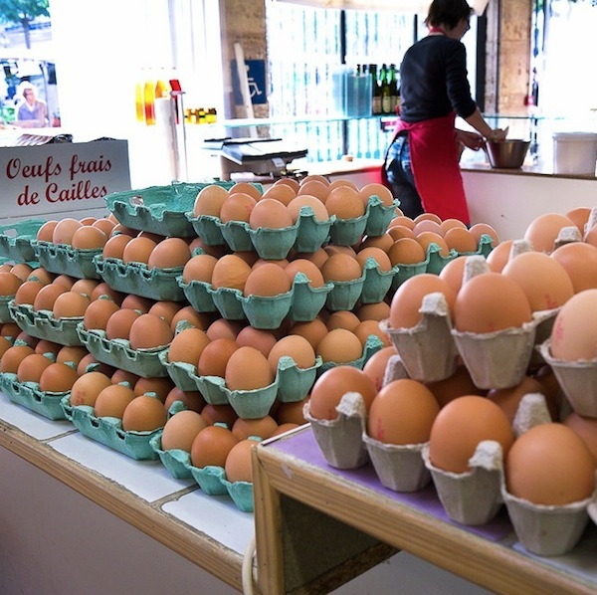
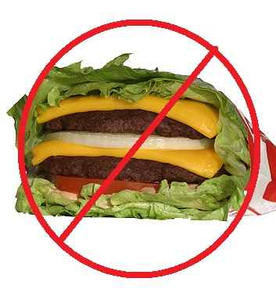
The Importance of Language
Language facilitates culture
Is American English the same as British English, dude?
Where would you find Eggplant in the grocery store?
Cheese + hamburger = cheeseburger
Lettuce + hamburger ≠ lettuceburger
Language allows human experiences to be cumulative
NOT the same thing!

Slide 21
Culture includes Norms and Values
Values are shared beliefs about what a group considers worthwhile or desirable; they guide the creation of norms.
Norms are the formal and informal rules regarding what kinds of behavior are acceptable and appropriate within a culture.
Vary from culture, time period and situation

Slide 22
Culture Gives us Our Values

Slide 23
“Make Me Look Beautiful.”
That's what Esther Honig asked 40 photo editors to do -- in over 25 countries. Using the service-sharing site Fiverr, Honig, a human interest reporter, sent a picture of herself to be photoshopped around the world to see just how much cultural values are applied to standards of beauty. The results throw the idea of "the perfect woman" into sharp relief.
Notes:
http://www.huffingtonpost.com/2014/06/26/photoshop-around-the-world_n_5534062.html

Slide 25
Types of norms can also be distinguished by the strictness with which they are enforced.

Slide 26
How did ‘doing nothing’ feel?

Slide 27
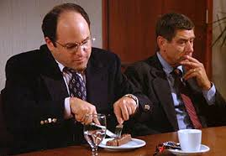
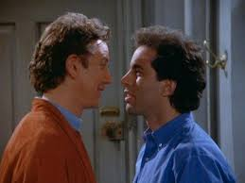
Types of Norms
A folkway is a loosely enforced norm that involves common customs, practices, or procedures that ensure smooth social interaction and acceptance.

Slide 28
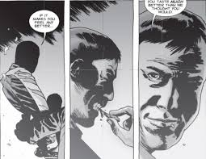
Types of Norms
A more is a norm that carries greater moral significance, is closely related to the core values of a group, and often involves severe repercussions for violators.
A taboo is a norm engrained so deeply that even thinking about violating it evokes strong feelings of disgust, horror, or revulsion for most people.

Slide 29
Sanctions and Social Control
Sanctions are positive or negative reactions to the ways that people follow or disobey norms, including rewards for conformity and punishments for norm violators. Sanctions help to establish social control, the formal and informal mechanisms used to increase conformity to values and norms and thus increase social cohesion.

Slide 30
Variations in Culture
The dominant culture refers to the values, norms, and practices of the group within society that is most powerful in terms of wealth, prestige, status, and influence.

Slide 31
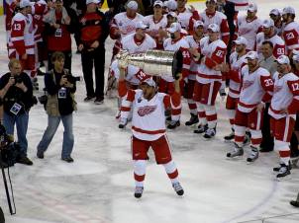
Variations within a Culture
A subculture is a group within society that is differentiated by its distinctive values, norms, and lifestyle.

Slide 32
Variation within a Culture
What do you call soft drinks?

Slide 33
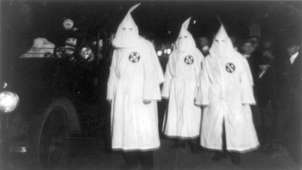
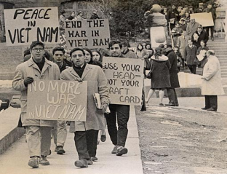
Variations within a Culture
A counterculture is a group within society that openly rejects, and may actively oppose, society’s values and norms.

Slide 34
Cultural Change
Cultures usually change slowly and incrementally, though change can also happen in rapid and dramatic ways.
At times, a subculture can influence the mainstream and become part of dominant culture, or something that is dominant can change to a counterculture.

Slide 35
Lesson Quiz
It is easy for us to perceive our own culture and see how it shapes and defines who we are.
a. true
b. false

Slide 36
Lesson Quiz
When a person uses his or her own culture as a standard to evaluate another group or individual, this is called:
a. egotism.
b. egocentrism.
c. ethnocentrism.
d. material culture.

Slide 37
Lesson Quiz
Which of the following is NOT a component of culture?
a. material culture
b. signs
c. language
d. symbolic culture
e. All of the above are components of culture.

Slide 38
Lesson Quiz
Which norm has the greatest moral significance?
a. folkways
b. pathways
c. mores
d. symbolic culture

Slide 39
Lesson Quiz
Which of the following groups within society openly rejects, and may actively oppose, society’s values and norms?
a. the dominant culture
b. a subculture
c. a counterculture
d. a materialistic culture

