Slide 1
DBI in Mathematics:
Session 5

Slide 2
Contact Information
Sarah Powell, Ph.D
The University of Texas at Austin
srpowell@austin.utexas.edu
@sarahpowellphd
119

Slide 3
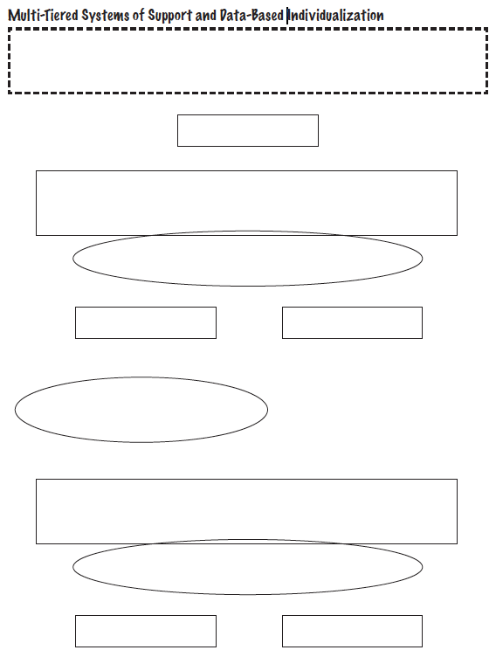
TIER ONE
AT-RISK
Sessions 4 and 5
Intervention
Session 2
Progress Monitoring
NON-RESPONSIVE
RESPONSIVE
Session 3
Diagnostic
Sessions 4 and 5
Intervention (Adapted)
Session 2
Progress Monitoring
NON-RESPONSIVE
RESPONSIVE

Slide 5
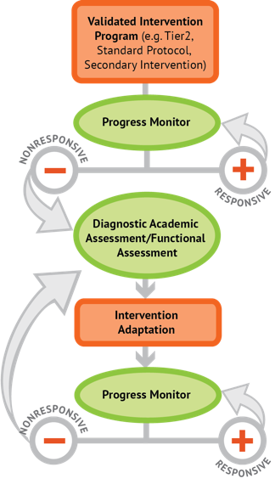
Intervention: Occurs frequently and with intensity
Assessment: Formative
Assessment: Diagnostic
Intervention adaptation: Content, dosage, explicit instruction, attention to transfer
Assessment: Formative

Slide 6
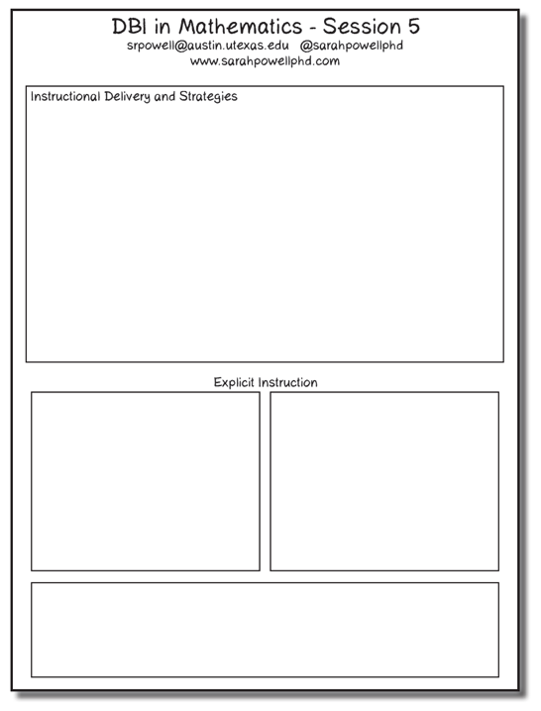

Slide 7
Instructional Platform
INSTRUCTIONAL DELIVERY
Explicit instruction
Concise language
Multiple representations
INSTRUCTIONAL STRATEGIES
Fluency building
Problem solving instruction
Motivation component

Slide 8
Explicit Instruction
Modeling
Practice
Clear Explanation
Guided
Practice
Planned
Examples
Independent Practice
Supporting Practices
Asking the right questions
Eliciting frequent responses
Providing immediate specific feedback
Maintaining a brisk pace

Slide 9
degree

Slide 10
Concise Language

Slide 11
Language of Mathematics
Technical terms
Subtechnical terms
Symbolic terms
General terms
trapezoid
rhombus
numerator
addend
subtract
base
degrees
cube
plane
arc
plus
zero
twelve
dollars
and
above
measure
answer
longest
outside

Slide 12
Use formal math language
Use terms precisely

Slide 13
Instead of…
Say…
“And the last one is 10.”
“8, 9, 10. We’ll stop counting there but we could count more.”
“What number is in the tens place?”
“What digit is in the tens place?”
“Six hundred and forty-eight”
“Six hundred forty-eight”
“Bigger number and smaller number”
“Number that is greater and the number that is less”
Hughes et al. (2016)

Slide 14
Instead of…
Say…
“Numbers in the fraction”
“This fraction is one number.”
“Top number and bottom number”
“Numerator and denominator”
“Reduce”
“Find an equivalent fraction”
“One point two nine”
“One and twenty-nine hundredths”
Hughes et al. (2016)

Slide 15
Instead of…
Say…
“Corner”
“Angle”
“Flips, slides, and turns”
“Reflections, translations, and rotations”
“Box or ball”
“Cube or sphere”
“Long hand and short hand”
“Minute hand and hour hand”
Hughes et al. (2016)

Slide 16
Multiple Representations
Abstract
Pictorial
Concrete

Slide 17
Abstract
Pictorial
Concrete
Three-dimensional objects

Slide 18
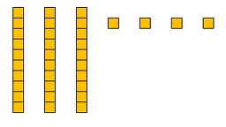
Abstract
Pictorial
Concrete
Two-dimensional images

Slide 19
Numerals, symbols, and words
Abstract
Pictorial
Concrete
34 = 3 tens and 4 ones
2 + 8 = 10
x – 6 = 8
4,179
+ 569

Slide 20
Fluency
Addition
Subtraction
Multiplication
Division

Slide 21
Instructional Platform
INSTRUCTIONAL DELIVERY
Explicit instruction
Concise language
Multiple representations
INSTRUCTIONAL STRATEGIES
Fluency building
Problem solving instruction
Motivation component

Slide 22
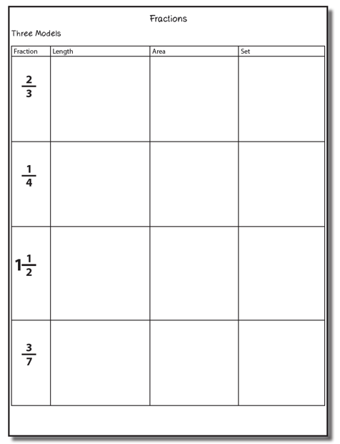
Fraction Concepts

Slide 23
Important Fraction Vocabulary
Whole
Unit
Equal parts
Fraction
Proper fraction
Improper fraction
Mixed number
Numerator
Denominator
Greatest common factor
Least common multiple (or denominator)

Slide 24
Fraction Models
Length/measurement/linear
Fraction bars, fraction strips, Cuisenaire rods, number lines, rulers
Area/region
Fraction circles, pattern blocks, geoboards, grid paper
Set/discrete
Chips, counters

Slide 25
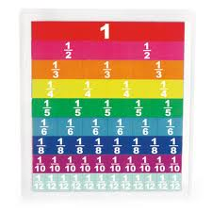
Length/Measurement
Fractions are appropriated by length

Slide 26
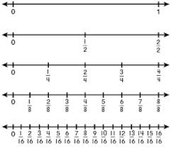
Length/Measurement

Slide 27
Area/Region
Shapes divided into equal sections

Slide 28
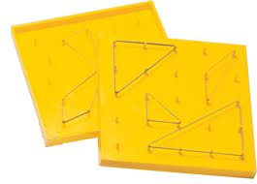
Area/Region
Shapes divided into equal sections

Slide 29
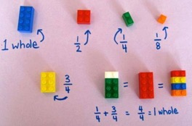
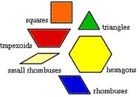
Area/Region

Slide 30
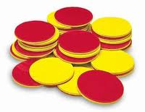
Set/Discrete
Individual shapes match the fraction

Slide 31
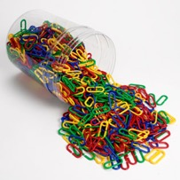
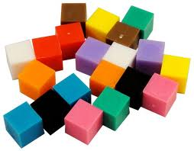
Set/Discrete

Slide 32
Teach this fraction to a student who doesn’t understand fraction concepts.
Explicit instruction
Multiple representations
Concise language

Slide 33
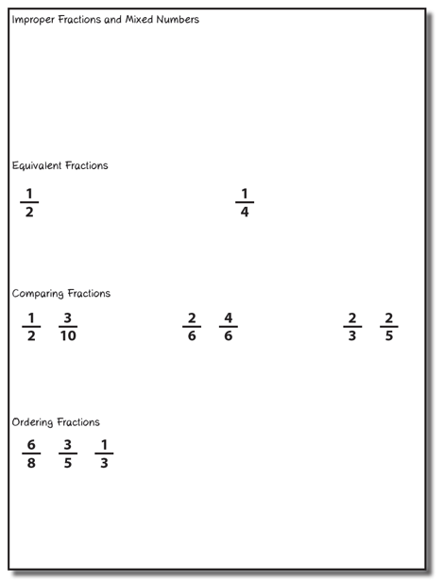
Choose one of the topic areas and design intensive instruction related to the topic.
Explicit instruction
Multiple representations
Concise language

Slide 34
Fraction Computation

Slide 35
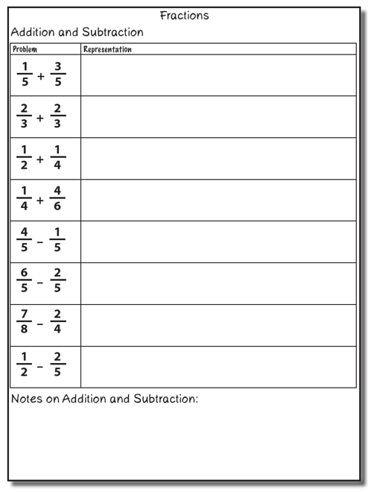
Addition

Slide 36
Addition

Slide 37
Addition

Slide 38
Explicit instruction
Multiple representations
Concise language

Slide 39
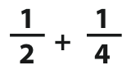
Addition

Slide 40
Addition
2: 2, 4, 6, 8, 10
4: 4, 8, 12, 16, 20

Slide 41
Addition

Slide 42
Explicit instruction
Multiple representations
Concise language

Slide 43
Subtraction

Slide 44
Subtraction

Slide 45
Explicit instruction
Multiple representations
Concise language

Slide 46
Subtraction
Take away from this set
This is for reference

Slide 47
Explicit instruction
Multiple representations
Concise language

Slide 48
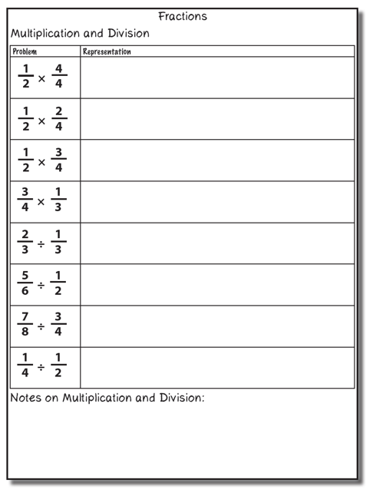
Multiplication

Slide 49
Multiplication
Show
One-half of four-fourths

Slide 50
Multiplication
Show
One-half of two-fourths

Slide 51
Multiplication
Show
One-half of three-fourths

Slide 52
Multiplication
Choose one of the multiplication problems and design intensive instruction related to the topic.
Explicit instruction
Multiple representations
Concise language

Slide 53
Division

Slide 54
Multiplication
Show
1 set of one-third
2 sets of one-third

Slide 55
Multiplication
Show
1 set of one-half
Two-thirds set of one-half

Slide 56
Division
Choose one of the division problems and design intensive instruction related to the topic.
Explicit instruction
Multiple representations
Concise language

Slide 57
Word-Problem Solving

Slide 58
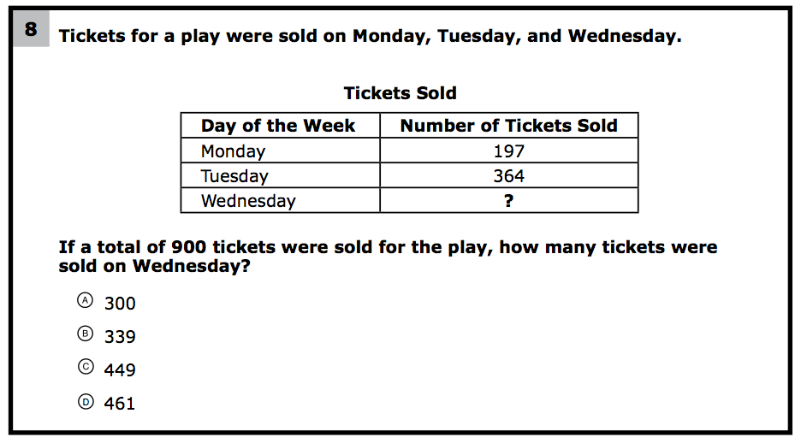
How would you teach this problem?
What do students need to know to solve this problem?
What might cause difficulty for students?

Slide 59
Problem Solving Difficulties
Reading problems
Understanding vocabulary
Identifying relevant information
Ignoring irrelevant information
Interpreting charts and graphs
Identifying appropriate operation(s)
Performing the computation(s)

Slide 60
Don’t tie key words to operations
Do have an attack strategy
Do teach word-problem schemas

Slide 61
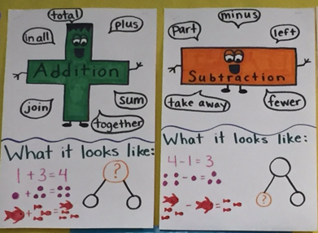
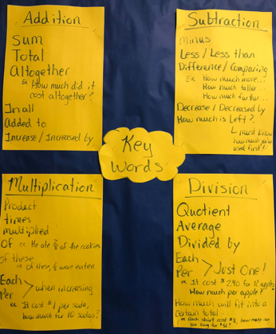

Slide 62
Kasey made $42, and Mandy made $37. How much money did they make in all?
Kasey and Mandy made $79 in all. If Kasey made $42, how much money did Mandy make?
Kasey mowed 12 lawns on Monday. Then, she mowed 10 more on Tuesday. How many lawns has Kasey mowed?
Kasey mowed 22 lawns and Mandy mowed 7 lawns. How many more lawns did Kasey mow than Mandy?

Slide 63
Becky has $70 more than Perla. If Becky has $120, how much money does Perla have?
Becky has $70 more than Perla. If Perla has $50, how much money does Becky have?
Becky had 9 dinosaurs and then her sister took away 4 of them. How many dinosaurs does Becky have now?
Becky had some dinosaurs and then her sister took away 4 of them. Now Becky has 5 dinosaurs. How many dinosaurs did she start with?

Slide 64
Matt baked 18 cookies. His brother baked twice as many. How many cookies did his brother bake?
Matt’s brother baked twice as many cookies as Matt. If Matt’s brother baked 36 cookies, how many did Matt bake?
Reece has 7 bags with 3 apples in each bag. How many apples does Reece have?
Reece had 21 apples and placed 3 apples each in several bags. How many bags does Reece need?

Slide 65
Rachel wants to share 36 brownies with 6 friends. How many cookies will each friend receive?
Rachel shared brownies with 6 friends. Each friend ate 6 brownies. How many brownies did Rachel have to start with?
Brent made 12 cupcakes. His brother made half as many cupcakes. How many cupcakes did Brent’s brother bake?
Brent made 12 cupcakes. He cut each cupcake into half. How many pieces of cupcake does Brent have?

Slide 66
Michelle made 17 paper airplanes. Dante made 24 paper airplanes. How many airplanes did they make altogether?
Michelle and Dante made 41 paper airplanes altogether. If Dante made 24 paper airplanes, how many did Michelle make?
Michelle made 4 paper airplanes using 2 pieces of paper for each airplane. How much paper did Michelle use altogether?
Dante and Michelle made 40 paper airplanes altogether. Dante made 24 of the paper airplanes. If Michelle gave 7 of her paper airplanes to her friend Nicole, how many planes does Michelle have now?

Slide 67
Students need to understand key words. But, key words should not be directly tied to operations.

Slide 68
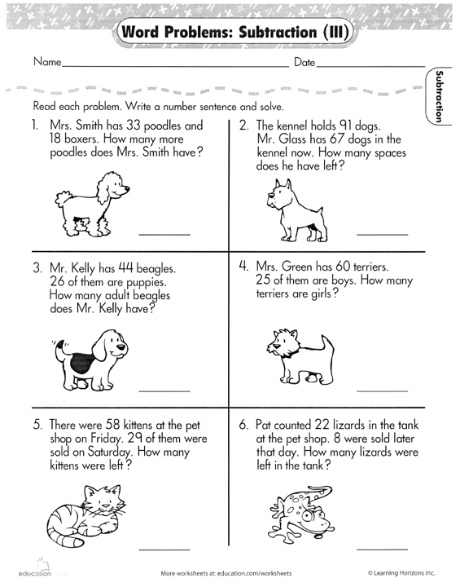

Slide 69
Don’t tie key words to operations
Do have an attack strategy
Do teach word-problem schemas

Slide 70
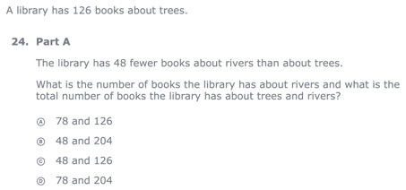
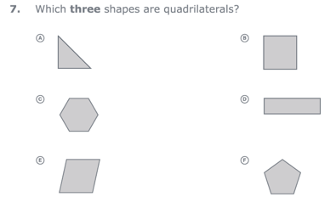
For every word problem
Regardless of problem type, students need an attack strategy for working through the problem
This strategy should work for any problem type
Routine Word Problems
Instructional Word Problems

Slide 71
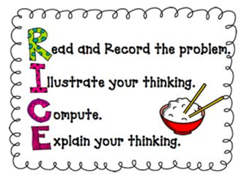
RIDGES
Read the problem.
I know statement.
Draw a picture.
Goal statement.
Equation development.
Solve the equation.
RIDE
Read the problem.
Identify the relevant information.
Determine the operation and unit for the answer.
Enter the correct numbers and calculate, then check the answer.

Slide 72
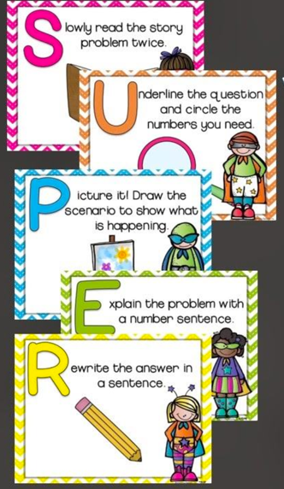

Slide 73
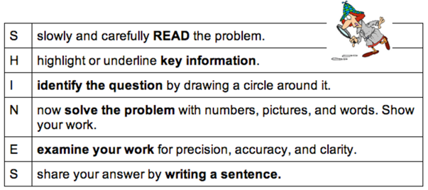
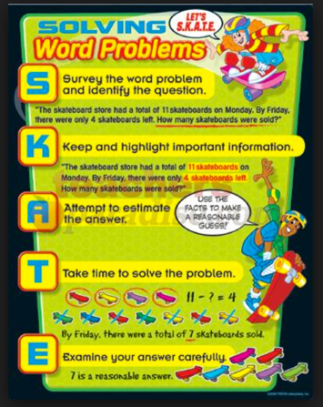
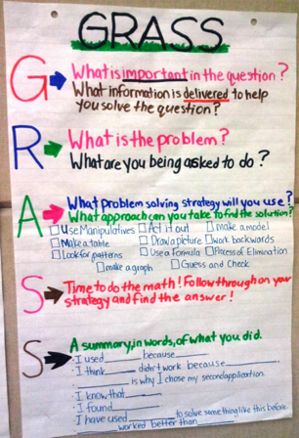

Slide 74
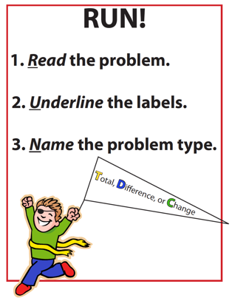
SIGNS
Survey questions
Identify key words
Graphically draw problem
Note operations
Solve and check
SOLVE
Study the problem.
Organize the facts.
Line up the plan.
Verify the plan with computation.
Examine the answer.

Slide 75
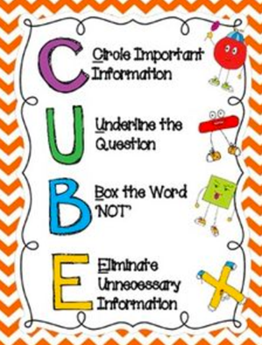
R-CUBES
Read the problem.
Circle key numbers.
Underline the question.
Box action words.
Evaluate steps.
Solve and check.

Slide 76
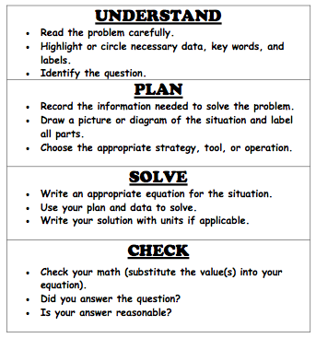

Slide 77
Don’t tie key words to operations
Do have an attack strategy
Do teach word-problem schemas

Slide 78
Additive Schemas

Slide 79
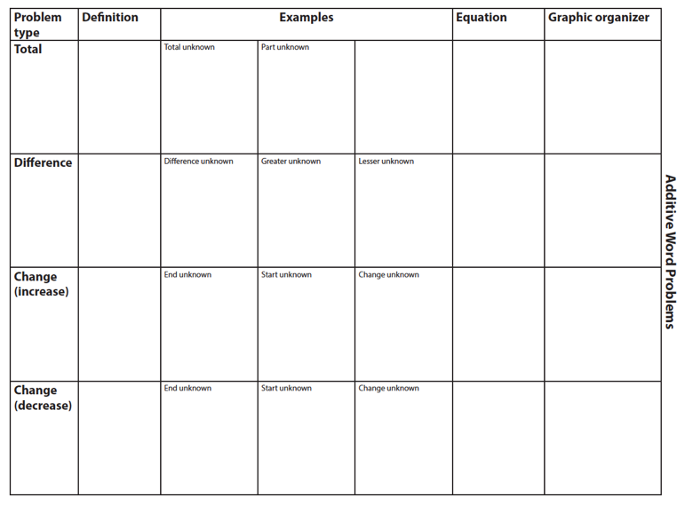

Slide 80
Total
Parts put together into a total
Emily saw 4 cardinals and 5 blue jays. How many birds did Emily see?
4 + 5 = ?
Emily saw 9 birds. If 4 of the birds were cardinals, how many were blue jays?
4 + ? = 9
Emily saw 9 birds. 5 of the birds were blue jays, how many were cardinals?
5 + ? = 9

Slide 81
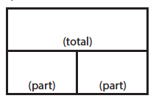
Total
P1 + P2 = T
Fuchs et al. (2008); Griffin & Jitendra (2009)

Slide 82
Total
“Are parts put together for a total?”

Slide 83
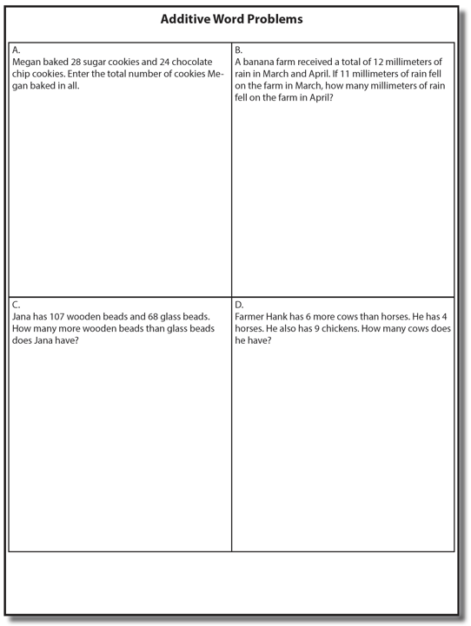
Total

Slide 84
Total
✔
✔
✔
P1 + P2 = T
U
P
S
✔
✔
28
+
24
=
?
✔
✔
28 + 24 = 52
? = 52 cookies
Grade 3 Smarter Balanced

Slide 85
Total
✔
✔
12
11
+ 1
12
12
- 11
1
✔
U
P
S
✔
✔
11
?
✔
✔
? = 1 millimeter
Grade 2 IXL

Slide 87
Difference
Greater and less amounts compared for a difference
Shinead has 9 apples. Amanda has 4 apples. How many more apples does Shinead have? (How many fewer?)
9 – 4 = ?
Shinead has 5 more apples than Amanda. If Amanda has 4 apples, how many does Shinead have?
? – 4 = 5
Amanda has 5 fewer apples than Shinead. Shinead has 9 apples. How many apples does Amanda have?
9 – ? = 5

Slide 88
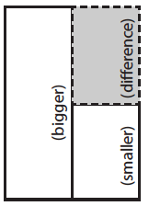
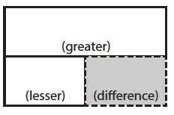
Difference
G – L = D
Fuchs et al. (2008); Griffin & Jitendra (2009)

Slide 89
Total
“Are parts put together for a total?”
Difference
“Are amounts compared for a difference?”

Slide 90
Difference

Slide 91
Difference
✔
✔
G – L = D
✔
U
P
S
✔
✔
107
-
68
=
B
107
68
68
+ ?
107
✔
✔
107 – 68 = 39
B = 39 more beads
Grade 3 Smarter Balanced

Slide 92
Difference

Slide 94
Change
An amount that increases or decreases
Shannah had $4. Then she earned $3 for cleaning her room. How much money does Shannah have now?
4 + 3 = ?
Shannah has $4. Then she earned money for cleaning her room. Now Shannah has $7. How much money did she earn?
4 + ? = 7
Shannah had some money. Then she made $3 for cleaning her room. Now she has $7. How much money did Shannah start with?
? + 3 = 7

Slide 95
Change
An amount that increases or decreases
Reece baked 9 cookies. Then, she ate 2 of the cookies. How many cookies does Reece have now?
9 – 2 = ?
Reece baked 9 cookies. Then, she ate some of the cookies. Now, she has 7 cookies. How many cookies did Reece eat?
9 – ? = 7
Reece baked some cookies. She ate 2 of the cookies and has 7 cookies left. How many cookies did Reece bake?
? – 2 = 7

Slide 96
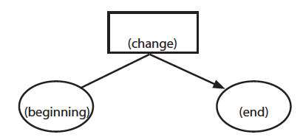
Change
ST +/– C = E
Fuchs et al. (2008); Griffin & Jitendra (2009)

Slide 97
Total
“Are parts put together for a total?”
Difference
“Are amounts compared for a difference?”
Change
“Does an amount increase or decrease?”

Slide 98
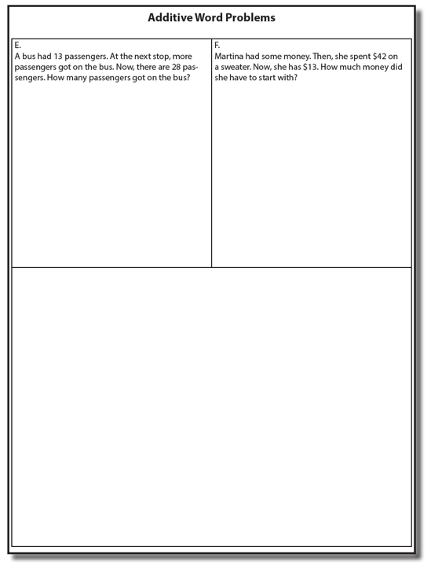
Change

Slide 99
Change
✔
A bus had 13 passengers. At the next stop, more passengers got on the bus. Now, there are 28 passengers. How many passengers got on the bus?
✔
✔
U
P
S
✔
ST + C = E
✔
13
+
?
=
28
✔
28
- 13
✔
13
+ ?
28
13 + 15 = 28
? = 15 passengers

Slide 100
Change

Slide 102
Total
P1 + P2 + P3 = T

Slide 103
Change
ST – C + C = E

Slide 104
Let’s Review
What’s a Total problem?
What’s a Difference problem?
What’s a Change problem?

Slide 105
Schema Quiz Time!

Slide 106
Total
Grade 4 Smarter Balanced

Slide 107
Change
Grade 3 PARCC

Slide 108
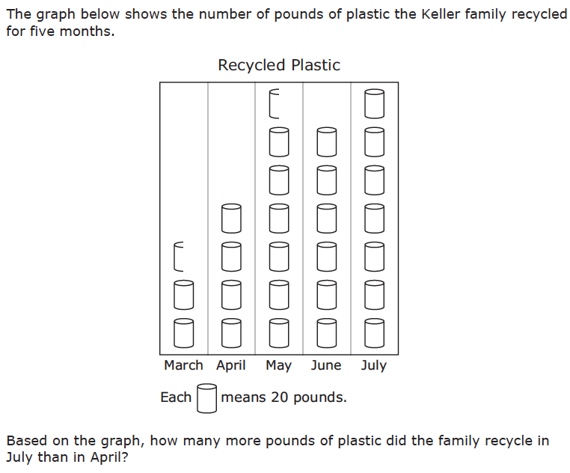
Difference
Grade 3 STAAR

Slide 109
Total
Grade 5 Smarter Balanced

Slide 110
Change
Grade 4 Smarted Balanced

Slide 111
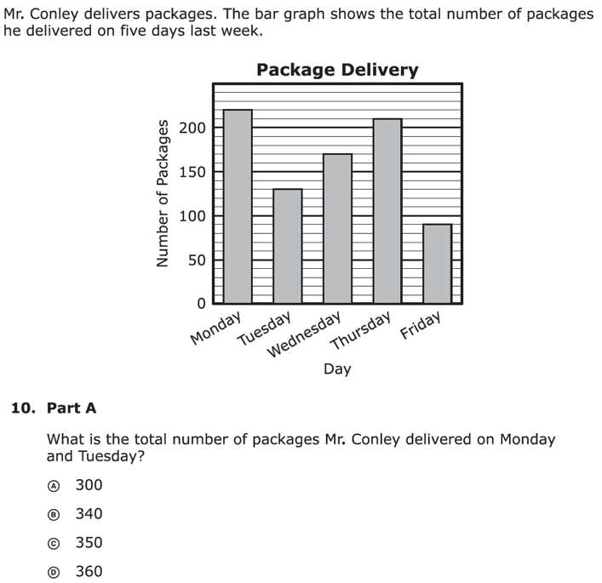
Total
Grade 3 PARCC

Slide 112
Change
Grade 1 K5Learning

Slide 113
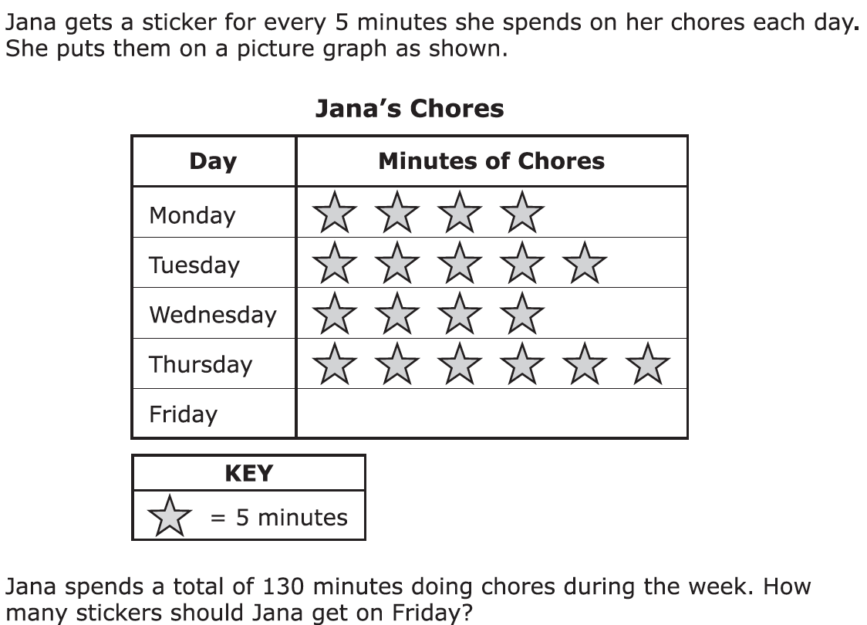
Total
Grade 3 PARCC

Slide 114
Change
Grade 2 WorksheetPlace

Slide 115
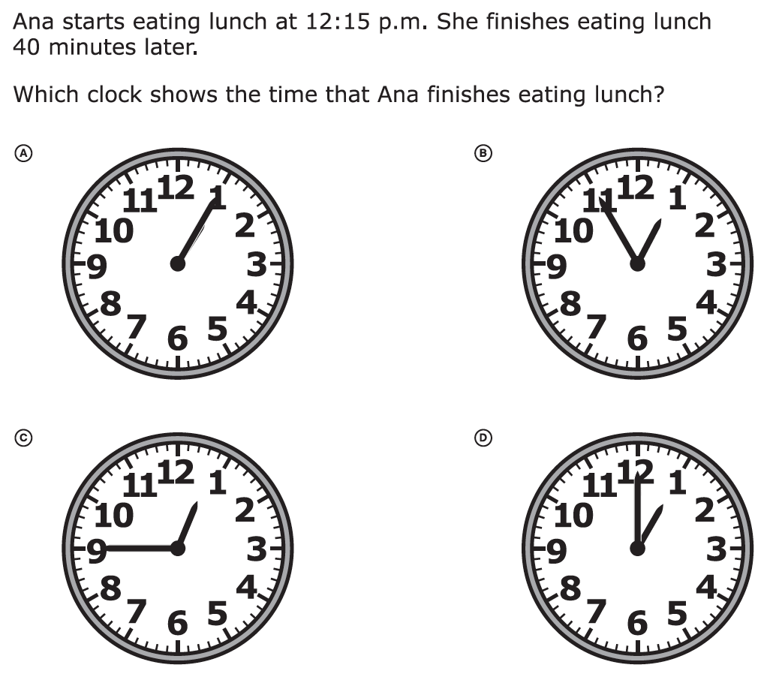
Change
Grade 3 PARCC

Slide 116
Difference
Grade 3 Smarter Balanced

Slide 117
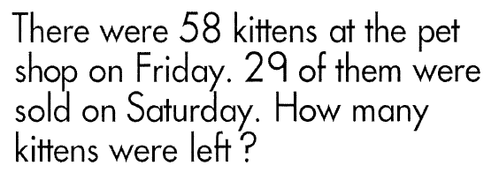
Change
Grade 2 Learning Horizons

Slide 118
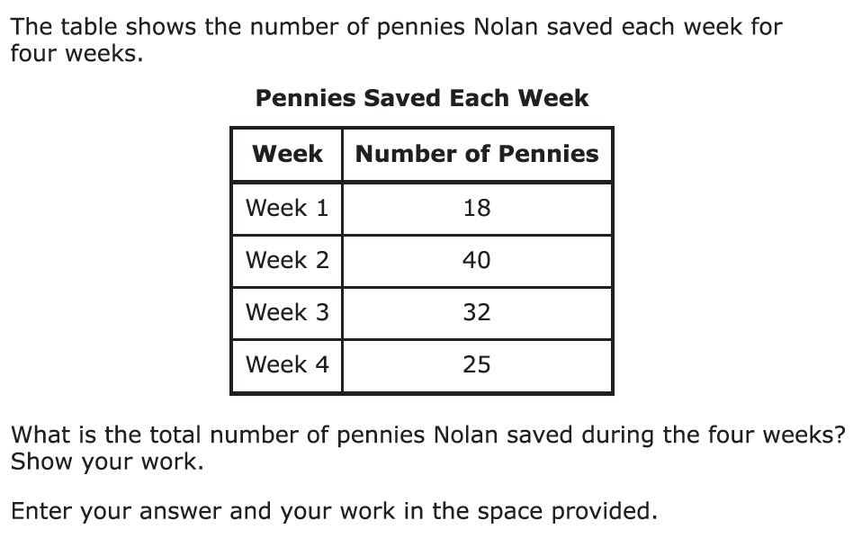
Total
Grade 3 PARCC

Slide 119
Change
Grade 3 STAAR

Slide 120
Difference
Grade 3 PARCC

Slide 121
Change

Slide 122
Total
Grade 2 Learning Horizons

Slide 123
Change
Grade 2 Math Aids

Slide 124
Change
Grade 5 STAAR

Slide 125
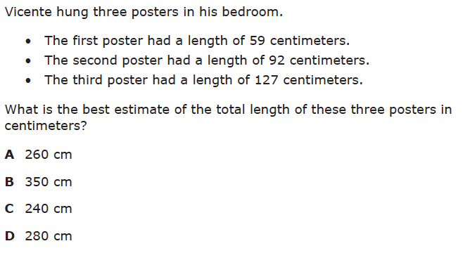
Total
Grade 3 STAAR

Slide 126
Don’t tie key words to operations
Do have an attack strategy
Do teach word-problem schemas

Slide 127
Multiplicative Schemas

Slide 128
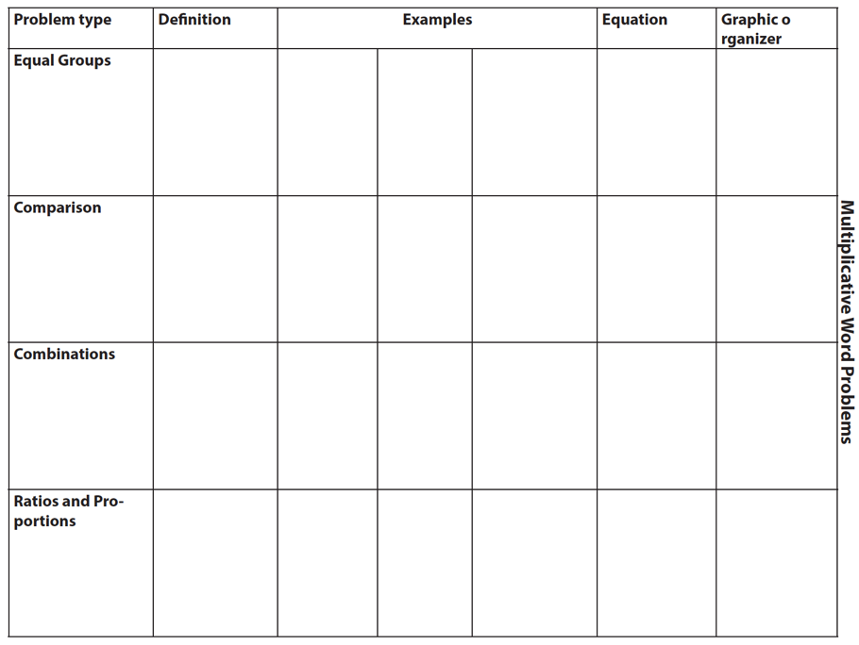

Slide 129
Equal Groups
Groups multiplied by number in each group for a product
Mark has 2 bags of apples. There are 6 apples in each bag. How many apples does Mark have altogether?
2 × 6 = ?
Mark has 12 apples. He wants to share them equally among his 2 friends. How many apples will each friend receive?
2 × ? = 12
Mark has 12 apples. He put them into bags containing 6 apples each. How many bags did Mark use?
? × 6 = 12

Slide 130
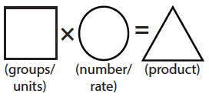
Equal Groups
G × N = P

Slide 131
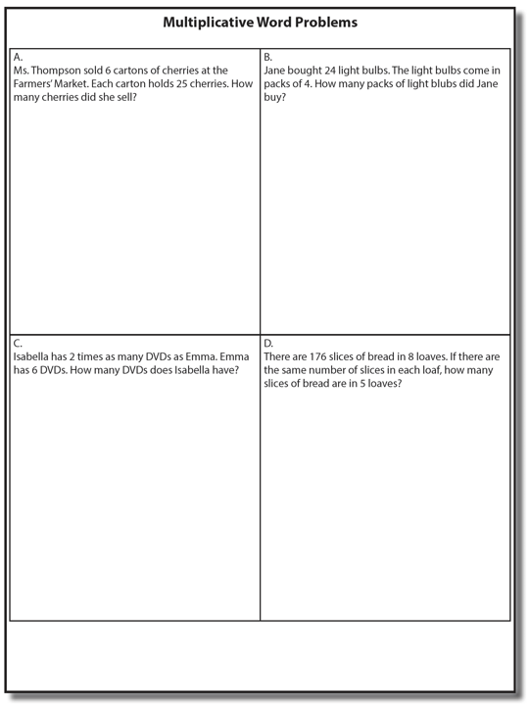

Slide 132
✔
✔
✔
G x N = P
U
P
S
✔
✔
x
=
6
25
?
✔
✔
6 x 25 = 150
? = 150 cherries

Slide 133
Equal Groups
“Are there groups with an equal number in each group?”

Slide 134
Equal Groups
✔
✔
✔
U
P
S
✔
✔
?
4
24
✔
✔
? x 4 = 24
4
4
Grade 3 STAAR
? = 6 packs

Slide 135
Comparison
Set multiplied by a number of times for a product
Jill picked 6 apples. Mark picked 2 times as many apples as Jill. How many apples did Mark pick?
6 × 2 = ?
Mark picked 12 apples. He picked 2 times as many apples as Jill. How many apples did Jill pick?
? × 2 = 12
Mark picked 12 apples, and Jill picked 6 apples. How many times as many apples did Mark pick as Jill did?
6 × ? = 12

Slide 136
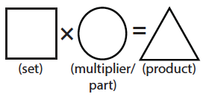
Comparison
S × T = P

Slide 137
Equal Groups
“Are there groups with an equal number in each group?”
Comparison
“Is a set compared a number of times?”

Slide 139
Comparison
✔
U
P
S
✔
6
2
?
✔
✔
✔
Grade 4 Smarter Balanced
? = 12 DVDs

Slide 140
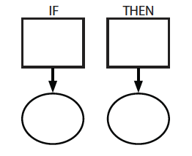
Ratios/Proportions
Description of relationships among quantities
Xin et al. (2005)

Slide 142
Ratios/Proportions
✔
✔
✔
✔
U
P
S
✔
✔
176
?
? = 110 slices
✔
✔
8
5

Slide 144
Ratios/Proportions

Slide 145
Equal Groups
“Are there groups with an equal number in each group?”
Comparison
“Is a set compared a number of times?”
Ratios/Proportions
“Are there relationships among quantities - if this, then this?”

Slide 146
Ratios/Proportions

Slide 147
Schema Quiz Time!

Slide 148
Equal Groups
Grade 4 PARCC

Slide 149
Equal Groups
Grade 4 STAAR

Slide 150
Ratios/Proportions
Grade 6 Smarter Balanced

Slide 151
Comparison
Grade 4 Smarter Balanced

Slide 152
Equal Groups

Slide 153
Comparison
Grade 4 PARCC

Slide 154
Equal Groups
Grade 3 STAAR

Slide 155
Equal Groups
Grade 4 PARCC

Slide 156
Ratios/Proportions
Grade 5 STAAR

Slide 157
Equal Groups
Grade 4 STAAR

Slide 158
Ratios/Proportions
Grade 5 Smarter Balanced

Slide 159
Ratios/Proportions
Grade 6 Smarter Balanced

Slide 160
Comparison
Grade 4 Smarter Balanced

Slide 161
Ratios/Proportions
Grade 6 PARCC

Slide 162
Equal Groups
Grade 4 STAAR

Slide 163
Let’s Review
What’s an Equal Groups problem?
What’s a Comparison problem?
What’s a Ratio/Proportions problem?

Slide 164
Schemas
Total
Difference
Change
Equal Groups
Comparison
Ratios/Proportions

Slide 165
Grade 3
Select a word problem at your grade level. Design intensive intervention.
Explicit instruction
Multiple representations
Concise language

Slide 166
Grade 4
Select a word problem at your grade level. Design intensive intervention.
Explicit instruction
Multiple representations
Concise language

Slide 167
Grade 5
Select a word problem at your grade level. Design intensive intervention.
Explicit instruction
Multiple representations
Concise language

Slide 168
Grade 6
Select a word problem at your grade level. Design intensive intervention.
Explicit instruction
Multiple representations
Concise language

Slide 169
Grade 7
Select a word problem at your grade level. Design intensive intervention.
Explicit instruction
Multiple representations
Concise language

Slide 170
Don’t tie key words to operations
Do have an attack strategy
Do teach word-problem schemas

Slide 171
TIER ONE
AT-RISK
Sessions 4 and 5
Intervention
Session 2
Progress Monitoring
NON-RESPONSIVE
RESPONSIVE
Session 3
Diagnostic
Sessions 4 and 5
Intervention (Adapted)
Session 2
Progress Monitoring
NON-RESPONSIVE
RESPONSIVE

Slide 172
Homework for Session 6
Upload or bring examples of your progress monitoring data for your students

Slide 173
Contact Information
Sarah Powell, Ph.D.
The University of Texas at Austin
srpowell@austin.utexas.edu
@sarahpowellphd
119

