Slide 1
Data-Based Individualization and Mathematics: Session 6
NYC Public Schools
May 9, 2018

Slide 2


Contact Information
Sarah Powell
  University of Texas at Austin
  srpowell@austin.utexas.edu
  @sarahpowellphd

Slide 3
Contact Information
Leanne Ketterlin-Geller
  lkgeller@mail.smu.edu
  @RME_SMU
Erica Lembke
  lembkee@missouri.edu
  @EricaLembke

Slide 4
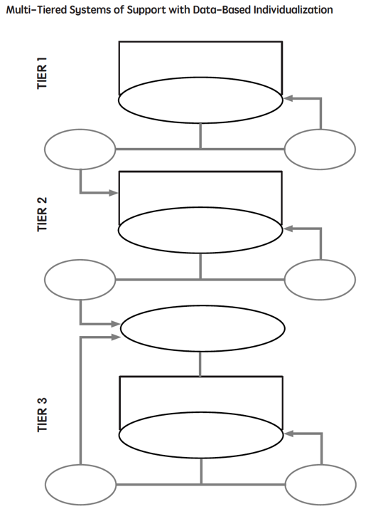
TIER ONE
INADEQUATE
ADEQUATE
Session 4 and 5
Intervention
Progress
Monitoring
Session 2
INADEQUATE
ADEQUATE
Session 3
Diagnostic
Session 4 and 5
Intervention (Adapted)
Progress
Monitoring
Session 2
INADEQUATE
ADEQUATE

Slide 5
Multi-tiered Systems of Support

Slide 6
Tier 1

Slide 7
Tier 1
Core instruction utilizes evidence-based programs or strategies
All students screened
Students scoring below a cut-score are suspected at risk for math difficulties
Suspected at-risk students monitored for 6 to 10 weeks during primary prevention using PM
Progress Monitoring

Slide 8
Tier 1
Slope = 1.0
13 – 6
7
X
Student NOT at risk.
X

Slide 9
Tier 1
Slope = 0.0
6 – 6
7
Student AT RISK.
Requires additional support!
X
X

Slide 10
Tier 1
TO REVIEW…
Evidence-based instruction
All classroom students screened to identify suspected at-risk students
Suspected at-risk students remain in primary prevention and are monitored using PM for 6 to 10 weeks:
  Students with adequate slopes remain in primary prevention
  Students with inadequate slopes move to
  Tier 2 (secondary prevention)

Slide 11
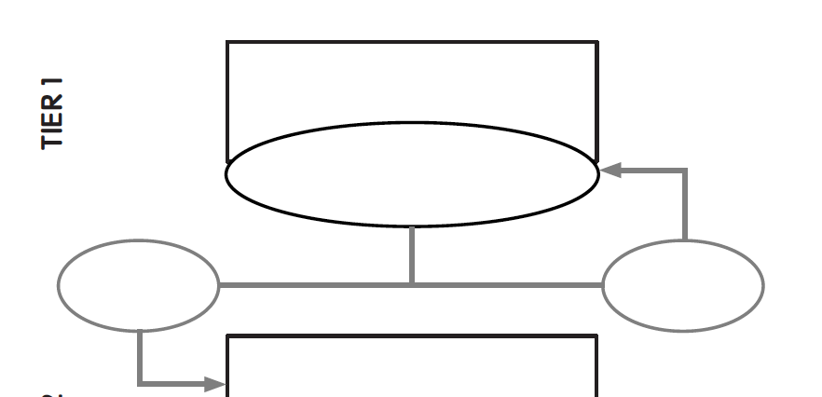
Evidence-based instruction
All students screened
At-risk students progress monitored for 6-10 weeks
inadequate
response
adequate
response

Slide 12
DBI

Slide 13
Tier 2
This is the start of DBI
Students are tutored in small groups using evidence-based practices
Tutoring takes place three or four times a week
Each tutoring session lasts 30 to 60 minutes
Tutoring lasts 10 to 20 weeks
Tutoring is conducted by resource personnel or paraprofessionals (not usually the classroom teacher)
PM continues weekly

Slide 14
Tier 2
If student response to secondary prevention is inadequate:
  In some RTI versions:
    Student participates in more small-group tutoring while weekly PM continues
  In other RTI versions:
    Student moves to Tier 3 (tertiary prevention)
    Comprehensive evaluation answers questions, determines disability, and suggests if special education services are appropriate

Slide 15
Tier 2
David

Slide 16
Tier 2
David
David’s slope:
(54 – 24) ÷ 8 = 3.75
X
X
David doesn’t require Tier 2/Tier3

Slide 17
Tier 2
Martha

Slide 18
Tier 2
Martha
Martha’s slope:
(10 – 6) ÷ 8 = 0.5
Martha requires Tier 3
X
X

Slide 19
Tier 2
TO REVIEW…
Suspected at-risk students with inadequate PM performance in Tier 1 are tutored in small groups
  Tutoring uses research-based interventions taught by school tutors
Student progress is monitored weekly:
  Students with adequate slopes return to primary prevention, with continued PM
  Students with inadequate slopes move to tertiary prevention (Tier 3)

Slide 20
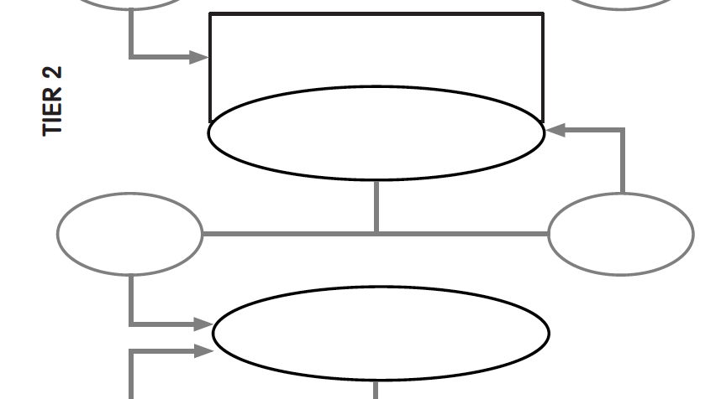
Evidence-based instruction provided in small groups
Progress monitoring for 10-20 weeks
inadequate
response
adequate
response
Diagnostic assessment

Slide 21
Tier 3
This is part of DBI
Adaptations are made to the student’s intervention
Student progress is monitored weekly
  With adequate slopes or end levels, students return to secondary or primary prevention

Slide 22
Tier 3
TO REVIEW…
Students receive individualized intervention
  Goals are set
Student progress is monitored:
  Students with adequate slopes and projected end levels return to Tier 2 or Tier 1, with ongoing PM
  Students with inadequate slopes and projected end levels remain in Tier 3, with ongoing PM

Slide 23
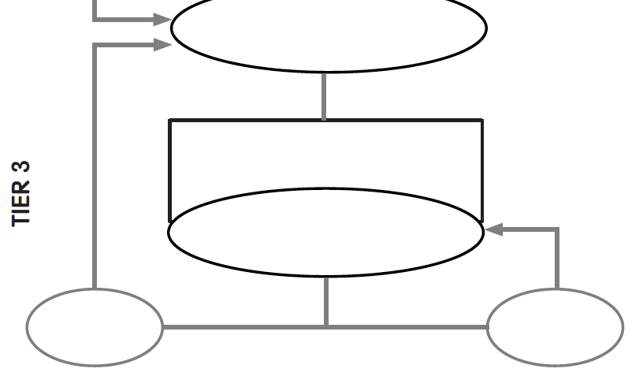
Diagnostic assessment
Evidence-based instruction provided individually or in small groups
Progress monitoring for 10-20 weeks
inadequate
response
adequate
response

Slide 24
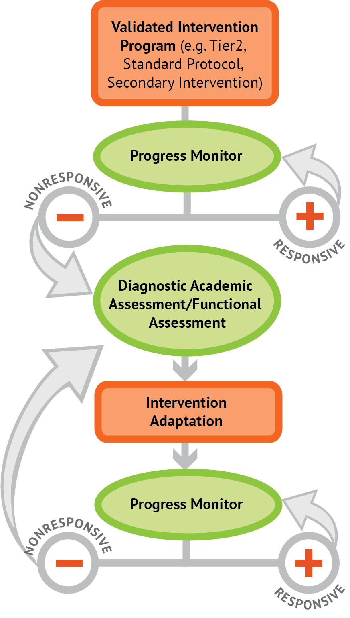
Intervention: Occurs frequently and with intensity
Assessment: Formative
Assessment: Diagnostic
Intervention adaptation: Content, dosage, explicit instruction, attention to transfer
Assessment: Formative

Slide 25
Intervention: Occurs frequently and with intensity
Assessment: Formative
Assessment: Diagnostic
Intervention adaptation: Content, dosage, explicit instruction, attention to transfer
Assessment: Formative
Sessions 1, 4, 5
Sessions 2, 3

Slide 26
Fundamentals of progress monitoring in mathematics
Dr. Erica Lembke
University of Missouri
lembkee@missouri.edu

Slide 27
Overview
How to locate and select progress monitoring measures in mathematics
How to administer and score early numeracy, computation, and applications progress monitoring measures
How to graph data
Decision making about meeting goals

Slide 28
Basic steps in the RTI process
Implementation of evidence-based core instruction
Schoolwide screening/benchmarking
Progress monitoring for students at risk
Discussion and decision-making about the data
Implementation of evidence-based interventions for students at-risk
Notes:
Evidence based interventions/instruction are those that have been directly studied. Use of evidence-based core program is key in the RTI model. We don’t want to provide a multitude of interventions if the system is actually ‘broken’ for students at the universal level.
Need to consider whether a class wide supplement like Peer Assisted Learning Strategies (PALS) is needed to help increase performance. One of the key items is monitoring fidelity. Create or utilize an existing fidelity checklist on a frequent basis. Have teachers do self checks, peer checks, or administrator checks.

Slide 29
How Do Assessments Fit Together?
1 to 3 times per year
Outcome tests
District test
CBM Benchmarking
? answered—how is this student
doing compared to peers or
benchmarks?
Weekly or monthly
Progress monitoring using CBM
for students deemed at-risk after
triangulation of data
? answered—is the student benefitting
from the instruction being provided?
Weekly or monthly
Diagnostic tests (unit or
chapter tests, teacher-made tests)
? answered—what specific skills are
mastered or do I need to reinforce?
Notes:
This is how we visualize assessments fitting together. 1 to 3 times per year, all students are screened to determine how students are doing compared to state or national benchmarks or norms. Then, as often as weekly, two additional pieces of assessment are in place—progress monitoring using CBM (aimsweb, dibels, star) that tells you whether students are benefiting from instruction and diagnostic tests that tell the teacher what skill needs to be focused on.

Slide 30
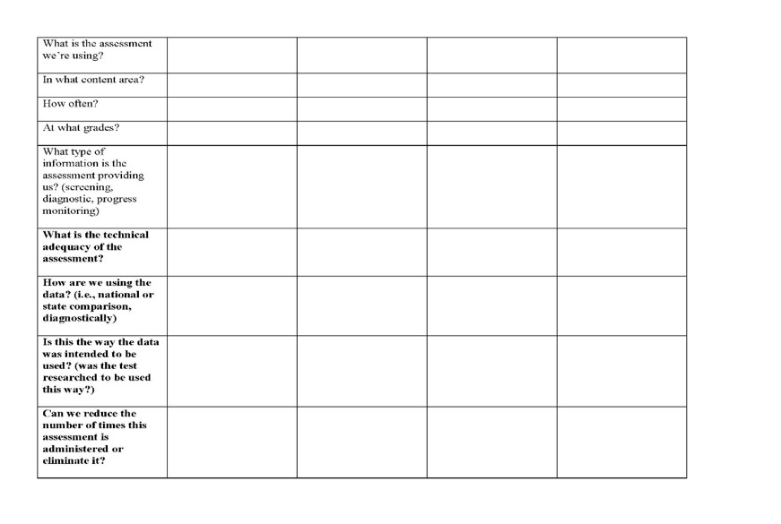
Assessment Audit

Slide 31
CBM—for use in screening and progress monitoring
Curriculum-Based Measurement (CBM) assessments like Aimsweb, EasyCBM, and DIBELSmath serve as indicators of academic proficiency, just like…
  Temperature in degrees serves as an indicator of overall wellness
  Weight in pounds serves as an indicator of overall health
  A litmus test serves as an indicator of a solution’s acidity
Notes:
Temperature serves as an indicator, just like words read is a good indicator (it isn’t everything!)
Also discuss weight loss as indicator of health.

Slide 32
How do temperature and weight and a litmus test relate to monitoring academic skills?
We want a graph of “educational health” or “educational strength.”
What do we measure?
Notes:
How difficult is it to do daily measurement with weight? How much time does it take? How expensive is it?
Inexpensive, easy, time efficient
Why do we measure in lbs and not tons? Ounces?
Sensitivity
What if we measured in kg?
Communication
What is a pound, anyway? How can we use it if we don’t know what it is?
Pound—a unit now in general use among English-speaking peoples equal to 16 avoirdupois or 7000 grains or .45359237 kgrams
If you want to weigh fewer pounds, why not just adjust the scale?
Not telling us what we really want to know
INDICATOR—of other things like health, well-being, etc.

Slide 33
Measuring Educational Health
We want to measure “educational health or strength” using something that is:
  Inexpensive
  Easy
  Time efficient
  Sensitive to change
  Easy to understand
  An INDICATOR of educational health
The measures do tell us if our teaching is effective. The measures do not tell us what to teach.

Slide 34
Measures Used For Monitoring
Math—CBM
--Make sure to choose measures that have been validated by experts (see rti4success.org and intensive intervention.org)
Early Numeracy
  Oral Counting, Missing Number, Number Identification, and Quantity Discrimination
Math Computation
Math Concepts & Applications
Algebra
Notes:
Math—basic fact probes, mixed problem probes

Slide 35
Administration
These measures are standardized and we can use nationwide norms because…
  We are consistent in how we administer the probes
  We are consistent in how we score the probes
  The probes that we use have documented reliability and validity

Slide 36
Selecting Measures
Make sure to check on how the measures have been evaluated utilizing the National Center on Intensive Intervention tools charts: intensiveintervention.org

Slide 37
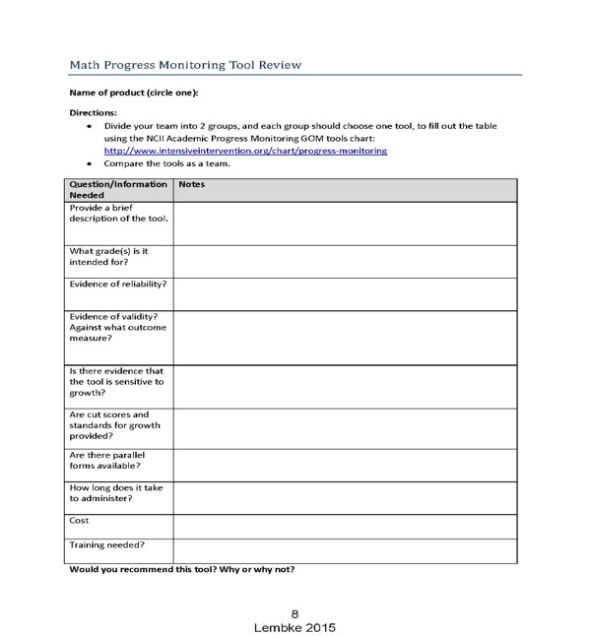

Slide 38
CBM mathematics measures

Slide 39
Examples of sources for CBM K-8 measures
DIBELS math
  Aligned with the common core standards
  Individually administered
  Free right now
https://dibels.org/mathearlyrelease/
username: math
password: 2017download

Slide 40
What are the options for secondary students?
“Stretch” existing elementary measures
  MBSP Computation, Concepts & Applications
Middle School options
  Estimation
  Facts
  Concept measures
High school measures
  AAIMS algebra measures
Taken from a presentation completed by Anne Foegen, Ph.D.

Slide 41
Example of a Source for Algebra Measures
Algebra Assessment and Instruction: http://www.education.iastate.edu/aaims/index.html
Continue to consider how these support the algebra clusters in the Common Core State Standards for Mathematics (CCSSM)
Anne Foegen, Iowa State University
Measures like basic skills, content analysis

Slide 42
Setting goals
Screening
  Use established benchmarks within the system you’re using
  Use tables that are not part of a system that provide end-of-year benchmarks
Progress monitoring or IEP goals:
  End-of-year benchmarking
  National norms for weekly rate of improvement (slope)
Notes:
There are three options for setting IEP goals. The first option uses end-of-year benchmarking. The second option uses an intra-individual framework. The third option uses national norms for weekly rate of improvement. Let’s look at these three options in more detail now.

Slide 43
Setting CBM goals using end-of-year benchmarking
Setting progress monitoring or IEP goals
  End-of-year benchmarking
    Identify appropriate grade-level benchmark
    Mark benchmark on student graph with an X
    Draw goal line from median score of baseline probes administered to X
Notes:
The first option is end-of-year benchmarking. For typically developing students at the grade level where the student is being monitored, identify the end-of-year CBM benchmark. This is the end-of-year performance goal. The benchmark is represented on the graph by an X at the date marking the end of the year. A goal-line is then drawn between the median of at least the first three CBM graphed scores and the end-of-year performance goal.

Slide 44
Mathematics Computation Benchmarks, aimsweb.com
1 | 2 | 3 | 4 | 5 | 6 | 7 | 8
16 | 24 | 30 | 56 | 49 | 39 | 38 | 39
Grade
Correct Digits
*Mean of spring scores
Notes:
Erica

Slide 45
Setting Goals With National Norms for Weekly Improvement
Median of the student’s first three scores (baseline).
  Baseline =
2. Find the appropriate norm from the table.
3. Multiply norm by number of weeks left in year.
4. Add to baseline.
5. Mark goal on student graph with an X.
6. Draw goal-line from baseline.
Notes:
This is how national norms for weekly rate of improvement would calculate Jane’s end-of-year goal. First, the baseline of the first three scores is calculated. Jane’s baseline is 11.33. Then the norm is found on a table. We just looked at this. The norm is Jane’s grade level on CBM computation is 0.30. The norm is multiplied by the number of weeks until the end of year: (0.30 × 17 = 5.1). 5.1 is added to Jane’s baseline score (5.1 + 11.33 = 16.43). Jane’s end-of-year goal is 16.43.

Slide 46
Mathematics Computation Rates of Improvement, aimsweb.com
1 | 2 | 3 | 4 | 5 | 6 | 7 | 8
.3 | .3 | .4 | .5 | .5 | .2 | .3 | .1
Grade
Correct Digits per week
*Rates of improvement for students at the 50th percentile
**Remember, these are based on the use of the aimsweb probes
Notes:
Erica

Slide 47
An example of setting long range or IEP goals using weekly growth criteria in mathematics:
First three scores median (baseline) = 10 Correct digits (CD)
Weekly growth criteria for 6th grade mathematics from aimsweb = 0.2
Multiply norm growth criteria by number of weeks left in year
  36 × 0.2 = 7.2
Add to median baseline
  7.2 + 10 = 17.2
Student’s end-of-year goal is 17 CD
Notes:
For example, a fourth-grade student’s average score from his first three CBM computation probes is 14. The norm for fourth-grade students is 0.70. To set an ambitious goal for the student, multiply the weekly rate of growth by the number of weeks left until the end of the year. If there are 16 weeks left, multiply 16 by 0.70: 16 × 0.70 = 11.2. Add 11.2 to the baseline average of 14 (11.2 + 14 = 25.2). This sum (25.2) is the end-of-year performance goal. This sum, 25.2, would be plotted on the student’s graph and a goal-line would be drawn.

Slide 48
Basic steps in the RTI process—and considerations!
#4--Discussion and decision-making about the data with grade level, content-specific, or school-wide teams
Consideration--Decision-making rules established. For instance:
  After 6 data points are collected over 6 weeks, use the trend line or 4-point rule to make a decision about current plan
Notes:
To make decisions about progress or lack of progress, the trend or individual data points are compared to the goal line every 4 to 6 weeks. If the trend of performance or last 4 data points are below the goal line, an instructional change is made. If trend or last 4 data points are the same as the goal line, the current plan is continued. If the trend or last 4 data points are above the goal line, the goal may need to be increased.

Slide 49
VIP of CBM (Very Important Pieces)—Graphing data, setting goals, and using data for instructional decision-making
1. Set annual goal for individual
3. Evaluate and modify instruction on basis of rate of progress towards goal
2. Monitor individual progress
towards goal
Notes:
This is an example of what a progress measurement graph might look like in CBM. Students’ current level of performance is established by collecting and graphing baseline data. From this baseline data, a long range goal is set for the student, across the time that the teacher will monitor. Goal line is in blue. For each intervention phase, the student’s slope of performance can be compared to the long range goal line. Slopes are in black. You can see in intervention 1, instruction was not effective, so an instructional change was implemented. This change had a positive effect on student performance, as can be seen by looking at the black slope line in intervention 2.

Slide 50
MOST IMPORTANT
Implement instructional changes based on decision-making rules
Decision rules for graphs:
  Only if you don’t have access to a trend--4-point rule—If at least 3 weeks of instruction have occurred AND at least 6 points have been collected, examine the 4 most recent data points
  Trend line rule-- If at least 4 weeks of instruction have occurred AND at least 8 data points have been collected, figure trend of current performance and compare to goal line
Notes:
Once IEP goals are set and individualized programs are implemented, it is important to monitor student progress. CBM can judge the adequacy of student progress and the need to change instructional programs. Standard decision rules guide decisions about the adequacy of student progress and the need to revise goals and instructional programs.
Decision rules are based on the four most recent consecutive scores or on the student’s trend-line. Let’s look at examples now.

Slide 51
Decision Making—Progress Monitoring Data
Every 4 to 6 weeks, examine trend of data compared to goal line or 4 most recent consecutive data points
  If trend or 4 points are below the goal line, make an instructional change.
  If trend or 4 points are above the goal line, consider past data to determine if the student can be moved to a lower tier or goal can be raised.
  If trend or 4 points are the same as the goal, stay the course.
Notes:
One of the ways that you can incorporate the decision making rules into a rubric follows. The three guiding questions that we can ask are above.

Slide 52
Discussion of Data and Decision Making
Use multiple validated measures.
Use decision-making rules.
Use guiding questions in your handout packet to discuss data with your grade-level team.

Slide 53
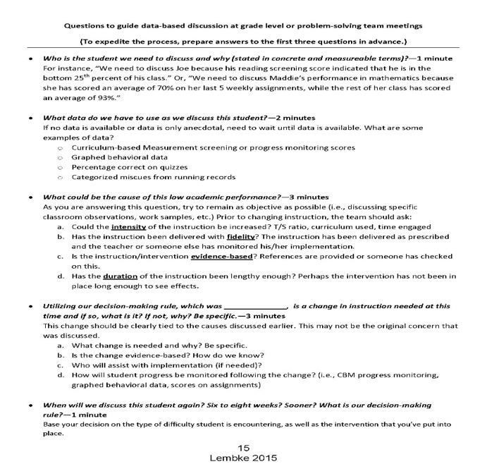

Slide 54
Decision-making Rubric
To be implemented at least every 6 to 8 weeks
Three questions to guide discussion on data at problem solving team meetings:
  What is the student’s goal? Current level?
  What decision-making rule are we using (i.e., trend line)? Can we apply that now?
  If a change needs to be made, what do we do?

Slide 55
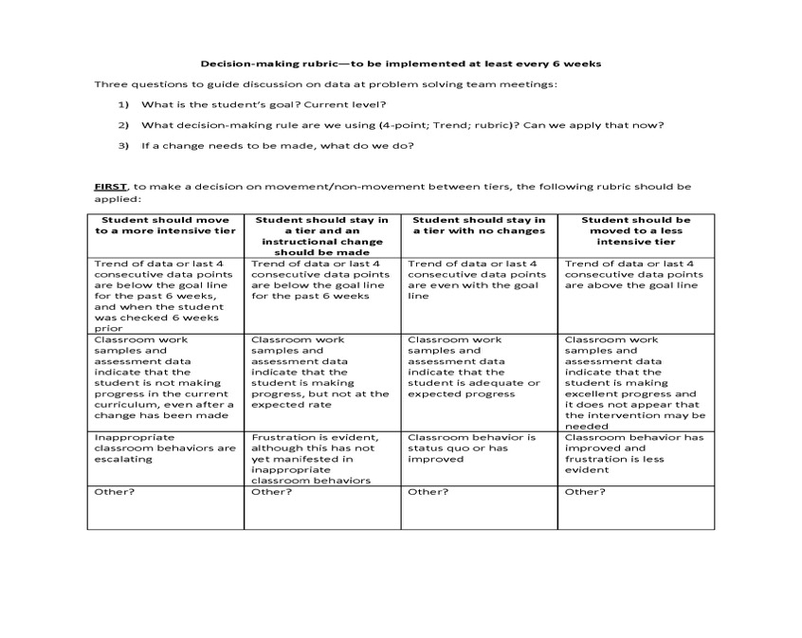

Slide 56
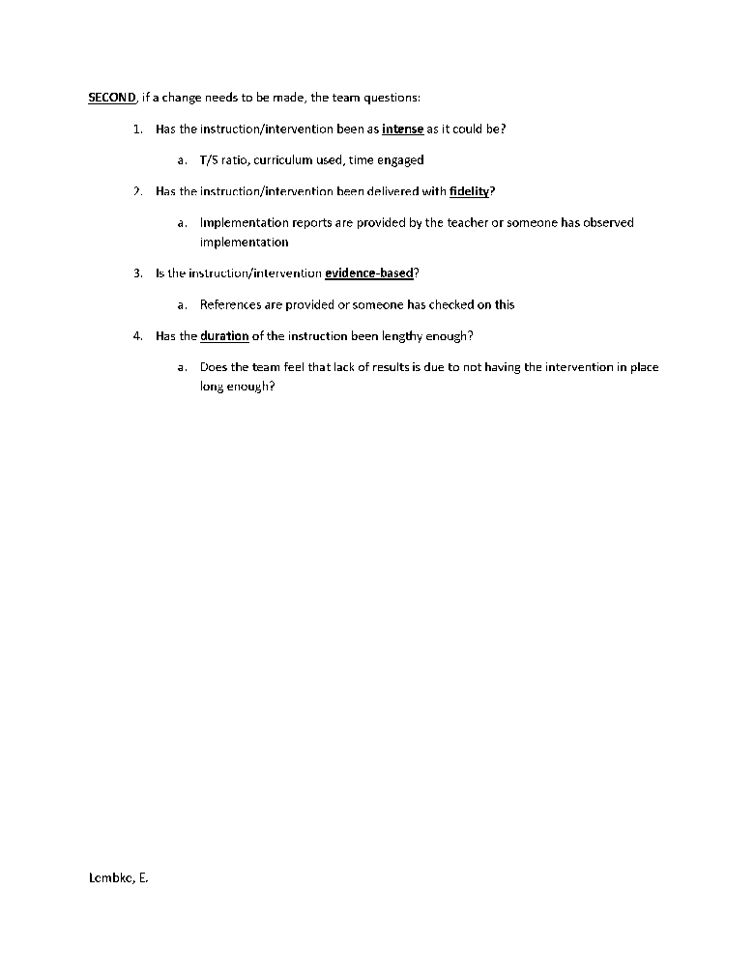

Slide 57
Basic steps in the RTI process—and considerations!
#5—Implementation of evidence-based interventions for students at-risk
Next step after looking at screening and progress monitoring data? Need diagnostic measures to determine which skills need to be retaught or remediated.
Notes:
Consider the characteristics of the interventions that you are choosing. How will you assess whether the interventions are evidence/research based? Consider examining the instructional tools chart on the National Center for RTI website: rti4success.org. Interventions can be individualized and developed for each student, or can be a specific program used for many students (standard treatment protocol).

Slide 58
Diagnostics
Aligning instruction and intervention to the Common Sore State Standards
Examining results from your common assessments
Mathematics interviews
Error analysis
Unit tests
Brief, timed, basic fact assessments
Using DIBELS math diagnostic information

Slide 59
Data Based Individualization
Diagnostic Assessments
Leanne Ketterlin Geller, Ph.D.
Southern Methodist University
LKGELLER@SMU.edu

Slide 60
Evidence-based instruction provided in small groups
Progress monitoring for 10-20 weeks
inadequate
response
adequate
response
Diagnostic assessment

Slide 61
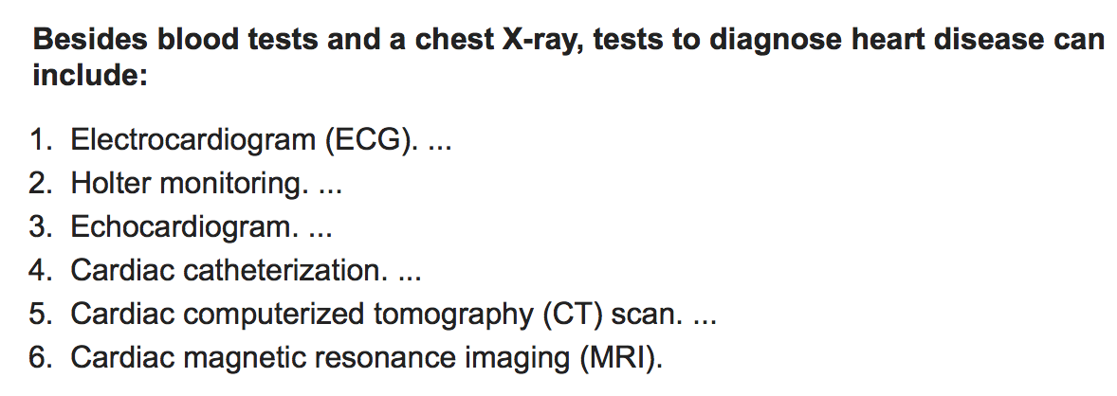
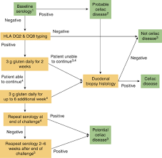

What is a Diagnostic Assessment?
Celiac Diagnostic
Decision Tree
Diagnostic testing for cars
Notes:
What do all of these have in common?
All occur after screening
All provide detailed information about causes and to explain symptoms
All lead to some information about possible treatments

Slide 62
Diagnostic Assessments in Math
Strengths and weaknesses
Tier 3
Tier 2
Tier 1
Intervention Design

Slide 63
Decisions from Diagnostic Data
Identify WHY students are underperforming
  Identify students’ current level of understanding in content
  Identify students’ persistent misconceptions in foundational content
Provides information that can be used to plan supplemental instruction
Not intended to provide screening information

Slide 64
Screening and/or Progress Monitoring
At-risk for not meeting curricular expectations
Diagnostic Assessment
Grade-level mathematics diagnostic assessment
Diagnosis
Treatment
Reasons why a student struggles
Intervention Design
Implement and Monitor
Notes:
This flow chart takes it from there.

Slide 65
Approaches to Gathering Diagnostic Data
Diagnostic Data
Diagnostic Interviews
Learning Progress-ions
Error Analysis

Slide 66
Approaches to Gathering Diagnostic Data
 | Diagnostic Interviews | Learning Progressions | Error Analysis
Definition
General procedures
Pros
Cons

Slide 67
Diagnostic Error Analysis
Analyze a student’s errors on a worksheet, test, or other measure
Provides information about types of errors
Examine the types of errors a student makes to check for
  Slips: random errors
  Bugs: persistent errors

Slide 68
Error Analysis
 | Error Analysis
Definition | Determine which errors students are making and whether they are making them consistently
General procedures | Collect student responses on computation problems Classify the type of errors Determine if the errors are consistent or random Follow up to determine why errors are being made
Pros | Allows teacher to directly teach the correct procedure Can be conducted on already collected data
Cons | While there are common errors, some errors may be specific to a particular student, which may make analysis challenging Limited “windows” into students’ thinking Focused primarily on computation errors Requires follow up information to be collected

Slide 69
Classifying Errors for Analysis
Add and simplify.
Component
Error
Strategy Error
Computation
Fact Error
Wrong Operation
Notes:
SAVE FOR SESSION 2 IN DECEMBER

Slide 70
Using Error Analysis for Diagnosis
Types of Errors
Analyze responses
Slips or bugs
Gather more data
Ask why
When, why
Notes:
1. Determine type of error for each computation procedure
2. Determine if it is persistent or not
3. Find out why the student is making the error; augment with questions to find out why a student is making the error and under what types of questions/problems

Slide 71
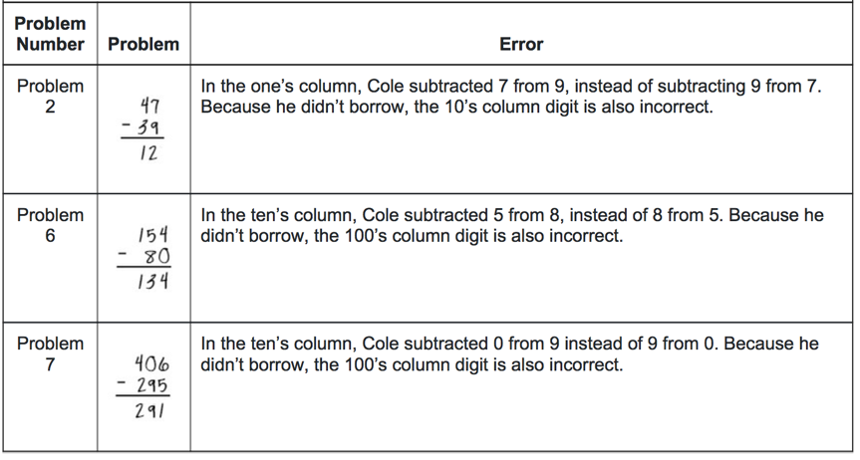
What Errors?
https://iris.peabody.vanderbilt.edu/module/dbi2/cresource/q2/p07/#content

Slide 72
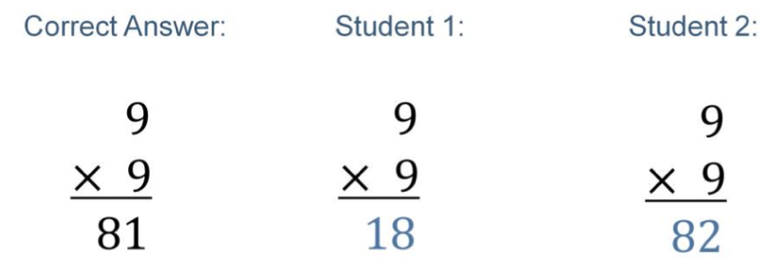
What Errors?
What errors?
How would you determine if these errors are slips or bugs?
Notes:
Student 1 appears to have added instead of multiplying. We should check if this reflects a problem with attention, the symbol, or the concept of multiplication.
Student 2 may simply have mis-remembered this specific multiplication fact, since the answer was close. This student may benefit from additional fluency-focused fact practice with corrective feedback.

Slide 73
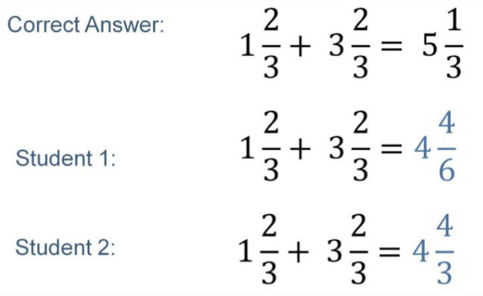
What Errors? What’s Next?
What errors?
How would you figure out if these errors are slips or bugs?
What would you do next?
Notes:
Student 1 added the digits in each place –whole number, numerator, and denominator —instead of only adding the numerators of the fractions. This student appears to need explicit instruction in adding fractions with the same denominator.
Student 2 added correctly but did not reduce the answer. This student may need instruction on how to convert improper fractions to mixed numbers.

Slide 74
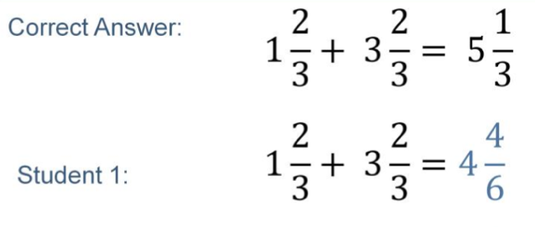
What Errors? What’s Next?
  Possible strategy error: Student added the digits in each place (whole numbers, numerator, denominator)
  Verify with other worked items
  May need explicit instruction in adding fractions with like denominators
Notes:
Student 1 added the digits in each place –whole number, numerator, and denominator —instead of only adding the numerators of the fractions. This student appears to need explicit instruction in adding fractions with the same denominator.
Student 2 added correctly but did not reduce the answer. This student may need instruction on how to convert improper fractions to mixed numbers.

Slide 75

What Errors? What’s Next?
Student may understand how to add fractions with like denominators
Need more samples to verify
Possible component error: Did not reduce
May need instruction on converting improper fractions to mixed numbers.
Notes:
Student 1 added the digits in each place –whole number, numerator, and denominator —instead of only adding the numerators of the fractions. This student appears to need explicit instruction in adding fractions with the same denominator.
Student 2 added correctly but did not reduce the answer. This student may need instruction on how to convert improper fractions to mixed numbers.

Slide 76
What Errors? What Next?
Student 1 Errors
Student added the digits in each place (whole numbers, numerator, denominator)
Possible Next Steps
Both: Explicit instruction on division with remainders
Student 2 Errors
Student may understand how to add fractions with like denominators
Student 2:
Estimation skills
Checking work
Reasonableness of answers
Need more samples to verify
Did not reduce
Notes:
Student 1 added the digits in each place –whole number, numerator, and denominator —instead of only adding the numerators of the fractions. This student appears to need explicit instruction in adding fractions with the same denominator.
Student 2 added correctly but did not reduce the answer. This student may need instruction on how to convert improper fractions to mixed numbers.

Slide 77
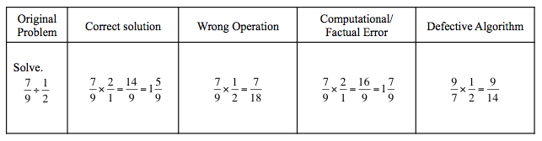
Classifying Errors for Analysis
What types of errors?
Notes:
SAVE FOR SESSION 2 IN DECEMBER

Slide 78
Diagnostic Error Analysis
Notes:
SAVE FOR SESSION 2 IN DECEMBER

Slide 79
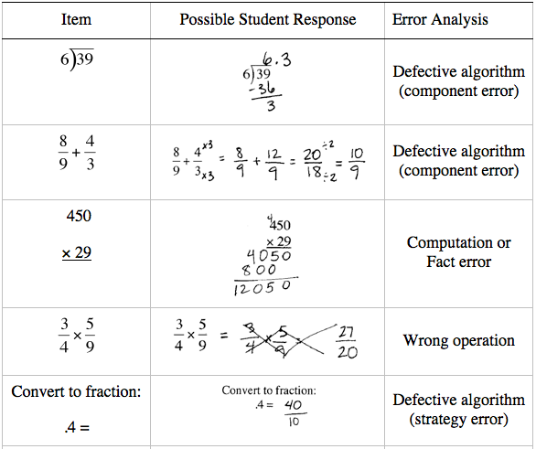
Classifying Errors for Analysis
What types of errors?

Slide 80
Diagnostic Error Analysis

Slide 81
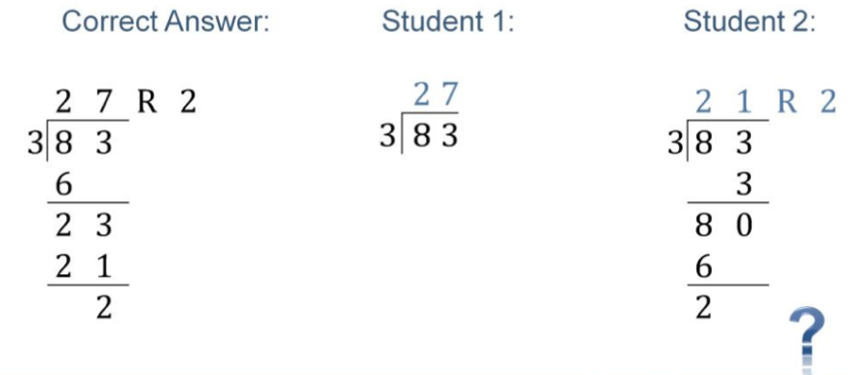
What Errors? What Next?

Slide 82
What Errors? What Next?
Student 1 Errors
May understand basic concept of division
Possible Next Steps
Both: Explicit instruction on division with remainders
Student 2 Errors
May understand to work across the place values
Does not show remainder or steps
Student 2:
Estimation skills
Checking work
Reasonableness of answers
May have defective algorithm
Student worked right to left (instead of left to right)
May have defective algorithm
Notes:
Student 1 added the digits in each place –whole number, numerator, and denominator —instead of only adding the numerators of the fractions. This student appears to need explicit instruction in adding fractions with the same denominator.
Student 2 added correctly but did not reduce the answer. This student may need instruction on how to convert improper fractions to mixed numbers.

Slide 83
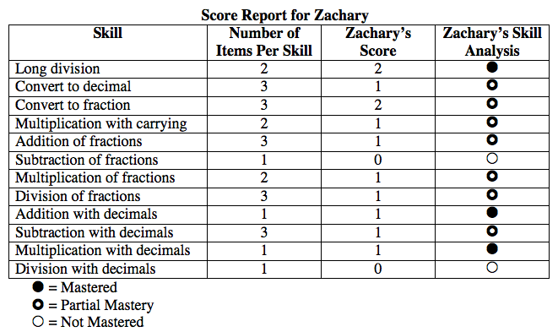
Tracking Errors and Mastery

Slide 84
Review your Data Sources Inventory from Session 2
Are there assessments or data that you are currently using that could help you make diagnostic decisions?
  How can you use these data to make diagnostic decisions?

Slide 85
What decisions will you make with data from diagnostic assessments?
Instructional
Decision
Diagnostic
Assessments
Diagnostic Data
Identify Student Needs
Individualize Intervention
Notes:
Individualized interventions are needed that are based on students needs that are informed by diagnostic data

Slide 86
Notes:
Within DBI, we use diagnostic assessment to help us design the intervention

Slide 87
Intervention: Occurs frequently and with intensity
Assessment: Formative
Assessment: Diagnostic
Intervention adaptation: Content, dosage, explicit instruction, attention to transfer
Assessment: Formative

Slide 88
About implementing intervention with fidelity…

Slide 89
Implements all lessons and all components and adds in additional practice.
Implements some lessons and some of the components.
Implements some lessons and all of the components.
Implements some lessons and some components and includes technology games.
Implements all lessons and some of the components.
Implements a totally separate intervention.
Implements all lessons and all of the components.

Slide 90
Fidelity
Adherence to the intervention or strategy
Quantitative
Qualitative

Slide 91
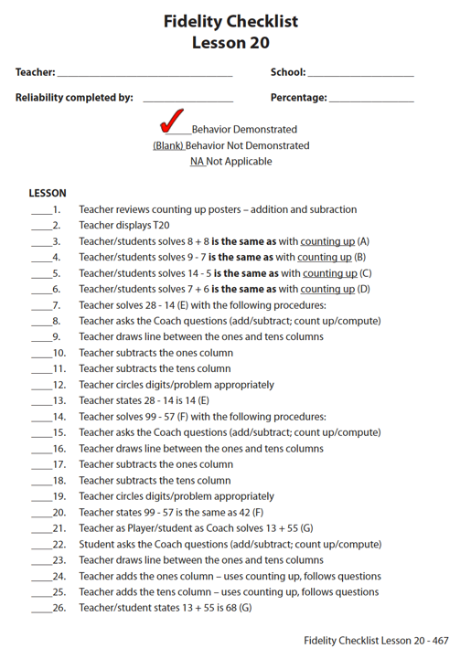
Quantitative
Fuchs, Powell, & Fuchs (2011)

Slide 92
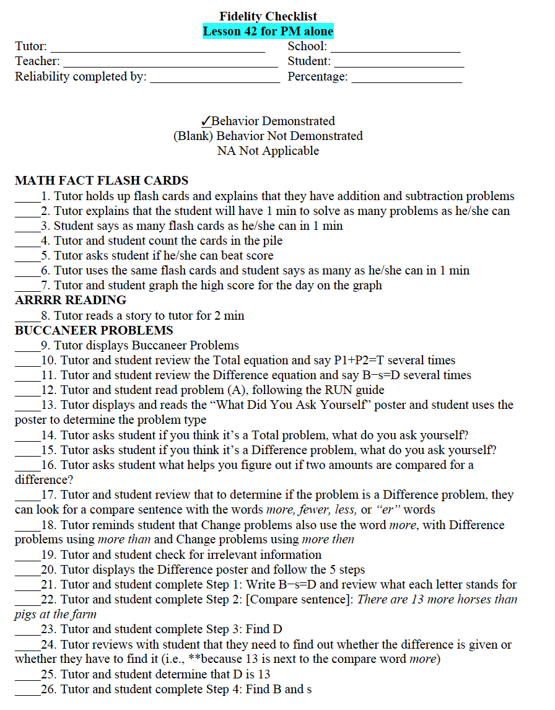
Quantitative
Powell & Berry (2016)

Slide 93
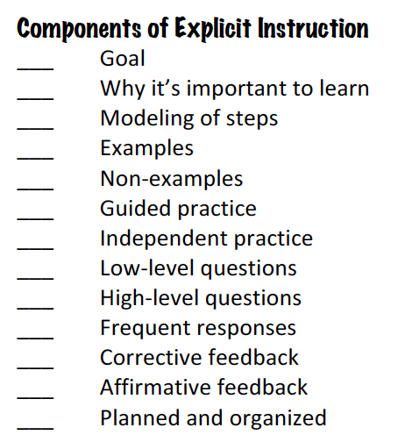
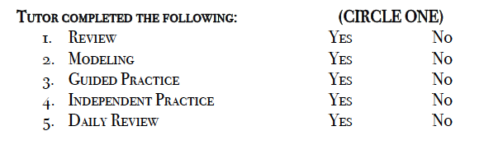
Quantitative

Slide 94
Implements some lessons and some of the components.
Implements all lessons and all components and adds in additional practice.
49%
94%
71%
Implements some lessons and all of the components.
Implements some lessons and some components and includes technology games.
64%
Implements all lessons and some of the components.
56%
Implements a totally separate intervention.
5%
Implements all lessons and all of the components.
97%

Slide 95
Implements all lessons and all components and adds in additional practice.
Implements some lessons and some of the components.
Implements some lessons and all of the components.
Implements some lessons and some components and includes technology games.
Implements all lessons and some of the components.
Implements a totally separate intervention.
Implements all lessons and all of the components.

Slide 96
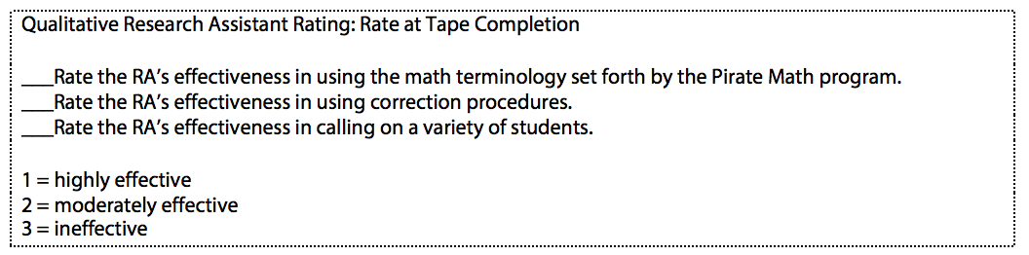
Qualitative
“On a score of 1 to 3…”
“Excellent, Good, Fair, Poor…”
Fuchs et al. (2014)

Slide 97
Implements some lessons and some of the components.
Implements all lessons and all components and adds in additional practice.
high
high
Implements some lessons and all of the components.
low
Implements some lessons and some components and includes technology games.
low
Implements all lessons and some of the components.
high
high
Implements a totally separate intervention.
Implements all lessons and all of the components.
medium

Slide 98
Why Is This Important?
All the evidence-based interventions and all the evidence-based strategies (in the world) can’t help a student unless the interventions and strategies are implemented with fidelity.

Slide 99
How do you make decisions about intervention progress?

Slide 100
Goal Setting
What do I do with that data?
  Set goals
  Monitor progress toward goals
End-of-year benchmarks
Weekly ROI
Intra-individual framework

Slide 101
Decision Making
Is Maria making adequate progress?

Slide 102
Graphing
x-axis: Weeks of instruction

Slide 103
Setting Goals
Once the scores are graphed, it’s time to set goals.
Is Maria making adequate progress?

Slide 104
Setting Goals
Benchmark
Slope (ROI)
Intra-individual

Slide 105
Benchmark
  Identify appropriate grade-level benchmark
  Mark benchmark on student graph with an X
  Draw goal-line from baseline progress monitoring scores to X

Slide 106
Benchmark
  Identify appropriate grade-level benchmark
Grade | Computation | Concepts and Applications
1 | 20 digits | 20 points
2 | 20 digits | 20 points
3 | 30 digits | 30 points
4 | 40 digits | 30 points
5 | 30 digits | 15 points
6 | 35 digits | 15 points
http://www.rti4success.org/resource/rti-implementer-series-module-2-progress-monitoring

Slide 107
Benchmark
  Identify appropriate grade-level benchmark
Grade | Computation | Concepts and Applications
1 | 20 digits | 20 points
2 | 20 digits | 20 points
3 | 30 digits | 30 points
4 | 40 digits | 30 points
5 | 30 digits | 15 points
6 | 35 digits | 15 points
Maria: 2nd-grade student using Computation
http://www.rti4success.org/resource/rti-implementer-series-module-2-progress-monitoring

Slide 108
  Mark benchmark on student graph with an X
  Draw goal-line from baseline progress monitoring scores to X
X

Slide 109
Benchmark
Slope (ROI)

Slide 110
Slope (ROI)
  Locate slope (i.e., rate of improvement – ROI)
  Multiply ROI by number of weeks left in intervention
  Add to baseline of progress monitoring scores
  Mark goal on student graph with an X
  Draw goal-line from baseline progress monitoring scores to X

Slide 111
Slope (ROI)
  Locate slope (i.e., rate of improvement – ROI)
Grade | Computation—Slope for Digits Correct | Concepts and Applications — Slope for Points
1 | 0.35 | No data available
2 | 0.30 | 0.40
3 | 0.30 | 0.60
4 | 0.70 | 0.70
5 | 0.70 | 0.70
6 | 0.40 | 0.70
http://www.rti4success.org/resource/rti-implementer-series-module-2-progress-monitoring

Slide 112
Slope (ROI)
  Locate slope (i.e., rate of improvement – ROI)
Grade | Computation—Slope for Digits Correct | Concepts and Applications — Slope for Points
1 | 0.35 | No data available
2 | 0.30 | 0.40
3 | 0.30 | 0.60
4 | 0.70 | 0.70
5 | 0.70 | 0.70
6 | 0.40 | 0.70
Maria: 2nd-grade student using Computation
http://www.rti4success.org/resource/rti-implementer-series-module-2-progress-monitoring

Slide 113
Slope (ROI)
  Locate slope (i.e., rate of improvement – ROI) 0.30

Slide 114

Slope (ROI)
  Locate slope (i.e., rate of improvement – ROI) 0.30
  Multiply ROI by number of weeks left in intervention 0.30 $×$

Slide 115
Slope (ROI)
Number of weeks left in intervention

Slide 116

Slope (ROI)
  Locate slope (i.e., rate of improvement – ROI) 0.30
  Multiply ROI by number of weeks left in intervention 0.30 $×$ 10 = 3

Slide 117

Slope (ROI)
  Locate slope (i.e., rate of improvement – ROI) 0.30
  Multiply ROI by number of weeks left in intervention 0.30 $×$ 10 = 3
  Add to baseline of progress monitoring scores 3 +

Slide 118
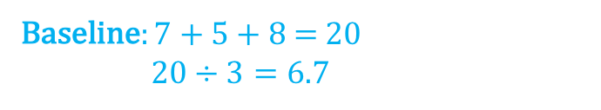
Slope (ROI)
Baseline: 7 + 5 + 8 = 20
20 $÷3=6.7$

Slide 119

Slope (ROI)
  Locate slope (i.e., rate of improvement – ROI) 0.30
  Multiply ROI by number of weeks left in intervention 0.30 $×$ 10 = 3
  Add to baseline of progress monitoring scores 3 + 6.7 = 9.7

Slide 120
Slope (ROI)
  Mark goal on student graph with an X
  Draw goal-line from baseline progress monitoring scores to X
X

Slide 121
Benchmark
Slope (ROI)
Intra-individual

Slide 122
Intra-individual
Identify student’s (slope)
Multiply slope by 1.5
Multiply by number of weeks until end of intervention
Add to student’s baseline score
  Mark goal on student graph with an X
  Draw goal-line from baseline progress monitoring scores to X

Slide 123
Intra-individual
Identify student’s (slope)
SLOPE CALCULATION:
3rd median – 1st median
#data points – 1

Slide 124
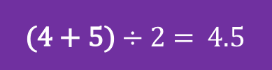
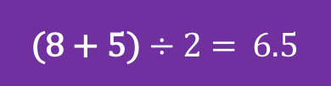
Intra-individual
SLOPE CALCULATION:
3rd median – 1st median
#data points – 1
Identify student’s (slope)
6.5 – 4.5
6 – 1
0.4
(4 + 5) $÷$ 2 = 4.5
(8 + 5) $÷$ 2 = 6.5

Slide 125
Intra-individual
Identify student’s (slope) 0.4

Slide 126

Intra-individual
Identify student’s (slope) 0.4
Multiply slope by 1.5 0.4 $×$ 1.5 = 0.6

Slide 127

Intra-individual
Identify student’s (slope) 0.4
Multiply slope by 1.5 0.4 $×$ 1.5 = 0.6
Multiply by number of weeks in intervention 0.6 $×$

Slide 128
Intra-individual
Number of weeks left in intervention

Slide 129

Intra-individual
Identify student’s (slope) 0.4
Multiply slope by 1.5 0.4 $×$ 1.5 = 0.6
Multiply by number of weeks in intervention 0.6 $×$ 10 = 6

Slide 130

Intra-individual
Identify student’s (slope) 0.4
Multiply slope by 1.5 0.4 $×$ 1.5 = 0.6
Multiply by number of weeks in intervention 0.6 $×$ 10 = 6
Add to student’s baseline score 6

Slide 131
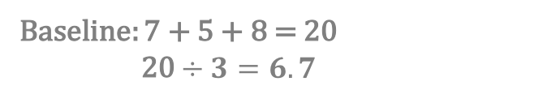
Intra-individual
Baseline: 7 + 5 + 8 = 20
20 $÷3=6.7$

Slide 132

Intra-individual
Identify student’s (slope) 0.4
Multiply slope by 1.5 0.4 $×$ 1.5 = 0.6
Multiply by number of weeks in intervention 0.6 $×$ 10 = 6
Add to student’s baseline score 6 + 6.7 = 12.7

Slide 133
Intra-individual
  Mark goal on student graph with an X
  Draw goal-line from baseline progress monitoring scores to X
X

Slide 134
Benchmark
Slope (ROI)
Intra-individual

Slide 135

Think-Pair-Share
Which of the goal setting structures do you plan to use?

Slide 136
Determining Response
Four most recent, consecutive scores
Trendline

Slide 137
Determining Response
Four most recent, consecutive scores
If at least 6 weeks of instruction have occurred:
If all four most recent scores fall above the goal-line, increase the goal.

Slide 138
Determining Response
Four most recent, consecutive scores
Raise the goal
X

Slide 139
Determining Response
Four most recent, consecutive scores
If at least 6 weeks of instruction have occurred:
If all four most recent scores fall above the goal-line, increase the goal.
If all four most recent scores fall below the goal-line, adapt the intervention.

Slide 140
Determining Response
Four most recent, consecutive scores
Adaptation
X

Slide 141
Determining Response
Four most recent, consecutive scores
If at least 6 weeks of instruction have occurred:
If all four most recent scores fall above the goal-line, increase the goal.
If all four most recent scores fall below the goal-line, adapt the intervention.
If the four most recent scores fall both above and below the goal-line, continue monitoring data.

Slide 142
Determining Response
Four most recent, consecutive scores
Continue monitoring
X

Slide 143
Determining Response
Four most recent, consecutive scores
Trendline

Slide 144
Determining Response
Trendline
If the trend-line is steeper than the goal line, then increase the goal.

Slide 145
Determining Response
Trendline
Raise the goal
X

Slide 146
Determining Response
Trendline
If the trend-line is steeper than the goal line, then increase the goal.
If the trend-line is flatter than the goal line, then adapt the intervention.

Slide 147
Determining Response
Four most recent, consecutive scores
Adaptation
X

Slide 148
Determining Response
Trendline
If the trend-line is steeper than the goal line, then increase the goal.
If the trend-line is flatter than the goal line, then adapt the intervention.
If the trend-line and goal-line are fairly equal, continue monitoring progress.

Slide 149
Determining Response
Four most recent, consecutive scores
Continue monitoring
X

Slide 150
Benchmark
Slope (ROI)
Intra-individual

Slide 151
Four most recent, consecutive scores
Trendline

Slide 152
How do you adapt interventions…

Slide 153
Intervention: Occurs frequently and with intensity
Intervention adaptation: Content, dosage, explicit instruction, attention to transfer

Slide 154
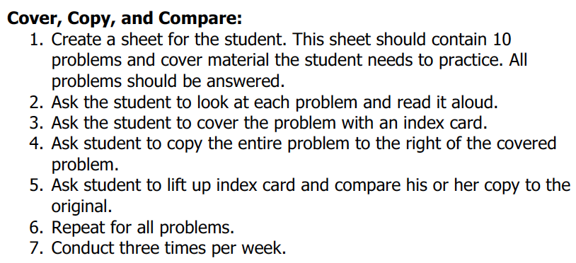
Implement with greater fidelity
Adaptation
Ensure that you are implementing the intervention or strategy with fidelity

Slide 155
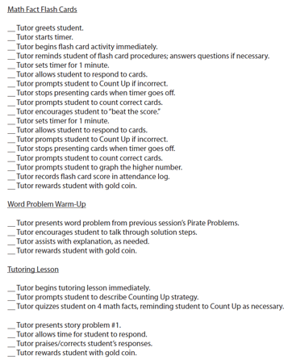
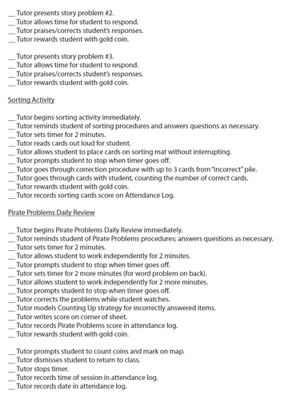
Implement with greater fidelity
Adaptation
Ensure that you are implementing the intervention or strategy with fidelity
Fuchs et al. (2008)

Slide 156
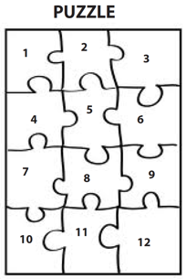
Implement with greater fidelity
Adaptation
Embed behavioral supports
May want to incorporate strategies to improve self-regulation and minimize nonproductive behavior
Powell, Driver, & Julian (2015)

Slide 157
Implement with greater fidelity
Adaptation
Embed behavioral supports
May want to incorporate strategies to improve self-regulation and minimize nonproductive behavior
UPSCheck
  Understand
  Plan
  Solve
  Check

Slide 158
Implement with greater fidelity
Adaptation
Embed behavioral supports
Increase dosage
Conduct longer sessions, more sessions per week, or more weeks within DBI

Slide 159
Implement with greater fidelity
Adaptation
Embed behavioral supports
Increase dosage
Conduct longer sessions, more sessions per week, or more weeks within DBI

Slide 160
Implement with greater fidelity
Adaptation
Embed behavioral supports
Increase dosage
Conduct longer sessions, more sessions per week, or more weeks within DBI
Number of weeks left in intervention

Slide 161
Implement with greater fidelity
Adaptation
Embed behavioral supports
Increase dosage
Adapt mathematics content

Slide 162
Implement with greater fidelity
Adaptation
Embed behavioral supports
Increase dosage
Adapt mathematics content
Where student IS
Where student NEEDS TO BE
Alter the scope and sequence
Explain why addition and subtraction strategies work, using place value and the properties of operations.
Use addition and subtraction within 100 to solve one- and two-step word problems…
Fluently add and subtract within 100 using strategies based on place value, properties of operations, and/or relationships.
Apply properties of operations as strategies to multiply and divide….
Fluently multiply and divide within 100, using strategies such as the relationship between multiplication and division…
Understand that the three digits of a three-digit number represent amounts of hundreds, tens, and ones.
Find whole number quotients and remainders with up to four-digit dividends and one-digit divisors, using strategies based on place value, …
Solve multi-step word problems posed with whole numbers and having whole-number answers using the four operations…
Understand that the two digits of a two-digit number represent amounts of tens and ones.
Use multiplication and division within 100 to solve word problems…
Fluently add and subtract multi-digit whole numbers using the standard algorithm.
Fluently multiply multi-digit whole numbers using the standard algorithm.
continuum of mathematics learning

Slide 163
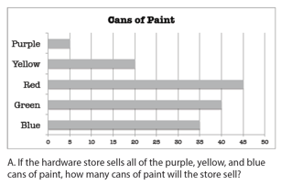
Implement with greater fidelity
Adaptation
Embed behavioral supports
Increase dosage
Solve
Adapt mathematics content
Write equation
Break down problems into smaller steps
Draw picture
Identify schema
Label graph
Underline labels
Read the problem

Slide 164
Implement with greater fidelity
Adaptation
Embed behavioral supports
Increase dosage
Adapt mathematics content
precise
Focus on the language of mathematics
concise

Slide 165
Implement with greater fidelity
Adaptation
Embed behavioral supports
Increase dosage
Adapt mathematics content
Focus on the language of mathematics
MATH JOURNAL

Slide 166
Implement with greater fidelity
Adaptation
Embed behavioral supports
Increase dosage
Adapt mathematics content
Define: | Characteristics:
Example: | Non-example:
Focus on the language of mathematics

Slide 167
Implement with greater fidelity
Adaptation
Embed behavioral supports
Increase dosage
“Tell me how you solved this problem.”
Adapt mathematics content
“What were you thinking about when you regrouped?”
Engage student in more discourse
“How would you teach this problem to another student?”
“Describe the word problem in 10 words or less.”

Slide 168
Implement with greater fidelity
Adaptation
Embed behavioral supports
Increase dosage
“Talk through this problem with me.”
Adapt mathematics content
Provide worked examples
405
+ 16
405
+ 16
411
421

Slide 169
Implement with greater fidelity
Adaptation
Embed behavioral supports
Increase dosage
Adapt mathematics content
Utilize more three-dimensional representations
Abstract
Representational
Concrete

Slide 170
Implement with greater fidelity
Adaptation
Embed behavioral supports
Increase dosage
Adapt mathematics content
Utilize more two-dimensional representations
Abstract
Representational
Concrete

Slide 171
Implement with greater fidelity
Adaptation
Embed behavioral supports
Increase dosage
Adapt mathematics content
Ensure student understand the abstract
Abstract
Representational
Concrete

Slide 172
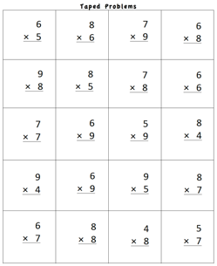
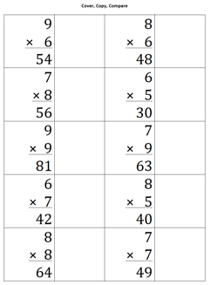

Implement with greater fidelity
Adaptation
Embed behavioral supports
Increase dosage
Adapt mathematics content
Focus on fact fluency

Slide 173
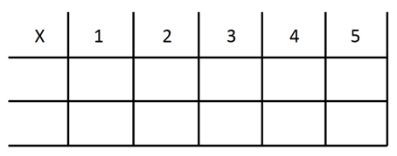
Implement with greater fidelity
Adaptation
Embed behavioral supports
Increase dosage
Adapt mathematics content
Focus on other types of fluency
-3 + (-4) = ___ 5 – (-6) = ___

Slide 174
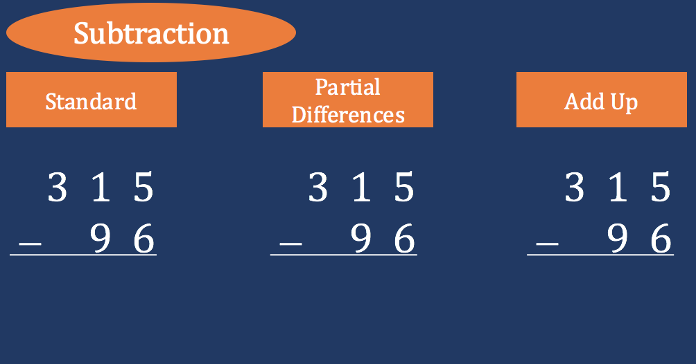
Implement with greater fidelity
Adaptation
Embed behavioral supports
Increase dosage
Adapt mathematics content
Teach alternate algorithms

Slide 175
Implement with greater fidelity
Adaptation
Embed behavioral supports
Increase dosage
Adapt mathematics content
Explicitly teach problem solving
Additive
Multiplicative
Total
Equal Groups
Difference
Comparison
Change
Ratios/
Proportions

Slide 176
Implement with greater fidelity
Adaptation
Embed behavioral supports
Increase dosage
Adapt mathematics content
Encourage alternate methods and solutions
405
+ 16
405
+ 16
500
10
11
521
521
+

Slide 177
Implement with greater fidelity
Adaptation
Embed behavioral supports
Increase dosage
I Do
Adapt mathematics content
Modeling
Practice
Utilize explicit instruction
Clear Explanation
Guided
Practice
We Do
Make sure you’re doing it! And do it well!
Planned
Examples
Independent Practice
You Do
Supporting Practices
Asking the right questions
Eliciting frequent responses
Providing immediate specific feedback
Maintaining a brisk pace

Slide 178
Implement with greater fidelity
Adaptation
Embed behavioral supports
Increase dosage
405
+ 16
4305
+ 216
Adapt mathematics content
Utilize explicit instruction
Explicitly teach transfer
Marney baked 89 cookies and sold 40 cookies at the bake sale. How many cookies does Marney have left?
Explicitly teach how current learning relates to other learning
Marney had $89 and spent $40 on shoes. How many much does Marney have left?
Marney had $89 and spent $40 on shoes. How much money will Marney have after buying the shoes?

Slide 179
Implement with greater fidelity
Adaptation
Embed behavioral supports
Increase dosage
Adapt mathematics content
Utilize explicit instruction
Explicitly teach transfer

Slide 180
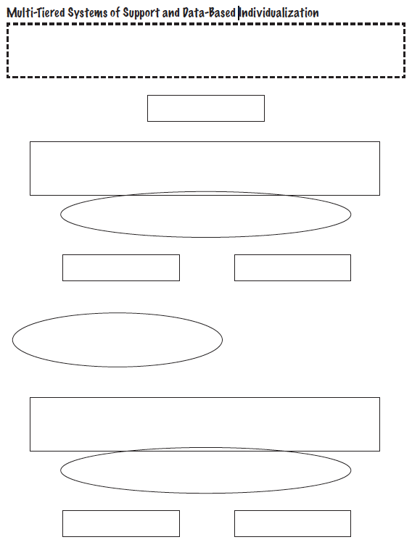
TIER ONE
AT-RISK
Session 4 and 5
Intervention
Session 2
Progress Monitoring
NON-RESPONSIVE
RESPONSIVE
Session 3
Diagnostic
Session 4 and 5
Intervention (Adapted)
Session 2
Progress Monitoring
NON-RESPONSIVE
RESPONSIVE

