Slide 1
MINE FLOOR MATERIAL RECOVERY MUST BECOME PART OF LIFE OF MINE PLAN (Au & Ni Prices Updated on 26 01 2022)
By Krzysztof (Kris) Biegaj
Ausvac Mining Pty Ltd
MAusIMM
Australia
Co-Author Dr Simon C Dominy
Camborne School of Mines University of Exeter, Penryn Cornwall TR10 9FE, UK
FAusIMM(CP), Member of PERC (Pan European Reserves and Resources Reporting Committee)

Slide 2
INTRODUCTION
Billions of Dollars have been, and continue to be wasted by companies and governments across the World due to the lack of legislation for the recovery of already broken ore left behind on mine floors never to be recovered
Recovery of broken ore left behind on mine floors will provide:
Additional revenue for companies
Increased royalties for governments
Additional funds for rehabilitation of mined waste disposed of on surface
Including that portion of waste generated whilst accessing/defining the ore left behind on mine floors

Slide 3
House vacuuming invented and implemented globally >120 years ago
Mine floor material vacuuming machines were first invented and used in South Africa and a few other countries
The Ausvac vacuuming machine is based on the late 1960 machines designed to mine opals in Coober Pedy Region in South Australia
Highly-efficient truly mobile mine floor material vacuuming technology was invented and developed in the Kalgoorlie Goldfields (WA), has been available since 2003 (diesel-powered/easily converted to electric-powered & can be upgraded to remotely-controlled operation)

Slide 4
Mining Project Stages
Exploration, Pre-feasibility study, Feasibility study, Mineral Resources/Ore Reserves/Life of Mine Plans
Approvals and finance secured/obtained
Development in waste to access ore and disposal of mined waste, including diamond drill/sludge ore definition drilling cuddies (excavated in waste)
Mining
Rehabilitation of mined waste disposed of on surface and mine closure

Slide 5
Mining – What is being missed
Cleaning - vacuuming/vamping of mine floors is globally not yet part of the mining cycle
To cover up the high-grade broken ore left behind on mine floors, “mine call/reconciliation factors” continue to be used
Floors of the excavations to be cleaned/vamped/vacuumed
Ore drives
Stopes (remotely controlled vacuuming only in open stopes)
Footwall of low-angle dipping stopes
Top of last lift in cut & fill/under-hand cut & fill mining
Top of mine pillars left behind for geotechnical reasons

Slide 6
Mine floor cleaning/vacuuming must become part of Mining Cycle
After appropriate testwork, metal loss to mine floors should be modelled and included in project studies to determine its impact
Mine floors material recovery must be included in Pre-feasibility/Feasibility Studies and Ore Resources/Reserves Estimation/Life of Mine Plans
left behind on mine f
Timing - Mine floors material recovery must be conducted whilst mine ventilation/fresh air and mine water/compressed air supply/dewatering and all infrastructures are fully operational - not after mine is flooded/put on care and maintenance

Slide 7
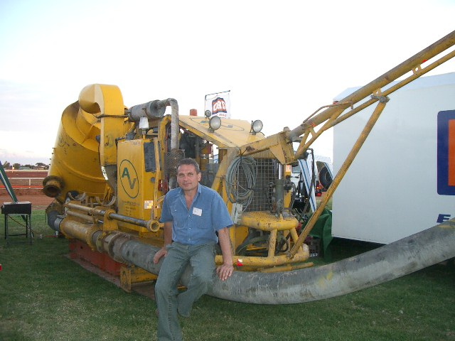

Slide 8
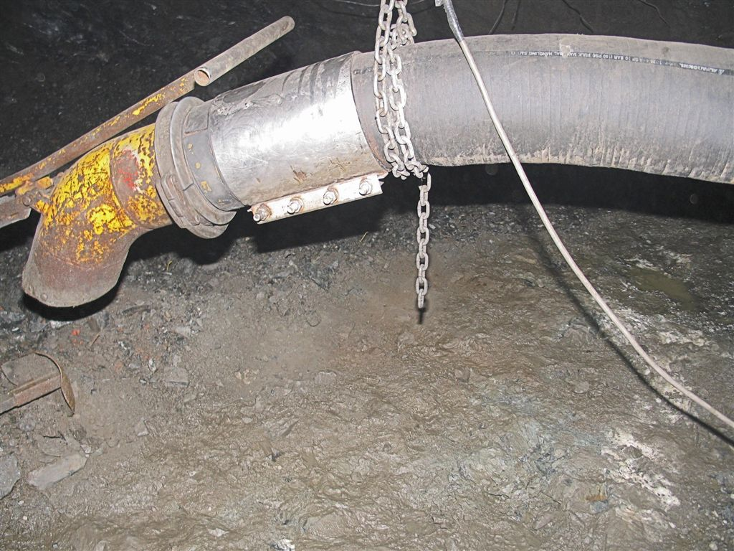
Nickel Mine in W. Australia - 2007
Suction hose Dia. 200mm/8 inch
Up to 0.5m thick high-grade mine floor material left behind had been vacuumed on gold and nickel mines in Australia by Ausvac Mining PL in 2003-2011 (Eight Projects)

Slide 9
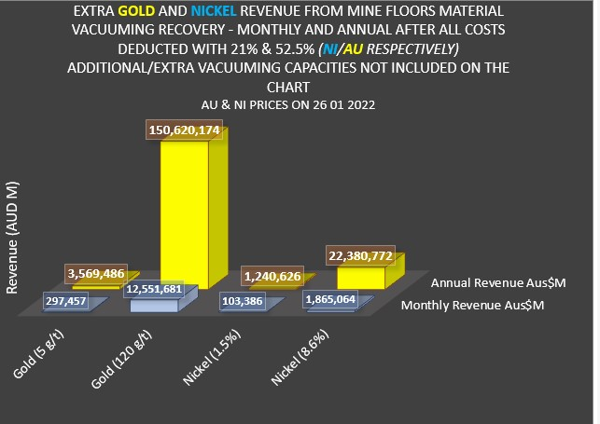

Slide 12
Costs Calculation – main Excel Spreadsheet
All Costs included i.e. Mine Floor Vacuuming, Ore Transportation and Milling & Roasting where applicable

Slide 13
evaluation of broken floor stocks – operating Mines
Sampling and testwork should be undertaken in support of mine designs, Feasibility studies and LOM plans
The Australasian Joint Ore Reserves Committee Code (JORC, 2012) must be applied in the context of Sections 37-41 and Table 1
Modifications to the JORC Code are needed to address the challenge of potential revenue loss
Where appropriate, vacuuming must be introduced to new and operating mines
ECONOMIC VALUE OF BROKEN ORE RECOVERY FROM MINE FLOORS - ore resources/reserves estimation/LOM Plans

Slide 14
Appendices
Costs
App 14 Vacuuming Costs
Costs
Costs

