Slide 1
Terrariums
A World of Tiny Ecosystems
Marisa Boan

Slide 2
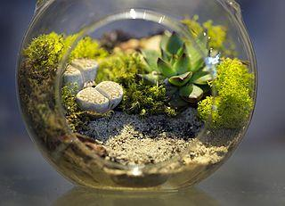
What is a Terrarium?
A terrarium is a type of miniature ecosystem of plants.
Terrariums are usually sealable glass containers that can be opened for maintenance and to access the plants inside. However, this is not essential; terrariums can also be made using other transparent materials, and some are open to the atmosphere rather than being sealed.
Terrariums are often kept as decorative or ornamental items in the same way as aquariums.

Slide 3
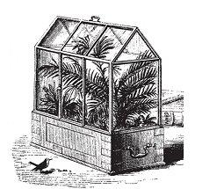
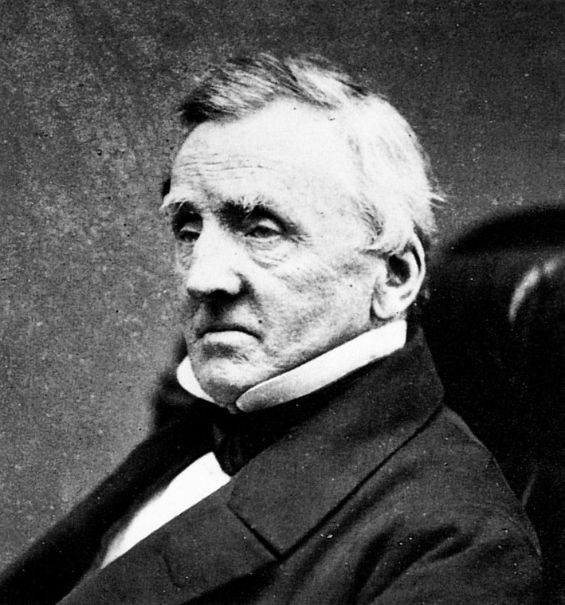
History of Terrariums
The first terrarium was developed by the botanist Nathaniel Bagshaw Ward in 1842.
Ward had interest in observing insect behaviour and accidentally left one of the jars unattended. A fern seed grew, germinated into a plant, and the terrarium was born.
Wardian Case

Slide 4
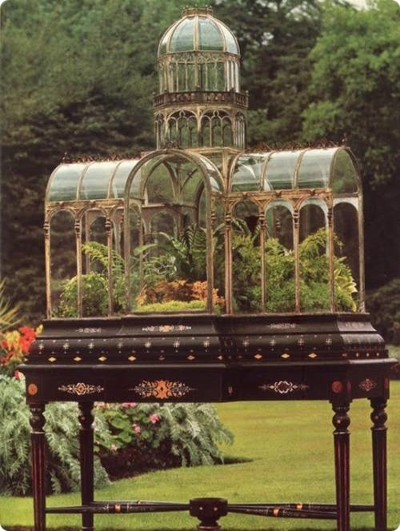
Wardian Case
The trend quickly spread in the Victorian Era amongst the English. Instead of the terrarium, it was known as the Wardian Case.
The story goes that Ward hired carpenters to build his Wardian Case's and began experimenting with them by exporting native British plants to Sidney, Australia.
After months of travel, through the ocean, these native plants arrived well and thriving. Likewise, plants from Australia were sent back to London with the same method, in a sealed Wardian Case.
Ward received his Australian plants, despite their grueling travel, these plants arrived in perfect conditions. This was an indication that plants can travel in a sealed glass without being exposed to the air and continue thriving. A great winning in Wards experiment!
Wardian Case

Slide 5
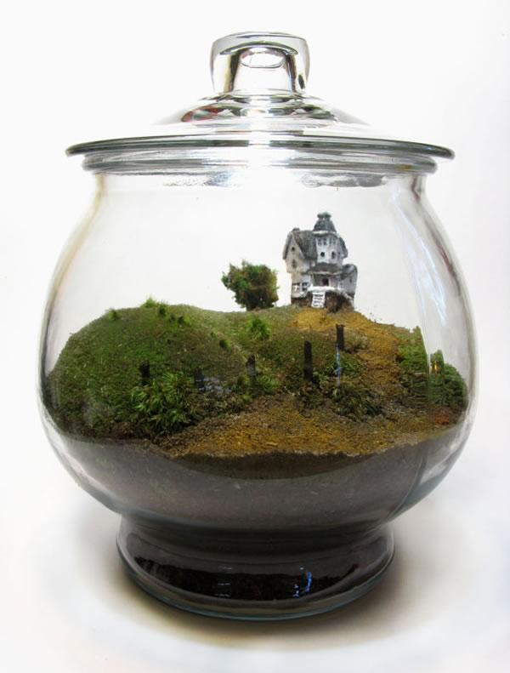
Closed Terrariums
Closed terrariums create a unique environment for plant growth, as the transparent walls allow for both heat and light to enter the terrarium.

Slide 6
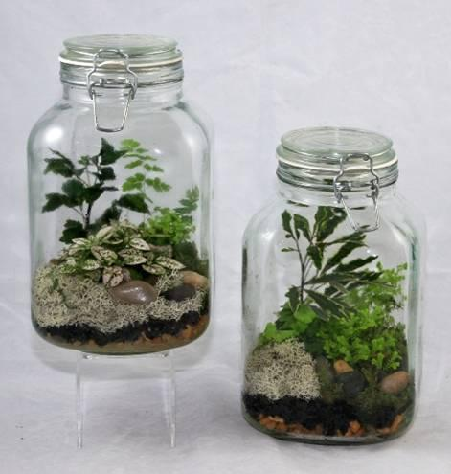
Closed Terrariums
The sealed container combined with the heat entering the terrarium allows for the creation of a small scale water cycle.
This happens because moisture from both the soil and plants evaporates in the elevated temperatures inside the terrarium.
This water vapour then condenses on the walls of the container, and eventually falls back to the plants and soil below.

Slide 7
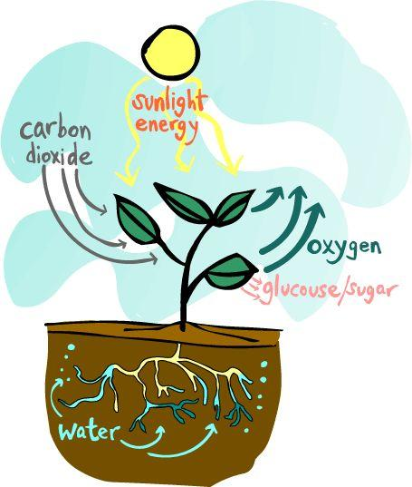
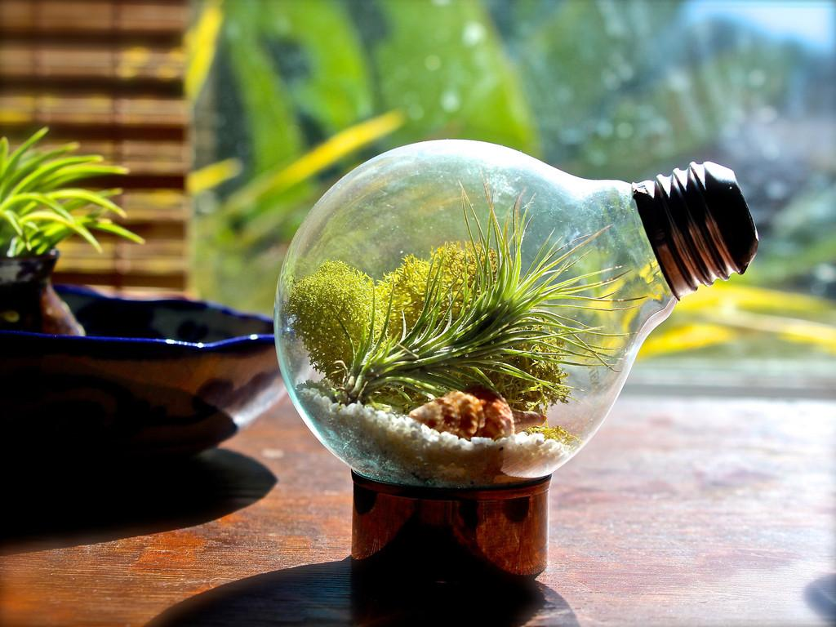
Closed Terrariums
This moisture contributes to creating an ideal environment for growing plants due to the constant supply of water, thereby preventing the plants from becoming over dry.
In addition to this, the light that passes through the transparent material of the terrarium allows for the plants within to photosynthesis, an important aspect of plant growth.

Slide 8
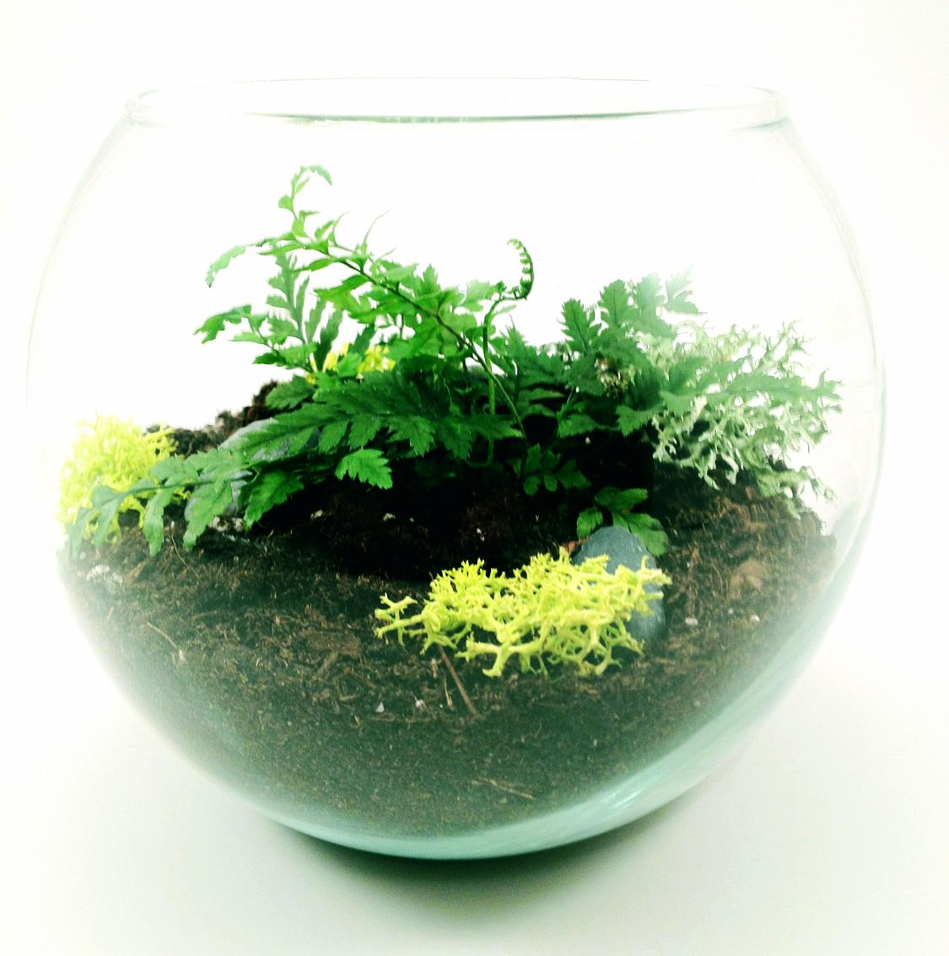
Open Terrarium
Open terrariums are better suited to dry plants such as succulents and cacti.
Not all plants require or are suited to the moist environment of closed terrariums.
So for plants adapted to dry climates, open, unsealed, terrariums are used to keep the air in the terrarium free from excess moisture.

Slide 9
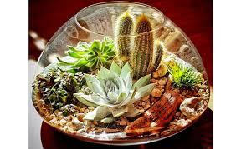
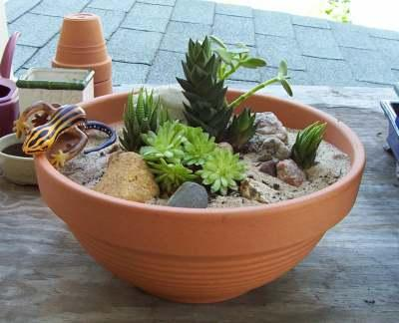
Desert Terrarium
A Desert themed terrarium is a fun project to make and it is something that is relatively easy to care for
You are using a variety of cacti and succulents which don't require a lot of water and are very tolerant of sunlight
You also do this kind of terrarium in an open dish which is easier to make than in a closed container.

Slide 10
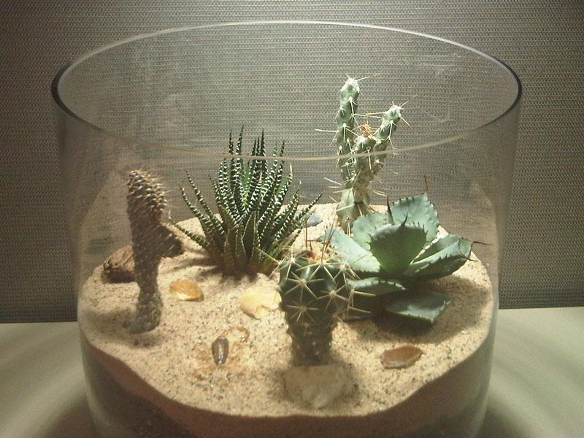
Desert Biome
The desert biome is an ecosystem that forms due to the low level of rainfall it receives each year
Deserts cover about 20% of the Earth. There are four major types of desert in this biome - hot and dry, semiarid, coastal, and cold
They are all able to sustain plant and animal life that are able to survive there.

Slide 11
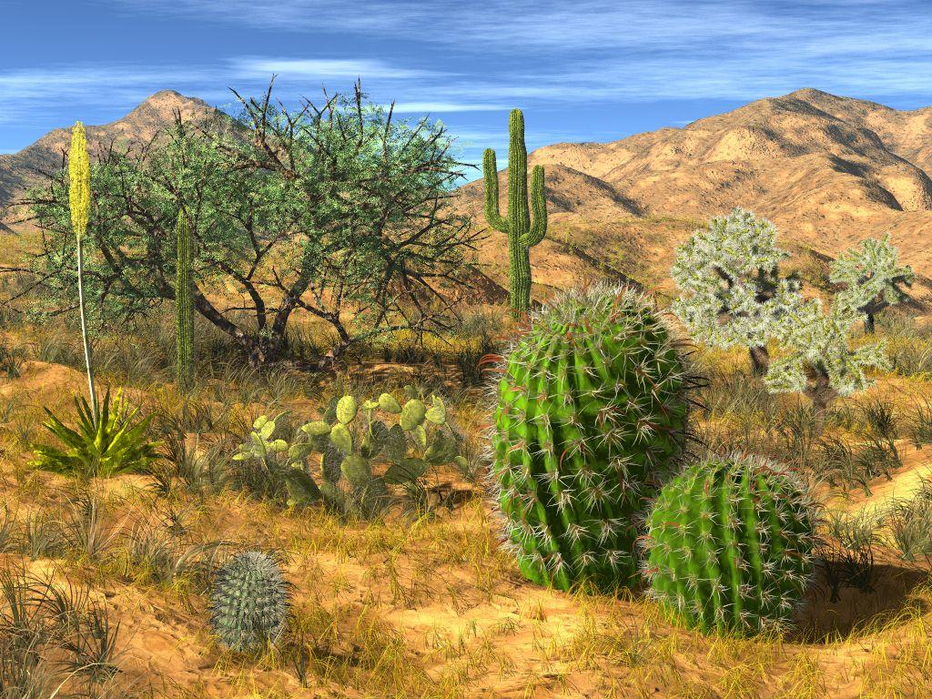
Desert Biome
Although the daytime temperatures of the desert biome are very hot, they can get very cold at night.
Because there is hardly any standing water in the desert biome, animals either store water in their bodies or get their water needs met by the foods they eat.
The plants that are able to grow in the desert biome store water in their stem. They normally grow spaced out so that their roots can extend and find water.
Some deserts are so hot that when it rains, the water evaporates in the air before ever hitting the ground.

Slide 12
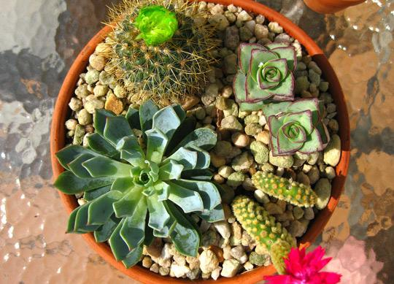
How to Make a Terrarium

Slide 13
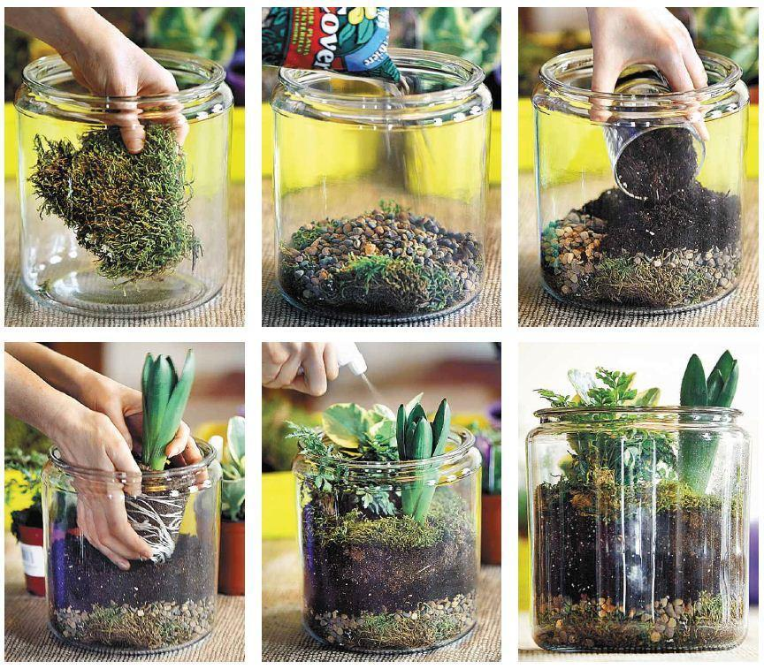
Directions for Making a Terrarium

Slide 14
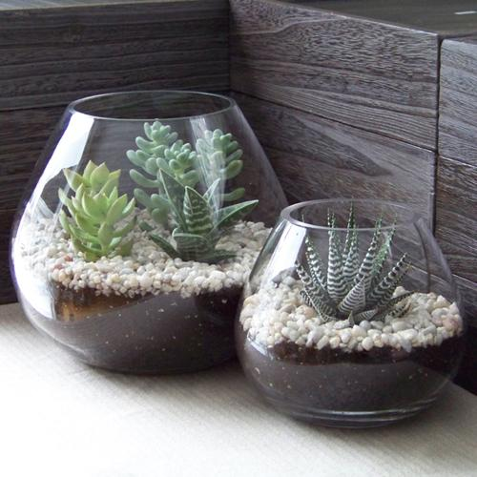
Supplies
Elements of an ecosystem include abiotic and biotic factors
sunlight
water
soil
oxygen
carbon dioxide
sand
charcoal
rocks
plants
animals

Slide 15
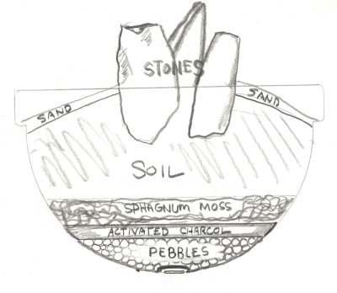
Purpose of Each Material
Desert Terrarium Materials List:
rocks: provide drainage
soil: nutrients for growth/hold moisture
sand: holds in moisture
charcoal: prevent mold, provides dryness
Types of Plants: use plants that store water and do well in hot, dry environments. Examples include succulents.
Not to be confused with cactus; nearly all cacti are succulents but not all succulents are cacti.
In botany, succulent plants, also known as succulents or sometimes fat plants, are plants having some parts that are more than normally thickened and fleshy, usually to retain water in arid climates or soil conditions. Succulent plants may store water in various structures, such as leaves and stems

Slide 16
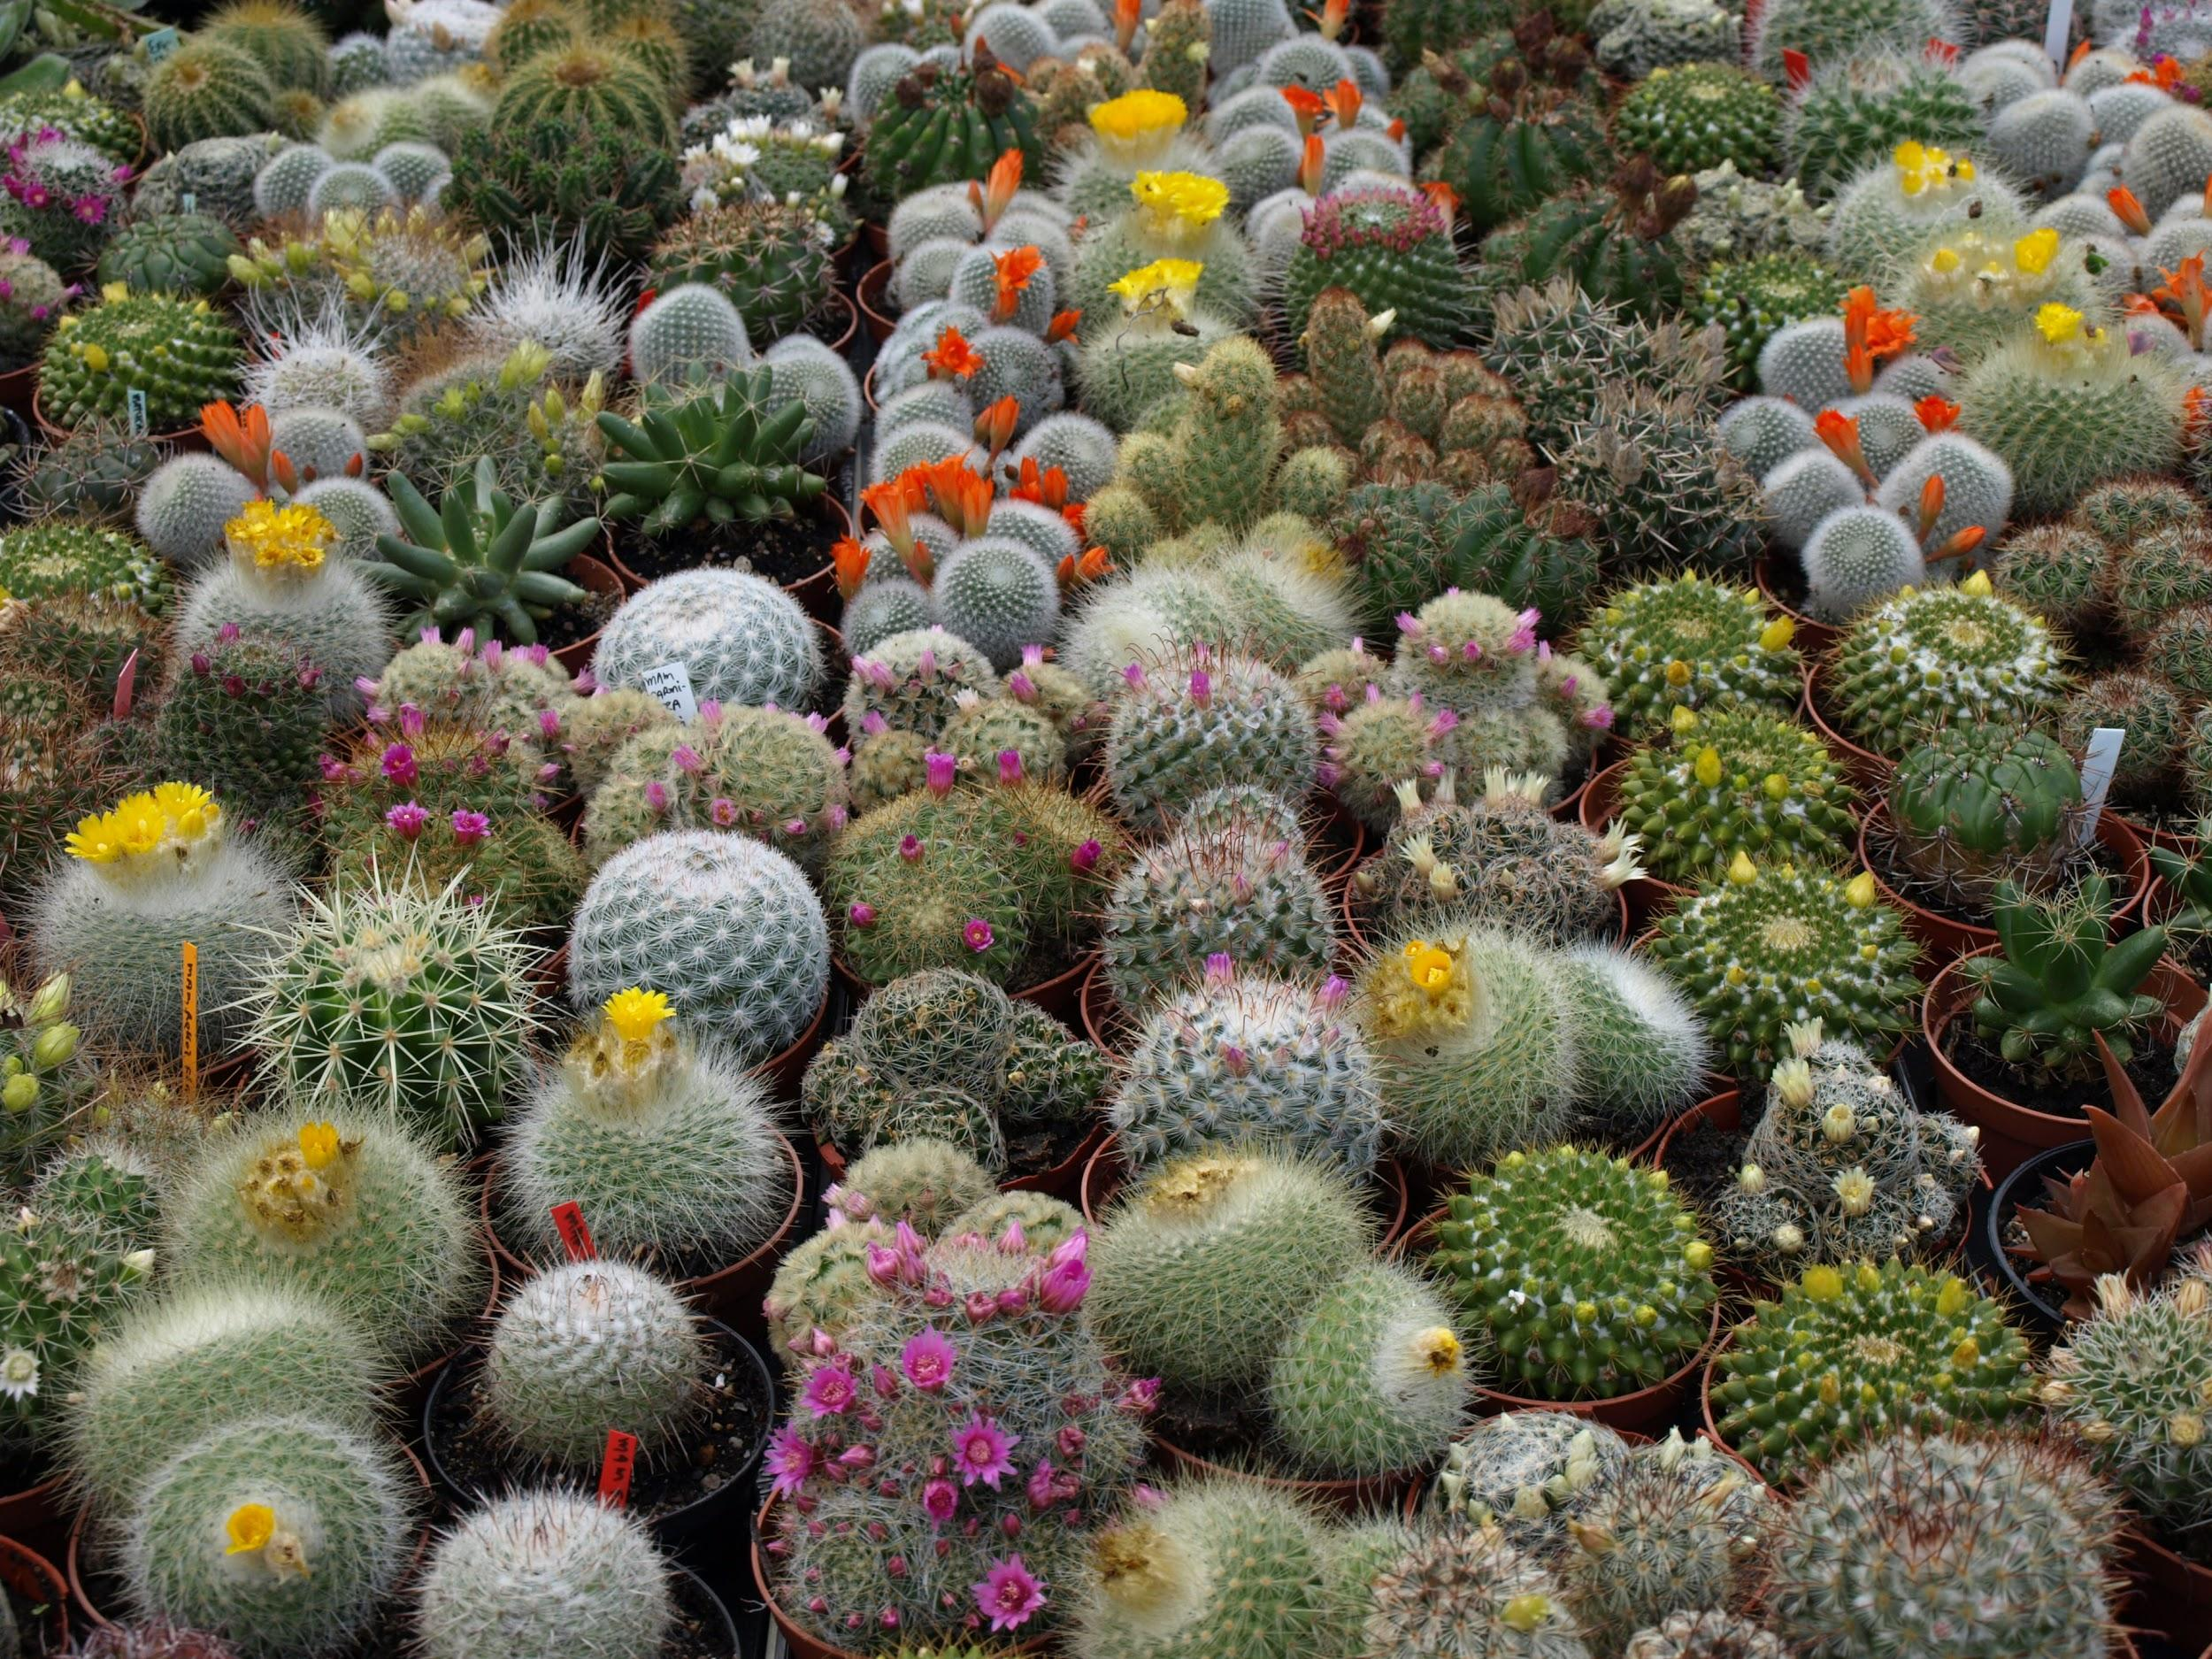
Cacti

Slide 17
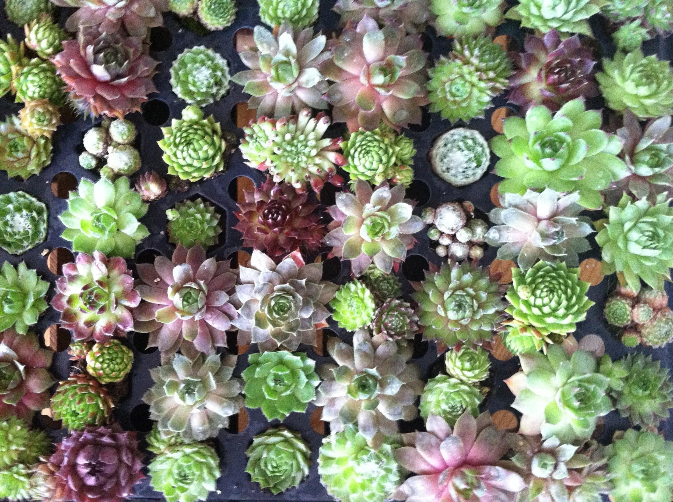
Succulents

Slide 18
Care and Maintenance
Cacti & Succulent Care - Desert Terrarium
Many people tend to think that cacti and succulents are too difficult to care for and decide against even buying them. As it turns out, many people are simply caring for them too much or too often. Cacti and succulents will do quite well under the same conditions which would be considered neglect with other plants.
-Watering- The most common problem people have with cacti and succulent plants is overwatering. They are 'water storing' plants and will do better with less water than they will with more. Since every situation is considerably different, there is not set time interval for when to water cacti and succulents. Many factors play a role in the timing (such as humidity, light, and temperature). General Rule: Water Cacti and succulents thouroghly and allow them to dry out completely between watering. If you are not sure if the soil is completely dried out it is useful to stick your finger in the soil (1" or so if necessary) to see if the soil is dry. Many plants will be potted with a sand or grit topping, be sure to check the soil for moisture, not just the topping. If you are still not sure and think it may be too moist, don't water it! Overwatering can lead to disease and rot and will kill your cactus and succulent plants!
-Light- Cacti and succulent plants love bright sun and will do quite well on a windowsill or on a porch.

