Slide 1
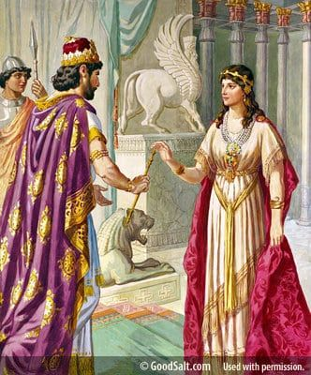
Esther
Lesson # 11
God’s Care
for a
Careless People

Slide 2
History
Author: The unknown author of the book of Esther was most likely a Jew very familiar with the royal Persian court. The detailed descriptions of court life and traditions, as well as the events that occurred in the book, point to an eyewitness author.
Because his perspective was pro-Jewish, scholars believe he was a Jew writing for the remnant that had returned to Judah under Zerubbabel, Ezra and Nehemiah. This book would give the diaspora an update on what was happening back in Persia.

Slide 3
History
Esther was written in the same time period of Ezra, Nehemiah and records the story of those who became assimilated in the Persian culture and did not want to leave.
Historically it falls within the reign of King Ahasuerus/Xerxes I of the Persian empire from 485 to 465 B.C.
Xerxes I, commonly known as Xerxes the Great, was the fourth King of the Achaemenid Empire, ruling from 486 to 465 BC. He was the son and successor of Darius the Great and his mother was Atossa, a daughter of Cyrus the Great, the founder of the Achaemenid empire. [Wikipedia]

Slide 4
History
Darius the Great and Xerxes I were a great builders of cities in Persia. They completed magnificent palaces in Susa where they stayed most of the time and where much of the book of Esther was carried out.
Xerxes I most magnificent achievement was the summer palace in Persepolis. In 1933 two sets of gold and silver plates recording in the three forms of cuneiform [Ancient Persian, Elamite, and Babylonian] that describe the boundaries of the Persian empire were discovered in the foundations of Darius’s hall of audience.

Slide 5
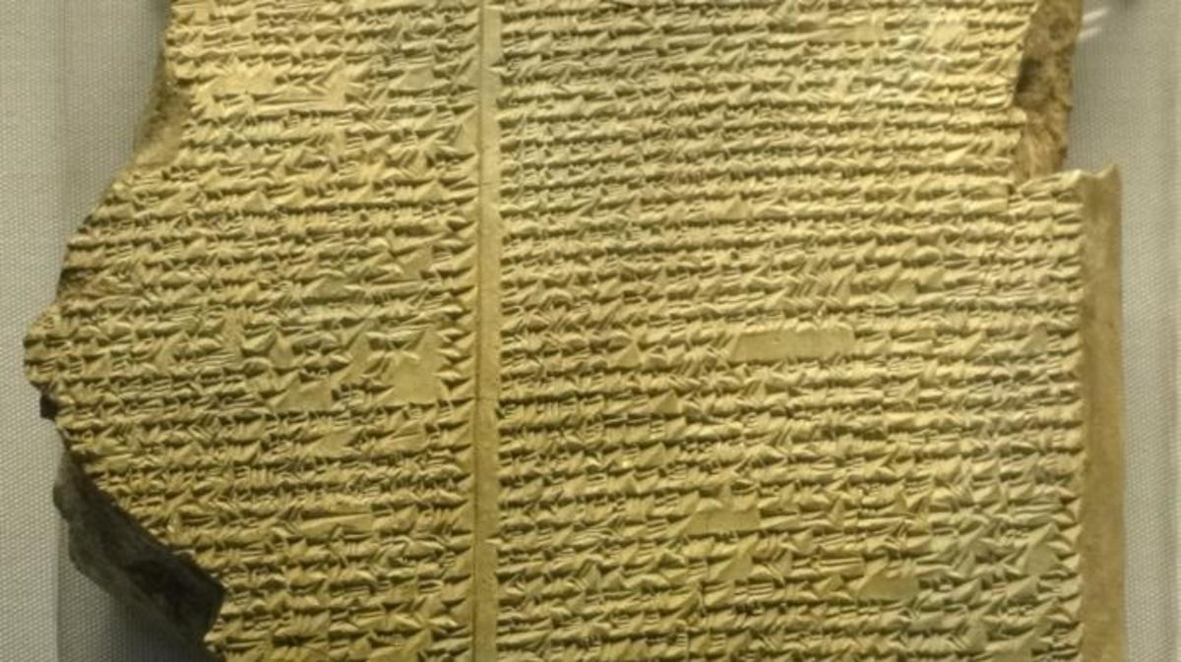
History
There are extensive records from the Babylonian and Persian period because of the extensive libraries which held thousands of cuneiform tables.

Slide 6
Palace in Susa/Shushan

Slide 7
Palace in Susa/Shushan
The ceiling of the Banquet Hall would have been 70 feet high.

Slide 8
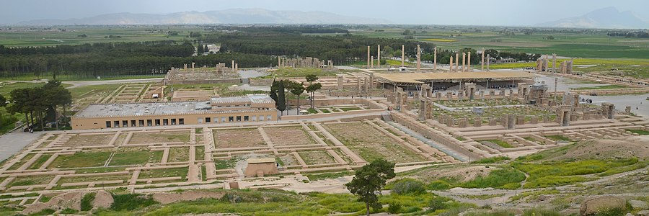
Xerxes’ Persepolis

Slide 9
Xerxes’ Persepolis

Slide 10
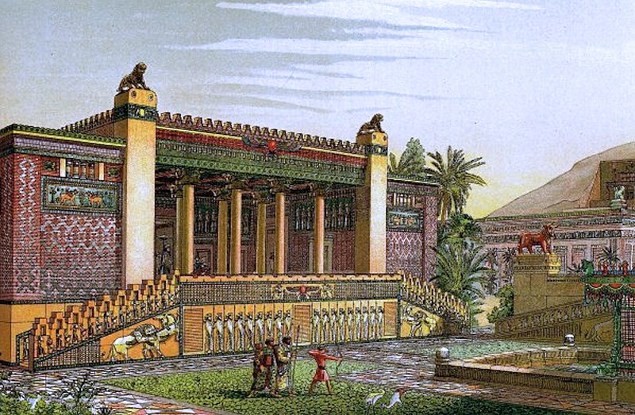
Xerxes’ Persepolis

Slide 11
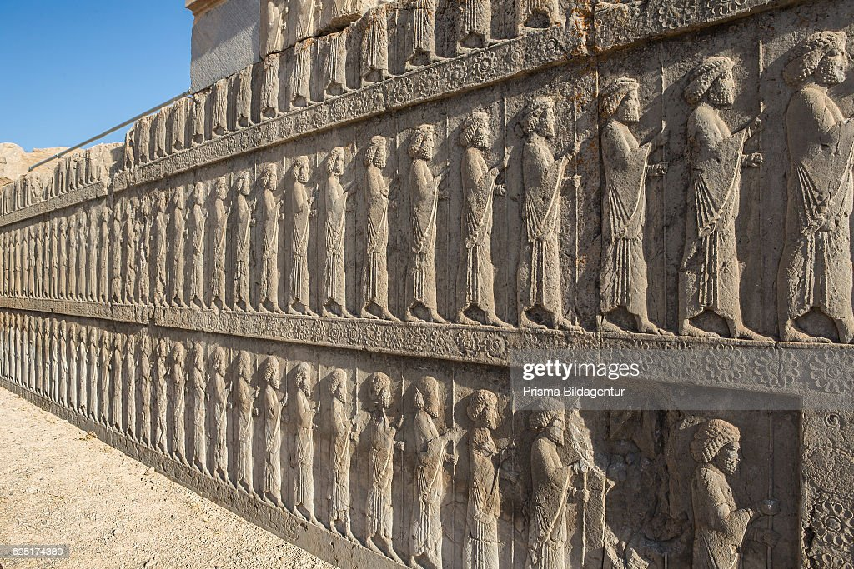
Xerxes’ Persepolis

Slide 12
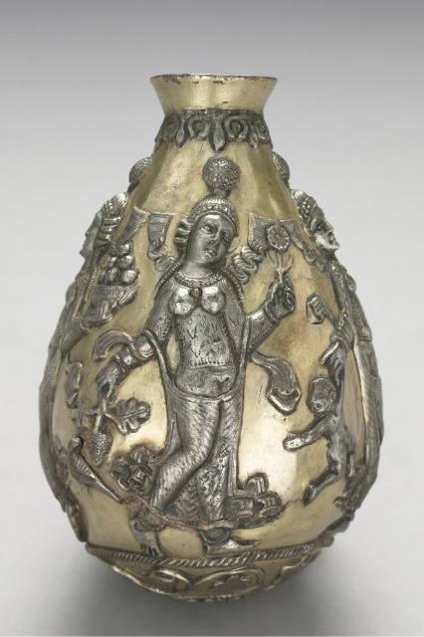
Persian Gods/Goddesses
Ahura Mazda - King of the Gods
Anahita (The Goddess of the Waters on the Earth)

Slide 13
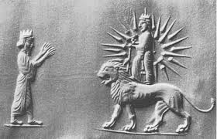
Persian Gods/Goddesses
Ishtar
Goddess of Fertility
Mithra (The God of the Sun)

Slide 14
Persian Women
Women in Persia were very honored and revered; they often had important positions in the Courthouse, Ministries, Military, State and Treasury Department, and other official administrations. Women were treated like Goddesses esteemed as mothers of creation before the barbaric invasion upon Persia.
The fortification tablets at the Ruins of Persepolis also reveals that men and women were represented in identical professions and that they received equal payments as skilled laborers and that gender was not a criterion at all (unlike our modern world).

Slide 15
Persian Women
The Star of Ishtar or Star of Inanna is a symbol of the ancient Persian and Sumerian goddess Inanna and her East Semitic counterpart Ishtar. Ishtar is mostly associated with the planet Venus, which is also known as the morning star.
It is interesting that Esther’s name in Hebrew is Hadassah which also means star or morning star. Once again God is working behind the scenes Esther becoming the Queen of the Persian Empire. Esther is going to bring life out of death for the Jews living in Persia just like Jesus who is the Morning Star brings life out of death for all of us.

Slide 16
Esther
God’s Care for a Careless People
Rise
Of
Esther
Rise
Of
Haman
Courage
Of
Esther
Plan
Of
Esther
Feast
Of
Purim
1:1 2:23 3:1 3:15 4:1 7:10 8:1 9:19 9:20 10:3
Party Power Purpose Protection Provision
King’s Favor
Haman’s Position
Mordecai’s Refusal
Mordecai’s Identity
Haman’s Disdain
Haman’s Complaint
Haman’s Plot
King’s Decree
Haman’s Bounty
City in Confusion
Mordecai’s Wailing
Jews Mourning
Jews fasting
Esther’s Anguish
Esther’s Inquiry
Esther’s Crisis
Esther’s Request
Haman’s Gallows
King’s Dream
Mordecai Honored
Haman Humiliated
Haman Caught
Haman hanged
King’s Gift to Esther
Mordecai Revealed
Esther’s Request
Decree Unchanged
King’s Response
Jews Armed
Mordecai’s News
Jews Rejoice
Jews Defense
Haman’s Sons Hanged
Jews Victory
Mordecai’s Report
Casting of the Pur
Feast of Purim
Esther’s Letter
Purim Established
Mordecai Elevated
Mordecai’s Legacy
King’s Request
Queen’s Refusal
King’s Counsel
Queen’s Demise
Beauty Pageant
Esther Taken
Hegai’s Kindness
Esther Chosen
Esther’s Secret
Mordecai’s Word
Esther’s Report
Assassins Killed
Issues
God not mentioned
Not Quoted in NT
No Law/Sacrifices
Fasting Mentioned
Prayer not mentioned
No Supernatural

Slide 17
Lesson from Esther
God is actively engaged in history and is working all things toward His purpose and design.
God uses imperfect and weak people to carry out his plans.
Christians have to constantly evaluate how much we have assimilated into our societal norms and weigh that against what scripture requires.
The thirst for power often inflates one’s ego which leads to foolish decisions. (Bowing to Haman)
The cultivation of inward beauty allows God’s glory to be manifested to those around you. (Esther respected)

Slide 18
Lesson from Esther
Hatred is often a generational issue. It is passed on by parents to their children on down through the generations and becomes institutionalized over time with policies that reinforce the prejudice and hatred. (History of the Agagites – Amalekites)
Hatred is often accompanied by jealously, envy, and pride. (All of these are seen in the actions of Haman.)
One person standing up with integrity and faith can challenge the intentions of someone filled with hate. (Mordecai refuses to bow)

Slide 19
Lesson from Esther
We demonstrate wisdom when we call on the community of believers to join us when face with overwhelming circumstances. (Esther calls a fast)
We need to remember we are where we are not by coincidence but because God has placed us here.
Courage mixed with patience is a virtue that will keep us from making foolish mistakes. (Esther waits)
Stepping out in faith is where we will experience the presence of God in new and refreshing ways. (Esther before the King)

Slide 20
Lesson from Esther
We are created in the image of God so that me might mirror His glory to the world. But pride replaces the mirror of God and allows us to mirror our own glory instead of God’s.
Pride easily gives way to hatred or indignation which is a poison that destroys us inwardly. (Haman’s anger)
We can boast of the things that God has done in our lives and we can boast of the powerful work that Christ has done on the cross.
We can overcome pride by not thinking any more highly of ourselves or less than ourselves but think soberly of ourselves which means seeing ourselves as God sees us. (Rom. 12:3)

Slide 21
Lesson from Esther
Knowing that “God works all things together for good” allows us to find peace in the midst of trials.
God gives us freedom to make choices for which we are responsible and yet uses all those contingencies to accomplish His plan. What a great mystery!! ‘
The timing of God’s plan includes both “chronos” and “Kairos”. God is able to intervene in time and space to bring transformation to any circumstance. He holds all of history in His hands and can intersect it at any time to carry out His will.

Slide 22
Lesson from Esther
We can take courage in that Justice and Judgment are part of God’s character based on righteousness, holiness, grace and loyal love towards us.
The wicked may flourish on this earth but they will have to stand and give an account for their deeds before a holy and righteous God. Truth is the greatest weapon against injustice.
As believers we will never stand before God to answer for our sinful deeds because they are removed through the death of Christ on the cross and Jesus has declared us righteous before the Father.

Slide 23
Lesson from Esther
The history of the bible is the great history of redemption. The fall of humankind in Adam and Eve sets in motion the great plan of redemption by a gracious and loving God.
Redemption was based on eternal love in the Godhead implemented in a decree. Ps.2“I will surely tell of the decree of the Lord: He said to Me, ‘You are My Son, Today I have begotten You.
No matter what we face in life we can find comfort in the fact that we have a mediator and an intercessor at the right hand of the Father in heaven.
As Christians we have the privilege of being intercessors and mediators for those around us having access to the very throne of God through Christ.

Slide 24
Lesson from Esther
God’s promises of deliverance may include using us to gain the victory. (Jews armed themselves)
We gain victory over Satan as we learn to put off the old and put on the new. (Col. 3:9-10)
We all must put on the full armor of God if we are to stand against the schemes of the Devil. (Eph. 6)
Never give up because God can turn the tables at any time in our life’s journey. (Haman gets what he intends for Mordecai)

Slide 25
Lessons from Esther
Our destiny is in His hands. He controls the dice. He numbers our days. He’s sovereign. He’s ruling over our world. We’re meant to find comfort in that
The Lord’s deliverance is coming. God will exalt Jesus and every knee will bow and every tongue will confess Jesus is Lord. (Phil. 2:10-11)
Think about our need to remember. We’re a part of God’s family that has seen Him act again and again, throughout history. God’s covenant love has chased his people down through the centuries. He has always been faithful.

Slide 26
God’s Mysterious Work
“It has been well said that the Book of Esther is a record of wonders without a miracle, and therefore, though equally revealing the glory of the Lord, it sets it forth in another fashion from that which is displayed in the overthrow of Pharaoh by miraculous power.” (Spurgeon)
Think of all that God arranged:
God arranged for the noble Queen Vashti to lose her place.
God arranged for a competition to replace Queen Vashti.
God arranged for Esther to enter the competition.

Slide 27
God’s Mysterious Work
God arranged special favor for Esther among the other women.
God arranged for Mordecai to have access to both Esther and the affairs of the kingdom.
God arranged the lot that was cast to give 11 months warning before the evil event (Esth. 3:12-13).
God arranged that the decree command that the Jews be killed by private hands, instead of by the army of Persia – which would have been much more difficult to stop.
God arranged that Haman restrain his anger and not kill Mordecai immediately (Esth. 5:10).

Slide 28
God’s Mysterious Work
God arranged for Esther to delay her request; first asking for a banquet with the king and then another banquet.
God arranged for Haman’s anger to come to a peak on one particular day.
God arranged for Ahasuerus to have a sleepless night.
God arranged for Ahasuerus to pick up a certain book in his sleepless night.
God arranged for Ahasuerus to read the passage about Mordecai in that particular book.

Slide 29
God’s Mysterious Work
God arranges for Haman to be humiliated by honoring Mordecai.
God arranges for Haman to be hung on the gallows designed for Mordecai.
God arranges for the Jews to defend themselves.
God arranges for the King accept the decree made by Mordecai.
God arranges for victory of the Jews against their enemies especially the Amalekites.

Slide 30
God’s Mysterious Work
“God’s hand in history never rules out our actions. The actions of Esther and Mordecai were critical to the preservation of the people of God.” (David Guzik)
God’s will is accomplished, and yet men are perfectly free agents; Haman did as he pleased, Ahasuerus did what he wanted, so did Mordecai and Esther. We see no interference, no coercion - they all do their will, and bear full responsibility, yet God works out His eternal plan for the ages through it all.

Slide 31
God’s Mysterious Work
“There it is; man is a free agent in what he does, responsible for his actions, and verily guilty when he does wrong, and he will be justly punished too, and if he be lost the blame will rest with himself alone: but yet there is One who ruleth over all, who, without complicity in their sin, makes even the actions of wicked men to subserve his holy and righteous purposes. Believe these two truths and you will see them in practical agreement in daily life, though you will not be able to devise a theory for harmonizing them on paper.” (Spurgeon)

Slide 32
God’s Mysterious Work
“God, in His wise and Providential plan, allows His people to be tested – sometimes severely so. We must not suppose that the servants of God will be protected from every trial, because the trials are part of God’s design.” (David Guzik)
• It was a great trial for Mordecai; he refused to bow to Haman and others would suffer for his refusal to pay homage to Haman.
• It was a great trial for Esther; she heard the news of the coming slaughter of her people and had to boldly approach the king to make an appeal.

Slide 33
Esther 10:1-3
Esther 10:1 King Xerxes imposed tribute throughout the empire, to its distant shores. 2 And all his acts of power and might, together with a full account of the greatness of Mordecai, whom the king had promoted, are they not written in the book of the annals of the kings of Media and Persia? 3 Mordecai the Jew was second in rank to King Xerxes, preeminent among the Jews, and held in high esteem by his many fellow Jews, because he sought the good of his people and spoke up for the welfare of all the Jews.

Slide 34
Esther 10:1-3
10:3 “because he sought the good of his people and spoke up for the welfare of all the Jews.”
To seek – means to tread a path, to look intently – This shows the dedication of Mordecai.
The good - The root of the Hebrew word here is the “best, bountiful, wealth”. Mordecai sought to enhance the lives of the Jews.
Did Mordecai know the promise in Jer. 29:7 7 And seek the welfare of the city where I have caused you to be carried away captive, and pray unto Jehovah for it; for in the peace (shalom) thereof shall ye have peace (shalom) .

Slide 35
Questions
Group discussion: What would it be like in our country if our politicians followed Mordecai’s example and “worked for the good of his people and spoke up for the welfare of all the people.”
Questions:
Why do you think the author of Esther felt the need to add these last three verses to the book of Esther?
What key insight do you get from these last three verses of Esther?
How would you summarize the overall character and leadership of King Ahasuerus?
How would you summarize the overall character and leadership of Mordecai?

Slide 36
Questions
How would you summarize the overall character and leadership of Esther?
What key lesson or lessons have you learned from the book of Esther?
Why do you think the Book of Esther has become one of the most favorite books of the Old Testament for the Jews?
If you were to summarize the book of Esther in one sentence, what would that sentence be?
What parallels do you see between the Book of Esther and our current culture here in the United States?

