Slide 1
UNION VALE LIBRARY STUDY
Planning Options
Aaron Cohen Associates
2022

Slide 2
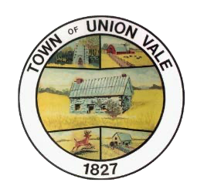
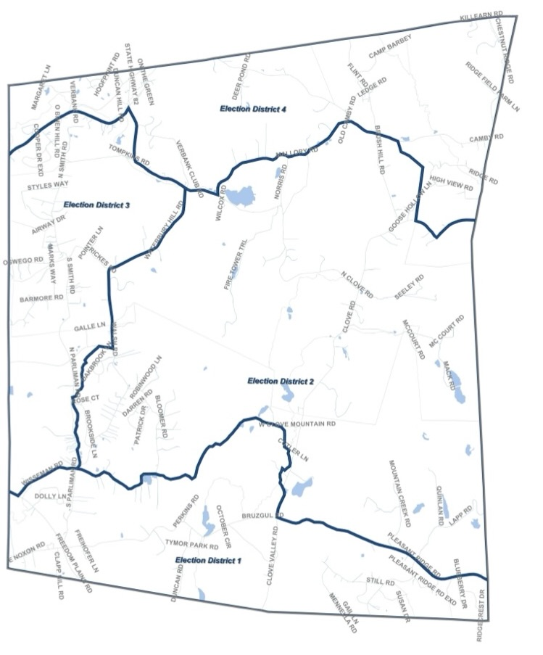
The Town of Union Vale has many strengths.
Population: 4,558
There is a rich history of outdoor life with many locals, weekenders and gun club members taking advantage of the natural beauty and open spaces.
There are new families moving in and indications that the local population is aging in place so a library would need to prioritize youth / children’s services as well as seniors.

Slide 3
The Town of Union Vale has many strengths.
Residents would like to go to the libraries that are nearest to them.
There are three school districts (Millbrook, Arlington & Dover). Residents would like an opportunity for Union Vale families that go to different school districts to meet and collaborate.
The dedicated senior center needs to be upgraded and re-purposed as a community center.
We need to develop a new remote work and meeting space.
Space to reduce residents’ isolation.
Develop a long-term plan to provide library, community center and recreation services and programs.
Create a new cybercafé that can be used for meeting or doing homework at Tymor Park.

Slide 4
What We Did…
Alexander Cohen, library consultant facilitated 8 zoom meetings and three public meetings for the Town of Union Vale.
(Public Meetings: April 30, 2022, May 14, 2022 & June 2,2022)
(Zoom Meetings with the Public, Fund Raising Committee, MHSL, NYS)
(Survey of the User Needs)
We worked with the community members to understand the history of Tymor Park and the Town.
We held workshops on why people move to Union Vale and what were their expectations.
We had discussions about the past and the future library situation.

Slide 5
What We Learned…
The local public libraries (e.g. Millbrook & Beekman) offer services to children and youth. Although the youth are not always restricted from getting a card, there are concerns that family access is constricted.
The local libraries offer limited supply of computers for the public. For example, the Beekman library has 6 public computers.
It was noted that the Union Vale Senior Center & Town Hall have 4 public computers, but not many residents knew about them
The older folks in the community need IT and computer support.
The local libraries need funding to improve their spaces.

Slide 6
What We Learned…
The Union Vale adults are very committed to the local libraries. They want to be able to use them as equal members.
The Union Vale library should be customized for the families who live in Union Vale.
A non-profit community center can charge for private events; the library can be a free resource (ex. tutoring space, meeting space, seniors’ programs, and story time programs)
Town residents, who could donate funds to set up a library service, have the means to privately fund spaces for computers, presentations, collections, meeting space and areas to read with the latest books. This project recognizes the need for fund raising efforts to off-set town taxes.
The library project is a chance to rethink community space needs, including new flex space(s) for adults and more educational group space(s) for tutors, as well as areas to promote early literacy, books, art, writers, film makers, historians, and space for the Town of Union Vale brand to build value.

Slide 7
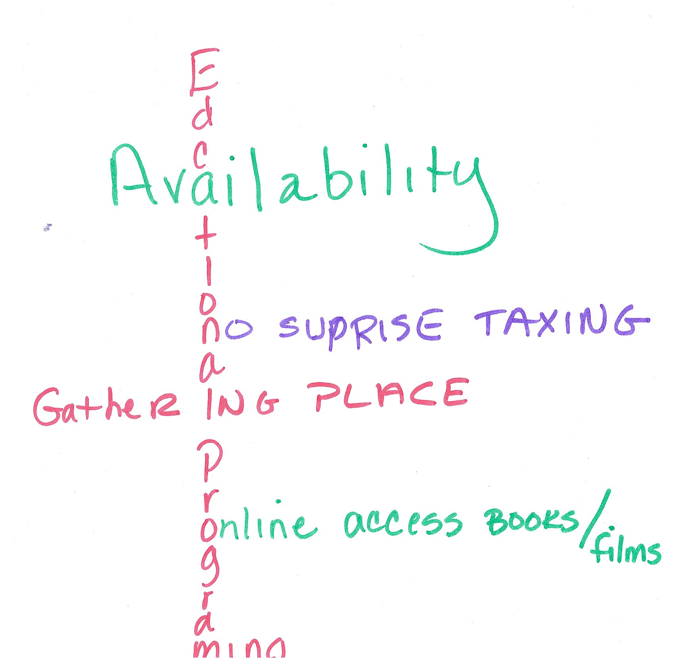
What We Learned…
The Town of Union Vale compensated for not having a library for many years. Before 2010, the Town made a gentleman’s agreement to pay for local library services. Each year the Town paid approximately $25,000 for access at the local library services. Today, we estimate that budget figure to be around $250,000 per year.
Public Characterization of Town Needs…

Slide 8
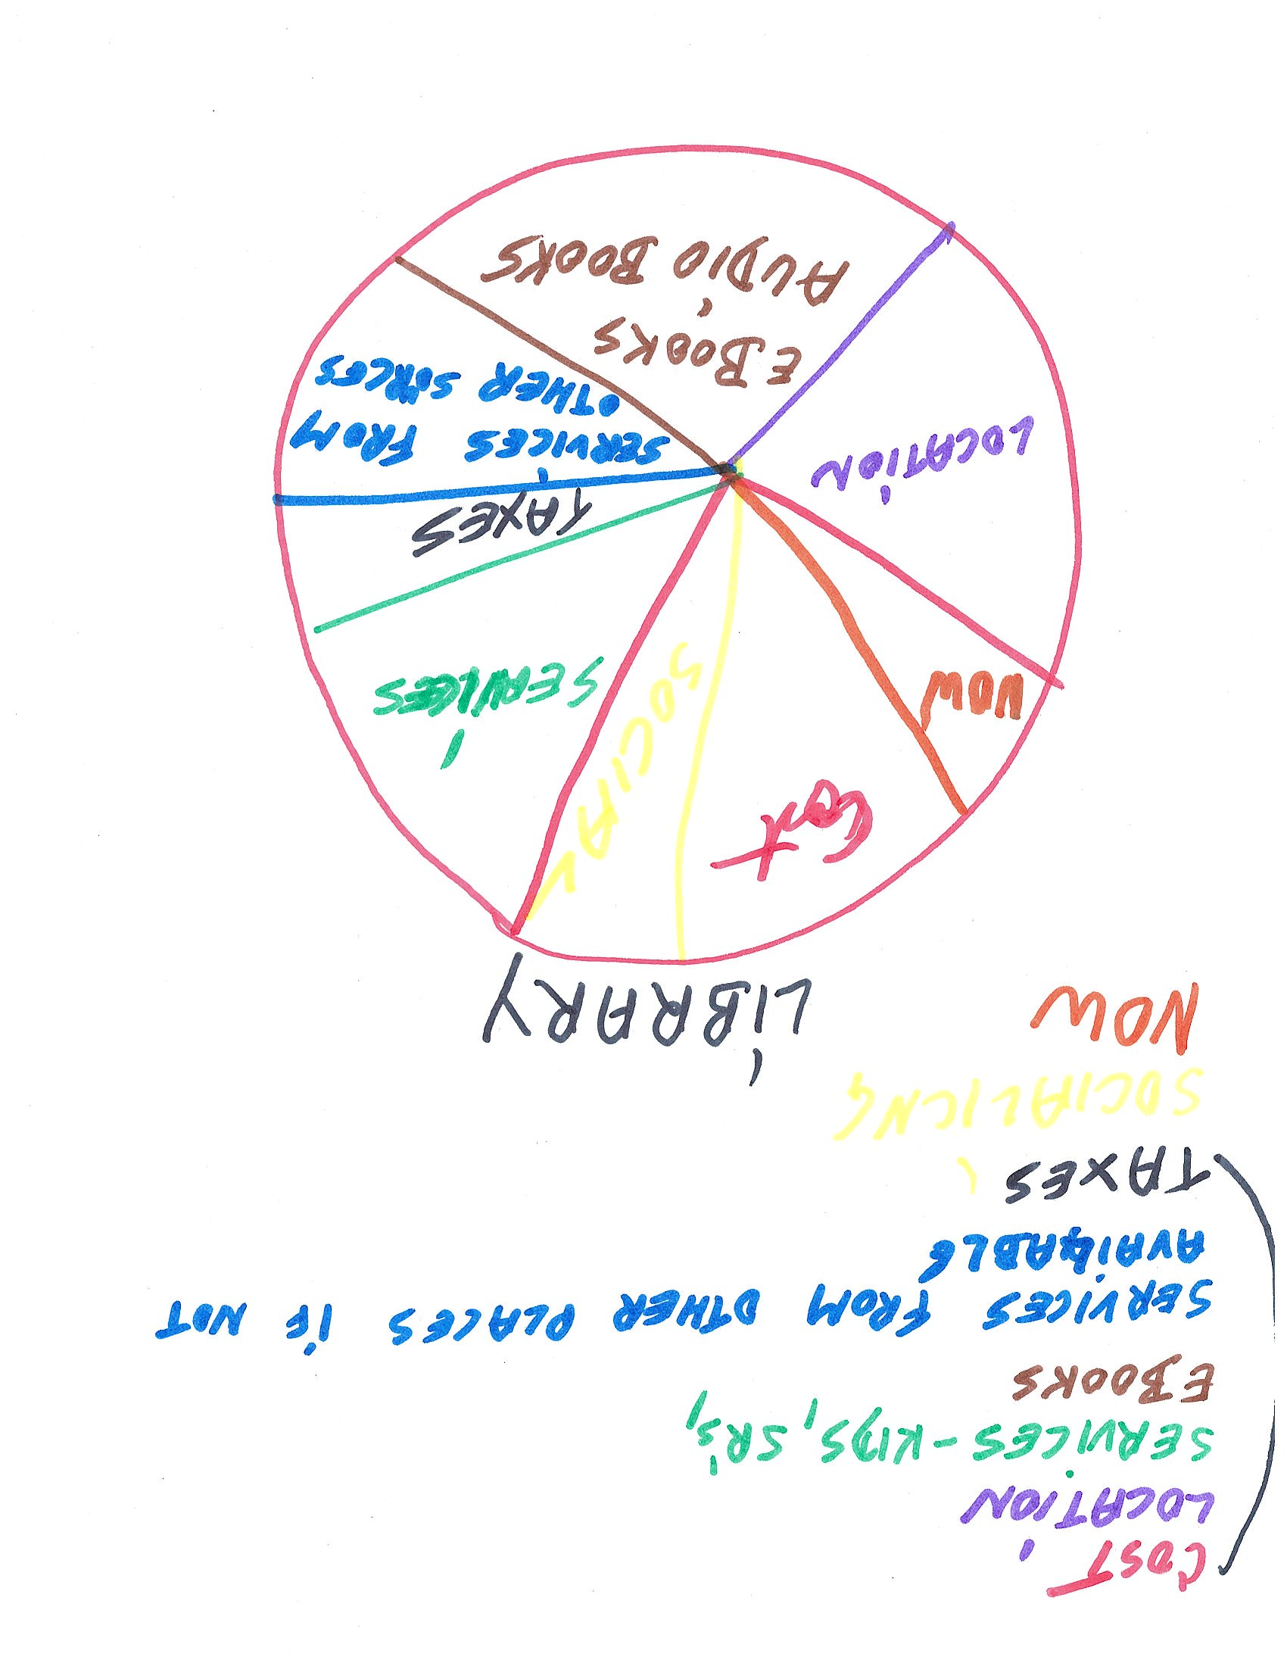
What We Learned…
We can make an agreement to allow residents to receive a library card that provided access to the Mid-Hudson Library System (MHLS).
However, Union Vale needs a library service department, supported primarily by local taxes, that offers support for and access to all residents. This also includes access to MHLS (66) independent public and free association libraries in Columbia, Duchess, Greene, Putnam, and Ulster counties.
Public Characterization of Town Needs…

Slide 9
Build a Community for Transformation
The local libraries do not have an urgent need to negotiate with an adjacent Town.
The issues need a long term and sustainable solution.
Today there are publicly stated restrictions placed on the residents of the Town of Union Vale. We have heard that services may be available to some, but this is a gray area.
This damages the effectiveness of local library services and access to education.
Young residents have been traumatized by the restrictions. (ex. A sticker was placed on residents’ cards that indicated that they were barred from library services. A child who won the reading challenge could not check out a book because she was a Union Vale resident.)
It is time for the Town of Union Vale to solve the library service issue.

Slide 10
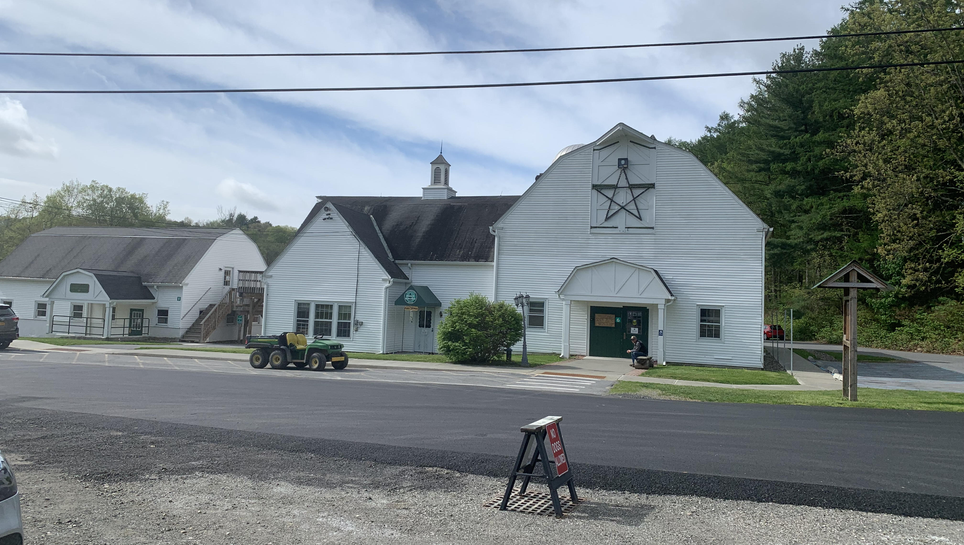
Old Barns are Heavenly

Slide 11
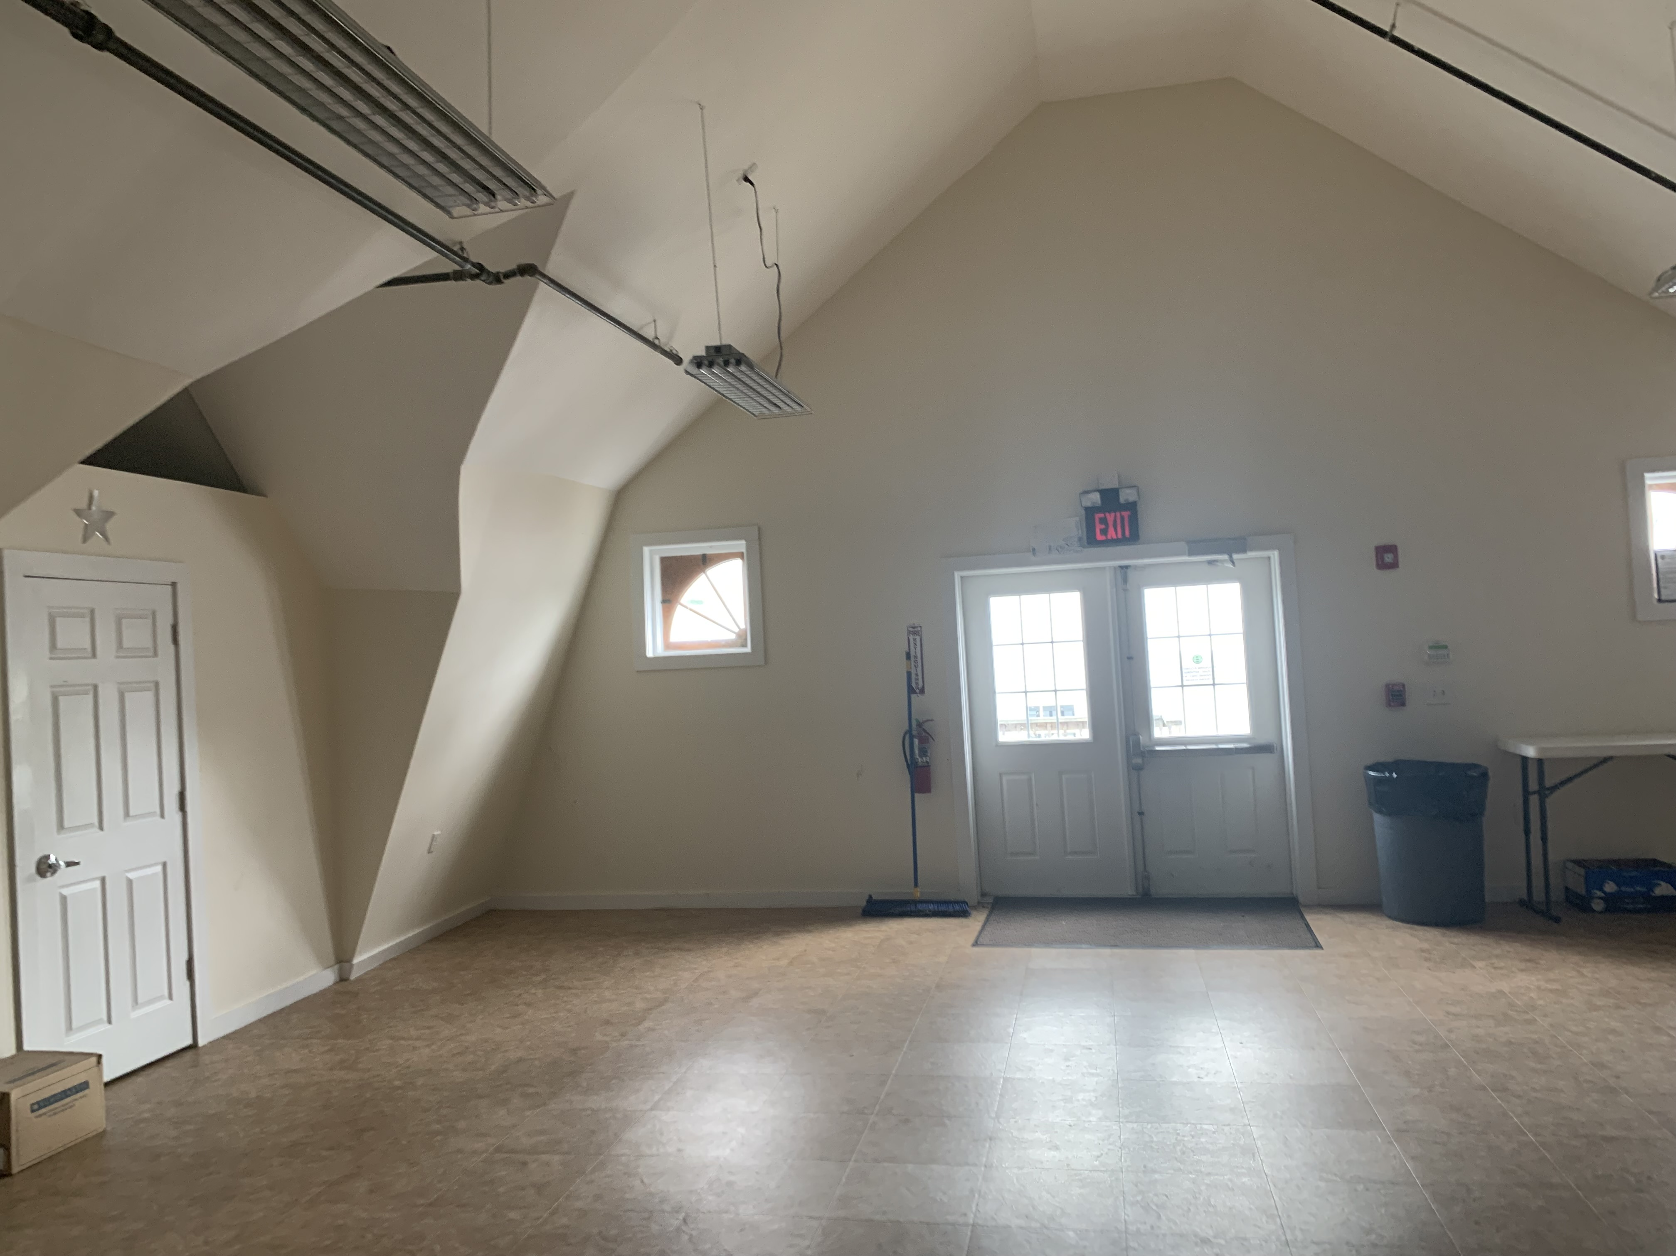
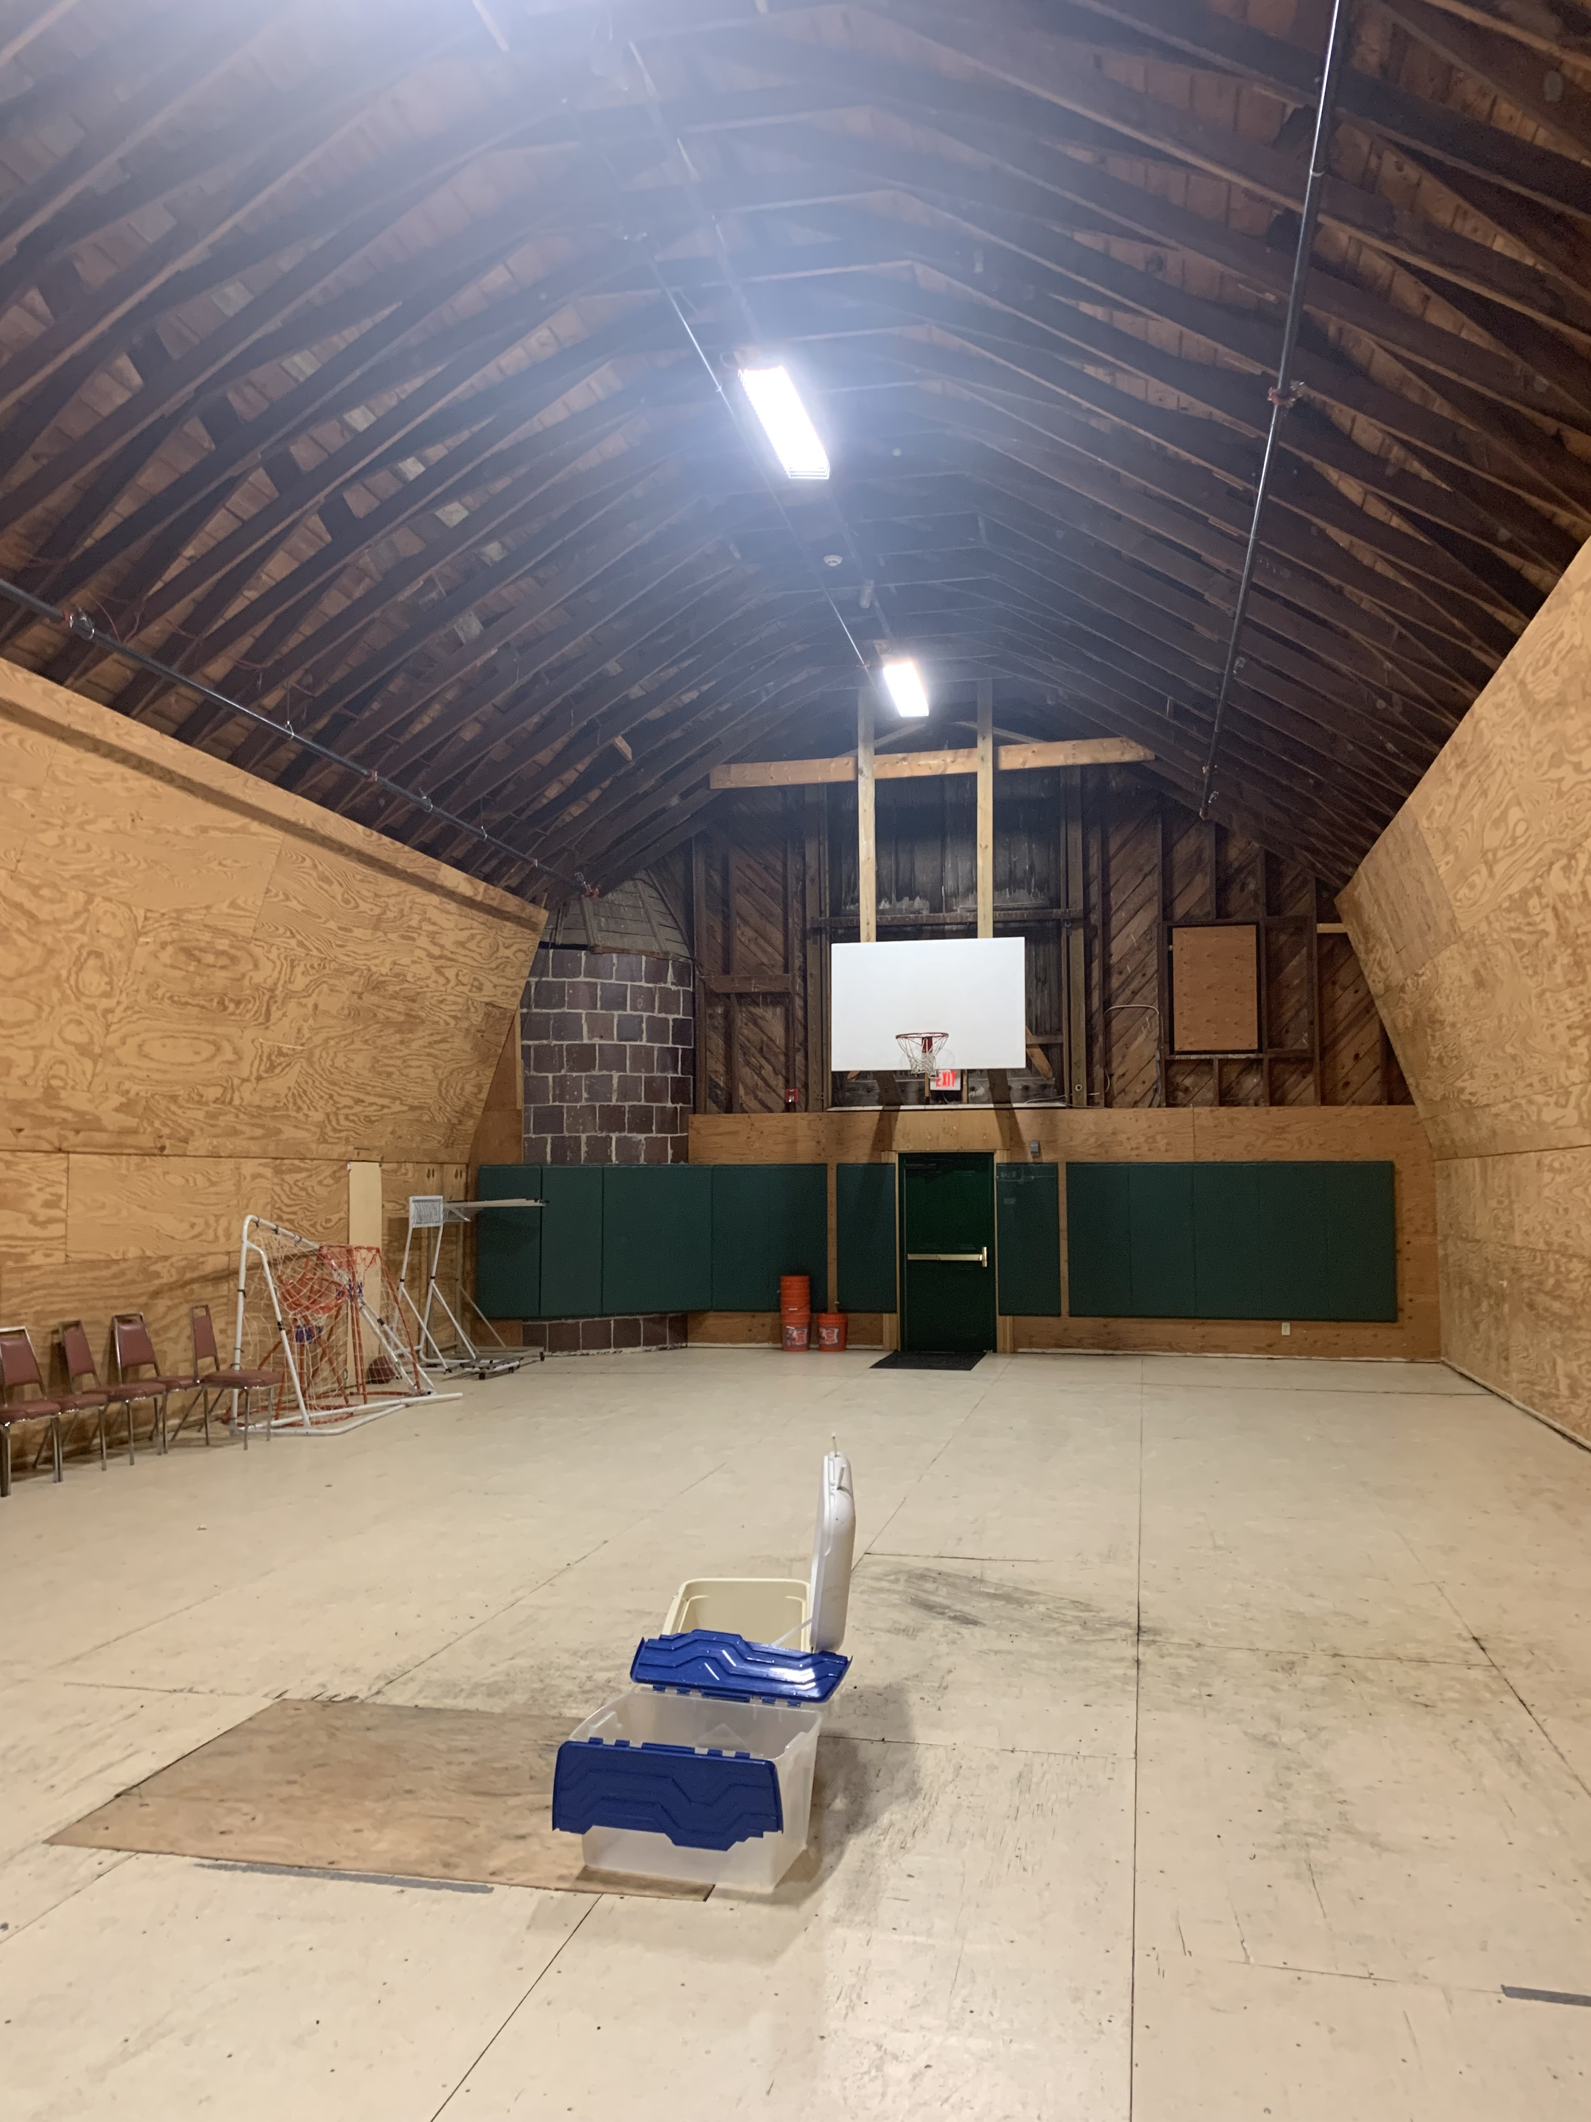
Old Barns are Heavenly
We found that there is a high demand for family services and space in Tymor Park to run a local outlet.
A new library can target Union Vale residents that use the Town’s swimming pool or camp in the summer.
There is a large group of seniors that supports the local libraries.
They understand how to support their community.
They have spent time supporting the local libraries.
They want to make an impact, but they don’t want to upset the local libraries or lose their unique connections to their services.

Slide 12
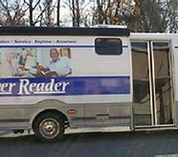
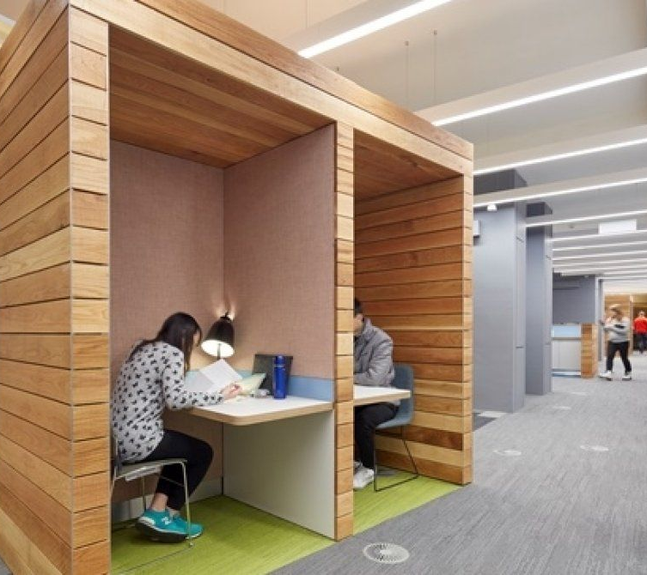
One of the major features of a growing community is the development of library programs, educational events, and civic functions.
There is a high demand for adult services. For example, remote work has changed the way we live.
There is a growing need for re-mote study / workspaces.
Places to meet and not be isolated.

Slide 13
The Value of Access
The Mid-Hudson library system includes a group of independent libraries. Each library receives its library funding based on its history and location, from the local taxpayers.
The sixty-six libraries that make up the MHLS are unique association libraries, school district libraries and municipal library communities.
The system enables the libraries to be tethered to each other, allowing the residents from the localities to access the whole system i.e., check out a book from any library.
The residents in the New York State (NYS) don’t usually need to reach across four different town boundaries to access library services.
The MHLS doesn’t contract with Towns that don’t have a chartered library. They contract with existing libraries to provide system services.
A municipal library will enable the MHLS to support the Town of Union Vale.

Slide 14
Status Quo
Overall, the Union Vale Public told us the status quo is a “mess” -- This means that people want to access the library that is nearest to their home. At a minimum, they want to use Tymor park as a community space. The capital costs and potential increases in taxes are scary to people with limited means.
On the other hand, there are residents who want to help financially. They want to have a book collection that is devoted to local culture (horses, apples, birding, swimming, hiking, outdoors, etc.) and/or collections that encourage literacy.
They expressed support for local exchanges of professional expertise and knowledge (ex. Equine, Banking/Finance, History, Local Services, etc.)

Slide 15
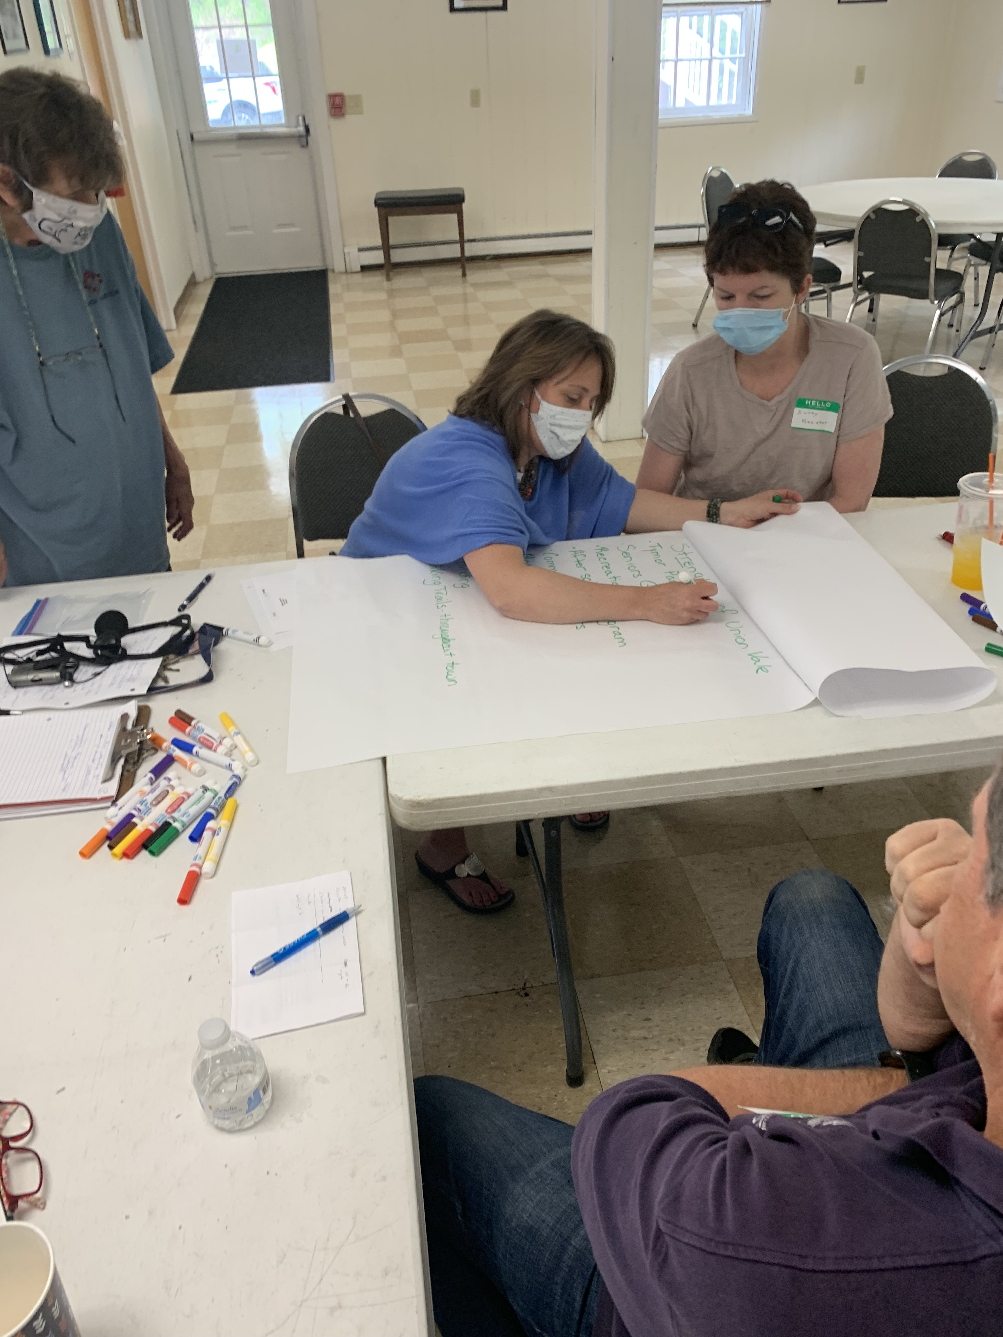

Slide 16
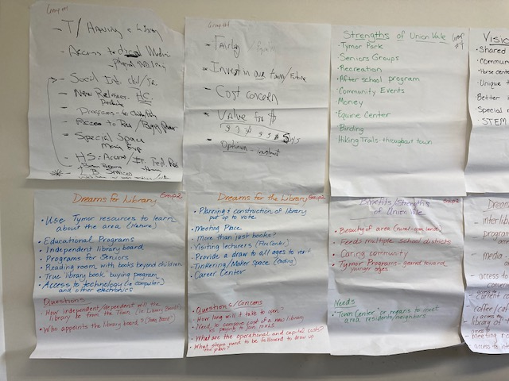

Slide 17
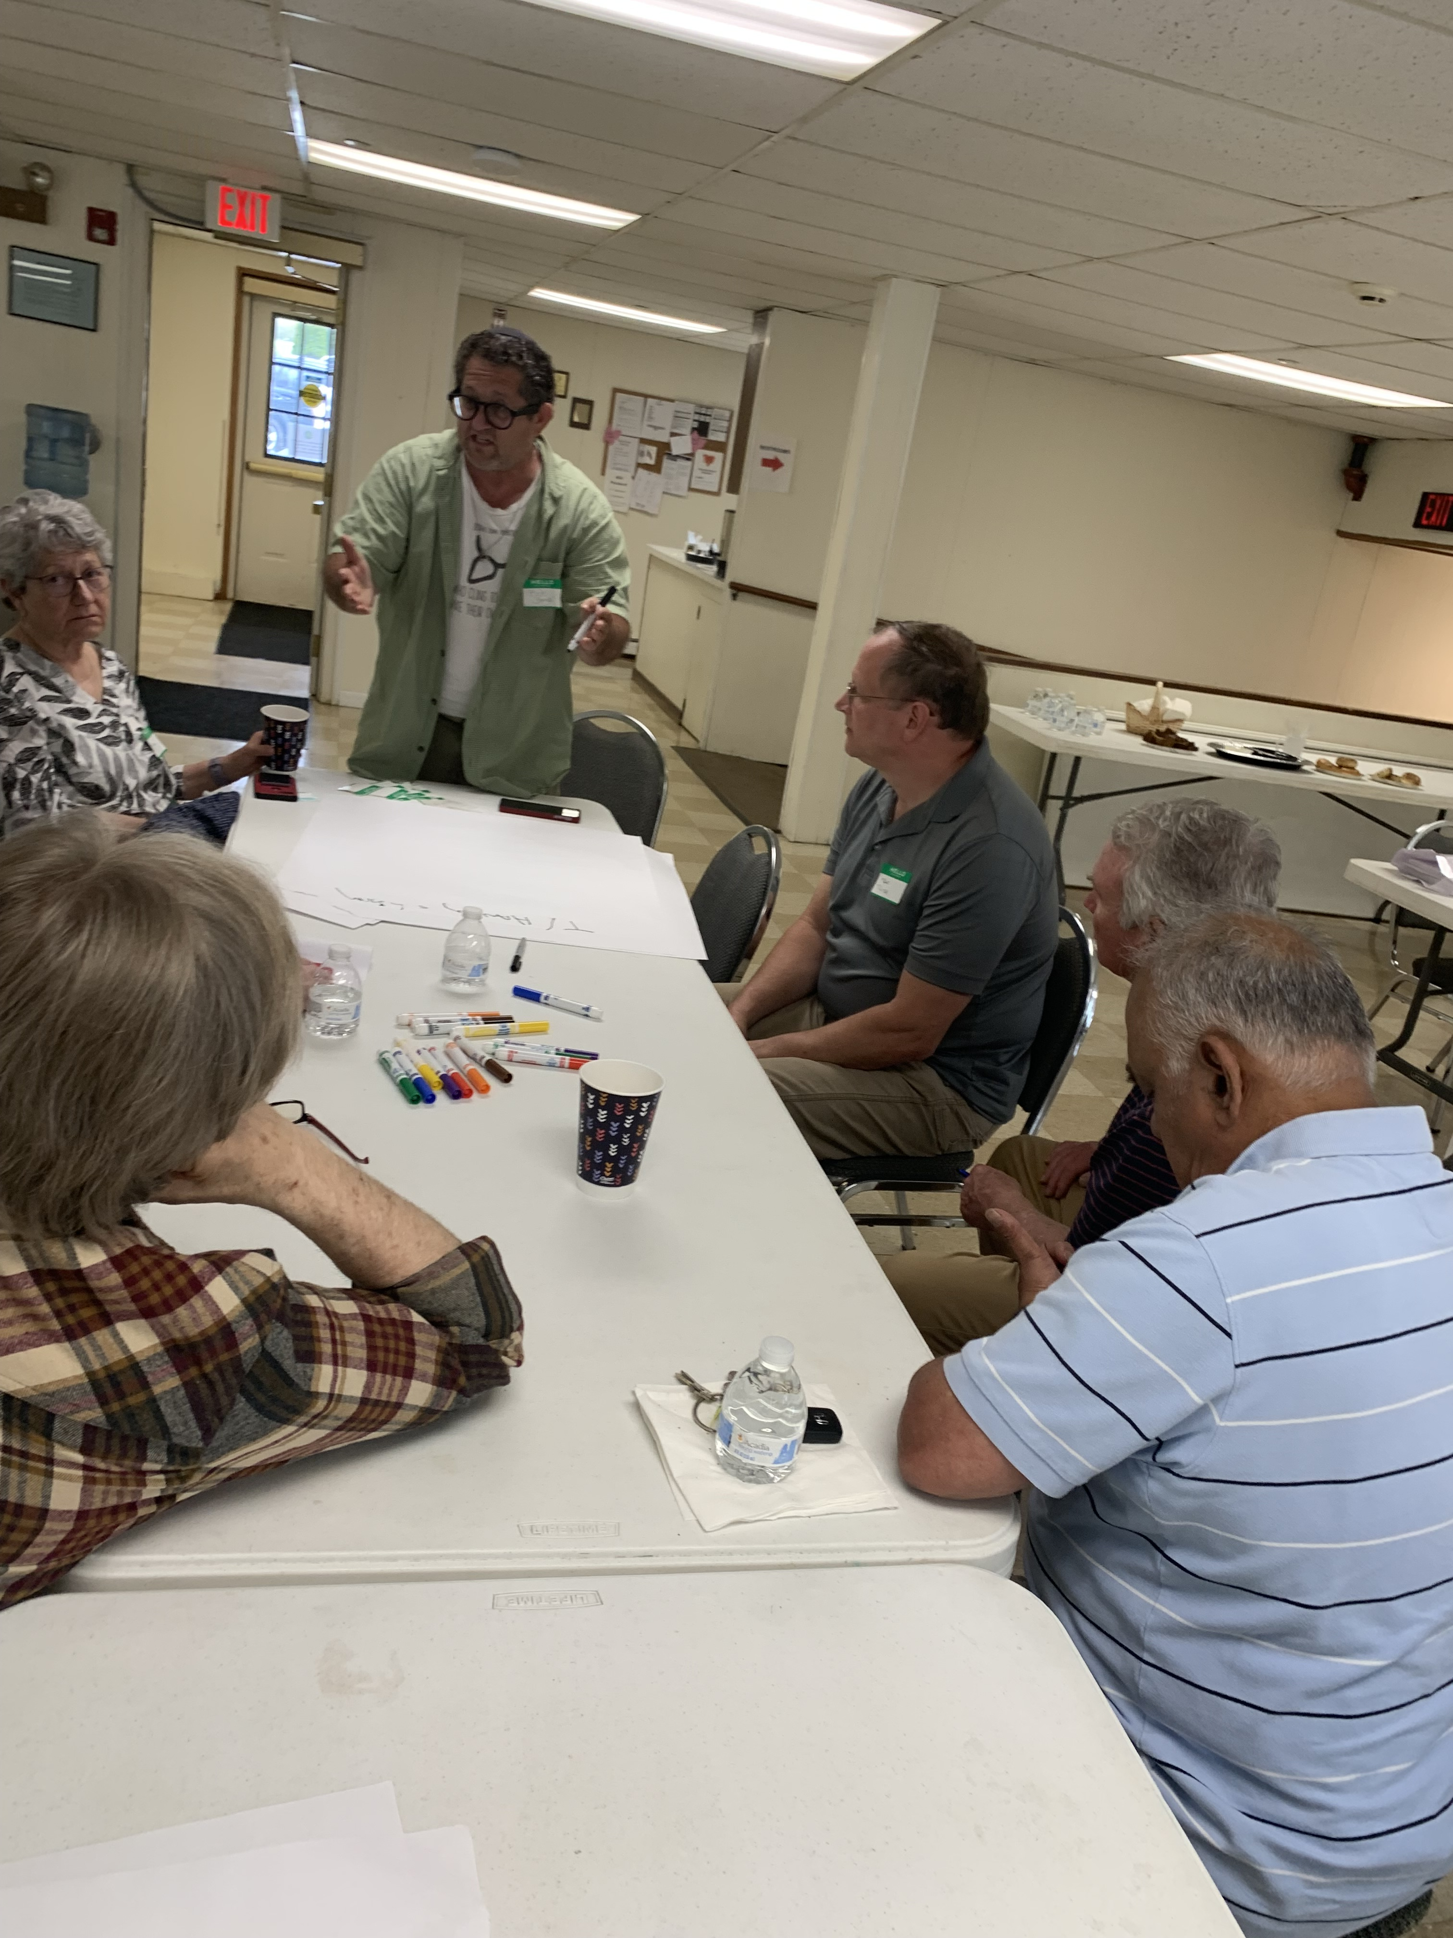

Slide 18
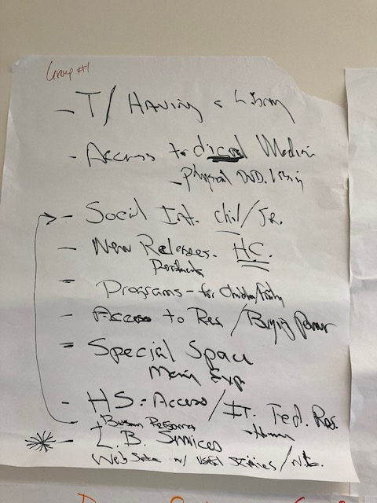

Slide 19
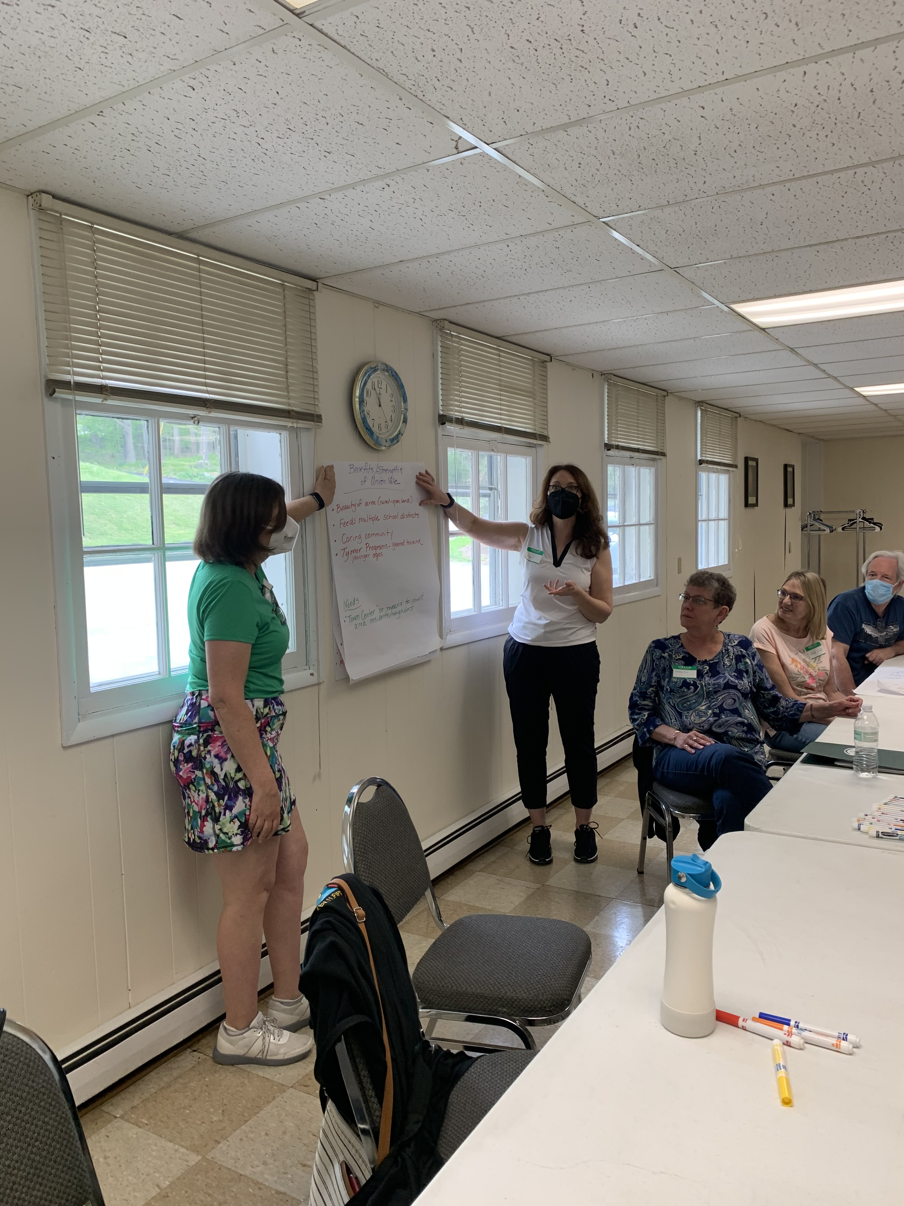

Slide 20
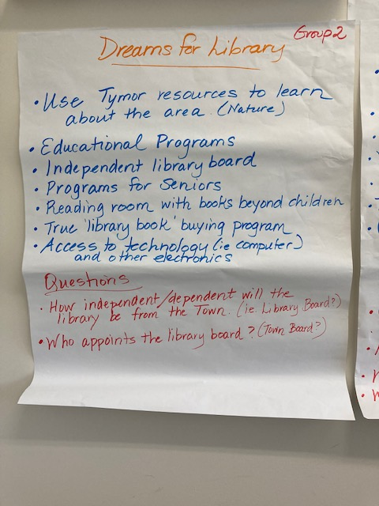

Slide 21
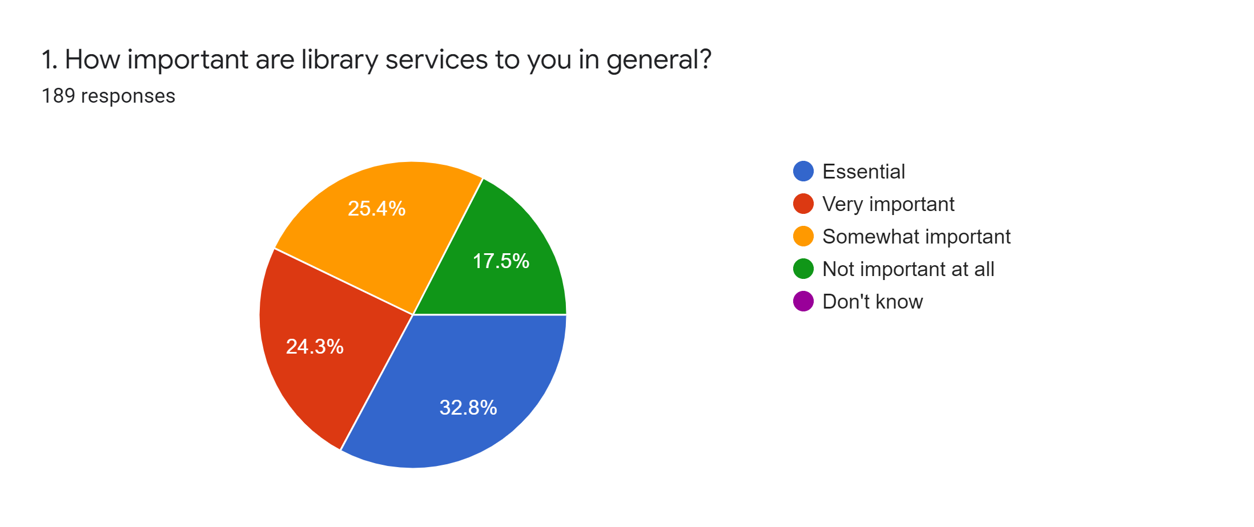

Slide 22
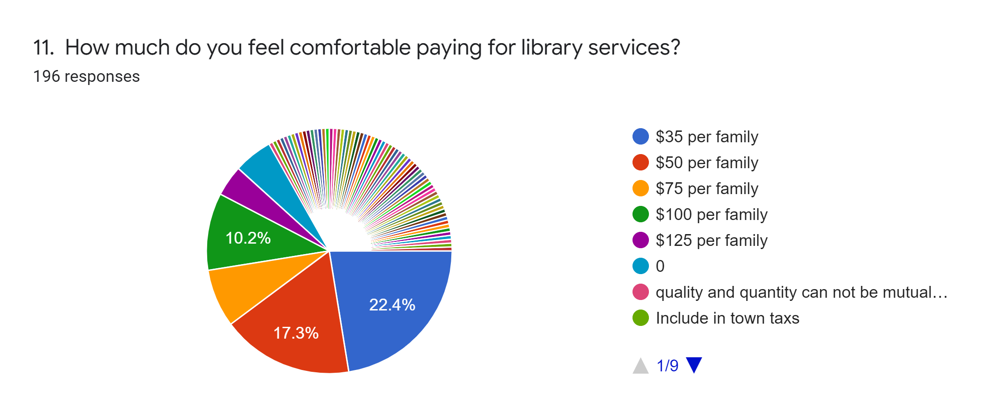

Slide 23
Work to Do…

Slide 24
Work to Do…

Slide 25
Work to Do…

Slide 28
Work to Do…
Develop a Library Department Business Plan
Create a plan to charter the Union Vale library.
Select a board of trustees to manage the library.
Hire a Library Director to manage space, inventory, staffing, and on-going operational costs.
Match library services to user needs

Slide 29
TASK | AUG 2022 |  | SEPT 2022 | OCT 2022 | NOV 2022 | NOV 2022 | DEC2022 | JAN 2023 | JAN 2023
Prepare for New Library | Pass Resolution for a Municipal Library (Department) Select 5 to 7 Trustees of the Library Review of Library Budget Existing Building Tymor Barn Trustees Prepare Applications for Chartering
Develop Library Service (apply for charter, fundraising activities) |  |  | Fund Raising Development Apply for Provisional Charter Hire a Director: Collection and Temp Development: Library Services & User Needs
Develop Library Space (architect, interior design, community engagement) Library Services Rollout |  |  |  | Open Forum Meetings Library Staff Input / Board Meeting Community Needs Review Barn Building Options Future Designs & Tests
Library Design / Presentation(s) |  |  |  | Design & Interior Development Layout |  | Preferred Concept Design and Program Option Tests Final Library Design and Recommendations, Support Town Library PR Efforts
Building Layout to Support New Municipal Library |  |  |  |  |  | Preferred Concept Design and Program Option Tests Architect Library Design and Recommendations, Support Town Library Efforts
Design & Development |  |  |  |  |  | Installation
Opening Day* |  |  |  |  |  | Prepare for Opening *2nd Quarter 2023

Slide 30
Next Steps…
Step 1: Town Board passes a Resolution to approve a library and prepares preliminary budget.
Step 2: Town Board solicits applications for Library trustees.
Step 3: Grants, endowments, and fund-raising efforts can begin.
Step 4: Town continues and expands Library concierge services (Kanopy, et al).
Step 5: Trustees prepare bylaws, long range plan of service, written policies, etc. and apply for provisional charter.
Step: 6: Prepare the Senior Center for use as an annex or interim library for chartering purposes.
Step 7: Renovate the 2nd floor of the barn and open permanent library for the Town of Union Vale.

