Slide 1
Considerations for Mathematics Intervention

Slide 2
Contact Information
Sarah Powell, Ph.D
The University of Texas at Austin
srpowell@austin.utexas.edu
@sarahpowellphd
119

Slide 4
What are contributing factors to mathematics difficulty?
COGNITIVE/ACADEMIC
Spatial reasoning

Slide 5
What are contributing factors to mathematics difficulty?
COGNITIVE/ACADEMIC
Spatial reasoning
Processing speed

Slide 6
What are contributing factors to mathematics difficulty?
COGNITIVE/ACADEMIC
Spatial reasoning
Processing speed
Language

Slide 7
What are contributing factors to mathematics difficulty?
COGNITIVE/ACADEMIC
Spatial reasoning
Processing speed
Language
Reading

Slide 8
What are contributing factors to mathematics difficulty?
COGNITIVE/ACADEMIC
Spatial reasoning
Processing speed
Language
Reading
EXECUTIVE FUNCTIONING
Working memory

Slide 9
What are contributing factors to mathematics difficulty?
COGNITIVE/ACADEMIC
Spatial reasoning
Processing speed
Language
Reading
EXECUTIVE FUNCTIONING
Working memory
Self-monitoring

Slide 10
What are contributing factors to mathematics difficulty?
COGNITIVE/ACADEMIC
Spatial reasoning
Processing speed
Language
Reading
EXECUTIVE FUNCTIONING
Working memory
Self-monitoring
Planning

Slide 11
What are contributing factors to mathematics difficulty?
COGNITIVE/ACADEMIC
Spatial reasoning
Processing speed
Language
Reading
EXECUTIVE FUNCTIONING
Working memory
Self-monitoring
Planning
Task initiation

Slide 12
What are contributing factors to mathematics difficulty?
COGNITIVE/ACADEMIC
Spatial reasoning
Processing speed
Language
Reading
EXECUTIVE FUNCTIONING
Working memory
Self-monitoring
Planning
Task initiation
Organization

Slide 13
What are contributing factors to mathematics difficulty?
COGNITIVE/ACADEMIC
Spatial reasoning
Processing speed
Language
Reading
EXECUTIVE FUNCTIONING
Working memory
Self-monitoring
Planning
Task initiation
Organization
INFORMATION PROCESSING
Sensory
Auditory
Spatial
Motor

Slide 14
What are contributing factors to mathematics difficulty?
COGNITIVE/ACADEMIC
Spatial reasoning
Processing speed
Language
Reading
EXECUTIVE FUNCTIONING
Working memory
Self-monitoring
Planning
Task initiation
Organization
INFORMATION PROCESSING
Sensory
Auditory
Spatial
Motor
Attention

Slide 15
What are contributing factors to mathematics difficulty?
COGNITIVE/ACADEMIC
Spatial reasoning
Processing speed
Language
Reading
EXECUTIVE FUNCTIONING
Working memory
Self-monitoring
Planning
Task initiation
Organization
INFORMATION PROCESSING
Sensory memory
Auditory
Spatial
Motor
Attention
Working memory
(Short-term memory)

Slide 16
What are contributing factors to mathematics difficulty?
COGNITIVE/ACADEMIC
Spatial reasoning
Processing speed
Language
Reading
EXECUTIVE FUNCTIONING
Working memory
Self-monitoring
Planning
Task initiation
Organization
INFORMATION PROCESSING
Sensory memory
Auditory
Spatial
Motor
Attention
Working memory
(Short-term memory)
Long-term memory

Slide 17
What are contributing factors to mathematics difficulty?
COGNITIVE/ACADEMIC
Spatial reasoning
Processing speed
Language
Reading
EXECUTIVE FUNCTIONING
Working memory
Self-monitoring
Planning
Task initiation
Organization
INFORMATION PROCESSING
Sensory memory
Auditory
Spatial
Motor
Attention
Working memory
(Short-term memory)
Long-term memory
ENVIRONMENTAL
Socio-economic status

Slide 18
What are contributing factors to mathematics difficulty?
COGNITIVE/ACADEMIC
Spatial reasoning
Processing speed
Language
Reading
EXECUTIVE FUNCTIONING
Working memory
Self-monitoring
Planning
Task initiation
Organization
INFORMATION PROCESSING
Sensory memory
Auditory
Spatial
Motor
Attention
Working memory
(Short-term memory)
Long-term memory
ENVIRONMENTAL
Socio-economic status
Race or ethnicity

Slide 19
What are contributing factors to mathematics difficulty?
COGNITIVE/ACADEMIC
Spatial reasoning
Processing speed
Language
Reading
EXECUTIVE FUNCTIONING
Working memory
Self-monitoring
Planning
Task initiation
Organization
INFORMATION PROCESSING
Sensory memory
Auditory
Spatial
Motor
Attention
Working memory
(Short-term memory)
Long-term memory
ENVIRONMENTAL
Socio-economic status
Race or ethnicity
Parent education level

Slide 20
What are contributing factors to mathematics difficulty?
COGNITIVE/ACADEMIC
Spatial reasoning
Processing speed
Language
Reading
EXECUTIVE FUNCTIONING
Working memory
Self-monitoring
Planning
Task initiation
Organization
INFORMATION PROCESSING
Sensory memory
Auditory
Spatial
Motor
Attention
Working memory
(Short-term memory)
Long-term memory
ENVIRONMENTAL
Socio-economic status
Race or ethnicity
Parent education level
Culture

Slide 21
What are contributing factors to mathematics difficulty?
COGNITIVE/ACADEMIC
Spatial reasoning
Processing speed
Language
Reading
EXECUTIVE FUNCTIONING
Working memory
Self-monitoring
Planning
Task initiation
Organization
INFORMATION PROCESSING
Sensory memory
Auditory
Spatial
Motor
Attention
Working memory
(Short-term memory)
Long-term memory
ENVIRONMENTAL
Socio-economic status
Race or ethnicity
Parent education level
Culture
EMOTIONAL
Anxiety

Slide 22
What are contributing factors to mathematics difficulty?
COGNITIVE/ACADEMIC
Spatial reasoning
Processing speed
Language
Reading
EXECUTIVE FUNCTIONING
Working memory
Self-monitoring
Planning
Task initiation
Organization
INFORMATION PROCESSING
Sensory memory
Auditory
Spatial
Motor
Attention
Working memory
(Short-term memory)
Long-term memory
ENVIRONMENTAL
Socio-economic status
Race or ethnicity
Parent education level
Culture
EMOTIONAL
Anxiety
Attitude

Slide 23
What are contributing factors to mathematics difficulty?
COGNITIVE/ACADEMIC
Spatial reasoning
Processing speed
Language
Reading
EXECUTIVE FUNCTIONING
Working memory
Self-monitoring
Planning
Task initiation
Organization
INFORMATION PROCESSING
Sensory memory
Auditory
Spatial
Motor
Attention
Working memory
(Short-term memory)
Long-term memory
ENVIRONMENTAL
Socio-economic status
Race or ethnicity
Parent education level
Culture
EMOTIONAL
Anxiety
Attitude
Confidence

Slide 24
What are contributing factors to mathematics difficulty?
COGNITIVE/ACADEMIC
Spatial reasoning
Processing speed
Language
Reading
EXECUTIVE FUNCTIONING
Working memory
Self-monitoring
Planning
Task initiation
Organization
INFORMATION PROCESSING
Sensory memory
Auditory
Spatial
Motor
Attention
Working memory
(Short-term memory)
Long-term memory
ENVIRONMENTAL
Socio-economic status
Race or ethnicity
Parent education level
Culture
EMOTIONAL
Anxiety
Attitude
Confidence
Numbers, Quantities, Counting, Comparison, Addition, Subtraction, Multiplication, Division, Place Value, Fact Fluency, Computation, Fractions, Decimals, Percentages, Geometry, Measurement, Algebra…

Slide 25
Descriptors of mathematics difficulty
Mathematics difficulty/disability
Mathematics learning difficulty/disability
Specific learning disability with IEP goals in mathematics
Dyscalculia

Slide 26
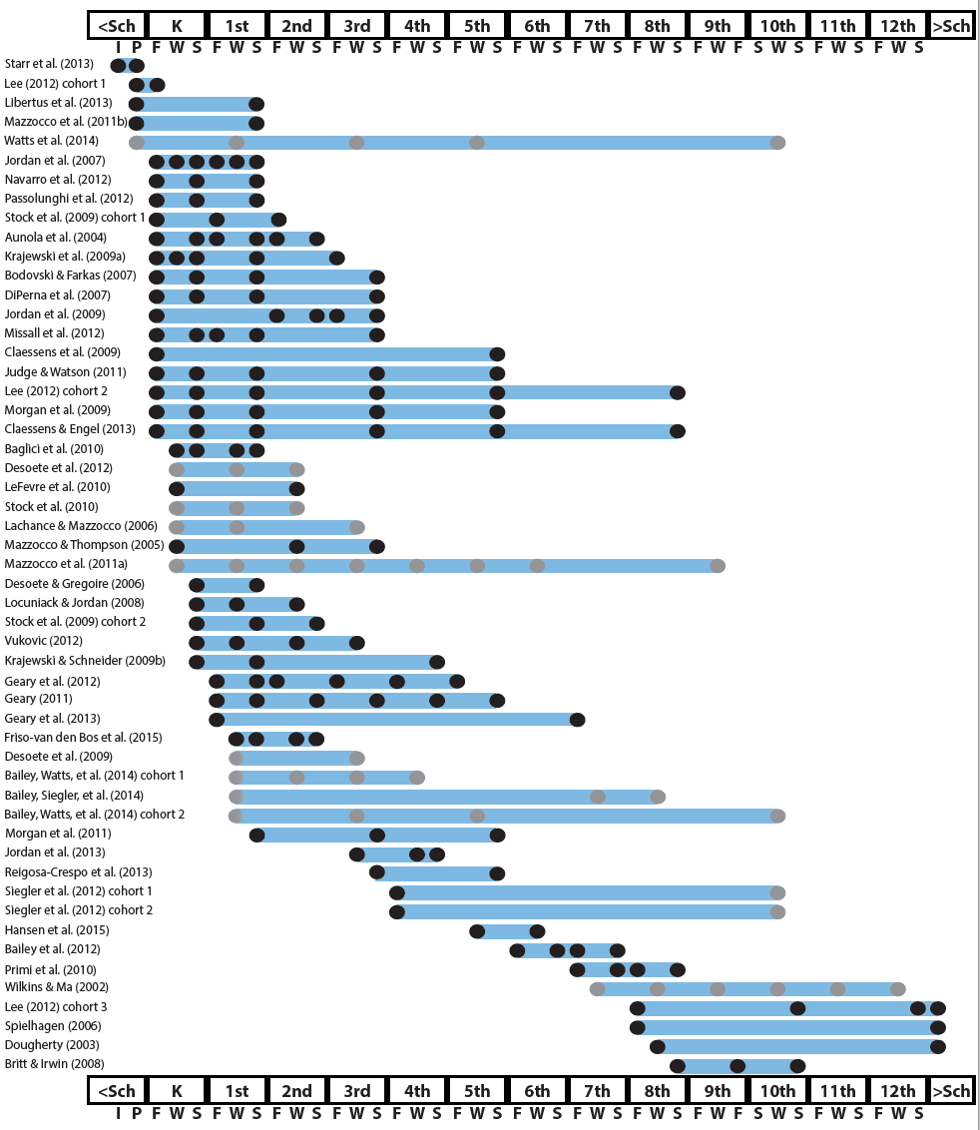
http://www.greatertexasfoundation.org/trajectories-of-mathematics-performance/

Slide 27
Broad math in preK predicted K broad math
Mathematics in preschool predicts later mathematics
http://www.greatertexasfoundation.org/trajectories-of-mathematics-performance/
Broad math in preK predicted grade 10 broad math

Slide 28
Counting in K predicted grade 1 broad math
Mathematics in kindergarten predicts later mathematics
http://www.greatertexasfoundation.org/trajectories-of-mathematics-performance/
Broad math in K predicted grade 8 broad math
K math accurately predicted math performance below 10th percentile in grades 2 and 3 with 84% correct classification

Slide 29
Mathematics in elementary school
predicts later mathematics
Addition influenced arithmetic with increasing importance from grades 1 to 5
http://www.greatertexasfoundation.org/trajectories-of-mathematics-performance/
Grade 1 arithmetic predicted arithmetic at grades 2, 3, and 4
Grade 1 broad math predicted broad math at grades 3, 5, and 10

Slide 30
Mathematics in middle school
predicts later mathematics
Counting and comparison in grades 2 or 4 predicted broad math 1 year later
http://www.greatertexasfoundation.org/trajectories-of-mathematics-performance/
Fractions at 10-12 years old predicted broad math 5 years later
Broad math in grade 7 predicted broad math in grade 8

Slide 31
Broad math in grade 8 predicted completion of 4-year college degree
Mathematics in
high school
predicts later outcomes
http://www.greatertexasfoundation.org/trajectories-of-mathematics-performance/
Students who took algebra in grades 8 took more advanced math courses and enrolled in 4-year colleges more often than students who took algebra in grade 9
Numeracy measured in adolescence impacted hourly earnings 7 to 15 years later

Slide 32
Mathematics in preschool predicts later mathematics
Mathematics in kindergarten predicts later mathematics
http://www.greatertexasfoundation.org/trajectories-of-mathematics-performance/
Mathematics in elementary school
predicts later mathematics
Mathematics in middle school
predicts later mathematics
Mathematics in
high school
predicts later outcomes

Slide 33
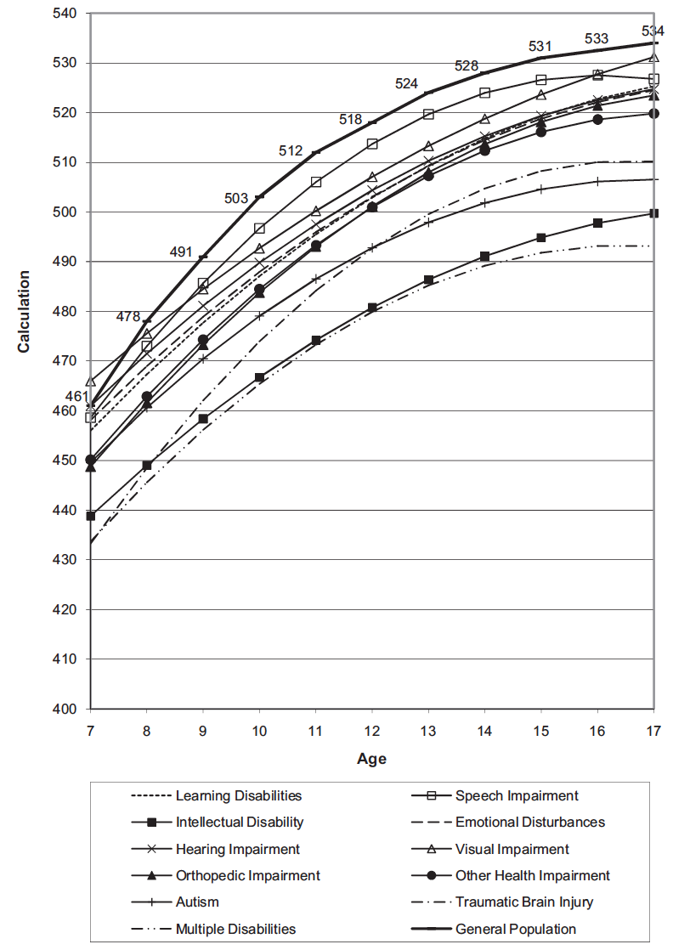
Wei, Lenz, & Blackorby (2013)

Slide 34
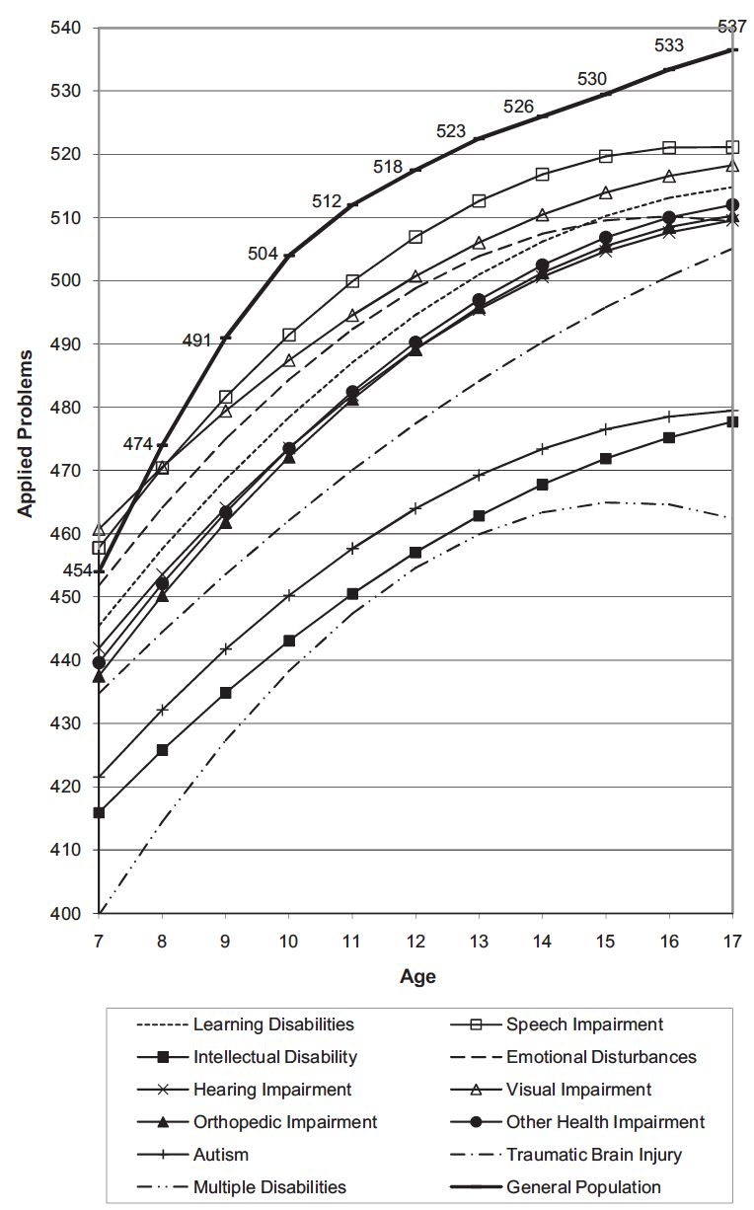
Wei, Lenz, & Blackorby (2013)

Slide 35
How would you convince your school of the need for providing services to at-risk students?
How would you convince caregivers of the need to provide services for their children?

Slide 36
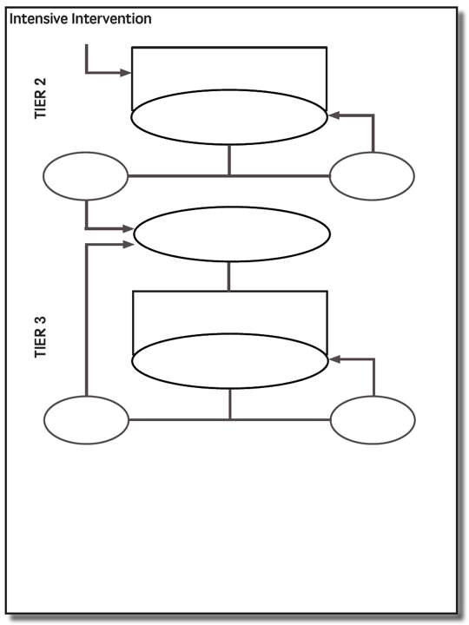

Slide 37
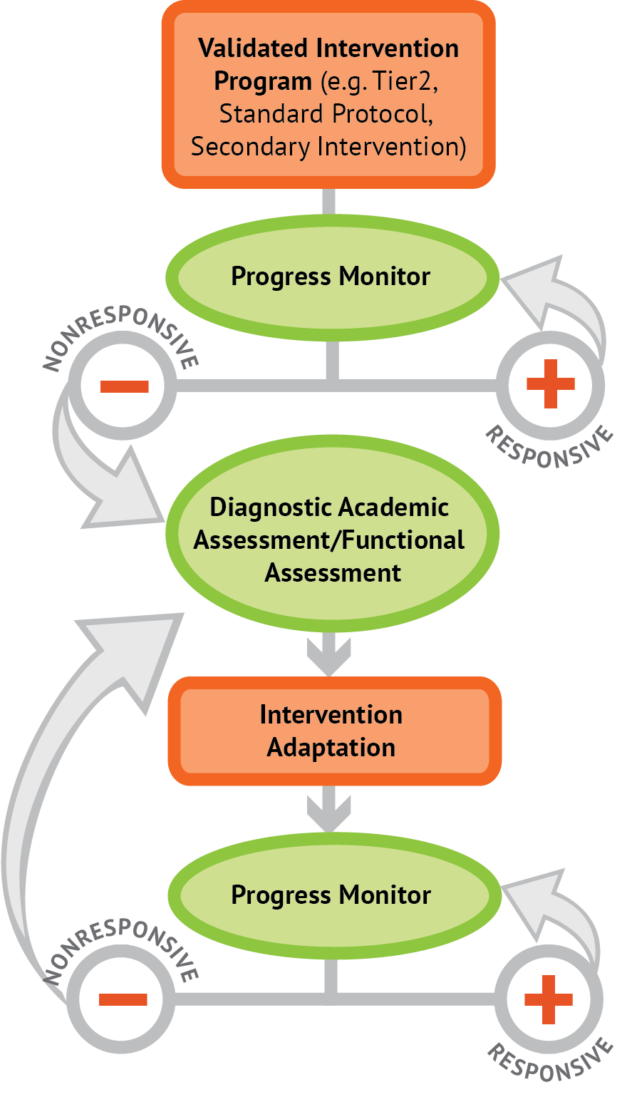
Intervention: Occurs frequently and with intensity
Assessment: Formative
Assessment: Diagnostic
Intervention adaptation: Content, dosage, explicit instruction, attention to transfer
Assessment: Formative

Slide 38
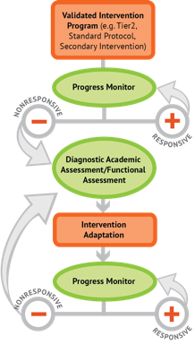
Where student IS
Where student NEEDS TO BE

Slide 39
Fluency

Slide 40
Fluently add and subtract within 5.
continuum of mathematics learning

Slide 41
Fluently add and subtract within 5.
Add and subtract within 20, demonstrating fluency for addition and subtraction within 10.

Slide 42
Fluently add and subtract within 5.
Add and subtract within 20, demonstrating fluency for addition and subtraction within 10.
Fluently add and subtract within 100 using strategies based on place value, properties of operations, and/or relationships.
continuum of mathematics learning

Slide 43
Fluently add and subtract within 5.
Add and subtract within 20, demonstrating fluency for addition and subtraction within 10.
Fluently add and subtract within 100 using strategies based on place value, properties of operations, and/or relationships.
Fluently multiply and divide within 100, using strategies such as the relationship between multiplication and division…

Slide 44
Fluently add and subtract within 5.
Add and subtract within 20, demonstrating fluency for addition and subtraction within 10.
Fluently add and subtract within 100 using strategies based on place value, properties of operations, and/or relationships.
Fluently multiply and divide within 100, using strategies such as the relationship between multiplication and division…
Fluently add and subtract multi-digit whole numbers using the standard algorithm.

Slide 45
Fluently add and subtract within 5.
Add and subtract within 20, demonstrating fluency for addition and subtraction within 10.
Fluently add and subtract within 100 using strategies based on place value, properties of operations, and/or relationships.
Fluently multiply and divide within 100, using strategies such as the relationship between multiplication and division…
Fluently add and subtract multi-digit whole numbers using the standard algorithm.
Fluently multiply multi-digit whole numbers using the standard algorithm.
continuum of mathematics learning

Slide 46
Fluently add and subtract within 5.
Add and subtract within 20, demonstrating fluency for addition and subtraction within 10.
Fluently add and subtract within 100 using strategies based on place value, properties of operations, and/or relationships.
Fluently multiply and divide within 100, using strategies such as the relationship between multiplication and division…
Fluently add and subtract multi-digit whole numbers using the standard algorithm.
Fluently multiply multi-digit whole numbers using the standard algorithm.
Fluently add, subtract, multiply, and divide multi-digit decimals using the standard algorithm.

Slide 47
Where student NEEDS TO BE
Fluently add and subtract within 5.
Add and subtract within 20, demonstrating fluency for addition and subtraction within 10.
Fluently add and subtract within 100 using strategies based on place value, properties of operations, and/or relationships.
Fluently multiply and divide within 100, using strategies such as the relationship between multiplication and division…
Fluently add and subtract multi-digit whole numbers using the standard algorithm.
Fluently multiply multi-digit whole numbers using the standard algorithm.
Fluently add, subtract, multiply, and divide multi-digit decimals using the standard algorithm.
continuum of mathematics learning

Slide 48
Where student IS
Where student NEEDS TO BE
Fluently add and subtract within 5.
Add and subtract within 20, demonstrating fluency for addition and subtraction within 10.
Fluently add and subtract within 100 using strategies based on place value, properties of operations, and/or relationships.
Fluently multiply and divide within 100, using strategies such as the relationship between multiplication and division…
Fluently add and subtract multi-digit whole numbers using the standard algorithm.
Fluently multiply multi-digit whole numbers using the standard algorithm.
Fluently add, subtract, multiply, and divide multi-digit decimals using the standard algorithm.
continuum of mathematics learning

Slide 49
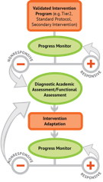
Where student IS
Where student NEEDS TO BE
Fluently add and subtract within 5.
Add and subtract within 20, demonstrating fluency for addition and subtraction within 10.
Fluently add and subtract within 100 using strategies based on place value, properties of operations, and/or relationships.
Fluently multiply and divide within 100, using strategies such as the relationship between multiplication and division…
Fluently add and subtract multi-digit whole numbers using the standard algorithm.
Fluently multiply multi-digit whole numbers using the standard algorithm.
Fluently add, subtract, multiply, and divide multi-digit decimals using the standard algorithm.
continuum of mathematics learning

Slide 50
Place Value
continuum of mathematics learning

Slide 51
Compose and decompose numbers from 11 to 19 into ten ones and some further ones…
Recognize that in a multi-digit number, a digit in one place represents 10 times as much as it represents in the place to its right and 1/10 of what it represents in the place to its left.
Use place value understanding to round whole numbers to the nearest 10 or 100.
Recognize that in a multi-digit number, a digit in one place represents ten times what it represents in the place to its right…
Understand that the two digits of a two-digit number represent amounts of tens and ones.
Understand that the three digits of a three-digit number represent amounts of hundreds, tens, and ones.

Slide 52
Compose and decompose numbers from 11 to 19 into ten ones and some further ones…
continuum of mathematics learning

Slide 53
Compose and decompose numbers from 11 to 19 into ten ones and some further ones…
Understand that the two digits of a two-digit number represent amounts of tens and ones.

Slide 54
Compose and decompose numbers from 11 to 19 into ten ones and some further ones…
Understand that the two digits of a two-digit number represent amounts of tens and ones.
Understand that the three digits of a three-digit number represent amounts of hundreds, tens, and ones.

Slide 55
Compose and decompose numbers from 11 to 19 into ten ones and some further ones…
Understand that the two digits of a two-digit number represent amounts of tens and ones.
Understand that the three digits of a three-digit number represent amounts of hundreds, tens, and ones.
Use place value understanding to round whole numbers to the nearest 10 or 100.

Slide 56
Compose and decompose numbers from 11 to 19 into ten ones and some further ones…
Understand that the two digits of a two-digit number represent amounts of tens and ones.
Understand that the three digits of a three-digit number represent amounts of hundreds, tens, and ones.
Use place value understanding to round whole numbers to the nearest 10 or 100.
Recognize that in a multi-digit number, a digit in one place represents ten times what it represents in the place to its right…

Slide 57
Compose and decompose numbers from 11 to 19 into ten ones and some further ones…
Understand that the two digits of a two-digit number represent amounts of tens and ones.
Understand that the three digits of a three-digit number represent amounts of hundreds, tens, and ones.
Use place value understanding to round whole numbers to the nearest 10 or 100.
Recognize that in a multi-digit number, a digit in one place represents ten times what it represents in the place to its right…
Recognize that in a multi-digit number, a digit in one place represents 10 times as much as it represents in the place to its right and 1/10 of what it represents in the place to its left.

Slide 58
Problem Solving
continuum of mathematics learning

Slide 59
Interpret and compute quotients of fractions, and solve word problems involving division of fractions by fractions…
Solve word problems that call for addition of three whole numbers whose sum is less than or equal to 20…
Solve real-world and mathematical problems involving the four operations with rational numbers.
Use addition and subtraction within 100 to solve one- and two-step word problems…
Use multiplication and division within 100 to solve word problems…
Solve real-world and mathematical problems leading to two linear equations in two variables.
Solve addition and subtraction word problems, and add and subtract within 10…
Solve multi-step word problems posed with whole numbers and having whole-number answers using the four operations…
Solve word problems involving addition and subtraction of fractions referring to the same whole, including cases of unlike denominators…

Slide 60
Solve addition and subtraction word problems, and add and subtract within 10…
Solve word problems that call for addition of three whole numbers whose sum is less than or equal to 20…
Use addition and subtraction within 100 to solve one- and two-step word problems…
Use multiplication and division within 100 to solve word problems…
Solve multi-step word problems posed with whole numbers and having whole-number answers using the four operations…
Solve word problems involving addition and subtraction of fractions referring to the same whole, including cases of unlike denominators…
Interpret and compute quotients of fractions, and solve word problems involving division of fractions by fractions…
Solve real-world and mathematical problems involving the four operations with rational numbers.
Solve real-world and mathematical problems leading to two linear equations in two variables.

Slide 61
Where student IS
Where student NEEDS TO BE
Solve addition and subtraction word problems, and add and subtract within 10…
Solve word problems that call for addition of three whole numbers whose sum is less than or equal to 20…
Use addition and subtraction within 100 to solve one- and two-step word problems…
Use multiplication and division within 100 to solve word problems…
Solve multi-step word problems posed with whole numbers and having whole-number answers using the four operations…
Solve word problems involving addition and subtraction of fractions referring to the same whole, including cases of unlike denominators…
Interpret and compute quotients of fractions, and solve word problems involving division of fractions by fractions…
Solve real-world and mathematical problems involving the four operations with rational numbers.
Solve real-world and mathematical problems leading to two linear equations in two variables.

Slide 62
Where student IS
Where student NEEDS TO BE
Use addition and subtraction within 100 to solve one- and two-step word problems…
Use multiplication and division within 100 to solve word problems…
Solve multi-step word problems posed with whole numbers and having whole-number answers using the four operations…
continuum of mathematics learning

Slide 63
Where student IS
Where student NEEDS TO BE
Explain why addition and subtraction strategies work, using place value and the properties of operations.
Understand that the two digits of a two-digit number represent amounts of tens and ones.
Use addition and subtraction within 100 to solve one- and two-step word problems…
Fluently add and subtract within 100 using strategies based on place value, properties of operations, and/or relationships.
Apply properties of operations as strategies to multiply and divide….
Fluently multiply and divide within 100, using strategies such as the relationship between multiplication and division…
Use multiplication and division within 100 to solve word problems…
Fluently add and subtract multi-digit whole numbers using the standard algorithm.
Find whole number quotients and remainders with up to four-digit dividends and one-digit divisors, using strategies based on place value, the properties of operations, and/or the relationship between multiplication and division.
Solve multi-step word problems posed with whole numbers and having whole-number answers using the four operations…
Understand that the three digits of a three-digit number represent amounts of hundreds, tens, and ones.
Fluently multiply multi-digit whole numbers using the standard algorithm.
continuum of mathematics learning

Slide 64
https://achievethecore.org/category/774/mathematics-focus-by-grade-level

Slide 65
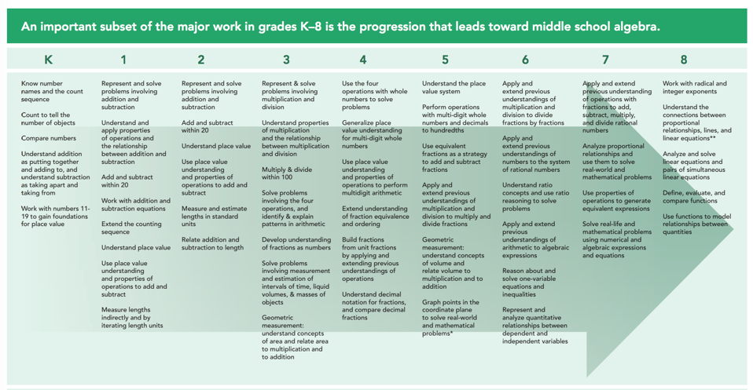
https://achievethecore.org/category/774/mathematics-focus-by-grade-level

Slide 66
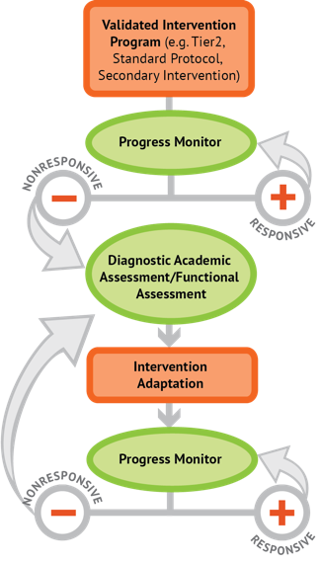
Instructional Platform
INSTRUCTIONAL DELIVERY
Explicit instruction
Multiple representations
Precise language
INSTRUCTIONAL STRATEGIES
Fluency building
Problem solving instruction
Motivation component

Slide 68
Explicit Instruction
Modeling
Practice
Clear Explanation
Guided
Practice
Planned
Examples
Independent Practice
Supporting Practices
Asking the right questions
Eliciting frequent responses
Providing immediate specific feedback
Maintaining a brisk pace

Slide 69
Goal and importance
“Today, we are learning about division. This is important because sometimes you have to share objects or things with your friends.”
Modeling
Practice
Clear Explanation
Guided
Practice
We Do
Planned
Examples
Independent Practice
“Let’s continue working with our three-dimensional shapes and volume. Understanding volume and calculating volume helps with measuring capacity.”
You Do
Supporting Practices
Asking the right questions
Eliciting frequent responses
Providing immediate specific feedback
Maintaining a brisk pace
Copyright 2018 Sarah R. Powell, Ph.D.

Slide 70
Goal and importance
Model steps
Modeling
Practice
Clear Explanation
Guided
Practice
“To solve 26 plus 79, I first decide about the operation. Do I add, subtract, multiply or divide?”
We Do
Planned
Examples
Independent Practice
“The plus sign tells me to add. So, I’ll add 26 plus 79. I’ll use the partial sums strategy. First, I add 20 plus 70. What’s 20 plus 70?”
You Do
Supporting Practices
“20 plus 70 is 90. I write 90 right here.”
Asking the right questions
Eliciting frequent responses
Providing immediate specific feedback
Maintaining a brisk pace
“Then I add 6 plus 7. What’s 6 plus 7?”
“6 plus 7 is 13. So, I write 13 here.”
“Finally, we add the partial sums: 90 and 13. 90 plus 13 is 103. So, 26 plus 79 equals 103.”
Copyright 2018 Sarah R. Powell, Ph.D.

Slide 71
Goal and importance
Model steps
Modeling
Practice
Clear Explanation
Concise language
Guided
Practice
We Do
Planned
Examples
Independent Practice
“To solve 26 plus 79, I first decide about the operation. Do I add, subtract, multiply, or divide?”
You Do
“The plus sign tells me to add. So, I’ll add 26 plus 79. I’ll use the partial sums strategy. First, I add 20 plus 70. What’s 20 plus 70?”
Supporting Practices
Asking the right questions
Eliciting frequent responses
Providing immediate specific feedback
Maintaining a brisk pace
“20 plus 70 is 90. I write 90 right here under the equal line.”
“Then I add 6 plus 7. What’s 6 plus 7?”
“6 plus 7 is 13. So, I write 13 here.”
“Finally, we add the partial sums: 90 and 13. 90 plus 13 is 103. So, 26 plus 79 equals 103.”
Copyright 2018 Sarah R. Powell, Ph.D.

Slide 72
Examples
“Today, we are learning about division. This is important because sometimes you have to share objects or things with your friends.”
Modeling
Practice
Clear Explanation
Guided
Practice
24 / 6
We Do
35 $)$ 5
28 $÷$ 7
Planned
Examples
Independent Practice
You Do
Supporting Practices
Asking the right questions
Eliciting frequent responses
Providing immediate specific feedback
Maintaining a brisk pace
Copyright 2018 Sarah R. Powell, Ph.D.

Slide 73
Examples
“Today, we are learning about division. This is important because sometimes you have to share objects or things with your friends.”
Modeling
Practice
Clear Explanation
Guided
Practice
24 / 6
We Do
35 $)$ 5
28 $÷$ 7
Planned
Examples
Independent Practice
You Do
With non-examples
Supporting Practices
Asking the right questions
Eliciting frequent responses
Providing immediate specific feedback
Maintaining a brisk pace
32 $÷$ 8
42 $÷$ 7
25 $−$ 5
Copyright 2018 Sarah R. Powell, Ph.D.

Slide 74
Modeling
Practice
Clear Explanation
Guided
Practice
Planned
Examples
Independent Practice
Supporting Practices
Asking the right questions
Eliciting frequent responses
Providing immediate specific feedback
Maintaining a brisk pace
Copyright 2018 Sarah R. Powell, Ph.D.

Slide 75
I Do
Modeling
Practice
Clear Explanation
Guided
Practice
Planned
Examples
Independent Practice
Supporting Practices
Asking the right questions
Eliciting frequent responses
Providing immediate specific feedback
Maintaining a brisk pace
Copyright 2018 Sarah R. Powell, Ph.D.

Slide 76
I Do
Modeling
Practice
Teacher and student practice together
Clear Explanation
Guided
Practice
Planned
Examples
Independent Practice
Supporting Practices
Asking the right questions
Eliciting frequent responses
Providing immediate specific feedback
Maintaining a brisk pace
Copyright 2018 Sarah R. Powell, Ph.D.

Slide 77
I Do
Modeling
Practice
Clear Explanation
Guided
Practice
Planned
Examples
Independent Practice
Student practices with teacher support
Supporting Practices
Asking the right questions
Eliciting frequent responses
Providing immediate specific feedback
Maintaining a brisk pace
Copyright 2018 Sarah R. Powell, Ph.D.

Slide 78
Modeling
Practice
Clear Explanation
Guided
Practice
Planned
Examples
Independent Practice
Supporting Practices
Asking the right questions
Eliciting frequent responses
Providing immediate specific feedback
Maintaining a brisk pace
Copyright 2018 Sarah R. Powell, Ph.D.

Slide 79
I Do
Modeling
Practice
Clear Explanation
Guided
Practice
We Do
Planned
Examples
Independent Practice
You Do
Supporting Practices
Asking the right questions
Eliciting frequent responses
Providing immediate specific feedback
Maintaining a brisk pace
Copyright 2018 Sarah R. Powell, Ph.D.

Slide 80
I Do
Modeling
Practice
Clear Explanation
Guided
Practice
Low-level and high-level
We Do
Planned
Examples
Independent Practice
You Do
“What is 7 times 9?”
“Which shape has 6 sides?”
“What do you do when you see a word problem?”
“Why do you have to regroup?”
“How would you solve this problem?”
“Why do you have to use zero pairs?”
Supporting Practices
Asking the right questions
Eliciting frequent responses
Providing immediate specific feedback
Maintaining a brisk pace
Copyright 2018 Sarah R. Powell, Ph.D.

Slide 81
I Do
Modeling
Practice
Clear Explanation
Guided
Practice
Low-level and high-level
We Do
Planned
Examples
Independent Practice
You Do
Classwide, individual, partner, write on paper, write on whiteboard, thumbs up, etc.
“Turn and discuss the formula for perimeter with your partner.”
“Write the multiplication problem on your whiteboard.”
Supporting Practices
Asking the right questions
Eliciting frequent responses
Providing immediate specific feedback
Maintaining a brisk pace
“In your math journal, draw a picture to help you remember to term parallelogram.”
Copyright 2018 Sarah R. Powell, Ph.D.

Slide 82
I Do
Modeling
Practice
Clear Explanation
Guided
Practice
Low-level and high-level
We Do
Planned
Examples
Independent Practice
You Do
Classwide, individual, partner, write on paper, write on whiteboard, thumbs up, etc.
Affirmative and corrective
Supporting Practices
“Good work using your word-problem attack strategy.”
Asking the right questions
Eliciting frequent responses
Providing immediate specific feedback
Maintaining a brisk pace
“Let’s look at that again. Tell me how you added in the hundreds column.”
Copyright 2018 Sarah R. Powell, Ph.D.

Slide 83
I Do
Modeling
Practice
Clear Explanation
Guided
Practice
Low-level and high-level
We Do
Planned
Examples
Independent Practice
You Do
Classwide, individual, partner, write on paper, write on whiteboard, thumbs up, etc.
Affirmative and corrective
Planned and organized
Supporting Practices
Asking the right questions
Eliciting frequent responses
Providing immediate specific feedback
Maintaining a brisk pace
Copyright 2018 Sarah R. Powell, Ph.D.

Slide 84
Modeling
Practice
Clear Explanation
Guided
Practice
Planned
Examples
Independent Practice
Supporting Practices
Asking the right questions
Eliciting frequent responses
Providing immediate specific feedback
Maintaining a brisk pace
Copyright 2018 Sarah R. Powell, Ph.D.

Slide 85
Modeling
Practice
Supporting Practices
Introduction of material
Review of material
Modeling
Practice
Modeling
Practice
Supporting Practices
Supporting Practices

Slide 86
How do you use explicit instruction within intensive intervention?
Model steps using concise language
Provide guided practice opportunities
Provide independent practice opportunities
Use supporting practices during modeling and practice
Ask the right questions
Elicit frequent responses
Provide feedback
Be planned and organized

Slide 87
Instructional Platform
INSTRUCTIONAL DELIVERY
Explicit instruction
Multiple representations
Precise language
INSTRUCTIONAL STRATEGIES
Fluency building
Problem solving instruction
Motivation component

Slide 89
Language of Mathematics
Technical terms
Subtechnical terms
Symbolic terms
General terms
trapezoid
rhombus
numerator
addend
subtract
base
degrees
cube
plane
arc
plus
zero
twelve
dollars
and
above
measure
answer
longest
outside

Slide 90
Instead of…
Say…
“And the last one is 10.”
“8, 9, 10. We’ll stop counting there but we could count more.”
“What number is in the tens place?”
“What digit is in the tens place?”
“Six hundred and forty-eight”
“Six hundred forty-eight”
“Bigger number and smaller number”
“Number that is greater and the number that is less”
Hughes et al. (2016)

Slide 91
Instead of…
Say…
“Numbers in the fraction”
“This fraction is one number.”
“Top number and bottom number”
“Numerator and denominator”
“Reduce”
“Find an equivalent fraction”
“One point two nine”
“One and twenty-nine hundredths”
Hughes et al. (2016)

Slide 92
Instead of…
Say…
“Corner”
“Angle”
“Flips, slides, and turns”
“Reflections, translations, and rotations”
“Box or ball
“Cube or sphere”
“Long hand and short hand”
“Minute hand and hour hand”
Hughes et al. (2016)

Slide 93
precise
“The denominator is the number of equal parts that make the whole.”
“A difference problem is two amounts compared for the difference.”
“To show the fraction, look at the denominator. A denominator of 5 means I need to break the whole into 5 equal parts.”
concise
“To use partial sums, add the hundreds, then add the tens, then add the ones. Finally, add all the partial sums.”

Slide 95
How do you attend to language within intensive intervention?
Understand why formal mathematical language is important
Plan for mathematical language to be precise
Plan for mathematical language to be concise

Slide 96
Instructional Platform
INSTRUCTIONAL DELIVERY
Explicit instruction
Multiple representations
Precise language
INSTRUCTIONAL STRATEGIES
Fluency building
Problem solving instruction
Motivation component

Slide 97
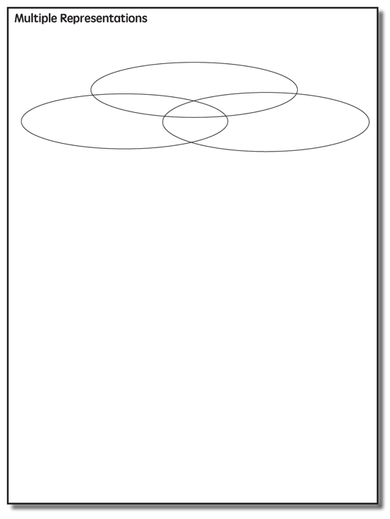

Slide 98
Multiple Representations
Abstract
Pictorial
Concrete

Slide 99
Abstract
Pictorial
Concrete
Three-dimensional objects

Slide 100
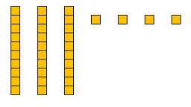
Abstract
Pictorial
Concrete
Two-dimensional images

Slide 101
Abstract
Pictorial
Concrete
Numerals and symbols
2 + 8 = 10
34 = 3 tens and 4 ones
x – 6 = 8
4,179
+ 569

Slide 102
How should multiple representations be used within intensive intervention?
Use three-dimensional concrete materials to teach concepts and procedures
Use two-dimensional representations to teach concepts and procedures
Ensure students understand mathematics with numbers and symbols (i.e., the abstract)

Slide 103
Some examples of Multiple Representations

Slide 104
Show 153.
Show 2,079.
Demonstrate regrouping with 4 hundreds, 13 tens, and 12 ones.
Explicit instruction
Multiple representations
Concise language

Slide 105
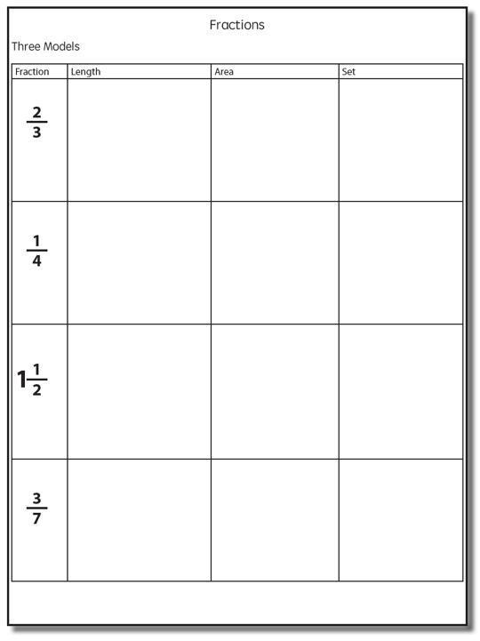

Slide 106
Fraction Models
Length
Area
Set

Slide 107
Length/Measurement
Fractions are appropriated by length
Fraction tiles/bars

Slide 108
Length/Measurement
Fractions are appropriated by length
Cuisenaire rods

Slide 109
Length/Measurement
Fractions are appropriated by length
Number line

Slide 110
Select a fraction and teach using the length model.
Explicit instruction
Multiple representations
Concise language

Slide 111
Area/Region
Shapes divided into equal sections
Fraction circles

Slide 112
Area/Region
Shapes divided into equal sections
Geoboards

Slide 113
Area/Region
Shapes divided into equal sections
Pattern blocks

Slide 114
Area/Region
Shapes divided into equal sections
Legos

Slide 115
Select a fraction and teach using the area model.
Explicit instruction
Multiple representations
Concise language

Slide 116
Set/Discrete
Individual shapes match the fraction
Two-color counters

Slide 117
Set/Discrete
Individual shapes match the fraction

Slide 118
Select a fraction and teach using the set model.
Explicit instruction
Multiple representations
Concise language

Slide 119
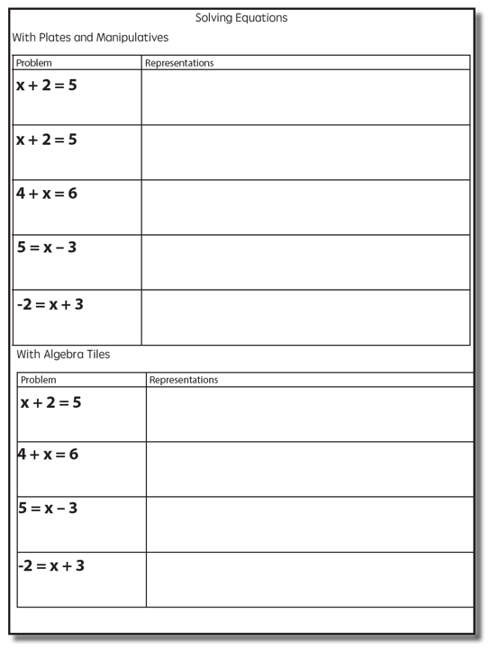
Solve with plates and manipulatives.
Solve with Algebra Tiles.
Explicit instruction
Multiple representations
Concise language

Slide 120
Instructional Platform
INSTRUCTIONAL DELIVERY
Explicit instruction
Multiple representations
Precise language
INSTRUCTIONAL STRATEGIES
Fluency building
Problem solving instruction
Motivation component

Slide 121
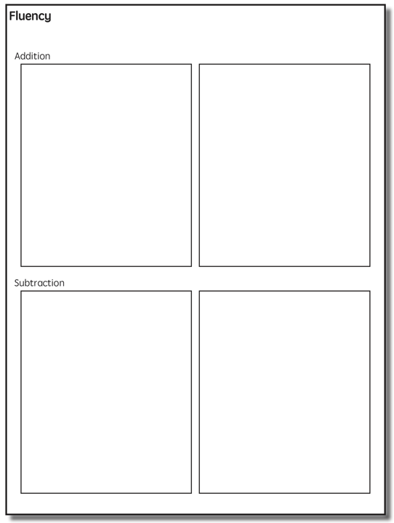

Slide 123
Addition Facts
100 addition basic facts
Single-digit addends sum to a single- or double-digit number
5 (addend)
+ 4 (addend)
9 (sum)

Slide 124
Addition: Part-Part-Whole (Total)
Count one set, count another set, put sets together, count sum
2 + 3 = 5

Slide 125
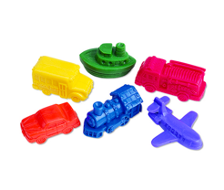
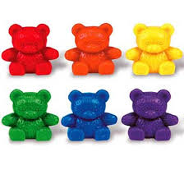
Addition: Part-Part-Whole (Total)
4 + 5 = __
3 + 7 = __
Teach this problem to a student.
Explicit instruction
Multiple representations
Concise language

Slide 126
Addition: Join (Change Increase)
Start with a set, add the other set, count sum
2 + 3 = 5

Slide 127
Addition: Join (Change Increase)
8 + 3 = __
5 + 6 = __
Teach this problem to a student.
Explicit instruction
Multiple representations
Concise language

Slide 128
Why is it important to understand addition in two separate ways?

Slide 129
Total
Parts put together into a total
Freddy saw 4 cardinals and 5 blue jays. How many birds did Freddy see?
4 + 5 = ?
Freddy saw 9 birds. If 4 of the birds were cardinals, how many were blue jays?
4 + ? = 9
Freddy saw 9 birds. 5 of the birds were blue jays, how many were cardinals?
5 + ? = 9

Slide 130
Change
An amount that increases or decreases
Lara had $4. Then she earned $3 for cleaning her room. How much money does Lara have now?
4 + 3 = ?
Lara has $4. Then she earned money for cleaning her room. Now Lara has $7. How much money did she earn?
4 + ? = 7
Lara had some money. Then she made $3 for cleaning her room. Now she has $7. How much money did Lara start with?
? + 3 = 7

Slide 131
Part-Part-Whole Versus Join
3 + 9 = __
7 + 4 = __
Determine a word problem for each schema.
Explicit instruction
Multiple representations
Concise language

Slide 133
Subtraction Facts
100 subtraction basic facts
Subtrahend and difference are single-digit numbers and minuend is single- or double-digit number
16 (minuend)
– 8 (subtrahend)
8 (difference)

Slide 134
Subtraction: Separate (Change Decrease)
Start with a set, take away from that set, count difference
5 – 3 = 2

Slide 135
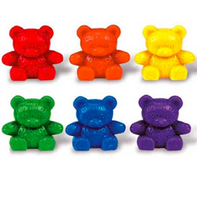
Subtraction: Separate (Change Decrease)
11 – 6 = __
13 – 7 = __
Teach this problem to a student.
Explicit instruction
Multiple representations
Concise language

Slide 136
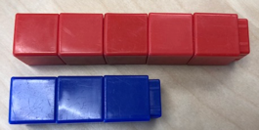
Subtraction: Compare (Difference)
Compare two sets, count difference
5 – 3 = 2

Slide 137
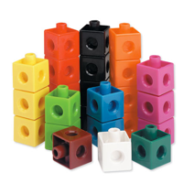
Subtraction: Compare (Difference)
10 – 7 = __
11 – 3 = __
Teach this problem to a student.
Explicit instruction
Multiple representations
Concise language

Slide 138
Why is it important to understand subtraction in two separate ways?

Slide 139
Difference
Greater and less amounts compared for a difference
Pedro has 9 apples. Silvia has 4 apples. How many more apples does Pedro have? (How many fewer does Silvia have?)
9 – 4 = ?
Pedro has 5 more apples than Silvia. If Silvia has 4 apples, how many does Pedro have?
? – 4 = 5
Silvia has 5 fewer apples than Pedro. Pedro has 9 apples. How many apples does Silvia have?
9 – ? = 5

Slide 140
Change
An amount that increases or decreases
Melissa had 9 cookies. Then she ate 2 of the cookies. How many cookies does Melissa have now?
9 – 2 = ?
Melissa had 9 cookies. She ate some of the cookies. Now, she has 7 cookies. How many cookies did Melissa eat?
9 – ? = 7
Melissa had some cookies. Then, she ate 2 of the cookies. Now she has 7 cookies left. How many cookies did Melissa have to start with?
? – 2 = 7

Slide 141
Separate Versus Compare
9 – 5 = __
8 – 3 = __
Determine a word problem for each schema.
Explicit instruction
Multiple representations
Concise language

Slide 143
Multiplication Facts
100 multiplication basic facts
Multiplication of single-digit factors results in a single- or double-digit product
2 (factor)
× 3 (factor)
6 (product)

Slide 144
Multiplication: Equal Groups
Show the groups, show the amount for each group, count product
3 × 2 = 6

Slide 145
Multiplication: Equal Groups
5 × 3 = __
2 × 5 = __
Teach this problem to a student.
Explicit instruction
Multiple representations
Concise language

Slide 146
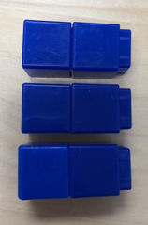
Multiplication: Array/Area
Make the array, count product
3 × 2 = 6

Slide 147
Multiplication: Array/Area
3 × 4 = __
2 × 5 = __
Teach this problem to a student.
Explicit instruction
Multiple representations
Concise language

Slide 148
Multiplication: Comparison
Show a set, then multiply the set
3 × 2 = 6

Slide 149
Multiplication: Comparison
6 × 3 = __
4 × 5 = __
Teach this problem to a student.
Explicit instruction
Multiple representations
Concise language

Slide 150
Why is it important to understand multiplication in different ways?

Slide 151
Equal Groups
Groups multiplied by number in each group for a product
Haley has 2 bags of apples. There are 6 apples in each bag. How many apples does Haley have altogether?
2 × 6 = ?
Haley has 12 apples. He wants to share them equally among his 2 friends. How many apples will each friend receive?
2 × ? = 12
Haley has 12 apples. He put them into bags containing 6 apples each. How many bags did Mark use?
? × 6 = 12

Slide 152
Comparison
Set multiplied by a number of times for a product
Beth picked 6 apples. Marcie picked 2 times as many apples as Beth. How many apples did Marcie pick?
6 × 2 = ?

Slide 154
Division Facts
90 division basic facts
Divisor and quotient are single-digit numbers and dividend is single- or double-digit number
8 ÷ 4 = 2
(dividend) (divisor) (quotient)

Slide 155
Division: Equal Groups (Partitive Division)
Show the dividend, divide equally among divisor, count quotient
6 ÷ 3 = 2

Slide 156
Division: Partitive Division
12 ÷ 4 = __
15 ÷ 3 = __
Teach this problem to a student.
Explicit instruction
Multiple representations
Concise language

Slide 157
Division: Equal Groups (Measurement Division)
Show the dividend, make groups of the divisor, count groups
6 ÷ 3 = 2

Slide 158
Division: Measurement Division
10 ÷ 5 = __
9 ÷ 3 = __
Teach this problem to a student.
Explicit instruction
Multiple representations
Concise language

Slide 159
Why is it important to understand division in different ways?

Slide 160
Equal Groups
Groups multiplied by number in each group for a product
Haley has 2 bags of apples. There are 6 apples in each bag. How many apples does Haley have altogether?
2 × 6 = ?
Haley has 12 apples. He wants to share them equally among his 2 friends. How many apples will each friend receive?
2 × ? = 12
Haley has 12 apples. He put them into bags containing 6 apples each. How many bags did Mark use?
? × 6 = 12

Slide 161
Instructional Platform
INSTRUCTIONAL DELIVERY
Explicit instruction
Multiple representations
Precise language
INSTRUCTIONAL STRATEGIES
Fluency building
Problem solving instruction
Motivation component

Slide 162
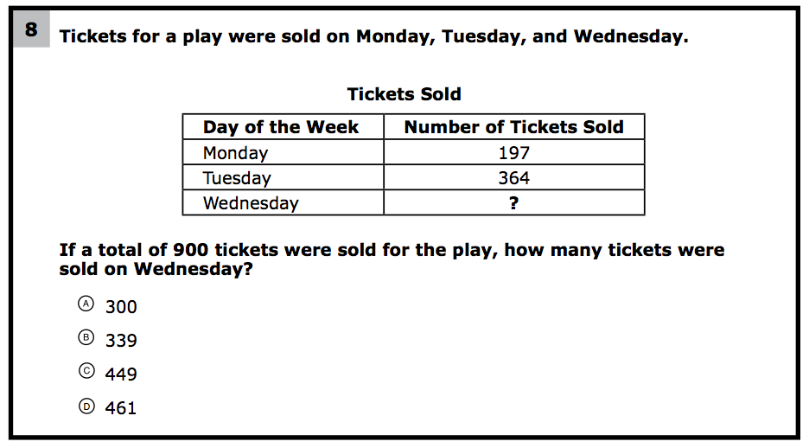
How would you teach this problem?
What do students need to know to solve this problem?
What might cause difficulty for students?

Slide 163
Problem Solving Difficulties
Reading problems
Understanding vocabulary
Identifying relevant information
Ignoring irrelevant information
Interpreting charts and graphs
Identifying appropriate operation(s)
Performing the computation(s)

Slide 164
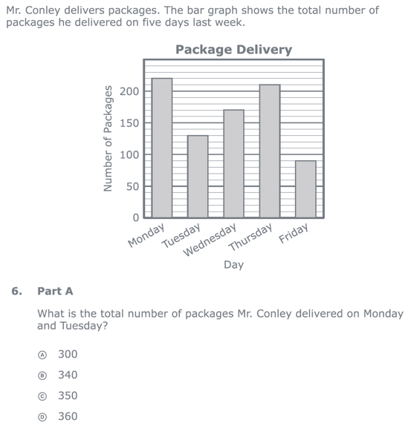
Reading problems
Understanding vocabulary
Identifying relevant information
Ignoring irrelevant information
Interpreting charts and graphs
PARCC third-grade release item (2015)
Identifying appropriate operation(s)
Performing the computation(s)

Slide 166
Don’t tie key words to operations
Teach word-problem schemas
Have an attack strategy

Slide 167
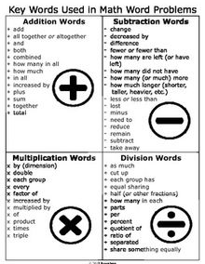
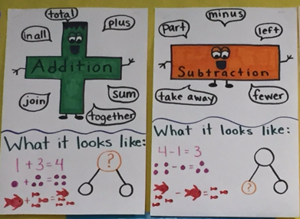

Slide 168
Kasey made $42, and Mandy made $37. How much money did they make in all?
Kasey and Mandy made $79 in all. If Kasey made $42, how much money did Mandy make?
Becky has $70 more than Perla. If Becky has $120, how much money does Perla have?
Becky has $70 more than Perla. If Perla has $50, how much money does Becky have?

Slide 169
Matt baked 18 cookies. His brother baked twice as many. How many cookies did his brother bake?
Matt’s brother baked twice as many cookies as Matt. If Matt’s brother baked 36 cookies, how many did Matt bake?
Rachel wants to share 36 brownies with 6 friends. How many cookies will each friend receive?
Rachel shared brownies with 6 friends. Each friend ate 6 brownies. How many brownies did Rachel have to start with?

Slide 170
Michelle made 17 paper airplanes. Dante made 24 paper airplanes. How many airplanes did they make altogether?
Michelle and Dante made 41 paper airplanes altogether. If Dante made 24 paper airplanes, how many did Michelle make?
Michelle made 4 paper airplanes using 2 pieces of paper for each airplane. How much paper did Michelle use altogether?
Dante and Michelle made 40 paper airplanes altogether. Dante made 24 of the paper airplanes. If Michelle gave 7 of her paper airplanes to her friend Nicole, how many planes does Michelle have now?

Slide 171
Students need to understand key words. But, key words should not be directly tied to operations.

Slide 172
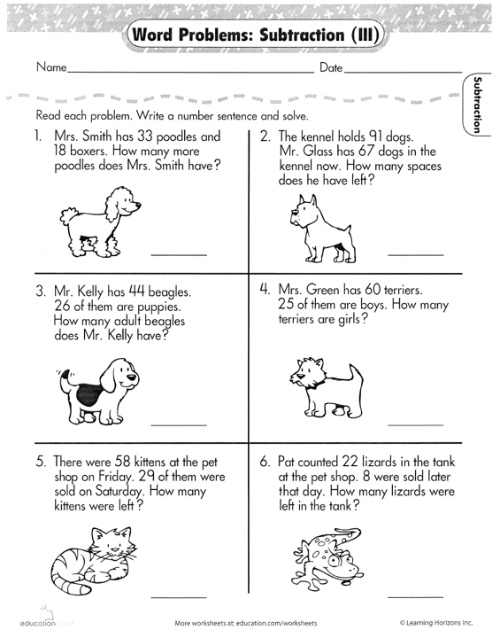

Slide 173
Identify a key word. Write a problem where the key word “works.” Write a problem where the key word doesn’t ”work.”

Slide 174
Don’t tie key words to operations
Teach word-problem schemas
Have an attack strategy

Slide 175
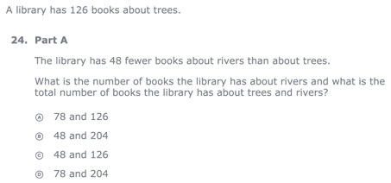
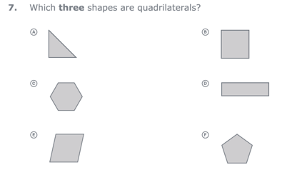
For every word problem
Regardless of problem type, students need an attack strategy for working through the problem
This strategy should work for any problem type
Routine Word Problems
Instructional Word Problems

Slide 176
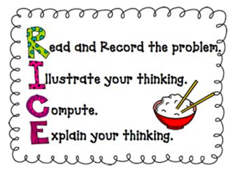
RIDGES
Read the problem.
I know statement.
Draw a picture.
Goal statement.
Equation development.
Solve the equation.
RIDE
Read the problem.
Identify the relevant information.
Determine the operation and unit for the answer.
Enter the correct numbers and calculate, then check the answer.

Slide 177
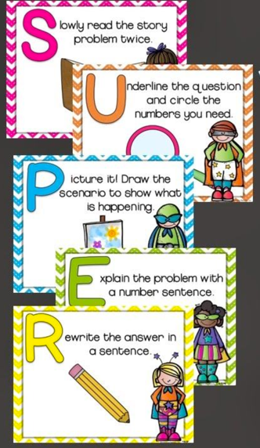

Slide 178
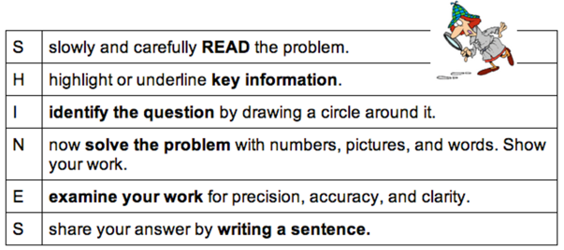
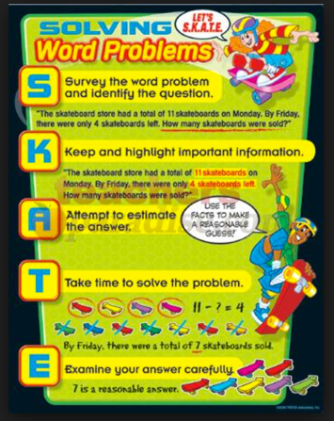
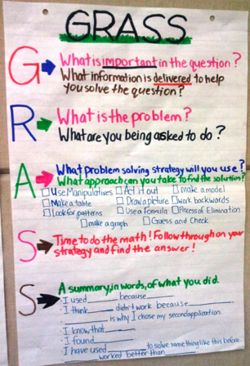

Slide 179
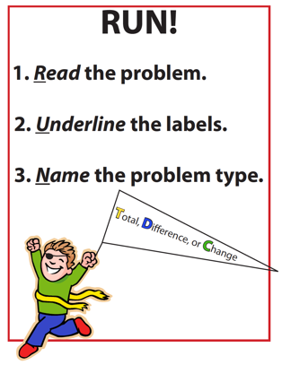
SIGNS
Survey questions
Identify key words
Graphically draw problem
Note operations
Solve and check
SOLVE
Study the problem.
Organize the facts.
Line up the plan.
Verify the plan with computation.
Examine the answer.

Slide 180
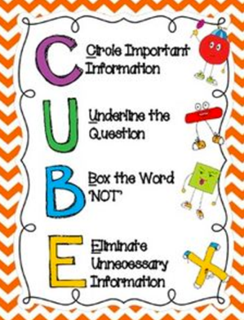
R-CUBES
Read the problem.
Circle key numbers.
Underline the question.
Box action words.
Evaluate steps.
Solve and check.

Slide 181
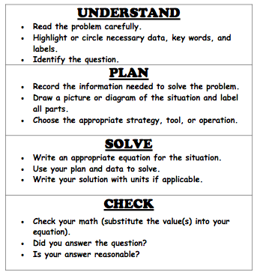

Slide 182
Don’t tie key words to operations
Teach word-problem schemas
Have an attack strategy

Slide 183
Additive Schemas

Slide 184
Instruction Using Schemas
A schema refers to the structure of the word problem
Total
Difference
Change

Slide 185
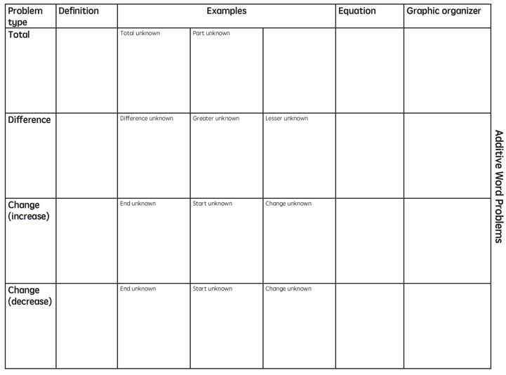

Slide 186
Total
Parts put together into a total
Jennifer saw 4 cardinals and 5 blue jays. How many birds did Jennifer see?
4 + 5 = ?
Jennifer saw 9 birds. If 4 of the birds were cardinals, how many were blue jays?
4 + ? = 9
Jennifer saw 9 birds. 5 of the birds were blue jays, how many were cardinals?
5 + ? = 9

Slide 187
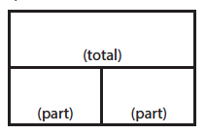
Total
P1 + P2 = T
Fuchs et al. (2008); Griffin & Jitendra (2009)

Slide 188
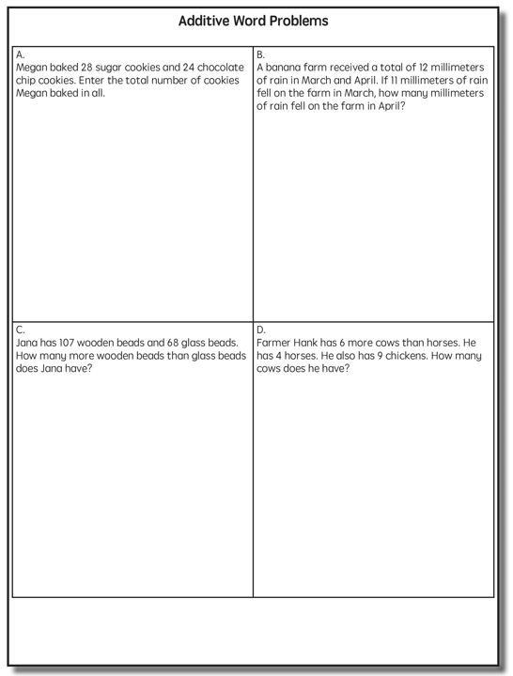
Total

Slide 189
Total
✔
✔
✔
P1 + P2 = T
U
P
S
✔
✔
28
+
24
=
?
✔
✔
28 + 24 = 52
X = 52 cookies
Grade 3 Smarter Balanced

Slide 190
Total
“Are parts put together for a total?”

Slide 191
Total
✔
✔
12
11
+ 1
12
12
- 11
1
✔
U
P
S
✔
✔
11
?
✔
✔
? = 1 millimeter
Grade 2 IXL

Slide 193
Difference
Greater and less amounts compared for a difference
Courtney has 9 apples. Silva has 4 apples. How many more apples does Courtney have? (How many fewer?)
9 – 4 = ?
Courtney has 5 more apples than Silva. If Silva has 4 apples, how many does Courtney have?
? – 4 = 5
Silva has 5 fewer apples than Courtney. Courtney has 9 apples. How many apples does Silva have?
9 – ? = 5

Slide 194
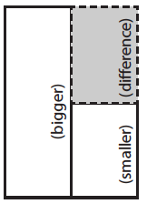
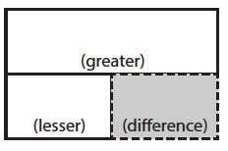
Difference
G – L = D
Fuchs et al. (2008); Griffin & Jitendra (2009)

Slide 195
Difference

Slide 196
Difference
✔
✔
G – L = D
✔
U
P
S
✔
✔
107
-
68
=
B
107
68
68
+ ?
107
✔
✔
107 – 68 = 39
B = 39 more beads
Grade 3 Smarter Balanced

Slide 197
Total
“Are parts put together for a total?”
Difference
“Are amounts compared for a difference?”

Slide 198
Difference

Slide 200
Change
An amount that increases or decreases
Sandra had $4. Then she earned $3 for cleaning her room. How much money does Sandra have now?
4 + 3 = ?
Sandra has $4. Then she earned money for cleaning her room. Now Sandra has $7. How much money did she earn?
4 + ? = 7
Sandra had some money. Then she made $3 for cleaning her room. Now she has $7. How much money did Sandra start with?
? + 3 = 7

Slide 201
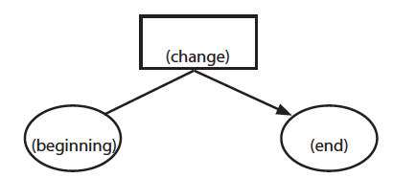
Change
ST +/– C = E
Fuchs et al. (2008); Griffin & Jitendra (2009)

Slide 202
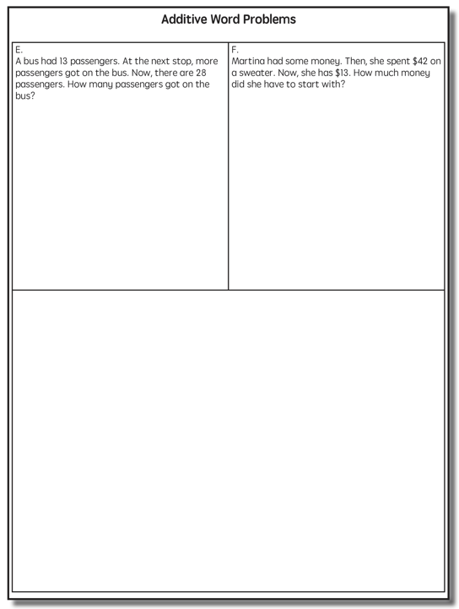
Change

Slide 203
Change
✔
A bus had 13 passengers. At the next stop, more passengers got on the bus. Now, there are 28 passengers. How many passengers got on the bus?
✔
✔
U
P
S
✔
ST + C = E
✔
13
+
?
=
28
✔
28
- 13
✔
13
+ ?
28
13 + 15 = 28
? = 15 passengers

Slide 204
Total
“Are parts put together for a total?”
Difference
“Are amounts compared for a difference?”
Change
“Does an amount increase or decrease?”

Slide 205
Change
An amount that increases or decreases
Yolanda baked 9 cookies. Then, she ate 2 of the cookies. How many cookies does Yolanda have now?
9 – 2 = ?
Yolanda baked 9 cookies. Then, she ate some of the cookies. Now, she has 7 cookies. How many cookies did Yolanda eat?
9 – ? = 7
Yolanda baked some cookies. She ate 2 of the cookies and has 7 cookies left. How many cookies did Yolanda bake?
? – 2 = 7

Slide 206
Change
ST +/– C = E
Fuchs et al. (2008); Griffin & Jitendra (2009)

Slide 207
Change

Slide 209
Total

Slide 210
Change

Slide 211
Difference

Slide 212
Total
P1 + P2 + P3 = T

Slide 213
Change
ST – C + C = E

Slide 214
Let’s Review
What’s a Total problem?
What’s a Difference problem?
What’s a Change problem?

Slide 215
Schema Quiz Time!

Slide 216
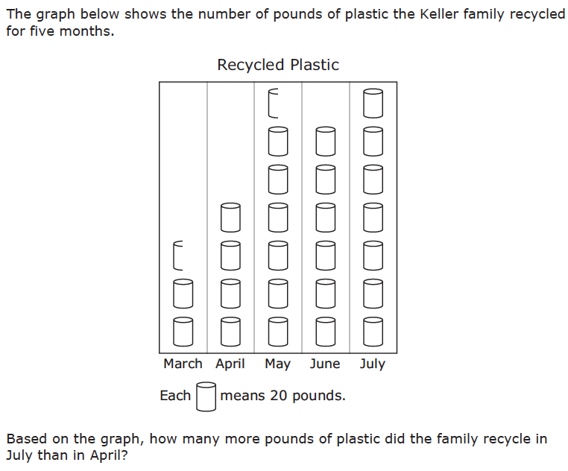
Difference
Grade 3 STAAR

Slide 217
Total
Grade 5 Smarter Balanced

Slide 218
Change
Grade 4 Smarted Balanced

Slide 219
Don’t describe using key words or operations
Teach word-problem schemas
Have an attack strategy

Slide 220
Multiplicative Schemas

Slide 221
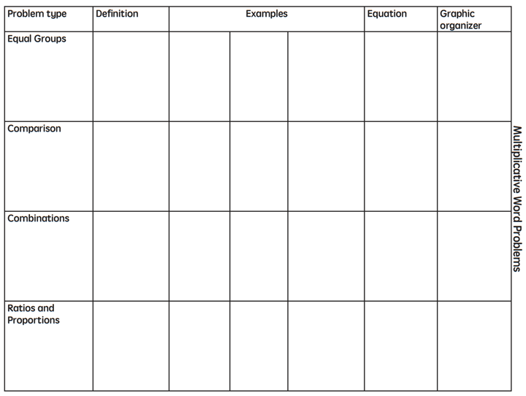

Slide 222
Equal Groups
Groups multiplied by number in each group for a product
Kristina has 2 bags of apples. There are 6 apples in each bag. How many apples does Kristina have altogether?
2 × 6 = ?
Kristina has 12 apples. She wants to share them equally among her 2 friends. How many apples will each friend receive?
2 × ? = 12
Kristina has 12 apples. She put them into bags containing 6 apples each. How many bags did Kristina use?
? × 6 = 12

Slide 223
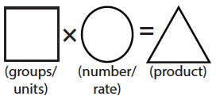
Equal Groups
G × N = P

Slide 224
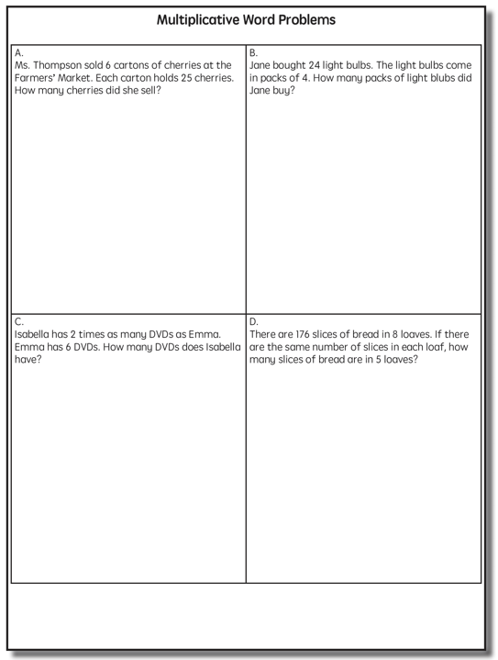

Slide 225
✔
✔
✔
G x N = P
U
P
S
✔
✔
x
=
6
25
?
✔
✔
6 x 25 = 150
? = 150 cherries

Slide 226
Equal Groups
“Are there groups with an equal number in each group?”

Slide 227
Equal Groups
✔
✔
✔
U
P
S
✔
✔
?
4
24
✔
✔
? x 4 = 24
4
4
Grade 3 STAAR
? = 6 packs

Slide 228
Comparison
Set multiplied by a number of times for a product
Marcie picked 6 apples. Lisa picked 2 times as many apples as Marcie. How many apples did Lisa pick?
6 × 2 = ?
Lisa picked 12 apples. She picked 2 times as many apples as Marcie. How many apples did Marcie pick?
? × 2 = 12
Lisa picked 12 apples, and Marcie picked 6 apples. How many times as many apples did Lisa pick as Marcie did?
6 × ? = 12

Slide 229
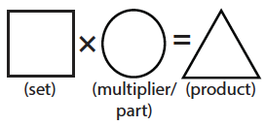
Comparison
S × T = P

Slide 231
Comparison
✔
U
P
S
✔
6
2
?
✔
✔
✔
Grade 4 Smarter Balanced
? = 12 DVDs

Slide 232
Equal Groups
“Are there groups with an equal number in each group?”
Comparison
“Is a set compared a number of times?”

Slide 233
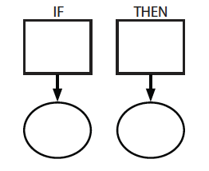
Ratios/Proportions
Description of relationships among quantities
Xin et al. (2005)

Slide 235
Ratios/Proportions
✔
✔
✔
✔
U
P
S
✔
✔
176
?
? = 110 slices
✔
✔
8
5

Slide 236
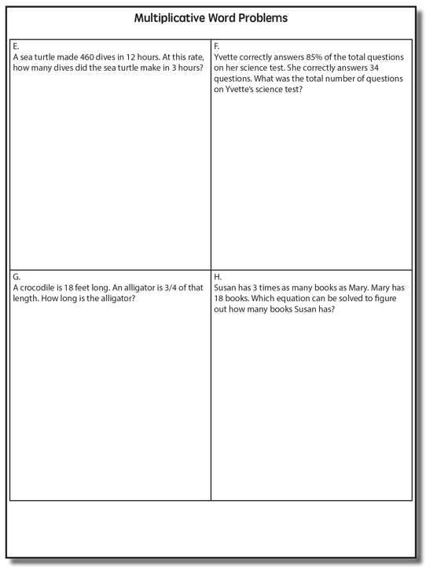

Slide 237
Ratios/Proportions

Slide 238
Equal Groups
“Are there groups with an equal number in each group?”
Comparison
“Is a set compared a number of times?”
Ratios/Proportions
“Are there relationships among quantities - if this, then this?”

Slide 240
Equal Groups

Slide 241
Ratios/Proportions

Slide 242
Comparison
Grade 4 Smarter Balanced

Slide 243
Let’s Review
What’s an Equal Groups problem?
What’s a Comparison problem?
What’s a Ratios/Proportions problem?

Slide 245
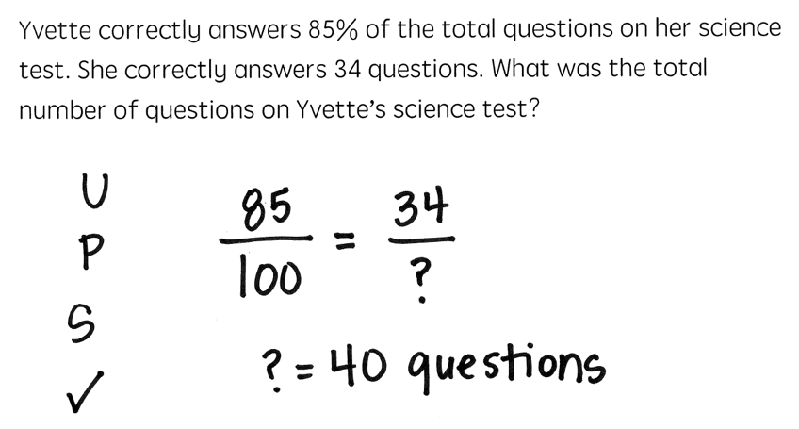

Slide 248
Schema Quiz Time!

Slide 249
Ratios/Proportions
Grade 6 Smarter Balanced

Slide 250
Equal Groups
Grade 4 PARCC

Slide 251
Comparison
Grade 4 Smarter Balanced

Slide 256
Schemas
Total
Difference
Change
Equal Groups
Comparison
Ratios/Proportions

Slide 257
Don’t describe using key words or operations
Teach word-problem schemas
Have an attack strategy

Slide 258
How do you incorporate effective problem-solving strategies within intensive intervention?
Don’t use key words tied to operations
Do teach students an attack strategy
Do teach students schemas
Do explicitly teach problem solving
Do provide problem-solving instruction regularly (i.e., several times a week)
Do practice schemas that students will encounter regularly

Slide 259
Instructional Platform
INSTRUCTIONAL DELIVERY
Explicit instruction
Multiple representations
Concise language
INSTRUCTIONAL STRATEGIES
Fluency building
Problem solving instruction
Motivation component

Slide 260
Motivation Component
on task
keep attention
regulate behavior

Slide 261
How do you incorporate a motivational component within intensive intervention?
Utilize a motivational component, when necessary

Slide 262
Instructional Platform
INSTRUCTIONAL DELIVERY
Explicit instruction
Multiple representations
Concise language
INSTRUCTIONAL STRATEGIES
Fluency building
Problem solving instruction
Motivation component

Slide 263
Resource

Slide 264
Contact Information
Sarah Powell, Ph.D.
The University of Texas at Austin
srpowell@austin.utexas.edu
@sarahpowellphd
119

Slide 265
https://redcap.prc.utexas.edu/redcap/surveys/?s=N3M4MMN44A

