Slide 1

Inchworm Micro Motor
Souvik Dubey
10th May 2016
UTA

Slide 2
Motivation
Most of the great inventions were inspired by nature.
There are multiple complex micro actuation mechanism present in nature.
Actuation in micro robots are extremely challenging since they have very limited budget.
Flagellum motions are one of the efficient micro actuation technique highly used in nature. It is very common bacterial motion its also can be seen in sperm cell actuation.

Slide 3
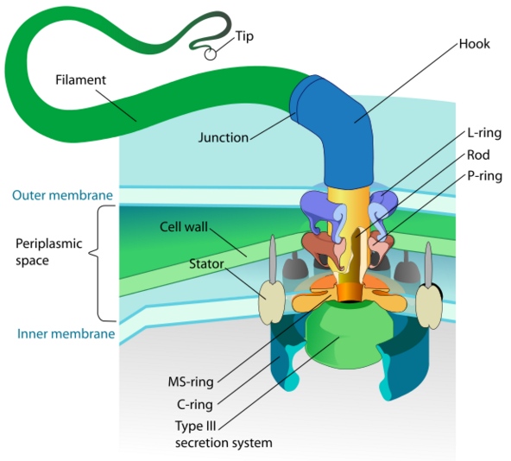

Flagellum Motion
Picture taken from Wikipedia: https://en.wikipedia.org/wiki/Flagellum#/media/File:Flagellum_base_diagram_en.svg
Source: www.youtube.com

Slide 4
Process Selection
Since we are already given POLYMUMPS process and we have only 3 poly layers this design is way complicated, so simplification required.
The circular motion in flagellum is achieved due to periodic change in ion concentration.
Switched to Inchworm mechanism to achieve circular motion and idea is to get similar locomotion using the tail.

Slide 5
Inchworm

Slide 6
Inchworm

Slide 7
Inchworm

Slide 8
Inchworm

Slide 9
Inchworm

Slide 10
Inchworm

Slide 11
Inchworm

Slide 12
Inchworm

Slide 13
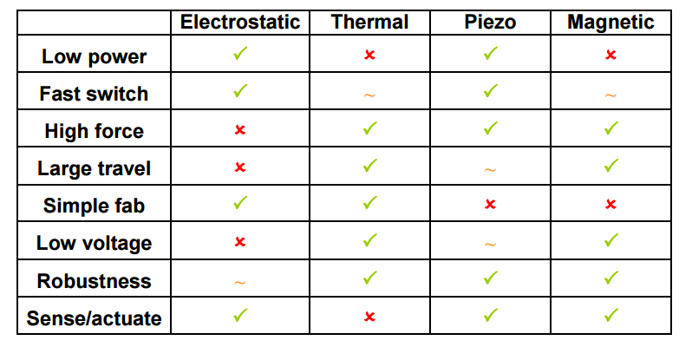
Actuation Selection
Reference: Carol Livermore, course materials for 6.777J / 2.372J Design and Fabrication of Microelectromechanical Devices, Spring 2007. MIT OpenCourseWare (http://ocw.mit.edu/), Massachusetts Institute of Technology.

Slide 14
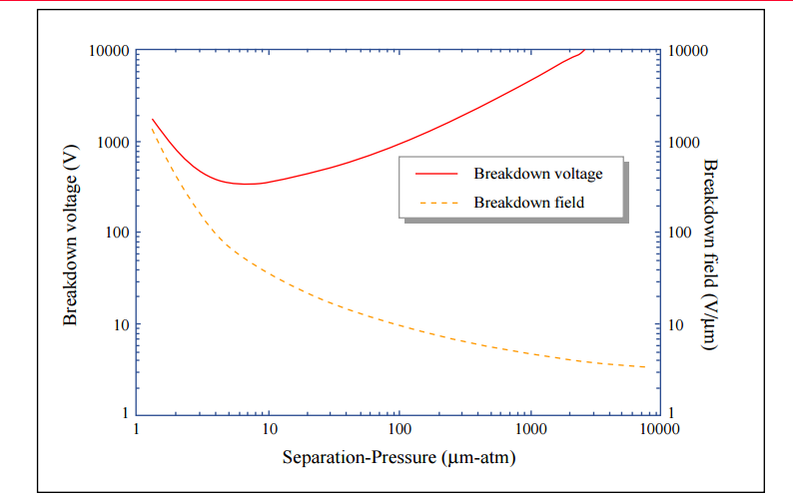
Electro Static Actuation
Reference: Carol Livermore, course materials for 6.777J / 2.372J Design and Fabrication of Microelectromechanical Devices, Spring 2007. MIT OpenCourseWare (http://ocw.mit.edu/), Massachusetts Institute of Technology.

Slide 15
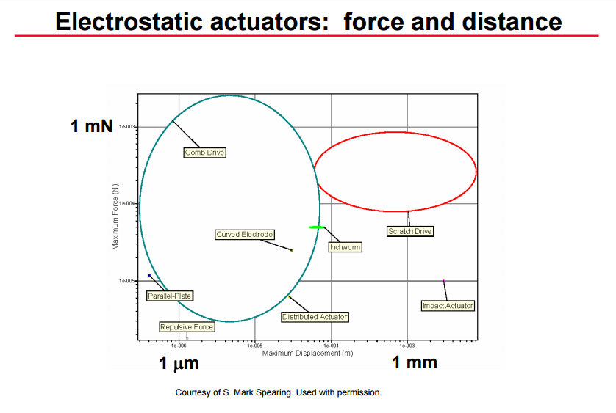
Electro Static Actuation
Reference: Carol Livermore, course materials for 6.777J / 2.372J Design and Fabrication of Microelectromechanical Devices, Spring 2007. MIT OpenCourseWare (http://ocw.mit.edu/), Massachusetts Institute of Technology.

Slide 16
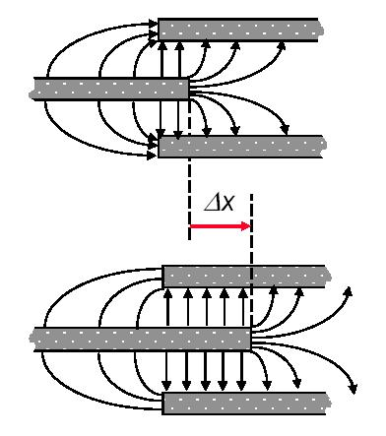
Electro Static Actuation
Gap Closing Actuator (Comb drive) is very popular and easy to fabricate.
N: Comb fingers
α,β: fitting parameters
h: height of comb fingers
d: width of gap
Reference: http://www.uta.edu/faculty/jcchiao/class/EE6345_2013_fall/ee6345_2013_fall_ref.htm

Slide 17
Electro Static Actuation
Gap Closing Actuator (Comb drive) is very popular and easy to fabricate.
N: Comb fingers
α,β: fitting parameters
h: height of comb fingers
d: width of gap
Reference: http://www.uta.edu/faculty/jcchiao/class/EE6345_2013_fall/ee6345_2013_fall_ref.htm

Slide 18
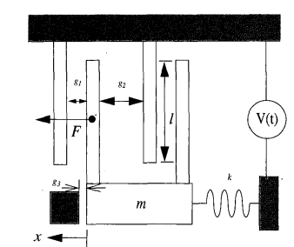




Analysis
Gap Closing Actuator (Comb drive) is very popular and easy to fabricate.
Reference: SINGLE MASK, LARGE FORCE, AND LARGE DISPLACEMENT
ELECTROSTATIC LINEAR INCHWORM MOTORS by Richard Yeh, Seth Hollar, and Kristofer S. J. Pister, University of California, Berkeley, CA 94720

Slide 19

Analysis
Spacing
Pull in time t_{pin}
Pull out time t_{pout}
g1 (min) 2 μm (poly1 spacing limitation for
polymumps)
$$t_{pin}α\frac{1}{V^{2}}$$
Reference: SINGLE MASK, LARGE FORCE, AND LARGE DISPLACEMENT
ELECTROSTATIC LINEAR INCHWORM MOTORS by Richard Yeh, Seth Hollar, and Kristofer S. J. Pister, University of California, Berkeley, CA 94720

Slide 20
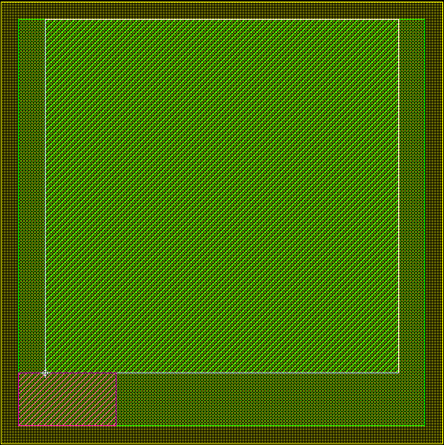
Device Parameters
2500 μm
100 μm
Available size of the device for POLYMUMPS process is 2500 × 2500 μm².
100 μm space is left from the edge for dicing imperfection.
A block of 550 μm × 300 μm is left for post processing evaluation of the run by MEMSCAP.
Area in green is net available space for device fabrication.
I used center 2000 × 2000 μm² for MEMS micro motor.
2500 μm
300 μm
550 μm
100 μm
Reference: PolyMUMPs Design Handbook, Revision. 8.

Slide 21
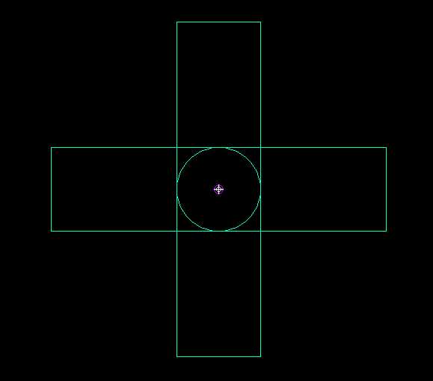
Device Level Design
2000 μm
Rotor diameter 400 μm.
Stator diameter 40 μm.
GCA blocks are of 600 μm × 400 μm.
Rotor and GCA are in Poly 1 layer.
Stator in Poly 2 layer.
GCA 2
2000 μm
GCA 3
Stator
GCA 1
Rotor
GCA 4
Reference: PolyMUMPs Design Handbook, Revision. 8.

Slide 22
GCA Design
600 μm
Parameters to be optimized :
  Pull-in Voltage (v_{pi)}
  Pull-in time (t_{pi})
  Pull-out time (t_{pout})
Design parameters :
  Total length (L)
  Number of GCA’s in the array (N).
  Overlap length (l).
  Spacing (g₁ and g₂).
  Depth of the fingers (t=2 μm fixed for Polymupms process.)
  Width of the fingers (w).
20 μm
200 μm
200 μm
180 μm
GCA Drive and Voltage 1 connection
GCA Clutch and Voltage 2 connection
Spring and ground connection
400 μm
Pawl
Reference: PolyMUMPs Design Handbook, Revision. 8.

Slide 23
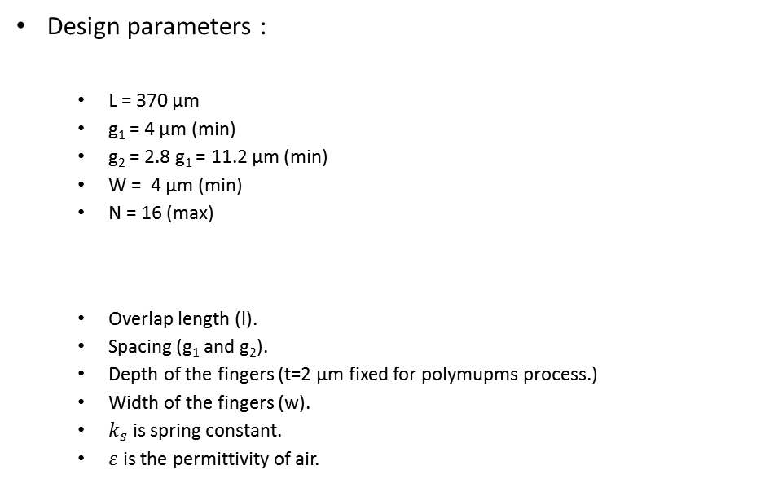
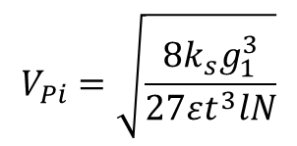
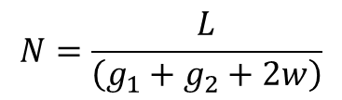
GCA Drive Design
Number of fingers can be calculated using the following equation:
Design parameters :
  L = 370 μm
  g₁ = 4 μm (min)
  g₂ = 2.8 g₁ = 11.2 μm (min)
  W = 4 μm (min)
  N = 16 (max)
  Overlap length (l).
  Spacing (g₁ and g₂).
  Depth of the fingers (t=2 μm fixed for polymupms process.)
  Width of the fingers (w).
  $k_{s}$ is spring constant.
  $ε$ is the permittivity of air.
$$N=\frac{L}{\left(g_{1}+g_{2}+2w\right)}$$
Pull in Voltage is the minimum voltage required to make the comb drive move:
$$V_{Pi}=\sqrt{\frac{8k_{s}g_{1}^{3}}{27εt^{3}lN}}$$
Reference: PolyMUMPs Design Handbook, Revision. 8.

Slide 24
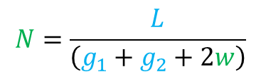


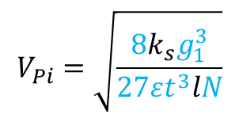
GCA Drive Design
200μm
Number of fingers can be calculated using the following equation:
$$N=\frac{L}{\left(g_{1}+g_{2}+2w\right)}$$
20 μm
66μm
56 μm
66 μm
Pull in Voltage is the minimum voltage required to make the comb drive move:
$$V_{Pi}=\sqrt{\frac{8k_{s}g_{1}^{3}}{27εt^{3}lN}}$$
Pull in voltage dependencies
Over lapping fingers
GCA Drive Anchor 1
Over lapping fingers
$$V_{Pi}=f\left(k_{s}\right)$$
400 μm
Pawl
$$V_{Pi}=f\left(l\right)$$
Reference: PolyMUMPs Design Handbook, Revision. 8.

Slide 25
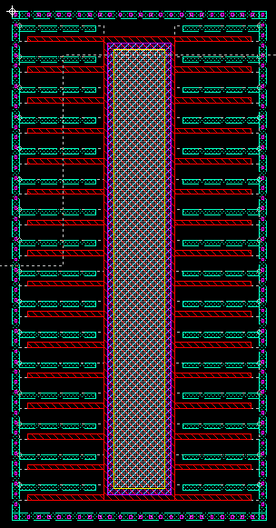
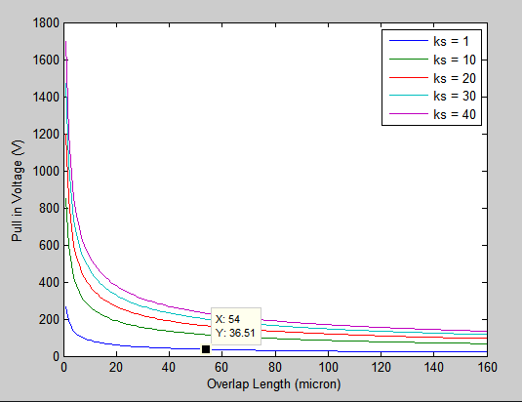



GCA Drive Finger Design
Number of fingers can be calculated : 16
Pull in voltage dependencies :
$$1≤l≤160$$
$V_{Pi}=f\left(l\right)$
$$k_{s}=\left\{1,10,20,30,40\right\}$$
For different spring constant values
Over lapping fingers

Slide 26
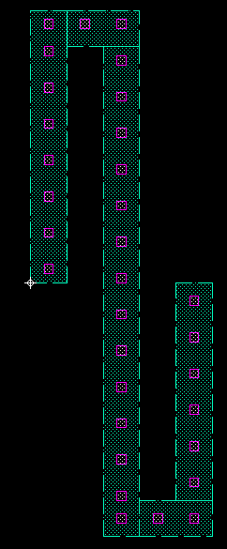
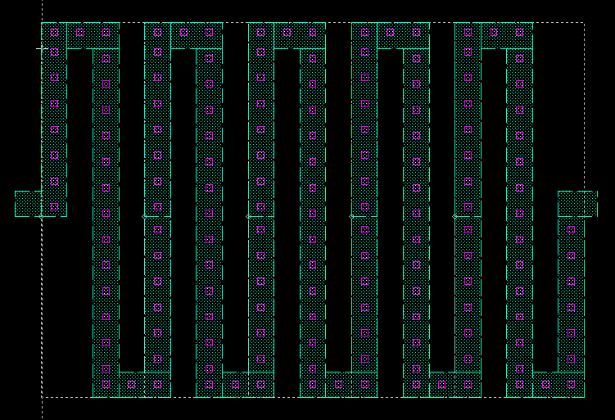
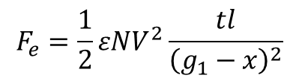

GCA Drive Finger Design
Force estimation:
  l = 54 μm
  g₁ = 4 μm (min)
  N = 32 (max)
  t = 2 μm
  Ε = 8.85 Χ 10⁻¹² F/m
$$F_{e}=\frac{1}{2}εNV^{2}\frac{tl}{{\left(g_{1}−x\right)}^{2}}$$
$F_{e}$ ~ 1.3 μN
8 μm
8 μm
8 μm
Spring Design:

Slide 27


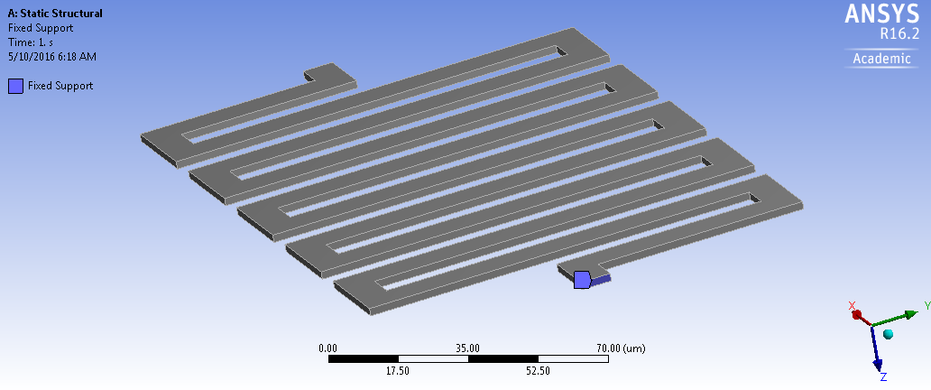
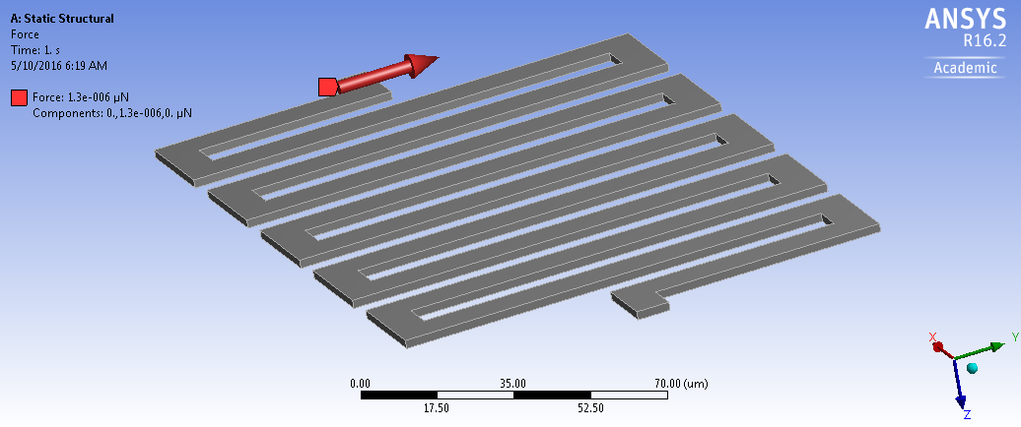
GCA Drive Finger Design
Ansys Simulation
  Parameters Used:
  Boundary Condition:
Force = 1.3 μN

Slide 28
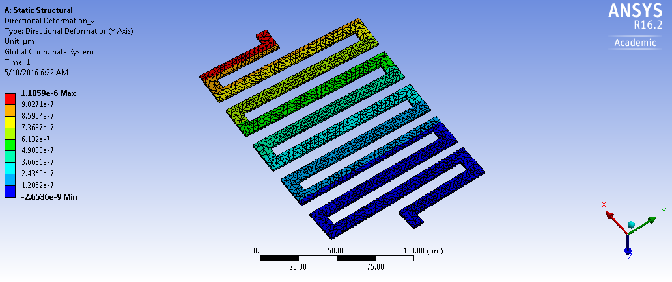


GCA Drive Finger Design
Ansys Simulation
  Results :
$$k=\frac{F}{x}$$
$k=$1.18

Slide 29
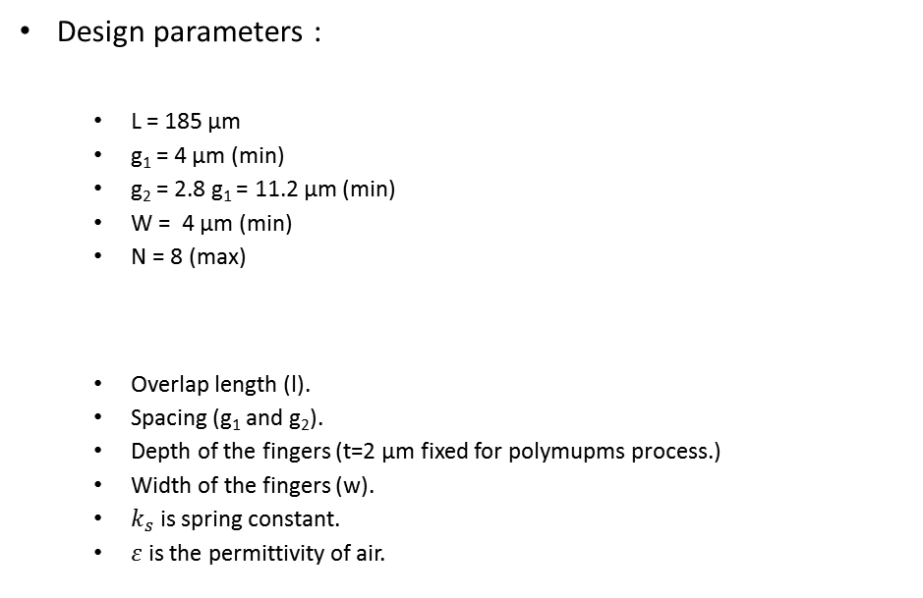
GCA Clutch Design
Number of fingers can be calculated using the following equation:
Design parameters :
  L = 185 μm
  g₁ = 4 μm (min)
  g₂ = 2.8 g₁ = 11.2 μm (min)
  W = 4 μm (min)
  N = 8 (max)
  Overlap length (l).
  Spacing (g₁ and g₂).
  Depth of the fingers (t=2 μm fixed for polymupms process.)
  Width of the fingers (w).
  $k_{s}$ is spring constant.
  $ε$ is the permittivity of air.
$$N=\frac{L}{\left(g_{1}+g_{2}+2w\right)}$$
Pull in Voltage is the minimum voltage required to make the comb drive move:
$$V_{Pi}=\sqrt{\frac{8k_{s}g_{1}^{3}}{27εt^{3}lN}}$$
Reference: PolyMUMPs Design Handbook, Revision. 8.

Slide 30
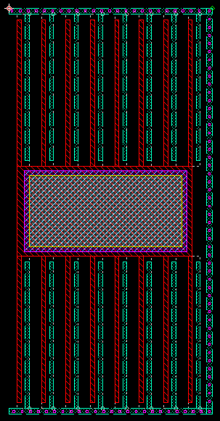
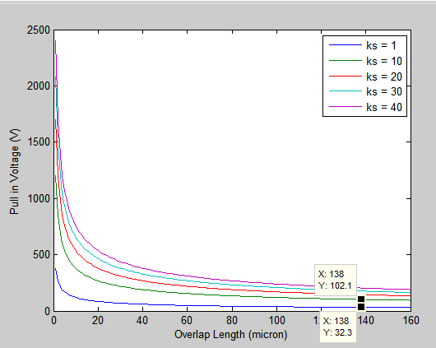
GCA Drive Finger Design
Number of fingers can be calculated : 16
Pull in voltage dependencies :
$$1≤l≤160$$
$V_{Pi}=f\left(l\right)$
$$k_{s}=\left\{1,10,20,30,40\right\}$$
For different spring constant values
Over lapping fingers

Slide 31

GCA Drive Finger Design
Force estimation:
  l = 128 μm
  g₁ = 4 μm (min)
  N = 16 (max)
  t = 2 μm
  Ε = 8.85 Χ 10⁻¹² F/m
$$F_{e}=\frac{1}{2}εNV^{2}\frac{tl}{{\left(g_{1}−x\right)}^{2}}$$
$F_{e}$ ~ 11.79 μN
8 μm
8 μm
8 μm
Spring Design:

Slide 32
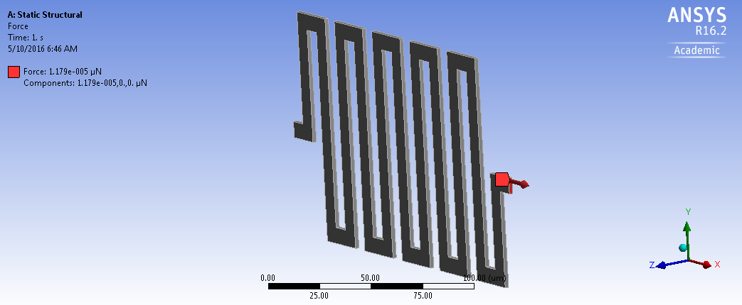
GCA Drive Finger Design
Ansys Simulation
  Parameters Used:
  Boundary Condition:
Force = 11.79 μN

Slide 33
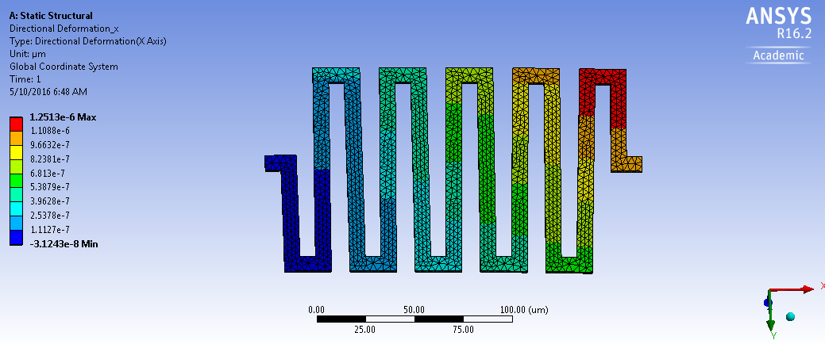

GCA Drive Finger Design
Ansys Simulation
  Results :
$$k=\frac{F}{x}$$
$k=$9.43

Slide 34
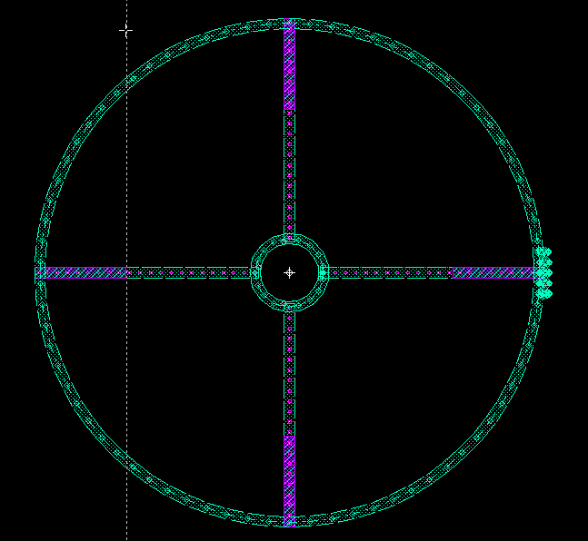
Rotor

Slide 35
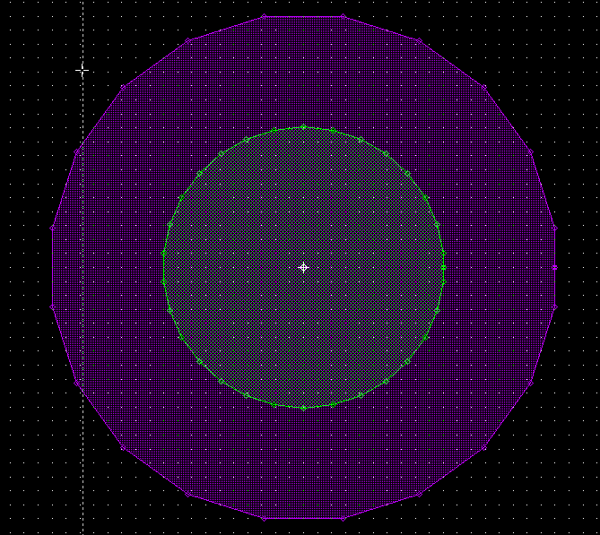
Stator

Slide 36
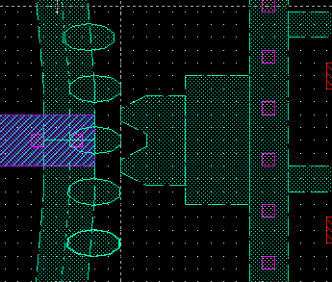
Gear

Slide 37
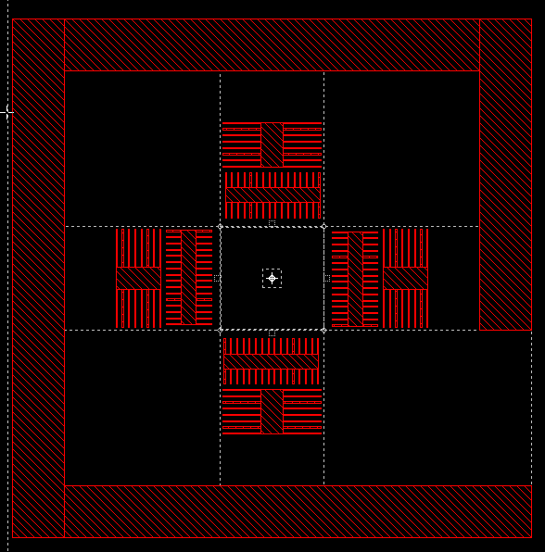
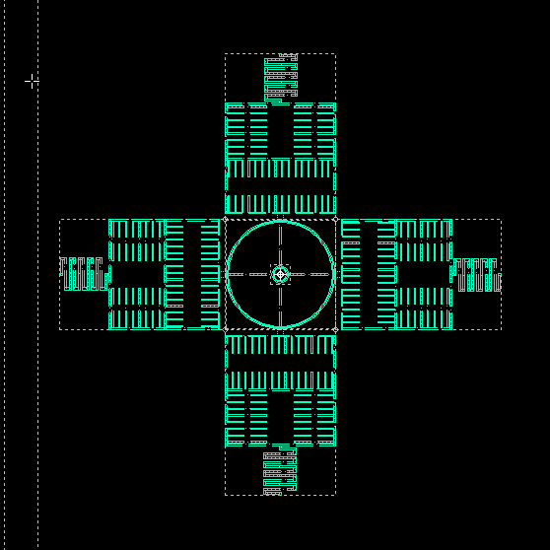
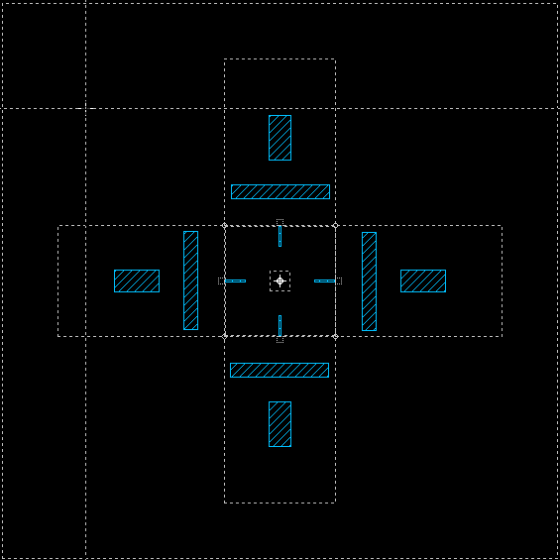
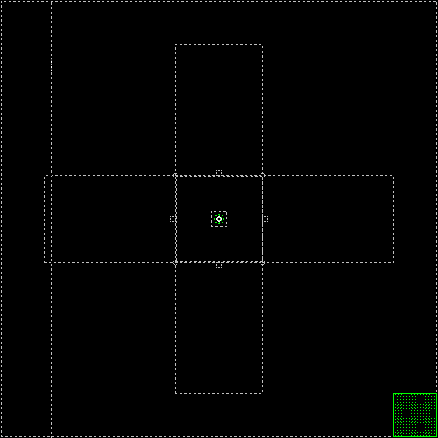
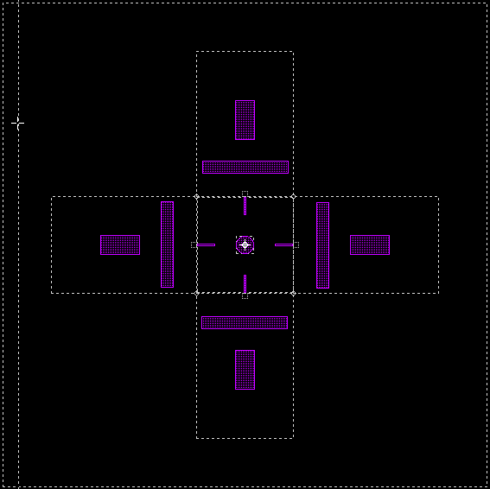
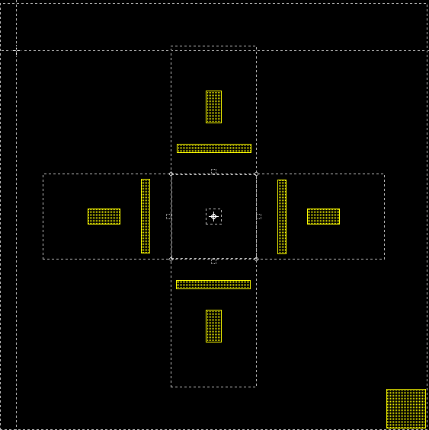
Final Design (Layers)
Anchor1
Poly 1
Poly 1-2 Via
Anchor2
Poly 2
Metal

Slide 38
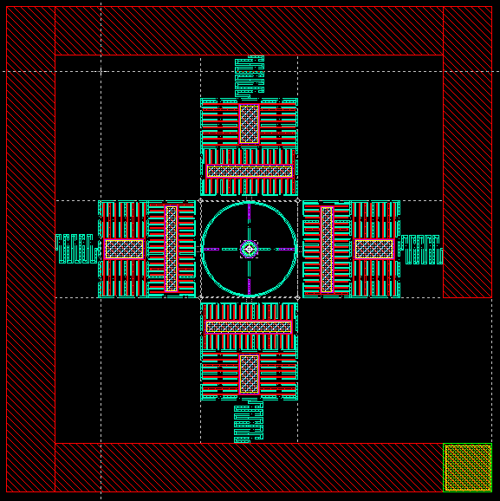
Final Design

Slide 39
Thank You !

