Slide 1

What is Academic Research?
Duties of a Professor
    Instruction & Teaching
    Organizational Service
    Academic Research

Slide 2
Why Academic Research?
Effective way of increasing one’s knowledge.
Effective way of increasing the body of knowledge.
Successful Research
often leads to Research Grant
Awards.

Slide 3
How To DO
Academic Research
Select a Topic (more next slide)
Read books on the topic
Read Popular articles on the topic
Read journal Theory,
Position, and Study
articles on the topic.

Slide 4
Your Area of Study
Read, Read, & Read
Examine your course work
Find relevant journals
Attend colloquiums
Interact with
Research Professors

Slide 5
Organize & Recall
Manual
  Build a personal library of books and printed journal articles.
Automate
  Use a software application to
  store, organize,
  and search
  documents.

Slide 6
WEB-BASED Software
REFWORKS
  Stores Documents
EBSCO
  Document Databases
GOOGLE SCHOLAR
    Document Databases

Slide 7
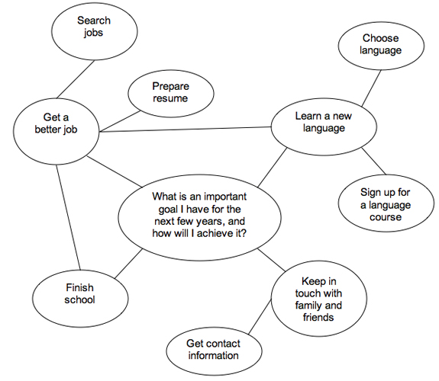
Idea Mapping

Slide 8
Dr. Allen
Dr. Nimon
Dr. Jones
Dr. spector
Thank you to the
University of North Texas
And for their contributions

