Slide 1
FELLOWSHIP & BIBLE STUDY - Held @ FORT RAPIDS 4560 Hilton Road in the Delaware Grand Ballroom (see attached for detailed directions)
1st Mar& 4th Mar
1st Sunday Service/Fellowship 10AM – 12PM
  The Gospel – What GOD has Done in CHRIST JESUS – WHO IS THE GOSPEL?
4th Wed Bible Study
  6:45PM – 7:15PM – Prayer & Weekly Inspiration; Minister Fannie West
  7:15 PM – 8:15PM – Baptism (What is it?)
8th Mar & 11th Mar
8th Sunday Service/Fellowship 10AM – 12PM
  The Gospel – What GOD has Done in CHRIST JESUS – Who YOU are OUTSIDE of CHRIST!
11th Wed Bible Study
  6:45PM – 7:15PM – Prayer & Weekly Inspiration; Minister Fannie West
  7:15 PM – 8:15PM – Baptism (What is it?)
  Fellowship-FRIDAYS - March 27TH, 2015 6PM-8PM (please get flyer for details of Fellowship FRIDAY S)
15th Mar & 18th Mar
15th Sunday Service/Fellowship 10AM – 12PM
  The Gospel – What GOD has Done in CHRIST JESUS – Propitiation of GOD
18th Wed Bible Study
  6:45PM – 7:15PM – Prayer & Weekly Inspiration; Minister Fannie West
  7:15 PM – 8:15PM – Baptism (What is it?)
22nd Mar & 25th Mar
22nd Sunday Service/Fellowship 10AM – 12PM
  The Gospel – What GOD has Done in CHRIST JESUS – Ministry OF RECONCILIATION!
25th Wed Bible Study
  6:45PM – 7:15PM – Prayer & Weekly Inspiration; Minister Fannie West
  7:15 PM – 8:15PM – Baptism (What is it?)
  Agape Love Feast March 28, 2015; 6PM-8PM (please get flyer for details held LAST SATURDAY of month)

Slide 2
Fort Rapids Indoor Waterpark Resort 4560 Hilton Corporate Drive Columbus, OH 43232
Fort Rapids Is Conveniently Located at I-70 and Hamilton Road in Columbus, Ohio
Getting Here Is Easy!
From West:
I-70 to Hamilton Road South.
Cross over Hamilton Road at end of exit ramp (appearing to merge onto I-70 East).
Turn right on Truro Station Drive.
Turn left on Hilton Corporate Drive.
Fort Rapids Indoor Waterpark Resort on left.
From East:
I-70 to Hamilton Road.
Turn left onto Hamilton Road, southbound.
Turn left at first traffic signal (appearing to merge onto I-70 East), and make an immediate right onto Truro Station Drive.
Turn left onto Hilton Corporate Drive.
Fort Rapids Indoor Waterpark Resort on left.
From North/South:
I-71 to I-70 East.
I-70 to Hamilton Road South.
Cross over Hamilton Road at end of exit ramp (appearing to merge onto I-70 East).
Turn right on Truro Station Drive.
Turn left on Hilton Corporate Drive.
Fort Rapids Indoor Waterpark Resort on left
From Port Columbus International Airport:
West on International Gateway.
Turn right onto Sawyer Road.
Turn right on N. Hamilton Road/OH 317 S.
Turn left at I-70 East Entrance Ramp (appearing to merge onto I-70 East), and make an immediate right onto Truro Station Drive.
Turn left onto Hilton Corporate Drive.
Fort Rapids Indoor Waterpark Resort on left

Slide 3
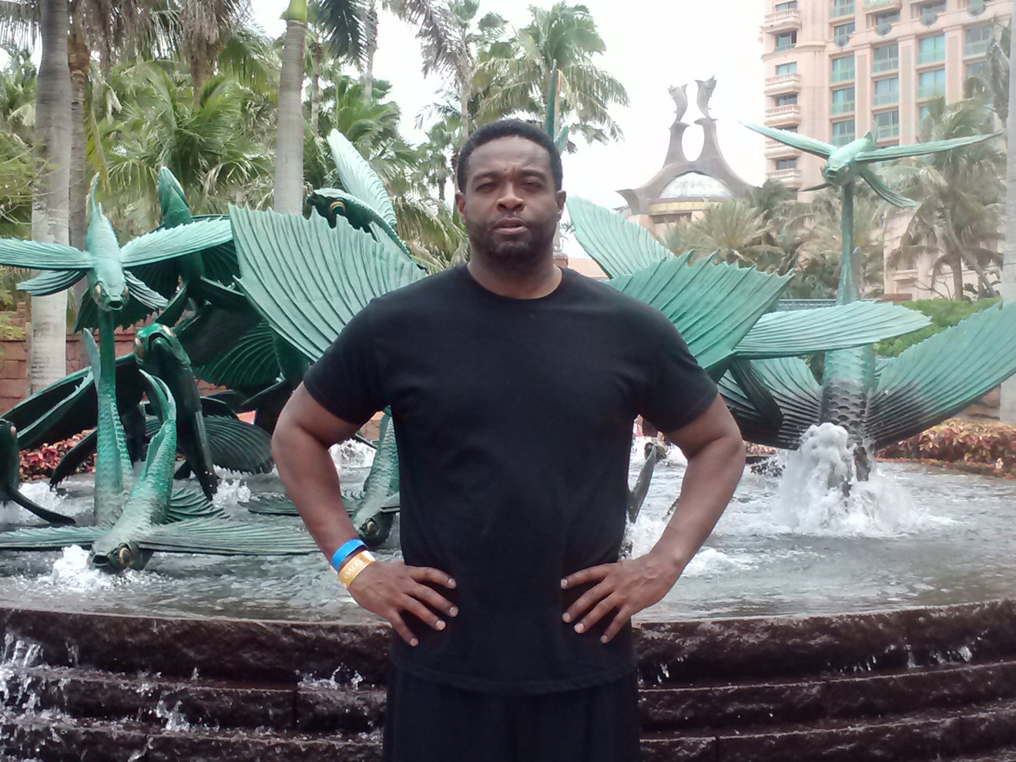
Minister William West
Disciple of CHRIST Called to prophesy THE BURDEN OF THE LORD CONCERNING THE APOSTATE GOSPEL AND CHURCH!

Slide 4

Minister Fanniemae West
Disciple of CHRIST called to evangelize, Encourage & INSPIRE through the ministering of the GOSPEL!

Slide 5
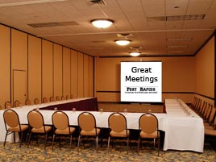
ACCOMMODATIONS
Small Meeting Room – seats approximately 25-30

Slide 6
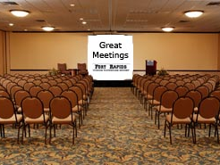
ACCOMMODATIONS
Medium – Large Meeting Room - seats approximately 80 - 90

Slide 7
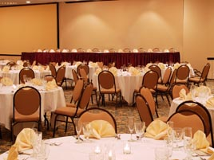
ACCOMMODATIONS
Full Grand Ball Room

