Slide 1
Lesson 6: Group Life
Robert Wonser
Introduction to Sociology

Slide 2
Some Important Realizations
Groups make us who we are.
Change the groups we’re a part of, change the person.

Slide 3
Why are we who we are?
Recall that socialization is the process where we internalize what those around us think is true and right. We learn our culture. But specific groups also impart a worldview to us. As well as a self.
Remember how we learn not to go for the banana?

Slide 4
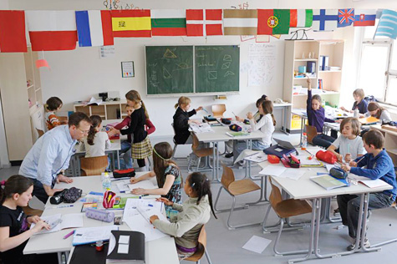
What are Groups?
A group is a collection of people who share some attribute, identify with one another, and interact with each other.
Social groups provide the values, norms, and rules that guide people’s lives.

Slide 5
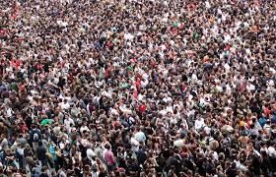
Not a Group
A crowd is different than a group because it is simply a temporary gathering of people in a public place, whose members may interact but do not identify with each other and will not remain in contact.

Slide 6
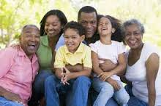
What Are types of Groups Then?
Primary groups usually involve the greatest amount of face-to-face interaction and cooperation and the deepest feelings of belonging.
In these groups, we are closely associated with the other members, such as family and friends.

Slide 7
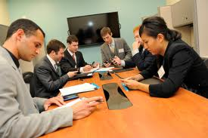
Larger, less personal groups are known as secondary groups. Secondary groups are usually organized around a specific activity or the accomplishment of a task.

Slide 8
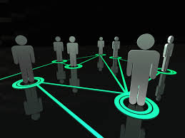
Social Network
A social network is the web of direct and indirect ties connecting an individual to other people.

Slide 9
You and your family, friends, peers, colleagues, teachers, and coworkers constitute your social network.

Slide 10
Research on social networks has shown that indirect ties can be as important as direct ties– so it’s not just who you know, but who they know as well.
The strength of weak ties

Slide 11
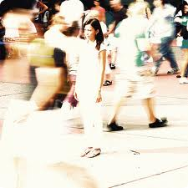
Anomie
Since groups provide values, norms, and rules that guide people’s lives, is it possible that the modern world makes people disconnected from their groups and creates feelings of anomie, or normlessness?

Slide 12
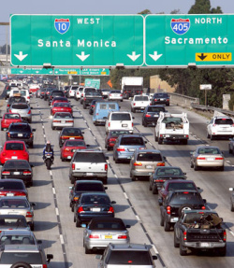
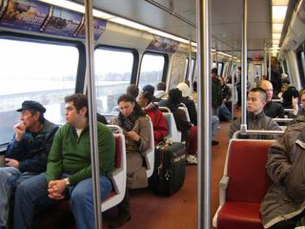
What does Anomie look like today?

Slide 13
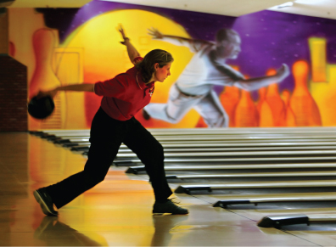
What’s wrong with Bowling alone?
Although the overall number of bowlers has increased, the number of people bowling in groups has dropped.
Are we seeing a decline in social engagement?

Slide 14
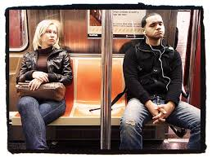
Separate from Groups: Anomie
Or are these worries are overstated, and that new technologies like the Internet allow us to connect with others in new ways?
Facebook, twitter, email, texts
Paradox: we are more connected yet more isolated than ever before
Simmel’s ‘stranger’ - physically close but psychologically far away

Slide 15
Group dynamics are the patterns of interaction between groups and individuals.
This includes the ways groups:
Form and fall apart
Influence members

Slide 16
Group Dynamics based on Size
A dyad, which is the smallest possible social group, consists of only two members and is fundamentally unstable because of the small size – if one person leaves the group the group no longer exists.
A triad, a three-person social group, is more stable than a dyad because the addition of a third member means that conflicts between two members can be mediated by the third. As groups grow they become more stable at the cost of intimacy.

Slide 18
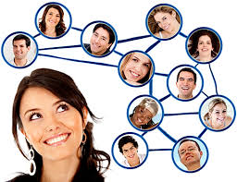
Social Influence
Social influence is the influence of one’s fellow group members on individual attitudes and behaviors.
Generally we conform to group norms because we want to gain acceptance and approval (positive sanctions) and avoid rejection and disapproval (negative sanctions).

Slide 19
In-Group/Out-Group Dynamic
An in-group is a group that one identifies with and feels loyalty toward.
An out-group is any group that an individual feels opposition, rivalry, or hostility toward.
Most of us are associated with a number of in-groups and out-groups based on our ethnic, religious, familial, professional, or educational backgrounds.
What function might this serve?

Slide 20
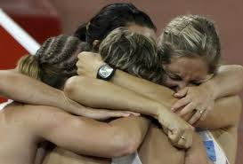
Cohesion
A basic concept in the study of group dynamics is group cohesion, the sense of solidarity or loyalty that individuals feel toward a group to which they belong.
A group is said to be more cohesive when the individual members feel strongly tied to the group.

Slide 21
Groupthink
Whereas a high degree of cohesion might seem desirable, it can also lead to the kind of poor decision-making often seen in groupthink (the tendency of very cohesive groups to enforce a high degree of conformity among members, creating a demand for unanimous agreement).

Slide 22
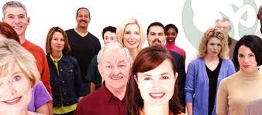
Reference Groups
A reference group is a group that provides a standard of comparison against which we evaluate ourselves.

Slide 23
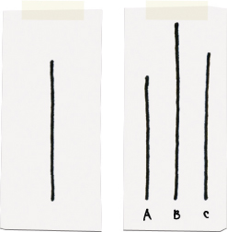
Soloman Asch
Which line is the same length as the line on the left?
A, B, C?

Slide 24
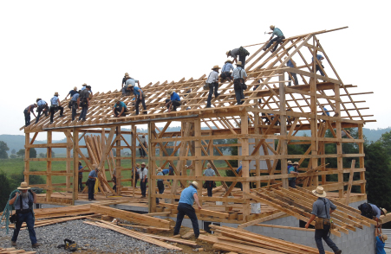
Teamwork
Sociologists have studied teamwork to determine whether groups are more efficient than individuals.
A group almost always outperforms an individual, but rarely performs as well as it could in theory.
A group’s efficiency usually declines as its size increases, because organizing takes time and social loafing increases with group size.

Slide 25
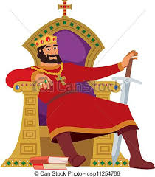
Qualities of Leadership: Authority
Max Weber identified three types of authority found in social organizations.
Traditional authority is authority based in custom, birthright, or divine right, and usually associated with monarchies and dynasties.

Slide 26
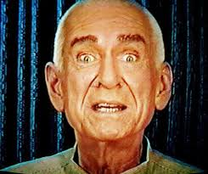
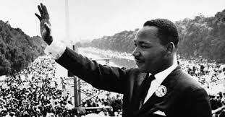
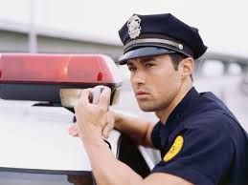
Qualities of Leadership: Authority
Legal-rational authority is authority based in laws, rules, and procedures, not in the lineage of any individual leader.
Charismatic authority is based in the perception of remarkable personal qualities in a leader.

Slide 27
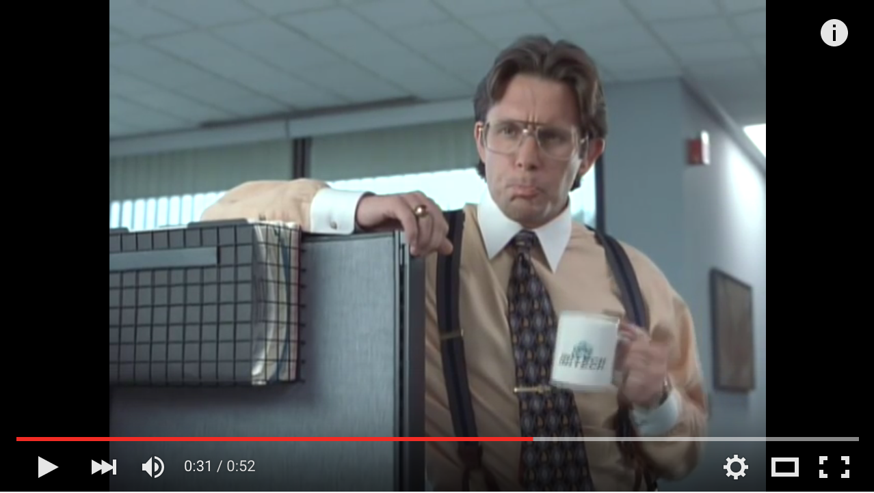
Bureaucracy
A bureaucracy is a type of secondary group designed to perform tasks efficiently.
Max Weber identified six characteristics of bureaucracies:
specialization,
technical
competence, hierarchy,
rules and regulations, impersonality, and formal written communication.
Notes:
https://www.youtube.com/watch?v=Fy3rjQGc6lA

Slide 28
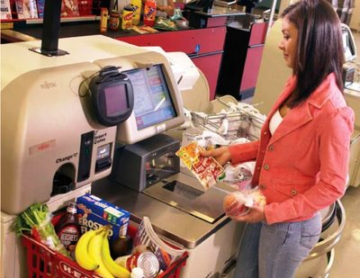
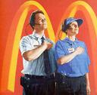
McDonaldization
George Ritzer coined the term McDonaldization to describe the spread of bureaucratic rationalization and the accompanying increases in efficiency and dehumanization.

Slide 29
McDonaldization of Society
What happens when McDonaldization Spreads beyond Fast Food? When the principles of the fast food industry come to dominate social life.
Predictability
Calculability
Efficiency
Control through technology

Slide 30
Take Away Points:
We spend our lives enmeshed in various social groups; they make us who we are! (refer to your TST)
Groups exert tremendous influence over our values, beliefs and behaviors.
Anomie is an ever present feature of modern life (the stranger, the lonely crowd, overly rationalized ‘iron cage’)

Slide 31
Lesson Quiz
1. A collection of people who share a physical location but do not have lasting social relations is called a/an:
a. social network.
b. category.
c. social group.
d. aggregate.

Slide 32
Lesson Quiz
2. You and your family, friends, peers, colleagues, teachers, and co-workers constitute a:
a. secondary group.
b. primary group.
c. social network.
d. social tie.

Slide 33
Lesson Quiz
3. Which of the following is NOT true about dyads?
a. A dyad is the smallest possible social group.
b. Relationships in a dyad are usually pretty intense.
c. A dyad is a two-person social group.
d. Dyads are more stable than triads because of their size.

Slide 34
Lesson Quiz
4. Which of the following is the strongest type of conformity?
a. identification
b. peer pressure
c. compliance
d. internalization

Slide 35
Lesson Quiz
5. A monarchy would be an example of:
a. charismatic authority.
b. legal-rational authority.
c. influential authority.
d. traditional authority.

Slide 36
Lesson Quiz
6. Which of the following is NOT one of the characteristics of bureaucracies according to Max Weber?
a. hierarchy
b. authority
c. impersonality
d. specialization

