Slide 1

The Central Ohio Compact:
A Regional Strategy for
College Completion and Career Success
3

Slide 2
The Central Ohio Compact
A Regional Strategy for College Completion and Career Success
What kind of partnership could:
Ensure that all college-bound high school graduates are college ready?
Increase the number of high school graduates with credit toward a college degree?
Dramatically increase the number of students earning a college degree or certificate?
Advance the region’s need for a highly skilled workforce aligned with employer labor market needs?
Reduce the costs of education for students, families, and taxpayers?
2

Slide 3
The Central Ohio Compact
A Regional Strategy for College Completion and Career Success
Strategic Principles: The Framework for Action
Aspiration and Access: Offer well-designed services and support to raise students’ college and career aspirations, readiness and success, such as school counseling, career exploration and parent education.
Alignment and Academic Preparation: Improve curricular alignment, provide more opportunities to accelerate learning, and eliminate post-secondary remediation to guarantee pathways to postsecondary degrees and certifications.
Alternative Pathways for Adult Learners: Develop innovative programs to remove obstacles facing adults and veterans who need more postsecondary credentials to transition to new careers and succeed in the economy.
Affordability: Implement programs and practices that facilitate earlier completion of degree or certification, eliminate redundancy, and promote shared services to make college more affordable for students, families, and communities.
4

Slide 4
The Central Ohio Compact
A Regional Strategy for College Completion and Career Success
Building Momentum/Achieving Scale
2010- 2012. Columbus State Community College as key architect of The Central Ohio Compact development.
Spring 2012. Adoption of the Lumina Foundation’s 60% Goal and formation of strategy team.
Fall 2012. Completion of strategy document, and adoption of the joint resolution by governing boards.
Winter 2012. Joined the Pathways to Prosperity Network with the support of JPMorgan Chase, the Ohio Business Roundtable, Battelle, and the Educational Service Center.
October 2013. Credits Count partnership with AEP, Columbus City Schools and Columbus State.
December 2013. Straight A Funds awarded to Compact K12 districts.
Spring 2014. JPMorgan Chase New Skills at Work, Nationwide Children’s Hospital and the City of Columbus partnership announcements.
Next. Operationalize and bring to scale. Integrate and align.
5

Slide 5


There is a new American majority on campus. Only 25% of today’s college students are “traditional.”
Part-time students rarely graduate.
Low-income students and students of color struggle the most to graduate.
Students take too many credits and too much time to graduate.
Remediation produces few students who ultimately graduate.
6

Slide 6
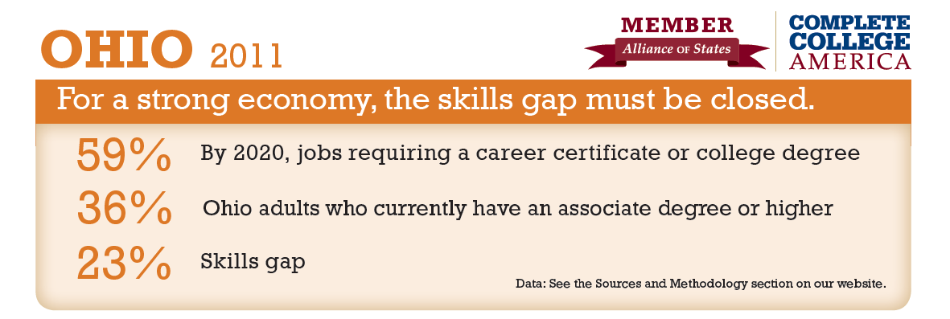
Closing the “skills gap.”
7
Notes:
There has been a lot of talk about the skills gap in our state and this is an illustration of it.
Go through the numbers.
These numbers aren’t precise; they don’t include certificate programs. But it gives you a good idea of the gap we’re experiencing.

Slide 7


By 2025, 60 percent of the region’s adults will have earned a postsecondary certificate or degree.
8

Slide 8


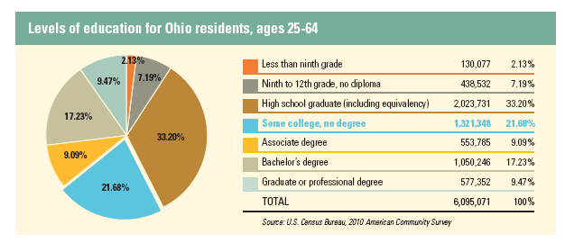
9

Slide 9

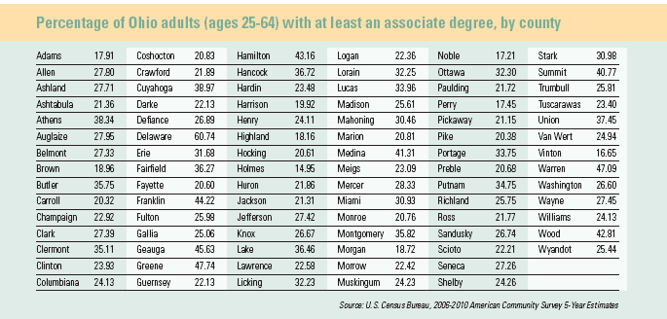
10

Slide 10
The Central Ohio Compact
A Regional Strategy for College Completion and Career Success
Priorities
  Remediation: eliminate or accelerate
  Completion: meaningful credentials along the way
  Transition: completion with a purpose
  Career Readiness: a good job matters in affordability
Principles
  Acceleration
  Integration
  Innovation
  Action (act, measure, adjust, improve)
11

Slide 11
The Central Ohio Compact
A Regional Strategy for College Completion and Career Success
Student Success Results:
Dramatically increase the number of students earning a post-secondary credential.
Ensure that all college-bound high school graduates are college ready.
Increase the number of high school graduates with credit toward a post-secondary credential.
Employ specific strategies for working adults, low-income and first generation students, and students of color.
12

Slide 12
The Central Ohio Compact
A Regional Strategy for College Completion and Career Success
Partnerships Matter:
Manage the costs of education for students, families, and taxpayers through 2+2 and 3+1 bachelor’s degree programs, shared facilities and services, and integrated planning.
Increase the number of community college transfer students earning bachelor’s degrees through guaranteed pathways to completion.
Economic Impact:
Advance the region’s need for a highly skilled workforce.
Align with regional workforce and economic development efforts, with meaningful measures of success.
13

Slide 13
Joint Resolution Adoption
School Districts
Colleges and Universities
Columbus City Schools
Dublin City Schools
Educational Service Center of Central Ohio
Grandview Heights City Schools
Hamilton Local Schools
Olentangy Local Schools
Reynoldsburg City Schools
South-Western Schools
Upper Arlington City Schools
Capital University
CCAD
Columbus State Community College
Franklin University
Ohio State University
Ohio Wesleyan University
Otterbein University
14

Slide 14

Problem Statement: Half of all young Americans arrive in their mid-20’s without the essential credentials for success in today’s workplace.
Pathways to Prosperity seeks to:
    Ensure that more youth complete high school, and attain a postsecondary credential with currency in the labor market.
    Build a system of 9-14 career pathways, combining high school and community college work.
Implementation “levers” include early career advising, employer engagement, intermediaries, and enabling state policies.
15

Slide 15

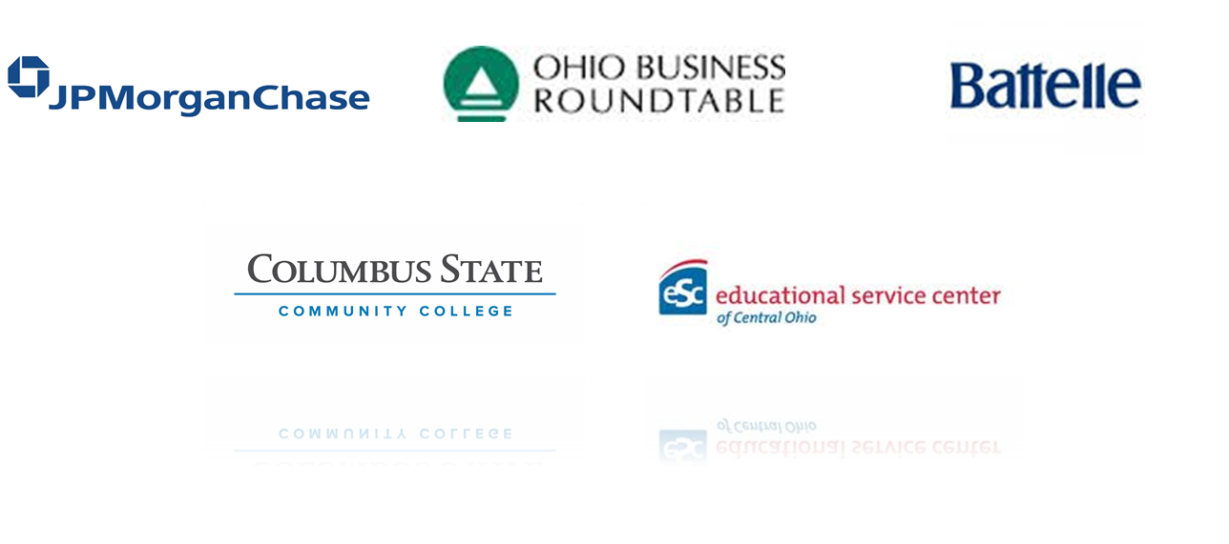
Initial Pathways to Prosperity Partners
16

Slide 16
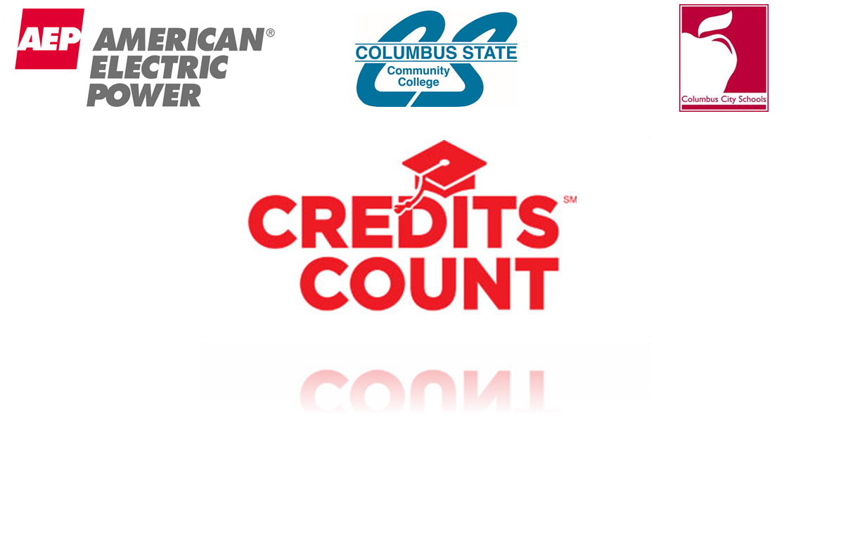

Credits Count Implementation:
5 high schools in 5 years.
17

Slide 17

18

Slide 18
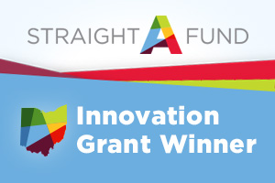
The Central Ohio Compact
A Regional Strategy for College Completion and Career Success
Straight A Grant District Partners
Bexley City Schools
Canal Winchester Local Schools
Columbus City Schools
Gahanna-Jefferson Public
Grandview Heights City Schools
Hilliard City Schools
Licking Heights Local Schools
Marysville Schools
New Albany-Plain Local Schools
Olentangy Local Schools
Pickerington Local Schools
Reynoldsburg City Schools
South-Western Schools
Upper Arlington City Schools
Westerville City Schools
Whitehall City Schools
19

Slide 20
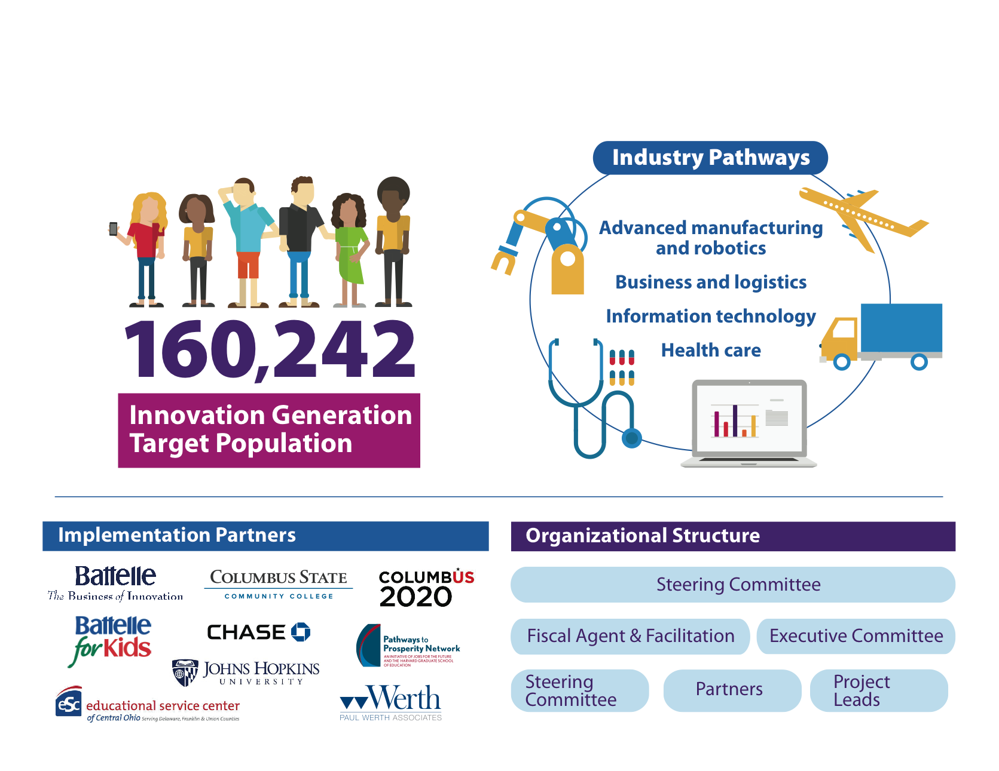

Slide 21
GRADES 9-14 INTEGRATED PATHWAYS
Rigorous Academics
System Outcomes:
Financially sustainable, aligned and integrated 9-14(+) career pathway systems
Increased number of skilled workers with credentials of value to the labor market
Greater cost efficiencies by reducing duplication of services
Secondary Pathways
Postsecondary Pathways
Stackable Credentials ➔
AA/AAS ➔
Acceleration & College/Career Readiness through
Dual Enrollment, Integrated Instruction, and WBL
BA/BS ➔
Intern-ships, WBL
Low Skilled Jobs
Semi-Skilled Jobs
Middle Skilled Jobs
Advanced Skilled Jobs
Career and Technical Ed.

Slide 22
Total investment
• $100,000 - initial private investment
• $14M - Straight A Fund $2.5M investment - JPMorgan Chase
• $8M - Straight A Fund
What are the big challenges?
• The learning curve for districts incorporating
career technical programming for the first time
• Developing meaningful and sustainable
employer partnerships
• The timeline and continued momentum

Slide 23
The Central Ohio Compact
A Regional Strategy for College Completion and Career Success
CSCC Partnership with K-12:
Through our work with the Reynoldsburg Straight A grant, Columbus State is digitizing upwards of 30 courses, and building concise pathways around those courses.
The Straight A grant is giving us the resources to advance these blended learning courses to new levels around teaching, learning, and the use of media and assessments.
Building community awareness around the value of a system of grades 9-14 career pathways in collaboration with employers and aligned with labor market demands;
12

Slide 24
The Central Ohio Compact
A Regional Strategy for College Completion and Career Success
CSCC Partnership with K-12:
Columbus State faculty are working closely with high school teachers – the collaboration is helping K12 understand college expectation/preparation; and illuminating to higher-ed faculty the high level of talent among our high school teachers!
This successful integration and application of blended learning increases the number of high school students with credit toward a degree or certificate;
And, dramatically increase the number of students with a postsecondary credential that will help them build successful careers.
12

Slide 25


Innovation Partnership
The Learning Accelerator’s mission is to accelerate the implementation of high-quality blended learning in schools across America
Mobilizing 100 million dollars in five years to fill gaps in the ecosystem
Goal is to sun-set in 5-years
Reynoldsburg City Schools named first National Demonstration Site

Slide 26
What is blended learning?
What does blended learning enable?
Can students learn at their own pace?
How much ownership do students have over their learning?
Is the learning environment radically increasing feedback to students and instructors?
Is the velocity of learning increasing?
How deep is the learning?
Is the learning mastery-based?
What modes of learning are offered to students?
How differentiated or personalized are they for different learners?
How is the student’s and the instructor’s role changing?
Are we unlocking resources? How are these resources being reallocated?
Notes:
-Content of this slide re-mastered & augmented by Lisa Duty, based on a blog by Alex Hernandez

Slide 27
Districts must complete the entire value chain in order to implement blended learning successfully
Strategy and Design
Infra-structure
IT Hardware
Education Software
Human Capital
Implementation Support
Continuous Improvement
Learning goals
Diagnostic and gap analysis
Instructional design
Technical design
Community engagement
Broadband
Power
Networking equipment
Facilities
Computers
Tablets
Non-education software
Accessories
Instructional materials
Analytics software
Integration with other school data systems
Teachers
Leaders
Support staff
New kinds of staff and skills
Initial set-up and launch
Ongoing support
Communications
Analysis of impact
Implementation lessons
Promising practices
Notes:
*TLA Value Chain
Discuss a few of the areas where RCS & TLA are working together, for instance: Design, infrastructure, human capital, software/systems challenge

Slide 28
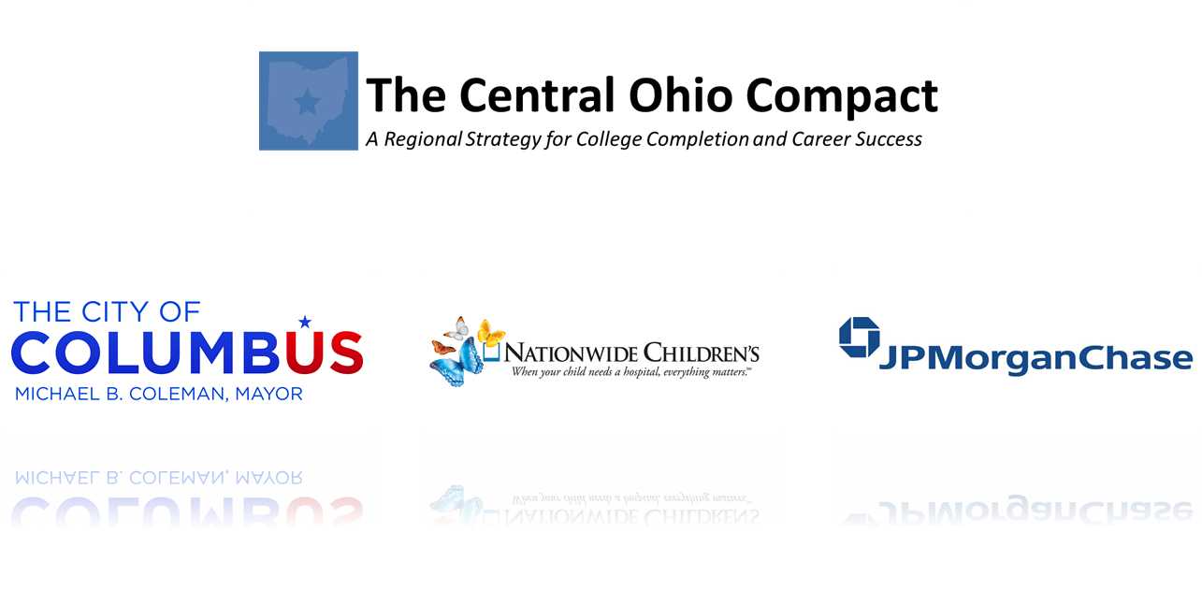
What’s Next?
20

Slide 29
The Central Ohio Compact
A System-wide Cooperative Regional Strategy
Dual Enrollment (Straight A Funds & AEP Credits Count):
  With early support of JPMorgan Chase, the Compact joined the Pathways to Prosperity Network, which has resulted in additional partnerships to support the innovative dual enrollment programs funded by the Straight A Grants and AEP.
FastPath Program:
  Implementation of FastPath in partnership with the City of Columbus and Nationwide Children’s Hospital will cultivate the network of community organizations designed to equip the underprepared, out-of-school adults and connect them with the college, employability skills training to secure jobs and get them back on the path of educational progress working towards independence.
21

Slide 30
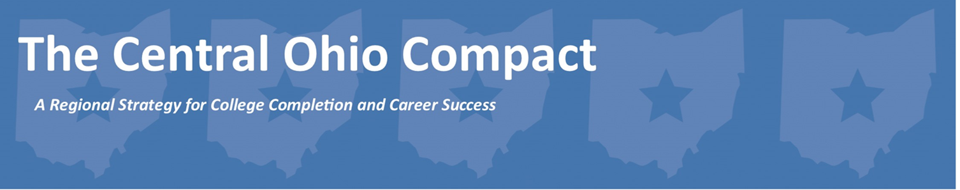


22

Slide 31
The Central Ohio Compact
A System-wide Cooperative Regional Strategy
The JPMorgan Chase New Skills at Work initiative would provide the regional framework and data collection infrastructure to bring to scale successful replicable models, further engage employers in the identification and development of industry credentials, determine regional metrics, and align throughout the region a measurable approach to responding to labor market needs.
Deliverables:
  Build a systemic process to focus more precisely and respond to employer needs.
  Replicate successful system-wide solutions to retain students within the education pipeline by reducing or eliminating remediation, and expanding early college opportunities.
  Collaborate with social service organizations and employers to reach deeper into the workforce pipeline to access the under-served population.
  Raise community awareness of postsecondary career opportunities.
23

Slide 32
Talent Development Pipeline
The Central Ohio Compact
Preferred Pathways
AEP Credits Count
Pathways to Prosperity
Straight A Grants
K12 Dual Enrollment
Postsecondary Degree
Stackable Certificates
Cougar Bridge
Industry Alignment and
Regional Infrastructure
Postsecondary Degree or Baccalaureate Pathway
Pre-College / Early College
or
Career Certifications
Employability Certification
Barriers to Employability
Partnerships with Support Services
FastPath
Nationwide Children’s
Demo Site
Contextualized Remediation
& Support Services
24

Slide 33
A Family of Related Initiatives
The Central Ohio Compact
Data Infrastructure & Operationalize Model Replication
Regional Alignment: employers, industry & education
Pathways to Prosperity Network
K12 Partnerships Dual Enrollment:
early college & remediation
Postsecondary Credentials:
K12, out-of-school adults & industry certificates
FastPath & CougarBridge
Tier 1: Employable & College Ready
(Post-secondary college credit for out-of-school adults & high school drop-outs)
Tier 2: Employability Barriers
(Industry certification, contextualized remediation, social service support)
JPMorgan Chase
Straight A Grant & AEP Credits Count
City of Columbus & Nationwide Children’s
25

Slide 34

A Family of Related Initiatives
Project | Scope | Funding | College Impact
AEP Credits Count | 9-14 career pathways, middle school career exploration | $5 million over 5 years | Career advising, recruiting, marketing, data analysis
Straight A - Reynoldsburg | 9-14 career pathways: health, IT, business, manufacturing | $15 million total | Online course development ($1 million); marketing
Straight A - Marysville | 9-14 career pathways: manufacturing; Early College High School | $13 million total | Regional needs assessment; career advising; substantial facilities; marketing
FastPath/Cougar Bridge | Transition adults into the workforce | $1.5 million; $192, 000 | Career advising, prior learning assessment. ITA's; technology
JPMC New Skills at Work | Infrastructure for the Central Ohio Compact | $2.5 million over 5 years | Leadership, coordination, alignment and integration; employer engagement; data analysis; technology
26

