Slide 1
OFFICIATING Intentional grounding
If a passer moves at least three full steps laterally, game officials should strongly consider whether or not the passer has left the free-blocking zone.
Notes:
OFFICIATING INTENTIONAL GROUNDING (Manual Point of Emphasis):
A new, second exception to the intentional grounding rule has been added effective with the 2022 season.
Intentional grounding is a foul when a forward pass is thrown into an area not occupied by an eligible offensive receiver, or, when a forward pass is intentionally thrown incomplete to save loss of yardage or to conserve time. These acts are fouls in NFHS play with two exceptions:
• NFHS Rule 7-5-2 EXCEPTION 1. – It is legal for a player positioned directly behind the snapper to conserve time by intentionally throwing the ball forward to the ground immediately after receiving the snap that has neither been muffed nor touched the ground.
• NFHS Rule 7-5-2 EXCEPTION 2, (NEW) – It is legal for a player to conserve yardage by intentionally throwing an incomplete forward pass if:
a) The passer has been beyond the lateral boundary of the free-blocking zone as established at the snap; and
b) The pass reaches the neutral zone including the extension beyond the sideline.
The free-blocking zone, as determined at the snap, is 4 yards on each side of the football (3 yards in 6-, 8-, and 9-player). The referee can use the following guidelines to judge whether the passer has been beyond the lateral boundary of the free-blocking zone:
• If a passer moves at least three full steps laterally they have likely left the free-blocking zone.
• In normal splits, the inside foot of the tight end is in the free-blocking zone.
• The distance between a hash mark and the nearest goal post upright is 5 yards.
• The goal post uprights are almost 4 yards from the center of the field.
• By keeping these distances in mind, if the ball is spotted on a hash mark, on a goal post upright, or in the center of the field, then these become very convenient points of reference to assist in determining whether the passer was beyond the lateral boundary of the free-blocking zone.

Slide 2
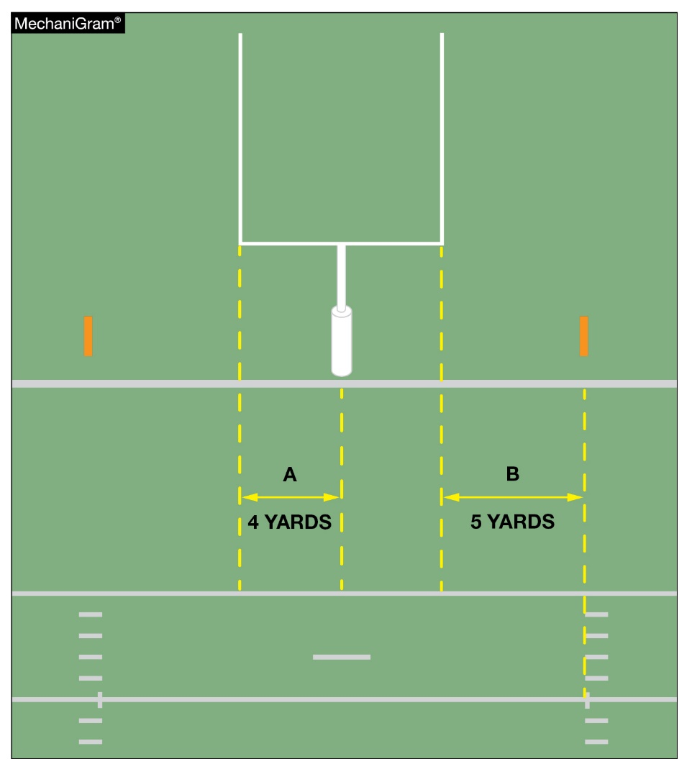
OFFICIATING Intentional grounding
A. The goal post uprights are nearly four yards from the center of the field.
B. The distance between a hash mark and the nearest goal post upright is five yards. Should the ball be spotted on the hash mark, on a goal post upright, or in the center of the field, these become very convenient points of reference.
Notes:
OFFICIATING INTENTIONAL GROUNDING (Manual Point of Emphasis) continued:
Remember, if the passer has not met both requirements in EXCEPTION 2, it remains a foul if there was no eligible offensive receiver in the area, or, if an eligible offensive receiver in the area cannot make a bona-fide attempt to catch the forward pass (e.g., the forward pass is intentionally thrown to the ground short of an eligible offensive receiver, or the forward pass is intentionally thrown over an eligible offensive receiver’s head). Many game officials choose to ignore this foul if there is an eligible offensive receiver in the general area of the forward pass. However, if the referee judges the forward pass was intentionally thrown incomplete, it is a foul. This is a foul that requires good crew communication and could be called after the game officials have gathered and discussed the play, or could result in the referee rescinding a flag that was dropped at the time the pass was thrown should a game official have additional information to provide to the referee that could alter the ruling.
Knowledgeable game officials recognize that some passes are incomplete or do not arrive in the immediate vicinity of the eligible offensive receiver because of the lack of skill on the part of the passer, a broken pattern on the part of the intended eligible offensive receiver, or because the passer’s accuracy was affected by the action of the defense. These game officials can also recognize an intentional and purposeful act and they can consistently and judiciously administer the rules so that the team whose passer purposely incompletes a pass is penalized as required. When a foul does occur, the penalty flag needs to be thrown by the referee. The penalty is 5 yards from the spot of the foul and loss of down.
GUIDES FOR “WHEN IN QUESTION”
• Passer in or outside of free-blocking zone……….outside
• Forward pass crossed the neutral zone or the neutral zone extended……….has crossed

Slide 3
FREE-KICK MECHANICS
Successful coverage of free kicks depends on game officials observing players in their assigned coverage zones. For the traditional deep kick, coverage of the goal line and pylons, downfield movement, return in or away from the game official’s position, starting the game clock and likely areas of illegal contact must be covered in the pre-game conference.
Notes:
FREE-KICK MECHANICS (Manual Point of Emphasis):
Except for the kickoffs starting each half, all others follow success or failure of teams on the previous series and are an opportunity to improve their position for subsequent play. During a kickoff, all 22 players are briefly moving the same direction (no kickoff shall start with more or less than 22 players ), then heading toward each other at full speed eventually merging at a point of attack. Contact must be observed over the entire field while officials themselves are moving - a challenging task whether four-, five- or seven-crew members are present.
Successful coverage of kickoffs rests on a thorough pregame discussion. Depending on the number of crew members used, specific assignments of free-kick lines, the legality of the kick, downfield areas or numbered kicking team members must be acknowledged. For the traditional deep kick, coverage of the goal line and pylons, downfield movement, return in or away from the game official’s position, clock starting and likely areas of illegal contact must be covered. Teams may prefer a shorter kick (referred to as a “pooch” kick) or they may execute a squib kick. Both types of kicks limit return options. A fair catch is a possible outcome of a pooch kick. Understanding of which game official has responsibility for the catch versus contact around the receiver must be discussed. The squib kick is quickly grounded and maintains the status of a kick and the officiating challenges of a loose ball. Illegal contact, first touching and ultimate possession require precise crew actions.
The onside kick is a unique challenge. Responsibility for the kick legality, free kick lines, first touching by Team K, contact – both who initiated and if legal – must be discussed because contact will occur quickly. Possession will be aggressively fought for. Quick and decisive movement, determination of possession and restraining of extra participants are needed.
Fouls on free kicks range from the dead ball (encroachment and illegal kicking formation), live-ball fouls where it is critical to determine if the foul occurred during the kick or after change of possession to correctly enforce and the most common – the free kick out of bounds untouched by Team R. Careful explanations of options to the offended sideline requires precise crew communication in offering possible enforcement scenarios.
With a thorough pregame discussion of free kick mechanics, rules and different kick scenarios, the crew will be better equipped to handle unusual circumstances that may arise.

Slide 4
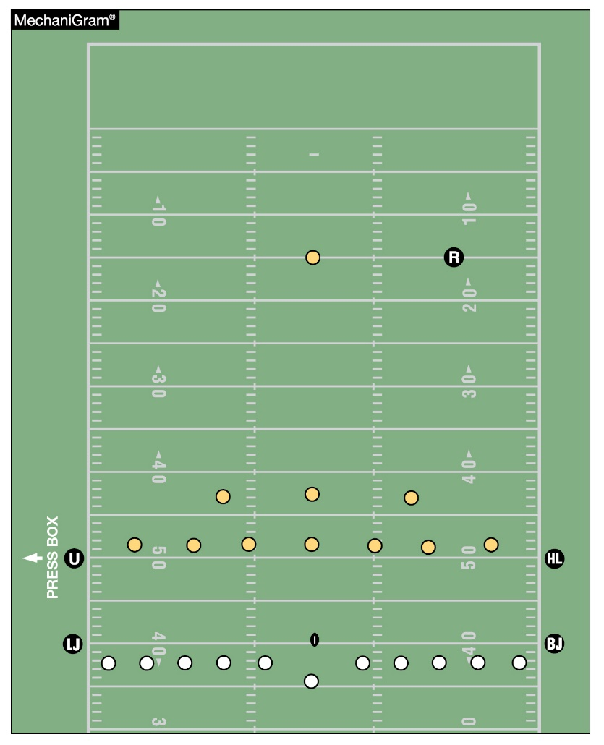
FREE-KICK MECHANICS
Onside kicks are especially challenging. Responsibility for the kick legality, free kick lines, first touching by Team K, contact— both who initiated and if legal — must be considered because contact will occur quickly. Teams will aggressively fight for possession. Quick and decisive movement, determination of possession and observation of participants not involved in the area around the ball is needed.
Notes:
FREE-KICK MECHANICS (Manual Point of Emphasis) continued:
See comments on slide.

Slide 5
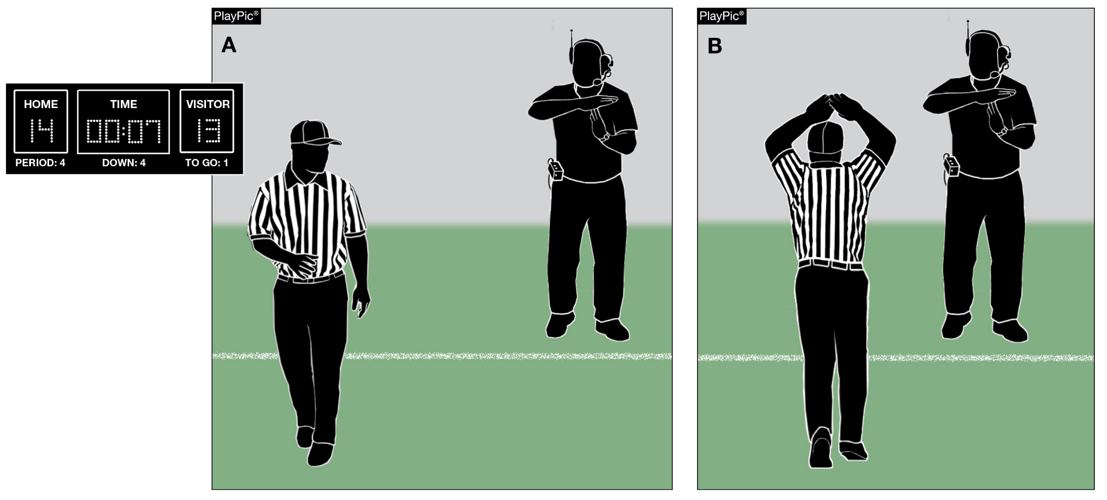
Time-Sensitive Situations – End of Second and Fourth Periods
Late in the second or fourth period, game officials should be aware of situations in which coaches may wish to request time-outs. Factors impacting the time remaining in a game include score, field position, available timeouts, injury and penalty timing. A quick glance to the sideline in those situations can save valuable seconds.
Notes:
TIME-SENSITIVE SITUATIONS – END OF SECOND AND FOURTH PERIODS (Manual Point of Emphasis):
Why is this important? One minute at the beginning of the game and one minute at the end of the game are both 60 seconds. Factors impacting the time remaining in a game include: score, field position, available time-outs, injury and penalty timing, and an early season game against a state championship. When one or a number of these situations occur, the game can become time-sensitive and the number of seconds in a minute carry great importance. Not only will the game be on the line, but everyone will be watching the clock.
NFHS football rules have been put in place to protect the integrity of the game timing. These rules are designed to prevent a team from either using an excessive amount of time or unfairly conserving time. The key to working time-sensitive situations is to understand the environment, and communicate that understanding to the game officials, coaches and players.
Working in a time-sensitive environment requires a heightened sense of awareness. When there are natural breaks in the game, game officials should remind each other when these conditions may exist. Game officials should discuss special clock rules relating to game time, fouls and injuries. Coaches should be reminded of the number of remaining time-outs, and that the game officials will be looking to them for their use. Game officials should also keep both teams informed of when the game clock will be starting (on the ready-for-play or on the snap). Game officials must know when to hustle to get the ball spotted, and referees should maintain a consistent tempo when winding the clock after an awarded first down, usually six to eight seconds into the play clock. If time may expire during live play, the off-game official (first to complete dead ball officiating) should check the game clock to determine if time remains in the half. If there is a penalty or other clock stopping event, game officials need to know whether the half is over, there is time remaining on the game clock or whether there will be an untimed down.
So, why is all of this important? Being prepared for time-sensitive situations can be the difference between a good night’s sleep and multiple restless nights.

