Slide 1

Team Building and Teamwork
Reggie Hucks
Inspections Director – City of High Point
Notes:
Today let’s discuss our team of professionals that administer the NC Building Code, Administrative Code, Local Ordinances, and support for the administration. Some of the ideas presented are common knowledge, my own or well-established practices in the corporate world. Today we must think more about who our customer is, and how we can serve that customer better. For years, departments looked at the general statutes and designed departments around those requirements (a check the box approach). For example, did you know, back in the day in some counties, you had to travel to three buildings in a car to get a mechanical permit. Instead of just following the general statutes, we should look at workflows and processes that make the code compliance an effective and efficient part of the construction process. There are 223 inspection jurisdictions in North Carolina. Does everyone do things the same way? We all do the same job, should everyone do things similarly? Did you know in Texas, every jurisdiction determines if they have a building code and what it is? This is a very disjointed system. Not where we want to be in a state like NC that has a centralized building code council and statewide code. Teamwork is so important today in a state that is growing as fast as any state in the US. We all have inside and outside customers. We should want to serve them as completely and efficiently as possible.

Slide 2
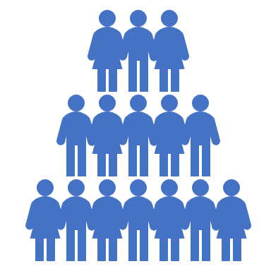
Definition of Team Building
Team building is the process of turning a group of individual contributing employees into a cohesive team—a group of people organized to work together to meet the needs of their customers by accomplishing their purpose and goals.
Notes:
Building our team: Department heads, plan reviewers, permit specialist, inspectors all work together in the administration of the NC Building Code and local ordinances. There has been some effort in the state legislature to change processes and add an extra team member ( private inspectors) or possibly change the way we do business (why?). To slow down that effort, let’s discuss ways that we can streamline workflows, consistently enforce laws and ordinances, and provide great customer service to the designers, contractors, homeowners, and business owners we serve daily.

Slide 3

Definition of Teamwork
  In business terms, teamwork is when a group of people collaborate to achieve a mutual goal or complete a task the most effective and efficient way.
Notes:
What tasks are we required by law to administer? Zoning, state building code, payment processing, data processing, legal records…..We build our team to support these legal requirements. What is considered effective and efficient in your jurisdiction? How can we collaborate to improve services? Hold that thought.

Slide 4
Teamwork
For effective teamwork to happen you need a team. Four key characteristics of a team are:
Shared goal (vision should be set by management and obtainable)
Interdependence (teammates depending on each other)
Boundedness (clearly defined members, rules, and limits)
Stability ( Getting to know each other, learn how to work together, and, as a result, increase performance)

Slide 5
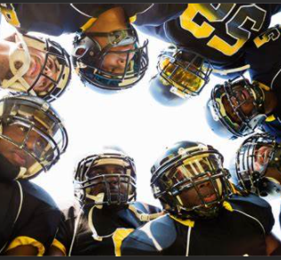

Teamwork
Let's look at two team sports – Basketball and Football
Notes:
Hoosiers and Remember the Titans – all classic examples of a teams working together under imperfect conditions (good examples of leadership, team building, and teamwork). Do we work under imperfect conditions? How over worked are we? How understaffed are we?

Slide 6


Which is the better team based on winning results?
Notes:
Why are the Bengals a better team than the Jets? Is the way the team is built or better teamwork? Possibly both….

Slide 7


Which is the better team based on winning results?
Notes:
However - Brooklyn Nets have Kevin Durant, Kyree Irving and James Harden (now traded), all great payers individually. Why was their record 29-25 before Hardin was traded? The Phoenix Suns have Devin Booker, Chris Paul (age 36), and Deandre Ayton. Their record is 45-10 before the all-star break. What do the Suns and the Bengals have in common? Could it start with leadership, cohesive team members, better teamwork?

Slide 8
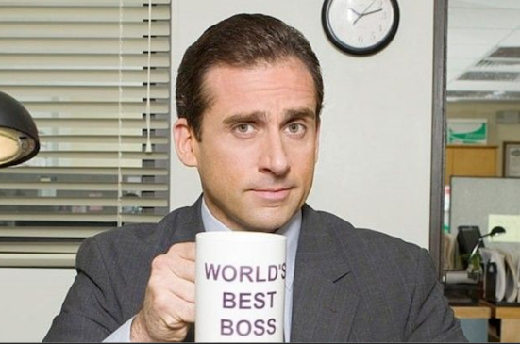
Team Building and Teamwork
What role does management play in team building and, ultimately, successful teamwork?
The department leaders must have a clear vision, clear message, open lines of communication, and mutual respect for all team members
Notes:
First let’s start at the top – management! Give examples of a clear vision. The message supports the vision. The communications supports the message. Mutual respect happens because each team member feels involved in the mission. (mention how important it is to say hello each morning)

Slide 9
teamwork
Responsibility and Dedication | When team members are aware of what expectations need to be met, they are more ready to be held accountable for their decisions and work. Similarly, these team members are willing to undertake proactive measures to finish the assigned tasks within a given timeframe. Overall, members of a good team are not only aware of the objectives, but they also commit themselves wholeheartedly to achieve the set goals.
What role can team members have in successful teamwork once management does its part?
Notes:
Cite occasions when a permit specialist wanted more information in order to understand the requirement. Describe how field trips helped with temporary power for new construction.

Slide 10
Team Building and Teamwork
Making teamwork specific to permitting and inspections.
Please answer the following questions?

Slide 11
Teamwork
Do you dislike your work environment (no cohesion among team members or a lack of collaboration)?
Can successful team building enhance our role in the building code process?
Can successful teamwork enhance our day to day permitting and inspection operations?
We administer building, zoning, and record keeping laws and ordinances but…
Notes:
Get the right people in the right places. Know your group strengths and where improvement is needed. (give example of electrical inspector/ plan reviewer) Keep people engaged. – let’s discuss leaders and team members.

Slide 12
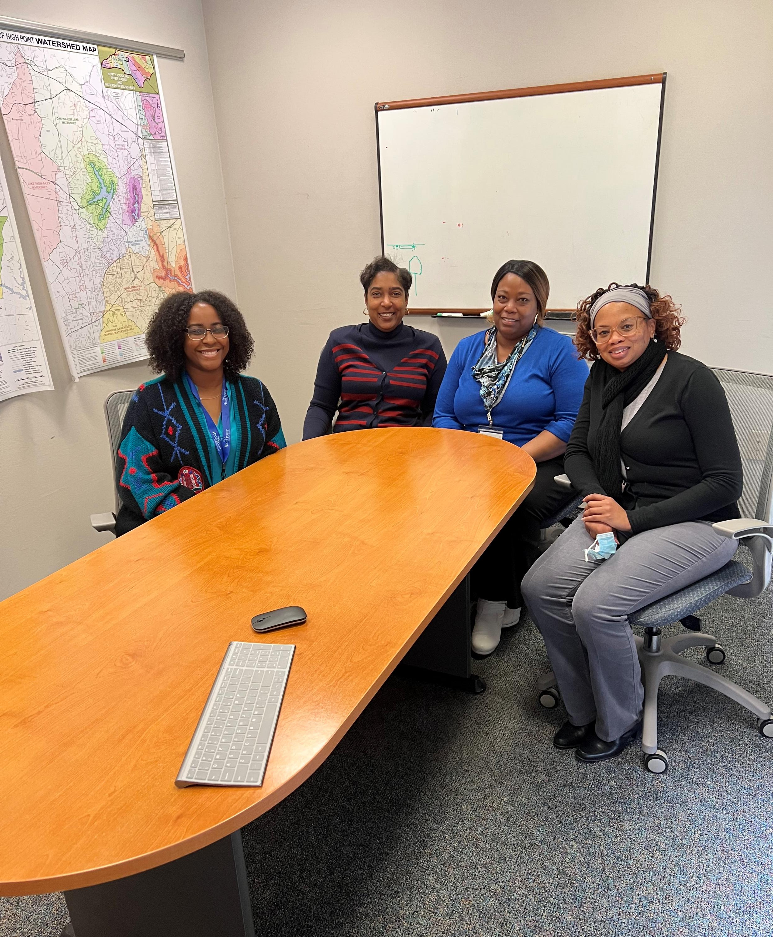
Teamwork
Do you have written standard operating procedures?
Do you work in a large or small department?
How is work distributed?
Does one person do the same task everyday or is cross-training included?
Do you feel overworked or is everyone doing their share?
Notes:
Do you work in a large department or small? How do you distribute your work? Does one person do the same tasks? How do you cover work while lunch breaks are taken? Does one person only answer telephones all day? How is cash handled? It’s important to remember, people should never be taken for granted or ignored. That is not the way to build a cohesive team.

Slide 13
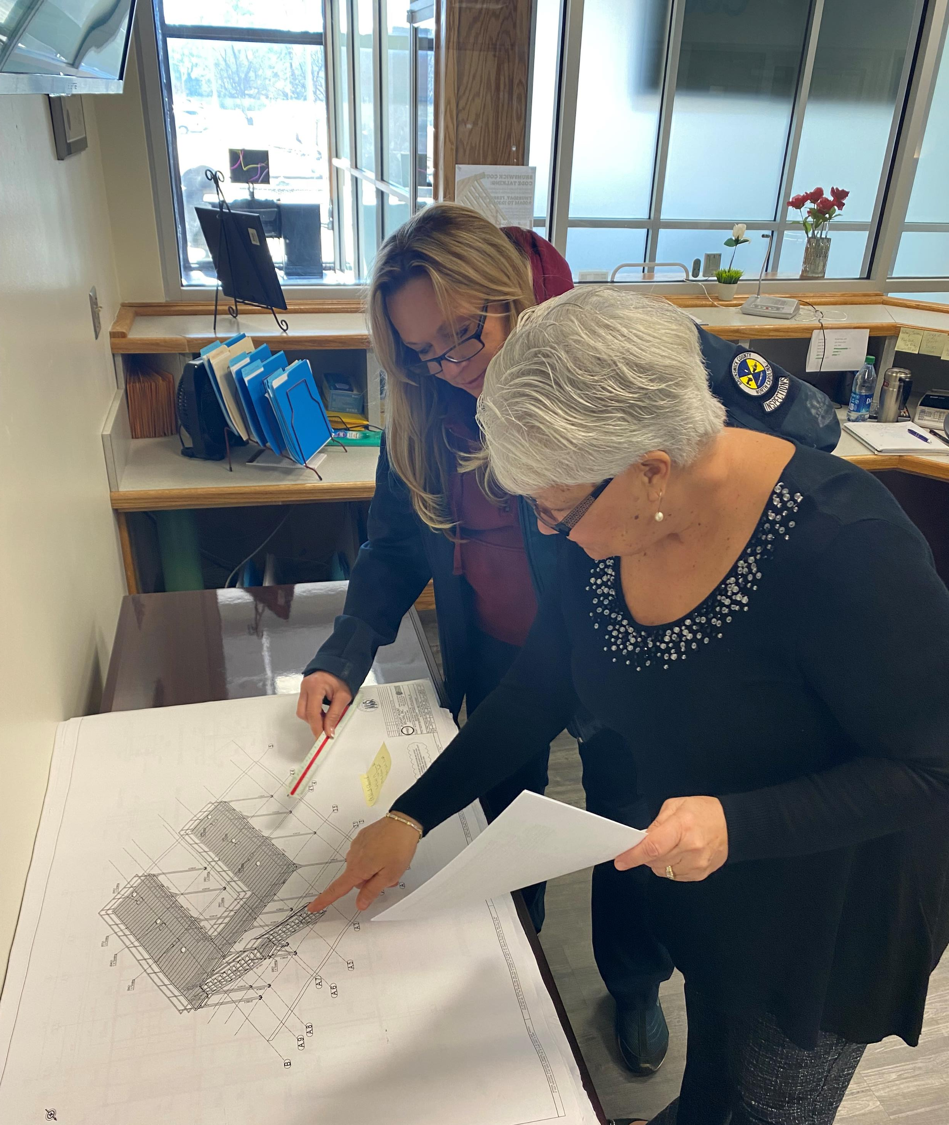
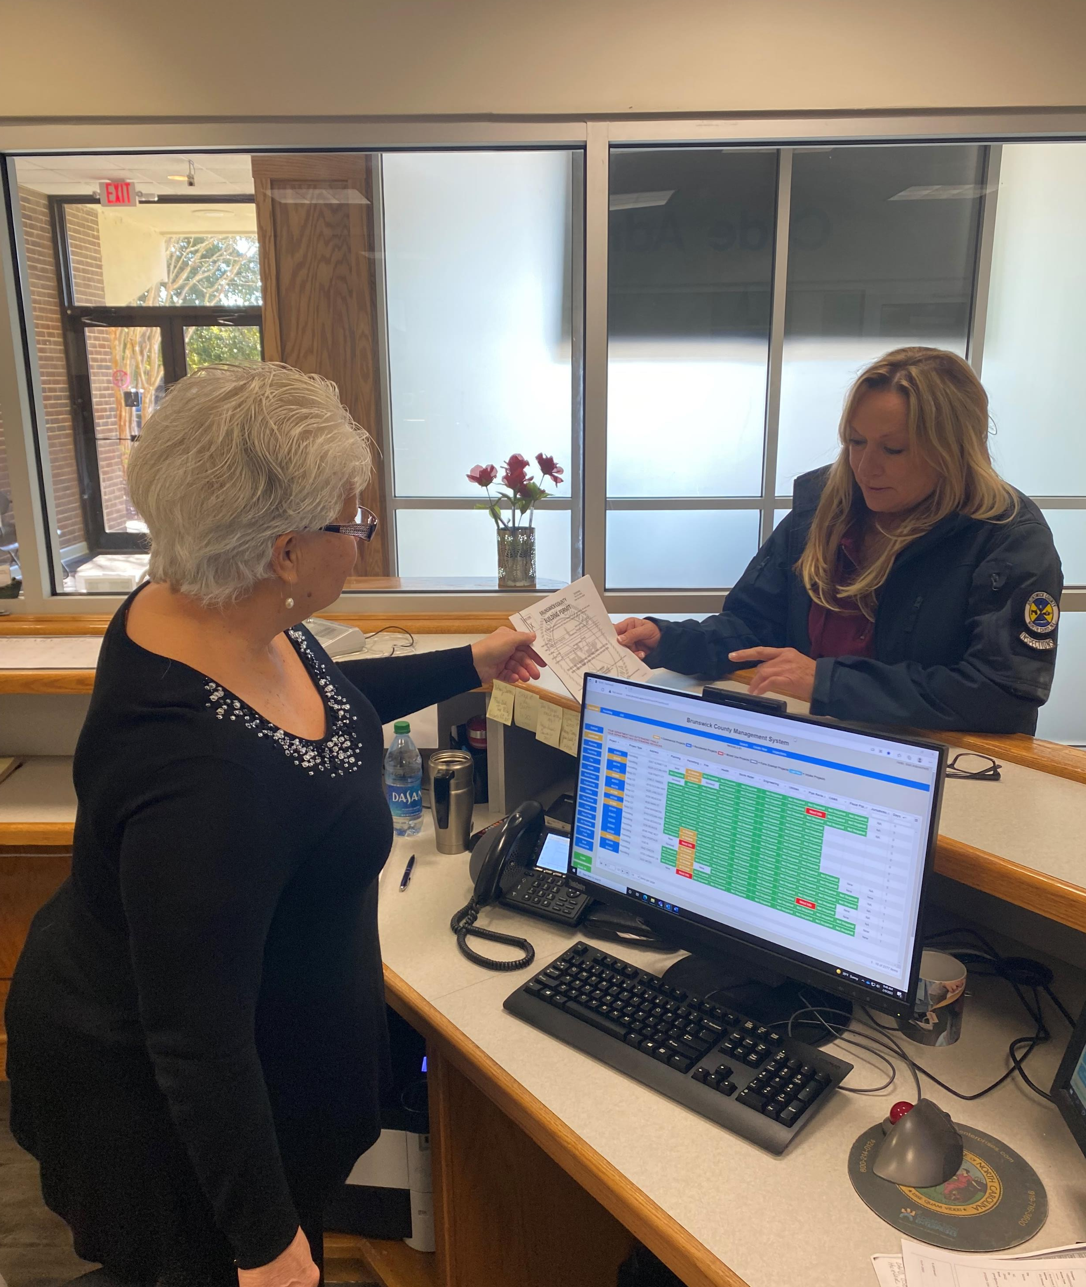
Team Building and Teamwork
What are your department's objectives and goals for your position as a permit professional?
Notes:
What does your job description say? Is it one borrowed from your jurisdiction’s definition of administrative assistant? Is cross-training an objective. Is there an opportunity to learn more? Are customer service and project management (permit issuance) a priority? Are there a career development and career ladder systems built into your management system?

Slide 14
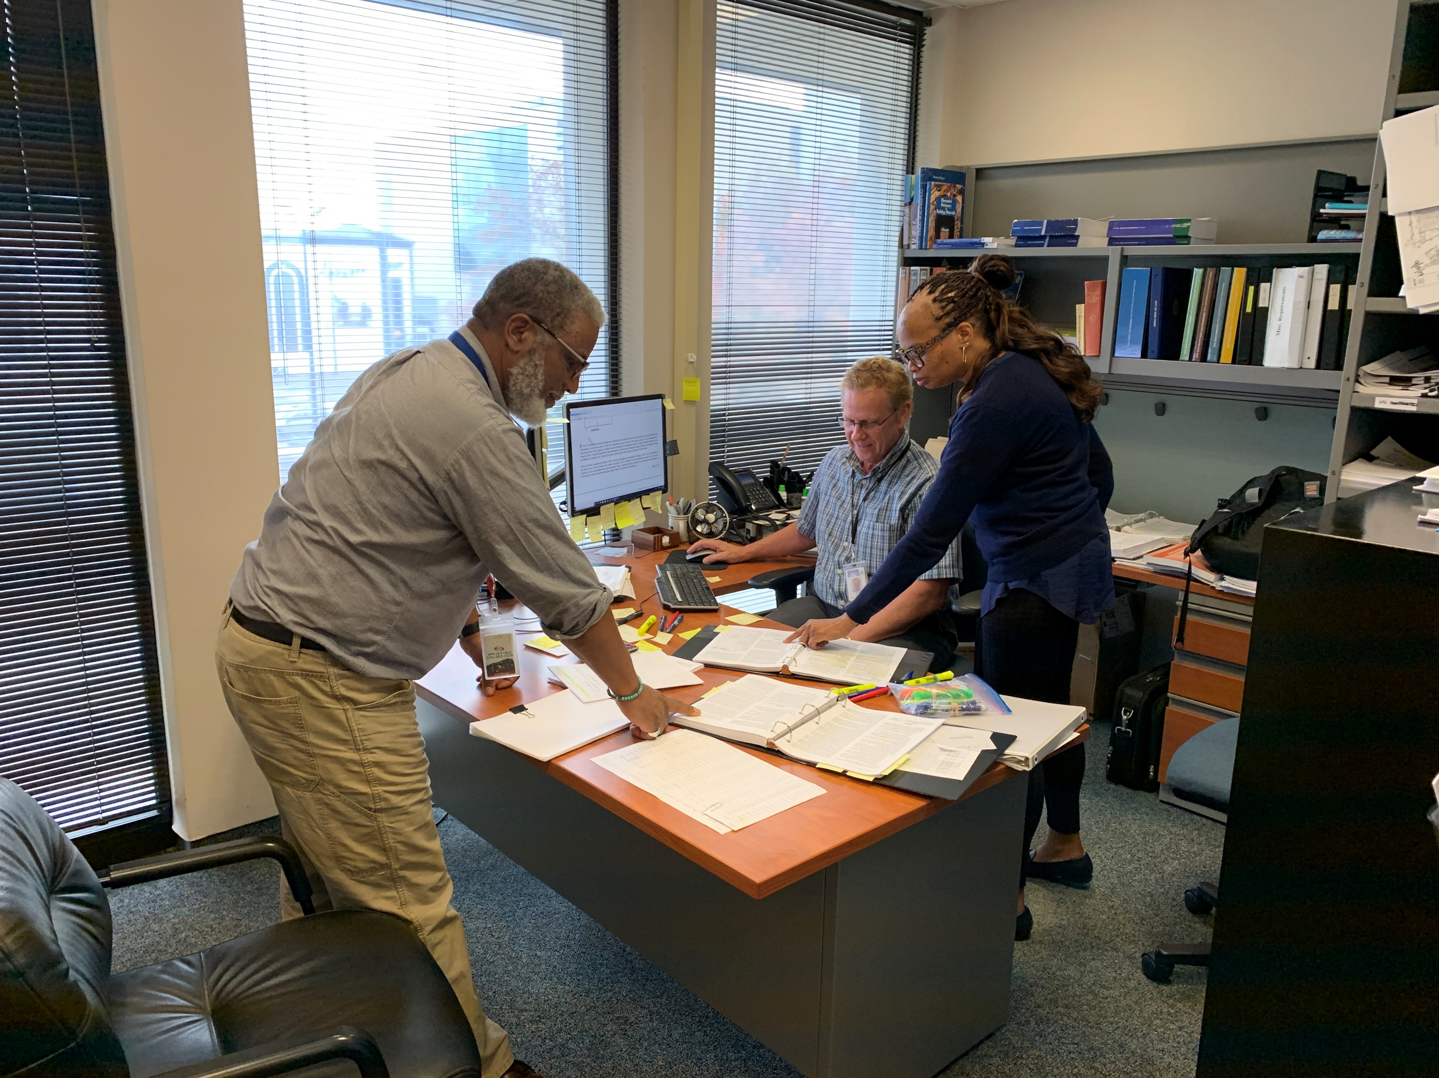
Team building and Teamwork
Are workflows built into your system so that everyone, including inspectors, know and do their part? What software do you use for permitting? Is it an enterprise system?
Notes:
Resulting inspections, resulting plan reviews, and calling customers are all part of the inspection job and process. Examples of poor workflow systems - Do you see inspectors walking up to you with bits of paper in their hands? Inspectors are part of the team too. Do they return calls or let their voicemail pile up and expect you to return calls for them? Give example of early New Hanover County system.

Slide 15
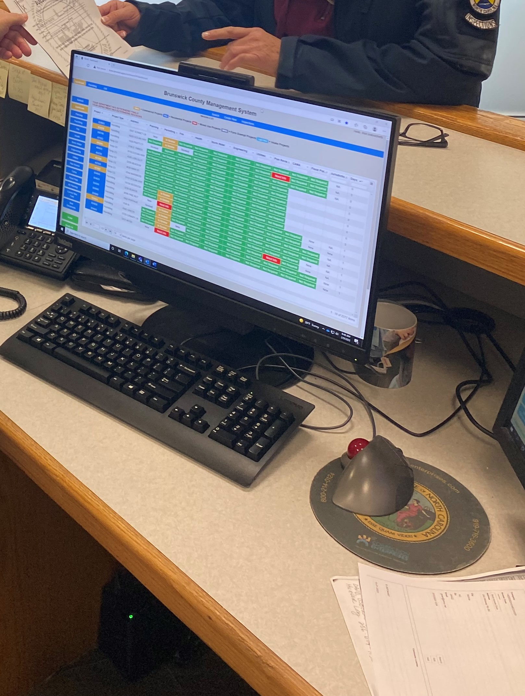
Team building and Teamwork
What percentage of your customers apply for permits and schedule inspections online? How are they encouraged to transition to online submittals? This can be an important customer service initiative that produces “win-win” results.
Notes:
Does your department have weekly, monthly, or quarterly outreach meetings? Do you present information at Home builders' meetings? A “win-win” result is when both sides benefit from a particular solution, which is a customer service goal we all want to achieve. Go to Dashboard and discuss how it improves project performance. Ask the audience how many of their customers submit online. Tell story about contractors lined up to submit plans and permit applications.

Slide 16
Team Building and Teamwork
Does your department require paper plans or is electronic plan review part of your workflow process?

Slide 17
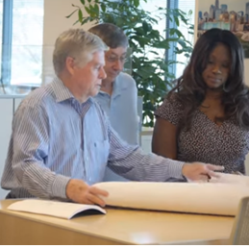
Team Building and Teamwork
Speaking of customer service, is it a priority in your department?
Notes:
Customer service priorities have been watered down during the pandemic, but not forgotten by homebuilders and legislators. I would argue that we could provide systems that could take most of the bluster from their complaints. Laws can and do change. Systems are changing too. Zoom, Teams, and WebEx have taken a large portion of in person meetings and made them virtual. The different ways we can provide service today is growing. Use the example of building contractor lines before electronic plan review and submittal, virtual inspections, and this meeting has gone virtual too. However, as a result of these improvements, people do not want to talk on the phone anymore. Don’t prolong a call to a frustrated customer (inspectors too). It could turn into a meeting with your county manager, mayor, etc.

Slide 18
Team Building and Teamwork
Remember, the building block of every team is the individual.
Phil Jackson said “ The strength of the team is each individual member. The strength of each member is the team.”
Notes:
Phil Jackson, coach of the Chicago Bulls in the 90’s had great team individuals and a great team. Anybody watch the Last Dance on Netflix?

Slide 19



Team Building and Teamwork
Notes:
How many staffs with two persons are represented today? How about three? Four or more? Tell me how your department handles the day-to-day traffic and how efficient to you think your department is? Any thoughts questions, thoughts, or comments on Team Building and Teamwork? Ask questions about teams for prizes.

Slide 20

Team Building and Teamwork
“Individually, we are one drop. Together, we are an ocean.”
Notes:
When raindrops come together, we create some great things!

