Slide 1
Median Arcuate ligament syndrome
Imaging, Diagnosis and Management
Jonathan B. Bard, MD
Medical Director, Envision Imaging McKinney

Slide 2
Jonathan B. Bard, MD
Radiology Residency UCLA
Neuroradiology Fellowship Stanford
Diagnostic Radiology Associates of Dallas – Partner
Solo Practice 2003- Present with Envision Radiology
Married, 2 boys, 15 and 11
Hobbies include piano lessons, Texas Hold’em, Bass, Music (Blues)
Disclosure Statement – No financial interest to disclose

Slide 3
Median Arcuate Ligament syndrome
MALS
Median arcuate ligament
Celiac artery compression syndrome
Dunbar syndrome, Horjola-Marable syndrome
Compression of the celiac trunk by the median arcuate ligament
Worse with expiration
Notes:
The median arcuate ligament is formed by the right and left crura of the diaphragm. The crura connect to form an arch, behind which is the aortic hiatus, through which pass theaorta, the azygos vein, and th
e thoracic duct.
condition characterized byabdominal painattributed to compression of the celiac artery and possibly the celiac ganglia by the median arcuate ligament.^{[1]} The abdominal pain may be related to meals, may be accompanied by weight loss, and may be associated with an abdominal bruit heard by a clinician. It is also called celiac artery compression syndrome.

Slide 4
MALS symptoms
Common symptoms
Preoperative workup
Post prandial pain
Emesis, bloating, weight loss
Diagnosis of exclusion and with Doppler ultrasound, CTA
Colonoscopy
Upper endoscopy
Testing for Celiac Disease
Testing for H Pylori
Upper GI barium swallow
Ultrasound and HIDA scan
Psychological and Pain evaluation
Notes:
The Team
The median arcuate ligament syndrome (MALS) multidisciplinary team is led by pediatric surgeon Dr. Grace Mak and vascular surgeon Dr. Christopher Skelly. This team consists of our MALS coordinator Christopher Speaker, APN; a psychiatrist, interventional radiologist and pain specialists.
The Program
Since its inception, the MALS program has diagnosed and treated this disease in both males and females of all ages from across the world. MALS is thought to be a multifactorial disease process leading to chronic abdominal pain most commonly following meals. The cause is likely multifactorial, consisting of compression of the celiac artery by the median arcuate ligament compromising blood flow as well as neuropathic pain due to the celiac plexus. At the University of Chicago Medicine, we use vascular duplex studies and computed tomography angiography (CTA) along with 3-D imaging to diagnose MALS. Treatment then consists of laparoscopic release of the median arcuate ligament performed by the combined team of pediatric and vascular surgery. Patients are followed long-term by surgery, repeat vascular duplex imaging, as well as psychiatry.
For more information regarding the UCMALS program, please visit www.ucmals.com.

Slide 5
MALS anatomy
Theories
Normal on left, abnormal on right
Abnormally inferior and anterior location of MALS
Compresses the celiac axis, causing ischemia
Possible compression of the celiac ganglia
However, this occurs in up to 25% of normal individuals
Notes:
ide views (sagittal plane) of the descending aorta and two of its branches, the celiac trunk andsuperior mesenteric artery, demonstrate normal and MALS anatomy. Left The median arcuate ligamentis normally several millimeters to centimeters superior to the origin of the celiac artery. Right In MALS, the ligament is anterior, rather than superior, to the celiac artery, resulting in compression of the vessel and a characteristic hook-shaped contour.
Horton KM, Talamini MA, Fishman EK (2005). "Median arcuate ligament syndrome: evaluation with CT angiography". Radiographics 25 (5): 1177–82.doi:10.1148/rg.255055001. PMID 16160104.

Slide 6
Celiac axis Anatomy
Celiac trunk
Left Gastric
Splenic artery
Common Hepatic artery
Gastroduodenal artery

Slide 7
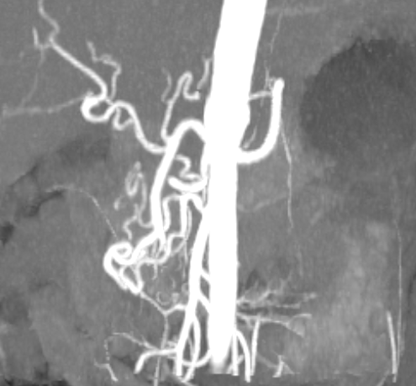
Celiac axis Anatomy
Celiac trunk
Left Gastric
Splenic artery
Common Hepatic artery
Gastroduodenal artery

Slide 8
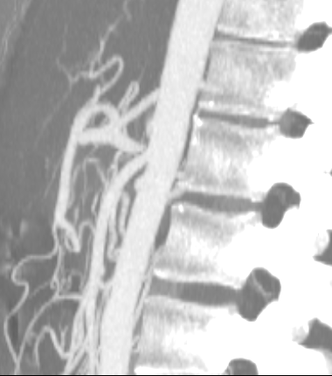
Celiac axis Anatomy
Celiac trunk
Left Gastric
Splenic artery
Common Hepatic artery
Gastroduodenal artery

Slide 9
MALS Management Theory
Compression of the Celiac axis leads to symptoms
Vascular - Bowel ischemia
Neurogenic - Celiac Ganglia compression cause pain
Laparoscopic treatment of MALS can help resolve symptoms by decompression of the artery, but also releasing or destroying the adjacent ganglia
Chronic Functional abdominal pain Syndrome overlaps with MALS
CFAP is similar to IBS, but no bowel changes (diarrhea, constipation)

Slide 10
Web and other Resources
Horton KM, Talamini MA, Fishman EK (2005). "Median arcuate ligament syndrome: evaluation with CT angiography". Radiographics 25 (5): 1177–82.doi:10.1148/rg.255055001. PMID 16160104.
YouTube “SMA Syndrome and Median Arcuate Ligament Syndrome: True Syndromes or Fantasy” ctisus
https://www.youtube.com/watch?v=L9ftfucwLWI
University of Chicago MALS Program
http://www.ucmals.com/mals.html

Slide 11
http://www.slideshare.net/pryce27/rsna-final-2?qid=1560f210-f9be-489a-b48f-1231cf91008d&v=qf1&b=&from_search=6
http://www.theparisreview.org/blog/2015/09/11/the-most-misread-poem-in-america
Notes:
http://pubs.rsna.org/doi/full/10.1148/rg.1103035010

Slide 12
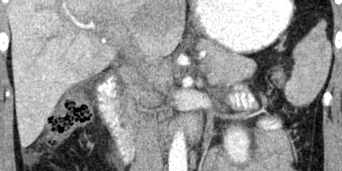
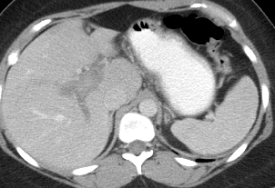
The Road Not Taken- Case 1

Slide 13
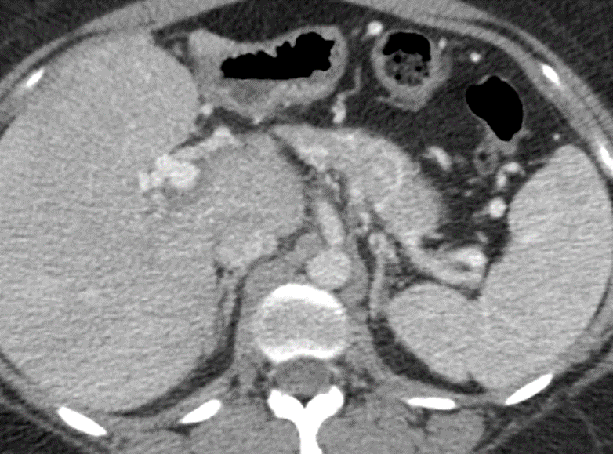
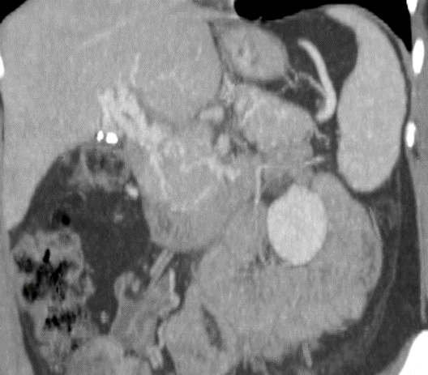
What has happened?
Partial resolution of PV thrombosis
Tumor invasion of PV
Cavernous transformation of PV

Slide 14
Ultrasound of MALS
Mesenteric/celiac duplex ultrasound interpretation criteria revisited.
J Vasc Surg. 2012 Feb;55(2):428-436.e6; discussion 435-6. doi: 10.1016/j.jvs.2011.08.052. Epub 2011 Dec 21.
he PSV threshold that provided the highest OA for ≥50% stenosis was ≥240 cm/s and for ≥70% stenosis was ≥320 cm/s
Notes:
J Vasc Surg. 2012 Feb;55(2):428-436.e6; discussion 435-6. doi: 10.1016/j.jvs.2011.08.052. Epub 2011 Dec 21.
Mesenteric/celiac duplex ultrasound interpretation criteria revisited.
AbuRahma AF¹, Stone PA, Srivastava M, Dean LS, Keiffer T, Hass SM, Mousa AY.

Slide 15
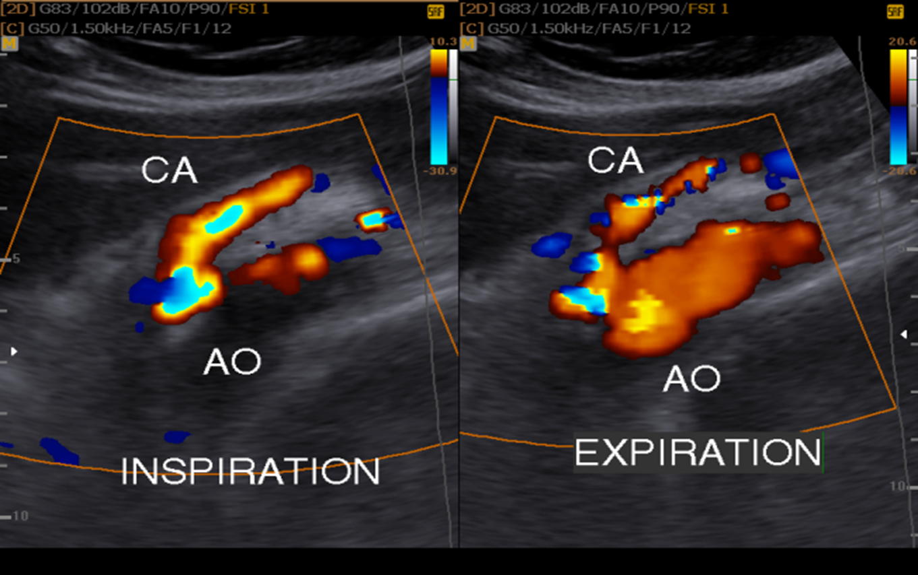

Slide 16
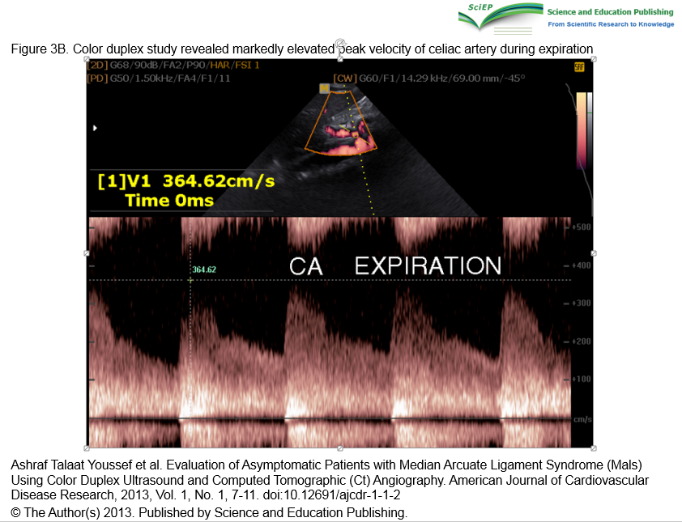

Slide 17
CTA of MALS
Narrowed Celiac Axis
Post stenotic dilation
Hooked proximal Celiac artery after stenosis
Vessel collaterals
Protocol varies, need 1mm recons, but arterial phase done in expiration, venous or delayed in normal respiration
Need thin MIPS for diagnosis and stenosis, thick MIPS for collaterals

Slide 18
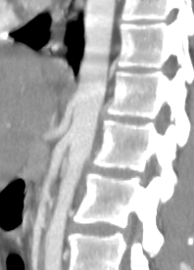
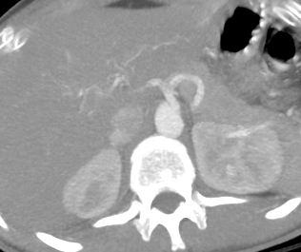
Motion artifact full expiration

Slide 19
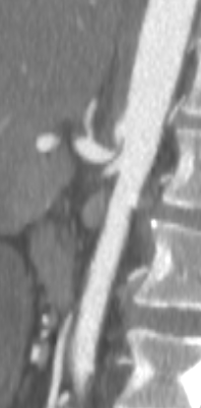
Same Patient in earlier slides – thin MIPS
High Grade stenosis of the Celiac trunk

Slide 20
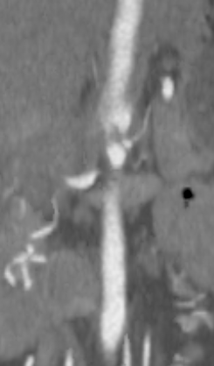
Same Patient – thin MIPS
High Grade stenosis of the Celiac trunk

Slide 21
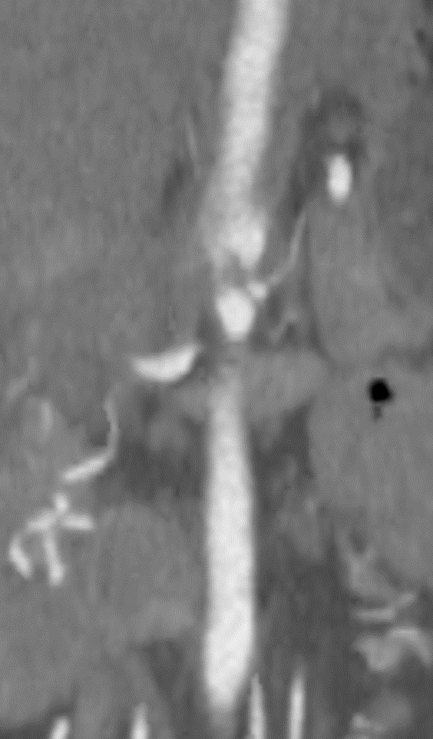
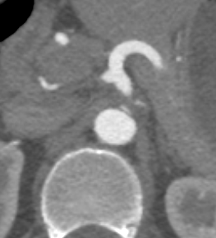
Same Patient – thin MIPS
High Grade stenosis of the Celiac trunk

Slide 22
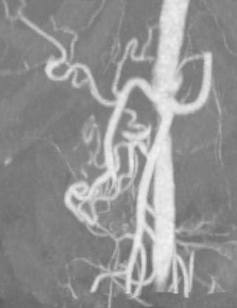
MALS - Collaterals
SMA to Gastroduodenal Collaterals
Same patient

Slide 23
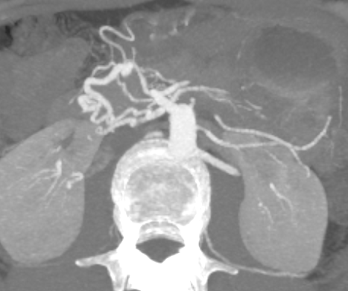
MALS - Collaterals
SMA to Gastroduodenal Collaterals
Same patient

Slide 24
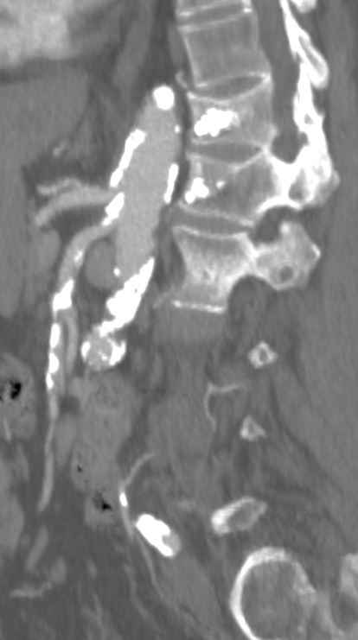
Atherosclerotic Disease
Notes:
Maybe collaterals, less likely however. Treatment is different

Slide 25
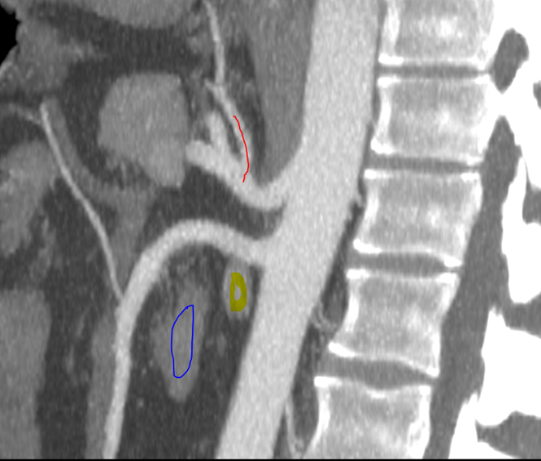
Second Year Case

Slide 26
Which of the following is false?
Red line is Left Gastric Artery
Yellow is Left Renal Vein
Blue is Duodenum
This patient has SMA Syndrome
This patient does not have MALS
0 of 0

Slide 27
SMA Angle

Slide 28
Nutcracker phenomenon
Congestion of left renal vein from SMA and Aorta
Some have urinary symptoms
Pelvic congestion syndrome cause?
Renin angiotensin system activation
Treatment
Notes:
Melinda Hager
Burky, Fiona A
Rockett, Endia F
MALS Harjola 1963
Elizabeth P Marsden

Slide 29
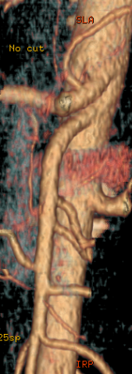
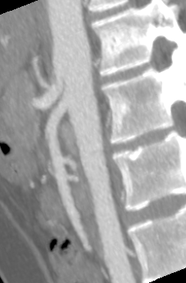
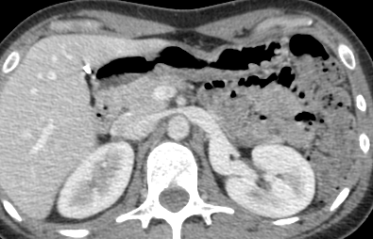
Is this MALS?

Slide 30
Challenges to MALS diagnosis and management
Defining Significant stenosis on CTA
Excluding other diagnoses (Nutcracker, SMA syndrome)
Recurrent symptoms after laparoscopic surgery
Recurrent stenosis
Repeat CTAs are done only on patients with recurrent symptoms
Here are some failures

Slide 31
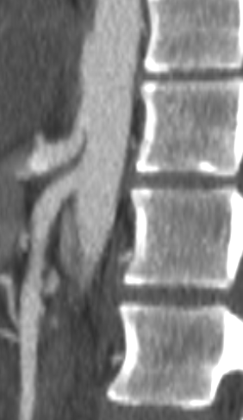
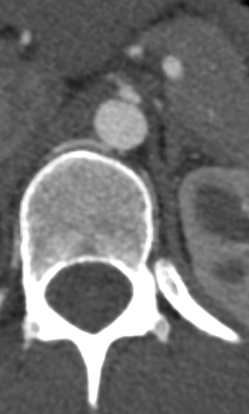
Initial study March 2015 pre-surgery

Slide 32
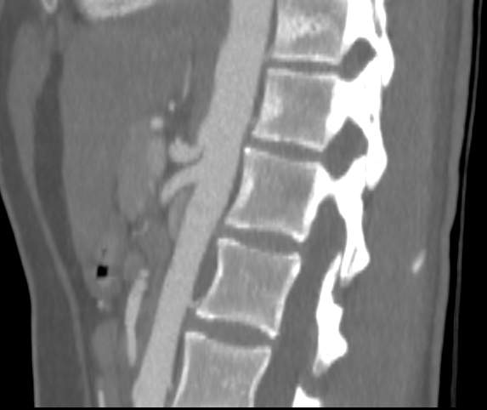
Post Surgery

Slide 33
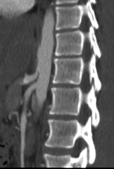
Preoperative MALS

Slide 34
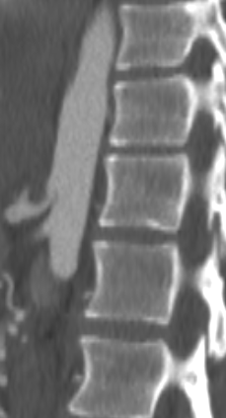
Recurrent post op stenosis

Slide 35
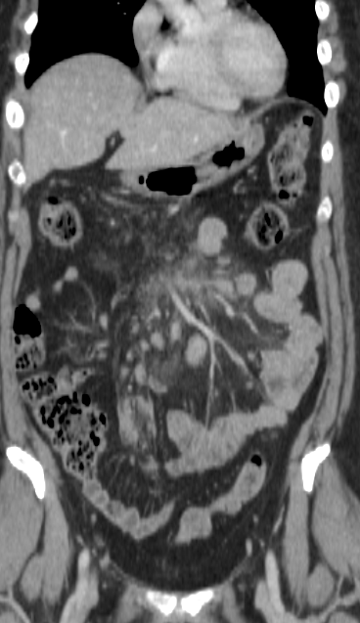
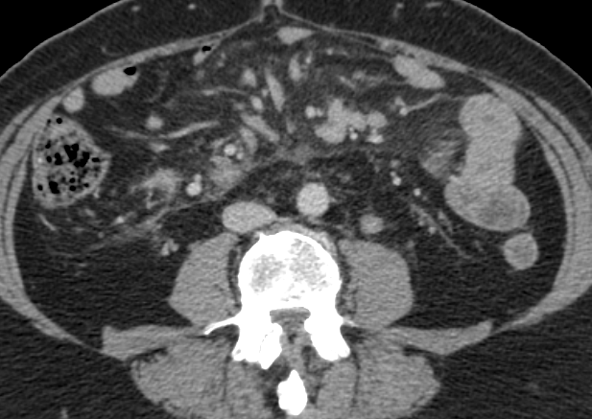
4th Year case - Pain

Slide 36
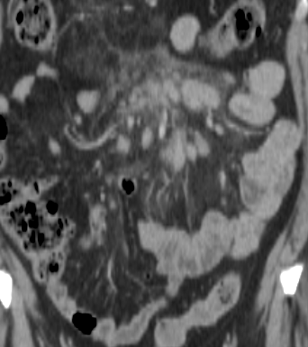
Differential?
Sclerosing Mesenteritis
Lymphoma
Carcinoid
Mesothelioma
Malignancy
All of the above

Slide 37
What would aid in narrowing the differential?
Desmoplastic Reaction
Calcification
Ascites
Hypervascular Liver tumors
All of the above
Notes:
http://pubs.rsna.org/doi/full/10.1148/rg.1103035010

Slide 38
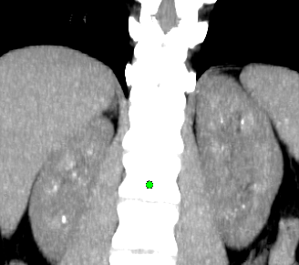
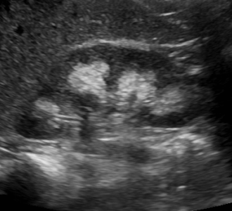
First Year – What Is the most common cause of this finding?
Medullary sponge kidney
Distal Renal tubular acidosis
Hyperparathyroidism
Hypercalcemia

Slide 39
With What is this finding NOT associated?
MEN type 2B
Polyhydramnios
Immobilization
Ehlers-Danlos Syndrome
Notes:
Bartter syndrome POLY HYDRAMNIOS is a rare inherited defect in the thick ascending limb of the loop of Henle. It is characterized by low potassium levels (hypokalemia),^{[1]}increased blood pH (alkalosis), and normal to low blood pressure. There are two types of Bartter syndrome: neonatal and classic. A closely associated disorder, Gitelman syndrome, is milder than both subtypes of Bartter syndrome.
MEN1 and MEN 2B are hyperparathyroidism
Multiple endocrine neoplasia type 2(MEN2) (also known as "Pheochromocytoma and amyloid producing medullary thyroid carcinoma",^{[1]} "PTC syndrome,"^{[1]} and "Sipple syndrome"^{[1]}) is a group of medical disorders associated with tumors of theendocrine system. The tumors may bebenign or malignant (cancer). They generally occur in endocrine organs (e.g. thyroid,parathyroid, andadrenals), but may also occur in endocrine tissues of organs not classically thought of as endocrine.^{[2]}
MEN2 is a sub-type of MEN (multiple endocrine neoplasia) and itself has sub-types, as discussed below. EN2 can present with a sign or symptom related to a tumor or, in the case of multiple endocrine neoplasia type 2b, with characteristic musculoskeletal and/or lip and/or gastrointestinal findings.
Medullary thyroid carcinoma (MTC) represent the most frequent initial diagnosis. Occasionally pheochromocytoma and primary hyperparathyroidism may be the initial diagnosis.
Pheochromocytoma occurs in 50% of cases.^{[3]}
In MEN2A primary hyperparathyroidism occurs in only 10–30% and is usually diagnosed after the third decade of life. It can occur in children but this is rare. It may be the sole clinical manifestation of this syndrome but this is unusual.
MEN2A associates medullary thyroid carcinoma with pheochromocytoma in about 20–50% of cases and with primary hyperparathyroidism in 5–20% of cases.
MEN2B associates medullary thyroid carcinoma with pheochromocytoma in 50% of cases, with marfanoid habitus and with mucosal and digestive neurofibromatosis.

Slide 40
Ehlers Danlos syndrome Q79.6
Inherited Connective tissue disorder
6 major types (consolidated from 10)
Multiple genes, can be x-linked or Dominant or Recessive
1 in 2,500-5,000 people.
Type 3 Hypermobility type most common
Joint instability, MSK Symptoms, early arthritis
Also Mitral valve prolapse, Ascending Aortic Rupture

Slide 41
EDS Type 3
1 in 10-15,000, most common subtype
Scoliosis
Fragile skin
Nerve compression disorders
Hiatal Hernia
Ascending Aorta Rupture
Raynaud’s Phenomenon
Postural orthostatic Tachycardia Syndrome

Slide 42
POTS (Postural Orthostatic Tachycardia Syndrome)
Increase of at least 30 bpm when going from supine to upright.
No orthostatic hypotension
Blood pressure does not drop
Chronic fatigue syndrome – up to 50 % may have POTS
EDS type 3 patients have POTS up to %40 comorbidity
Theory – Underlying Dysautonomia

Slide 43
POTS (Postural Orthostatic Tachycardia Syndrome)
Theory– Underlying Dysautonomia
Hyper adrenergic POTS – hypovolemia or autonomic neuropathy
Neuropathic POTS – Denervation of sympathetic nerves, impaired constriction of vessels
Causes
Genetics
Post viral illness or parasitic infection, Lyme, MS, Lupus
Many others
Syrinx – Chiari type 1

Slide 44
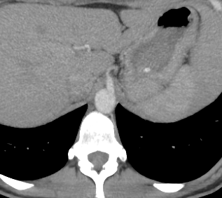
Symptomatic but no stenosis
Notes:
Wiley, Michael, A

Slide 45
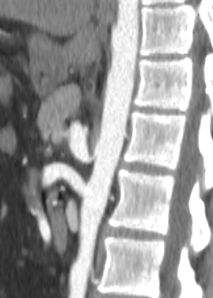
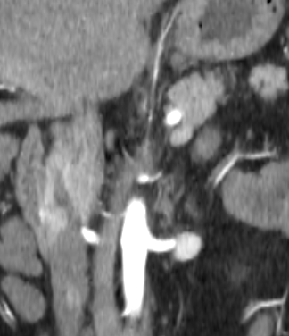
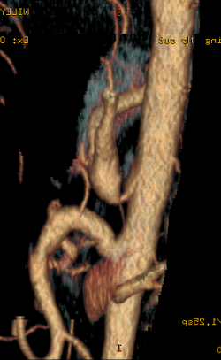
Recurrent Stenosis Post operative

Slide 46
Summary
MALS Diagnosis is not as straightforward as we thought
Treatment failures cause reevaluation of imaging studies
Is there something on the images that can guide management and alter the outcome? I suspect so
Data are still being collected – 60 patients so far, 65 studies total

Slide 47
THANK YOU

Slide 48
Fellow case - 57 year old with soccer injury
Notes:
1. Complete tear with retraction of the unipennate, direct, portion of the rectus femoris muscle. There is 47 mm of retraction of this muscle and aponeurosis.
2. The bipennate, central and anterior, portion an indirect tendon are intact.

Slide 49
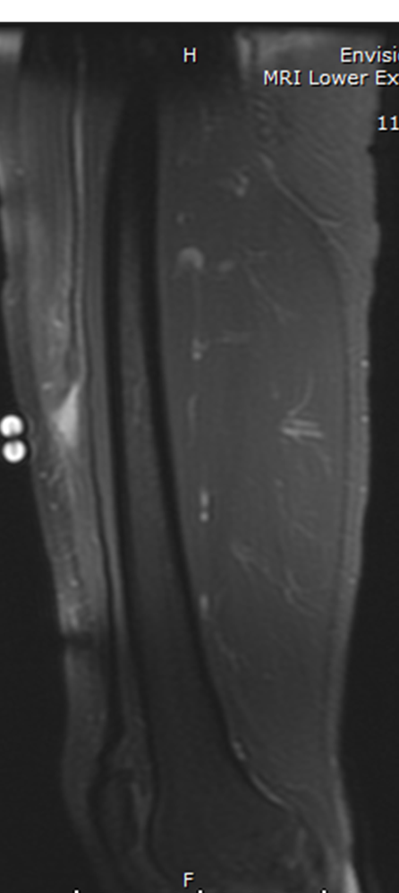
Regarding the rectus femoris muscle tear:
The bipennate portion is torn
The unipennate portion is torn
The indirect tendon is torn
The bipennate portion surrounds the unipennate portion
Notes:
1. Complete tear with retraction of the unipennate, direct, portion of the rectus femoris muscle. There is 47 mm of retraction of this muscle and aponeurosis.
2. The bipennate, central and anterior, portion an indirect tendon are intact.

Slide 50
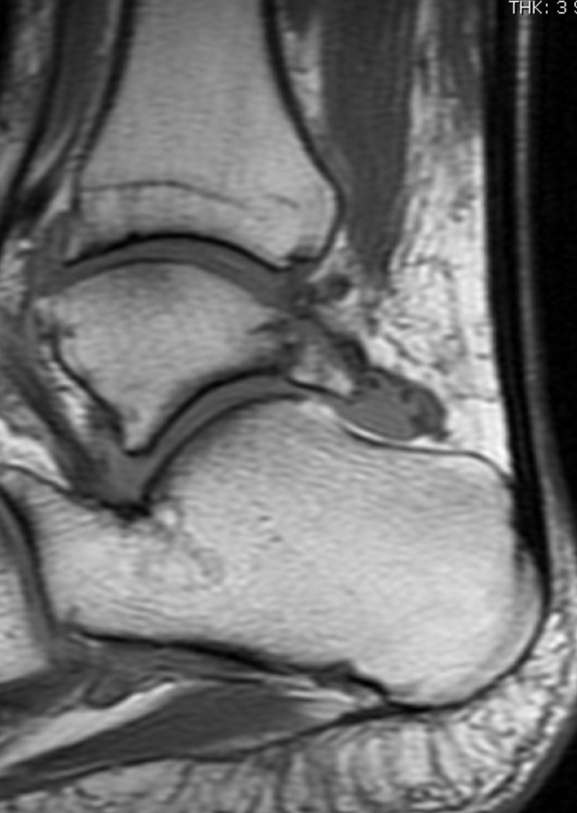
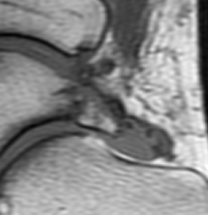
3rd year case - Which is false?
There is an Os trigonum
There is a Shephard Fracture
Tibiotalar arthrosis
Stieda’s process is fractured
There is posterior impingement
Notes:
Mechanism of injury
injury to lateral tubercle (also called a Shepherd fracture) is caused by inversion or extreme equinus
injury to medial tubercle (also called a Cedell fracture) is uncommon and is caused by forced dorsiflexion and pronation

Slide 51
Potpourri - Which of the following is false?
Bard-Pic Syndrome is Progressive obstructive jaundice, Large palpable gallbladder (Courvoisier’s sign) and rapid cachexia due to Pancreatic Head Carcinoma
Bard Syndrome is military pulmonary metastases from Gastric neoplasm
A Bard was Behind the plate when Barry Bonds hit his 756th career home run, breaking Hank Aaron’s record
BARD1 is a gene on Chromosome 2 that is associated with BRCA1 mutations and increase risk of cancer

Slide 52
True

Slide 53
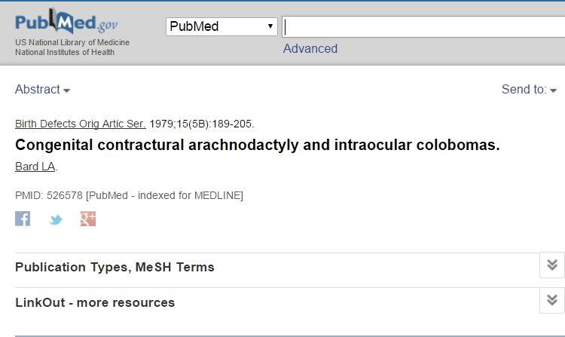
The Real Bard syndrome

