Slide 1
The Vietnam war era, 1945 - 1975
The War for Independence in Vietnam

Slide 2
The Vietnamese Declaration of Independence
Written in 1945 as a declaration of independence from France, Ho Chi Minh embraced many of the ideas in the United States Declaration of Independence – Thomas Jefferson’s work – and the ideas of the French Revolution, which emphasized the need for free men to live under self-government.

Slide 3
The Vietnamese war for Independence begins
In his Declaration of Independence, Ho argued that the Vietnamese had won their independency by defeating the Japanese Army – a feat which the French were incapable of. Once the Declaration was written, though, war with France was imminent. The United States did not intervene, indeed, we assisted the French in re-establishing control of their former colony.
War with France
French Indochina War, 1945 - 1954

Slide 4
The battle of Dien bien phu
In 1954, Vietnamese forces finally defeated the French in their war for independence. Surrounding the French at Dien Bien Phu, they eventually forced the Army to surrender and negotiate the Geneva Accords, end the war.

Slide 5
The Geneva Accords Divide Vietnam
When the Geneva Accords were signed in 1954, French Indochina was divided into three new nations: Cambodia, Laos, and Vietnam. Vietnam itself, however, was divided into two portions: North and South, to be separated at the 17th Parallel north latitude. In the future, elections were supposed to be held to unify the nation under one government. These elections, sadly, never took place.
New Nations in Southeast Asia
Divided Vietnam

Slide 6
The policy of containment, continued…
Despite the fact that Americans have always professed a strong belief in self-determination of nations, despite our anti-imperialist beliefs, and despite the fact that any democratic election would have resulted in victory for Ho Chi Minh and his supporters, the United States continued to oppose Ho on one ground – he was a communist.

Slide 7
The domino Theory
The Domino Theory postulated that if one nation in a region fell to communism, neighboring nations would be threatened by communism as well – in Vietnam, the belief was that nations like Cambodia, Laos, and Thailand would all fall to communism.

Slide 8
The dictatorship of Ngo Dinh Diem –South Vietnam’s leader
Because Americans would not vary from their belief in containment – and due to the domino theory’s threats to other nations, the US supported the ruthless Diem dictatorship in South Vietnam – instead of allowing elections to unify Vietnam under the leadership of Ho Chi Minh. Meanwhile, in Vietnam, Buddhist monks burned themselves alive – self-immolation – in order to protest Diem’s horrific methods.

Slide 9
Ngo dinh diem’s assassination
In November of 1963, Diem, who was opposed by the Buddhist community of Vietnam, the Vietcong (who were actively trying to overthrow him in favor of Ho Chi Minh), and him own military, was assassinated.

Slide 10
Military rule in South Vietnam
After Diem’s assassination, there were a series of military dictatorships which governed South Vietnam. The United States always supported these regimes because they were anti-communist. None, however, were democratic governments. The most stable government, which lasted from 1967 to the end of the war and ultimate surrender to Ho Chi Minh’s forces, was that of General Nguyễn Văn Thiệu.

Slide 11
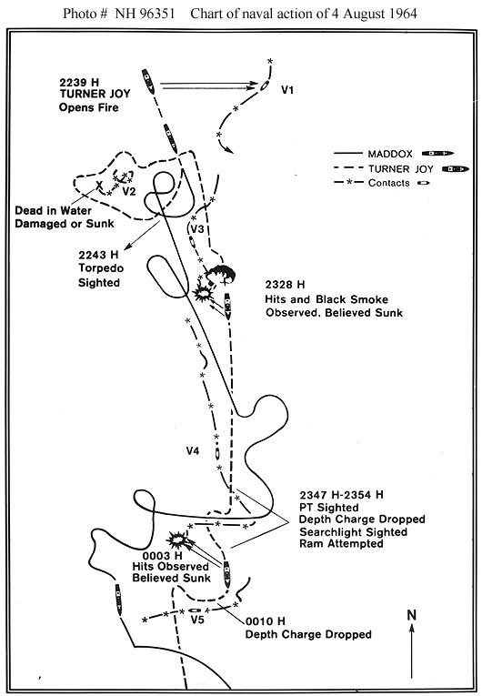
The gulf of Tonkin Incident & the gulf of Tonkin Resolution
The United States Navy reported to have been attacked by North Vietnamese gunboats in the Gulf of Tonkin in 1964. Many historians doubt whether the attacks even happened – the North Vietnamese Navy was not a formidable force.

Slide 12
The Gulf of Tonkin Resolution
Passed by Congress in 1964, the Gulf of Tonkin Resolution gave the power to wage war in Vietnam to the President of the United States – without ever declaring war on the sovereign nation of North Vietnam.

Slide 13
Between 1964 and 1968, The United States of America escalated its involvement in Vietnam.
By 1968, the United States had over 500,000 men on the ground in Vietnam – many of whom had been drafted into the Army and forced there against their will.

Slide 14
Operation Rolling Thunder
During Operation Rolling Thunder, the United States Air Force sought to completely incapacitate the North Vietnamese ability to produce weapons and supplies. They also sought to find and destroy the supply routes used by the Viet Cong – known as the Ho Chi Minh Trail. Although more bombs were rained down upon North Vietnam between 1964 and 1973 than had been delivered to the enemy during all of World War II, the efforts were largely unsuccessful. The war continued, despite millions of Vietnamese deaths and casualties.

Slide 15
Defoliants and Chemicals
Napalm
Agent Orange

Slide 16
General William Westmoreland
"In evaluating the enemy strategy," he said, "It is evident to me that he believes our Achilles heel is our resolve ... Your continued strong support is vital to the success of our mission ... Backed at home by resolve, confidence, patience, determination and continued support, we will prevail in Vietnam over the Communist aggressor!"

Slide 17
The tet offensive – January, 1968
During the Tet Offensive in 1968, Vietnamese forces struck at every American stronghold throughout South Vietnam. Although the military attack was unsuccessful, it sent a powerful message to Americans that Vietnamese communist forces were not going to surrender – and that the war would continue.

Slide 18
The tet offensive

Slide 19
Hawks and doves

Slide 20
Hawks favored aggressive prosecution of the war

Slide 21
doves

Slide 22
Vietnamization
Richard Nixon’s cynical “secret plan” to end the war in Vietnam. Declare victory and leave! The United States withdrew its forces in 1973, promising to supply the South Vietnamese Army with the weapons and expertise they would need to protect themselves against invasion from the North – the plan failed.

Slide 23
Paris Peace Accords
Officially ended the US involvement in Vietnam in January 1973.
The Paris agreement called for:
The withdrawal of US troops from Vietnam within
60 days.
The release of prisoners of war.
All parties involved would end military activities
in Laos and Cambodia.
The 17th parallel would continue to divide North
and South Vietnam.

Slide 24
The Paris Peace accords and American withdrawal

Slide 25
The Fall of Saigon, 1975

Slide 26
Communist Vietnam, 1975

