Slide 1
FETAL ALCOHOL SPECTRUM DISORDERS “The Invisible Disability”
FASD
PRESENTED BY: ROBIN VANEERDEN MS, LPC, NCC, NADD-CC

Slide 2
OBJECTIVES
To understand criteria for diagnosing Fetal Alcohol Spectrum Disorders
To have an understanding of how FASD affects development in the areas of learning, communication and behavioral health
To learn strategies that are FASD effective and friendly
To review resources that are available when working with someone with and FASD

Slide 3
terminology
Fetal Alcohol Syndrome
Fetal Alcohol Effects
Alcohol Related Neurodevelopmental Disorder
Fetal Alcohol Spectrum Disorder
Notes:
2. Terminology: The original name used was Fetal Alcohol Syndrome (FAS). There were three criteria for the diagnosis: 1) hysical growth deficiency, 2) physical abnormalities observable primarily in the face, and 3) some evidence of Central Nervous System (CNS) malfunction. For children who were exposed to alcohol in the womb but did not demonstrate all three criteria, the term, Fetal Alcohol Effects (FAE) was used. This division into categories has created confusion and has most probably led to children with alcohol-based deficits being missed altogether because they didn’t manifest all the criteria. Eventually, FAS and FAE were combined into the term, Alcohol Related Neurodevelopmental Disorder (ARND). More recently this has been replaced with Fetal Alcohol Spectrum Disorder (FASD) to communicate that alcohol-based deficits come in a variety of forms that lie along a spectrum similar to a number of other psychiatric conditions (AD/HD for example).

Slide 4
Teratology
Teratogens are anything that produces birth defects as a result of intrauterine exposure
Four classes of effects: death, growth deficiency, deformity, and deficits in functioning
Alcohol can produce all four
Notes:
. Teratology: Alcohol is a teratogen. Teratogens are anything that produces birth defects as a result of intrauterine exposure. Teratogens have four classes of effects: death, growth deficiency, deformity, and deficits in functioning. Alcohol can produce all four. The pattern, timing, and amounts of dose exposures all influence the fetal impact. Animal research has shown that, depending on timing, exposure to alcohol on just a single day can generate fetal defects. The blood alcohol level in a fetus reaches the mother’s level within minutes of consumption. There is no “safe” level of alcohol exposure in pregnancy.

Slide 5
Five different ways alcohol damages
Kills brain cells
Distorts the migration of nerve cells
Causes abnormal levels of neurotransmitters
Interferes with blood flow to the fetus producing oxygen deprivation
Interferes with genetic expression and the results may not become apparent until the affected genes are activated at various ages.

Slide 6
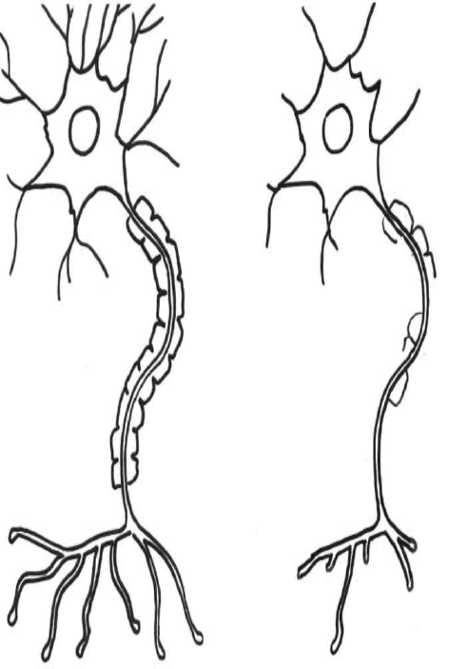
Adrienne Bishista Trainer, 2015 from Diane Malbin’s works on FASD
Notes:
Brain cell prenatally exposed
Demyelination, processes slowly
Fewer interconnections
Typical brain cell
Processes quickly
Many interconnections
Dendrites
Nucleus
Axon
Myelin sheath
Typical brain cell
Processes quickly
Many interconnections
Brain cell prenatally exposed
Demyelination, processes slowly
Fewer interconnections

Slide 7
Physiology
Affects metabolic capacities and growth hormones
Frequently fall below the tenth percentile in height weight and head circumference
Can be mistaken for failure to thrive
Brain damage can occur at alcohol levels below that required to create physical defects.
Notes:
FASD affects the body’s metabolic capacities and growth hormones. As a result, children with FASD often grow very slowly and, are often short in stature and petite in build, frequently falling below the tenth percentile in height, weight, and head circumference. This can look like conventional failure to thrive, but it isn’t. Such a growth pattern should raise the diagnostic possibility of FASD. Height often does not catch up to norms as FASD adults are often below the twenty-fifth percentile. The petite build however, usually disappears with weight gain in adolescence; and a subset, primarily girls, become significantly overweight. Brain damage can occur at alcohol levels below that required to create physical defects. Research has continued to demonstrate that ever lower and singular doses of alcohol are sufficient to produce damage. Hence, the majority of children along the FASD spectrum do NOT exhibit the craniofacial symptoms, of which the most common are: 1) thin upper lip, 2) flattened philtrum, 3) shortened palpebral fissures which makes the eyes look farther apart, and 4) a shortened nose relative to the length of the midface.

Slide 8
Physical features
1) thin upper lip
2) flattened philtrum
3) shortened palpebral fissures which makes the eyes look farther apart
4) a shortened nose relative to the length of the midface.
The majority of children along the spectrum do NOT exhibit the craniofacial symptoms

Slide 9
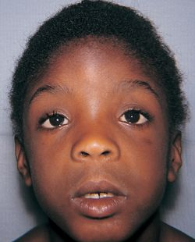
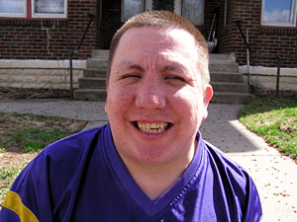
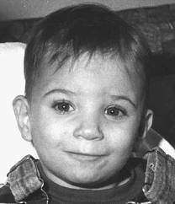

Slide 10
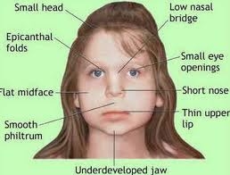

Slide 11
A Variable: Gestational Timing Coles C. Critical periods for prenatal alcohol exposure. Alcohol Health Res World. 1994;18:22-29.) Dark bars-most sensitive periods of development; Lighter bars represents periods of development during which psychological defects and minor structural abnormalities would occur.
Notes:
Coles C. Critical periods for prenatal alcohol exposure. Alcohol Health Res World. 1994;18:22-29.) Dark bars - most sensitive periods of development;
Lighter bars represents periods of development during which psychological defects and minor structural abnormalities would occur.

Slide 12
FASD and the Brain
Notes:
The picture on the right is an autopsy photo of an infant with FAS so severe that was fatal. Most people with FAS do not have brains that are this dramatically affected.

Slide 13
Regarding Amount of Alcohol…
There’s no safe amount.
In addition…
Binge drinking (CDC: binge drinking for women = 4 or more alcohol drinks per occasion) is especially hazardous because:
Women who binge prior to pregnancy are more likely to have unwanted pregnancies
Exposure to high levels of blood alcohol is especially likely to cause teratogenicity in the first trimester

Slide 14
Economic Costs of FAS
One prevented case of FAS saves:
$130,000 in the first 5 years
$360,000 in 10 years
$587,000 in 15 years
More than $1 million in 30 years
Lupton, Burd, and Harwood (2004)
Notes:
FAS Community Resource Center (one of several sites with estimated costs) $5 million estimated expected lifetime costs for one child with FAS, as shown below. This figure may not be representative of other children with FAS because treatment costs are higher than generally incurred, and some costs are projections that may not actually be incurred. Costs do not include the caregiver's lost wages or the costs of incarceration for the person living with FAS, if it were to occur:
$1,508,000 for medical and dental care
$1,376,000 for residential placement
$624,000 for supported employment
$530,000 for psychiatric care
$360,000 for foster care and respite care
$360,000 for Supplemental Security Income
$240,000 for special education

Slide 15
100% PREVENTABLE

Slide 16
Because of the challenges of establishing accurate and timely prevalence information, the number of cases of FASD is likely far greater than current data indicate.
Current estimates:
FASD occurs in at least 1 per 100 births
FASD affects nearly 40,000 babies per year
2015 new research indicates it is closer to 4 per 100 live births (May, 2015)
NOFAS Curriculum for Allied Health Professionals

Slide 17
Diagnosis Challenges

Slide 18
Challenges to identification of FASD include:
Lack of specific and uniformly accepted diagnostic criteria
Only FAS has specific diagnostic guidelines.
No uniform guidelines exist for other types of fetal alcohol spectrum disorders. FASD is an umbrella term and not an actual diagnosis.
Neither FAS nor FASD are in the DSM (MH) nomenclature.
Thus, health providers are hampered in their efforts to screen and identify children (individuals) with FASD.
NOFAS Curriculum for Allied Health Professionals

Slide 19
Challenges to identification:
FAS diagnosis based on clinical examination of features, but not
all individuals with FAS or an FASD look or act the same
Because each symptom has a broad range of possible diagnoses,
a clinician might miss or misdiagnose FASD.
Some physicians are aware of the high prevalence of attention deficit/hyperactivity disorders (ADHD), but might not link attention problems to FASD.
NOFAS Curriculum for Allied Health Professionals
Notes:
Often undiagnosed: Since the facial features of FAS are harder to observe in adolescents and adults, and since the focus of dysmorphologists is typically on children, adolescents and adults are often undiagnosed. In addition, many diagnosticians will only diagnose FAS and not a fetal alcohol spectrum disorder without the facial features.
More difficulties: Those without the facial features of FAS and those with higher IQs frequently have more difficulties due to the fact that they are viewed as more capable than they may actually be in managing day-to-day life. Teachers and others may see an IQ of 90 or 100 and assume that the person’s behavior must be purposeful since they are bright enough to do better.
Adaptive functioning: Their adaptive functioning is what is most impaired; that is their ability to appropriately use communication skills, socialization skills, and daily living skills. Adaptive functioning testing is often not done, as it is not part of a routine psychological testing profile. It needs to be asked for specifically. Adaptive functioning testing may be helpful in pointing out to service providers where a person’s disabilities lie regardless of IQ. There are a number of adaptive functioning scales that are currently being used. None of them have been examined for sensitivity to the issues of FASD. The scale that Ann Streissguth utilized in her earlier studies was the Vineland Adaptive Behavior Scale. Some feel that this scale may not be the best one. There is some preliminary work being done in Canada to look at the adaptive functioning tests that are currently available and determine if any of them are better than any others at identifying the specific difficulties in FASD.
Neuropsychologicals done at a hospital to look at the total disability are preferred.
Susan Rose and Dianne O’Connor: www.fassn.org

Slide 20
Challenges to identification:
ARND and pFAS lack the distinct clinical facial features
of FAS, so these children appear “typical” in appearance,
making identification even more difficult. Hence,
FASD as “the invisible disorder.”

Slide 21
Challenges to identification:
Lack of knowledge and misconceptions among primary care providers.
Many professionals believe that FASD can only occur if the
mother is an alcoholic, poor, or African American or Native American.
Few know about the full range or the progressive nature of the neurobehavioral symptoms that result from prenatal
exposure to alcohol.
NOFAS Curriculum for Allied Health Professionals

Slide 22
From a study of 80 birth mothers who have a child with an FASD:
AS A CHILD
57.5% were sexually abused as a child
46.2% were physically abused as a child
43.7% had been in a juvenile detention center
23.8% had foster parents
22.5% were involved with Child Protective Services as a child
17.5% lived in group home
AS AN ADULT
86.3% were emotionally abused as an adult
85% were physically abused as an adult
51.3% were sexually abused as an adult
80% had birth children in foster care or Child Protective Services
OVERALL
95% were sexually and/or physically abused during their life
(Astely, Bailey, Talbot and Clarren, 2000)
Notes:
The Secondary Disabilities study was a 4-year study done by the University of Washington under a grant from CDC. The study examined 415 individuals with FAS or FAE who had been through their clinic over the years. They ranged in age from 6 to 51 years. They found that, in addition to the primary disabilities already mentioned, a significant proportion of these individuals had experienced what was termed “secondary disabilities.”

Slide 23
Protective Factors
Early diagnosis and effective interventions
The most protective environmental factors against secondary disabilities are:
Living in a stable and nurturing home of good quality
Not having frequent changes of household
Not being a victim of violence
Two intrinsic characteristics are associated with a higher level of secondary disabilities:
Having FASD rather than FAS
Having an IQ above 70, rather than below
Reason: Less access to services
Streissguth and O’Malley (1997)
Notes:
•Early diagnosis
A child who is diagnosed at a young age can be placed in appropriate educational classes and get the social services needed to help the child and his or her family. Early diagnosis also helps families and school staff to understand why the child might act or react differently from other children sometimes.
•Involvement in special education and social services
Children who receive special education geared towards their specific needs and learning style are more likely to reach their full potential. Children with FASDs have a wide range of behaviors and challenges that might need to be addressed. Special education programs can better meet each child's needs. In addition, families of children with FASDs who receive social services, such as counseling or respite care have more positive experiences than families who do not receive such services.
•Loving, nurturing, and stable home environment
Children with FASDs can be more sensitive than other children to disruptions, changes in lifestyle or routines, and harmful relationships. Therefore, having a loving, stable home life is very important for a child with an FASD. In addition, community and family support can help prevent secondary conditions, such as criminal behavior, unemployment, and incomplete education.
•Absence of violence
People with FASDs who live in stable, non-abusive households or who do not become involved in youth violence are much less likely to develop secondary conditions than children who have been exposed to violence in their lives. Children with FASDs need to be taught other ways of showing their anger or frustration.

Slide 24
Possible Co-occurring DSM disorders for Individuals with an FASD across all ages
Attention Deficit/
Hyperactivity Disorder
Depression
Bipolar Disorder
Schizophrenia
Substance use disorders
Medical disorders (i.e. seizure disorder, heart abnormalities)
Sensory integration disorder
Reactive Attachment Disorder
Posttraumatic Stress Disorder
Traumatic Brain Injury
Borderline Personality Disorder

Slide 25
“Red Flags”
The individual has been diagnosed with a mental health disorder as a preschooler, such as ADHD, oppositional defiance, or bipolar disorder
The individual responds to immediate feedback rather than distant consequences such as point or reward systems
The individual has received multiple diagnoses and has a history of failed interventions, which may include medication and a range of mental health treatments

Slide 26
“Red Flags”
The child has been excluded from another preschool program for behavioral issues
The child requires “hands on” or visual learning, rather than auditory
The child is easily fatigued and overwhelmed by external stimulation
The child has difficulty applying what has been learned, and may make the same mistakes over and over
The child is a concrete thinker and does not understand metaphors or jokes, etc.

Slide 27
Strengths of Individuals with an FASD
Friendly and outgoing
Verbal
Helpful
Affectionate and lovable
Well-intentioned
Generous
Determined
Artistic
May be intelligent and have special abilities and skills

Slide 28
Impairments by age
Infancy: arching of back, poor sleep/wake cycle, adapting to stimuli, muscles rigid or limp, head banging, rocking, prolonged agitation, difficult to soothe
Preschool: hyperactivity, poor eye-hand coordination, poor balance/gait, fine/gross motor problems, slow language development
School age: attention is weak, mathematic disability, impulsive behavior, memory problems, expressive/receptive language deficits.
Notes:
. Impairments by age: Infancy- arching of back, poor sleep / wake cycle, adapting to stimuli, muscles rigid or limp, head banging, rocking, prolonged agitation, difficult to soothe. Preschool / toddlerhood: hyperactivity, poor eye-hand coordination, poor balance / gait, fine / gross motor problems, slow language development. School age: attention is weak, mathematic disability, impulsive behavior, memory problems, expressive / receptive language deficits.

Slide 29
Some statistics from 2008
44% of children with FASD have a mean IQ of 66
FASD is the leading cause of intellectual disabilities in the US, outpacing Down Syndrome by 2:1
90% have mental health problems of varying kinds
70% have experienced physical or sexual abuse or both
Notes:
44% of children with FASD are in the mentally retarded range (mean IQ = 66). FASD is the leading cause of mental retardation in the United States, outpacing the second cause, Down’s Syndrome, 2:1.
32% have prominent craniofacial abnormalities; and therefore, 68% don’t.
30% of FASD children live with one or both birth parents and another 10% live with some other family member. 30% are in the foster care system. 25% are in adoptive homes. 5% are in some form of institutional care. Those raised in foster and adoptive homes have fewer social problems compared to those who remain within the biological family system.
90% have mental health problems of varying kinds.
70 % have experienced physical or sexual abuse or both (increases the likelihood of inappropriate sexual behavior by a factor of 4).
60 % have been suspended, expelled, or dropped out of school.
45% have had difficulties with inappropriate sexual behavior.
50% have had some form of legal involvement.
50% above age 12 have either experienced inpatient psychiatric or substance abuse treatment or legal incarceration.
30% above age 12 develop alcohol or drug problems.
20% above age 21 achieve full self-sufficiency as adults.
40% of mothers with FASD drink during at least one of their pregnancies

Slide 30
diagnostics
Commonly misdiagnosed as Attention Deficit Hyperactivity Disorder
FASD is not listed in the DSM-IV-TR, however it is listed in the International Classification of Diseases
FASD is also listed in the DM-ID

Slide 31
Criteria as per the DM-ID
a.) An identification of the crucial intra-uterine and extra-uterine growth retardation
b.) Facial anomalies
c.) Structural, neurologic and/or neurodevelopmental abnormalities, which can take the form of ID or learning and behavioral deficits
d.) The confirmation of intra-uterine alcohol exposure
Notes:
Attentional problems, including short attention span, motor overactivity, impulsivity, and a peculiar deficit in cause and effect relationships are extremely common. Social skills and social behavior deficits exceed what can be accounted for solely on the basis of cognitive function. A variety of co-occurring disorders such as mood disorders, substance abuse, psychotic disorders. Lower rates of anxiety disorders, eating disorders. (See the DM-ID for details).
International: Germany has the highest national average per capita intake of alcohol. Of any country for which statistics are known. In excess of 1% of infants are born to alcoholic mothers. These infants do not find their way into the U.S. because Germany is an insignificant source of international adoptions. Russia, on the other hand, has been a leading source of international adoptees and Russia has the highest rate of alcoholism of countries for which the statistic exists. Alcoholism is the most frequent reason for removal of children from their mothers in Russia, and hence Russian adoptees are at greater risk of having FASD.

Slide 32
school
Preschool and primary grades academic concerns predominate
Achievement is marked by lapses in learning
By later elementary and middle school years, behavioral concerns usually become predominant.
Behaviors may be driven by academic frustration
Academic ceilings are commonly reached between 7th and 9th grades.
Notes:
School: In the preschool and primary elementary grades, academic concerns predominate. Achievement is marked by lapses in learning; and material once learned, can disappear only to reappear unpredictably at a later time. While attributing poor performance to lack of effort has some surface appeal, it fundamentally misses the point. By later elementary grades or middle school, behavioral concerns usually trump academic problems and partly as a result of increasing academic frustration. It is not uncommon for children with FASD to reach an academic ceiling of achievement somewhere between seventh and ninth grades.
Special Education Statistics K-12
States that keep an educational census of FASD students: 0
States that recognize FASD as an educational disability: 0
States which list FASD on IEP’s: 0
States with any kind of specific programming for FASD: 3
States with no idea of the extent of FASD in the state: 24
States that do not define FASD as a problem: 28
States with no mechanism for identifying FASD: 31
States that provide no inservice training in FASD: 35

Slide 33
Peer relationships/interpersonal skills
May make friends easily
Difficulties lie in maintaining friendships due to making repeated social mistakes
Do not realize the mistakes
Look like there is no remorse for the social error

Slide 34
Developmental timeline
Strengths and delays differ significantly between people.
The strengths can obscure the delays, leading others to develop unrealistic expectations.
Notes:
. Developmental timeline: Children with FASD manifest an array of strengths and delays which can differ significantly between individuals. The strengths can obscure the delays, leading others to develop unrealistic expectations of an FASD individual. Below are listed the average developmental ages, in different skill areas, of an eighteen year old with FASD.
Receptive language- 6.
Emotional regulation- 6.
Social skills- 7.
Time and money management- 8.
Personal care skills- 11.
Reading skills- 16.
Physical maturity- 18.
Expressive language- 20.
10. Adulthood: If adults with FASD often reach financial independence, they often do not do so until around thirty. Maintaining employment is typically a challenge and ongoing coaching / mentoring is an essential resource. Money management skills are generally insufficient to the task as FASD adults tend to be overly generous. As parents, they can be quite affectionate, but lack the judgment to provide the necessary structure for their children. Too often, women with FASD give birth to children with FASD. As with employment, ongoing mentoring is critical

Slide 35
Dynamic characterisitcs
Stimulus filters
Attention/Executive functions
Visuospatial processing
Language processing
Temporal perception
Notes:
1. Stimulus Filters: FASD impairs the capacity to filter out incoming stimulation. This, combined with a reduced capacity to process stimulation, leaves FASD children very vulnerable to states of stimulus overload. Turning away of the face or the entire body or backing up / moving away are all common signals of approaching overstimulation. They should be understood as such and not misinterpreted as defiance or oppositionalism. Stimulus overload reliably spawns emotional escalation and behavioral deterioration and reinforces the fragmentation of the child’s nervous system.
2. Attention / Executive Functions: FASD compromises both the maintaining and shifting of attention which produces distractibility. In addition, self-monitoring skills, part of executive functioning, are generally minimal. Risk assessment is likely to be faulty, resulting in FASD children putting themselves in danger with no recognition they are doing so. Cognitive functioning as a whole deteriorates extremely rapidly under stress. Taken together, these factors make children with FASD look a lot like children with AD/HD, and they are often misdiagnosed solely as AD/HD and the larger FASD component is missed.
3. Visuospatial Processing: Children with FASD have weaknesses in their perception of spatial relationships between objects. Thus, they have difficulty organizing space and are prone to misplacing objects or inaccurately remembering their location.
4. Language Processing: FASD commonly causes deficits in language processing. Receptive language is often more severely affected than expressive language. This is because the encoding of verbal material into memory is erratic with FASD. On the other hand, the expressive language of FASD children is often quite age appropriate. This can mislead others into overestimating the child’s true overall language processing and cognitive skills. The danger here is twofold: 1) the FASD child’s weaker receptive skills get overtaxed by adults offering more verbal input than the child can truly handle, and 2) the adults incorrectly believe the child understood more than is really the case. This can lead to a language-induced overload with consequences similar to that of stimulus overload.
5. Temporal Perception: Typically there is a lack of a continuous sense of time that runs from the past, through the present, and out into the future. Instead, time is experienced as a series of disconnected moments; and hence, children with FASD mostly live in the present moment. They tend not to think either about the past or the future. This has a number of ripple effects. Learning from experience usually does not occur because there is no reference to the past. Possible future consequences, of a behavioral choice in the moment, are not invoked to guide behavior in the present. Connections that must be made across time, such as triggers > behaviors > consequences, go unmade. Cause and effect reasoning founders as this requires connecting the cause, through intervening time, to the effect. This all results in a common pattern, with FASD children, of repeating the same mistakes over time.

Slide 36
Egocentrism
Literal thinking
Rigid thinking
Boundaries
Personal responsibility
Memory/Integration/Generalization
Notes:
. Egocentrism: FASD brings with it a very egocentric stance in the world. This is not emotionally-based self-centeredness. The egocentrism of FASD is an aspect of thinking and perception itself, more like the egocentrism of preschool children. Children with FASD often don’t even realize there is a “bigger picture alternative” to their egocentrism. Self-centeredness is simply “the way things are”. This egocentrism introduces fantasy elements into thinking beyond what is typical for a child of the age. Fantasy is not recognized as fantasy however, so reality testing suffers as a result. Egocentrism also leads to a generalized obliviousness to the impact of their behavior on others, often with negative consequences for relationships. FASD children also lack an understanding of others’ motives which sets them up to be fairly easily victimized.
7. Literal Thinking: FASD imparts a very literal bias to the thinking process. Abstract and higher level conceptual thinking is usually limited. Symbolic language, such as metaphors, are typically lost on the FASD child. So saying “six of one, a half dozen of the other” may lead to a search for six of “what” and a half dozen of “what else”. There is absolutely no awareness of the misinterpretation on the child’s part. Obviously, this can create a lot of social difficulties that are both mystifying and painful to the FASD child. Weakened higher level thinking skills sabotage FASD children’s attempts to proactively organize their environment and to interpret the meaning of overall situations. Impaired conceptual thinking interferes with generalization, for much of generalization rests on being able to distill out principles and then apply them across situations. The collective results of this literal thinking bias is a major reason that clear external structure is necessary to support the functioning of FASD children.
8. Rigid Thinking: Once they settle on an idea or plan of action, children with FASD wed themselves to it. They are apt to be highly resistant to any alternative information. This characteristic undercuts effective problem-solving and can make novelty, transitions, changes in routine, or surprises problematic to the point that a behavioral meltdown ensues. The meltdown isn’t oppositionalism per se, but more of an attempt to stave off a disorganizing change.
9. Boundaries: Children with FASD frequently have a limited concept of interpersonal boundaries. They invade others’ personal space with no sense that they have caused an affront. They can be physically intrusive, again with no awareness of their social blunder. They usually have trouble with the concept of personal ownership of things and so they appropriate others’ things without asking. They may take things outright, more as an impulsive “crime of opportunity”, and not understand it as theft. As FASD children mature into the prepubescent and pubescent years, their lack of boundaries leads them into sexual transgressions that they do not initially see as inappropriate. All of this produces repeated social rejection that can be painful and mysterious to them.
10. Personal Responsibility: A sense of personal responsibility is minimal to absent in children with FASD. This, like egocentrism, is more of a cognitive lack of awareness rather than a rejection of responsibility that they realize they should have. Predictably, the outcome is a blaming of external factors or other people for events. This blaming hides the destructive underlying sense that they can’t effectively influence events in the world.
11. Memory / Integration / Generalization: As FASD fragments a child’s sense of time, it also tends to fragment thinking and memory as a whole. It has been said that FASD children wake up into a new world every day. Sometimes the problem is storage, meaning that incoming information is stored in some erratic manner. Sometimes the problem is retrieval, meaning that the children cannot find information they have or they find it one day only to lose it the next and then rediscover it two days later. Sometimes the problem is application, meaning that information that has been retrieved is not properly applied. Consequently, information / learning usually does not generalize across situations, circumstances, people or time, but is limited to the immediate situation in which the learning occurred. What occurs in therapy may not leave the office. Behavioral discussions at home disappear when the child arrives at school. Social skills in the context of interacting with one peer may not be applied to any other peers. Change one or two details in a situation, and to FASD children, it may well appear to be an entirely new situation to which no knowledge they have is relevant. All of this serves to impair learning from experience.

Slide 37
Lying
Emotional regulation
Behavioral regulations
Behavioral outbursts
Motivation
Attachment
Notes:
. Lying: FASD children do consciously lie for self-serving reasons as do all children (and adults for that matter). However, much of what looks like “lying” really emerges out of their various cognitive weaknesses and the inaccuracies these weaknesses introduce into perception and reporting of events.
13. Emotional Regulation: The emotional regulatory skills of children with FASD are extremely weak. Thus, it takes very little emotional stimulation to light a fast-burning fuse of emotional escalation that is likely to ignite a behavioral meltdown.
14. Behavioral Regulation: These skills are also typically impaired in children with FASD. The two primary manifestations are hyperactivity and impulsivity, which can also lead to FASD being misdiagnosed as AD/HD. Combine these vulnerabilities with weaknesses in emotional regulation, poor filtering of incoming stimuli, and language processing deficits, and FASD children’s proneness to states of overload and behavioral deterioration is easily understandable.
15. Behavioral Outbursts: Along with their multiple vulnerabilities to overload, children with FASD commonly have very low resiliency in the face of stress. Thus, behavioral outbursts can be frequent. The most common triggers to such outbursts are insufficient attention from others, too much environmental stimulation, too little environmental structure, and internal confusion in the face of novelty. The behavioral outbursts of children with FASD are not so much controlling as they are protective. Outbursts are fundamentally a primitive attempt to generate some distance between the child and some source of overload to prevent becoming overwhelmed. It is not necessarily emotional closeness that is feared, but nervous system overload. The goal here is to maintain some inner balance and organization rather than to avoid intimacy per se. Unlike attachment disordered children, children with FASD frequently feel and express remorse after they have settled from an outburst. Such outbursts are best viewed as indicators of the limits of the child’s functioning at that point in time, limits that the adults need to learn to work within. While is certainly true that FASD children can be oppositional, the majority of their behavior problems are matters of compromised ability rather than outright defiance.
16. Motivation: Children with FASD tend to be motivated to do well and to please adults. When these are not in evidence, it is generally a reflection of repeated frustration with their functional weaknesses rather than a manipulative attempt to prove adults can’t make them achieve. However, their motivation may be minimal or absent with tasks whose rewards are out in the future. Such tasks do not provide immediate / concrete results, and such results are the stock and trade of FASD children. In their absence, FASD children are apt to have no meaningful reason for effort.
17. Attachment: FASD children can attach to varying degrees, depending upon their pattern of neurological vulnerabilities. What they typically cannot do is sustain the attachment over time. Emotional connections get temporarily undone during periods of overload, but can be repaired after the outburst has passed. What parents need to avoid is being a frequent source of overload, for FASD children are susceptible to viewing those who provoke states of overload as persecutors. This has obvious troubling implications for attachment going forward.
FASD and Attachment Disorder (AD): Similarities and Differences
If a baby is born with FASD, some degree of AD is a near certainty because FASD typically impairs one or more of the systems that are necessary for the development of attachments. AD is thus secondary to the preceding and primary FASD. The FASD must be addressed first or its effects will continue to undermine efforts to work on the attachment difficulties.

Slide 38
treatment
Protective factors
Medication
Therapy/Mentoring/Coaching
Buffered environment
Language
Comprehension
Structure
Supervision
Notes:
. Protective Factors: A number of protective factors that lead to relatively better outcomes have been identified. In order of the strength of their positive impact they are:
Living in a predictable and supportive home environment for 3/4 of life (primarily reduces odds of institutionalization).
Being diagnosed prior to age 6- occurs in about 11% of cases (primarily reduces odds of being institutionalized and increases chances of living as a self-sufficient adult).
If placed in more than one caretaking arrangement, spending at least 2 ¾ years in each placement.
Establishing eligibility for services through the state’s Developmental Disabilities Administration. 2. Medication: The use of medications must be very closely monitored, and dosages individually adjusted across a wider than normal range, due to FASD children’s highly idiosyncratic responses to most psychoactive medicines. Children with FASD also tend to have a higher rate of adverse reactions. The data that exists suggests that stimulant medications impact hyperactivity but have little effect on attention. Expect a longer than usual period of trial and error with different medicines and different dosages to get the optimal response. Reliable communication between home, school, and physician is essential in sorting this out. 3. Therapy / Mentoring / Coaching: Children (and adults) with FASD tend to do better in one-on-one situations vs. group or programmatic contexts because the environment can be more effectively managed and the consistency of dealing with the same person. 4. Buffered Environment: Due to FASD children’s multiple pathways to overstimulation ( language processing, emotional / behavioral regulation, stimulus filters, rigid thinking) and their low resiliency, prevention of states of overload is a key component to working successfully with them. Increased experience of being in a calm state is essential for the nervous system to learn to relax and for the child to get a glimmer of the difference between feeling “calm” and “overloaded”. Buffering the environment is key to creating more experience of “calm”. Without this, both nervous system and child come to define “overloaded” as the default condition of life. Most simply put, buffering the environment means removing as many environmental sources of overstimulation as possible. This can involve any of a number of things: reducing light levels, lowering noise levels, restricting access to electronics, keeping the number of choices limited, avoiding surprises, avoiding inducing language overload, and avoiding certain places or activities are all examples. Tasks should be divided into manageable segments that are not overwhelming to the child with FASD. Overall, what is necessary is determining the sources of overload for an individual child and then systematically reducing or eliminating as many as possible. The child’s nervous system then gets greater opportunity to operate in a relaxed state. 5. Language: It is critical that the adults interacting with an FASD child monitor their use of language to prevent language overload and behavioral meltdown. The amount of language at any one time needs to always be limited. Get to the point without the explanation. In addition to limited amounts of language, adults need to keep their language simplistic and concrete- no metaphors or other symbolism, and the vocabulary should remain basic. In line with these recommendations, directions should be clear, succinct, and concrete (generally single-step). Adults usually do not do an adequate job of contouring their use of language with FASD children, and end up unintentionally provoking behavioral eruptions. 6. Comprehension: Due to FASD children’s receptive language delays, their comprehension of verbal information should almost never be taken for granted. Regular comprehension checks in which the child plays back what was heard, are essential. Simply asking the child if she understands is ill-advised, as children with FASD often don’t know that they didn’t understand. 7. Structure: FASD children need clear external structure and schedules to support their optimal functioning. Depending upon the structure, the situational environment serves as either a therapeutic tool or a sabotaging influence. Making schedules unvarying reduces the demands on the FASD child’s compromised memory skills. Automatic repetition can replace “remembering”. In addition, clearly designed structure, because it comes from outside, can usefully intrude on the egocentrism of the child with FASD and make them more aware of the external world. 8. Supervision: Supervision is clearly closely related to structure. FASD children generally need intensive supervision, beyond what an average child of the age needs, to keep them functioning in constructive ways. Their own ability to police themselves comes very slowly and it is easy to overestimate their ability to do this. . Protective Factors: A number of protective factors that lead to relatively better outcomes have been identified. In order of the strength of their positive impact they are:
Living in a predictable and supportive home environment for 3/4 of life (primarily reduces odds of institutionalization).
Being diagnosed prior to age 6- occurs in about 11% of cases (primarily reduces odds of being institutionalized and increases chances of living as a self-sufficient adult).
If placed in more than one caretaking arrangement, spending at least 2 ¾ years in each placement.
Establishing eligibility for services through the state’s Developmental Disabilities Administration. 2. Medication: The use of medications must be very closely monitored, and dosages individually adjusted across a wider than normal range, due to FASD children’s highly idiosyncratic responses to most psychoactive medicines. Children with FASD also tend to have a higher rate of adverse reactions. The data that exists suggests that stimulant medications impact hyperactivity but have little effect on attention. Expect a longer than usual period of trial and error with different medicines and different dosages to get the optimal response. Reliable communication between home, school, and physician is essential in sorting this out. 3. Therapy / Mentoring / Coaching: Children (and adults) with FASD tend to do better in one-on-one situations vs. group or programmatic contexts because the environment can be more effectively managed and the consistency of dealing with the same person. 4. Buffered Environment: Due to FASD children’s multiple pathways to overstimulation ( language processing, emotional / behavioral regulation, stimulus filters, rigid thinking) and their low resiliency, prevention of states of overload is a key component to working successfully with them. Increased experience of being in a calm state is essential for the nervous system to learn to relax and for the child to get a glimmer of the difference between feeling “calm” and “overloaded”. Buffering the environment is key to creating more experience of “calm”. Without this, both nervous system and child come to define “overloaded” as the default condition of life. Most simply put, buffering the environment means removing as many environmental sources of overstimulation as possible. This can involve any of a number of things: reducing light levels, lowering noise levels, restricting access to electronics, keeping the number of choices limited, avoiding surprises, avoiding inducing language overload, and avoiding certain places or activities are all examples. Tasks should be divided into manageable segments that are not overwhelming to the child with FASD. Overall, what is necessary is determining the sources of overload for an individual child and then systematically reducing or eliminating as many as possible. The child’s nervous system then gets greater opportunity to operate in a relaxed state. 5. Language: It is critical that the adults interacting with an FASD child monitor their use of language to prevent language overload and behavioral meltdown. The amount of language at any one time needs to always be limited. Get to the point without the explanation. In addition to limited amounts of language, adults need to keep their language simplistic and concrete- no metaphors or other symbolism, and the vocabulary should remain basic. In line with these recommendations, directions should be clear, succinct, and concrete (generally single-step). Adults usually do not do an adequate job of contouring their use of language with FASD children, and end up unintentionally provoking behavioral eruptions. 6. Comprehension: Due to FASD children’s receptive language delays, their comprehension of verbal information should almost never be taken for granted. Regular comprehension checks in which the child plays back what was heard, are essential. Simply asking the child if she understands is ill-advised, as children with FASD often don’t know that they didn’t understand. 7. Structure: FASD children need clear external structure and schedules to support their optimal functioning. Depending upon the structure, the situational environment serves as either a therapeutic tool or a sabotaging influence. Making schedules unvarying reduces the demands on the FASD child’s compromised memory skills. Automatic repetition can replace “remembering”. In addition, clearly designed structure, because it comes from outside, can usefully intrude on the egocentrism of the child with FASD and make them more aware of the external world. 8. Supervision: Supervision is clearly closely related to structure. FASD children generally need intensive supervision, beyond what an average child of the age needs, to keep them functioning in constructive ways. Their own ability to police themselves comes very slowly and it is easy to overestimate their ability to do this.

Slide 39
Rules
Prevention
Saying “no”
Thinking connectedly
Thinking realistically
Teaching and learning
Social interaction
Notes:
. Rules: Behavioral rules need to be specific, clear, and phrased in behavioral language that states what the child needs to do vs. not-do or stop doing. The rules need to be stated proactively because the unconscious mind does not process negatives. Thus, negatively stated rules actually increase subconscious focus on the behavior being prohibited. This increases the future chances that the undesirable behavior will reoccur. The rules need to be communicated with the expectation that they will be learned and followed. This is best conveyed with a matter-of-fact tone of voice that is free of any emotional edge. Example: “You will go to your room right after dinner and do your homework.” Thanking the child in advance for his cooperation can improve compliance. The interaction should be broken off after the parent expresses gratitude for expected compliance. In addition, establish the ground rule ahead of time and always in play, that the FASD child needs to ask what the rules might be for anything that has never been discussed before. This removes ignorance as an escape route, from the FASD child's repertoire. 10. Prevention: With situations that have been repeatedly problematic, remind the FASD child, in advance of the situation’s next occurrence, not to engage in the problematic behavior specific to that situation. Influencing thinking ahead of time can help the FASD child not lapse into an egocentric perspective from which problem behaviors are more likely (Example: Problem taking things from others’ houses. Before the next playdate, tell the child he is expected not to take anything while there). 11. Saying “No”: When responding negatively to an FASD child’s request, a limited no is preferable to an absolute no. An absolute no is simply stating “no” with no indication of when the answer might become a “yes”. With FASD children’s limited perception of time, this is easily interpreted as “no forever” and a outburst of disappointment and frustration is a probable result. A limited no is in the spirit of “not now” and includes a concrete reference (such as, after the toys are cleaned up) to when the request would be possible. This reference should not be vague, such as “later” or based on a time period like “in an hour”. To the FASD child, these are also apt to sound like forever. 12. Thinking connectedly: Because of their multiple neurological vulnerabilities, children with FASD tend to perceive the world as a fragmented place in which things are discrete, separate, and random rather than connected. They need ongoing instruction in making connections of all types. FASD children need to be taught, over and over, that behavior is connected to triggers on the front end, to choices in the middle, and to consequences on the back end. The same is true of feelings; they need to learn that feelings are connected to triggers on the front end, to some form of expression (bodily, behavioral, or verbal) in the middle, and to outcomes on the back end. They need to be taught to make connections across time, across situations (generalization), and in social interaction. All of this instruction must be concrete and specific. 13. Thinking realisitically: FASD children can easily incorporate fantasy elements into what they say without realizing it. This reflects their weak fantasy / reality boundary. In instances where reality and fantasy can be separated, point out to the child the aspects they made up that were inaccurate to bring more awareness to this. 14. Teaching / Learning: Given their neurological weaknesses, FASD children learn best through observation, rote repetition, and practice, whether it be an academic skill, a behavioral skill, a social skill, hygiene skills, etc. Verbal instruction by itself, is typically the least effective way to teach children with FASD. Adults need to bring a healthy reservoir of patience to their work with FASD children. Progress comes, but slowly, and adult frustration only retards the progress further. 15. Social Interaction: Children with FASD need to be overtly taught about the impact of their behavior on others, for their egocentrism blinds them to this. Role playing, props such as dolls or puppets, and drawing can all supplement verbal explanation. This teaching needs to be specific and based on real situations- no hypotheticals. Comprehension checks should be included. Repetition and reminders are to be expected.

Slide 40
Visual and spatial cues
Temporal perception
Consequences
Longer term incentives
Sexuality
Residential
Notes:
. Visual and Spatial Cues: FASD children tend to process and retain information more thoroughly if its presentation involves visual and / or hands-on elements. Additionally, pictures or colors or other visual symbols can be used to define the purpose of particular locations (play vs. work spaces for example) and can also be used to illustrate schedules (a picture / symbol for each activity). It can be useful to demarcate spaces with tape or some other physical object. Limiting the number of objects in the environment and items on the wall, particularly in the child’s room and the classroom, is advised as well. When doing homework or other paperwork, there should be only one piece of paper and materials for only one task on the work surface at a time. Worksheets should have whitespace and not be cluttered with too much printed matter. All of these tips support internal organization for the FASD child. 17. Temporal perception: To make time more meaningful to FASD children, represent it visually. An hourglass is particularly useful as it visually depicts both the time that has already passed and the time that remains. Numbers are completely removed from the process. Having several hourglass timers of differing periods of time, for different situations, is ideal. Another option is the use of time lines, either drawn or laid out with ribbon. Events, going forward and backward can be placed along the time line In terms of teaching the skill of telling time, digital devices are a necessity. Even these can be difficult, but an analog clock requires conceptual and spatial thinking that is likely to make the task overwhelming. The addition of an intervalled alarm can assist by bracketing time periods. 18. Consequences: Due to the poor temporal perception of FASD children, consequences should be imposed expediently relative to the problematic behavior. A delay weakens, if not obliterates, any possible learning. Consequences should also be relatively short-term as children with FASD are very skilled at habituating to things not in their immediate environment (out-of-sight / out-of-mind). Repetitive smaller consequences are much more effective than searching for some “nuclear” consequence, for the repetition is a key element in teaching FASD children. 19. Longer term incentives: Again, given poor temporal perception, for FASD children, longer term incentives that require earning something over a few days or longer, are likely to seem either unattainable or meaningless, and will therefore not affect motivation. Longer-term incentives should be bridged with smaller incentives that can be earned on a daily basis for incremental steps towards the larger goal. 20. Sexuality: Pre-adolescents and adolescents with FASD need repeated concrete instruction regarding people being the owners of their own bodies; and therefore, others don’t have the right to “trespass” on the FASD child’s body, nor he on theirs. This instruction should begin before any problems have occurred, and this often necessitates discussion in advance of what parents would normally do. The key concept is that the FASD child touches another only with permission- no exceptions. This should be supplemented by defining categories of whom it is fine to touch with permission and whom it is never alright to touch. When this is clear, then basic teaching of private vs. non-private parts should be added. This teaching should be combined with very tight supervision of the FASD adolescent in interpersonal contexts. It can be a risky proposition to leave an FASD adolescent alone with others of the same age or younger, including family members. It may be useful to alert the school, depending upon circumstances. Incarceration amplifies the sexual behavioral problems of those with FASD for they are frequently sexually victimized in prison. 21. Residential treatment: Sometimes due to behavioral crisis, children with FASD should properly be placed in residential care primarily out of safety considerations. This should not be viewed as the primary mode of treatment, but as an intensive interim. Unfortunately, specialized residential resources for children with FASD are scarce. FASD children typically do not fare well in conventional RTC’s because the level of supervision is often too low while the level of stimulation is too high. The need for enhanced structure is what renders the commonplace Behavioral Level System, that is the backbone of most standard Residential Treatment Programs, ineffective for FASD children. They may well make progress at lower levels where the structure is more intensive. This progress allows them to rise up through the levels with their increasing freedom from structure. Eventually, the structure becomes inadequate to support functioning and deterioration ensues. Essentially, success sets up failure. The National Organization for Fetal Alcohol Syndrome (NOFAS) maintains a state by state listing of specialized treatment resources on its website: NOFAS.org.

Slide 41
Assessment, When FASD is Suspected
History
Maternal history, alcohol/substances, pregnancy
Atypical development of child & other “red flags”
Physical exam
Check for possible facial features and growth deficits
CNS deficits
Possible use of structural brain imaging (sMRI)
Psychological testing
Standard testing (IQ, achievement tests, & adaptive functioning)
Neuropsychological testing (when indicated)

Slide 42
Making the Case for Neuro-psych Testing
Rationale for neuropsychological testing = “a possible
underlying CNS condition”
Additional rationale:
History and clinical presentation
Under-performing student, with behavioral concerns
Results of prior psych and educational testing
Key findings on prior testing
Verbal IQ significantly greater than performance IQ
Overall IQ greater than achievement scores (WRAT)
Overall IQ significantly greater than adaptive behavior scores
(at least 15 points, Vineland)

Slide 43
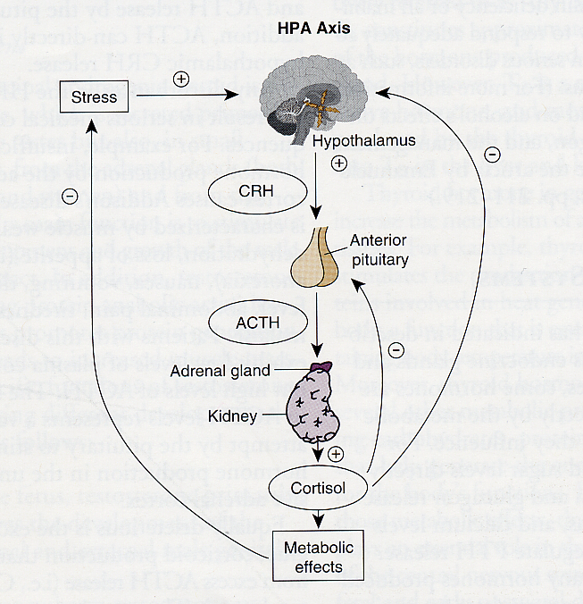
The Stress Axis/ Hypothalamic-
Pituitary-
Adrenal
(HPA) Axis
Adapted from: http://www.montana.edu/wwwai/imsd/alcohol/Vanessa/vwhpa.htm
Notes:
43
The stress axis involves the hypothalamus in the brain, the pituitary at the base of the brain, and the adrenal glands in the body. In response to a stressor, there is a cascade of hormonal responses originating in the brain, and increasing stress hormones throughout the body and brain. (Fight or flight system). This system works well with an acute stressor (i.e. run into a grizzly bear), as it turns off biological systems that are not immediately essential to deal with the current threat. However, in current society, chronic stress occurs, ultimately resulting in long-term dysregulation of the HPA axis. Importantly, dysregulation of the HPA axis is associated with increased mental health problesms, and is observed among individuals with a FASD (and in animal models of prenatal alcohol exposure).
DEFINE: disruption in homestasis following the presentation of a stressor to which the organism attempts to adapt.
This diagram illustrates the stress system or stress axis, also known as the Hypothalamic-Pituitary-Adrenal (HPA) axis.
One area of the brain, the hypothalamus, produces hormones called Releasing Hormones that act on the pituitary, a small gland at the base of the brain. In this case the releasing hormone is CRH.
The pituitary is often called the master gland because it produces hormones that stimulate all the other glands in the body. In this particular system, the pituitary produces a hormone called ACTH, which acts specifically on the adrenal glands, sitting right here on the dorsal surface of the kidneys.
The adrenal glands then increase their production or secretion of the glucocorticoids hormones – cortisol in human, corticosterone in most rodents.
The GC hormones then provide feedback to the brain to shut off the stress response and reduce stress hormone levels so the system doesn’t produce too much.
-AVP enhances CRH in hypothalamus
-also the LC/NE stress system that, although important, is not the focus of this proposal. The rationale for focus on the HPA axis will be further explained when I introduce the role of stress in addiction.

Slide 44
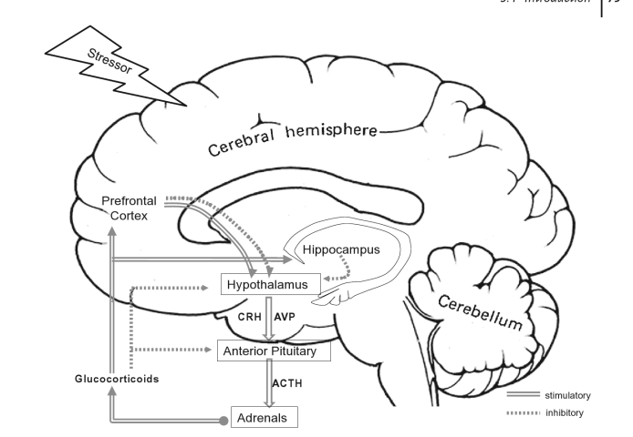
Brain’s stress system
Notes:
Both external (eg grizzly bear/car accident) and internal (eg anxious thoughts) can activate the HPA axis via extra brain regions involved in the brain’s stress system.

Slide 45
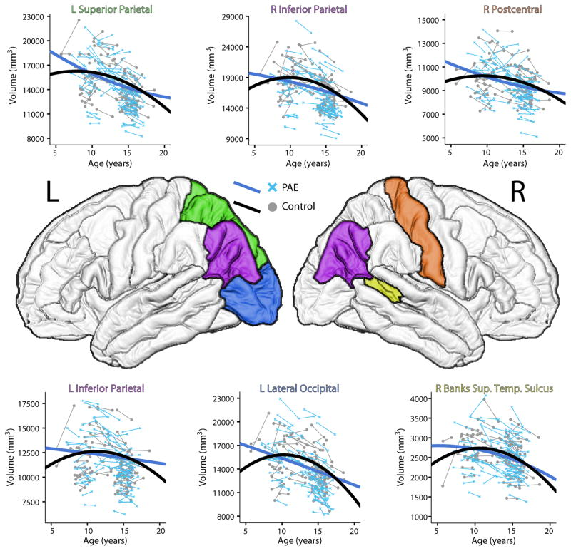
Altered developmental trajectory
Lebel et al., 2012
Notes:
Change in brain volume of specific regions though out development. Adolescents with prenatal alcohol exposure show alterations in brain development compared to controls: the effect is wide spread throughout the brain.
Brain regions with significantly different development trajectories between subjects with PAE and controls are shown in various colors on the brain surface, with accompanying volume-age plots. In general, the PAE trajectories (blue) showed more linear trends with smaller magnitudes of change (both increasing and decreasing volumes) than controls (black), suggesting reduced brain plasticity.

Slide 46
Introduction

Slide 47
A FASD Perspective
Primary Symptoms
learning disabilities, deficits in executive functioning, hyperactivity, attention and memory deficits, dysmaturity, sensory challenges
Secondary Behavioral Symptoms
confused, easily frustrated, easily manipulated, easily fatigued, aggression, anxiety
Tertiary Symptoms:
running away, involved in the legal system, trouble at home/work/school, multiple diagnosis, self injury,
Notes:
primary symptoms reflect how the brain works some primary neurobehavioral symptoms of fasd include:
secondary characteristics are defensive behaviors that are developed over time as a result of trauma, failure, chronic frustration. These are preventable but are normal responses to which indicate a poor fit between need and the environment
tertiary reflect the cumulative effect of frustration and are often preventable

Slide 48
FASD Informed Supports
“Behaviors” are a result of a physical-sometimes invisible disability.
Damage is permanent but the brain changes during life and so abilities and behaviors may also change.
Problems arise when others view behavior symptoms through a lens that assigns judgment and because of a poor fit between needs and environment. This includes targeting behavioral change instead of looking for reasonable and appropriate accommodations in communication, the physical environment, activities, etc. ---FASD Centre---
Failure to recognize the brain based condition leads to effort without results and everyone being frustrated. ---FASD Centre---
Notes:
Supports that focus on the individual strengths, unique needs, are respectful can help to support people create meaning contributions to society, positive relationships, learn and adapt to their FASD, and achieve personal success--supporting success article---

Slide 49
Challenges to FASD Informed Supports
Reliance on the use of standard learning theories
Lack of understanding and knowledge about FASD

Slide 50
Creative Interventions and Supports
How do we try differently?

Slide 51
Diagnosis and Education
Acknowledgement and Understanding that the FASD is the underlying cause of difficulties can decrease anger and frustration
Develop the right circle of supports-a trusted, caring group who understands FASD
Ongoing training and education for the community, all support members, judicial system, the community, etc.
Appropriate and ongoing assessment
Notes:
-someone who at least understands and acknowledges the FASD and will develop supports and services , understand FASD and the interplay with functioning/behavior as well as understand that medications may react differently in a person with FASD

Slide 52
The External Executive Function
FASD Interpretation
Primary deficits: limited ability to understand cause/effect,
An individual with an FASD will always need an external executive function. ---Sterling Clarren
Possible Strategies
Trusted group of mentors, coaches, and support staff-that are consistent provide positive feedback and support the person in decision making
Interdependence vs. Independence

Slide 53
EF Strategies
Visual is King
Reasonable Accommodations
Who can we actually trust
Model and Role Play!
Structure-lists, schedules, timers- assisting in managing these aids may always be needed

Slide 54
Memory and Comprehension
FASD Interpretation
May on surface appear to understand/agree in order please others, save face but underneath do not fully understand the conversation, direction, etc.
Unable to keep track of events and may “fill in the blanks” if cornered
Possible Strategies
Change the way we communicate
concrete-avoid conditional words ( likely/however); keep it simple (1-2 directions at a time);

Slide 55
Sensory Issues
FASD Interpretation
Possible Strategies
simple uncluttered environment
putt away in the same place
Be aware of an over stimulating environment!

Slide 56
Self Regulation
FASD Interpretation
Possible Strategies
If the person is frustrated: STOP and try a different strategy
Put feelings into words-then help to identify a coping skills (ask for a break/walk away/count to 10 listen to music)
Start simple-keep it simple
What is the current developmental age(sometimes this fluctuates) and what accommodations are appropriate while still acknowledging and treating the person as an adult.

Slide 57
Strengths Focused
Who is this person and what are their strengths?
curious, artistic, creative, generals, tenacious
Accept the difference between can’t and won’t (and sometimes can one day and can’t the next)

Slide 58
Resources and Questions

Slide 59
Recognize the need to individualize the approach to those with an FASD:
“We must move from viewing the individual as failing if s/he does not do well in a program to viewing the program as not providing what the individual needs in order to succeed.”
Dubovsky, 2000

Slide 60
references
Resources The Challenge of Fetal Alcohol Syndrome. Ed.: Ann Streissguth Jonathan Kanter. 1997 Fetal Alcohol Syndrome: A Guide for Families and Communities. Ann Streissguth. 1997. National Organization on Fetal Alcohol Syndrome. NOFAS.org 800-666-6327. June 1, 2008
DM-ID Diagnostic Manual-Intellectual Disability: A Textbook of Diagnosis of Mental Disorders in Persons with Intellectual Disability, 2000, NADD Press

Slide 61
Resources

Slide 62
BEAMS: The Fasstar Trek Method: http://www.comeover.to/FAS/BEAM.htm-
The Eight Magic Keys for Teachers: http://www.fasdcenter.samhsa.gov/documents/eightmagickeys.pdf
SCREAMS: http://www.come-over.to/FAS/ScreamsArticle.htm
SAMHSA: http://www.fasdcenter.samhsa.gov/documents/FASDGuide12_01
4 Digit Code – Washington State University: http://depts.washington.edu/fasdpn/index.htm

Slide 63
National Screening Tool Kit - Canadian Association of Paediatric Health Centres: http://www.caphc.org
PA Families, Inc : http://pafamiliesinc.com/about.php
Fetal Alcohol Spectrum Disorder Support Group – Pittsburgh area contact kimjaxon1218@yahoo.com
Stone Soup (support group): www.stonesoupgroup.org/FASDnetwork.html
Adrienne Bishista Trainer, 2015 from Diane Malbin’s works on FASD slide #6

Slide 64
Assessments for Infants and Children
Recommended Evaluation Tools: (Please read the articles on Early Intervention for Infants with FAS first)
Bayley Scales of Infant Development for cognitive and motor evaluations from ages 0-2.
K-ABC is useful for cognitive evaluations for children ages 3-5.
Peabody Individual Achievement Test-Revised (PIAT-R) measures scholastic achievement in children, grades K-12.
Vineland Adaptive Behavior Scales for children of all ages is essential to measure functional abilities and life skills.
Source: FAS Community Resource Center, FAStar http://come-over.to/FASCRC
http://www.usd.edu/~/media/files/medicine/center-for-disabilities/fasd-educational-strategies-handbook.ashx?la=en - FASD Educational Strategies Book Free download
http://store.samhsa.gov/product/TIP-58-Addressing-Fetal-Alcohol-Spectrum-Disorders-FASD-/SMA13-4803 - Free download

