Slide 1
Fostering Numeracy and Mathematical Concepts
Sarah R. Powell
November 17, 2017

Slide 2
Contact Information
Sarah Powell
University of Texas at Austin
srpowell@austin.utexas.edu
@sarahpowellphd

Slide 3
Today’s Materials

Slide 4
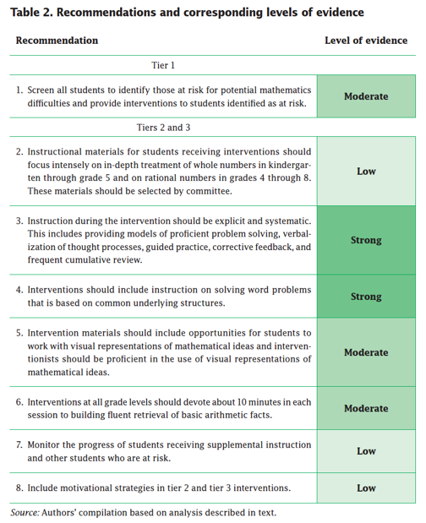
Explicit instruction
Multiple representations
Concise language
Fluency building
Problem solving instruction
Motivation component
Gersten et al. (2009)

Slide 5
Explicit instruction

Slide 6
Explicit Instruction
I Do
Modeling
Practice
We Do
Clear Explanation
Guided
Practice
Planned
Examples
Independent Practice
You Do
Supporting Practices
Asking the right questions
Eliciting frequent responses
Providing immediate specific feedback
Maintaining a brisk pace

Slide 7
Goal and importance
“Today, we are learning about division. This is important because sometimes you have to share objects or things with your friends.”
Modeling
Practice
Clear Explanation
Guided
Practice
We Do
Planned
Examples
Independent Practice
“Let’s continue working with our three-dimensional shapes and volume. Understanding volume and calculating volume helps with measuring capacity.”
You Do
Supporting Practices
Asking the right questions
Eliciting frequent responses
Providing immediate specific feedback
Maintaining a brisk pace

Slide 8
Goal and importance
Model steps
Modeling
Practice
Clear Explanation
Guided
Practice
“To solve 26 plus 79, I first decide about the operation. Do I add, subtract, multiply or divide?”
We Do
Planned
Examples
Independent Practice
“The plus sign tells me to add. So, I’ll add 26 plus 79. I’ll use the partial sums strategy. First, I add 20 plus 70. What’s 20 plus 70?”
You Do
Supporting Practices
“20 plus 70 is 90. I write 90 right here.”
Asking the right questions
Eliciting frequent responses
Providing immediate specific feedback
Maintaining a brisk pace
“Then I add 6 plus 7. What’s 6 plus 7?”
“6 plus 7 is 13. So, I write 13 here.”
“Finally, we add the partial sums: 90 and 13. 90 plus 13 is 103. So, 26 plus 79 equals 103.”

Slide 9
Goal and importance
Model steps
Modeling
Practice
Clear Explanation
Concise language
Guided
Practice
We Do
Planned
Examples
Independent Practice
“To solve 26 plus 79, I first decide about the operation. Do I add, subtract, multiply or divide?”
You Do
“The plus sign tells me to add. So, I’ll add 26 plus 79. I’ll use the partial sums strategy. First, I add 20 plus 70. What’s 20 plus 70?”
Supporting Practices
Asking the right questions
Eliciting frequent responses
Providing immediate specific feedback
Maintaining a brisk pace
“20 plus 70 is 90. I write 90 right here.”
“Then I add 6 plus 7. What’s 6 plus 7?”
“6 plus 7 is 13. So, I write 13 here.”
“Finally, we add the partial sums: 90 and 13. 90 plus 13 is 103. So, 26 plus 79 equals 103.”

Slide 10
Examples
“Today, we are learning about division. This is important because sometimes you have to share objects or things with your friends.”
Modeling
Practice
Clear Explanation
Guided
Practice
24 / 6
We Do
35 $)$ 5
28 $÷$ 7
Planned
Examples
Independent Practice
You Do
Supporting Practices
Asking the right questions
Eliciting frequent responses
Providing immediate specific feedback
Maintaining a brisk pace

Slide 11
Examples
“Today, we are learning about division. This is important because sometimes you have to share objects or things with your friends.”
Modeling
Practice
Clear Explanation
Guided
Practice
24 / 6
We Do
35 $)$ 5
28 $÷$ 7
Planned
Examples
Independent Practice
You Do
Also use non-examples
Supporting Practices
Asking the right questions
Eliciting frequent responses
Providing immediate specific feedback
Maintaining a brisk pace
32 $÷$ 8
42 $÷$ 7
25 $−$ 5

Slide 12
I Do
Modeling
Practice
Clear Explanation
Guided
Practice
We Do
Planned
Examples
Independent Practice
You Do
Supporting Practices
Asking the right questions
Eliciting frequent responses
Providing immediate specific feedback
Maintaining a brisk pace

Slide 13
Teacher and student practice together
I Do
Modeling
Practice
Clear Explanation
Guided
Practice
Planned
Examples
Independent Practice
Supporting Practices
Asking the right questions
Eliciting frequent responses
Providing immediate specific feedback
Maintaining a brisk pace

Slide 14
Teacher and student practice together
I Do
Student practices with teacher support
Modeling
Practice
Clear Explanation
Guided
Practice
Planned
Examples
Independent Practice
Supporting Practices
Asking the right questions
Eliciting frequent responses
Providing immediate specific feedback
Maintaining a brisk pace

Slide 15
I Do
Modeling
Practice
Clear Explanation
Guided
Practice
We Do
Planned
Examples
Independent Practice
You Do
Supporting Practices
Asking the right questions
Eliciting frequent responses
Providing immediate specific feedback
Maintaining a brisk pace

Slide 16
I Do
Modeling
Practice
Clear Explanation
Guided
Practice
Low-level and high-level
We Do
Planned
Examples
Independent Practice
You Do
“What is 7 times 9?”
“Which shape has 6 sides?”
Supporting Practices
“What do you do when you see a word problem?”
Asking the right questions
Eliciting frequent responses
Providing immediate specific feedback
Maintaining a brisk pace
“Why do you have to regroup?”
“How would you solve this problem?”
“Why do you have to use zero pairs?”

Slide 17
I Do
Modeling
Practice
Clear Explanation
Guided
Practice
Low-level and high-level
We Do
Planned
Examples
Independent Practice
You Do
Classwide, individual, partner, write on paper, write on whiteboard, thumbs up, etc.
Supporting Practices
Asking the right questions
Eliciting frequent responses
Providing immediate specific feedback
Maintaining a brisk pace
“Turn and discuss the formula for perimeter with your partner.”
“Write the multiplication problem on your whiteboard.”
“In your math journal, draw a picture to help you remember to term parallelogram.”

Slide 18
I Do
Modeling
Practice
Clear Explanation
Guided
Practice
Low-level and high-level
We Do
Planned
Examples
Independent Practice
You Do
Classwide, individual, partner, write on paper, write on whiteboard, thumbs up, etc.
Supporting Practices
Asking the right questions
Eliciting frequent responses
Providing immediate specific feedback
Maintaining a brisk pace
Affirmative and corrective
“Good work using your word-problem attack strategy.”
“Let’s look at that again. Tell me how you added in the hundreds column.”

Slide 19
I Do
Modeling
Practice
Clear Explanation
Guided
Practice
Low-level and high-level
We Do
Planned
Examples
Independent Practice
You Do
Classwide, individual, partner, write on paper, write on whiteboard, thumbs up, etc.
Supporting Practices
Asking the right questions
Eliciting frequent responses
Providing immediate specific feedback
Maintaining a brisk pace
Affirmative and corrective
Planned and organized

Slide 20
Modeling
Practice
Supporting Practices
Introduction of material
Review of material
Modeling
Practice
Modeling
Practice
Supporting Practices
Supporting Practices

Slide 21
Explicit instruction
Multiple representations
Concise language
Fluency building
Problem solving instruction
Motivation component
Gersten et al. (2009)

Slide 22
Multiple representations

Slide 23
Multiple Representations
Abstract
Representational
Concrete

Slide 24
Abstract
Representational
Concrete
Three-dimensional objects

Slide 25
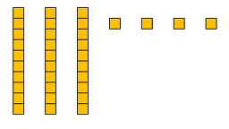
Abstract
Representational
Concrete
Two-dimensional images

Slide 26
Abstract
Representational
Concrete
Numerals and symbols
2 + 8 = 10
34 = 3 tens and 4 ones
x – 6 = 8
4,179
+ 569

Slide 27
Concise language

Slide 28
Mathematical Language
Homonyms
Homophones
left
square
mean
base
round
ate
eight
some
sum
pie
pi
rows
rose

Slide 29
Technical terms
Subtechnical terms
Symbolic terms
General terms
trapezoid
rhombus
numerator
addend
subtract
base
degrees
cube
plane
arc
plus
zero
twelve
dollars
and
above
measure
answer
longest
outside

Slide 30
Instead of…
Say…
“And the last one is 10.”
“8, 9, 10. We’ll stop counting there but we could count more.”
“What number is in the tens place?”
“What digit is in the tens place?”
“Six hundred and forty-eight”
“Six hundred forty-eight”
“Bigger number and smaller number”
“Number that is greater and the number that is less”
Hughes et al. (2016)

Slide 31
Instead of…
Say…
“Numbers in the fraction”
“This fraction is one number.”
“Top number and bottom number”
“Numerator and denominator”
“Reduce”
“Find an equivalent fraction”
“One point two nine”
“One and twenty-nine hundredths”
Hughes et al. (2016)

Slide 32
Instead of…
Say…
“Corner”
“Angle”
“Flips, slides, and turns”
“Reflections, translations, and rotations”
“Box or ball
“Cube or sphere”
“Long hand and short hand”
“Minute hand and hour hand”
Hughes et al. (2016)

Slide 33
precise
“The denominator is the number of equal parts that make the whole.”
“A difference problem is two amounts compared for the difference.”
“To show the fraction, look at the denominator. A denominator of 5 means I need to break the whole into 5 equal parts.”
concise
“To use partial sums, add the hundreds, then add the tens, then add the ones. Finally, add all the partial sums.”

Slide 34
Counting

Slide 35
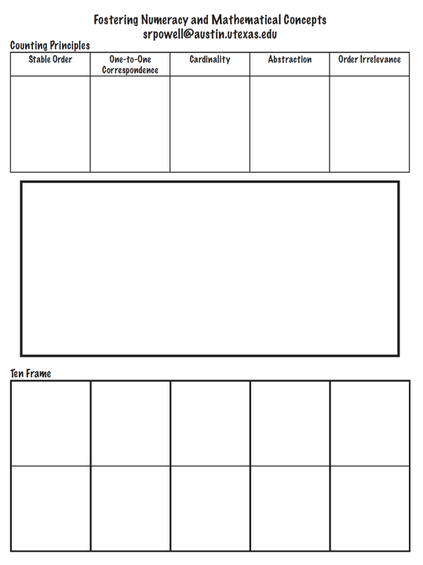

Slide 36
Five Counting Principles
Stable order
One-to-one correspondence
Cardinality
Abstraction
Order irrelevance

Slide 37
Stable order
Saying the number words in order
“One, two, three, four, five…”
Count from 1 to 20
Count from 1 to 100
Count forward from __
Count backward

Slide 38
Stable order
Teacher modeling with echoing
One-minute timings
Count to 12 as many times as you can
Songs
www.youtube.com/watch?v=g9EgE_JtEAw
www.youtube.com/watch?v=F5QLp9Wxrrg
www.youtube.com/watch?v=dk9Yt1PqQiw
www.youtube.com/watch?v=uxPfPyYp84E
www.youtube.com/watch?v=tocO1HKG2Ug
www.youtube.com/watch?v=xx5GWCgklhw
www.youtube.com/watch?v=JVREuQsPY00
www.youtube.com/watch?v=fZ9WiuJPnNA
(Sesame Street, Feist to 4)
Good songs are repetitive, not based on music, and focused on lyrics.

Slide 39
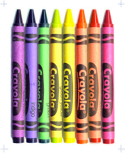
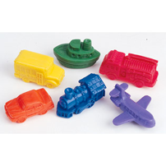
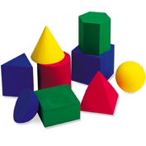
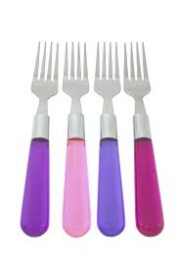
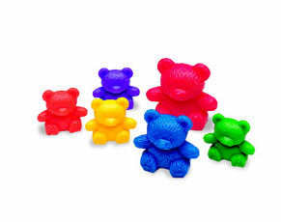
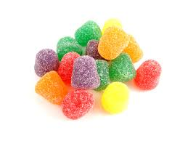
One-to-one correspondence
Ability to match number words to objects

Slide 40
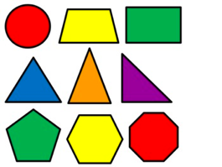
One-to-one correspondence
Ability to match number words to objects

Slide 41
One-to-one correspondence
Partitioning and tagging
Transferred from the “to-be-counted” category to the “already-counted” category
A distinct numeral word is assigned and not to be used again in the counting sequence

Slide 42
One-to-one correspondence

Slide 43
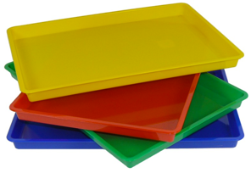
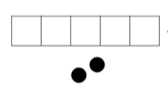
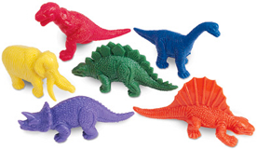
One-to-one correspondence
Count to 4 (with mat)
Count to 8 (with frame)
Count to 7 (with mat)
Count to 10 (with frame)

Slide 44
Cardinality
The number tag used for the last object in a count symbolizes the total number of objects in a set
Students must coordinate the stable order and one-to-one correspondence

Slide 45
Cardinality
Teacher asking, “How many?”
Count to 9
Count to 4

Slide 46
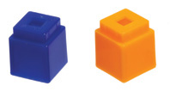
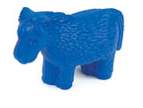
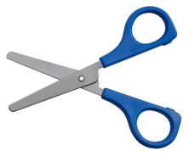
Abstraction
Any types of objects can be counted together in a set

Slide 47
Order irrelevance
The order in which objects are counted does not matter as long as none of the other counting principles are violated
When teaching counting to “inefficient” counters, however, you should teach a strategy – like partitioning and tagging, working left to right, or using a work mat.

Slide 48
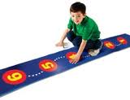
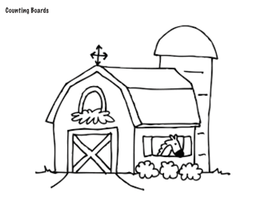
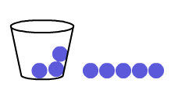
Counting
Practice with number lines
Counting on
I’m hiding three. Count, starting from the hidden counters.

Slide 49
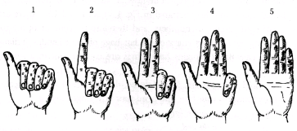
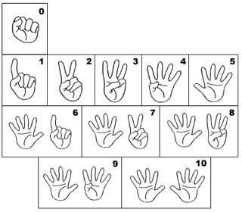
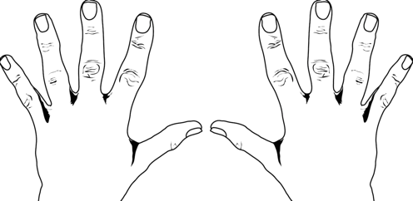
Counting
Finger counting

Slide 50
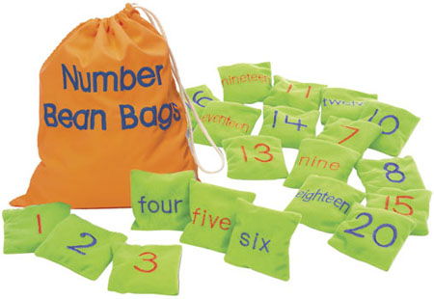
Ordinal Counting
Numbers relative to their position in time or space
First, second, third, fourth, fifth…
Notes:
Hudson & Miller (2006)

Slide 51
Ordinal Counting
Modeling and activities for counting can be used plus:
Lining up in classroom
Running a race and determining place
Following steps in a recipe
Calendar dates
Chapters in a book
Notes:
Hudson & Miller (2006)

Slide 52
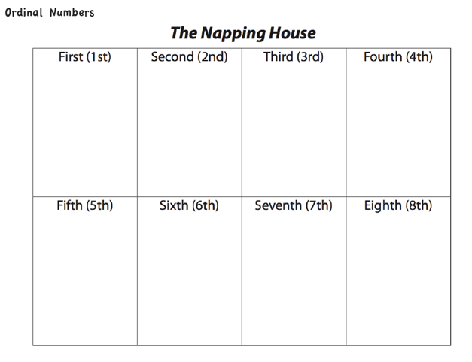
Ordinal Counting Instruction
Notes:
Hudson & Miller (2006)

Slide 53
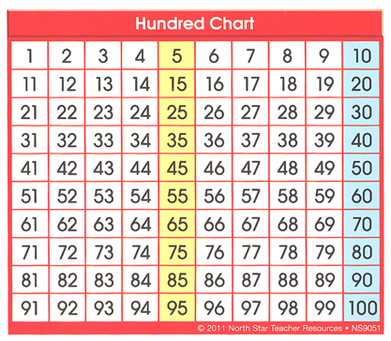
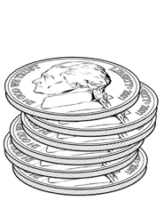
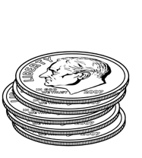
Skip Counting
Counting by 2s, 5s, and 10s
Notes:
Hudson & Miller (2006)

Slide 54
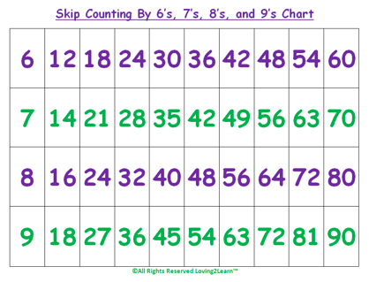
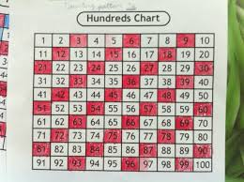
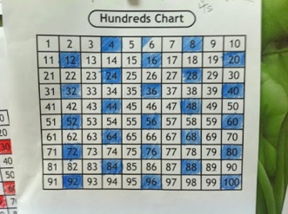
Skip Counting
Counting by 3s, 4s, 6s, 7s, 8s, 9s
Notes:
Hudson & Miller (2006)

Slide 55
Talk to a Friend
What are the five counting principles?
Which three are necessary?
What does it mean to partition and tag?
How do your students practice counting?
Count to 7
Count to 10

Slide 56
Zero

Slide 57
Zero
Most important digit in Base-10 system
Typically introduced after 1, but should be introduced alongside 1

Slide 58
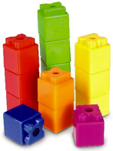
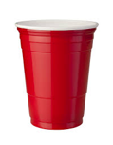
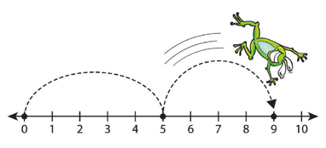
Zero
C
any manipulatives with a mat/plate:
any pictures; any number line with 0:
R

Slide 59
Numerals and Number Words

Slide 60
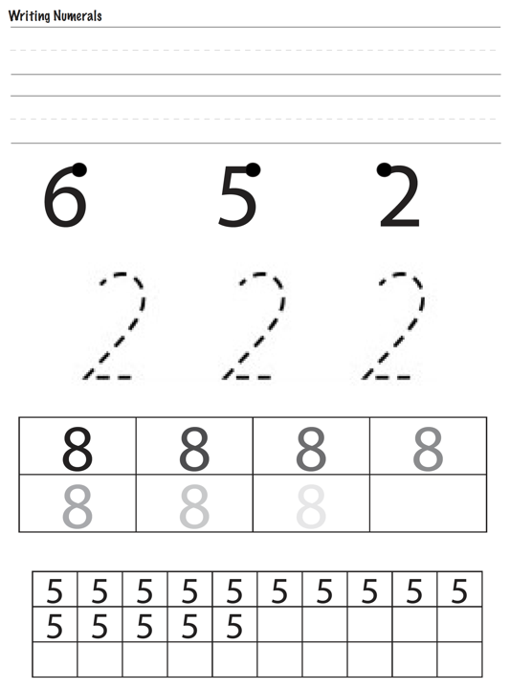

Slide 61
Numerals and Number Words
Numerals
0, 1, 2, 3, 4, 5, 6, 7, 8, 9…
Number words (cardinal)
one, two, three, four, five…
Ordinal numerals
1st, 2nd, 3rd, 4th, 5th…
Ordinal number words
first, second, third, fourth, fifth…

Slide 62
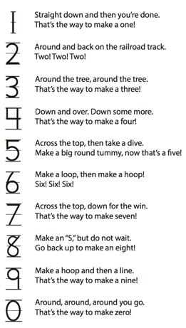
Numerals and Number Words

Slide 63
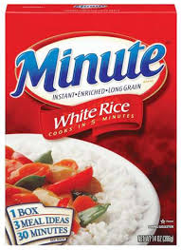
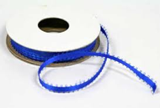
Numerals
Pudding
Rice
Sand
Ribbon & stickers

Slide 64
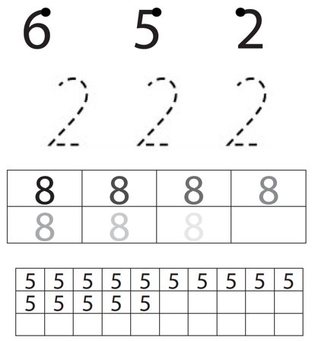
Numerals
Tracing
Air writing
Whiteboards

Slide 65
Numeral, Number Word, and Quantity
7
seven

Slide 66
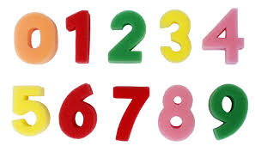
Numeral, Number Word, and Quantity
Instruction
Sponges and writing
Magnets and writing
French fry packets

Slide 67
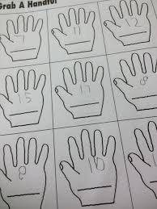
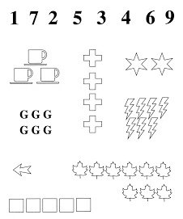
Numeral, Number Word, and Quantity
Instruction
Squares on paper
Grab a handful
Match games
To numerals
To words
To quantities

Slide 68
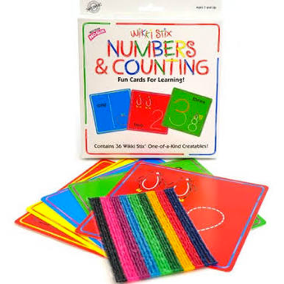
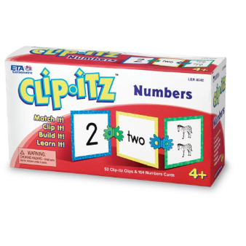
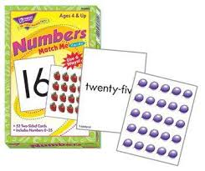
Numeral, Number Word, and Quantity

Slide 69
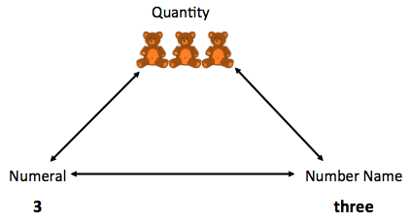
Early Numeracy Literature
Literature should have three representations of number
Literature should be accurate
Objects should be easy to count

Slide 70
Talk to a Friend
What are the three representations of numbers?
What are ways to help children learn to write numbers?

Slide 71
Quantity Comparison

Slide 73
Quantity Comparison
Determining whether two or more groups have the same, more, or fewer items
Vocabulary:
More, greater, bigger
Less, smaller, fewer
Same, as many as

Slide 74
Quantity Comparison Instruction
Modeling
Find the pairs
Finish when one group runs out of items
Figure out more than, less than, or equal

Slide 75
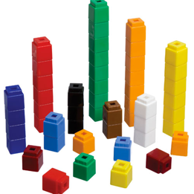
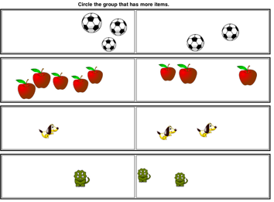
Quantity Comparison
C
any manipulatives:
any sets of pictures:
R

Slide 76
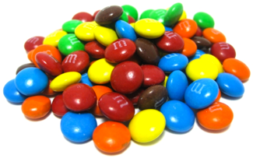
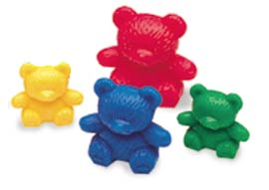
Quantity Comparison
Make chains
Bear compare
Counting cars

Slide 77
Talk to a Friend
What are ways to practice comparing quantities?
Compare 7 to 9
Compare 8 to 4

Slide 78
Subitizing

Slide 79
Subitizing
Instantly seeing how many
Young students can subitize sets of 1, 2, or 3 without counting (perceptual subitizing)
4 or 5 is the maximum subitizing amount
Students can subitize larger amounts by combining smaller amounts (conceptual subitizing)

Slide 80
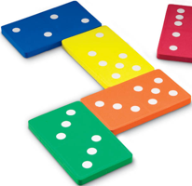
Subitizing

Slide 81
Talk to a Friend
What is subitizing?
Why is subitizing important?
What are ways to practice subitizing?

Slide 82
Math Facts

Slide 84
Addition and Subtraction

Slide 85
Addition and Subtraction Facts
100 addition basic facts
Single-digit addends sum to a single- or double-digit number
5 (addend)
+ 4 (addend)
9 (sum)
100 subtraction basic facts
Subtrahend and difference are single-digit numbers and minuend is single- or double-digit number
16 (minuend)
– 8 (subtrahend)
8 (difference)

Slide 86
Addition and Subtraction Facts
Lack of mastery of basic facts influences higher-level math performance and attitudes about math
CRA teaching sequence is helpful for teaching basic facts
C
R
A
5 + 4 = 9

Slide 87
Three-Step Approach
Understand the Concept of addition or subtraction
Learn and use Strategies
Memorize facts by using a variety of daily Practice

Slide 88
Concepts
Part-Part-Whole
Involve the relationship between a set and two subsets
Join
Elements are added to a given set
Separate
Elements are removed from a given set
Compare
Involve comparisons between two disjointed sets

Slide 89
CRA Sequence: Addition Part-Part-Whole
Count one set, count another set, put sets together, count sum
C
R
A
2 + 3 = 5

Slide 90
CRA Sequence: Addition Part-Part-Whole
4 + 5 = __
3 + 8 = __

Slide 91
CRA Sequence: Addition Join
Start with a set, add the other set, count sum
C
R
A
2 + 3 = 5

Slide 92
CRA Sequence: Addition Join
9 + 4 = __
3 + 7 = __

Slide 93
Part-Part-Whole versus Join
3 + 5 = __
6 + 4 = __

Slide 94
CRA Sequence: Subtraction Separate
Start with a set, take away from that set, count difference
C
R
A
5 – 3 = 2

Slide 95
CRA Sequence: Subtraction Separate
11 – 6 = __
8 – 4 = __

Slide 96
CRA Sequence: Subtraction Compare
Compare two sets, count difference
C
R
A
10 – 5 = 5

Slide 97
CRA Sequence: Subtraction Compare
10 – 7 = __
11 – 6 = __

Slide 98
Separate versus Compare
9 – 5 = __
8 – 3 = __

Slide 101
Strategies
Properties
Teach “rules” about facts
Teach counting strategies

Slide 102
Zero Facts
Adding any number by zero is equal to the number itself
Identity Property of Addition
Facts remaining: 100 – 19 = 81
+ | 0 | 1 | 2 | 3 | 4 | 5 | 6 | 7 | 8 | 9
0 | 0 | 1 | 2 | 3 | 4 | 5 | 6 | 7 | 8 | 9
1 | 1 | 2 | 3 | 4 | 5 | 6 | 7 | 8 | 9 | 10
2 | 2 | 3 | 4 | 5 | 6 | 7 | 8 | 9 | 10 | 11
3 | 3 | 4 | 5 | 6 | 7 | 8 | 9 | 10 | 11 | 12
4 | 4 | 5 | 6 | 7 | 8 | 9 | 10 | 11 | 12 | 13
5 | 5 | 6 | 7 | 8 | 9 | 10 | 11 | 12 | 13 | 14
6 | 6 | 7 | 8 | 9 | 10 | 11 | 12 | 13 | 14 | 15
7 | 7 | 8 | 9 | 10 | 11 | 12 | 13 | 14 | 15 | 16
8 | 8 | 9 | 10 | 11 | 12 | 13 | 14 | 15 | 16 | 17
9 | 9 | 10 | 11 | 12 | 13 | 14 | 15 | 16 | 17 | 18

Slide 103
One More Than
Next Number Fact
Corresponds with “One Less Than” for subtraction
Facts remaining: 81 – 17 = 64
+ | 0 | 1 | 2 | 3 | 4 | 5 | 6 | 7 | 8 | 9
0 | 0 | 1 | 2 | 3 | 4 | 5 | 6 | 7 | 8 | 9
1 | 1 | 2 | 3 | 4 | 5 | 6 | 7 | 8 | 9 | 10
2 | 2 | 3 | 4 | 5 | 6 | 7 | 8 | 9 | 10 | 11
3 | 3 | 4 | 5 | 6 | 7 | 8 | 9 | 10 | 11 | 12
4 | 4 | 5 | 6 | 7 | 8 | 9 | 10 | 11 | 12 | 13
5 | 5 | 6 | 7 | 8 | 9 | 10 | 11 | 12 | 13 | 14
6 | 6 | 7 | 8 | 9 | 10 | 11 | 12 | 13 | 14 | 15
7 | 7 | 8 | 9 | 10 | 11 | 12 | 13 | 14 | 15 | 16
8 | 8 | 9 | 10 | 11 | 12 | 13 | 14 | 15 | 16 | 17
9 | 9 | 10 | 11 | 12 | 13 | 14 | 15 | 16 | 17 | 18

Slide 104
Two More Than
Skip One Fact or skip count by two
Corresponds with “Two Less Than” for subtraction
Facts remaining: 64 – 15 = 49
+ | 0 | 1 | 2 | 3 | 4 | 5 | 6 | 7 | 8 | 9
0 | 0 | 1 | 2 | 3 | 4 | 5 | 6 | 7 | 8 | 9
1 | 1 | 2 | 3 | 4 | 5 | 6 | 7 | 8 | 9 | 10
2 | 2 | 3 | 4 | 5 | 6 | 7 | 8 | 9 | 10 | 11
3 | 3 | 4 | 5 | 6 | 7 | 8 | 9 | 10 | 11 | 12
4 | 4 | 5 | 6 | 7 | 8 | 9 | 10 | 11 | 12 | 13
5 | 5 | 6 | 7 | 8 | 9 | 10 | 11 | 12 | 13 | 14
6 | 6 | 7 | 8 | 9 | 10 | 11 | 12 | 13 | 14 | 15
7 | 7 | 8 | 9 | 10 | 11 | 12 | 13 | 14 | 15 | 16
8 | 8 | 9 | 10 | 11 | 12 | 13 | 14 | 15 | 16 | 17
9 | 9 | 10 | 11 | 12 | 13 | 14 | 15 | 16 | 17 | 18

Slide 105
Doubles
A number added to itself
Facts remaining: 49 – 7 = 42
+ | 0 | 1 | 2 | 3 | 4 | 5 | 6 | 7 | 8 | 9
0 | 0 | 1 | 2 | 3 | 4 | 5 | 6 | 7 | 8 | 9
1 | 1 | 2 | 3 | 4 | 5 | 6 | 7 | 8 | 9 | 10
2 | 2 | 3 | 4 | 5 | 6 | 7 | 8 | 9 | 10 | 11
3 | 3 | 4 | 5 | 6 | 7 | 8 | 9 | 10 | 11 | 12
4 | 4 | 5 | 6 | 7 | 8 | 9 | 10 | 11 | 12 | 13
5 | 5 | 6 | 7 | 8 | 9 | 10 | 11 | 12 | 13 | 14
6 | 6 | 7 | 8 | 9 | 10 | 11 | 12 | 13 | 14 | 15
7 | 7 | 8 | 9 | 10 | 11 | 12 | 13 | 14 | 15 | 16
8 | 8 | 9 | 10 | 11 | 12 | 13 | 14 | 15 | 16 | 17
9 | 9 | 10 | 11 | 12 | 13 | 14 | 15 | 16 | 17 | 18

Slide 106
Near Doubles
Not always helpful
for students
with MD
Doubles plus one or doubles minus one
Facts remaining: 42 – 12 = 30
+ | 0 | 1 | 2 | 3 | 4 | 5 | 6 | 7 | 8 | 9
0 | 0 | 1 | 2 | 3 | 4 | 5 | 6 | 7 | 8 | 9
1 | 1 | 2 | 3 | 4 | 5 | 6 | 7 | 8 | 9 | 10
2 | 2 | 3 | 4 | 5 | 6 | 7 | 8 | 9 | 10 | 11
3 | 3 | 4 | 5 | 6 | 7 | 8 | 9 | 10 | 11 | 12
4 | 4 | 5 | 6 | 7 | 8 | 9 | 10 | 11 | 12 | 13
5 | 5 | 6 | 7 | 8 | 9 | 10 | 11 | 12 | 13 | 14
6 | 6 | 7 | 8 | 9 | 10 | 11 | 12 | 13 | 14 | 15
7 | 7 | 8 | 9 | 10 | 11 | 12 | 13 | 14 | 15 | 16
8 | 8 | 9 | 10 | 11 | 12 | 13 | 14 | 15 | 16 | 17
9 | 9 | 10 | 11 | 12 | 13 | 14 | 15 | 16 | 17 | 18

Slide 107
Make Ten
Not always helpful
for students
with MD
One addend is 8 or 9, making it easy to “make ten”
Facts remaining: 30 – 18 = 12
+ | 0 | 1 | 2 | 3 | 4 | 5 | 6 | 7 | 8 | 9
0 | 0 | 1 | 2 | 3 | 4 | 5 | 6 | 7 | 8 | 9
1 | 1 | 2 | 3 | 4 | 5 | 6 | 7 | 8 | 9 | 10
2 | 2 | 3 | 4 | 5 | 6 | 7 | 8 | 9 | 10 | 11
3 | 3 | 4 | 5 | 6 | 7 | 8 | 9 | 10 | 11 | 12
4 | 4 | 5 | 6 | 7 | 8 | 9 | 10 | 11 | 12 | 13
5 | 5 | 6 | 7 | 8 | 9 | 10 | 11 | 12 | 13 | 14
6 | 6 | 7 | 8 | 9 | 10 | 11 | 12 | 13 | 14 | 15
7 | 7 | 8 | 9 | 10 | 11 | 12 | 13 | 14 | 15 | 16
8 | 8 | 9 | 10 | 11 | 12 | 13 | 14 | 15 | 16 | 17
9 | 9 | 10 | 11 | 12 | 13 | 14 | 15 | 16 | 17 | 18

Slide 108
Counting Strategies

Slide 109
Talk to a Friend
What are math facts?
How many addition?
How many subtraction?
How would you teach the concepts of addition and subtraction?
7 + 4
2 + 9
13 – 6
10 – 8

Slide 110
Contact Information
Sarah Powell
University of Texas at Austin
srpowell@austin.utexas.edu
@sarahpowellphd

