Slide 1
SERVOS (For Lib Arts Majors) Speaker: Rich Bryan

Slide 2
DISCLAIMER!
I am NOT expert! I am not an engineer or electrician and I didn’t even stay at a Holiday Inn Last night!
The information presented is only how this amateur home haunter has set up his personal haunt and show. Please ensure that your haunt follows all local codes, rules and laws to keep you and your guests safe. Electricity is dangerous! If you don’t know what you are doing seek expert help.

Slide 3
Introduction (AKA: why should we listen to you?)
Nationally recognized Home yard haunt in Corvallis, Oregon
‘CITY of the DAMMED’.
Graveyard with 12 minute musical, light, video, laser, fog, fire and animatronic show every 20 minutes on Halloween night/weekends.

Slide 4
Overview
This presentation will focus on the basic description and use of hobby servos to create animated Halloween Props.
Topics:
Differences between a hobby servo and “regular” motors
Servo Hardware
Servo Control Hardware
Programming Servos for Movement/speech
Demonstrations!
NOT Discussed Today:
Arduino/Raspberry Pi

Slide 5
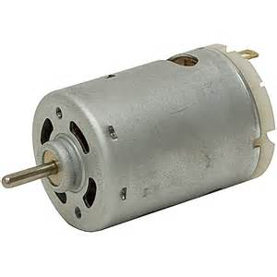
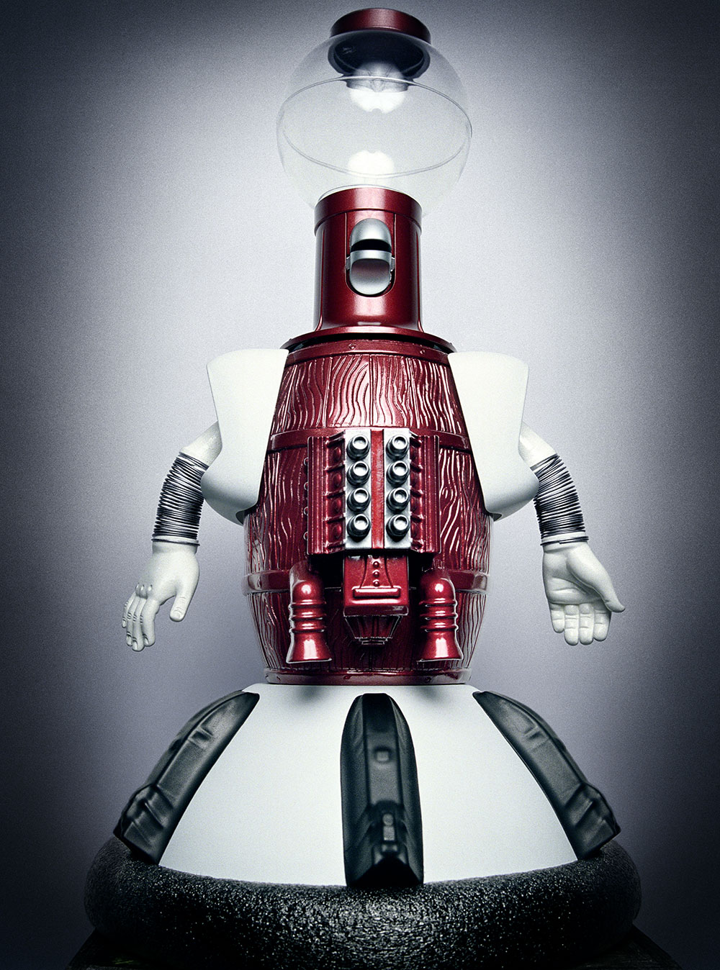
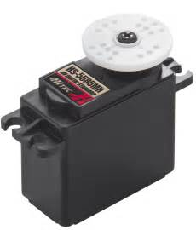
What is a Servo?

Slide 6
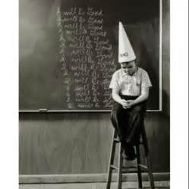
DC Motor
=
Basic DC motors have Pos + and Neg – input. Reversing the polarity will cause the motor to run backwards or forwards. The motors don’t have feedback or know where they are. AC (110v) motors are usually not as easy to reverse and again, only have power input for on/off capability.

Slide 7
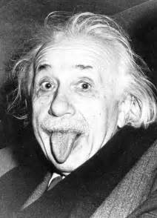
Hobby Servo
=
Unlike a traditional DC motor that just spins when power is applied servo motors operate through a Pulse Width Modulated (PWM) signal supplied by 3 wires.
This data controls the position of the servo motor’s gears.

Slide 8
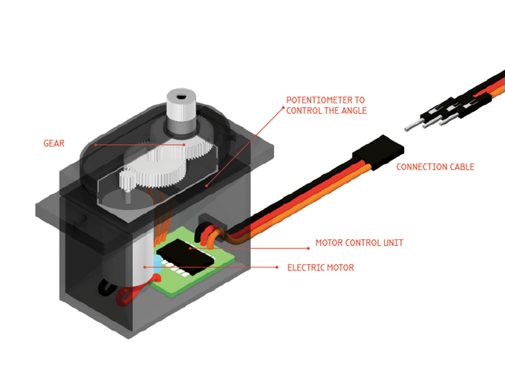
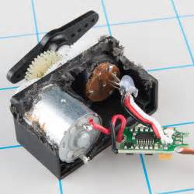
Servo

Slide 9
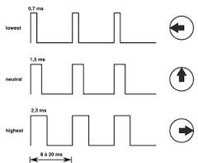
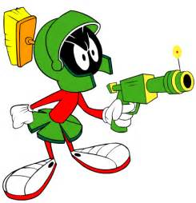
Modulated Frequency
Illudium PU-36 Space Modulator

Slide 10
Digital vs. Analog Servo??
Components are identical
Analog servo, pulses are sent to the motor at a rate of 50 per second.
Digital pulse rate = 300 per second.
Digital servos = faster, smoother, stronger movement. Digital cost more $$ and require more power. Great for RC cars, planes etc. Not typically required for a Halloween prop.
It is recommend to spend money to buy a servo with a higher number of bearings. Servos with ball bearings have lower friction, smoother operation and a longer life. Look for servos that have two ball bearings vs. one.

Slide 11
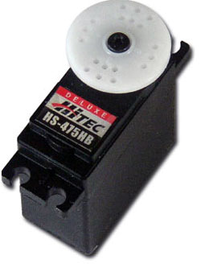
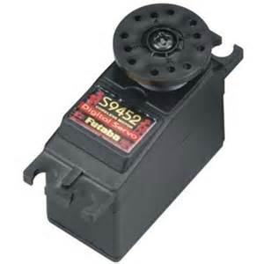
Servo Brands
Hi Tec and Futaba are the most widely available servos.
Shaft spline pattern, default direction of rotation and number of teeth on the shaft vary among servo manufacturers.
Other brands “may” work for less $ but there is a risk.

Slide 12
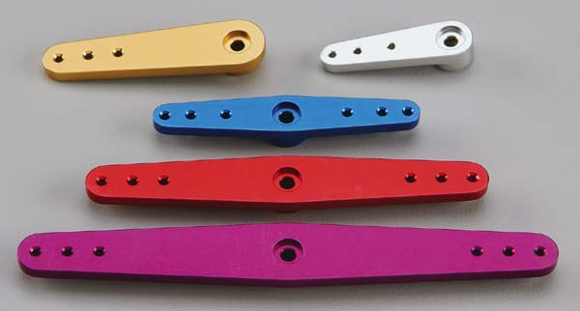
Parts/Accessories
Horns, splines typically come with servo
Wire extensions –mostly universal
Arms/extensions, hobby shop, ball and socket,
Consider aluminum horn
Servo jacket for super duty use. Servos are fragile
Mounting servo to prop.

Slide 13
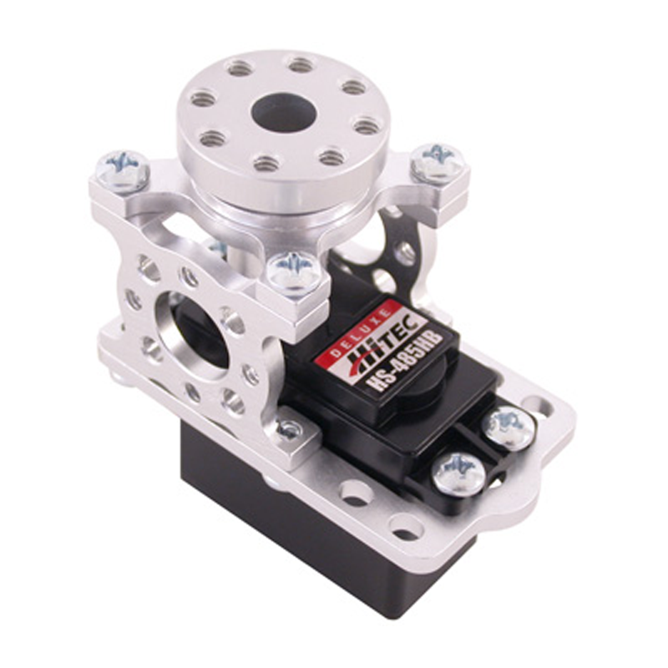
Parts/Accessories
Heavy Loads = Servo Block

Slide 14
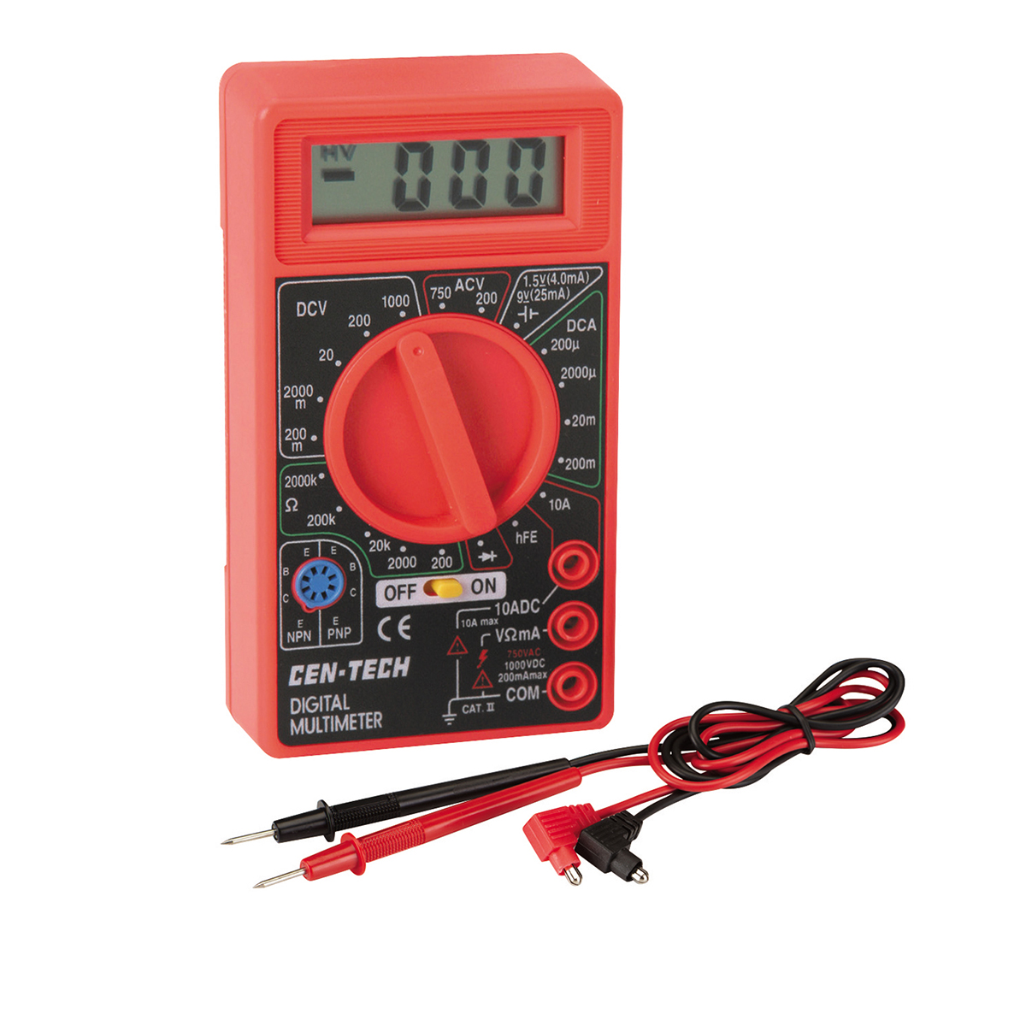
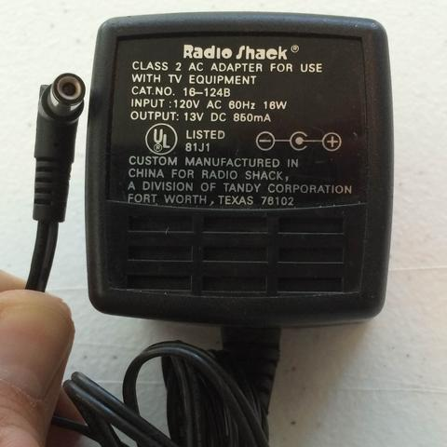
Power Supplies
Check polarity

Slide 15
Servo Control Boards-AUDIO
Simple-plug and play
No/limited programming
Cost per channel higher
Not as precise
Sensitive to audio file high/low
Notes:
DEMO AUDIO SERVO
OPEN AUDACITY:

Slide 16
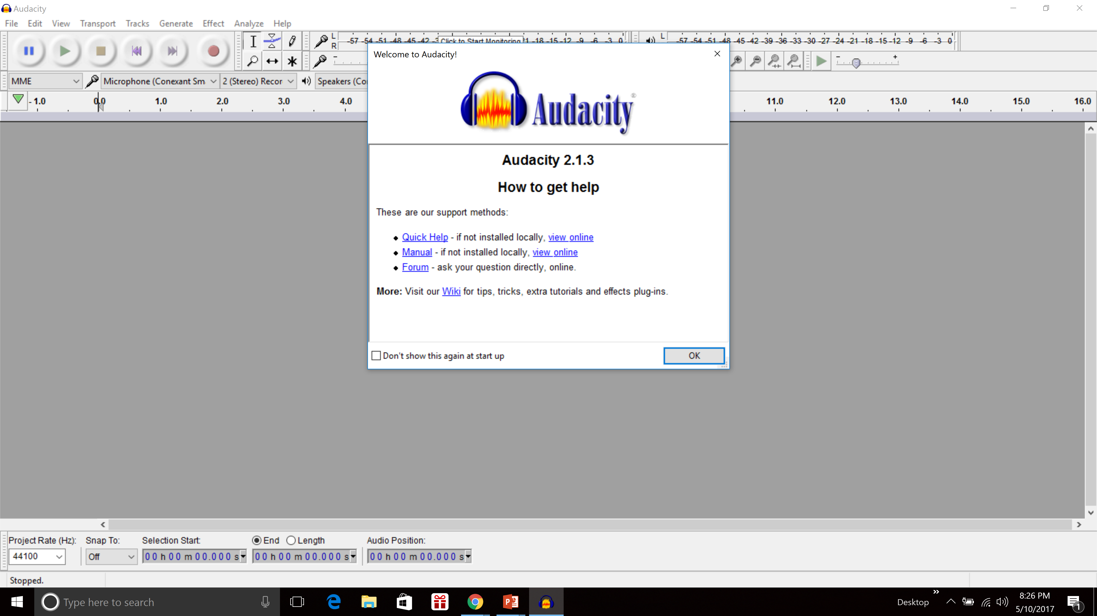
Audacity

Slide 17
Servo Control Boards-DMX
DMX Control = industry standard
Precision control (1/10 second) for true theme park quality animation
Less cost per channel of control
Time to program (except track skull)

Slide 18
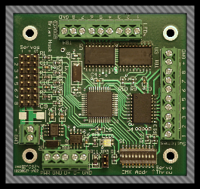
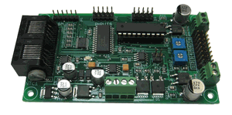
DMX Servo/Motor Boards
Servo control boards
Medusa
LOR ServoDog
Board of Chucky (BOC)
SOS
Servo, LED and Relay
Notes:
SHOW BOARD/MOVEMENT WITH SKULL

Slide 19
DMX 512
DMX is now the standard for digital communication networks. It allows for very low cost per channel of control.
DMX is based on a 512 channel “universe”
Each device has it’s own address, some devices require multiple addresses
Notes:
Multiple universes can be created
RGB requires 3 channels per light.

Slide 20
DMX (DMX512)

Slide 21
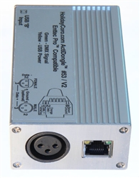
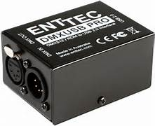
DMX
DMX requires a “Dongle” to output the signal from the computer to devices.
Holiday Coro, ENTTEC
Notes:
NOTE CABLE CONNECTORS
CAT 5
5 PIN
3PIN

Slide 22
LOR Program
Notes:
-Show program (program a DMX Light)
-Timing Grid
-Basically turn each channel on/off
-Show show builder.

Slide 23
VSA
VSA is produced by Brookshire Software
Software only
Best program for control of servo and animatronic props such as 3 axis skull. **
Great flexibility
Requires outside vendor hardware
No supported hardware
Limited channel count
110 requires relay packs
Notes:
BOC is VSA Only
VSA will now run multiple projection sources.

Slide 24
Light O Rama
Commercially manufactured hardware and software designed for outdoor light displays.
No guess work
Scalable to 1000’s of channels
Controls 110v and DMX
Visualizer
Audio and Video control
Not as servo friendly as VSA (GETTING CLOSE!)
Notes:
LOR is the industry standard
Hardware and software is integrated
SERVO DOG
MONKEY BASIC now works with LOR

Slide 25
Isn’t there an easier way????
Yes there is!

Slide 26
Questions?
Notes:
BRING IT ALL TOGETHER!!

