Slide 1
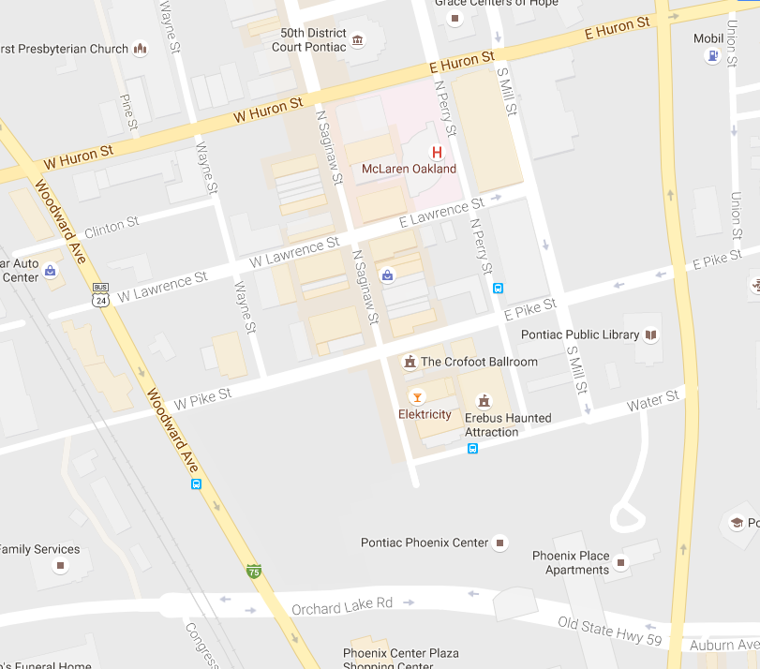
PONTIAC CITY SQUARE.com
50881 Woodward Ave. Pontiac, MI 48342 (248-877-6006)
N
PIKE ST. ENTRANCE
WATER ST. ENTRANCE

