Slide 1
AMA INTERNATIONAL UNIVERSITY – BAHRAIN
COLLEGE OF ADMINISTRATIVE
AND FINANCIAL SCIENCES
Dr. Steve S. Guansi
Professor
BSBI 622
PROJECT MANAGEMENT

Slide 2
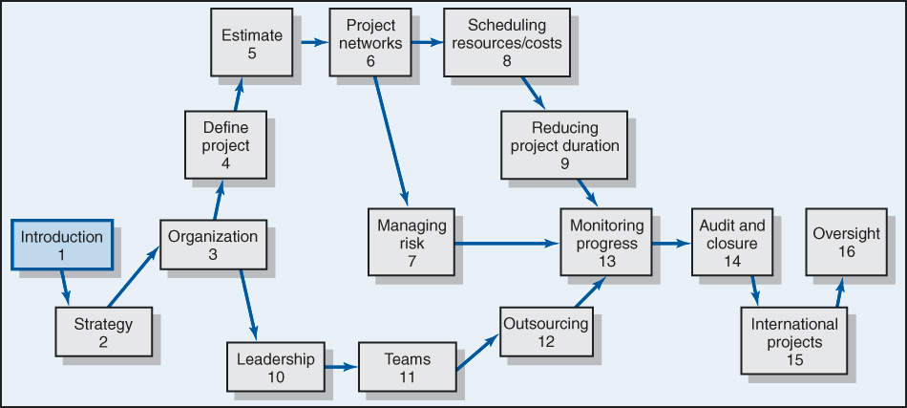
CHAPTER 1
INTRODUCTION TO MODERN PROJECT MANAGEMENT

Slide 3
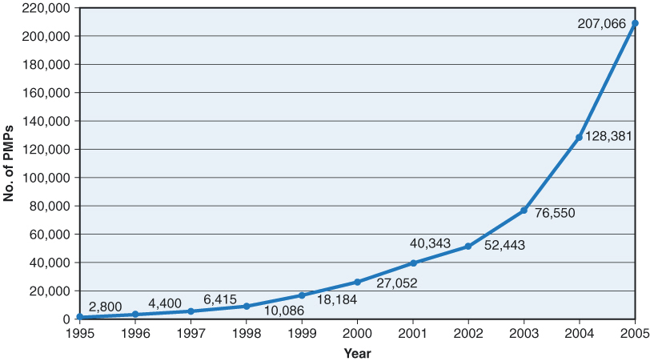
GROWTH OF PMP CERTIFICATION
(Project Mgmt Professional Certifications)

Slide 4
WHAT IS A PROJECT?
Temporary work performance to produce a unique product or service;
Each project has a definite Start and End Date.
  A complex, non routine, one-time effort limited by time, budget, resources, and performance specifications designed to meet customer needs.
Works performed by people, constrained by limited resources, planned, executed and controlled.

Slide 5
Examples of a Project
Re - modeling a house
  Start Date
  End Date
  Work is temporary
  Unique product
2. Creating a You tube Video
  Start Date
  End Date
  Work is temporary
  Unique product
3. Delivering a Seminar

Slide 6
What is Not a Project?
Work which is ongoing and repetitive is not a project
Examples:
Exercising Drill
On going
No end date
No unique product or service
2. Processing Orders
3. Maintaining car

Slide 7
Major Characteristics of a Project
  Established objective.
  Defined life span with a beginning and an end.
  Several department & professionals.
  Involves doing something never been done before.
  Specific time, cost, and performance requirements.

Slide 8
PROJECT VS PROGRAM
In practice, they are used synonymously but differ is some ways: Time and Scale
Program (is a group of related projects)
A series of coordinated, related, multiple projects that continue over an extended time and are intended to achieve a goal while Project is an activity achieved in a short span and the scale is small.
Example:
Project: completion of a required course in project mgmt.
Program: completion of all courses required for a business major.

Slide 9
ROUTINE, REPETITIVE WORK VS PROJECTS
Taking class notes
Daily entering sales receipts into the accounting ledger
Writing a term paper
Responding to a supply-chain request
Routine manufacture of an Apple iPod
Writing a term paper
Setting up a sales kiosk for a professional accounting meeting
Designing an iPod that is approximately 2 X 4 inches, interfaces with PC, and stores 10,000 songs
Wire-tag projects for GE and
Wal-Mart
Attaching tags on a manufactured product

Slide 10
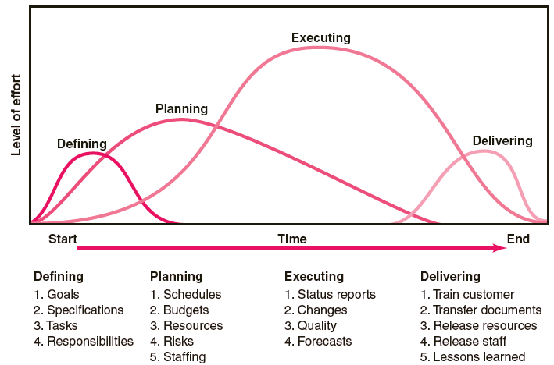
THE PROJECT LIFE CYCLE

Slide 11
THE PROJECT LIFE CYCLE
Closing
Train customers
Transfer documents
Release resources
Evaluation
Lessons learned
Executing
Status reports
Changes
Quality
Forecasts
Planning
Schedules
Budgets
Resources
Risks
Staffing
Defining
Goals
Specifications
Tasks
Responsibilities

Slide 12
The Project Manager
  Manages temporary, non-repetitive activities and frequently acts independently of the formal organization.
    Marshals resources for the project
    Provides direction, coordination, and integration to the project team
    Manages a diverse set of project stakeholders
    Dependent upon others for technical answers
    Is responsible for performance and success of the project
  Must induce the right people at the right time to address the right issues and make the right decisions.

Slide 13
The Project Manager
5 Project Manager Skills
Project Management Fundamentals
Business Acumen
Technical Knowledge
Communication
Leadership

Slide 14
What is Project Management?
Application of knowledge, skills, tools and techniques to project activities to meet project requirements.
5 Project Management Process Groups
Initiative
Plan
Execute
Control
Close

Slide 15
9 Knowledge Areas of Project Management
Scope
Time
Cost
Quality
Resources
Communications
Risks
Procurement
Integration

Slide 16
Factors Leading to the Increased Use of Project Management:
  Compression of the product life cycle
  Global competition
  Knowledge explosion
  Corporate downsizing
  Increased customer focus
  Small projects that represent big problems

Slide 17
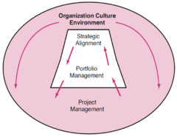
Integrated Management of Projects
Governance is designed to improve project management in the whole organization. The rationale for integration of project management is to provide senior management with:
Overview of all project management activities
A big picture of how organizational resources are being used
An assessment of the risk their portfolio of projects represents.

Slide 18
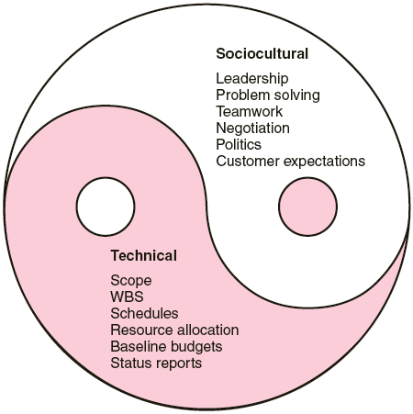
The Technical and Socio-cultural Dimensions
of the Project Management Process

