Slide 1
Email for SAP
Jodi M. Dyson, CIS Systems Analyst,
Forsyth Technical Community College

Slide 2

Communications Management Email Benefits
Automation
One SAP Notification
Tracking
Flexibility

Slide 3
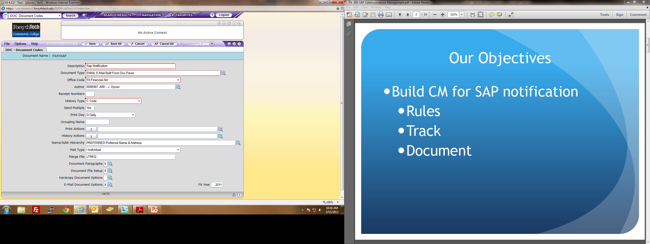
DOC
Notes:
This is the basic starting point for CM documents. Using LTREQ as merge file because the actual merge file for paragraphs will be added on DPAR.

Slide 4
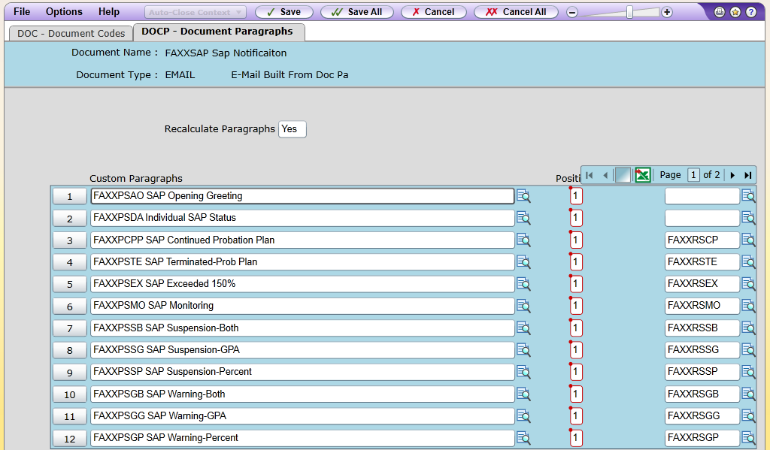
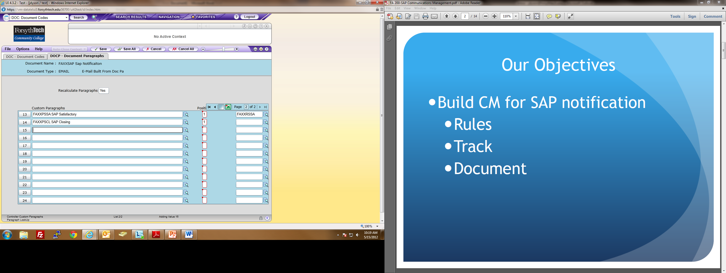
DOCP
Notes:
Any paragraph that does NOT have a rule attached will go in every message. Paragraphs with rules will only be included in the message if the rule conditions are met.

Slide 5
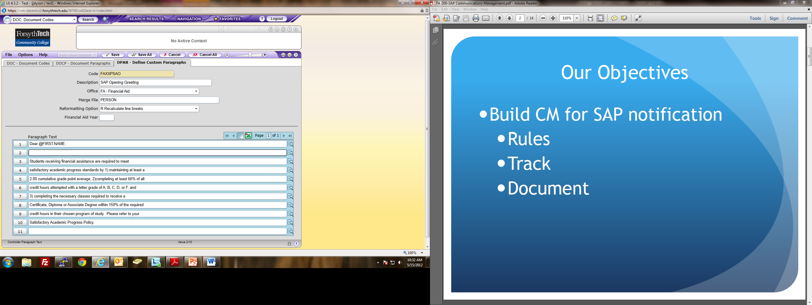
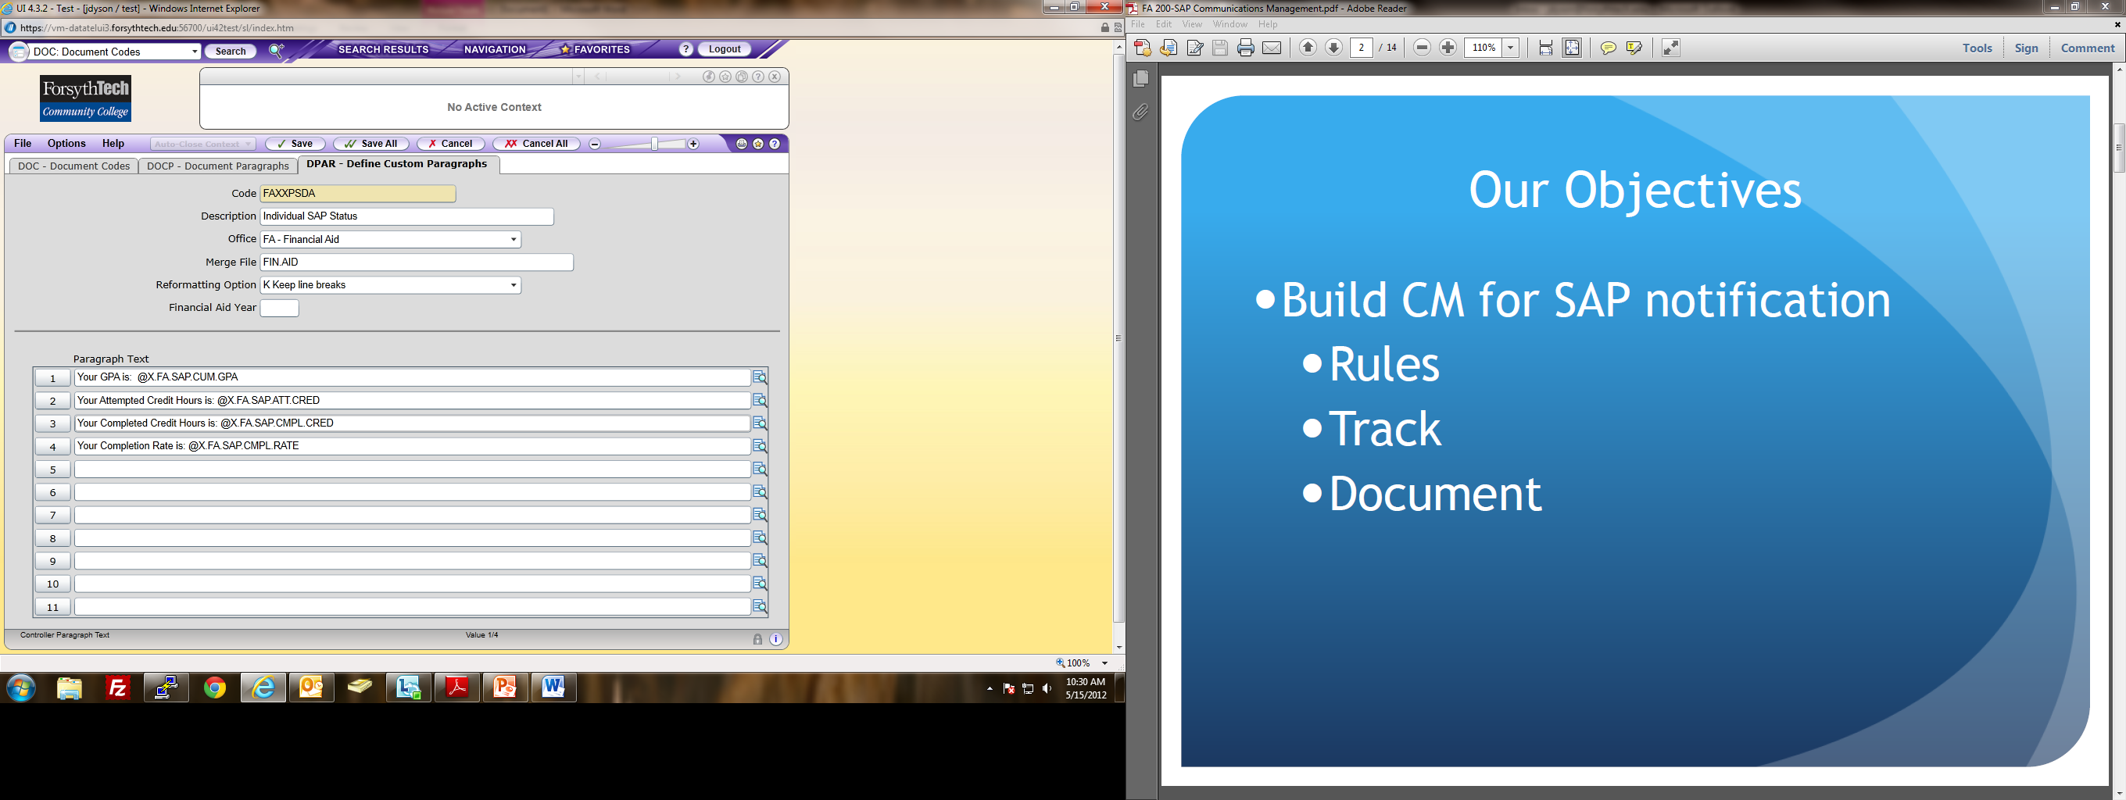

DPAR
Notes:
Each paragraph may or may not have a merge file. If there is nothing ‘personalized’ in the message, no merge file is necessary. The merge file would be the file that contained the data to be included, or merged, into the paragraph.

Slide 6
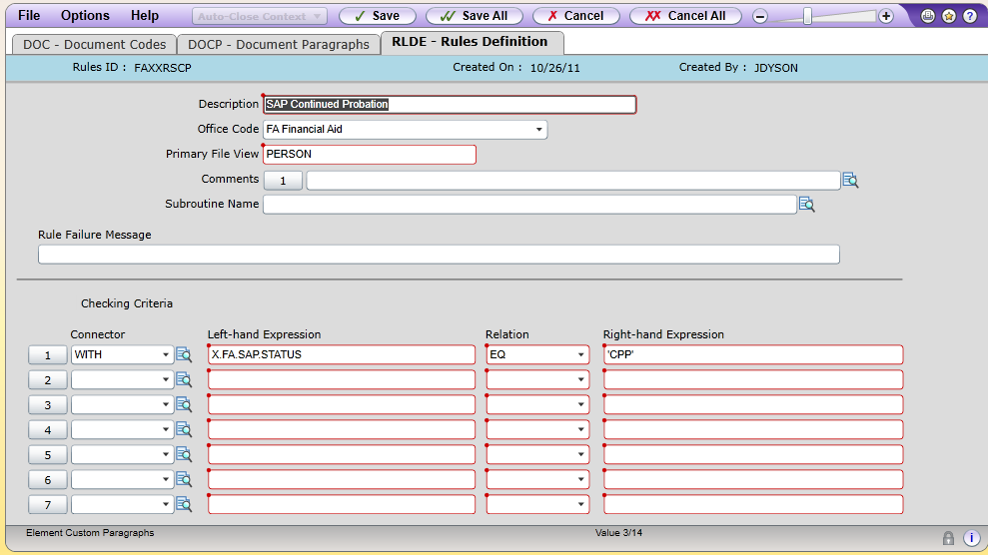
Rules (RLDE)
Notes:
The right hand expression comes from VAL-SAP.STATUSES which are set up before ever running SAP the first time.

Slide 7
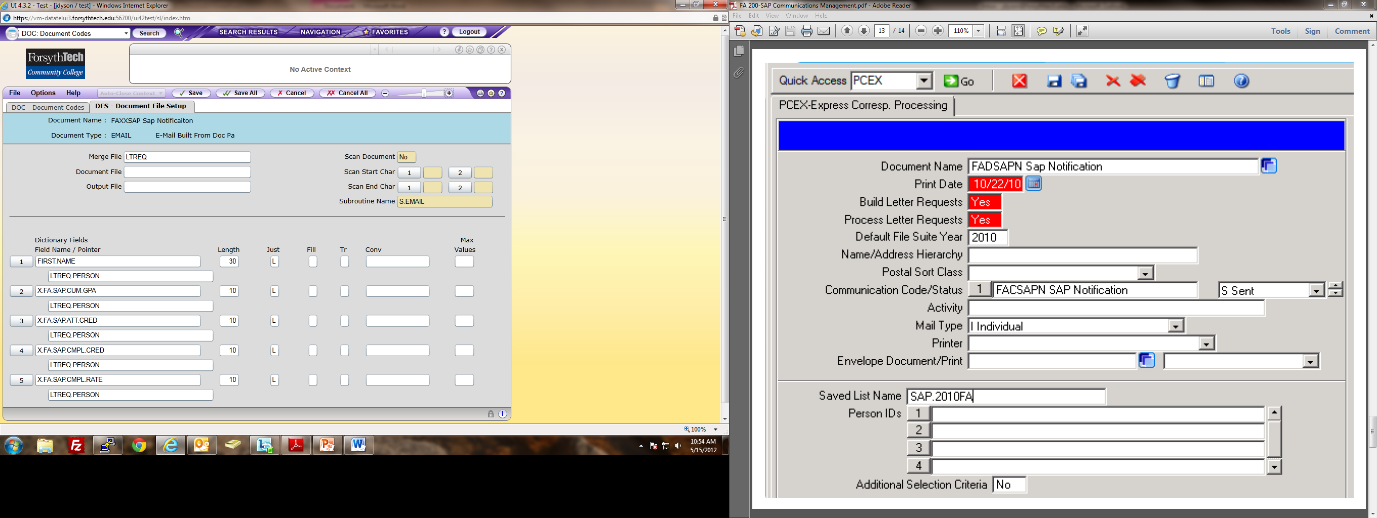
DFS
Notes:
All merge fields from the paragraphs on DOCP will go on this screen. This screen links everything up.

Slide 8
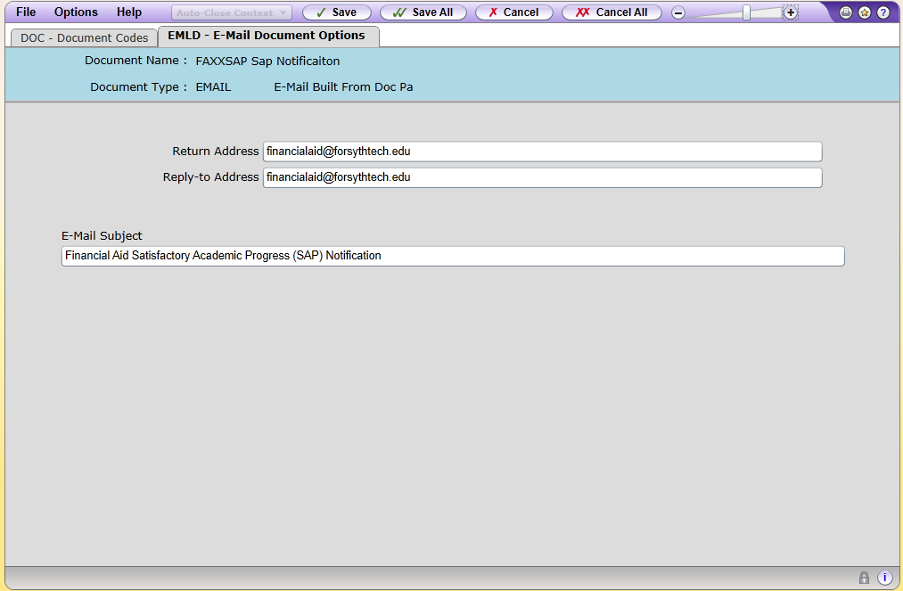
EMLD
Notes:
It is acceptable to use “donotreply@....” here if users do not wish to receive responses to the message(s).

Slide 9
So what now??

Slide 10

Hit the easy button!
Query students that need SAP and create savedlist
Run SAPC using savedlist to calculate SAP
Run PCEX using savedlist to notify students

Slide 11
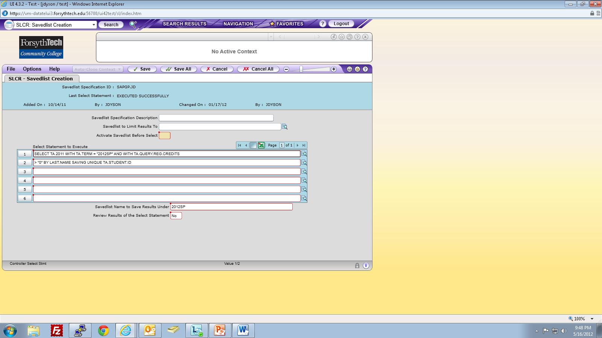
SLCR
Notes:
Sample savedlist for SAPC and PCEX

Slide 12
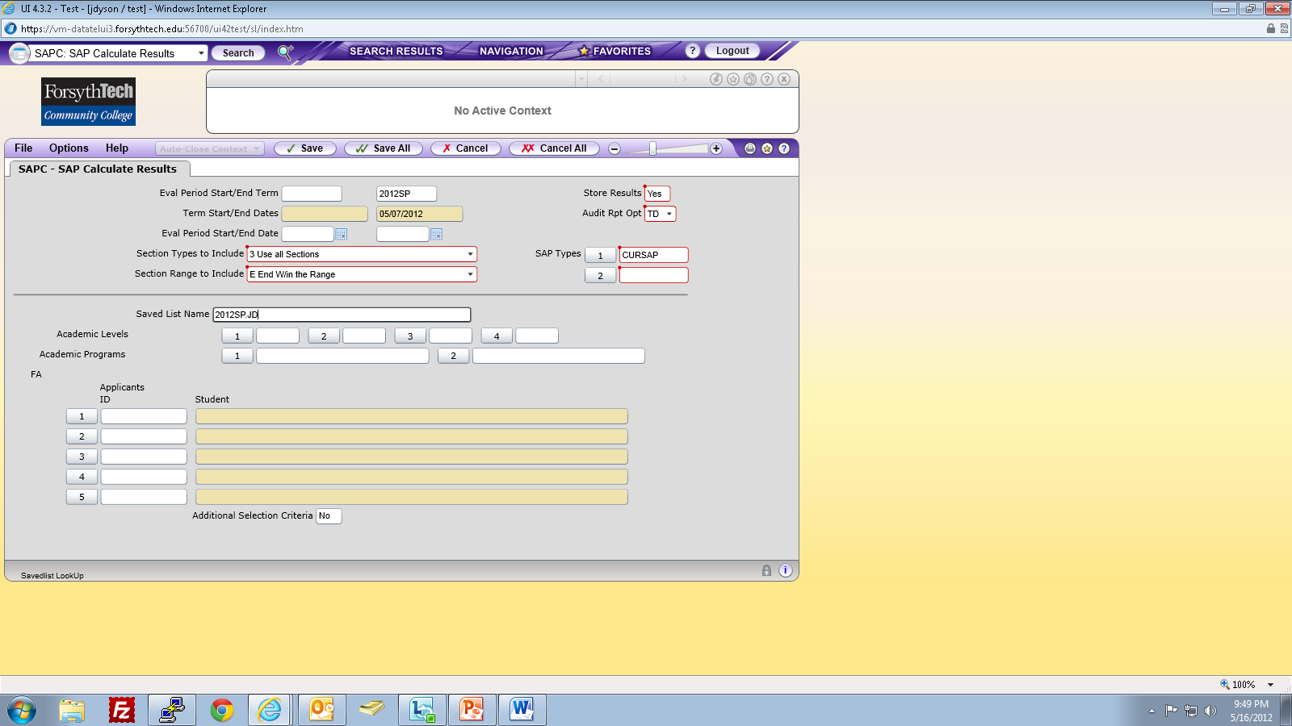
SAPC
Notes:
This savedlist can also be used on PCEX.

Slide 13
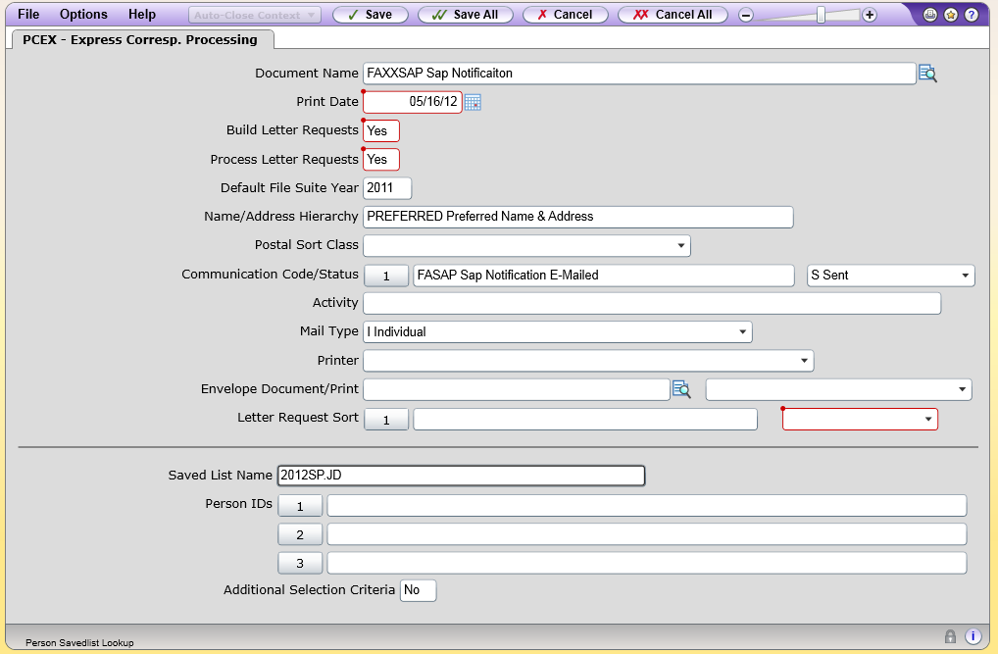
PCEX

Slide 14
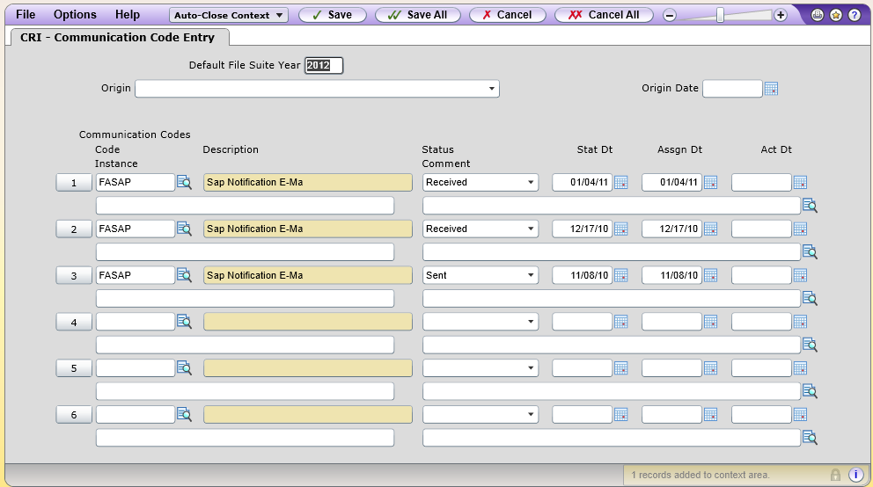
Ta-da!!

Slide 15

Thank you for coming!!

