Slide 1
Machine Guard Inventory
Company
Department

Slide 2
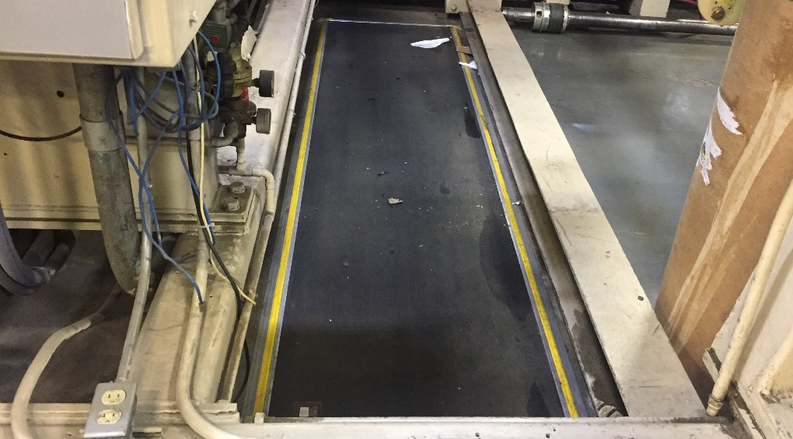
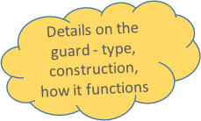
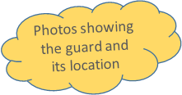
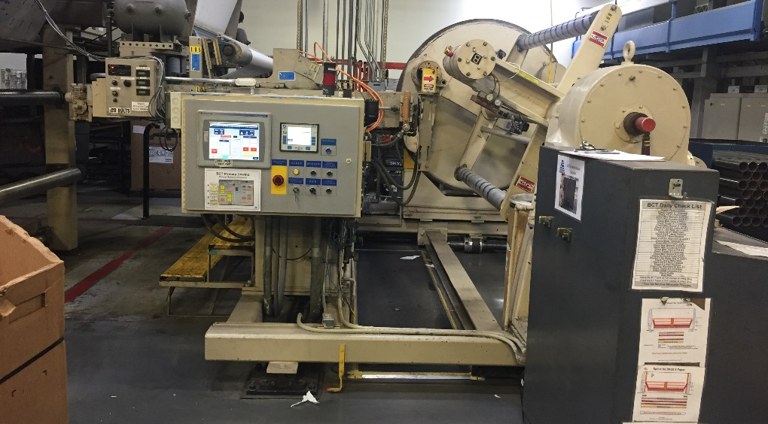
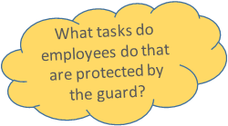
Department: Extrusion | Machine ID: BCT | Section (if applicable): Unwind
Guarding Operation Parameters:
Pressure activated mat
Fixed
Tasks Performed:
Cleaning
Re-webbing
Maintenance
3/25/19

