Slide 1
Assessing & Teaching Communication & Social Skills
Malika Pritchett, MS, BCBA
Positive Enlightenment, Inc.

Slide 2
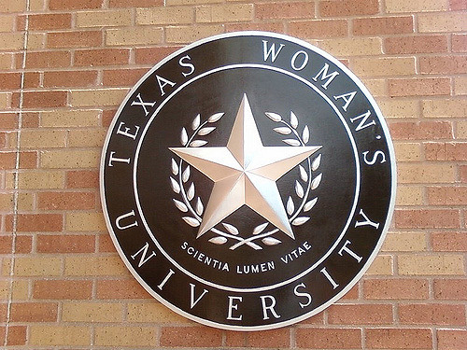
Introduction
A.S. in Science from Collin College
American Sign Language (ASL) Certificate
B.S. in Communication Sciences & Disorders from Texas Woman's University
M.S. in Behavior Analysis from the University of North Texas
Board Certified Behavior Analyst (BCBA)
Positive Enlightenment provides the greater Austin, Texas area with comprehensive and individualized behavioral services
HUB Learning Community
Group Homes
Nursing Facilities
Schools/Daycares
Family Homes

Slide 3
Objectives
Develop knowledge of communication skills
Discriminate between evidence-based and non-evidence based interventions
Learn how to individualize communication programs

Slide 4
Assessment to Treatment Flow
Assessment
Treatment
Evaluation

Slide 5
What is an Intellectual Disability (Intellectual Developmental Disorder)?
Involves impairments of general mental abilities that impact adaptive functioning in three domains, or areas. These domains determine how well an individual copes with everyday tasks:
The conceptual domain includes skills in language, reading, writing, math, reasoning, knowledge, and memory
The social domain refers to empathy, social judgment, interpersonal communication skills, the ability to make and retain friendships, and similar capacities
The practical domain centers on self-management in areas such as personal care, job responsibilities, money management, recreation, and organizing school and work tasks (DSM V)
Notes:
http://www.dsm5.org/documents/intellectual%20disability%20fact%20sheet.pdf

Slide 6
Communication Deficits
The social domain refers to empathy, social judgment, interpersonal communication skills, the ability to make and retain friendships, and similar capacities
Notes:
http://www.dsm5.org/documents/intellectual%20disability%20fact%20sheet.pdf

Slide 7
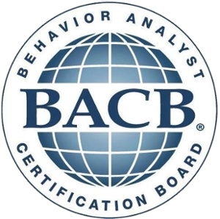
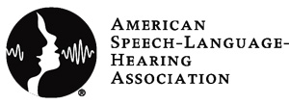
Treatment Practitioners
Applied Behavior Analysis (aba)
Speech-Language Pathology (SLP)
Board Certified Behavior Analyst (BCBA; BCBA-D)
Certified by the Behavior Analyst Certification Board
Speech-Language Pathologist (SLP)
Licensed by the State of Texas
ASHA Certificate of Clinical Competence for Speech-Language Pathologists (CCC-SLP)
Notes:
www.bacb.com
www.asha.org

Slide 8
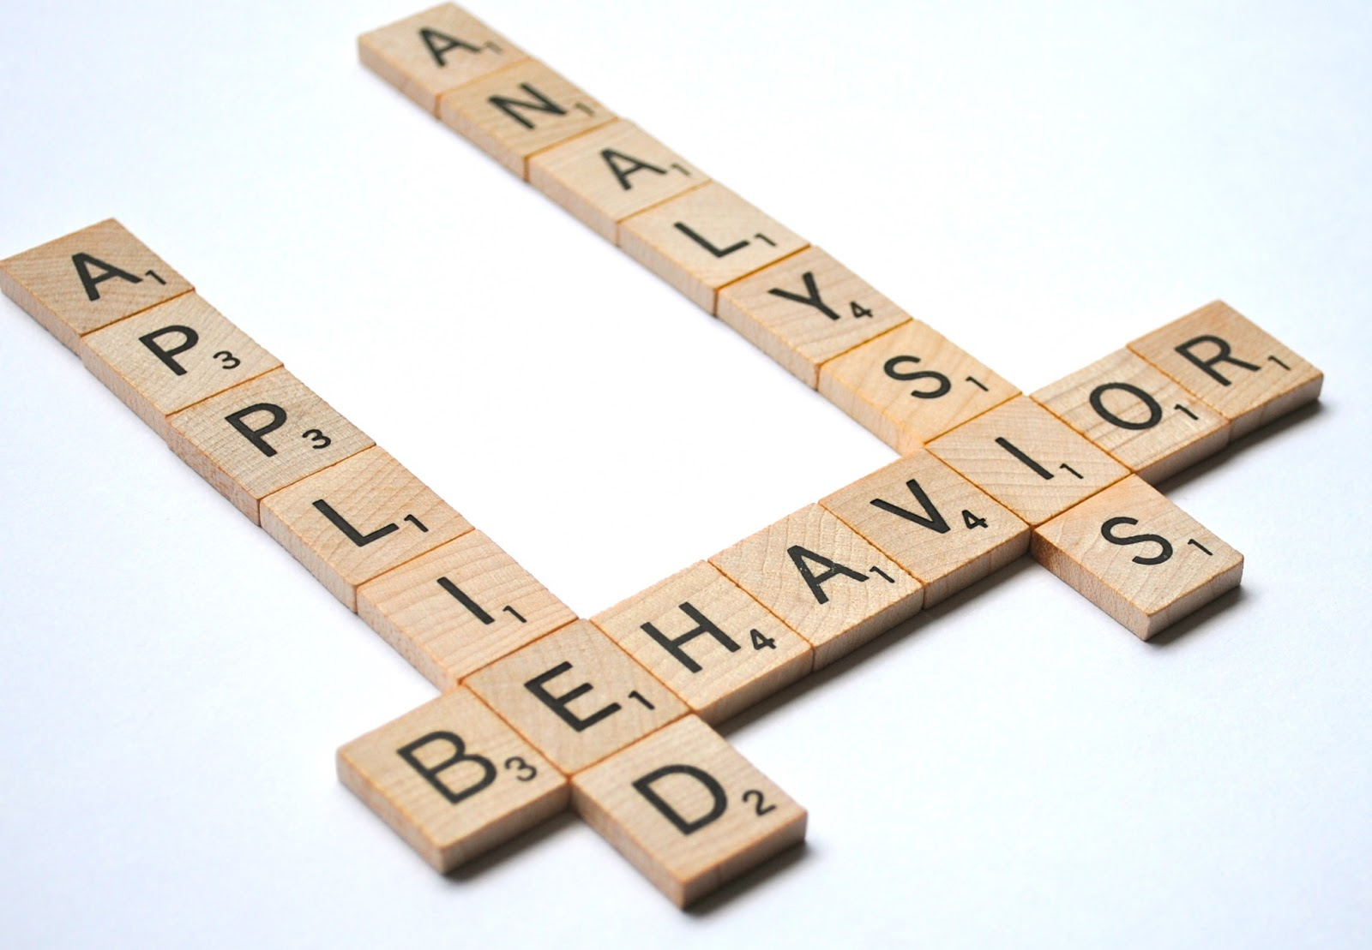
Applied Behavior Analysis (ABA)
The science in which tactics derived from the principles of behavior are applied to improve socially significant behavior and experimentation is used to identify the variables responsible for the improvement in behavior
Notes:
https://www.google.com/search?q=applied+behavior+analysis&espv=2&biw=1366&bih=623&source=lnms&tbm=isch&sa=X&ved=0ahUKEwjDppP1h6nOAhWD8CYKHRQiBhgQ_AUICSgE#imgrc=IUpYJj2NakQvpM%3A

Slide 9
The Science of Behavior on Big Bang Theory
https://www.youtube.com/watch?v=qy_mIEnnlF4
The Big Bang Theory - Sheldon Trains Penny
Notes:
https://www.youtube.com/watch?v=qy_mIEnnlF4

Slide 10
ABA Treatment Programs
Functional Communication Training (FCT)
Self-Management
Imitation
Labeling Items
Identifying Items
Perspective Taking (Theory of Mind)
Initiating Conversations
Interjecting Information
Asking Questions
Eye Contact
Looking Towards a Speaker
Idioms
Identifying Emotions
Notes:
A Work in Progress – Behavior Management Strategies and a Curriculum for Intensive Behavioral Treatment of Autism – Ron Leaf & John McEachin

Slide 11
Key Components to Treatment Programs
Individualized
Behavior analysts must tailor behavior-change programs to the unique behaviors, environmental variables, assessment results, and goals of each client (BACB Compliance Code 4.03a).
Evidence-based treatments vs. Non-evidence based treatments
Professional Competency
Licensure
Certification
Experience/Specialization
Referral
Collaborative
Culturally Responsive
Notes:
https://www.google.com/search?q=team+collaboration&espv=2&biw=1366&bih=667&source=lnms&tbm=isch&sa=X&ved=0ahUKEwjN5P78m6nOAhXDSSYKHc4yArEQ_AUIBigB#imgrc=3NTYZ74QltgteM%3A

Slide 12
Evidence Based Practice (ebp)
“Evidence-based practice (EBP) is spreading in popularity in many health care disciplines. One of its main features is the reliance on the partnership among hard scientific evidence, clinical expertise, and individual patient needs and choices. Librarians play an important role in the spread of EBP because of the importance of identifying and retrieving appropriate literature from various sources for use in making health care decisions” (McKibbon, 1998)
Notes:
McKibbon, K. A. (1998). Evidence-based practice. Bulletin of the Medical Library Association, 86(3), 396–401.

Slide 13
culturally & Linguistically Diverse Backgrounds
Consider treatment targets within the context of the person’s cultural values (Wilczynski et. al., 2012)
Many cultures may value communication patterns that differ from those that are in the dominant culture (Wilder et. al., 2004)
For example: In some Native American and Asian American cultures, children’s avoidance of eye contact with adults is considered a sign of respect
Notes:
Treatment of Autism Spectrum Disorders – Prelock & McCauley 2012

Slide 14
Always Remember
Start where the organism is
Everybody can learn
Continually reevaluate and change goals as the learner progresses
Communication is key to a meaningful life

Slide 15
Q & a
Notes:
http://www.asha.org/public/
http://bacb.com/resources/
http://www.parentcenterhub.org/repository/speechlanguage/
http://www.csld.org/contact.htm
http://do2learn.com/SocialSkills/overview.htm
Positiveenlightenment.com
American Psychiatric Association. (2013). Diagnostic and statistical manual of mental disorders (5th ed.). Arlington, VA: American Psychiatric Publishing.
Collins, John William. "The greenwood dictionary of education". Greenwood, 2011. page 86. ISBN 978-0-313-37930-7
Friman, P. C. (2010). COOPER, HERON, AND HEWARD’S APPLIED BEHAVIOR ANALYSIS (2ND ED.): CHECKERED FLAG FOR STUDENTS AND PROFESSORS, YELLOW FLAG FOR THE FIELD. Journal of Applied Behavior Analysis, 43(1), 161–174. http://doi.org/10.1901/jaba.2010.43-161
Professional and Ethical Compliance Code for Behavior Analysts
Treatment of Autism Spectrum Disorders Prelock & McCauley
Wilczynski, S.M., Menousek, K., Hunter, M., & Mudgal, D. (2007). Individualized education programs for youth with autism spectrum disorders. Psychology in the Schools, 44(7), 653-666
Wilder, L.K., Dyches, T.T., Obiakor, F.E., & Algozzine, B. (2004). Multicultural perspectives on teaching students with autism. Focus on Autism and Other Developmental Disabilities, 19, 105-113.

Slide 16
Keep In Touch
Positive Enlightenment
www.positiveenlightenment.com
malika@positiveenlightenment.com

