Slide 1
Bonding and Isomerism
Review and Introduction to Organic Chemistry

Slide 2
Where are electrons?
Atomic structure
Atomic number
Atomic weight
Energy levels
Electron configurations
Energy Levels
Sublevels
Orbitals
Lewis structures (electron dot structures)

Slide 3
Ionic Compounds
Ionic bonds
Cation
Anion
Electropositive
Electronegative

Slide 4
Covalent Bonding
Sharing
Molecules
Bond energy
Bond length
H2 is 0.74 Å

Slide 5
Glorious Carbon and the Covalent Bond
Lewis structure
Four bonds

Slide 6
Carbon-carbon Single Bonds

Slide 7
Carbon-carbon Single Bonds
Equal sharing
BE = 368 kJ
BL = 1.54 Å
Radical—molecular fragment w/odd number of unshared electrons

Slide 8
Catenation
Ability of element to form chains due to bonding between like atoms
Draw structure of propane, C₃H₈

Slide 9
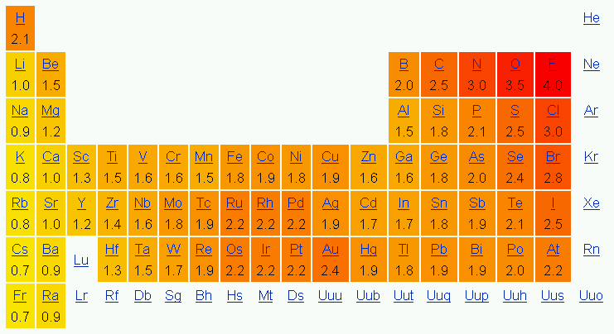
Electronegativity Values

Slide 10
C-H Bond
EN difference is 0.4 (some sources say H’s EN is 2.2)
Considered nonpolar

Slide 11
Polar Covalent Bonds
Unequal sharing
Differences in EN >1.0 and <2.0
δ+ and δ- or

Slide 12
Indicating Polarization

Slide 13
Do you get it?
Draw the structure and indicate polarity for each molecule
Dichlorodifluoromethane, CCl₂F₂
Methanol, CH₃OH

Slide 14
Multiple Covalent Bonds
CO2
HCN

Slide 15
Hydrocarbons
3 cpds have just 2 C’s
Ethane, C₂H₆
Ethene (ethylene), C₂H₄
Ethyne (acetylene), C₂H₂

Slide 16
Valence
Number of bonds that an element tends to have
Number of electrons needed to fill valence shell
H
C
N
O
F
Cl

Slide 17
Isomerism
Molecular formula v. structural formula
Isos + meros
Structural or constitutional isomers
Consider C₂H₆O
2 isomers
1 has bp = 78.5°C, and the other has bp = −23.6°C…why?
Ethanol v. methoxymethane

Slide 18
Structures of C₂H₆O

Slide 19
Writing Structural Formulas
Continuous chain
Branched chain
C₅H₁₂—3 isomers

Slide 20
Structures of C₅H₁₂

Slide 21
Abbreviating Structural Formulas
Condense atoms
Non-horizontal bonds and multiple bonds are usually shown
Ethanol
Methoxymethane

Slide 22
Using lines as abbreviations
Each line segment has a carbon at each end
H’s are omitted, but every C has 4 bonds
Multiple bonds represented by multiple parallel lines

Slide 23
Formal Charge
Which atom bears the charge?
# valence e⁻ neutral atom − (unshared e⁻ + ½ shared e⁻)
# valence e⁻ neutral atom − (dots + bonds)
Consider hydronium ion, H₃O⁺
Draw its Lewis structure

Slide 24
Hydronium’s Formal Charge
Each H
1 − (0 + 1) = 0
The O
6 − (2 + 3) = 1+
Thus, the O carries the formal charge of 1+

Slide 25
Resonance
Multiple structural formulas for the same molecule or ion
None of them is accurate
Hybrid
Use ↔ to indicate resonance between structures

Slide 26
Resonance of carbonate, CO₃²⁻

Slide 27
Resonance hybrid of carbonate, CO₃²⁻

Slide 28
Arrow Formalism
Curved arrows
Full head—indicates electrons are moved in resonance
Shows direction of transfer of electrons
Half-head—”fishhook” indicates movement of a single electron
Look at the decomposition rxn of ethane to form to methyl radicals
Straight arrows
Reactants to products; half-head—equilibrium
Double-headed arrows—resonance

Slide 29
Arrow Formalism

Slide 30
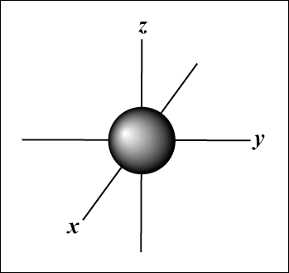
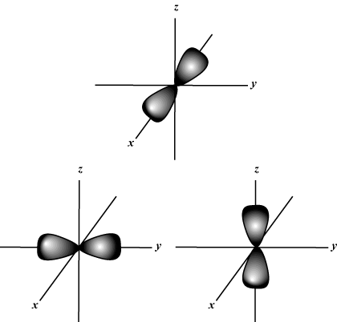
Orbital Shapes
s
p

Slide 31
Molecular Orbitals
Atomic orbitals combine
Spaces occupied by electrons in a molecule
s orbitals can bond as in H₂
Sigma bonding (σ bonding)—overlapping

Slide 32
Carbon sp³ Hybrid Orbitals
Explains the fact that C forms 4 bonds even though its orbital diagram shows

Slide 33
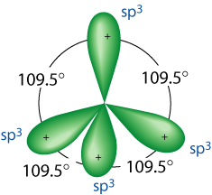
Carbon sp³ Hybrid Orbitals
2s and 2p combine (hybridize) to form 4 identical hybrid orbitals

Slide 34
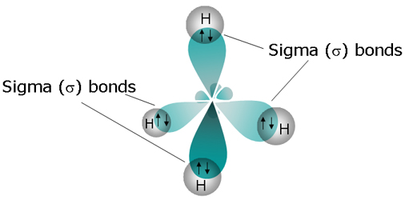
Tetrahedral Carbon—bonding in Methane

Slide 35
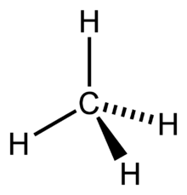
Tetrahedral Carbon—bonding in Methane
Solid lines—lie in the plane of the page
Dashed wedges—extend behind the plane of the page
Solid wedges—project out toward you

Slide 36
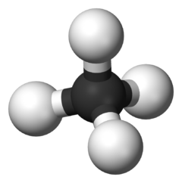
Tetrahedral Carbon—bonding in Methane
Ball & Stick Model

Slide 37
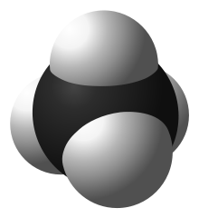
Tetrahedral Carbon—bonding in Methane
Space-filling model

Slide 38
Tetrahedral Carbon—bonding in Methane
Electrostatic Potential Map
Blue indicates partial positive charge
Red represents partial negative charge

Slide 39
Classification According to Molecular Framework
Acyclic cpds
Straight
Branched
No rings
Carbocyclic cpds
At least 1 ring
Smallest carbocyclic cpd has 3 C’s
Heterocyclic cpds
At least 1 ring in which another atom other than C is a part

Slide 40
Classification According to Functional Group
Characteristic properties regardless of molecular framework to which they are attached
Tend to be sites where rxns take place

Slide 41
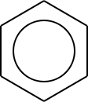
Functional Groups that are part of Molecular Framework
Alkanes
C single bonds
Alkenes
At least one C to C double bond
Alkynes
At least one C to C triple bond
Arenes
Contain benzene ring

Slide 42
Functional Groups Containing Oxygen
Alcohol
R−OH
Ether
R−O−R’
Aldehyde
R—C=O
H
Ketone
R—C−C=O
C—R’
Carboxylic acid
R—C=O
OH
Ester
R—C=O
O−C

Slide 43
Functional Groups Containing Oxygen, Nitrogen, Halogen, or Sulfur
Primary Amine
R−NH₂
Nitrile
R≡N
Amide
R—C=O
NH₂
Halide
R—X
Thiol (mercaptan)
R—SH
Thioether (sulfide)
R—S—R’

