Slide 2
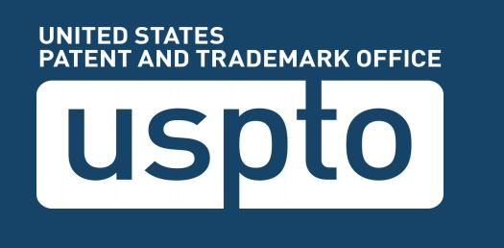
What is the USPTO?
The United States Patent and Trademark Office (USPTO or Office) is an agency of the U.S. Department of Commerce. The role of the USPTO is to grant patents for the protection of inventions and to register trademarks. It serves the interests of inventors and businesses with respect to their inventions and corporate products, and service identifications. It also advises and assists the President of the United States, the Secretary of Commerce, the bureaus and offices of the Department of Commerce, and other agencies of the government in matters involving all domestic and global aspects of “intellectual property.” Through the preservation, classification, and dissemination of patent information, the Office promotes the industrial and technological progress of the nation and strengthens the economy.

Slide 3
What is the role of USPTO?
In discharging its patent related duties, the USPTO examines applications and grants patents on inventions when applicants are entitled to them; it publishes and disseminates patent information, records assignments of patents, maintains search files of U.S. and foreign patents, and maintains a search room for public use in examining issued patents and records. The Office supplies copies of patents and official records to the public. It provides training to practitioners as to requirements of the patent statutes and regulations, and it publishes the Manual of Patent Examining Procedure to elucidate these. Similar functions are performed relating to trademarks. By protecting intellectual endeavors and encouraging technological progress, the USPTO seeks to preserve the United States’ technological edge, which is key to our current and future competitiveness. The USPTO also disseminates patent and trademark information that promotes an understanding of intellectual property protection and facilitates the development and sharing of new technologies worldwide.

Slide 4
What Are Patents, Trademarks, Servicemarks, and Copyrights?
Some people confuse patents, copyrights, and trademarks. Although there may be some similarities among these kinds of intellectual property protection, they are different and serve different purposes.

Slide 5
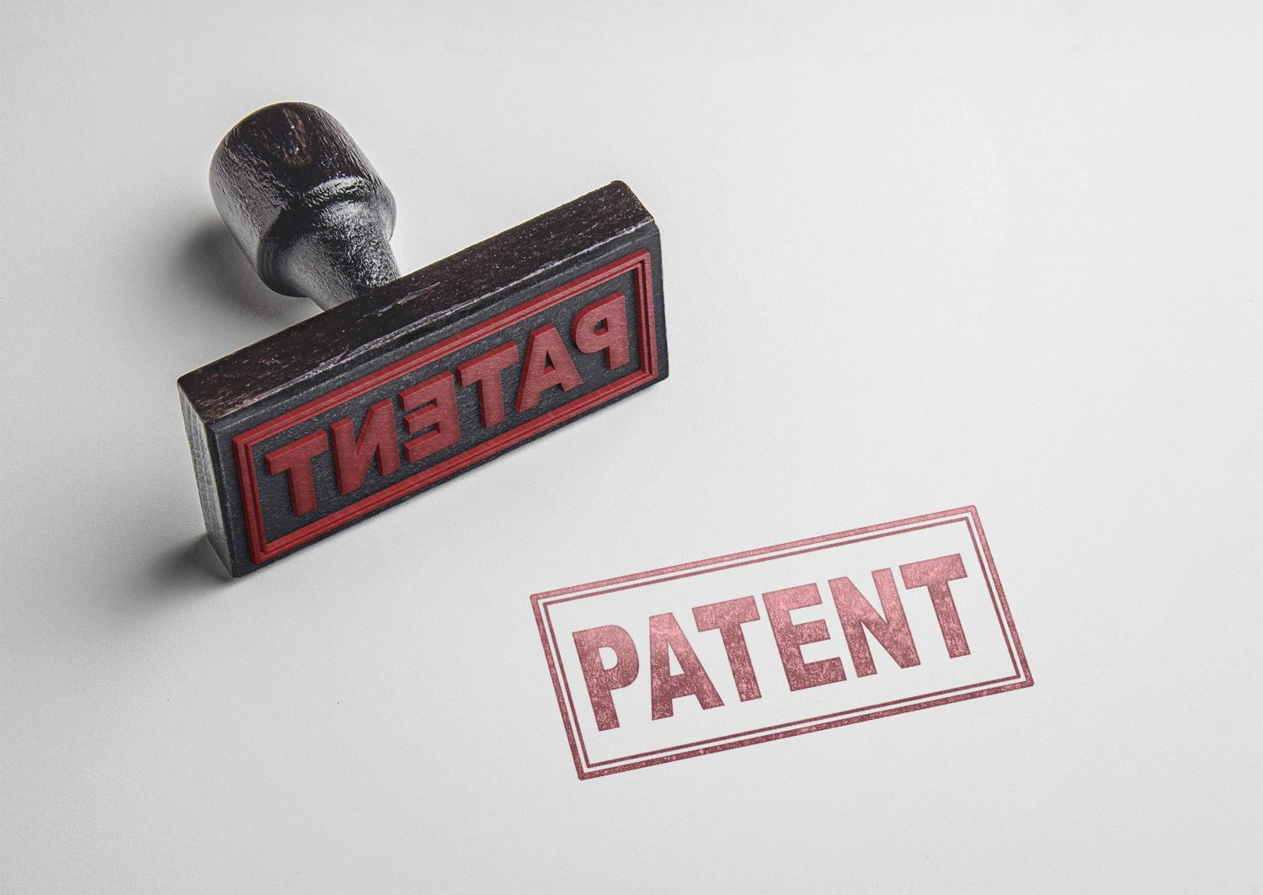
What is a Patent?
A patent for an invention is the grant of a property right to the inventor, issued by the United States Patent and Trademark Office. Generally, the term of a new patent is 20 years from the date on which the application for the patent was filed in the United States or, in special cases, from the date an earlier related application was filed, subject to the payment of maintenance fees. U.S. patent grants are effective only within the United States, U.S. territories, and U.S. possessions. Under certain circumstances, patent term extensions or adjustments may be available.
The right conferred by the patent grant is, in the language of the statute and of the grant itself, “the right to exclude others from making, using, offering for sale, or selling” the invention in the United States or “importing” the invention into the United States. What is granted is not the right to make, use, offer for sale, sell or import, but the right to exclude others from making, using, offering for sale, selling or importing the invention. Once a patent is issued, the patentee must enforce the patent without aid of the USPTO.

Slide 6
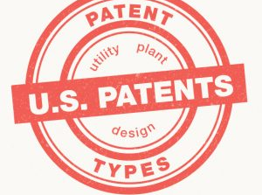
There are three types of patents
1) Utility patents may be granted to anyone who invents or discovers any new and useful process, machine, article of manufacture, or composition of matter, or any new and useful improvement thereof; 2) Design patents may be granted to anyone who invents a new, original, and ornamental design for an article of manufacture; and 3) Plant patents may be granted to anyone who invents or discovers and asexually reproduces any distinct and new variety of plant.

Slide 7
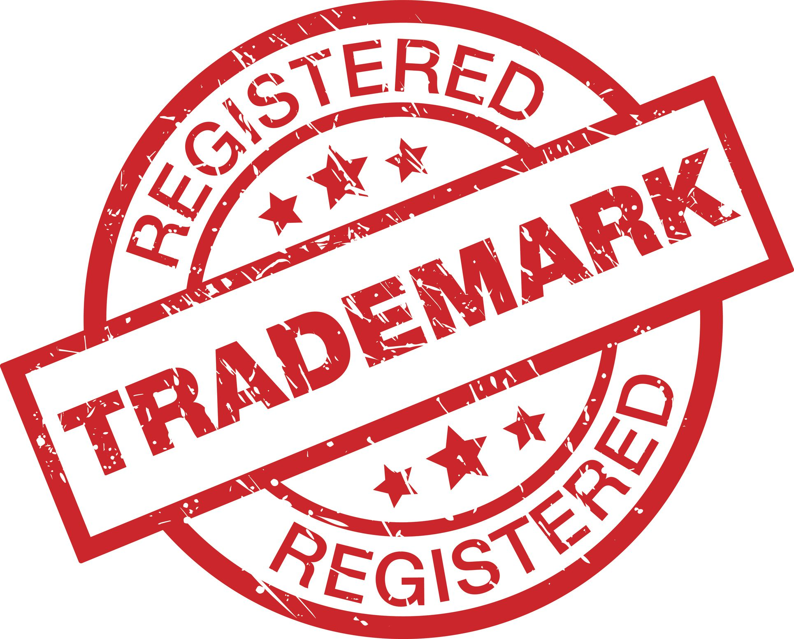
What Is a Trademark or Servicemark?
A trademark is a word, name, symbol, or device that is used in trade with goods to indicate the source of the goods and to distinguish them from the goods of others. A servicemark is the same as a trademark except that it identifies and distinguishes the source of a service rather than a product. The terms “trademark” and “mark” are commonly used to refer to both trademarks and servicemarks.
Trademark rights may be used to prevent others from using a confusingly similar mark, but not to prevent others from making the same goods or from selling the same goods or services under a clearly different mark. Trademarks that are used in interstate or foreign commerce may be registered with the USPTO.

Slide 8
What is a Copyright?
Copyright is a form of protection provided to the authors of "original works of authorship" including literary, dramatic, musical, artistic, and certain other intellectual works, both published and unpublished. The 1976 Copyright Act generally gives the owner of copyright the exclusive right to reproduce the copyrighted work, to prepare derivative works, to distribute copies or phonorecords of the copyrighted work, to perform the copyrighted work publicly, or to display the copyrighted work publicly.
The copyright protects the form of expression rather than the subject matter of the writing. For example, a description of a machine could be copyrighted, but this would only prevent others from copying the description; it would not prevent others from writing a description of their own or from making and using the machine. Copyrights are registered by the Copyright Office of the Library of Congress.

Slide 9
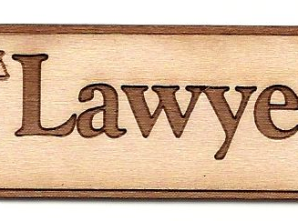
Recommended
United States Patent and Trademark Office recommend that all seek to apply for a patent or trademark to use an attorney who is familiar with the law. The law in these matters can be extremely complicated and having one who specializes in this field is the best course of action.

