Slide 1
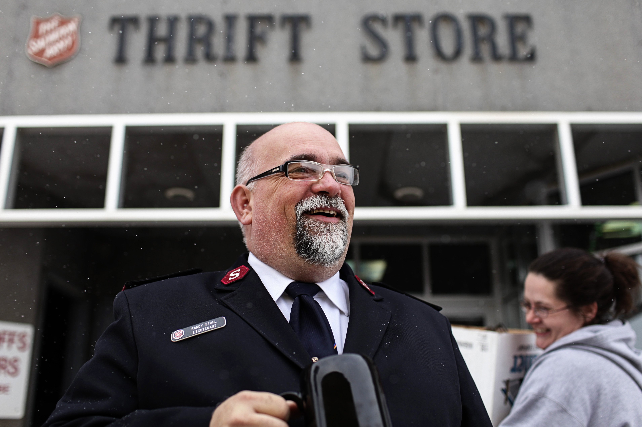
2015 WealthEngine™ Overlays for TSAS
Fueling our ability to do the most good
Notes:
Welcome to the 2015 WealthEngine Presentation. In this presentation, we’ll discuss what data WealthEngine gathered for TSAS and what we can do with the overlay results.

Slide 2
This presentation
Why we put our stock in WealthEngine
Become a beneficiary of the big picture
Accrue some data details
Data Deposit into InterChange

Slide 3
THe “ONE THING”
We are leaving a lot of money on the table

Slide 4
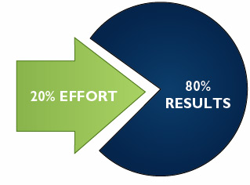
Pareto Principal
80% of our money comes from 20% of the donors (80/20 rule)
Limited resources → Concentrate on valuable resources (Our 20%)
Challenge:
-Who are our 20%?
-Who will most likely become one of our 20%
Notes:
As many of you know, in a non-profit, about 80% of our money comes from a very small minority-about 20% of our constituents. Because we have limited resources of time, energy, money and human capital, a solid strategic move is to concentrate on the 20%. But finding who is and who could become our 20% is a challenge, which is why WeathEngine was contracted to conduct this wealth overlay for the Southern Territory.

Slide 5
Assumptions we can’t afford to make
Capacity = Propensity
Capacity = Propensity to give to TSA
No major gift in the past = no major gift in the future
Gift size tells the whole story
Fundraisers will be able to identify major donor prospects
Notes:
Here are the assumptions we CANNOT afford to make (pun intended). 1-Just because someone is loaded doesn’t mean they’re philanthropic (Ebenezer Scrooge!) 2-Just because someone has the capacity and propensity to give doesn’t mean they want to give to TSA. 3-No major gift in the past doesn’t mean they won’t give in the future. 4-Gift size does not tell the whole story (use the multimillionare example; the guy who donates $100 every year to TSA but thousands to other non-profits). 5-Fundraisers aren’t statisticians and even if they were, they don’t have access to all of the information they need to identify major donor prospects.

Slide 6
We hired WealthEngine™ to Assist us
enhance and model Our records
Notes:
This is why we hired WealthEngine-to help us with the daunting challenging of figuring out who are 20% are.

Slide 7
Our Goals
Understand current individual donors and prospects (giving capability, areas of interest, ways to engage and involve them)
Identify potential major donors and engage them in the donor cycle
Identify potential bequest and gift annuity donors
Obtain more sophisticated data in regards to predicting donors (not simply recency/frequency/money)
Identify and cultivate new donors (especially as most of our donors are ageing out)
Notes:
These were the goals we were hoping to accomplish by hiring WE to run our wealth overlays.

Slide 8
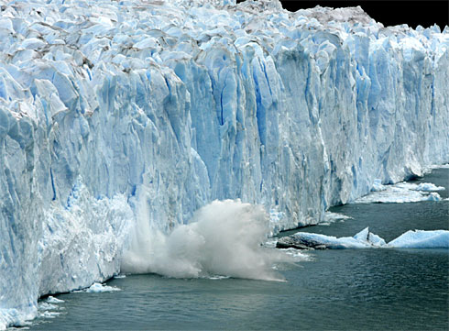
The Glacier is Melting!

Slide 9
Process
WealthEngine uses many different data sources (see handout for more info)
Used statistically-based predictions on the top-secret stuff (such as Cash on Hand, Salaries, etc.)
Enhance, then model
Allows us to make better predictions about who may give to TSAS (customized and tailored data rather than one-size-fits-all)

Slide 10
Enhance, Then Model= Customized Donor predictors
Net Worth
Board Member
Our Model Score→Deciles
Past Giving History
Total Assets
Age

Slide 11
The Deliverables
Three Predictive Models:
1. Major Gift
II. Planned Gift: Bequest
III. Planned Gift: Gift Annuity
Notes:
At the end of the day, we wanted to use the data to have 3 predictive models of giving for: 1-Major Gifts, 2-Bequest Planned Gifts, 3-Annuity Planned Gifts. This way, we’ll know who in InterChange, we need to make prospects and target.

Slide 12
Wealth StalkENgine
WealthEngine can find your salary.
WealthEngine can find your foreign investments.
WealthEngine can find find your real estate holdings.
WealthEngine can find how much money you have in your checking account.
WealthEngine can find the number of adults in your household.
WealthEngine can find how much money you have in your savings account.
WealthEngine can find your insider stock holdings.
WealthEngine can find out if you own an airplane.
WealthEngine can find out if you serve on a Board.
WealthEngine can find out if you own a boat.

Slide 13
The Results
Let’s be beneficiaries of the big picture
Notes:
Let’s take a look at an overview of the data; later on in the presentation we’ll talk more about the details. This will help you get an idea of what WE discovered about our constituent base.

Slide 14
Notes:
Here is the basic data of who was screened. Screened means WE used a bunch of their data points and data from our major donors to create what’s called “models” of giving.

Slide 15
Key Takeaways
Our data set has far more major giving prospects and planned giving prospects that Wealth Engine is used to seeing →good identification of prospects…
…BUT a lot of our donors are giving way under their capacity
And there are a lot of prospects who have NOT been identified by both RD and PG professionals in InterChange who are very likely to become major gift donors.
Major Gift Model can also inform Planned Giving, both gift annuities and bequests.
We have a bunch of ‘everyday givers’ who would make excellent bequest prospects.
Notes:
(Explain takeaways)

Slide 16
Notes:
Wealthiest individuals aren’t necessarily giving huge gifts (sustained givers)

Slide 17
Our donors could be giving a lot more
Notes:
We’ll discuss the P2G score in a bit, but right now, the important take away is that our donors could be giving a lot more.

Slide 18
Notes:
We’ve got a lot of potential Planned Givers who aren’t yet listed as Planned Giving Prospects.

Slide 19
The details
Let’s Accrue some details
Notes:
Now let’s go into some of the details.

Slide 20
P2G Score: Propensity to give score
1|3
Two-digit score
First digit: Shows how well the constituent’s data aligns with major giving behavior
Second digit: Indicates estimated giving capacity; used to further rank donors
The lower the number, the higher the likelihood of becoming a major donor
Notes:
The P2G Score is one of the most important pieces of data that WE gave us about each constituent. This score basically tells us how likely this person is to give to TSA based on a number of data predictors. The lower the score, the better. The first digit is more important that the second digit. 1-0 is the best.

Slide 21
First Digit Score Defined…
Notes:
Here’s what the first digit score means. Pay attention to the 5 score; we’ll be discussing this later. A 5 doesn’t means the person won’t give or hasn’t given; in fact TSA has some high givers who’ve received a 5 for the first digit. What this means is that the data we have on them in InterChange isn’t accurate enough. Data hygiene and some personal research could alleviate this.

Slide 22
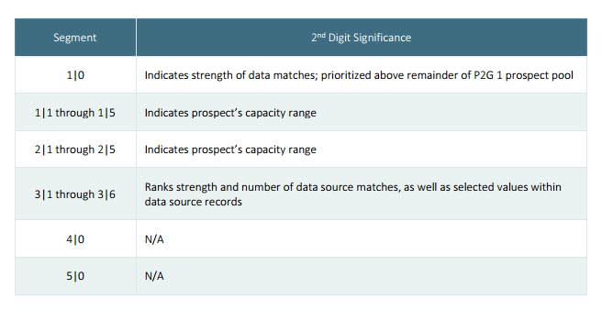
second Digit Score Defined…
Notes:
Second digit helps us figure out their Estimated Giving Capacity (the range in which we could expect them to make a gift).

Slide 23
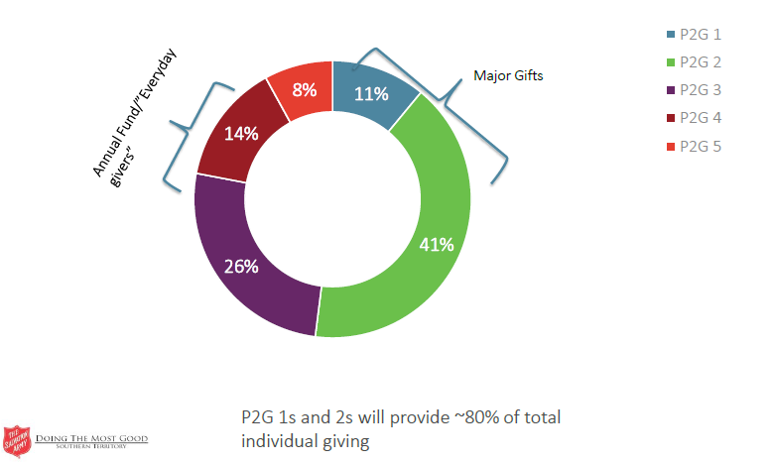
Over half of our file is p2G 1’s and 2’s→Our 20%!
Notes:
Over half our file has PG 1 and 2’s, which is great. 1’s and 2’s are our 20%!

Slide 24
Notes:
P2G 1-0 is the crème de la crème of our file. These are the people who possess the highest likelihood of giving us a big gift. So, of the ¾ of a million constituents who are in InterChange, these 25,000 people are the ones we should be pursuing.

Slide 25
EGC: Estimated Giving Capacity
Notes:
EGC= Estimated Giving Capacity. This is another data point that WE uses to determine major giving feasibility. The factors pictured here help WE create the EGC.

Slide 26
Notes:
Interesting tidbit about our data…

Slide 27
Our donors ourperform the national average in certain ranges and underperform in others
Notes:
We outperform in the 50-75K range but underperform in the 75-100K and in the lower ranges. We could probably be asking for bigger gifts from the more affluent prospects and cultivating more gifts from those less affluent.

Slide 28
Truth we can Invest in
P2G + EGC + Model Scores = High likelihood of becoming a major donor to TSA
Notes:
Wealth Engine takes constituents’ P2G score, plus their EGC plus other data points to help develop our predictors.

Slide 29
Major Gift=$2500+ Predictors
Notes:
Here are the predictors of major gift prospects. (A major gift is $2500 or higher)

Slide 30
Planned giving-Bequest predictors
Notes:
Here are the predictors of bequest prospects

Slide 31
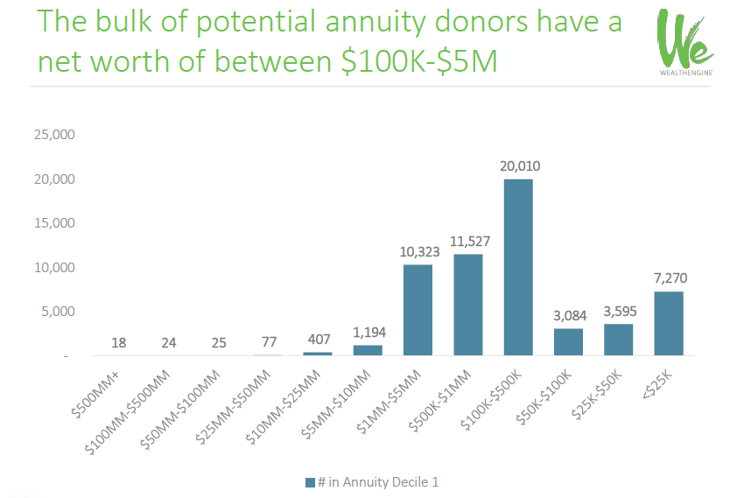
Gift Annuity stats
Notes:
Here is the data about our potential annuity donors. Their assets are primarily tied up in stock and in real estate.

Slide 32
Deciles created using Logistic regression
Notes:
A Decile is a way to break down data into sets of 10 in order to see results more easily using logistic regression. As you can see, in this chart, data is broken down by donor type. Decile 1 contains 6100 of our current major donors, but look at how many more there are in this decile! 60k! That means, there are at least 60K more potential donors we can cultivate to give major gifts.

Slide 33
Action Steps: Recommended
Analyze your current portfolio for untapped potential and weak prospects. Update prospect plans accordingly.
Get MG Priority 1 prospects into a fundraiser’s portfolio, then move on to Priorities 2 and 3 (see handout).
Include a Planned Giving Message in any communication.
Pursue gifts of stock, real estate or other liquidated assets.
Notes:
Remember that a P2G5 isn’t someone who can’t or won’t give but means the data in IC didn’t match the data WE searched. This could happen if someone provided a PO Box instead of an address, name was misspelled, etc.

Slide 34
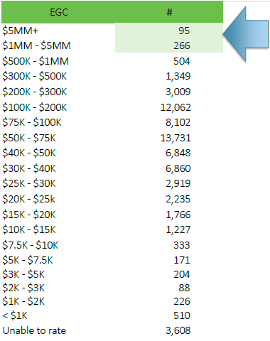
Action Steps: Recommended
Focus on our highest capacity givers in the highest ranges for major gift success
Notes:
Focuing on the deep pockets is the smartest strategic move.

Slide 35
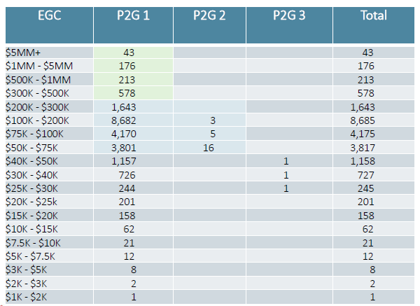
Action Steps: Recommended
There are over 22,000 possible Bequest Donors identified. Create a strategy to get them into a portfolio.
Notes:
Use data to rework bequest donor prospect plans

Slide 36
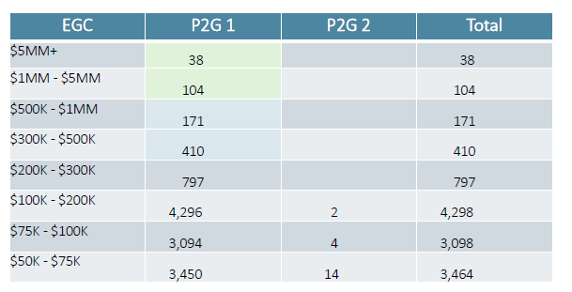
Action Steps: Recommended
About 12,000 possible gift annuity prospects have been identified. Create a strategy to get them into a portfolio.
Notes:
There are about 15K possible annuity prospects identified by the data

Slide 37
WE DATA captured in InterChange
Notes:
We have captured these 20 attributes-the most essential predictors of a potential major giver-and populated constituent records with these. A handout will be given to you that contains more information.

Slide 38
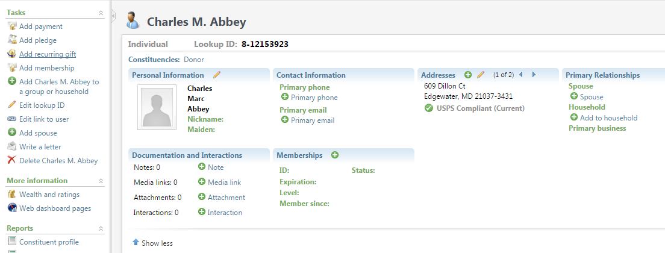
Here’s how you find it
Notes:
First, you’ll locate the constituent’s record. Click on the Wealth and Ratings hyperlink. Then, click on the Model Scores tab on the Wealth Profile. Here, you’ll see the Wealth Engine attributes and their corresponding values.

Slide 39
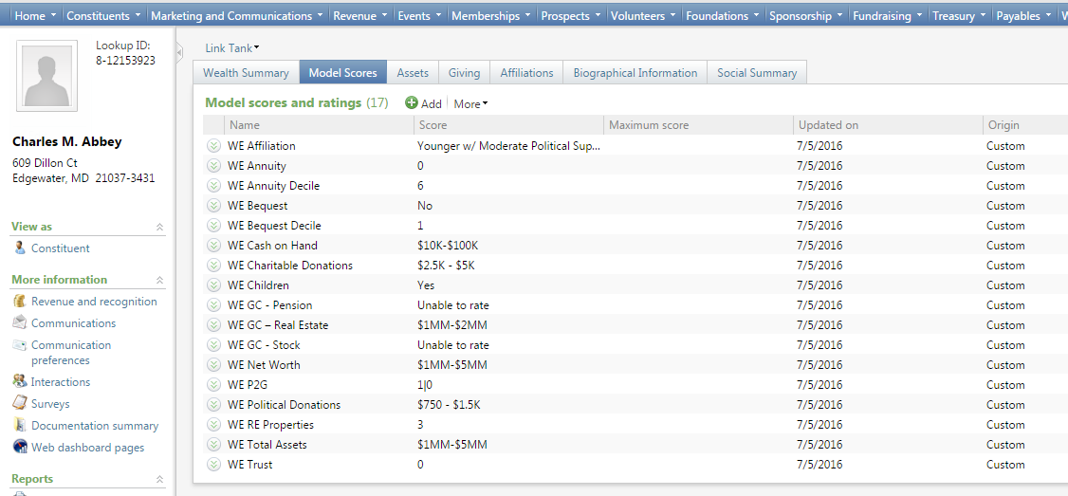
The Model Scores Tab
Notes:
First, you’ll locate the constituent’s record. Click on the Wealth and Ratings hyperlink. Then, click on the Model Scores tab on the Wealth Profile. Here, you’ll see the Wealth Engine attributes and their corresponding values.

Slide 40
You can Use a smart query to find the data

