Slide 1
EAST MESABI JOINT WATER SYSTEM A JOINT VENTURE BETWEEN THE CITY OF AURORA & TOWN OF WHITE City of Aurora, APPLICANT
“WHERE
COMMUNITY NEEDS
MEETS 21ST
CENTURY
OPPORTUNITIES”
Notes:
Introductions

Slide 2
Why we are here
To request your support and consideration for $8.6 million in State Funding
Purpose: Final design, land acquisition, and to build a new water treatment facility & infrastructure system
Serving the East Range as a consolidated system
Outcome: Ensures the ability to provide essential services to our communities
Notes:
We are here today to discuss the request for $8.6 million of State Funding in order to complete final design, land acquisition, and to build a new water treatment facility & infrastructure system serving the East Range as a consolidated system
If successfully funded, this request ensures the ability to provide essential services to citizens of the City of Aurora, the Town of White (which includes Scenic Acres), and allows for future economic development and expansion extending to the cities of Hoyt Lakes and Biwabik. The expansion and future economic development opportunities would be lost because our existing facility and infrastructure doesn’t support expansion.
Why not possible for current facility (for reference if asked):
Current source of St. James Pit is not stable – water level fluctuates (currently flooding)
Does not meet current environmental, ADA, or department of health standards (currently grand-fathered in)
Would require complete renovation and even if upgraded would not have ability to expand footprint to meet future expansion needs

Slide 3
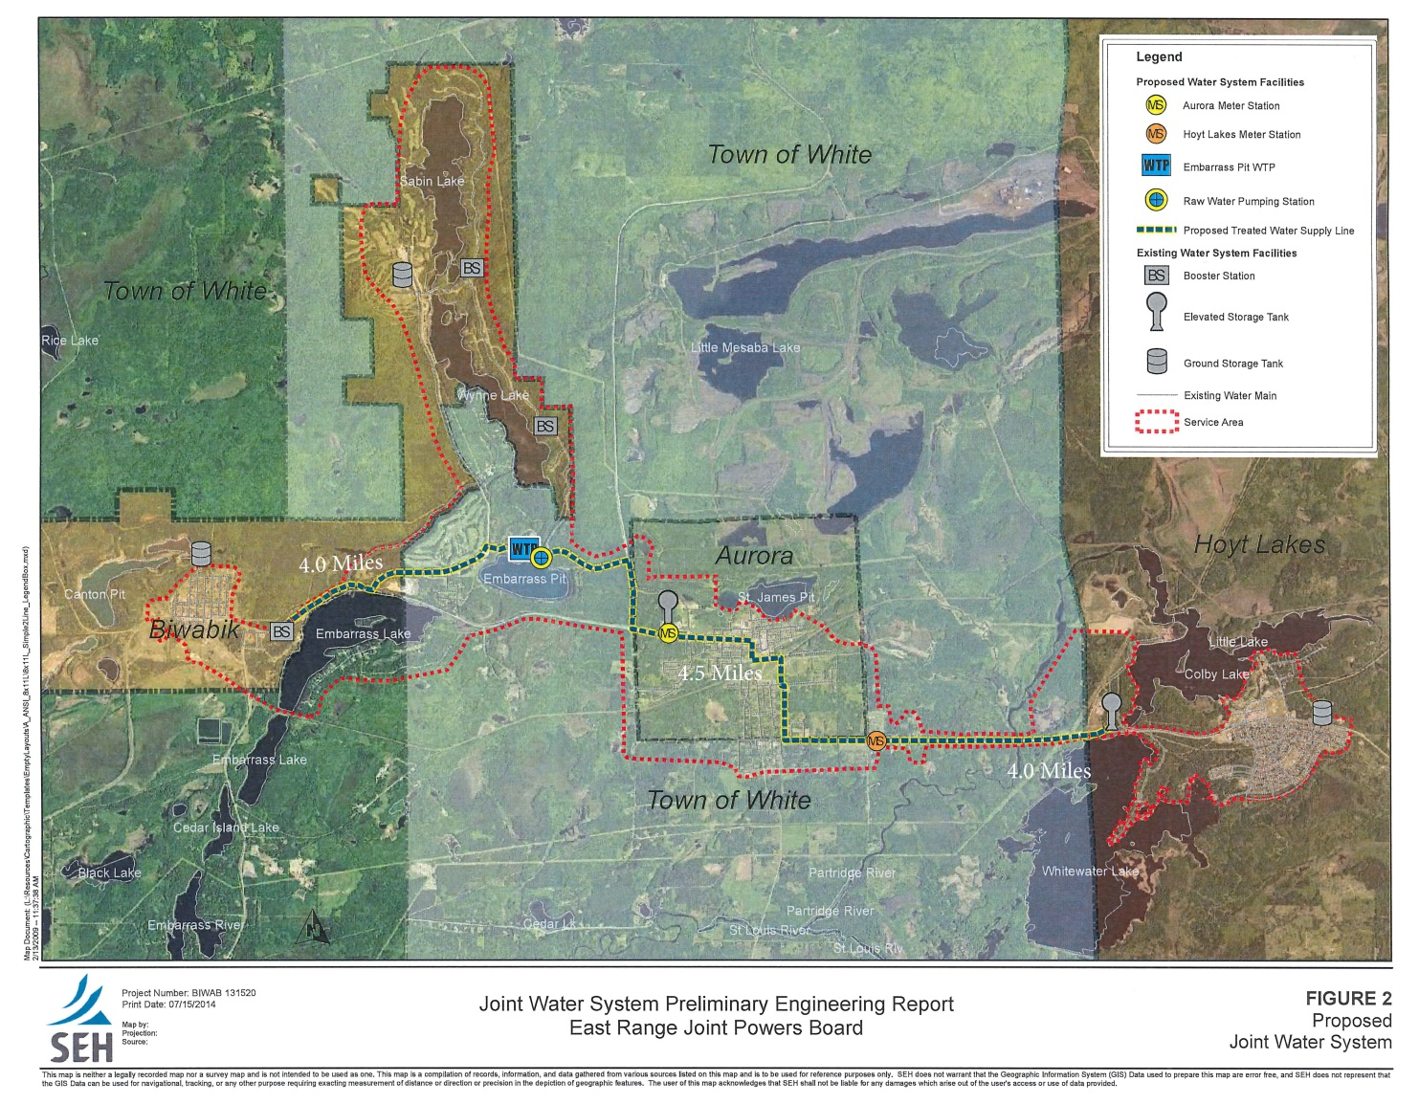
MAP OF AREA SERVED
PARTICIPANTS
City of Aurora Population 1682 887 Households Median Household Income $44,167
Town of White Population 1509 646 Households Median Household Income $46,395
Notes:
The total possible coverage area for service with the new plant location is 6 miles wide, approximately 48 square miles.
Old language:
The impact of a new joint water facility is far reaching on the East Range and addresses current emergency & safety needs. The future economic development impact would provide quality water to over 6000 residents. Currently, the neighboring communities of Aurora, Biwabik, and Hoyt Lakes each own and operate their own water supply, treatment and distribution system. The town of white is served through the Aurora plants but owns it’s own infrastructure.

Slide 4
New plant location
Notes:
The new plant would be located in Pineville with the source being Lake Mine located between Biwabik and Aurora, within the Township boundary, conveniently centrally located.

Slide 5
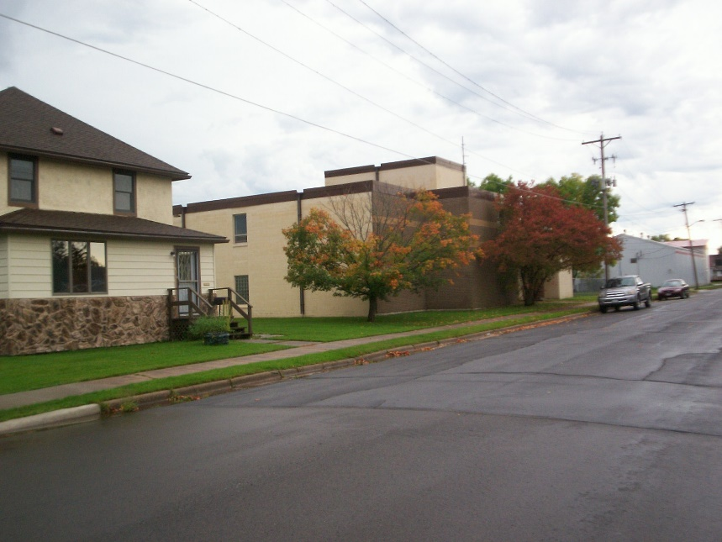
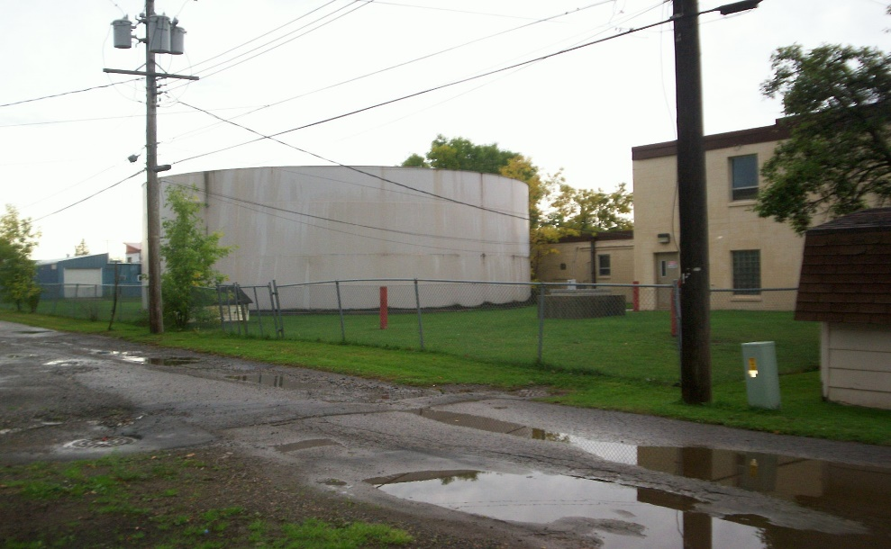
PROJECT NEED
THE CHALLENGES WE FACE TOGETHER
Plant built in 1953 showing age (failing intake pumps, old operating system) Plant will require major restoration in order to sustain current capacity Upgrading current Aurora plant is not economically feasible according to studies completed Current water source of St. James Pit is unstable Emergency situation with pump house flooding
Notes:
The Aurora plant is facing significant current and long range challenges. To address these challenges, the potential for a joint water system for the communities has been studied for feasibility. The studies have shown that a joint water system provides economies of scale for the member communities and offers more reliability than separate systems.
Completion of this project will ensure a more economical approach to these member communities in providing quality water to their residents and will drastically reduce their annual operating and maintenance costs.
Another concern of the Aurora plant is lack of expansion space as you can see from the pictures above.

Slide 6
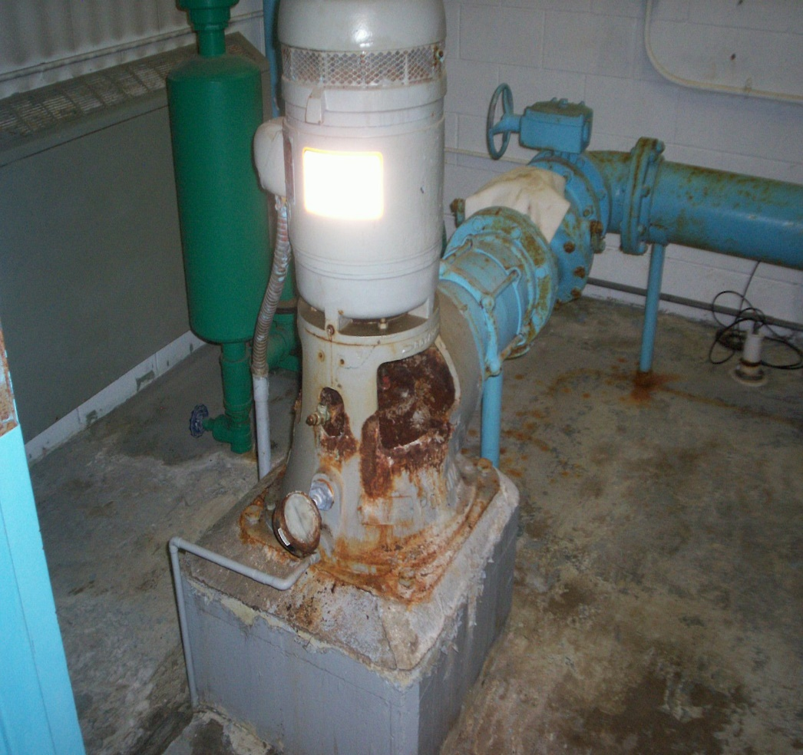
Current Water plant
Obsolete electronics and worn out infrastructure dating back to 1953

Slide 7
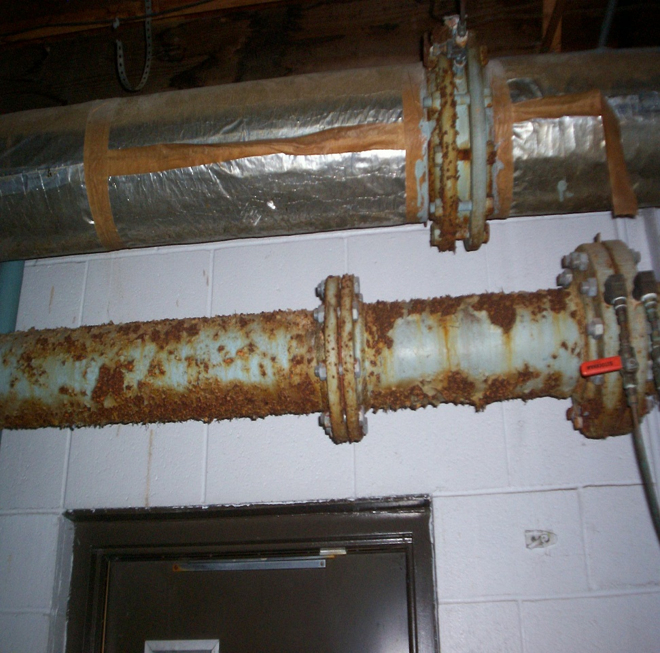
Current water plant
Electrical not up to code and infrastructure in rusted, poor condition
Notes:
These photos tell the story …

Slide 8
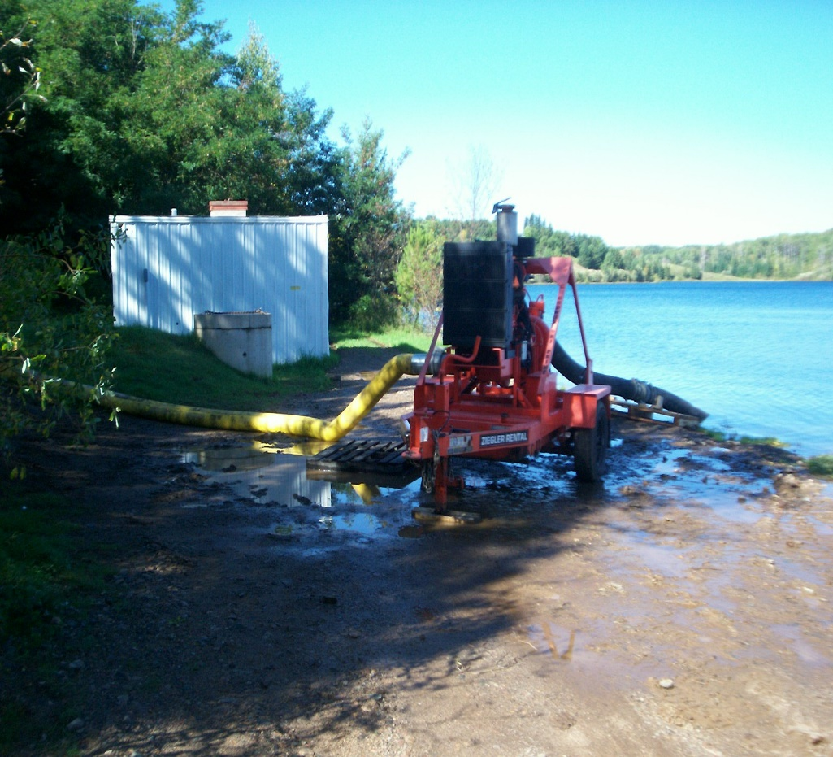
Current pump house
Pump house is in danger of flooding causing us to dewater due to instability of St. James Pit

Slide 9
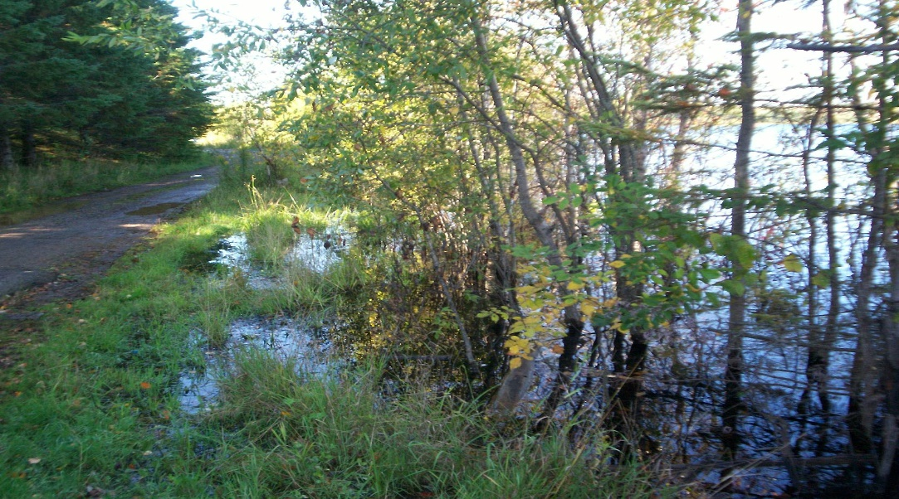
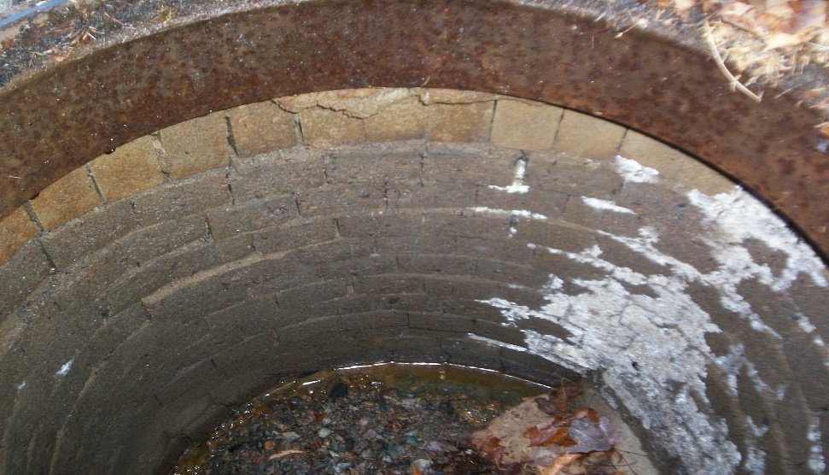
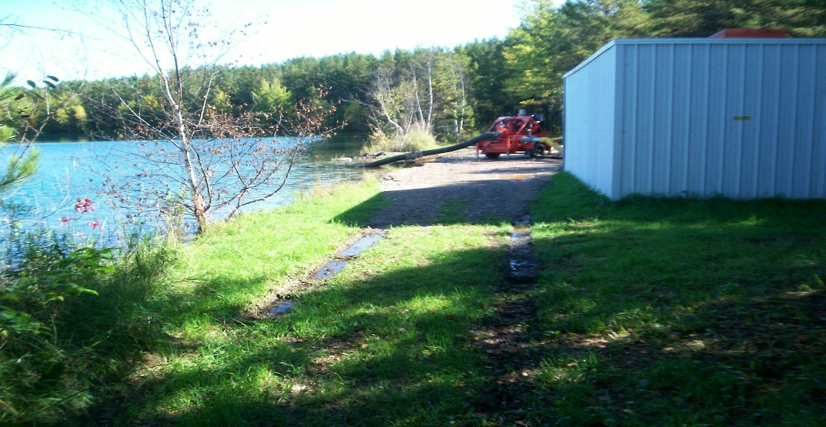
Current pump house

Slide 10
Challenges of current situation
Current system does not serve entire population and doesn’t have the capacity for expansion to meet those needs Emergency/Safety Need - Scenic Acre residents (92 homes) are down to one functioning well - if it fails, they will have NO water Fire Protection Need - No water hydrants exist to fight fires in Scenic Acres – Hazard Mitigation Planning Residents with private wells are facing a depletion of their aquifer on Wynne Ridge Road
Notes:
Serving more than one community and addressing needs for clean water is the goal. A new plant would provided clean drinking water for residents of Scenic Acres as well as fire protection.

Slide 11
PROJECT HISTORY
1997
Town of White brought water lines to HWY 135 with intention of providing water to Scenic Acres
2011
Cities of Aurora, Biwabik, Hoyt Lakes, and the Town of White began planning for Joint Water Facility
2012
East Range Central Water System Bonding Bill Project presented to Bonding Bill Committee with no funding allocated
2013
Funding received from MN State Legislature for Planning and Modeling
2015
Funding request submitted for State of MN Bonding Bill by the City of Aurora for a joint facility to be utilized by the East Range with no funding allocated
2017-2018
Funding request submitted for $8.6 million for State of MN Bonding Bill
Notes:
The communities of Aurora, Biwabik, Hoyt Lakes and Town of White have been meeting for over six years to discuss various options for a joint water system. These communities, through the East Range Joint Powers Board, received a $30,000 grant to start the preliminary planning and design for this new system in 2011. Since that time, additional funding was received in 2012 to study the feasibility of the selected water source. This new system would include one central water treatment plant with a system of distribution lines that would connect to each of the member communities.

Slide 12
PROJECT COSTS/SOURCES
Funding Source | Prior Years | FY 2018
State of MN General Obligation Bonds | $0 | $8,600,000
Other Local Government Funds (City/Entity Match) | $0 | $4,300,000
Pending Government Funds (City/Federal) | $0 | $4,300,000
TOTAL | $0 | $17,200,000
Project Costs | Prior Years | FY 2018
Embarrass Pit Intake Facility | $0 | $3,800,000
Embarrass Pit WTP | $0 | $11,000,000
Pineville/Scenic Acres Trunk Main | $0 | $2,400,000
TOTAL | $0 | $17,200,000
Notes:
As stated previously, this request is for $8.6 M in state funding to continue this project. If successful in obtaining funding, final design and land acquisition work shall begin in Fall 2018 with construction in 2019-20.
Cost of $17.2 M includes everything (engineering, architectural, and inflation – all in)
Construction Management – 2018
Plant construction
Distribution System Upgrades

Slide 13
WHY FUNDING IS CRITICAL
To better serve our citizens with drinking water, from a more stable source
Allows a more cost effective service while meeting current and future environmental standards
Supports collaboration, improves efficiencies, and addresses emergency/safety concerns
Enhances and improves utilization of current infrastructure and supports investment to date
Notes:
This project is an important one as it allows us to comply with current and proposed new water standards while reducing chemical and treatment costs.
Immediate cost savings would be realized from adding water meters which we currently don’t have, as well as reduced wastewater treatment costs due to the use of a different water source
A new plant would allow us to deliver improved water quality to the residents due to less treatment.
The current area has approximately 572 acres of developable property to be opened up for Community and Economic Development.
Distribution infrastructure will be placed in many of these areas and the new plant would be sized to allow room for growth and expansion.
The City of Aurora needs to renovate and/or maintain their own facilities within the next 5 to 20 years at an expense of approximately $7 million. The average cost to run an individual water plant is $195,000 annually.

Slide 14
WHY FUNDING IS CRITICAL
Addresses needs for Water Supply, Treatment, and Distribution demands
Supports Economic and Community Development
New system could provide service to 3100+ homes covering a 186 square miles radius
Supports expansion of Residential/Commercial growth in over 295 acres of undeveloped property
Improved environmental footprint impact – wells vs. municipal water
Immediate cost savings would be realized
Creates jobs in the short term and long term in an economically depressed area

Slide 15
Projected outcome
CONSOLIDATION OF ESSENTIAL SERVICES
Since 1984, collaborative efforts between the East Range have improved governance and impacted economic development by consolidating essential services:
Police
Ambulance/EMT
Recreation
Purchases
Comprehensive planning
Personnel/Staffing
Emergency Planning
Results: A more coordinated, efficient, fiscally responsible service to the communities
Notes:
Pairing and sharing is not a new venture for us. We have historically been combining services in areas such as Public Safety, Economic Development, Community Development and Staffing. Based on the history of our Joint Cooperative and Collaborative efforts, we are confident that if the project were to secure funding, this project would prove feasible as we have a long history of successful cooperative efforts.

Slide 16
Projected Outcome
Providing water to these communities in a coordinated, consolidated manner will be more fiscally responsible and have a tremendous economic impact

Slide 17
Thank you
EAST MESABI JOINT WATER SYSTEM
This is a critical time to move to a more efficient, cost effective facility. This is the proper long term investment for our region and for the state.
Thank you for the opportunity to present our project today!

