Slide 1
Constitution Test REVIEW

Slide 2
We are studying the Constitutional Era!
1 The Constitutional Era is characterized
by which of the following?
A philosophical differences and compromises in forming the new government
B wars and threats to American independence were solved through treaties
C disagreements led to few lasting results
D None of the above are correct.

Slide 3
Checks and Balances was established to keep the executive from becoming to powerful
2 Use the excerpt and your knowledge of social studies to
answer the following question.
Such has been the patient Sufferance of these Colonies; and such is now the Necessity which constrains them to alter their former Systems of Government. The History of the Present King of Great Britain
is a History of repeated Injuries and Usurpations, all having in direct Object the Establishment of an absolute Tyranny over these States. To prove this, let Facts be submitted to a candid World.
—Declaration of Independence
How were the grievances described in the quote addressed in the Constitution?
F states have a voice in taxation
G checks established against legislative power
H checks established against executive power
J ratification of the 4th Amendment

Slide 4
The First Amendment guarantees the freedom of Religion
3 Use the list and your knowledge of social studies to answer the
following question.
*New England churches elected officials
*Roger Williams founded colony with separation of church and state *William Penn guaranteed religious freedom in Pennsylvania
*Maryland founded as haven for Catholics
* ________?_________
Which amendment to the Bill of Rights
best completes this sequence?
A First Amendment
B Second Amendment
C Third Amendment
D Fourth Amendment

Slide 5
Popular Sovereignty means that the people are the power of the government
4 Which democratic principle of the Constitution allows people to create, change, or alter government?
F popular sovereignty
G separation of powers
H checks and balances
J limited government

Slide 6
Federalism is how power is shared between the state and national governments
5 The Constitution describes a
government with powers divided
between the national government and
state governments. This
constitutional principle is known as
which of the following?
A republicanism
B federalism
C checks and balances
D popular sovereignty

Slide 7
A judge should always apply the Constitution to any case. That is the law he is upholding
6 Which of the following is the most
important factor a judge uses when
conducting a judicial review of a
government action?
F rules and laws set forth in the U.S. Constitution
G grievances set forth in the Declaration of Independence
H recent polls conducted by the news
J popular opinion

Slide 8
You had to read the information provided to find the answer
7 Which sections of Article I of the United States Constitution BEST reflect the ideas of the Great Compromise of 1787?
A 1 and 2
B 1 and 3
C 2 and 3
D 2 and 4

Slide 9
Under checks and balances the President can veto laws written by congress
8 Using the graphic above, which of the
following belongs in Box I?
F may impeach the president
G may override a veto
H may reject appointments
J may veto bills

Slide 10
Through Judicial Review the Judicial branch can decide that a Presidential executive order unconstitutional
9 Which of the following completes box
III?
A may impeach the president
B may override a veto
C may determine actions unconstitutional
D may veto bills

Slide 11
The 3rd Amendment forbids the government from housing troops in your home
10 Use the excerpt and your knowledge of social studies to answer the following question.
For quartering large Bodies of Armed
Troops among us
—Declaration of Independence
How was the grievance described in
the quote addressed in the
Constitution?
F ratification of the 1st Amendment
G ratification of the 2nd Amendment
H ratification of the 3rd Amendment
J ratification of the 6th Amendment

Slide 12
The 6th and 7th amendments guarantee you the right to a trial by jury
11 Use the exerpt and your knowledge of social studies to
answer the following question.
For depriving us, in many Cases, of
the Benefits of Trial by Jury
—Declaration of Independence
How was the grievance described in
the quote addressed in the
Constitution?
A ratification of the 1st Amendment
B ratification of the 3rd Amendment
C ratification of the 4th Amendment
D ratification of the 6th and 7th Amendment

Slide 13
The Freedom of Speech allows you to speak out against the government
12 Use the quote and your knowledge of social studies to answer the following question.
All tyranny needs to gain a foothold is for people of good conscience to remain silent. -Thomas Jefferson
Which of the freedoms listed below is Jefferson expressing as an important liberty to
limit tyranny?
F trial by jury
G right to bear arms
H freedom of religion
J freedom of speech

Slide 14
As a result of the abuses under the Writs of Assistance the founding fathers guaranteed citizens protection against unreasonable search and seizure with the 4th amendment
13 Which right is guaranteed protection by the Fourth Amendment to the U.S. Constitution?
A freedom to own property
B freedom from unreasonable searches
C right to a trial by jury of peers
D right to own firearms

Slide 15
The 3rd Amendment forbids the government from housing troops in your home
14 Which of the following was a grievance listed in the Declaration of Independence that led to the Third Amendment of the U.S. Constitution?
F quartering of troops
G dissolving of representative legislatures
H cutting off trade withother nations
J imposing taxes without consent

Slide 16
The 6th amendment says that a trial must take place where the crime was committed
15 Use the quote and your knowledge of social studies to answer the following question.
For transporting us beyond Seas to be tried for pretended offences...
This colonial grievance from the Declaration of Independence was addressed in which of the following?
A 1st Amendment
B 3rd Amendment
C 4th Amendment
D 6th Amendment

Slide 17
The principle of Separation of Powers keeps control of the government away from just one person or group
16 Use the quote below to answer the question.
"The accumulation (collection) of all powers, legislative, executive, and judiciary, in the same hands...may justly be pronounced the very definition of tyranny.“ -James Madison, Federalist Papers #47
James Madison was defending which principle in the above statement?
F separation of powers
G limited government
H popular sovereignty
J Federalism

Slide 18
Our individual rights are listed and protected in the Bill of Rights, the first ten amendments
17 Which principle of the constitution is represented by the Bill of Rights?
A Republicanism
B Checks and Balances
C Federalism
D Individual Rights

Slide 19
The ideas behind limited government include holding members of government to the same standards and laws as every other citizen
18 Officer Jones was on patrol when he pulled over a car for speeding 20 mph over the speed limit. When he approached the car, it's driver was Senator Contreras. Officer Jones wrote Senator Contreras a speeding ticket for her violation.
What principle of the Constitution applies to the scenario above?
F Republicanism
G Federalism
H Limited Government
J Popular Sovereignty

Slide 20
The 10th amendment states that any powers not delegated to the National Government are left to the States
19 Which of these amendments from the Bill of Rights declares that individual states are given powers not granted to the federal government?
A Second
B Third
C Eighth
D Tenth

Slide 21
Checks and Balances gives the President the power to veto a bill that he does not want to sign into law
20 In accordance with Checks and Balances, what must happen to this bill in order for it to become law?
F Both House and Senate have to approve it by 2/3 vote
G A majority of state legislatures must approve it
H The President must sign it into law
J The Supreme Court must approve of it

Slide 22
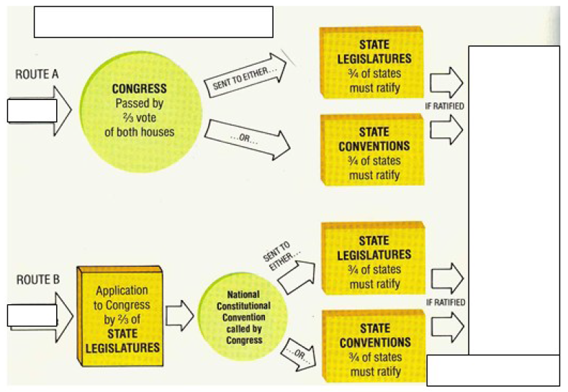
The amendment process requires that 2/3 of Congress or State Legislatures request and amendment then that it be approved by ¾ of the States
21 The BEST title for this chart would be...
A How a Bill Becomes Law
B How to Amend the U.S. Constitution
C How to Censure a Presedent
D How a Law is Overturned

Slide 23
The Congress of the Legislative branch is responsible for making laws
22 Which branch of government makes the law?
F Legislative
G Executive
H Judicial
J Gubernatorial

