Slide 1

Update on Doppler lidar measurements
Prof Janet Barlow
Dr Natalie Theeuwes, Dr Hannah Gough, Matt Williams, Jess Brown, Ian Read
Dept. of Meteorology, Uni. of Reading
Dr Elsa Aristodemou
London Southbank University

Slide 2
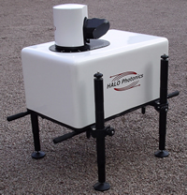
What is a Doppler lidar?
Doppler effect – frequency shift proportional to velocity
Wind, turbulence, particulate pollution at heights typically up to 1-2km
Doppler lidar (HALO Photonics Streamline)
Eye-safe (1.5 μm, pulsed)
Gate length 18m
Integration time: 2s
Scan patterns:
vertical stare
Velocity Azimuth Display (VAD) at 0°
VAD at 75°

Slide 3
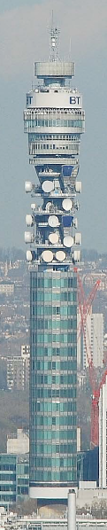
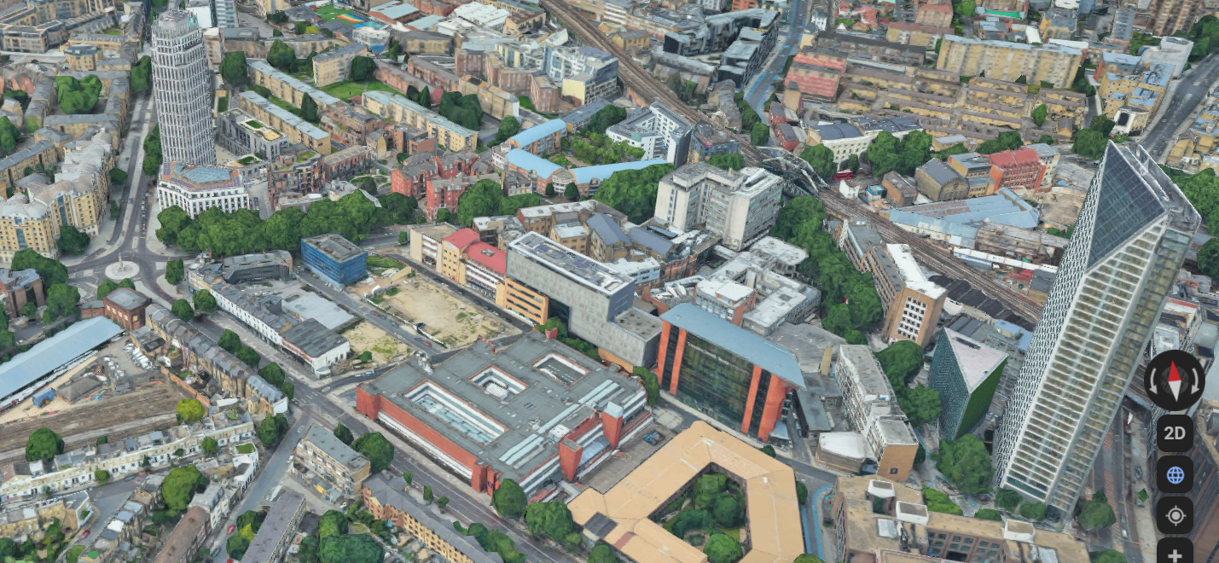
MAGIC field site
190m
Clarence Centre
Street Intersection
LSBU (K2) Building
Building 43 (81 metres)
Building 12 (134 metres)

Slide 4
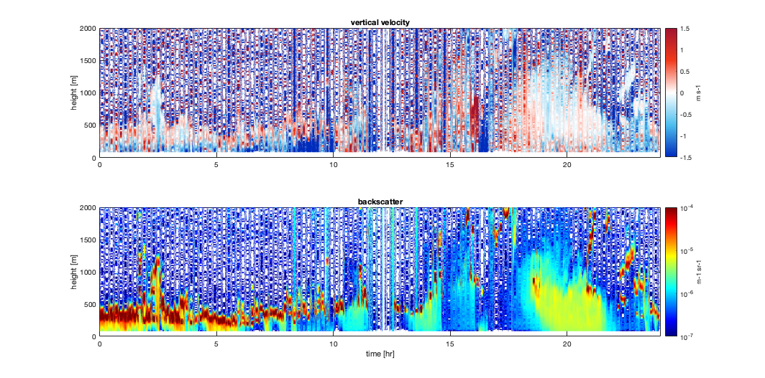
1) Vertical stare: rainfall
24th Sep 2019
Notes:
Heavy Rainfall on this day as low pressure system moves over the SE. Occluded fronts lots of rain. Lighter rain after 8.

Slide 5
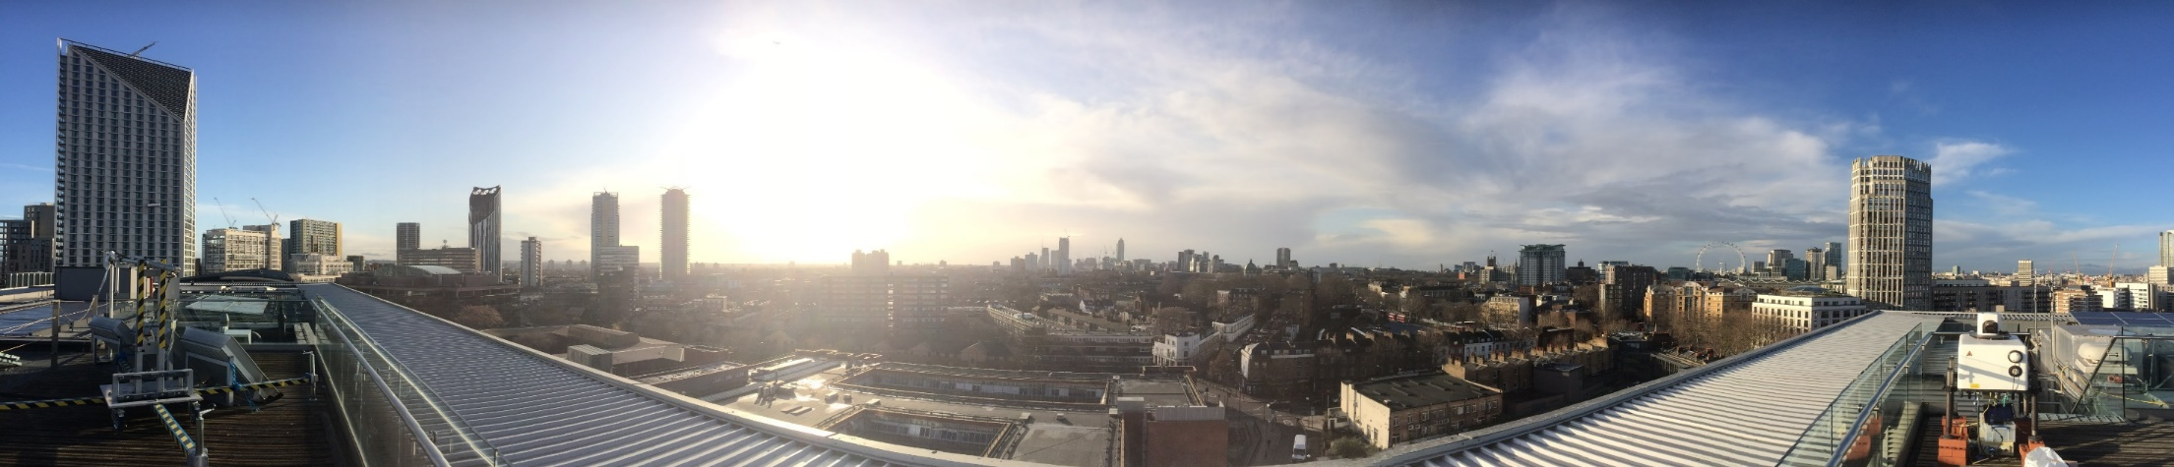
2) Horizontal scan (VAD 0°)
A
B
T134
B
A

Slide 6
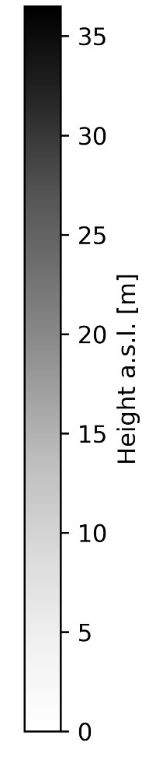

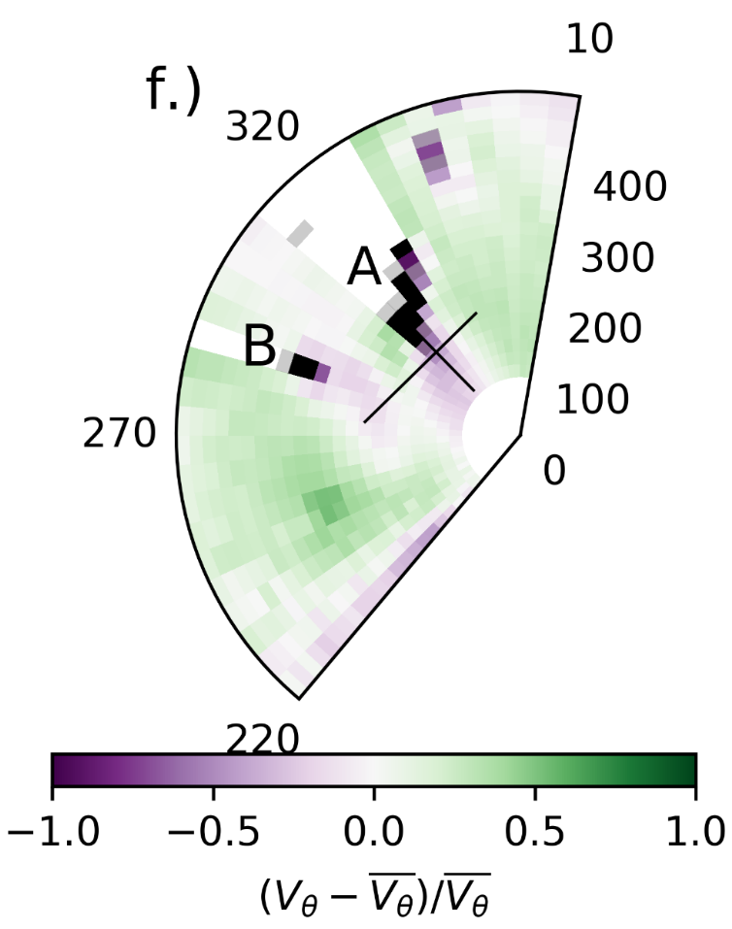
How long are building wakes?
Natalie Theeuwes et al., draft paper
Lidar beam intersects buildings A and B. A is 81m tall (H)
Velocity deficit (purple) behind tall buildings – slower, more turbulent winds
NW wind
Building A wake approx. 150m long ≈ 2x Height under range of atmospheric conditions
°

Slide 7
Comparison with ADMS-Build
(dispersion model)
wake width
Building A
wake length
Natalie Theeuwes et al., in prep.

Slide 8
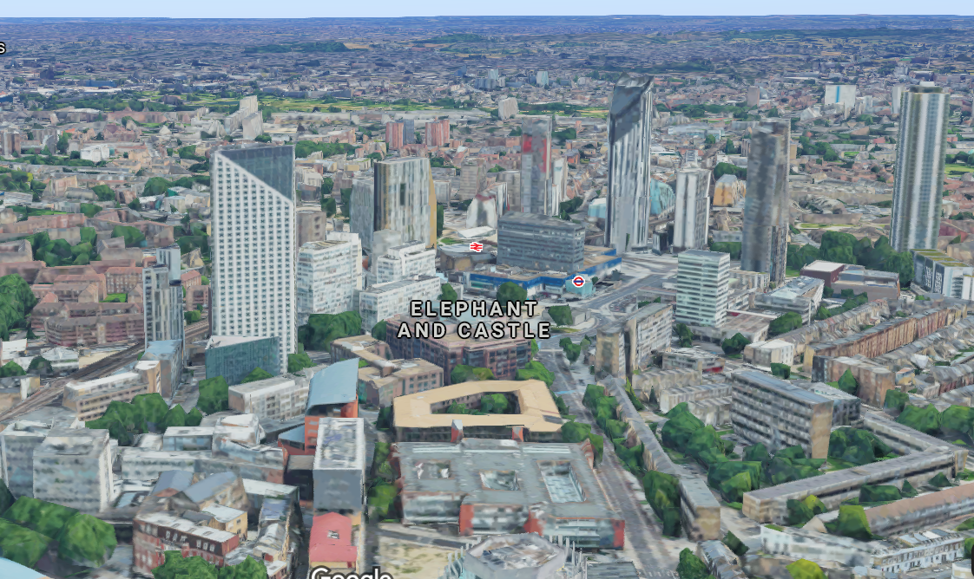
3) Vertical wind profiles (VAD 75°)
T134
Street Intersection
LSBU (K2) Building
Building 12 (134 metres)
Strata Building
Matt Williams, MSc student

Slide 9
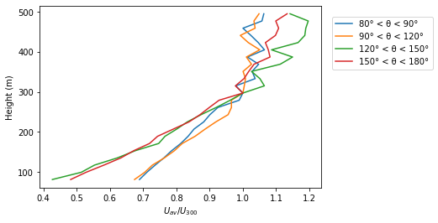

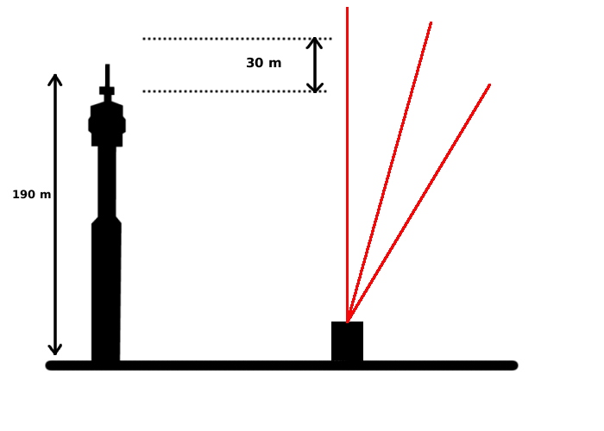
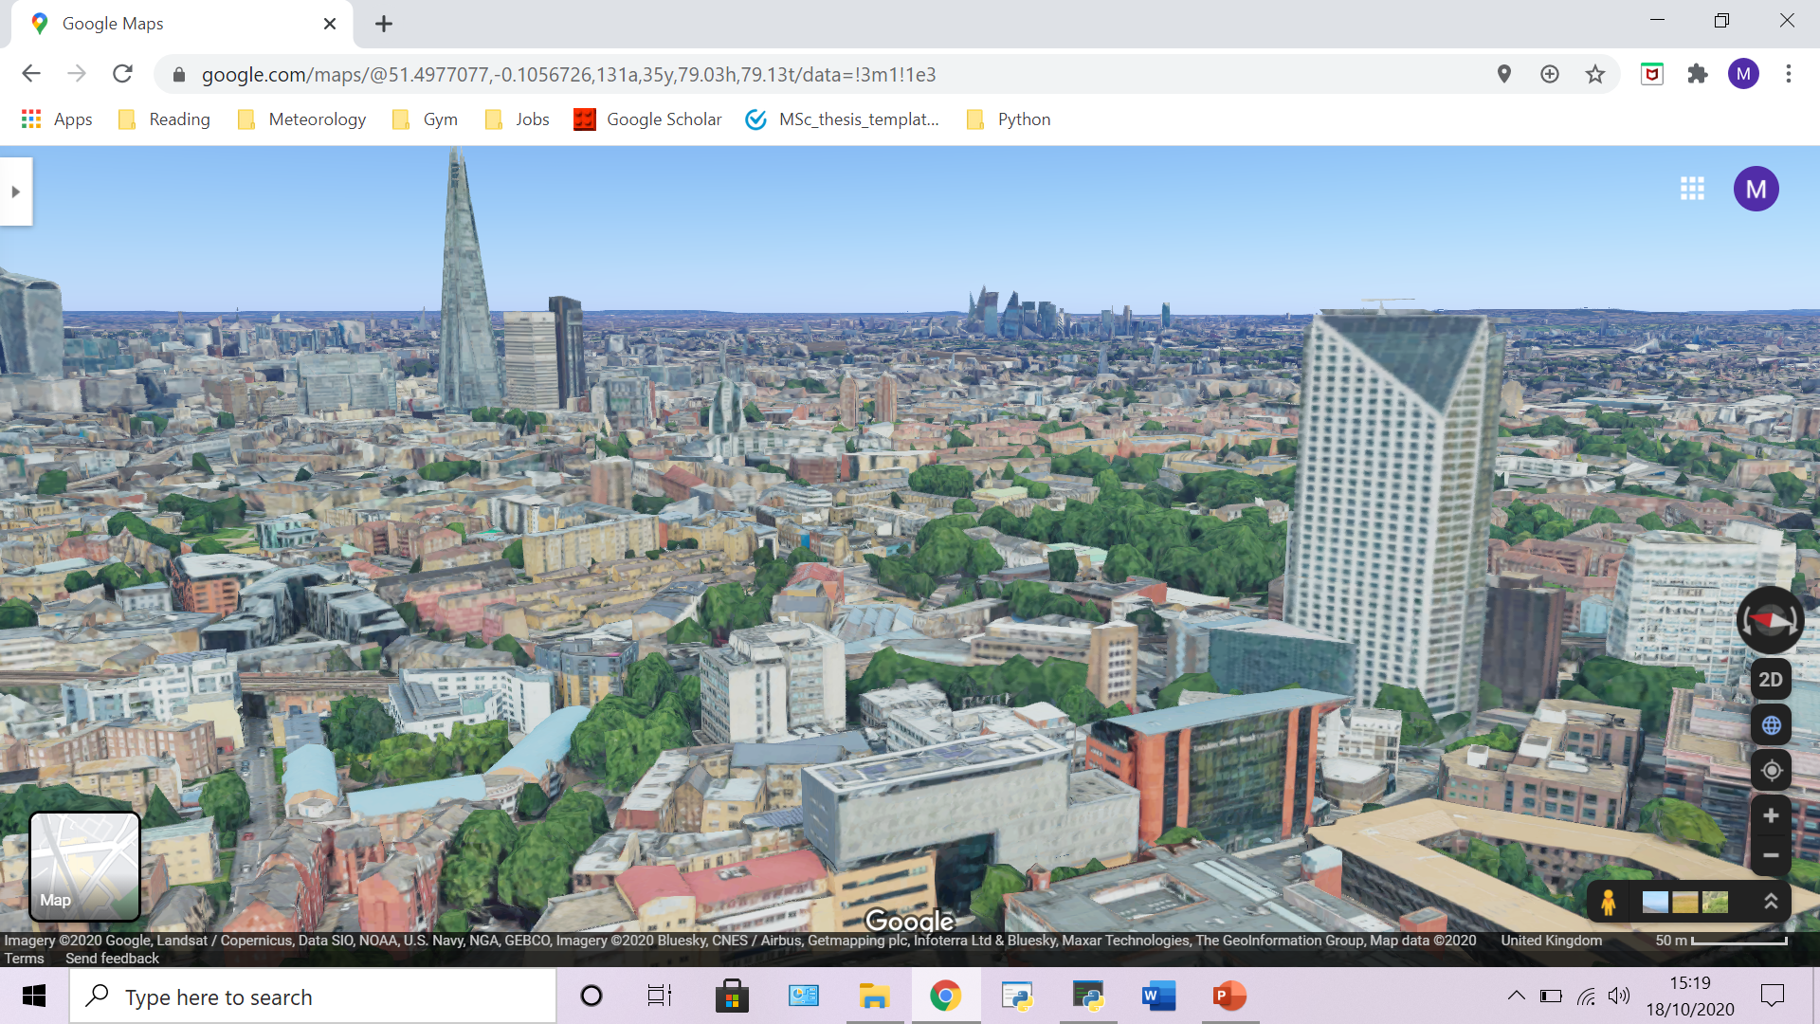
How much do tall buildings affect wind profiles?
Upper quartile windspeed profiles (strongest windspeeds)
Important data for building design (Drew et al. 2013) J Wind Eng Ind Aer
Matt Williams, MSc student

Slide 10
Next steps
Submitting papers on work to date
Using lidar profiles to drive Fluidity simulations of field campaign days (Huw Woodward)
Any questions please?
j.f.barlow@reading.ac.uk

