Slide 1
Conceptual Understanding of Multiplication and Division
Ralston Schools
October 18, 2018

Slide 2
Contact Information
Sarah Powell, Ph.D
The University of Texas at Austin
srpowell@austin.utexas.edu
@sarahpowellphd
119

Slide 3
Materials

Slide 4
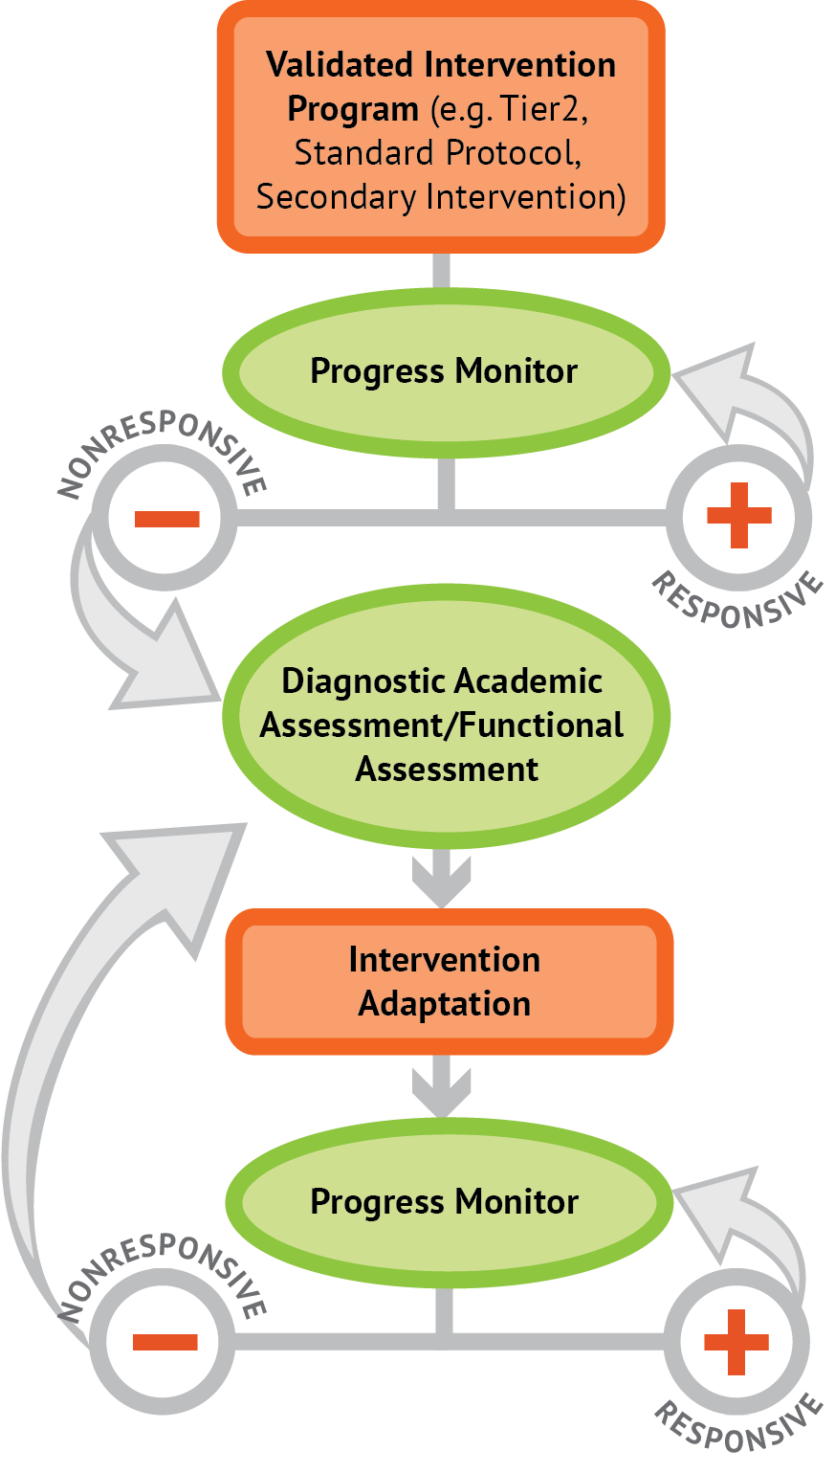
Instructional Platform
INSTRUCTIONAL DELIVERY
Explicit instruction
Concise language
Multiple representations
INSTRUCTIONAL STRATEGIES
Fluency building
Problem solving instruction
Motivation component

Slide 5
Explicit Instruction
Modeling
Practice
Clear Explanation
Guided
Practice
Planned
Examples
Independent Practice
Supporting Practices
Asking the right questions
Eliciting frequent responses
Providing immediate specific feedback
Maintaining a brisk pace

Slide 6
Multiple Representations
Abstract
Pictorial
Concrete

Slide 7
Focus on Language
precise
concise

Slide 9
Multiplication Facts
100 multiplication basic facts
Multiplication of single-digit factors results in a single- or double-digit product
2 (factor)
× 3 (factor)
6 (product)

Slide 10
Multiplication: Equal Groups
Show the groups, show the amount for each group, count product
3 × 2 = 6

Slide 11
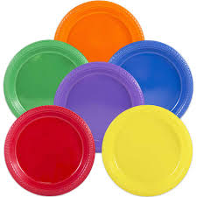
Multiplication: Equal Groups
5 × 3 = __
2 × 5 = __
Teach this problem to a student.
Explicit instruction
Multiple representations
Concise language

Slide 12
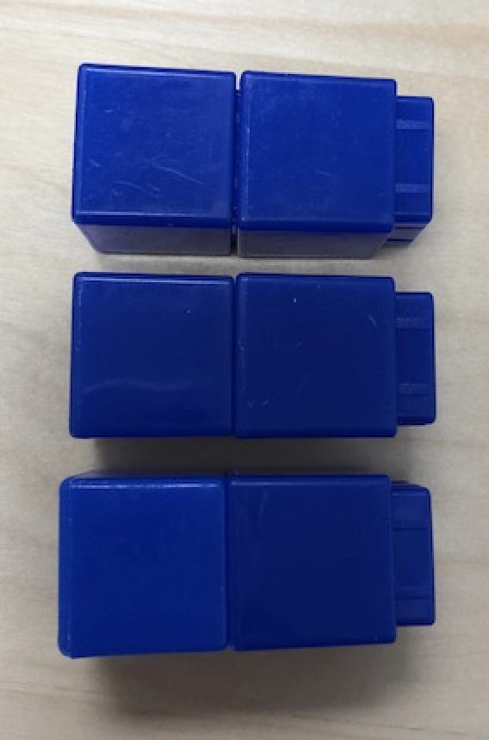
Multiplication: Array/Area
Make the array, count product
3 × 2 = 6

Slide 13
Multiplication: Array/Area
3 × 4 = __
2 × 5 = __
Teach this problem to a student.
Explicit instruction
Multiple representations
Concise language

Slide 14
Multiplication: Comparison
Show a set, then multiply the set
3 × 2 = 6

Slide 15
Multiplication: Comparison
6 × 3 = __
4 × 5 = __
Teach this problem to a student.
Explicit instruction
Multiple representations
Concise language

Slide 16
Why is it important to understand multiplication in different ways?

Slide 17
Equal Groups
Groups multiplied by number in each group for a product
Mark has 2 bags of apples. There are 6 apples in each bag. How many apples does Mark have altogether?
2 × 6 = ?

Slide 18
Comparison
Set multiplied by a number of times for a product
Jill picked 6 apples. Mark picked 2 times as many apples as Jill. How many apples did Mark pick?
6 × 2 = ?

Slide 19
Equal Groups versus Comparison
3 × 4 = __
5 × 2 = __
Determine a word problem for each schema.
Explicit instruction
Multiple representations
Concise language

Slide 21
Division Facts
90 division basic facts
Divisor and quotient are single-digit numbers and dividend is single- or double-digit number
8 ÷ 4 = 2
(dividend) (divisor) (quotient)

Slide 22
Division: Equal Groups (Partitive Division)
Show the dividend, divide equally among divisor, count quotient
6 ÷ 3 = 2

Slide 23
Division: Partitive Division
12 ÷ 4 = __
15 ÷ 3 = __
Teach this problem to a student.
Explicit instruction
Multiple representations
Concise language

Slide 24
Division: Equal Groups (Measurement Division)
Show the dividend, make groups of the divisor, count groups
6 ÷ 3 = 2

Slide 25
Division: Measurement Division
10 ÷ 5 = __
9 ÷ 3 = __
Teach this problem to a student.
Explicit instruction
Multiple representations
Concise language

Slide 26
Why is it important to understand division in different ways?

Slide 27
Equal Groups
Groups multiplied by number in each group for a product
Mark has 12 apples. He wants to share them equally among his 2 friends. How many apples will each friend receive?
2 × ? = 12
Mark has 12 apples. He put them into bags containing 6 apples each. How many bags did Mark use?
? × 6 = 12

Slide 28
Partitive versus Measurement
12 ÷ 4 = __
15 ÷ 3 = __
Determine a word problem for each schema.
Explicit instruction
Multiple representations
Concise language

Slide 29
Instructional Platform
INSTRUCTIONAL DELIVERY
Explicit instruction
Concise language
Multiple representations
INSTRUCTIONAL STRATEGIES
Fluency building
Problem solving instruction
Motivation component

Slide 30
Contact Information
Sarah Powell, Ph.D.
The University of Texas at Austin
srpowell@austin.utexas.edu
@sarahpowellphd
119

