Slide 1
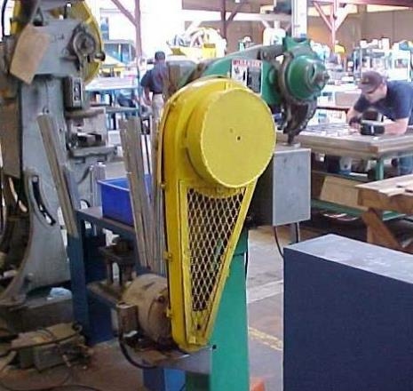
MACHINE GUARDING
Subpart O OSHA
29 CFR 1910.211-219
Notes:
Machines can assist in improving production efficiency in the workplace. However these machines have moving parts, sharp edges, and hot surfaces with the potential to cause severe workplace injuries such as crushed fingers or hands, amputations, burns, or blindness. Safeguards are essential for protecting workers from these preventable injuries. Any machine part, function, or process that might cause injury must be safeguarded. When the operation of a machine may result in a contact injury to the operator or others in the vicinity, the hazards must be eliminated or controlled.

Slide 2
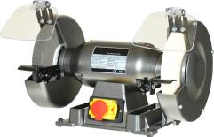
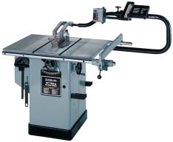
T
Topics Covered:
General Requirements
National Emphasis Program-Amputations
Woodworking Machinery
Abrasive Wheel Machinery
Mechanical Power Presses
Prime Mover Guards
Notes:
This presentation will be address the following topics:
General Requirements
National Emphasis Program-Amputations
Woodworking Machinery
Abrasive Wheel Machinery
Mechanical Power Presses
Prime Mover Guards

Slide 3
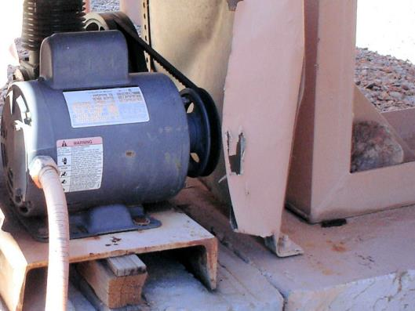
General Requirements
29 CFR 1910.212
Damaged guard Should be repaired or replaced
Notes:
The picture shows an issue that can exist in many different environments where machinery is in place. Notice the damaged guard which could actually add to an injury due to the sharp edges and the opening that could allow something thrown from the machine if caught in the belt.

Slide 4
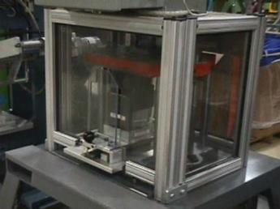
Types of Guarding
Per 1910.212(a)(1)
One or more methods of machine guarding shall be provided to protect the operator and other employees in the machine area from hazards such as those created by:
Point of operation
Ingoing nip points
Rotating parts
Flying chips/sparks
Notes:
Hazards such as these need to be guarded to protect machine operators and employees in the area from being injured:
Point of operation
Ingoing nip points
Rotating parts
Flying chips/sparks

Slide 5
Standard Interpretations
Machine Guarding Requirements
By not specifying the types of guards this standard is referred to as a "performance standard” (i.e., the employer is free to adopt a guard that "performs” or meets the objective of protecting employees from the hazards).
If OSHA had specified the types of machine guards that must be used, the standard would be a "specification standard.”
Notes:
OSHA’s Machine Guarding Standard is classified as a “performance standard” because it allows employers the freedom to adopt a guard that meets or “performs” the objective of protecting employees from the hazards associated with the machine in question. In other words, employers are given leeway in adapting the type of guards that can be installed on machines.
If OSHA had specified certain types of guards for certain types of machines the Machine Guarding Standard would have been classified as a “specification standard.”

Slide 6
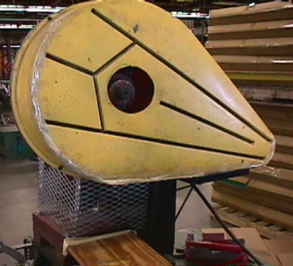
General Requirements
1910.212(a)(2)
Guards shall be affixed to the machine (where possible) and secured elsewhere if attachment to the machine is not possible.
The guard shall be such that
it does not offer an
accident hazard in itself.
Notes:
Guards must be affixed to a machine where possible and if not possible then they must be secured to the machine at another point.
Guards must be constructed and attached so that they do not become a hazard in and of themselves.

Slide 7
Point of Operations
1910.212(a)(3)
Point of operation = area on a machine where work is actually performed upon the material being processed.
(ii) The point of operation on machines where operation exposes an employee to injury shall be guarded.
Notes:
The point of operation on a machine is the area where work is actually performed on the material being processed.
The point of operation where that operation exposes employees to injuries must be guarded.

Slide 8
Point of Operations
1910.212(a)(3)
(ii) The guarding device shall be in conformity with any appropriate standards, or in the absence of applicable specific standards, shall be so designed and constructed so as to prevent the operator from having any part of his/her body in the danger zone during the operating cycle.
Notes:
Guards shall conform with any appropriate standards or if there are no applicable specific standards must be designed and constructed so it prevents the operator from having any part of his/her body in the danger zone during the operating cycle.

Slide 9
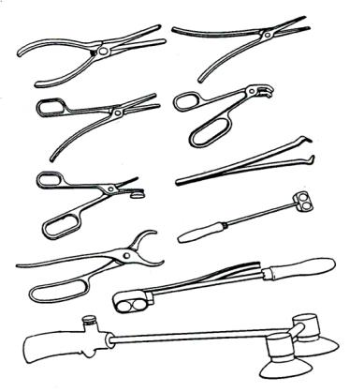
Hand Tools
1910.212(a)(3)(iii)
Special hand tools for placing and removing material shall be such as to permit easy handling of material without the operator placing a hand in the danger zone*.
*Such tools shall not be in lieu of other guarding, but can only be used to supplement protection provided.
Notes:
Any special hand tools for placing and removing material need to be constructed to permit easy handling of material without requiring the operator to place their hand in the danger zone. These types of tools cannot be used in place of other guarding, but can only be used to supplement protection provided.

Slide 10
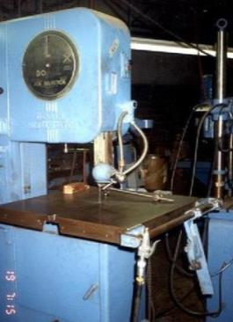
Examples of Machines
1910.212(a)(3)(iv)
Types of machines that normally require point of operation guarding:
▪ Mills
▪ Drills
▪ Grinders
▪ Power Presses
▪ Shears
▪ Saws
Notes:
These types of machines normally require point of operation guarding:
→ Mills
→ Drills
→ Grinders
→ Power Presses
→ Shears
→ Saws

Slide 11
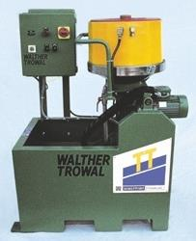
Barrels, Containers, Drums
1910.212(a)(4)
Revolving drums, barrels, containers:
▪ Shall be guarded by an enclosure that is interlocked.
▪ Must prohibit movement unless guard enclosure is in place.
Notes:
Revolving drums, barrels and/or containers shall be guarded by an enclosure that is interlocked and must prohibit movement unless the guard enclosure is in place.

Slide 12
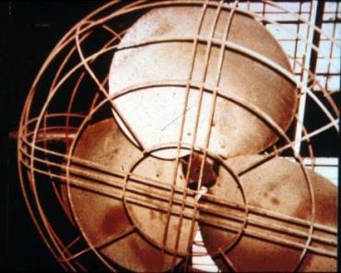
Exposure of Blades
1910.212(a)(5)
When the periphery of the blades of a fan is less than seven (7) feet above the floor or working level, the blades shall be guarded.
NO! The guard shall have openings no larger than one-half (1/2) inch.
Is this fan blade properly guarded?
Notes:
When the edge of the fan blade is less than seven (7) feet above the floor or working level the blades shall be guarded.
Remember that fan guards cannot have openings that are larger than one-half (1/2) inch.

Slide 13
Anchoring Fixed Machinery
1910.212(b)
Machines designed for a fixed location shall be securely anchored to prevent walking or moving.
This pedestal grinder is designed for anchoring but is not anchored, creating a potential hazard.
Notes:
Machines designed for a fixed location shall be securely anchored to prevent walking or moving.
The picture shows a pedestal grinder which is designed to be anchored but is not thereby creating a potential hazard.

Slide 14
Amputation Safety
CPL 2-1.35 National Emphasis Program on Amputations
Identify and reduce workplace amputation hazards
Top five machines that cause amputations are:
▪ Saws
▪ Slitters
▪ Slicers
▪ Shears
▪ Presses
Notes:
OSHA has a National Emphasis Program on preventing amputations in the workplace. The program requires employers to identify and reduce workplace hazards which are likely to cause amputations.
The top five machines that cause amputations are:
→ Saws
→ Slitters
→ Slicers
→ Shears
→ Presses

Slide 15
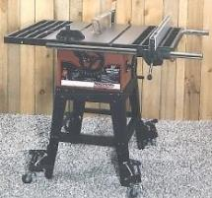
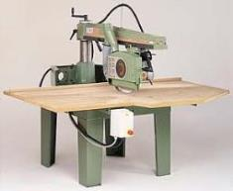
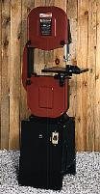
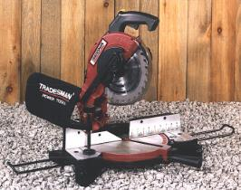
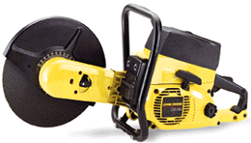
Saws
Used primarily in woodworking & manufacturing shops
Two types
Table
Radial arm
Other types include:
Hand held
Band saw
Miter saw
Notes:
Saws are primarily used in woodworking and manufacturing shops and consist of table or radial arm types. In addition other types of saws such as hand held, band and miter are used.

Slide 16
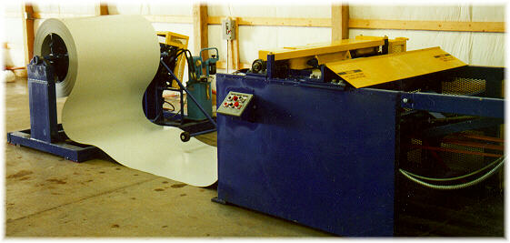
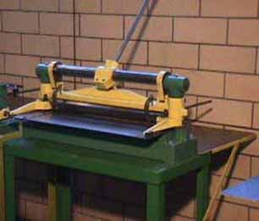
Shears
Self-contained machines using a mechanically driven ram.
Ram moves a non-rotary blade at a constant rate past the edge of fixed blade.
Notes:
Shears are self-contained machines that use a mechanically driven ram that moves a non-rotary blade at a constant rate past the edge of a fixed blade.

Slide 17
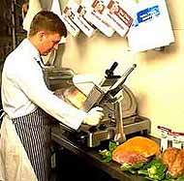
Slicers
Commonly used to slice meat and food.
Use rotary blade.
Guillotine cutters used in other industries.
Most injuries occur in restaurants and grocery stores.
Notes:
Slicers:
Are commonly used to slice meat and food.
Use a rotary blade.
Guillotine cutters used in other industries.
Most injuries involving slicers occur in restaurants and grocery stores.

Slide 18
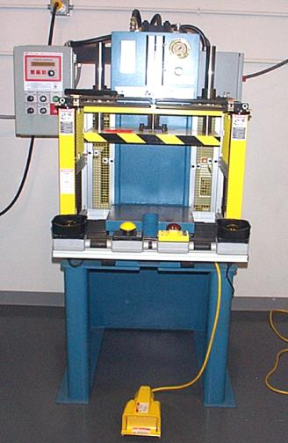
Power Presses
Nat’l Emphasis Program (NEP) covers all types of power presses.
Presses consist of stationary bed and slide.
Used in a variety of industries.
Notes:
There is a National Emphasis Program that covers all types of power presses. Power presses consist of a stationary bed and slide and are used in a variety of industries.

Slide 19
Program Procedures
If presses are present, a thorough inspection will be conducted focusing on:
Nip points
Pinch points
Shear points
Cutting actions
Point(s) of operation
NEP includes three activities:
Outreach
Targeting/selection
Inspection
Notes:
The NEP on power presses includes these three activities: outreach, targeting/selection and inspection.
If power presses are present, a thorough inspected will be conducted on:
Nip points
Pinch points
Shear points
Cutting actions
Point(s) of operation

Slide 20
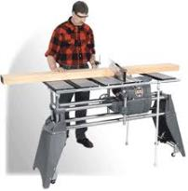
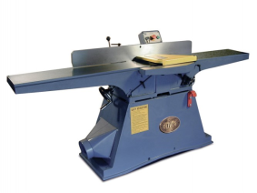
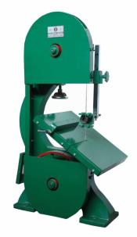
Woodworking Machinery
29 CFR 1910.213
Notes:
There are many different types of woodworking machinery and in some cases operators chose to remove the guards from them for whatever reason during operation. Consideration should be given to what methods can be used to effectively guard these types of machines.

Slide 21
1910.213 Woodworking Machinery
(a)(11)The frames and all exposed metal parts of portable electric woodworking machinery operated at more than 90 volts to ground shall be grounded.
Portable motors driving electric tools which are hand held shall be grounded.
The ground shall be a separate ground wire and polarized plug and receptacle.
Notes:
The frames and all exposed metal parts of portable electric woodworking machinery operated at more than 90 volts to ground shall be grounded.
Portable motors driving electric tools which are hand held shall be grounded.
The ground shall be a separate ground wire and polarized plug and receptacle.

Slide 22
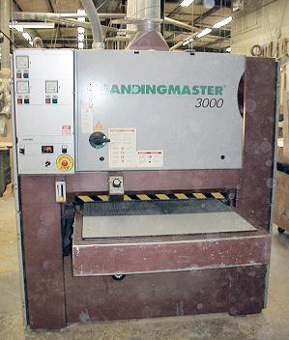
Machine Controls/Equipment
1910.213(b)
A mechanical or electrical power control:
Shall be provided on each machine.
Makes it possible for operator to cut off power from machine without leaving his/her position at point of operation.
Notes:
A mechanical or electrical power control:
▪ Shall be provided on each machine.
▪ Makes it possible for operator to cut off power from machine without leaving his/her position at point of operation.

Slide 23
Non-Restart Devices
1910.213(b)(3)
On applications where injury to the operator might result if motors were to restart after power failures:
Provision shall be made to prevent machines from automatically restarting upon restoration of power.
Notes:
On applications where injury to the operator might result if motors were to restart after power failures a provision shall be made to prevent machines from automatically restarting upon restoration of power.

Slide 24
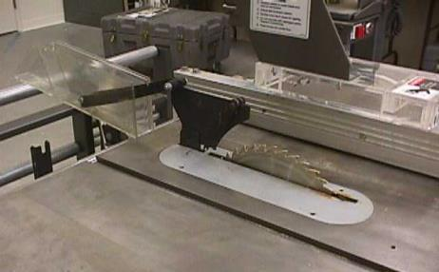
Spreaders
1910.213(c)(2)
Each hand-fed circular ripsaw shall be furnished with a spreader to prevent material from squeezing the saw or being thrown back on the operator.
Spreader
Notes:
Each hand-fed circular ripsaw shall be furnished with a spreader to prevent material from squeezing the saw or being thrown back on the operator.

Slide 25
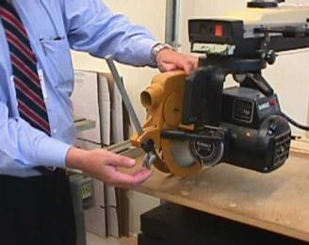
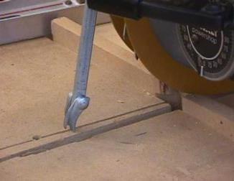
Non-Kickback Fingers
1910.213(c)(3)
Each hand-fed circular ripsaw shall be provided with:
Non-kickback fingers or dogs
so located as to oppose the thrust or tendency of the saw to pick up the material or to throw it back toward the operator.
Notes:
In addition, each hand-fed circular ripsaw shall be provided with non-kickback fingers or dogs so located as to oppose the thrust or tendency of the saw to pick up the material or to throw it back toward the operator.

Slide 26
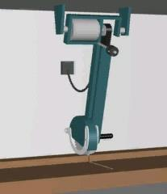
Swing Cutoff Saws
1910.213(g)(1)
Each swing cutoff saw shall be provided with a hood that will completely enclose the upper half of the saw, the arbor end, and the point of operation at all positions of the saw.
Swing saw with hood and limiting chain
Notes:
Each swing cutoff saw shall be provided with a hood that will completely enclose the upper half of the saw, the arbor end, and the point of operation at all positions of the saw.

Slide 27
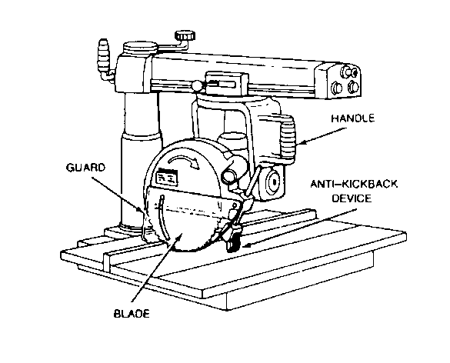
1910.213(h) Radial Saws
Upper hood completely encloses the upper portion of the blade, including the end of the saw arbor.
Radial saws used for ripping shall be provided with non-kickback fingers or dogs located on both sides of the saw (prevents material from being picked up or thrown back toward the operator).
Notes:
Radial saws should have an upper hood that completely encloses the upper portion of the blade including the end of the saw arbor.
Radial saws used for ripping shall be provided with non-kickback fingers or dogs located on both sides of the saw (prevents material from being picked up or thrown back toward the operator).

Slide 28
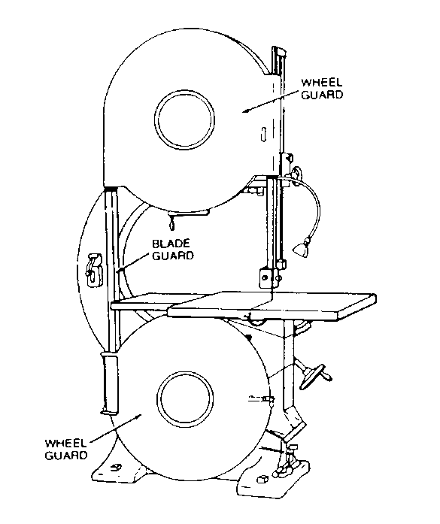
1910.213(i) Band Saws
Band saw wheels shall be fully encased.
Outside periphery of cover shall be solid.
The front and back of the band wheels shall be either enclosed by solid material or by wire mesh.
Notes:
Band saws:
Band saw wheels shall be fully encased.
Outside periphery of cover shall be solid.
The front and back of the band wheels shall be either enclosed by solid material or by wire mesh.

Slide 29
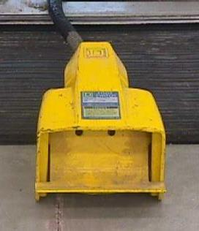
Treadle
Each operating treadle shall be covered by an inverted U-shaped metal guard, fastened to the floor, and of adequate size to prevent accidental tripping.
Notes:
Treadles:
Each operating treadle shall be covered by an inverted U-shaped metal guard, fastened to the floor, and of adequate size to prevent accidental tripping.

Slide 30
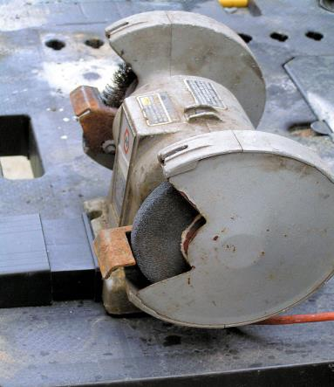
Abrasive Wheel Machinery
29 CFR 1910.215
Notes:
One of the biggest hazards with abrasive wheel machines occurs when a person gets too close while operating or adjusting the wheel. A hand or finger that hits the moving wheel surface is in real danger of being mangled or cut off.
Eye injuries are another serious hazard with abrasive wheel grinders. The grinding operation can loosen chips or particles that can fly into the eye. On rare occasions, excessive speed can make an abrasive wheel disintegrate, which could send pieces of metal flying through the work area—and into a workers eyes.
Yet another hazard is inhaling the dust and fumes generated during grinding, which can lead to respiratory diseases.
An additional risk is the noise a grinding operation makes. That noise can damage a person’s hearing if they’re using the wheel for any amount of time.

Slide 31
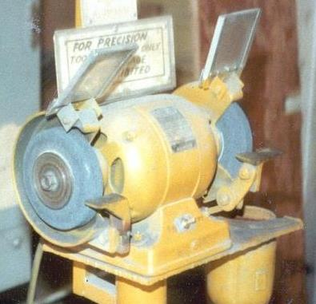
Guard Design
1910.215(a)(2)
The safety guard shall cover the spindle end, nut, and flange projections.
The safety guard shall be mounted so as to maintain proper alignment with the wheel.
No end guards on this device!
Notes:
The safety guard for an abrasive wheel machine:
Shall cover the spindle end, nut, and flange projections.
Shall be mounted so as to maintain proper alignment with the wheel.
The picture shows an abrasive wheel that is not properly guarded due to not having end guards.

Slide 32
1910.215(a)(4) Work Rests
For off hand grinding: work rests are required to support the work.
Rigid construction and adjustable with wheel wear.
Must be kept closely adjusted (max gap = 1/8”) to prevent work from jamming & breaking wheel.
Work rest is closely adjusted
Notes:
Work rests are required to support the work when doing off hand grinding. A work rest should be of rigid construction and adjustable as the wheel wears. The rest must be kept closely adjusted with a maximum gap of no more than 1/8” to prevent work from jamming and breaking the wheel.

Slide 33
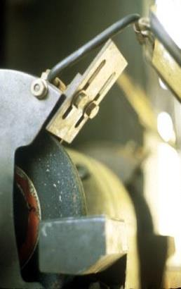
Exposure Adjustment
1910.215(b)(9)
Safety guards of the type where the operator stands in front of the opening, shall be adjusted to the constantly decreasing size of the wheel.
The distance between the periphery and the adjustable tongue guard shall never exceed one-fourth inch.
Notes:
Adjusting for exposure to materials:
Safety guards of the type where the operator stands in front of the opening, shall be adjusted to the constantly decreasing size of the wheel.
The distance between the periphery and the adjustable tongue guard shall never exceed one-fourth inch.

Slide 34
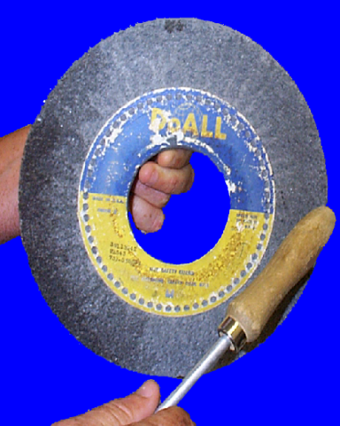
Mounting “Ring Test”
1910.215(d)
“Sound” the wheel by tapping around its periphery with a wooden handled screwdriver.
Good wheel portions will “ring” like a bell.
Cracks will sound “dead.”
Notes:
A “ring test” should be performed on an abrasive wheel before installing it for use. This is done by tapping the wheel around its periphery with a wooden screwdriver to “sound” it. The good portions of the wheel will ring like a bell while cracks will sound “flat” or “dead.”

Slide 35
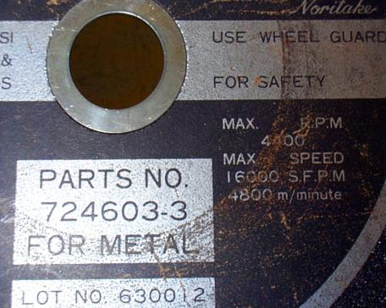
1910.215(d) Mounting
Must check spindle speed of machine before mounting wheel to be certain it doesn’t exceed maximum operating speed marked on wheel.
Compare this number to the
spindle speed on the grinder
motor.
Notes:
The spindle speed of an abrasive wheel machine should always be checked and compared to the maximum operating speed marked on the wheel that will be installed to ensure they are compatible. If the machine spins faster than the wheel is capable of supporting the wheel could break apart during use.

Slide 36
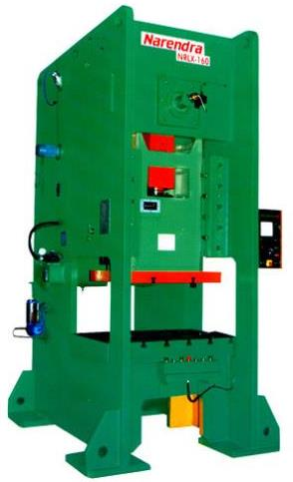
Mechanical Power Presses
29 CFR 1910.217
Notes:
Recent statistics compiled by OSHA indicate that approximately 49% of the injuries on mechanical power presses result in an amputation. These types of machines can be dangerous and therefore need to be guarded with proper training on safe operation given to all operators.

Slide 37
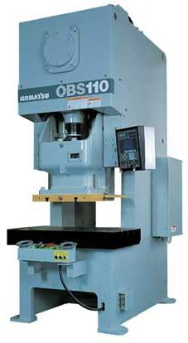
Definitions
"Press" - Mechanically powered machine that shears, punches, forms or assembles metal or other material by means of cutting, shaping, or combination dies attached to slides.
A press consists of:
Stationary bed or anvil, and
A slide (or slides) having a controlled reciprocating motion toward the bed surface.
Slide guided in a definite path by the frame of the press.
Notes:
A “press” is defined as a mechanically powered machine that shears, punches, forms or assembles metal or other material by means of cutting, shaping, or combination dies attached to slides and consists of:
A stationary bed or anvil, and
A slide (or slides) having a controlled reciprocating motion toward the bed surface. The slide is guided in a definite path by the frame of the press.

Slide 38
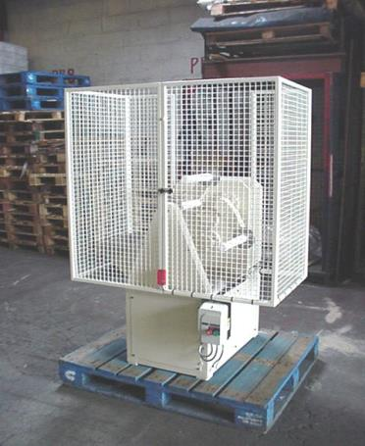
Definitions
“Guard” = barrier that prevents entry of operators hands or fingers into the point of operation.
Notes:
A “guard” is a barrier that prevents entry of operators hands or fingers into the point of operation.

Slide 39
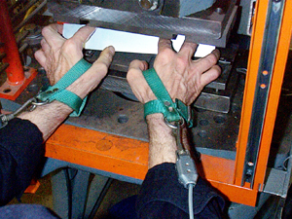
Definitions
"Device" means a press control or attachment that:
Restrains the operator from inadvertently reaching into the point of operation, or
Prevents normal press operation if the operator's hands are inadvertently within the point of operation, or………
Notes:
A “device" means a press control or attachment that:
Restrains the operator from inadvertently reaching into the point of operation, or
Prevents normal press operation if the operator's hands are inadvertently within the point of operation, or………

Slide 40
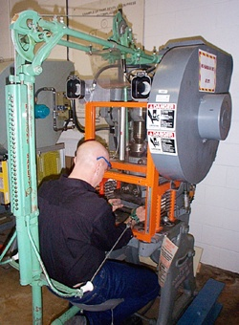
Definitions
Automatically withdraws the operator's hands if inadvertently within the point of operation as the dies close.
Prevents the initiation of a stroke, or stops of stroke in progress, when there is an intrusion through the sensing field by any object.
Notes:
A “device” also:
Automatically withdraws the operator's hands if inadvertently within the point of operation as the dies close.
Prevents the initiation of a stroke, or stops of stroke in progress, when there is an intrusion through the sensing field by any object.

Slide 41
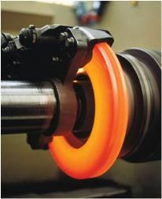
1910.217(b)(2) Brakes
Friction brakes provided for stopping or holding a slide movement:
Shall be inherently self-engaging.
Requires power or force from an external source to cause disengagement.
Notes:
Friction brakes provided for stopping or holding a slide movement:
Shall be inherently self-engaging.
Requires power or force from an external source to cause disengagement.

Slide 42
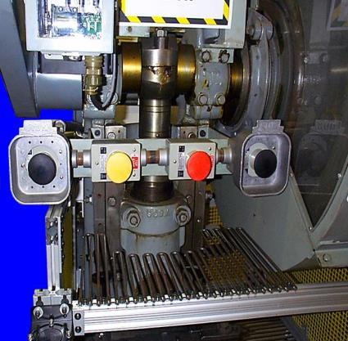
Two-Hand Trip Controls
1910.217(b)(6)
Hand controls protected against unintentional operation.
Two-hand trip systems on full revolution clutch machines shall incorporate an anti-repeat feature.
Notes:
Two hand trip controls are hand controls that are protected against unintentional operation and require two hands to operate.
Two-hand trip systems on full revolution clutch machines shall incorporate an anti-repeat feature.

Slide 43
Point of Operation Guards
1910.217(c)(2)
Shall prevent entry of hands or fingers into the point of operation by reaching through, over, under or around the guard.
Shall conform to the maximum permissible openings of Table O-10.
Notes:
Point of Operation guards:
Shall prevent entry of hands or fingers into the point of operation by reaching through, over, under or around the guard
Shall conform to the maximum permissible openings of Table O-10.

Slide 44
Table O-10 (In Inches)
Distance of opening from point | Maximum width of
of operation hazard | opening
____________________________ |__________________
|
1/2 to 1 1/2 ................. | 1/4
1 1/2 to 2 1/2 ............... | 3/8
2 1/2 to 3 1/2 ............... | 1/2
3 1/2 to 5 1/2 ............... | 5/8
5 1/2 to 6 1/2 ............... | 3/4
6 1/2 to 7 1/2 ............... | 7/8
7 1/2 to 12 1/2 .............. | 1 1/4
12 1/2 to 15 1/2 ............. | 1 1/2
15 1/2 to 17 1/2 ..........… | 1 7/8
17 1/2 to 31 1/2 ............. | 2 1/8
Notes:
The table shown lists the distance of an opening from the point of operation hazard as well as the maximum width of that opening.

Slide 45
Presence Sensing Devices
May not be used on machines with full revolution clutches!
Notes:
Presence sensing devices may not be used on machines with full revolution clutches mainly because these devices won’t prevent an individual from getting injured since the machine would still operate to a point until the clutch would stop its rotation.

Slide 46
Pull-Out Device
1910.127(c)(3)(iv)(d)
Pull-Out Devices:
Each pull-out device in use shall be visually inspected and checked for proper adjustment at the start of each operator shift, following a new die set-up, and when operators are changed.
Necessary maintenance, repair, or both shall be performed and completed before the press is operated.
Records of inspections and maintenance shall be kept in accordance with paragraph (e) of this section.
Notes:
Pull-Out Devices:
Each pull-out device in use shall be visually inspected and checked for proper adjustment at the start of each operator shift, following a new die set-up, and when operators are changed.
Necessary maintenance, repair, or both shall be performed and completed before the press is operated.
Records of inspections and maintenance shall be kept in accordance with paragraph (e) of this section.

Slide 47
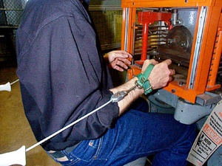
Pull Back Devices
Pullback
device
Adjustable
wrist
straps
Notes:
Pullbacks/pullouts are used as safeguarding devices on both full and part revolution power presses. They are similar to restraints but pullbacks are designed to pull the operator's hands away from the area of the closing dies (point of operation) during each stroke of the power press.

Slide 48
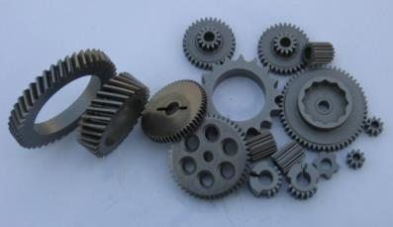
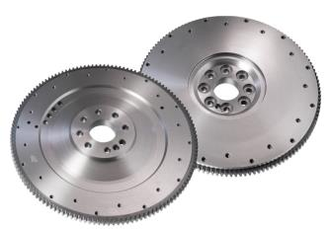
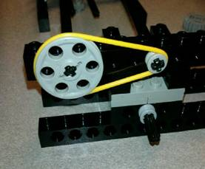
Prime Mover Guards
29 CFR 1910.219
Flywheels
Pulleys
Belt, Rope, & Chain Drives
Gears & Sprockets
Shafts
Notes:
All the ones listed can cause injury to a person who inadvertently contacts them so they should be appropriately guarded where appropriate.

Slide 49
Flywheels
1910.219(b)(1)
Flywheels 7 feet or less above the ground shall be guarded by
Sheet, perforated, or expanded metal or woven wire, or with
Guard rails between 15 to 20 inches from flywheel rim.
Toe board if within 12 inches of floor or extends into a pit.
All projections shall be covered.
Notes:
Flywheels are used a great deal on machines and should be guarded where possible/appropriate:
Flywheels 7 feet or less above the ground shall be guarded by sheet, perforated, or expanded metal or woven wire, or with guard rails between 15 to 20 inches from flywheel rim.
A toe board should be installed if the flywheel is within 12 inches of floor or extends into a pit.
All projections shall be covered.

Slide 50
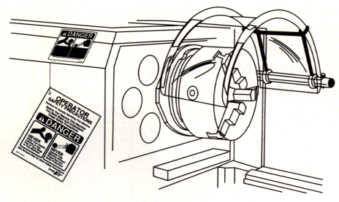
1910.219.(c) Shaft
Projecting end shafts shall present a smooth edge and project not more than 1/2 the diameter of the shaft.
Unused key ways shall be filled up or covered.
Notes:
Shafts:
Projecting end shafts shall present a smooth edge and project not more than 1/2 the diameter of the shaft.
Unused key ways shall be filled up or covered.

Slide 51
1910.219(d) Pulleys
Pulleys seven feet or less from floor or working platform shall be guarded in accordance with the standards specified in paragraphs (m) & (o).
Pulleys serving as balance wheels (e.g., punch presses) on which the point of contact between belt and pulley is more than six feet six inches from the floor or platform may be guarded with a disc covering the spokes.
Notes:
Pulleys:
Pulleys seven feet or less from floor or working platform shall be guarded in accordance with the standards specified in paragraphs (m) & (o).
Pulleys serving as balance wheels (e.g., punch presses) on which the point of contact between belt and pulley is more than six feet six inches from the floor or platform may be guarded with a disc covering the spokes.

Slide 52
1910.219(o)(2) Wooden Guards
Wooden guards may be used in:
Woodworking industry
Chemical industry
Industries where there is presence of fumes
Industries where manufacturing conditions can cause rapid deterioration of metal guards
Construction work and outdoors where extreme cold or heat make metal guards and railings undesirable
Notes:
Wooden guards may be used in:
Woodworking industry,
Chemical industry,
Industries where there is presence of fumes,
Industries where manufacturing conditions can cause rapid deterioration of metal guards.
Construction work and outdoors where extreme cold or heat make metal guards and railings undesirable.

Slide 53
Summary
If it moves, turns, spins, reciprocates, cuts, etc., GUARD IT!
Guard: point of operation, ingoing nip points, pinch points, rotating parts, against flying objects/chips.
Guards should not be a hazard in and of themselves.
Guards should not be removed unless working on the machine and Lock Out/Tag Out (LOTO) is in place.
Ensure guards are put back on after working on machinery.
Notes:
In summary:
If it moves, turns, spins, reciprocates, cuts, etc., GUARD IT!
Guard: point of operation, ingoing nip points, pinch points, rotating parts, against flying objects/chips.
Guards should not be a hazard in and of themselves.
Guards should not be removed unless working on the machine and Lock Out/Tag Out (LOTO) is in place.
Ensure guards are put back on after working on machinery.

Slide 54
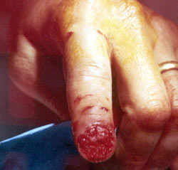
Bottom Lime
Guards are there for your safety, use them or you may suffer the consequences!

