Slide 1
Managing and Using Information Systems: A Strategic Approach – Fifth Edition
Keri Pearlson and Carol Saunders
Chapter 7
The Business of IT
PowerPoint® files by Michelle M. Ramim
Huizenga School of Business and Entrepreneurship
Nova Southeastern University

Slide 2
Learning Objectives
Understand the business of IT and the customers it serves.
Describe a maturity model.
Understand the balancing act between IS supply and business demand.
Describe key IT organization activities and how the leadership within the IT organization ensures that the various activities are conducted efficiently and effectively.
List the business processes within the IT department including building a business case, managing an IT portfolio, and valuing and monitoring IT investments.
Describe funding models and total cost of ownership.
Notes:
Duplicate this slide as necessary.
This and related slides can be moved to the appendix or hidden if necessary.

Slide 3
Real World Example
The CIO of Avon Products Inc. relies heavily on hard-dollar metrics like NPV and IRR to demonstrate business value in IT investments.
Although not the typical IT metrics, they are the language of business.
Avon uses payback, NPV, IRR, and risk analysis for every investment.
The business side of IT is similar to the business itself.
Notes:
The IS organization has to consider what services and products it needs to deliver to the other departments in the organization and how it can fund and effectively deliver those offerings.

Slide 4
Organizing to Respond to Business Demand: A Maturity Model
Responding to the demands of business requires that the IT department organize to supply the services and products that are needed.
IT managers must be partners with their business colleagues in every sense of the word. It’s not enough to call in the IT manager late in the project discussion to identify tools to support the project. Rather, IT managers are business people, and can do a better job of being a partner if they are consulted early in the project.
Sometimes the misalignment between the demands on the business side and the IT offerings on the supply side is because IT and the business are at different levels of maturity in their growth and development.
Maturity Model framework is a useful tool for understanding the differences in capabilities (Figure 7.1).
When the capabilities of the IT organization are in balance with the demand of the business, both are at the same level.
Notes:
Responding to the demands of business requires that the IT department organize to supply the services and products that are needed.

Slide 5
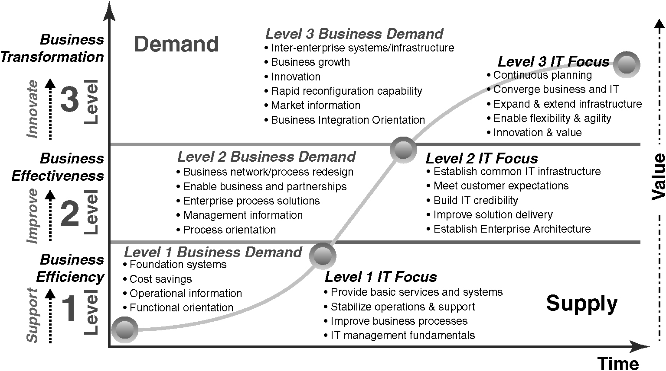
Figure 7.1 Business-IT maturity model.
“Organizational maturity” is the level of organization's readiness and experience in relation to people, processes, technologies and consistent measurement practices.
Notes:
This model differentiates between the supply of IT (the capabilities) and the demand for IT (what the business wants).

Slide 6
Understanding the IT Organization
IT organizations all provide services to their businesses at the right time and in the right way based on:
the skills and capabilities of their people.
the organizational focus of management.
Firms differ in their IT activities because of:
their organizational goals.
the firms’ size.
the organizational structure.
the level of maturity.

Slide 7
What a Manager Can Expect From the IT Organization
Managers must learn what to expect from the IT organization so they can plan and implement business strategy accordingly.
A manager typically can expect some level of support in 14 core activities (Figure 7.2):
Developing and maintaining IS.
Managing supplier relationships.
Managing data, information, and knowledge.
Managing Internet and network services.
Managing human resources.
Operating the data center.
Providing general support.
Notes:
Managers must learn what to expect from the IT organization so they can plan and implement business strategy accordingly.

Slide 8
What a Manager Can Expect From the IT Organization (Cont.)
Planning for business discontinuities.
Innovating current processes.
Establishing architecture platforms and standards.
Promoting enterprise security.
Anticipating new technologies.
Participating in setting and implementing strategic goals.
Integrating social IT.
Activities could be found at any maturity level.
Notes:
Managers must learn what to expect from the IT organization so they can plan and implement business strategy accordingly.

Slide 9
What a Manager Can Expect From the IT Organization (Cont.)
Level 1 – The functional view predominates.
The IT organization is focused on the basic services needed to:
generate cost savings.
provide operational information needed.
Level 2 – Makes the business effective.
The IT organization adopts a process view to provide services of an integrated nature across the organization.
Information delivered by IS supports managerial decision making.
Enables business partnerships.
Level 3 - Focuses on innovation.
Provides support for strategic initiatives.
Helps spur innovation.

Slide 10
Activities in the IT Organization
The scope of activities in the IT organization is expanding.
Integrating social IT into the organization’s business activities (e.g., wikis, forums, and social networks).
Encouraging new forms of collaboration.
Creating new processes to accomplish the firm’s goals.
Managing the sourcing relationships.
Identifying and working with vendors who provide services.
Traditional activities have been outsourced to vendors for decades.
Data center operations, network management, and system development and maintenance (including application design, development, and maintenance).
Outsourcing process management is also called business process outsourcing.

Slide 11
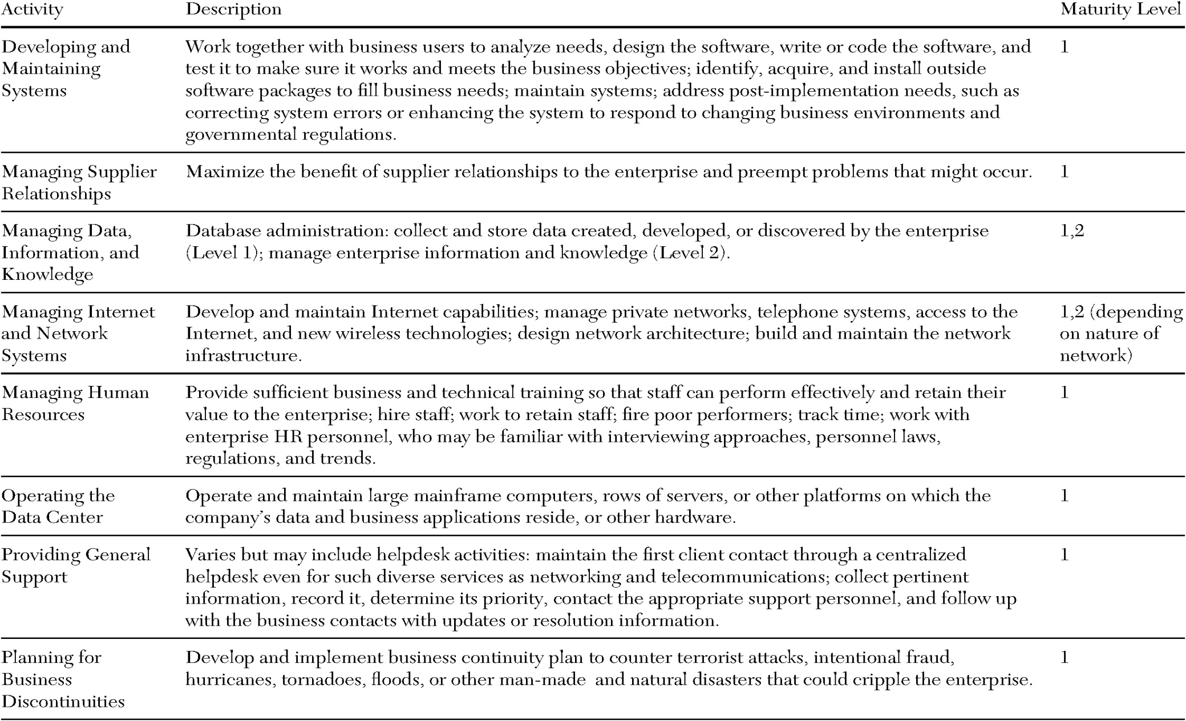
Figure 7.2 IT organization activities and related level of maturity.

Slide 12
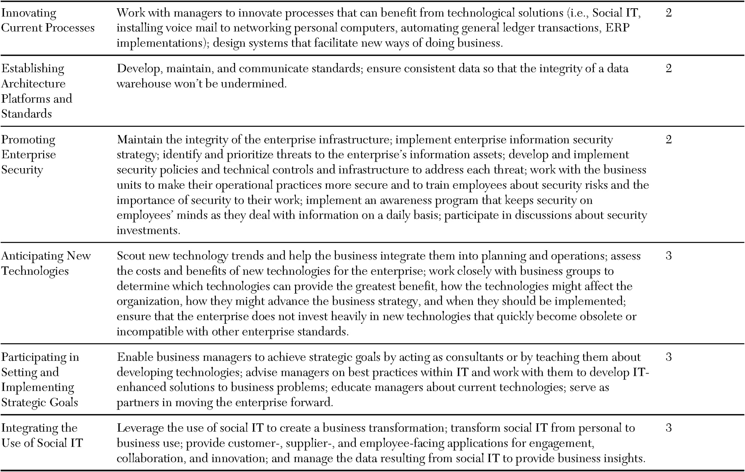
Figure 7.2 (Cont.)

Slide 13
Managing IT Activities Globally
Large global IT organizations:
perform many of the same activities listed in Figure 7.2.
face many of the same organizational issues as any other global department, including differences in:
time zones.
languages.
customs and holidays.
cultures.
Figure 7.3 summarizes how a global IT perspective affects six information management issues.

Slide 14
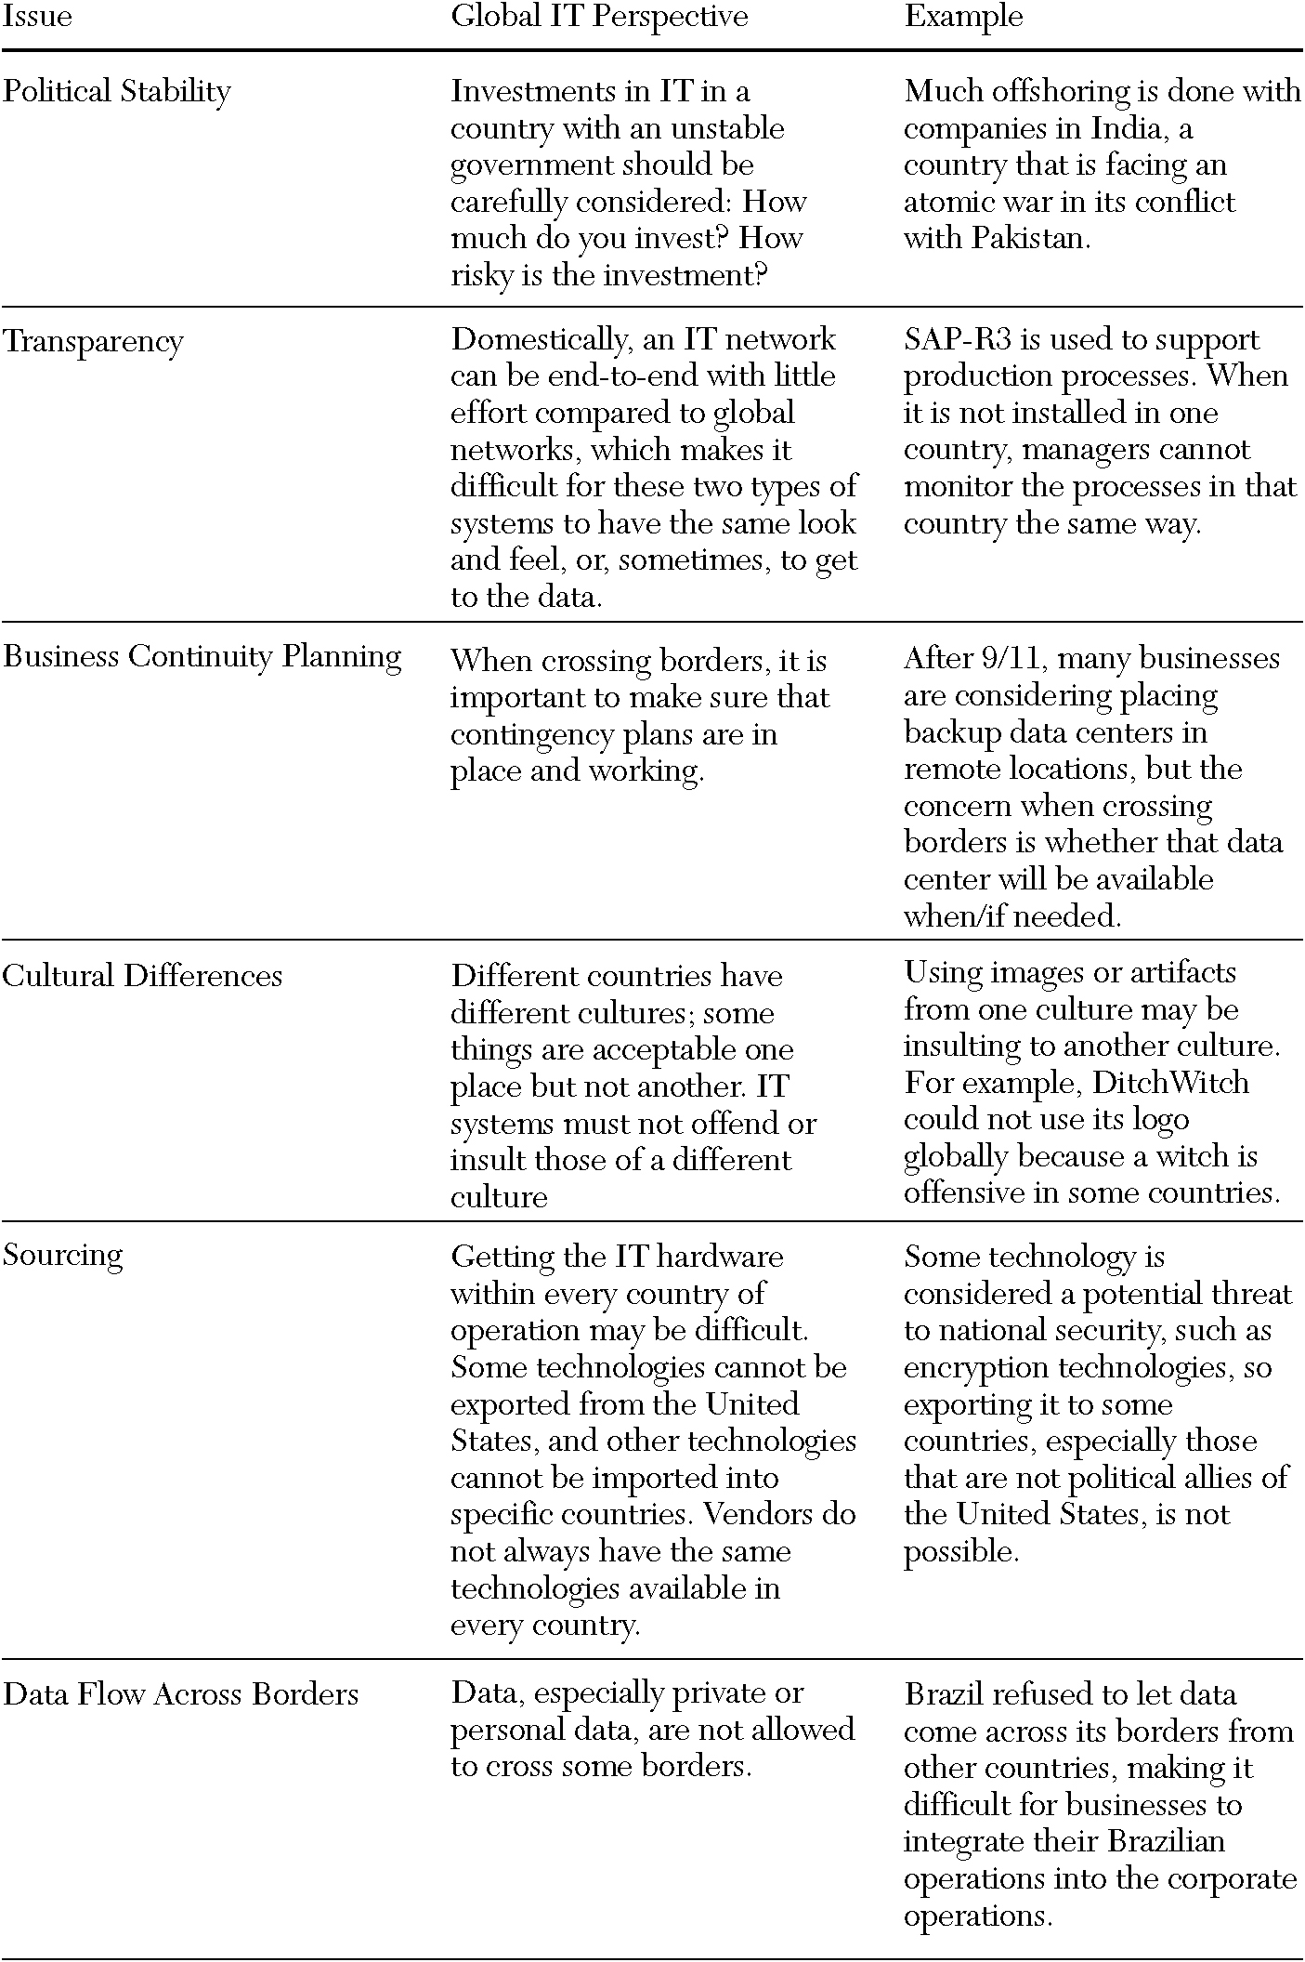
Figure 7.3 Global considerations for the IT organization.

Slide 15
What the IT Organization Does Not Do
The IT organization does not directly perform core business functions (e.g. selling, manufacturing, and accounting).
Managers’ lack of involvement in the design of systems turns over control of business operations.
The IT organization does not typically design business processes.
Partnerships between the general managers and IT professionals are important.
The IT organization does not set business strategy.
Notes:
Managers of core business functions inadvertently delegate key operational decisions to the IT organization.

Slide 16
Chief Information Officer (CIO)
The senior-most executive in the enterprise (Figure 7.4).
Responsible for technology vision.
Leadership for designing, developing, implementing, and managing IT initiatives.
Focus on operating effectively in a constantly changing and intensely competitive marketplace.
Works with the executive team in strategy formulation processes.
A business technology strategist or strategic business leader.
Uses technology as the core tool in creating competitive advantage and aligning business and IT strategies.
In the early days, the CIO was predominantly responsible for controlling
costs and reported to the CFO.
Notes:
The CIO is an executive who manages IT resources to implement enterprise strategy.

Slide 17
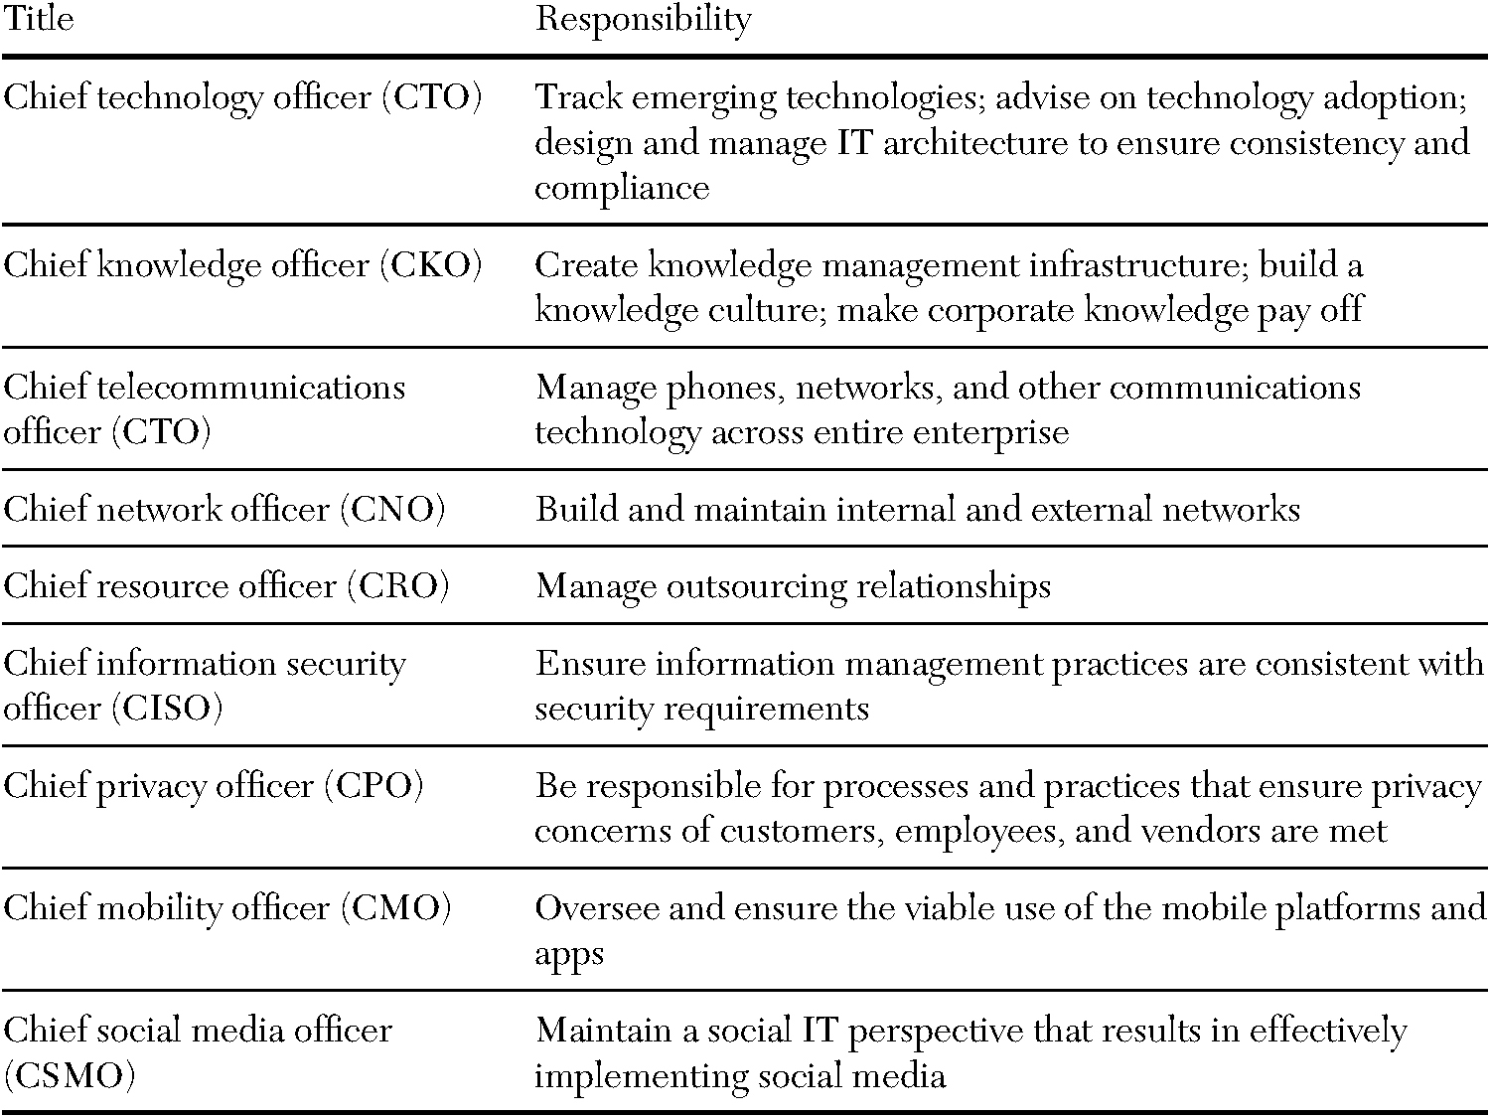
Figure 7.4 The CIO’s lieutenants.
Notes:
Many organizations recognize that certain strategic areas of the IT organization require more focused guidance. This recognition led to the creation of new positions.

Slide 18
Building a Business Case
The IT organization is often charged with providing solutions.
A business case:
is created to gain support and a “go-ahead” decision on an IT investment.
is similar to a legal case.
is a structured document that lays out all the relevant information needed to make a go/no-go decision (Figure 7.5).
helps establish priorities for investing in different projects.
identifies how IT and the business can deliver new benefits.
gains commitment from business managers.
creates a basis for monitoring the investment.
Daniel and Peppard have suggested a framework for identifying and describing both financial and nonfinancial benefits (Figure 7.6).
Figure 7.7 contains a sample of the cost-risk-benefit analysis.

Slide 19
Figure 7.5 Components of a business case.
Section or Component | Description
Executive Summary | One or two page description of the overall business case document.
Overview and Introduction | Includes a brief business background, the current business situation, a clear statement of the business problem or opportunity, and a recommended solution at a high level.
Assumptions and Rationale | Includes issues driving the proposal (could be operational, human resource, environmental, competitive, industry or market trends, financial, or otherwise).
Program Summary | Includes a high level and then detailed description of the project, well-defined scope, objectives, contacts, resource plan, key metrics (financial and otherwise), implementation plan (high level discussion and potential impacts), and key components to make this a success.
Financial Discussion and Analysis | Starts with financial summary then includes details such as projected costs/revenues/benefits, financial metrics, financial model, cash flow statement, and assumptions that went into creating financial statements. Total Cost of Ownership (TCO) calculations analysis would go in this section.
Benefits and Business Impacts | Starts with business impacts summary then includes details on all non-financial outcomes such as new business, transformation, innovations, competitive responses, organizational, supply chain, and human resource impacts.
Schedule and Milestones | Outlines the entire schedule for the project, highlights milestones and details expected metrics at each stage (what makes the go/no-go decision at each stage). If appropriate, this section can also include a marketing plan and schedule (sometimes this is a separate section).
Risk and Contingency Analysis | Includes details on risks, risk analysis, and contingencies to manage those risks. Includes sensitivity analysis on the scenario(s) proposed and contingencies to manage anticipated consequences. Includes interdependencies and the impact they will have on potential outcomes.
Conclusion and Recommendation | Reiterates primary recommendation and draws any necessary conclusions.
Appendices | Can include any backup materials that were not directly included in the body of the document such as detailed financial investment analysis, marketing materials, and competitors literature.
Notes:
In building the business case, it is particularly important to describe the benefits to be gained with the acceptance of the project.

Slide 20
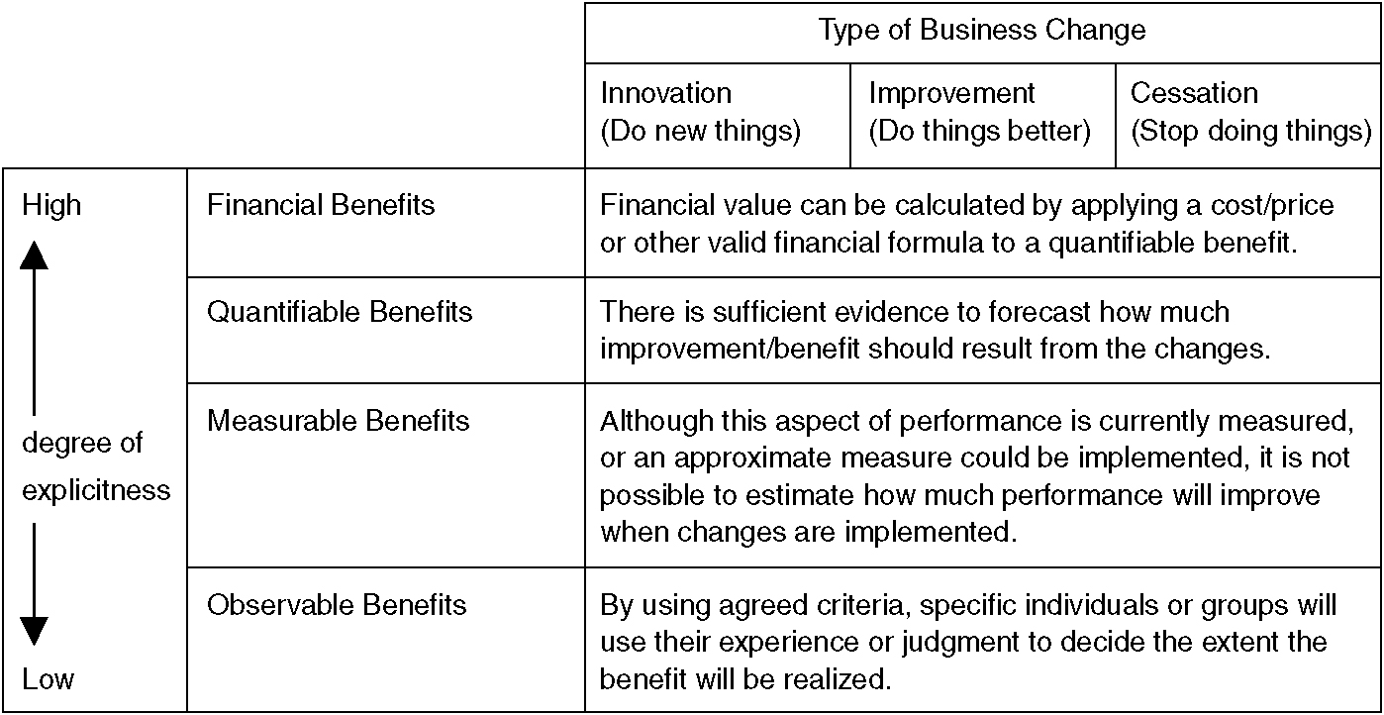
Figure 7.6 Classification framework for benefits in a business case.

Slide 21
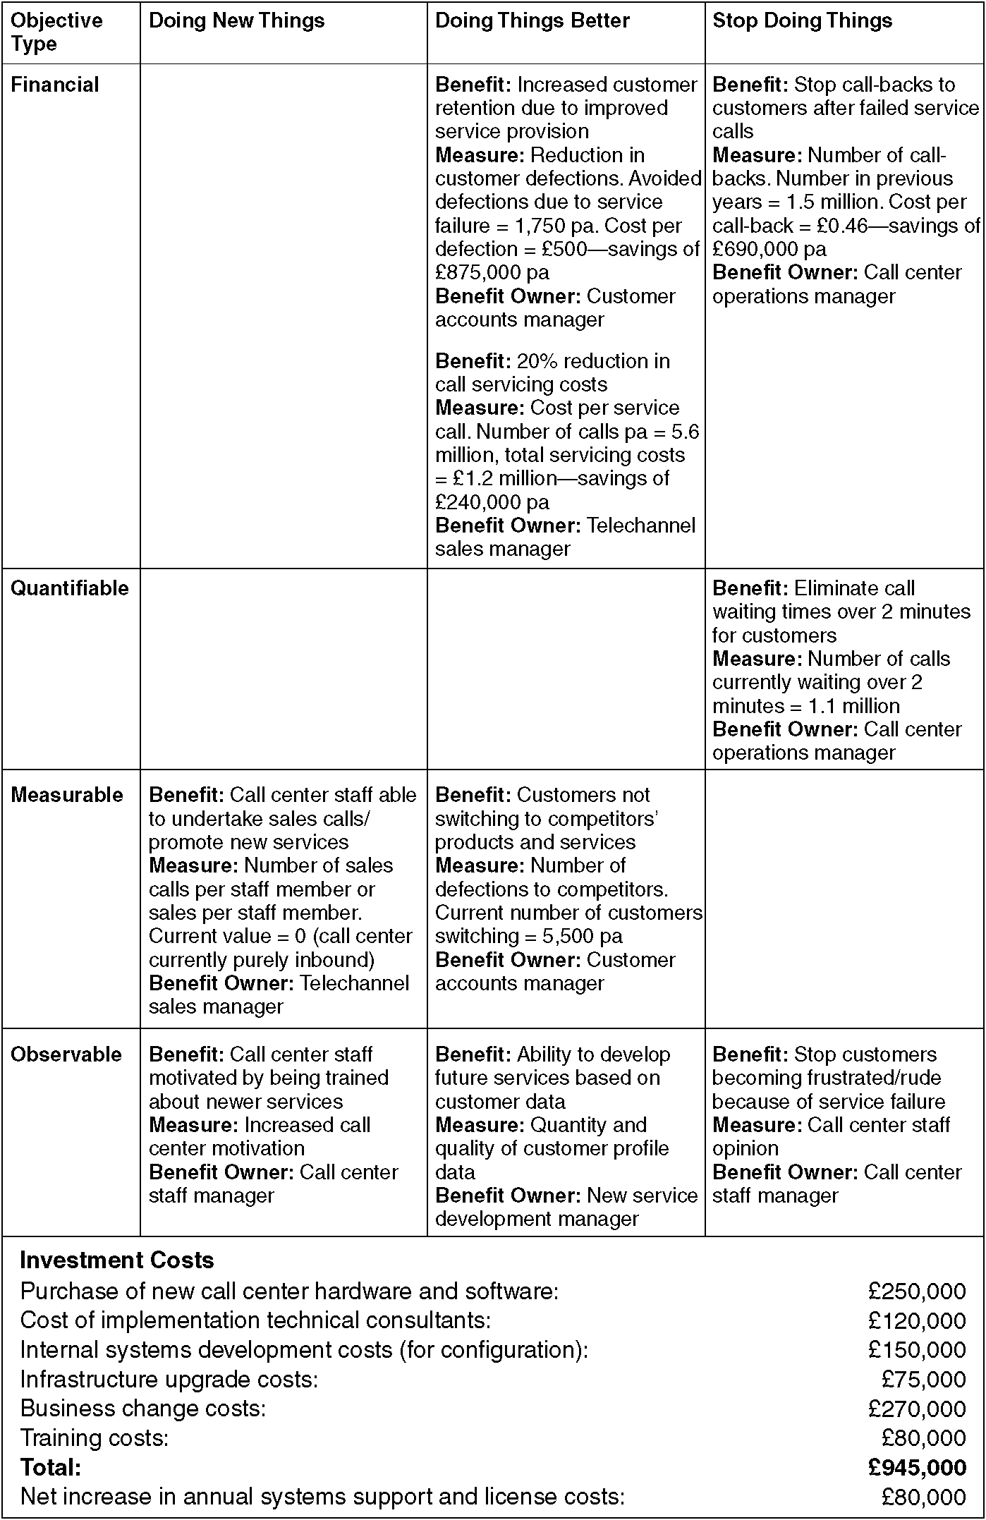
Figure 7.7 Cost-risk-benefit analysis for a business case.
Notes:
Note that in this example, costs were described in terms of six categories: purchases, implementation technical consultants, development, infrastructure, business change, and training costs. Risks were categorized as financial risks, technical risks, and organizational risks.

Slide 22
Figure 7.7 (Cont.)

Slide 23
IT Portfolio Management
IT portfolio management refers to:
“evaluating new and existing applications collectively on an ongoing basis to determine which applications provide value to the business in order to support decisions to replace, retire, or further invest in applications across the enterprise.”
Continually deciding on the right mix of investments from funding, management, and staffing perspectives.
The goal is for the company to fund and invest in the most valuable initiatives that, taken together as a whole, generate maximum benefits to the business.

Slide 24
Asset Classes of IT Investments
Professor Peter Weill and colleagues at MIT’s Center for Information Systems Research (CISR) describe four asset classes of IT investments:
Transactional Systems
Systems that streamline or cut costs.
Infrastructure Systems
Shared IT services used for multiple applications such as servers, networks, databases, or laptops.
Informational Systems
Systems that provide information used to control, manage, communicate, analyze, or collaborate.
Strategic Systems
Systems used to gain a competitive advantage in the marketplace.

Slide 25
Portfolio Management Perspective
New systems are evaluated on their own merits as well as their overall impact on the portfolio.
Systems can’t stand alone.
Evaluated based on their ability to meet business demand as part of an integrated web of applications.
Figure 7.8 summarizes a typical IT portfolio.
Weill’s study found that the average firm allocates:
46% of its total IT investment each year to infrastructure.
25% of its total IT investment in transactional systems.
Different industries allocate their IT resources differently.
Managers use a portfolio view of IT investments to manage IT resources.
Shows where money is being spent on IT.

Slide 26
Figure 7.8 Average company’s IT portfolio profile.

Slide 27
IT Portfolio Business Strategies
Decision makers use the portfolio to analyze risk.
Assess fit with business strategy.
Identify opportunities for reducing IT spending.
Portfolio management helps prioritize IT investments across multiple decision criteria.
Value to the business.
Urgency.
Financial return.
The IT portfolio must be aligned with the business strategy.
Weill’s work suggests that a different balance between IT investments is needed for a cost-focused strategy compared to an agility-focused strategy.
Figure 7.9 summarizes the different business strategies.
Notes:
A company with a cost-focused strategy would seek an IT portfolio that helps lower costs as the primary business objective.

Slide 28
Figure 7.9 Comparative IT portfolios for different business strategies.

Slide 29
Valuing IT Investments
New IT investments are often justified in terms of monetary costs and benefits.
Soft benefits, such as the ability to make future decisions, make it difficult to measure the payback of IT investment.
The systems are complex, and calculating the costs is an art—not a science.
Calculating a payback period may be more complex than other types of capital investments.
Many times the payback cannot be calculated because the investment is a necessity rather than a choice—without any tangible payback.
IT managers need to learn to express benefits in a business-like manner such as ROI or increased customer satisfaction.
Figure 7.10 shows the valuation methods used.
Notes:
Monetary costs and benefits are important but are not the only considerations in making IT investments.
IT managers, like the business managers who propose IT projects, are expected understand and to try to calculate the true return on these projects.

Slide 30
Figure 7.10 Valuation methods.
Valuation Method | Description
Return on Investment (ROI) | ROI= (Estimated lifetime benefits-Estimated lifetime costs)/Estimated lifetime costs.
Net Present Value (NPV) | Calculated by discounting the costs and benefits for each year of system’s lifetime using present value.
Economic Value Added (EVA) | EVA = net operating profit after taxes.
Payback Analysis | Time that will lapse before accrued benefits overtake accrued and continuing costs.
Internal Rate of Return (IRR) | Return on the IT investment compared to the corporate policy on rate of return.
Weighted Scoring Methods | Costs and revenues/savings are weighted based on their strategic importance, etc.
Prototyping | A scaled-down version of a system is tested for its costs and benefits.
Game Theory or Role-playing | These approaches may surface behavioral changes or new tasks attributable to a new system.
Simulation | A model is used to test the impact of a new system or series of tasks; low-cost method.

Slide 31
Management Approach to Valuing IT Investments
Despite the difficulty, the task of evaluating IT investments is necessary.
Know which approaches to use and when to use them.
Managers should choose based on the attributes of the project.
Use return on investment (ROI) or payback analysis when detailed analysis is not required.
A project is short-lived.
The costs and benefits are clear.
Use net present value (NPV) and economic value added (EVA) when the project lasts long enough that the time value of money becomes a factor.
EVA is particularly appropriate for capital intensive projects.

Slide 32
Analysis Pitfalls
Both IT and business managers may encounter a number of pitfalls when analyzing return on investment:
Not every situation calls for in-depth analysis.
Not every evaluation method works in every case. Factors to consider include:
the assets employed.
the duration of the project.
any uncertainty about implementation.
Circumstances may alter the way a particular valuation method is used.
Managers use an “adjusting” factor in their estimates.
Managers can fall into “analysis paralysis.”
Experience and being mindful of the risks of incorrect valuation help decide when to stop analyzing.
Even when the numbers say a project is not worthwhile, the investment may be necessary to remain competitive.

Slide 33
Monitoring IT Investments
Ensure that the money spent on IT results in benefits for the organization.
A common, accepted set of metrics must be created.
Metrics must be monitored and communicated to senior management and customers of the IT department.
Metrics are often financial in nature (e.g., ROI, NPV).
IT metrics include:
logs of errors encountered by users, end-user surveys, user turnaround time, logs of computer and communication up/downtime, system response time, and percentage of projects completed on time and/or within budget.
Business metrics include:
the number of contacts with external customers, sales revenue accrued from web channels, and new business leads generated.
Notes:
An old adage is, “If you can’t measure it, you can’t manage it.”

Slide 34
The Balanced Scorecard
Two methods for communicating metrics are scorecards and dashboards.
Robert Kaplan and David Norton developed the balanced scorecard.
Focuses attention on the organization’s value drivers—which include, but are not limited to, financial performance.
Companies use it to assess the full impact of their corporate strategies on their customers and workforce as well as their financial performance.
This methodology allows managers to look at the business from four perspectives (Figure 7.11):
Customer, internal business, innovation/learning, and financial.
Notes:
Deciding on appropriate measures is half of the equation for effective IT organizations. The other half of the equation is ensuring that those measures are accurately communicated to the business.

Slide 35
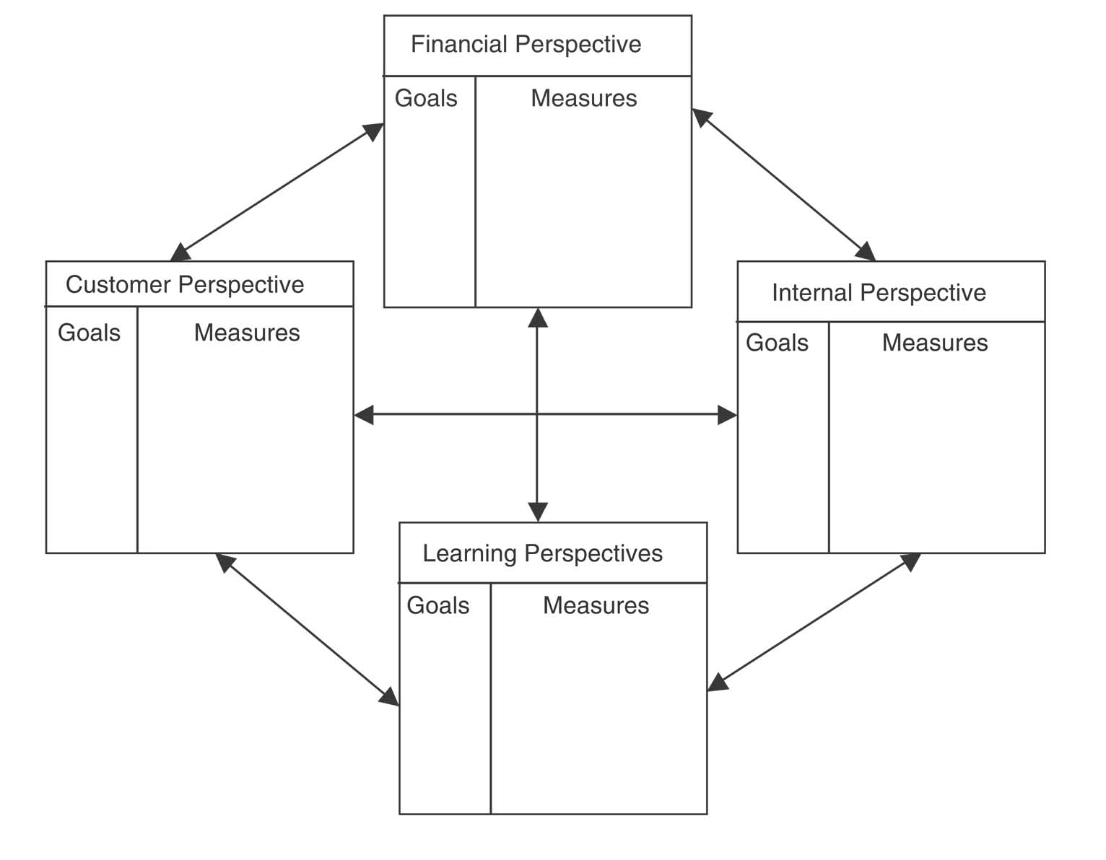
Figure 7.11 The Balanced Scorecard perspectives.

Slide 36
The Usefulness of the Balanced Scorecard
Managers of IT found the scorecard to be useful in managing and communicating the value of the IT department.
Applying the categories of the balanced scorecard to IT might mean interpreting them more broadly than originally conceived by Kaplan and Norton.
The questions asked when using this methodology within the IT department are summarized in Figure 7.12.
Norton found the balanced scorecard to be the most effective management framework for achieving organizational alignment and strategic success.
Senior IT managers understand their organization’s performance and measure it in a way that supports its business strategy and goals.

Slide 37
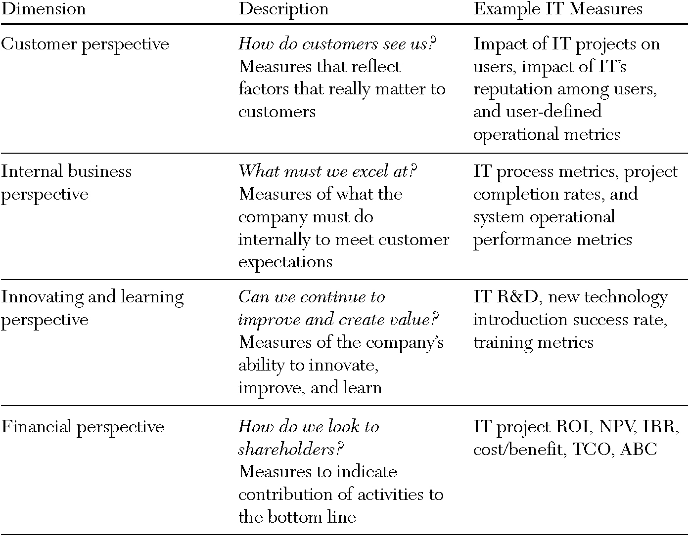
Figure 7.12 Balanced scorecard applied to IT departments.

Slide 38
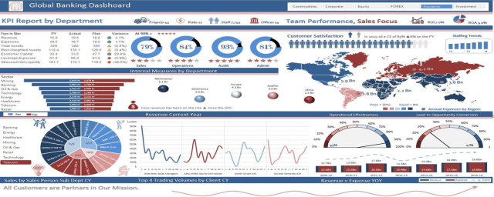
IT Dashboards
IT dashboards:
summarize key metrics for senior managers in a way that provides quick identification of the status of the organization.
provide frequently-updated information on areas of interest within the IT department.
The data focuses on project status or operational systems’ status.
In order to increase its transparency, the U.S. federal government created an IT dashboard website in 2009. The increased transparency
increased accountability
for managing the investments.

Slide 39
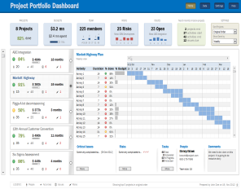
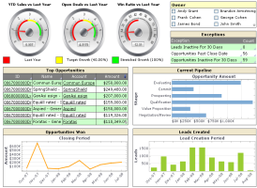
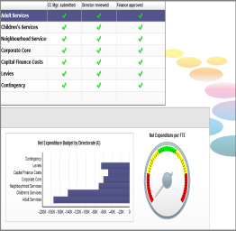
Types of IT Dashboards
Portfolio dashboards.
Show senior IT leaders the status, problems, milestones, progress, expenses, and other metrics related to specific projects.
Business-IT dashboards.
Show relevant business metrics and link them to the IT systems that support them.
Service dashboards.
Show the important metrics about the IS such as up-time, throughput, service tickets, progress on bug fixes, help desk satisfaction, etc.
Improvement dashboards.
Monitor the three to five key improvement goals for the IT group.

Slide 40
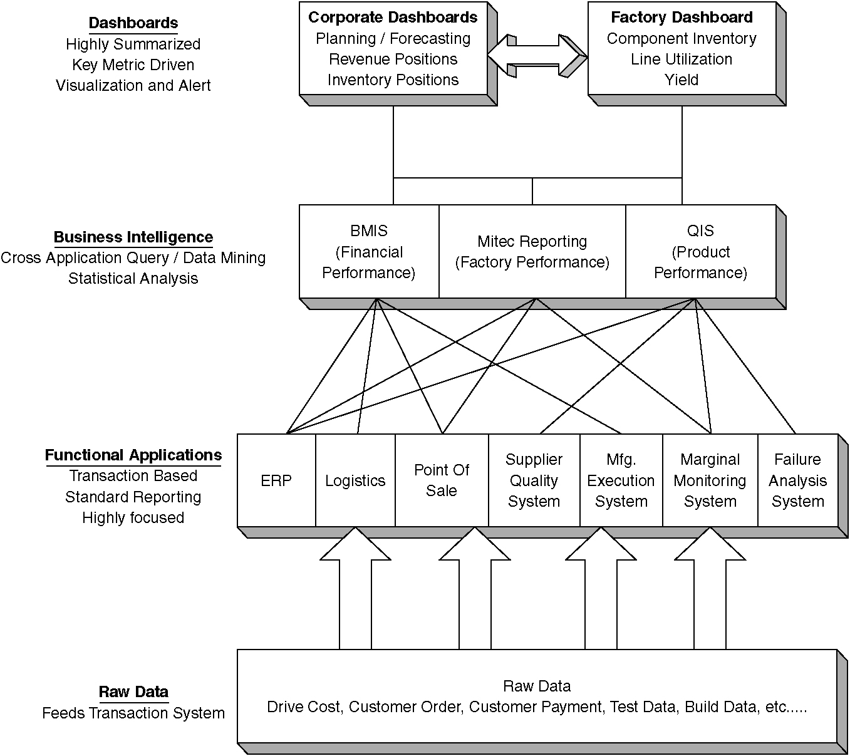
Figure 7.13 Example architecture of a dashboard.

Slide 41
Funding IT Resources
Who pays for IT?
The three main funding methods are chargeback, allocation, and corporate budget.
Both chargeback and allocation methods distribute the costs back to the businesses, departments, or individuals within the company.
In corporate budgeting, costs are not linked directly with any specific user or business unit; costs are recovered using corporate coffers.

Slide 42
Chargeback
IT costs are recovered by charging individuals, departments, or business units based on actual usage and cost.
The IT organization collects usage data on each system it runs.
Rates for usage are calculated based on the actual cost to run the system and are billed out on a regular basis.
When the IT organization wants to recover administrative and overhead costs using a chargeback system, costs are built into rates charged for each of the services.
Chargeback systems are popular and are:
Viewed as the most equitable way to recover IT costs.
Expensive to create and manage.
Most appropriate when there is a wide variation in usage among users or when actual costs need to be accounted for by the business units.
Notes:
Costs are distributed based on usage or consumption of resources, ensuring that the largest portion of the costs is paid for by the group or individual who consumes the most.

Slide 43
Allocation
Allocation funding method recovers costs based on something other than usage such as revenues, login accounts, or number of employees.
Simpler to implement and apply each month compared to the chargeback mechanism.
The rate charged is often fixed at the beginning of the year.
Two main advantages:
The level of detail required to calculate the allocations is much less.
Leads to cost savings.
Charges from the IT organization are predictable.
Generates far less frequent arguments from the business units.

Slide 44
Allocation Mechanisms
Two major complaints about allocation systems:
The free-rider problem.
A large user of IT services pays the same amount as a small user.
Deciding the basis for allocating the costs.
Choosing the number of employees over the number of desktops or other basis is a management decision.
Allocation mechanisms work well when a corporate directive requires use of this method and when the units agree on the basis for dividing up the costs.
A follow-up (“true-up”) process is needed at the end of the fiscal year.
The total IT expenses are compared to total IT funds recovered.
Extra funds are given back to the business units.
Notes:
Business managers often prefer the predictability of their monthly IT bills along with a true-up process instead of the relative unpredictability of being charged actual costs each month.

Slide 45
Corporate Budget
With the corporate budget funding method, the costs fall to the corporate bottom line rather than levying charges on specific users or business units (Figure 7.14).
Corporate budget advantages:
Relatively simple method for funding IT costs.
Requires no calculation of prices of the IT systems.
Bills are not generated on a regular cycle to the businesses.
Concerns are raised less often.
IT managers control the entire budget.
Control the use of the funds.
Have more input into what systems are created, how they are managed, and when they are retired.
Encourages the use of new technologies because learners are not charged for exploration and inefficient system use.
Notes:
An entirely different way to pay for IT costs is to simply consider them all to be corporate overhead and pay for them directly out of the corporate budget.

Slide 46
Corporate Budget Drawbacks
Corporate budget drawbacks:
All IT expenditures are subjected to the same process as all other corporate expenditures—the budgeting process.
One of the most stressful events of the year.
Everyone is competing for scarce funds.
When business units do not get billed, it is hard to control usage.
The IT group may feel less accountable.
The IT organization may be less end-user or customer oriented.

Slide 47
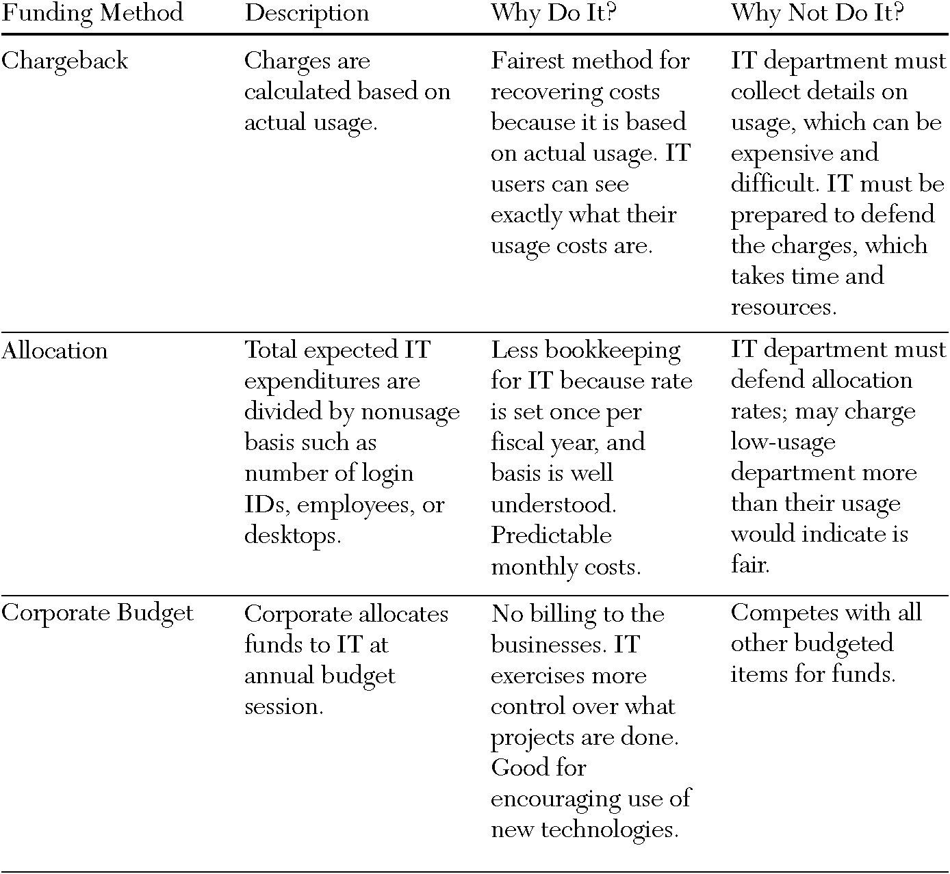
Figure 7.14 Comparison of IT funding methods.

Slide 48
How Much Does it Cost?
The three major IT funding approaches are designed to recover the costs of building and maintaining IS.
The goal is to cover the costs, not to generate a profit.
The most basic method for calculating the costs of a system is to add the costs of all the components including:
hardware.
software.
network.
people involved.
IT organizations calculate the initial costs and ongoing maintenance costs in this way.
Notes:
Some IT organizations are actually profit centers for their corporation.

Slide 49
Direct and Indirect Costs
Traditional accounting methods account for direct and indirect costs.
Direct costs can be clearly linked to a particular process or product.
E.g., components used to manufacture the product, assembler’s wages for time spent building the product, etc.
Indirect costs are the overhead costs.
E.g. the electric bill, the salary of administrative managers, the expenses of administrative function, the wages of the supervisor overseeing the assembler, the cost of running the factory, the maintenance of machinery used for multiple products, etc.

Slide 50
Activity-Based Costing (ABC)
The allocation process can be cumbersome and complex.
A source of trouble for many organizations.
Calculates costs by counting the actual activities that go into making a specific product or delivering a specific service.
Activities are processes, functions, or tasks that occur over time and produce recognized results.
Activities are the common denominator between business process improvement and information improvement across departments.
ABC calculates the amount of time that system was spent supporting a particular activity and allocates only that cost to that activity.
Charges all costs to “profit centers” instead of to “cost centers.”
Notes:
Indirect costs are allocated or absorbed elsewhere in the pricing model.

Slide 51
Total Cost of Ownership
When a system is proposed and a business case is created to justify the investment, the decision is often made on incomplete information.
Total cost ownership (TCO): one technique used to calculate a more accurate cost that includes all associated costs.
Rapidly becoming the industry standard.
Gartner Group introduced TCO in the late 1980s to calculate PC-based IT infrastructures.
TCO looks beyond initial capital investments.
Includes costs associated with technical support, administration, training, and system retirement.

Slide 52
TCO Calculation for IT Infrastructure
TCO:
estimates annual costs per user for each potential infrastructure choice and then totals them.
provides the best investment numbers to compare with financial return numbers when analyzing the net returns on various IT options.
A major IT investment is for infrastructure.
Figure 7.15 uses the hardware, software, network, and data categories to organize the TCO components the manager needs to evaluate.
The manager can assess infrastructure components at a medium level of detail and categorically allocate “softer” costs like administration and support.

Slide 53
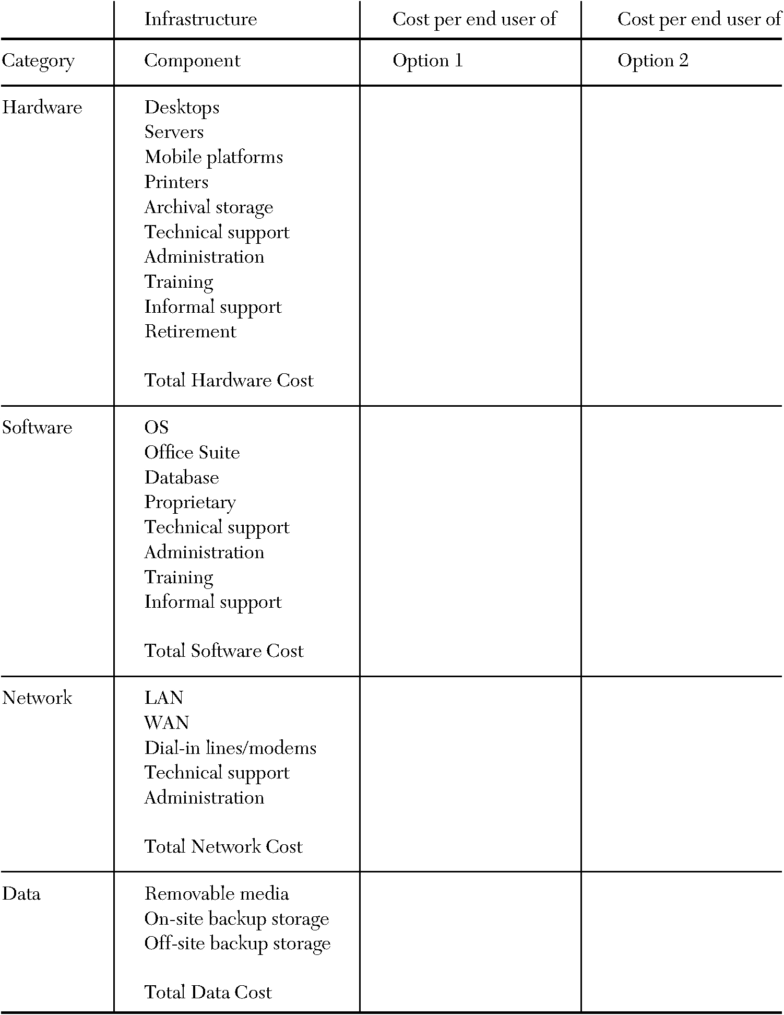
Figure 7.15 TCO component evaluation.
Notes:
The manager can adapt this framework for use with varying IT infrastructures.

Slide 54
TCO Component Breakdown – Hardware and Software
The TCO framework for the hardware category includes computing platforms and peripherals.
The components listed are somewhat arbitrary.
Highly unusual that every user possesses every component.
For shared components, such as servers and printers, TCO estimates should be computed per component and then divided among all users who access them.
When only certain groups of users possess certain components, it is wise to segment the hardware analysis by platform.
Soft costs, such as technical support, administration, and training, are easier to estimate than they appear.
These calculations can be broken down (Figure 7.16).
The final soft cost, informal support, is important but may be harder to pin down.

Slide 55
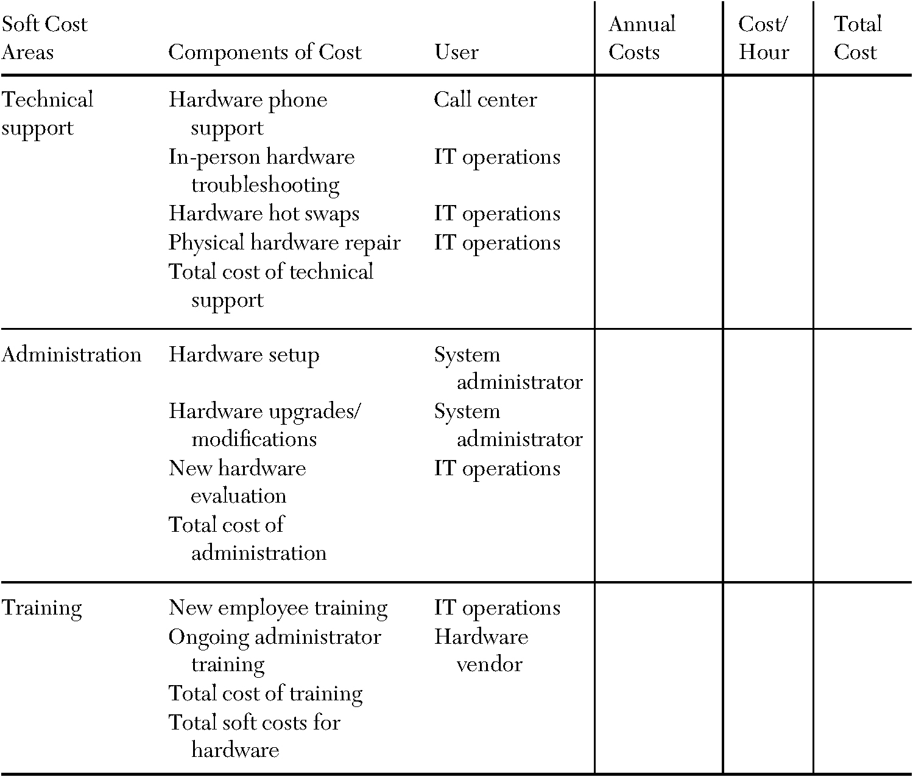
Figure 7.16 Soft costs considerations.

Slide 56
TCO Component Breakdown – Informal Support
Managers want to analyze the costs of informal support for two reasons:
The costs—both in salary and in opportunity.
Nonsupport employee costs may prove significantly higher than analogous costs for a formal support employee.
The quantity of informal support activities in an organization provides an indirect measure of the efficiency of its IT support organization.
The formal support organization should respond with sufficient promptness and thoroughness to discourage all but the briefest informal support transactions.
Putting dollar values on informal support may be a challenge.
Managers want to gauge the relative potential of each component option to affect the need for informal support.
Even if the figures are inaccurate, managers can be more aware of areas where costs can be cut.
Notes:
Various IT infrastructure options affect informal support activities differently.

Slide 57
TCO as a Management Tool
TCO:
is a tool for evaluating which infrastructure components to choose.
can help managers understand how infrastructure costs break down.
Labor costs associated with an IT infrastructure far outweigh the actual capital investment costs.
TCO provides the fullest picture of where managers spend their IT dollars.
TCO results can be evaluated over time against industry standards.
TCO studies assist in decisions about budgeting, resource allocation, and organizational structure.
The cost of implementing TCO can be a detriment to the program’s overall success.
Both ABC and TCO are complex approaches.
Require significant effort to determine the costs to use in the calculations.
Managers must weigh the benefits of using these approaches with the costs of obtaining reliable data.
Notes:
TCO target data for various IT infrastructure choices is available from industry research firms.

Slide 58
Chapter 7 - Key Terms
Activity-based costing (ABC) (p. 227) - calculates costs by counting the
actual activities that go into making a specific product or delivering a
specific service.
Allocation funding method (p. 224) - recovers costs based on
something other than usage$—$such as revenues, login accounts, or number of
employees.
Balanced scorecard (p. 218) - focuses attention on the organization’s value
drivers—which include, but are not limited to, financial performance.
Business case (p. 209) - a structured document that lays out all the relevant
information needed to make a go/no-go decision.

Slide 59
Chapter 7 - Key Terms (Cont.)
Business-IT Maturity Model (p. 198) - a useful tool for
understanding the differences in capabilities.
Business technology strategist (p. 206) - the strategic business
leader who uses technology as the core tool in creating competitive
advantage and aligning business and IT strategies.
Chargeback funding method (p. 223) - charging individuals,
departments, or business units based on actual usage and cost.
Chief Information Officer (CIO) (p. 206) - the senior-most executive in the
enterprise responsible for technology vision and leadership for designing,
developing, implementing, and managing IT initiatives for the enterprise to
operate effectively in a constantly changing and intensely competitive
marketplace.

Slide 60
Chapter 7 - Key Terms (Cont.)
Corporate budget funding method (p. 225) - the costs fall to the
corporate bottom line rather than levying charges on specific users or
business units.
Dashboard (p. 221) - provides a snapshot of metrics at any given
point in time.
Economic value added (EVA) (p. 216) - accounts for opportunity costs
of capital to measure true economic profit and revalues historical costs to
give an accurate picture of the true market value of assets.
IT portfolio management (p. 213) - “evaluating new and existing
applications collectively on an ongoing basis to determine which applications
provide value to the business in order to support decisions to replace, retire, or
further invest in applications across the enterprise.”

Slide 61
Chapter 7 - Key Terms (Cont.)
Net present value (NPV) (p. 216) - calculated by discounting the
costs and benefits for each year of the system’s lifetime using the
present value factor calculated each year as 1/(1+ discount rate) ^{year}.
Return on investment (ROI) (p. 216) - Percentage rate that
measures the relationship between the amount the business gets back
from an investment and the amount invested.
Total cost of ownership (TCO) (p. 228) – calculation that includes all costs associated with technical support, administration, training, and system retirement.

Slide 62
Copyright 2013 John Wiley & Sons, Inc.
All rights reserved. Reproduction or translation of this work beyond that named in Section 117 of the 1976 United States Copyright Act without the express written consent of the copyright owner is unlawful. Request for further information should be addressed to the Permissions Department, John Wiley & Sons, Inc. The purchaser may make back-up copies for his/her own use only and not for distribution or resale. The Publisher assumes no responsibility for errors, omissions, or damages, caused by the use of these programs or from the use of the information contained herein.

