Slide 1

Summary of the Police Department Audit
Salt Lake City, Utah

Slide 2
Study Objectives
Last year, the City Council initiated a process of police reform that focused both on budgeting and operational issues.
The public participated in the development of the scope of work for a consulting-assisted effort to evaluate opportunities to make the Police Department more accountable and transparent.
The result was the creation of 17 scope areas focused on:
  The development of a ’zero-based budget’ approach to assist the Council in decision-making about resource allocation.
  The examination of alternative response issues associated with lower priority calls for service and calls involving mental health issues.
  The examination of issues associated with disciplinary processes.
  The examination of body worn camera reviews and other issues.

Slide 3
Overview of Budget Issues
The City Council’s zero based budgeting effort was prompted by a desire to implement more informed decision-making regarding allocated resources and service delivery outcomes.
The current approaches to budgeting do not provide the level of detail or transparency needed for critical and informed decisions to be made.
Additionally, current practices do not easily allow decisions to be made on services or services levels with immediately available budget and staffing impacts.
The analysis conducted in the financial scope provides necessary background to develop an informed framework for a new budget process and monitoring that is tied, eventually, to service outcomes.

Slide 4
Financial Scope of Work
Key areas of inquiry included:
  1) Analyze actual and budgets for each cost center and object code (FY18, 19, 20)
  2) Identify special projects, onetime purchases and short-term contracts
  3) Identify associated expenses and revenues for activity outside General Fund
  4) Define organizational units to establish consistent language and identify costs.
  5) Identify costs and service levels associated with each functional group.
  6) Quantify smallest organizational blocks (employees and associated costs).
  7) Recommend best practices for use in department’s budgeting.
  8) Facilitate the Council’s zero based budget exercise.

Slide 5
Cost Centers and Object Codes
Cost Centers are not aligned with services due to frequent organizational changes and changes in initiatives and programs.
Many costs within the Police Department are not charged to appropriate cost centers based on functional use of funds.
Generally, the budget is developed with amounts representing anticipated expenditures. However, over a 3 period some line items identified that have actuals much lower or higher than budget.
Object code evaluation shows they are generally appropriately utilized, however:
  Some object codes have no budgeted amount but show expenditures
  Others have a budgeted amount but show no expenditures.

Slide 6
Special Projects and Expenditures
The department should more closely monitor and track all costs associated with these types of expenditures – especially for unbudgeted projects.
The lack of a master contract listing for all contracts (especially short-term contracts) impedes a holistic view of all obligations for the delivery of police services.
For unbudgeted efforts, costs should be coded with a ‘project code’ to enable full reporting of all associated costs and expenditures.

Slide 7
Functional Area Cost Center Review
Costs for department-wide efforts should be consolidated into a central services / administrative overhead category.
  This will enable more accurate and easier costing of functional units, and
  Increases insight into costs that will be incurred regardless of changes in services levels or organizational structure.

Slide 8
Organizational Blocks (1)
Future ZBB efforts will depend on establishing and consistently using organizational blocks, scaling factors, and defining desired service levels.
All costs associated with the direct provision of services must be allocated at the organizational block level.

Slide 9
Organizational Blocks (2)
The report provides an approach to establishing an organizational structure and organizational units based on functions performed, span of control factors, and position scaling factors:
  Workload based: Staff based upon workload to be handled (e.g., patrol).
  Span of control: Targeted or maximum span for supervisory positions
  Fixed coverage: Based on number of hours and posts that must be covered. (e.g., K9 units).
  Ratio-based: Scales based on size of organization. Typically used for internal service functions (e.g., human resources, training).
  Non-scaling: Unique or static positions that do not scale based upon workload such as the Chief of Police.

Slide 10
Best Practices (1)
The City’s planned implementation of a new ERP is timely as most issues raised in the financial review can most easily be addressed as part of the new ERP implementation.
Future budgets must be reorganized to group expenditures by appropriate functional levels.
All expenditures within the functional areas must be allocated to organizational blocks (coded to the service provided).
All airport expenditures must be fully defined and tracked whether or not they are covered by the agreement.

Slide 11
Best Practices (2)
Alternative approaches to budgeting for personnel costs should be considered.
  Current approach requires department to cover some routine expenditures from “attrition savings”
  This approach impedes effectively resource allocation and budgetary decisions.
All department-wide non-organizational unit specific costs should be centralized into one cost center.
Routine costs for facilities maintenance, building operations, and information technology should be considered for removal from Police Department budget and handled in a centralized manner.

Slide 12
Best Practices (3)
Line items that routinely have expenditures but no budgeted amount should have a budget developed for future years to set stage for ZBB effort.
Line items that routinely have a budgeted amount but no expenditures should be eliminated and the amounts reallocated in the budget.

Slide 13
Zero Based Budget Exercise
Will be conducted at a future date.
Will enable review of impact on staffing and overall expenditures by making decisions at the organizational block level regarding:
  Types of services provided by the department, and
  Levels of service provided.

Slide 14
Overview of Operational Issues
While Salt Lake City has historically focused policing on safety and efficiency, the past year has emphasized:
  Accountability to the public
  Transparency
  Ensuring that policies and training reflect the best in policing
  Effective community support and engagement
As a result, the scope of work for this project was expanded to include these areas.
The community was brought into the process of defining an ‘operational’ scope of work.

Slide 15
Operational Scope of Work
Key areas of inquiry included:
  Internal affairs structure and processes
  Disciplinary processes in comparison to best practices
  Personnel management through effective evaluations
  Memorandum of understanding issues
  Body worn camera reviews
  Core policing functions that can be handled through alternative means
  Mental health response
  Mental health services available to employees
  Potential for additional partnerships

Slide 16
Current Approaches to MH Crisis
SLCPD provides alternative response and services for mental health needs and crisis intervention through :
  Community Connection Center: Walk-in facility with clinicians and case managers that can connect individuals with services.
  CIT/HOST: Team of sworn officers and a sergeant that respond to mental health crisis events and provide CIT training, as well as proactive policing.
  Co-response: CIT/HOST officers respond with CCC clinicians to mental health crisis events, triaging 911 calls to be the primary responder when possible.
The project team examined current operations and opportunities to better implement these strategies, with the goal of ultimately achieving better outcomes.

Slide 17
MH Crisis Event Methodology
To quantify calls for service involving persons experiencing mental health crisis, the project team examined the call types that most likely involve mental health crisis.
  For instance, “Psychiatric Problem – Non Violent” frequently involve CIT/HOST officers.
The need for specialized co-response to mental health crisis events are then modeled for all hours and days of the week.
  This is critical for the hours and days when CIT/HOST is not on duty, in order to understand ‘unmet demand’.

Slide 18
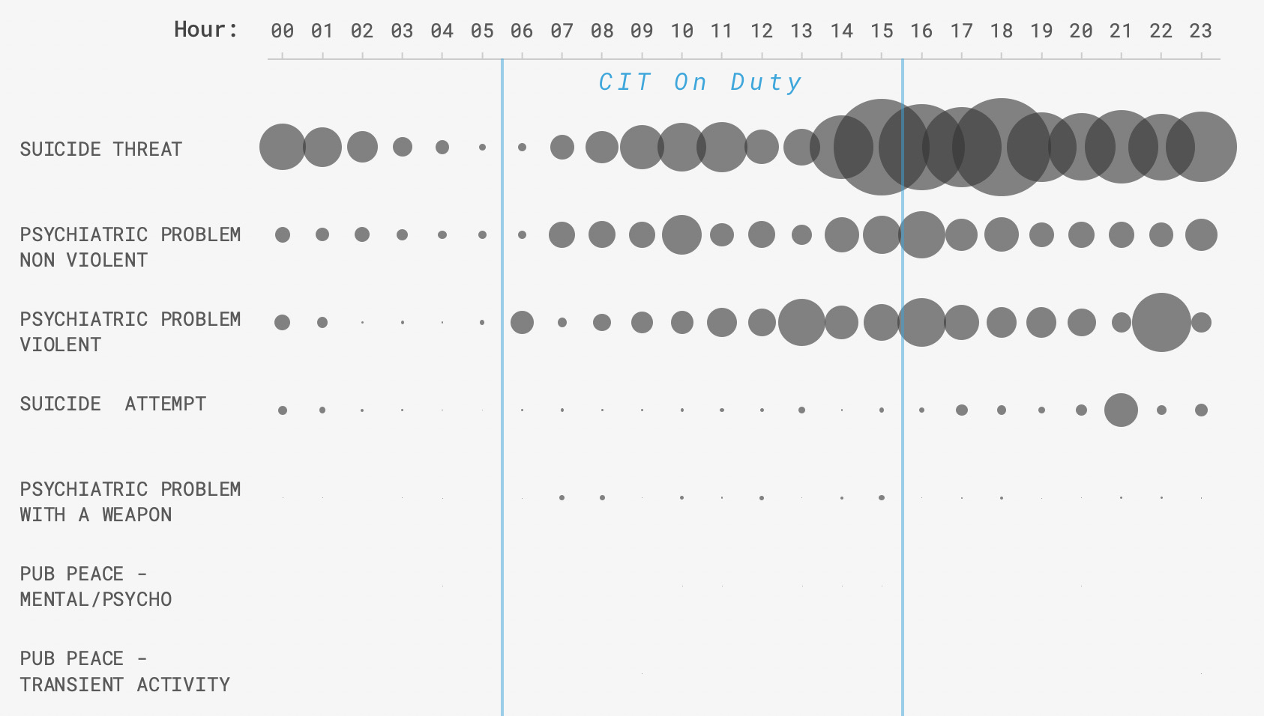
Demand for MH Co-Response
The frequency of events that are most likely to require specialized MH co-response shows significant unmet needs:

Slide 19
Addressing MH Response Needs
Evening hours appear to have the greatest need for specialized co-response, while CIT is not working.
Saturday and Sunday also have comparable levels of activity.
Staff should be redeployed to address these needs.
Pursuing both the co-response model and prioritizing training all officers in CIT certification + refresher training comes at the cost of both.
  Providing the CIT training takes significant time. Current refresher training is short of best practice levels.
  By concentrating officers on one shift, co-response is only available at certain times.

Slide 20
Addressing MH Response Needs
Consequently, fully implementing co-response should be prioritized over widespread CIT training in order to focus on achieving outcomes such fewer uses of force and arrest.
In order to address these needs:
  Redeploy 2 CIT/HOST officers and 2 Community Connections staff to Afternoon Shift hours to cover the evening.
  Stagger workdays on both teams to cover Saturday and Sunday.
  Increase CIT/HOST staffing by two officer positions, and add an additional clinician to provide for relief factors.
  These recommendations will provide for specialized co-response to MH events that is available 20.5 hours per day, 7 days per week.

Slide 21
Core and Non-Core Functions
The project team examined the core and non-core functions of the police department in order to identify potential opportunities to for alternative service provision.
In general, units within a police organization can be considered as part of one or more core functions of a policing:
  Response to calls for service
  Investigation of crime
  Suppression and prevention of crime and disorder (traffic enforcement is a component of this)
  Build and maintain relationships and trust within the community

Slide 22
Call for Service Diversion
Among these, call response represents a significant opportunity.
The roles of police officers have expanded in recent decades, and are asked to serve in new capacities.
  Call diversion examines how some of these new responses can be diverted to other, more specialized means.
  The approach enables officers to focus on their core services and have more time to be proactive and engage with the community.
Many departments throughout the country staff civilian community service officers (CSOs) that response to non-emergency calls for service that do not require a sworn officer.

Slide 23
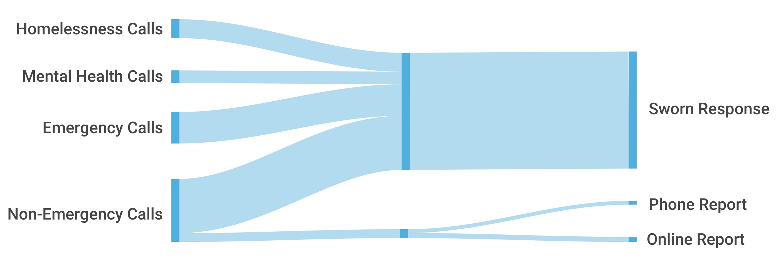
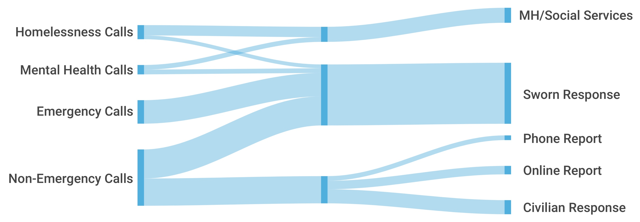
Framework for Call Diversion
Before:
After:

Slide 24
Call Diversion Potential Impacts
The project team examined the feasibility of implementing such an approach, using dispatch data to determine the number of calls could be diverted.
The analysis shows that up to 14,303 calls for service could be diverted from sworn patrol to civilian responders.
Based on the workload of each call, this would require adding 20 positions to a new CSO classification.
Impacts include dramatic improvements to patrol service levels, including in proactive time and response time to low-priority incidents.

Slide 25
Internal Affairs in the SLCPD (1)
The process in the SLCPD is similar to other larger agencies that we reviewed.
SLCPD conforms to best practice in several areas:
  They accept complaints from a variety of sources
  All complaints are accepted
  All complaints are tracked in a database
  There is a set timeline of 75 days to conduct the investigation.
44% of complaints are internally generated indicating a high level of internal accountability.
However, there is a lack of transparency.

Slide 26
Internal Affairs in the SLCPD (2)
Current policy does not require Internal Affairs complaints to be completed on employees who resign or retire prior to an IA investigation.
SLCPD is in the process of updating their Internal Affairs policy – requiring an update to the MOU to allow supervisors to better address low level policy violations with written warnings or verbal counseling without activating the discipline investigation clause.

Slide 27
Proposed Internal Affairs Changes
Update IA processes to the new proposed policy which outlines types of corrective action that can be taken that are not considered discipline.
Adopt the proposed change that allows sergeants to handle limited minor complaints in the field and provides that the complaint be entered into the employee management database.
Adopt the proposed policy change that would require minor complaints to be handled by division commands and more serious complaints to be handled by IA investigators.
Post complete IA complaint statistics on public website.
Post more Use of Force information, including demographics
Adopt a policy that would require IA investigations be completed even when an employee resigns or retires

Slide 28
Discipline Process and Issues
The current system includes a three-tier level system based on the seriousness of the complaint
The department is looking to move to a formalized discipline matrix which is an emerging practice among larger departments
A formalized discipline matrix helps to make discipline more consistent.
A formalized discipline matrix also assists in transparency.

Slide 29
Discipline Recommendations
Adopt a proposed policy recommendation that includes a “policy deficiency” finding
Adopt a proposed policy recommendation that includes a “coaching / counseling” finding
Add a “training deficiency” finding which denotes that the member did not violate policy because they were not trained or there is a training gap that should be addressed department wide.
Adopt a formalized discipline matrix

Slide 30
Personnel Management Systems
The current early warning system does not operate effectively and needs significant changes to be more effective.
The system as currently operated may not trigger soon enough on some issues while triggering to often on others.
Changes may require different software.
The IA Lieutenant is the system administrator which is not a best practice.

Slide 31
Employee Wellness
Two recent employee surveys indicated that many officers are struggling with depression, had difficulty concentrating and 12% had suicidal thoughts.
SLCPD has identified the need for clinician to address some of these issues
There is a need to further develop a wellness program

Slide 32
Wellness Recommendations
Create a steering committee of stakeholders to make actionable recommendations to address the 2019 and 2020 officer survey
Develop an executive-led and department-wide plan to train all personnel regarding trauma, stress and PTSD for first responders from accredited behavioral science experts
Use the steering committee to research resiliency training for employees in high stress/trauma environments
Measure outcomes of implemented education, programs, and strategies

Slide 33
HR Recommendations (1)
Remove Early Intervention System Administrator duties from the IA Lieutenant responsibilities
Designate an Early Intervention and Identification System coordinator and move the administration of EIIS from under the Internal Affairs Unit in the Professional Standards Division
Identify and implement a personal management system that can be tailored to collect pre-programmed criteria specific to SLPD agency needs and community expectations
Review categories for inclusion in data collection that could be useful as early indicators of potential problematic behavior (e.g., lawsuits and traumatic Incidents).

Slide 34
HR Recommendations (2)
Communicate in EIIS policy the stated goals for the personal management system
Replace the current method of data collection to a system that can be modified to capture data that supports the agency goals and purpose of a personal management system
Provide agency wide executive communication to agency personnel regarding personal management system goals, to include training on policy and/or system changes

Slide 35
MOU Issues
Article 15 of the MOU presents a barrier to effective low-level intervention and corrections to employee as even verbal counseling or written warning may interpreted as discipline.
Revise policy to enable supervisors to investigate and address low level complaints without violating agreed upon contractual rights.
Negotiate with the Salt Lake Police Association regarding wording and/or what is considered discipline at the lowest level.

Slide 36
Body Worn Camera Issues
The body worn camera policy is clearly written and incorporates State code.
Audit results indicate that officers properly activate their camera 92% of the time, however they only noted activation 47% of the time and interrupted video within policy only 43% of the time.
Compared to other police department audits reviewed, SLCPD had a better activation rate than several of their peers.
The Ordinance only requires 5 audits per month which is not adequate to gain meaningful insight into whether body worn cameras are operated within policy consistently.

Slide 37
BWC Recommendations
Make mandatory the monthly BWC auditing by supervisors.
Conduct random BWC audits by the audits and inspections unit.
Post body worn camera compliance on the public website.
Add an annual body worn camera audit role to the police civilian review board (PCRB). Create a new position to do this.
The independent body worn camera auditor should review a minimum of 20 videos per month.
Establish BWC review performance metrics.

