Slide 1

Immunization Education Update
For Physicians and Staff
Immunizations for Children and Adolescents
September 2017
Celebrating 16 years
Notes:
Educating Physicians In their Communities is:
A peer-to-peer immunization education program presented in the practice setting for practitioners and staff or in a classroom for students.
Presented by a team of 2 professionals: physician or other primary care provider (nurse practitioner, physician's assistant) and a nurse or office manager.
Our Beginnings…
EPIC is in its 16th year of immunization education. The first EPIC Immunization Education program was developed and implemented in Pennsylvania (a joint venture between public health and the PA chapter of the American Academy of Pediatrics). The program has been replicated in several states - Georgia most closely resembling the Pennsylvania program. Georgia was first to add adult vaccines to the program. In 2009 the Georgia Chapter created a separate Women’s Health Immunization Education program for obstetricians and gynecologists. Presentations are also available for students in healthcare training. Presentation on Coding are available to members of the Georgia Chapter of AAP
In 2003 the National Vaccine Advisory Committee (NVAC) approved and published updated standards for adult and child/adolescent immunization practices.
EPIC programs are designed to meet Standard #10 of the Standards for Child and Adolescent Immunization Practices:
"Persons who administer vaccines and staff who manage or support vaccine administration are knowledgeable and receive on-going education"
And
Standard #8 of the Standards for Adult Immunization Practices: “Persons who administer vaccines are properly trained."

Slide 2
Presented By:
Georgia Chapter - American Academy of Pediatrics
Georgia Immunization Program
In Cooperation with:
Georgia Academy of Family Physicians
Georgia Chapter American College of Physicians
Georgia OB/Gyn Society
Notes:
The EPIC immunization education program is developed and updated annually, and more frequently when necessary, by the Georgia Chapter of the American Academy of Pediatrics in partnership with the Georgia Immunization Program and in cooperation with the Georgia Academy of Family Physicians, the Georgia Chapter of the American College of Physicians/American Society of Internal Medicine, and the Georgia OB/GYN Society.
EPIC education programs utilize information from the Centers for Disease Control and Prevention, ACIP Recommendations, The Immunization Action Coalition and other reliable resources. When there is more than one vaccine manufacturer for a specific type of vaccine the presenter utilizes the generic name (ie. Tdap, hepatitis b etc.)
Note: Vaccine manufacturers who provide funding for administrative support of the EPIC Program have no editorial control over the program materials or presentations.

Slide 3
Faculty Disclosure Information
In accordance with ACCME* Standards, all faculty members are required to disclose to the program audience any real or apparent conflict of interest to the content of their presentation.
This presentation will include the most current ACIP recommendations for frequently used vaccines but is not a comprehensive review of all available vaccines.
Some ACIP recommendations for the use of vaccines have not currently been approved by the FDA.
Detailed information regarding all ACIP Recommendations is available at www.cdc.gov/vaccines/acip/recs/index.html
*Accreditation Council for Continuing Medical Education
Notes:
Presenters for the EPIC program do not discuss vaccines that are not licensed by the FDA or any pending vaccines that are still undergoing clinical trials. Sometimes an ACIP recommendation may not be listed as an indication for a specific vaccine or a specific age group on the manufacturers package insert. Therefore, the recommendation is considered “off label” use of the vaccine. The presenters will discuss the most recent ACIP recommendations during this presentation. All new ACIP Recommendations discussed have been published in MMWR.

Slide 4
Objectives
At the end of this presentation, you will be able to:
Recall the role vaccines have played in preventing diseases
Discuss the importance of vaccines for children, adolescents and adults
Discuss the role of a vaccine champion
Review the most recent CDC recommendations for storage and handling of vaccines
List at least 2 reliable sources for immunization information
Notes:
These are the objectives for this EPIC presentation.

Slide 5
The Impact of Vaccines
Disease | Average Annual Reported Cases Pre-vaccine* | Cases in U.S. 2015** | Provisional Cases in U.S. 2016** | Provisional % Reduction In U.S. 2016
Smallpox | 48,164 | Eradicated worldwide in 1980
Diphtheria | 175,885 | 0 | 0 | 100%
Measles | 503,282 | 188 | 69 | >99.9%
Mumps | 152,209 | 1,329 | 5,311 | 96.5%
Pertussis | 147,271 | 20,762 | 15,737 | 89.3%
Polio (paralytic) | 16,316 | 0 | 0 | 100%
Rubella | 47,745 | 5 | 5 | >99.9%
Congenital Rubella Syndrome | 823 | 1 | 1 | >99.9%
Tetanus | 1,314 | 29 | 33 | 97.5%
H. Influenzae Type b Age<5 years | 20,000 | 29 | 22 | 99.9%
*MMWR 48(12);243-248 April 2, 1999
**MMWR 65(52), ND-924-ND-941, January 6, 2017
Notes:
This table shows the impact of vaccines on the annual reported cases of some vaccine preventable diseases in the United States.
Column 2 shows the average number of reported cases of a specific disease prior to the licensure of the vaccine.
Column 3 shows the number of reported cases in the United States in 2015.
Column 4 shows the provisional number of reported cases in the U.S in 2016.
Column 5 shows the percentage decrease in reported cases in the United States based on the provisional number of reported cases in 2016 compared with the pre-vaccine years.
Reference:
Achievements in Public Health, 1900-1999 Impact of Vaccines Universally Recommended for Children - United States, 1990-1998 MMWR April 02, 1999 / 48(12);243-248
MMWR 65(52);ND-924-ND-941, January 6, 2017

Slide 6

Advisory Committee on Immunization Practices (ACIP)
15 voting members with expertise in one or more of the following:
Vaccinology
Immunology
Infectious diseases
Pediatrics
Internal Medicine
Preventive medicine
Public health
Consumer perspectives and/or social and community aspects of
immunization programs
ACIP develops recommendations and schedules for the use of
licensed vaccines
Notes:
The dramatic reduction of vaccine preventable diseases in the United States can be attributed to the availability of vaccines, as well as recommendations and an organized vaccine schedule developed by the Advisory Committee on Immunization Practices (ACIP).
Ask the audience if they are familiar with the ACIP. If they are familiar with the ACIP the presenter can spend a minimal amount of time on this slide.
The nurse/non-physician partner will discuss the schedules later in the presentation.
The Advisory Committee on Immunization Practices (ACIP) consists of 15 experts in fields associated with immunization who have been selected by the Secretary of the U. S. Department of Health and Human Services to provide advice and guidance to the Secretary, the Assistant Secretary for Health, and the Centers for Disease Control and Prevention (CDC) on the most effective means to prevent vaccine-preventable diseases.
The Committee develops written recommendations for the routine administration of vaccines to the pediatric and adult populations, along with schedules regarding the appropriate periodicity, dosage, and contraindications applicable to the vaccines. ACIP is the only entity in the federal government which makes such recommendations.
The overall goals of the ACIP are to provide advice which will assist the Department and the Nation in reducing the incidence of vaccine preventable diseases and to increase the safe usage of vaccines and related biological products.
For more information: http://www.cdc.gov/vaccines/acip/index.html

Slide 7
Community Immunity
Formerly known as “Herd Immunity”
Transmitting case
Immune
Immune
Immune
Immune
Immune
Susceptible
(Indirectly
Protected)
Immune
Susceptible
(Indirectly
Protected)
Reference: Presentation from Immunize Georgia, September 9, 2016 by Walt A. Orenstein, MD
Professor of Medicine Global, Health, Epidemiology and Pediatrics
Emory Department of Medicine, Associate Director, Emory Vaccine Center Director
Vaccine Policy and Development, Emory University, Atlanta, GA
Notes:
EPIC 2017

Slide 8
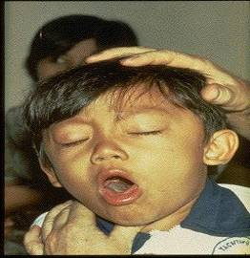
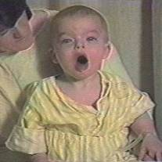

Diphtheria
©AAP
Tetanus
Pertussis
Notes:
Diphtheria, Tetanus and Pertussis (Whooping Cough) are all toxin mediated diseases. This means that the toxin or toxins produced by the bacteria are responsible for the symptoms of the disease.
DIPHTHERIA
Slide shows a child with diphtherial membrane in nasopharynx
Diphtheria is caused by a bacteria (Corynebacterium diphtheriae) that produces a toxin.
The bacterial growth and toxin cause local tissue destruction & membrane formation in nasopharynx & larynx & possible obstruction of respiratory tract.
Most common complications are myocarditis & neuritis (motor nerves).
TETANUS
Slide shows a child with muscle rigidity from tetanus.
Tetanus spores that are found everywhere in soil usually enter body through contaminated puncture wounds, lacerations or abrasions. Spores germinate and bacteria (Clostridium tetani) begin to multiply and produce an exotoxin. Toxin affects the neuromuscular junction and produces generalized rigidity and convulsive spasms of skeletal muscles, starting with the jaw and muscles of swallowing (lockjaw).
PERTUSSIS
Slide shows two children with pertussis (whooping cough) with paroxysmal coughing. (Sound is the typical pertussis cough and whoop. Pertussis, caused by a bacterium (Bordetella pertussis), produces multiple antigens and biologically active components that cause inflammation of the respiratory tract, paralysis of the cilia of the respiratory tract and lung damage resulting in pooling of secretions and characteristic cough lasting up to 12 weeks. Humans are the only reservoir. Transmission is by direct contact with respiratory droplets.
For more details about these 3 diseases refer to: Epidemiology and Prevention of Vaccine-Preventable Diseases, 13th edition. 2015 HHS, CDC.

Slide 9
Diphtheria, Tetanus and Pertussis Vaccines for Children, Adolescents, and Adults
ACIP recommends:
A 5 dose series of DTaP:
  Administered at 2, 4, 6, 15-18 months and 4-6 years (Do not administer after age 6)
And one dose of Tdap:
  For children and adolescents starting at 11 or 12 years of age
  For all adults aged 19 years and older who have not had Tdap previously
Boostrix is licensed for persons 10 years and older
Adacel is licensed for persons 10 through 64 years
For adults 65 years and older Boostrix should be used, when feasible;
however, either vaccine product provides protection and is considered valid.
  There is no minimal interval between the last dose of Td and Tdap.
MMWR, September 23, 2011, Vol 60, #37 MMWR, January 14, 2011, Vol 60, #01 MMWR, June 29, 2012 Vol 61, #25
Notes:
Note: Children age 7 through 10 years who receive Tdap as part of a catch-up series may be given an additional Tdap for the routinely recommended adolescent dose at 11–12 years of age.

Slide 10
ADMINISTER THE RIGHT VACCINE!
PRODUCT | COMPONENT(S) | USE FOR AGES | USE FOR DTaP DOSES | ROUTE
Daptacel (SP) | DTaP | 6 wks. thru 6 yrs. | Doses 1 thru 5 | IM
Infanrix (GSK) | DTaP | 6 wks. thru 6 yrs. | Doses 1 thru 5 | IM
Pediarix (GSK) | DTaP-HepB-IPV | 6 wks. thru 6 yrs. | Doses 1 thru 3 | IM
Pentacel (SP) | DTaP-IPV/Hib | 6 wks. thru 4 yrs. | Doses 1 thru 4 | IM
Kinrix (GSK) | DTaP-IPV | 4 thru 6 yrs. | Dose 5 | IM
Quadracel (SP) | DTaP-IPV | 4 thru 6 yrs. | Dose 5 | IM

Slide 11
Tdap for Pregnant Women
ACIP recommends:
One dose of Tdap during each pregnancy, irrespective of a prior history of receiving Tdap.
Optimal timing for Tdap administration is between 27 and 36 weeks gestation. ACIP guidance and current data suggest that vaccinating earlier in the 27 through 36 week window will maximize passive antibody transfer to the infant.
If Tdap is not given during pregnancy, and has not been given previously, administer Tdap immediately postpartum.
According to ACIP, Pregnant women and adolescents may receive additional doses of Tdap.
2017 Childhood Schedule: Children 7-10 years of age who receive Tdap as part of the catch-up series can be given Tdap again at ages 11-12 years
Ref: Advisory Committee on Immunization Practices. Updated ACIP statement for pertussis, tetanus and diphtheria vaccines presented by Jennifer L. Liang, October 19, 2016.
MMWR, February 7, 2017, Vol. 66
Notes:
Guidance on use of Tdap products for pregnant women:
All pregnant women should receive a dose of Tdap during each pregnancy, irrespective of prior history of receiving Tdap. Optimal timing for administration is between 27 and 36 weeks gestation. If a dose is given early in that same pregnancy, do NOT repeat it at 27-36 weeks. If not given during pregnancy, give Tdap immediately postpartum³.
References:
1. Advisory Committee on Immunization Practices. Updated ACIP statement for per
2. MMWR, February 22, 2013, Vol 62, #7
3. www.immunize.org, Ask the Experts, Tetanus section, IAC, Sept. 2013

Slide 12







Cocooning Strategy
Parents
Siblings
Child Care Provider
Healthcare Worker
Grandparents
Notes:
An infant who is infected with pertussis under 6 months of age can experience a devastating disease, frequently resulting in death, because the infant can not tolerate the severe inflammation of the respiratory tract. The primary series of DTaP is usually not completed until 6 months of age. Therefore, the best method to prevent the infant from infection with pertussis is to eliminate exposure to the disease. This is accomplished by immunizing ALL pregnant women, and all caregivers with Tdap vaccine. Ninety percent of pertussis deaths between 2000-2009 were in infants less than 3 months of age.

Slide 13
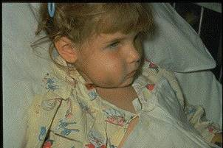
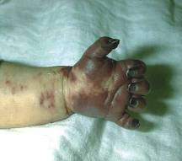
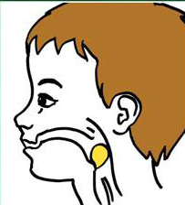
Haemophilus influenzae type b (Hib)
ACIP recommends:
3-4 doses of Hib (depending on brand)
  Dose 1 @ 2 months of age
  Dose 2 @ 4 months of age
  Dose 3 @ 6 months of age
  (Not required if Pedvax HIB® is administered at 2 and 4 months of age)
  Booster dose @ 12 through 15 months of age
One dose of Hib for unimmunized persons 5 through 18 years who have asplenia, sickle cell disease or HIV infection.
One dose of Hib may be given to adults with immunocompromising conditions.
MMWR, February 28, 2014, Vol 63, #RR01
Notes:
Slide shows a child with cellulitis of cheek and an infant with gangrenous fingers due to invasive Hib disease. The drawing shows a child with a markedly swollen epiglottis due to epiglottitis (croup) due to Hib infection.
Haemophilus influenza infection is caused by a bacteria which has 6 different polysaccharide serotypes and some non-typable strains
Type b (Hib) causes 95% of invasive disease
Hib enters body through the nasopharynx, spreads via blood stream to other sites (meninges, joints, skin, epiglottis and/or bone)
Prior to licensure of a vaccine Hib was the leading cause of bacterial meningitis in young children with a case fatality rate of 2-5%. 15-30% of survivors had hearing impairment and neurologic sequelae.
Hib also causes cellulitis, septic arthritis, osteomyelitis, pneumonia and epiglottitis.
Peak age for infection is 6-7 months. Invasive Hib disease is uncommon beyond 5 years of age.
Before Hib vaccine was licensed there were about 20,000 cases of invasive Hib in the U.S. each year
By 5 years post licensure of Hib vaccine, the incidence decreased by > 99%. In 2013, 31 cases of Hib type b were reported in the U.S. No cases were reported in Georgia.
40 cases were reported in the U.S. in 2014 and 23 cases in 2015.
Many physicians and nurses who were trained after the mid 1990s have never seen a case of invasive Hib
For additional information refer to:
Epidemiology and Prevention of Vaccine-Preventable Diseases, 13th edition 2015. HHS, CDC.

Slide 14
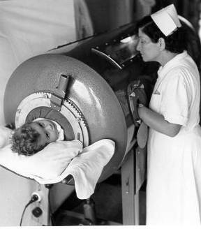
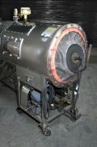
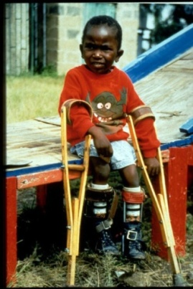
Polio
ACIP recommends:
Four dose series of IPV at : 2, 4, 6 through 18 months
and 4 through 6 years of age.
  Minimum interval from dose 3 to dose 4
  is six months
  Final dose at 4 years of age or older regardless of the number of previous doses
    For guidance in assessing polio vaccination status for children immunized outside the U.S., see https://www.cdc.gov/mmwr/volumes/66/wr/mm6606a7.htm?s_cid=mm6606a7_w
A booster dose may be recommended, depending on length of stay and the timing of the last dose of polio vaccine, for persons travelling to countries experiencing polio outbreaks.
MMWR, August 7, 2009, Vol 58, #30
MMWR, July 11, 2014, Vol 63, # 27
Source: World Health Organization
Notes:
Slide shows child in an iron lung due to weak respiratory muscles (common in polio era) and a child with muscle weakness, as a result of polio, requiring the assistance of braces and crutches in order to walk.
Polio, also called poliomyelitis and infantile paralysis is caused by an Enterovirus (Serotypes 1,2,3)
Infection acquired through mouth, virus replicates in pharynx and GI tract, then spreads to lymphatics and other tissues.
Clinical response to infection is varied:
Up to 95% of polio infections are inapparent and asymptomatic;
4-8% non specific illness; 1-2% cause aseptic meningitis - full recovery;
<1% of infections result in flaccid paralysis
Attacks motor neurons in spinal cord & brain stem
Persons with impaired muscles of respiration or involvement of respiratory center require a ventilator
(“Iron lung” used in the 1940s and 1950s)
Most persons with paralytic polio recover completely
Muscle weakness or paralysis for more than 12 months after acute infection is usually permanent
25-40% of people who had paralytic polio in childhood develop “Post-polio Syndrome” (new muscle
pain, exacerbation of existing weakness or new weakness) 30-40 years after the acute infection
Last endemic polio case in the US in 1979; last indigenous case in Western Hemisphere in 1991
Three regions of the world are certified polio free—the Americas, Europe, and the Western Pacific. Only three polio-endemic countries (countries that have never interrupted the transmission of wild poliovirus) remain—Afghanistan, Nigeria, and Pakistan. Transmission has been documented in other countries in Africa. Syria is also experiencing an outbreak due to interruption of STOP program during the civil war there.
223 cases worldwide in 2012
For additional information about polio refer to: Epidemiology and Prevention of Vaccine-Preventable Diseases, 13th edition, 2015. HHS, CDC.

Slide 15
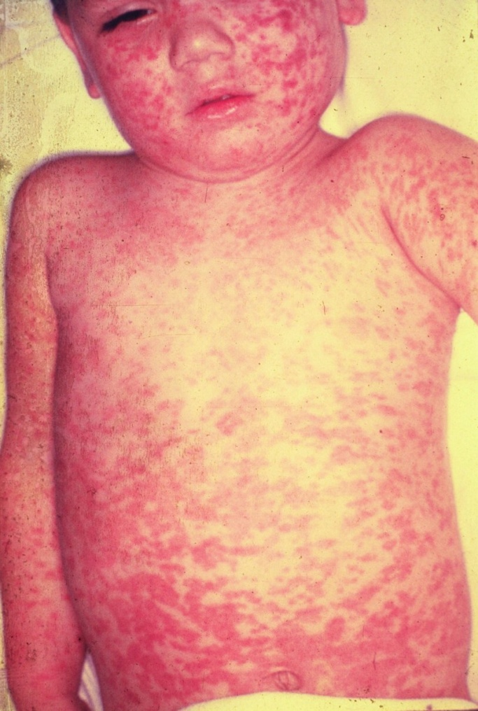
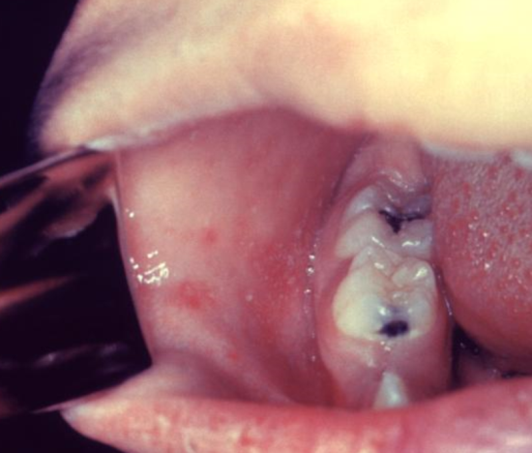
MEASLES
Incubation period generally 8 to 14 days from exposure to onset of symptoms.
Symptoms are fever, cough, coryza, conjunctivitis, maculopapular rash and Koplik spots.
Complications include otitis media, pneumonia, croup, & diarrhea.
Acute encephalitis occurs in 1 out of 1,000 cases.
Death occurs in 1 to 3 of every 1,000 cases.
Subacute sclerosing panencephalitis (SSPE) occurs in 1 to 609 infants
Measles Vaccine
95% of people develop serum
measles antibody after one dose.
99% after 2 doses.
5% or less may lose protection
after several years.
Koplik Spots
Source: American Academy of Pediatrics, Red Book Online Visual Library
Source: Centers for Disease Control and Prevention
AAP Red Book, 30th Edition 2015
Notes:
Subacute Sclerosing Panencephalitis (SSPE) is a neurological disorder that can appear years after a person is infected with measles and is always fatal. It is characterized by behavioral and intellectual deterioration and seizures that occur 7-11 years after measles infection. In rare cases the virus spreads to the brain, but then becomes dormant. Eventually it can lead to SSPE, resulting in deterioration and death. Researchers don’t know what causes the virus to reactivate.
There is no cure for SSPE and the only way to prevent it is to vaccinate everyone against measles.
Reference: Infection Diseases Society of America. Always Deadly Measles Complication more Common than Believed. October 29, 2016.

Slide 16
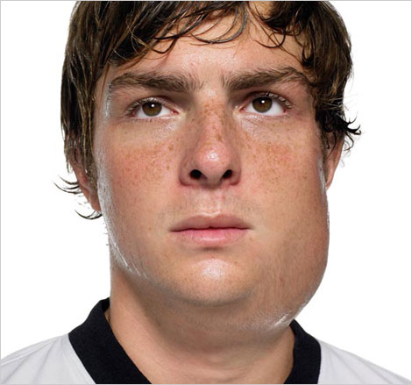
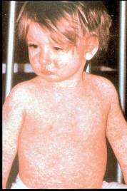
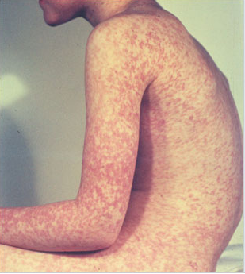
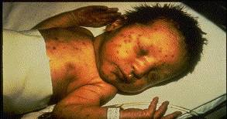
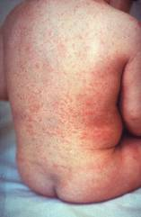
Measles, Mumps, Rubella
Measles (M)
Mumps (M)
Source: Creative Commons
Source: American Academy of Pediatrics
Red Book On Line Visual Library
Rubella (R)
Congenital Rubella (R)
Notes:
MEASLES (caused by paramyxovirus)
Slide shows two children with typical measles rash and conjunctivitis in younger child
Initial symptoms are runny nose, followed by increasing fever (103º-105º), cough, conjunctivitis, Koplik spots, and a maculopapular rash that lasts 5-6 days
Complications include otitis media (7%), pneumonia (6%), and acute encephalitis (0.1%) 1 in 1000 cases, death (0.2%) Although measles elimination was declared in the United States in 2000 , importation of measles cases continues to occur.
MUMPS (caused by paramyxovirus)
Slide shows an adolescent with parotitis due to mumps
Parotitis occurs in 30-40% of infected persons, 40-50% have only nonspecific or respiratory symptoms
Complications include aseptic meningitis, & deafness
Post pubertal individuals may have orchitis, ovarian inflammation, & pancreatitis
RUBELLA (Caused by togavirus)
In children, the rash may be the first manifestation of infection. Adults may have low-grade fever, malaise, URI, and lymphadenopathy prior to rash. Arthralgia and arthritis is common in adults, especially women. Complications include encephalitis and hemorrhagic manifestations
Rubella is no longer endemic in the U.S. However, it is still present in other countries and can be imported
CONGENITAL RUBELLA
Slide shows an adult and child with a typical rash from rubella and an infant with congenital rubella syndrome Infant was infected in utero and has “blueberry muffin spots” on skin due to petechial lesions, cataracts, hearing loss and congenital heart lesion and will most likely be developmentally delayed.
All woman of child bearing age should be certain they are immune to rubella.
For additional information refer to: Epidemiology and Prevention of Vaccine-Preventable Diseases, 13th edition, 2015. HHS, CDC.

Slide 17
MMR Vaccine
ACIP recommends 2 doses of MMR:
  Dose 1 @ 12 through 15 months of age
  Dose 2 @ 4 through 6 years of age
  Second dose can be given 28 days after first dose, if necessary.
  Anyone traveling to a foreign country should be appropriately immunized with MMR prior to leaving U.S.
  Infants 6-12 mos. of age travelling abroad should receive 1 dose of MMR
Acceptable presumptive evidence of MMR immunity
Documentation of age appropriate vaccination with MMR vaccine
Laboratory evidence of immunity
Laboratory confirmation of disease
Birth before 1957
Birth date not acceptable evidence of rubella immunity for women who could become pregnant
MMWR, June 14, 2013, Vol 62, #RR-04
Notes:
MMR vaccine has been successful in reducing the cases of measles in the United States and many young physicians, physician’s assistants and nurse practitioners have never seen an acute case of measles. The symptoms of measles are more than a rash and include conjunctivitis, fever and white lesions (Koplik spots) on the buccal mucosa. Practitioners who have not seen a case of measles sometimes make a diagnosis solely on the basis of a rash. Serologic testing is now required to confirm a case of measles.

Slide 18
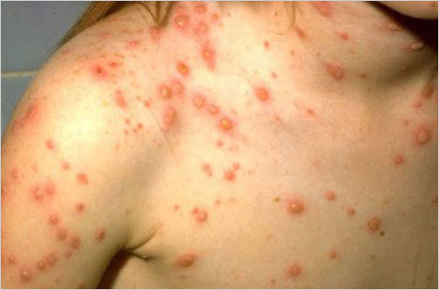
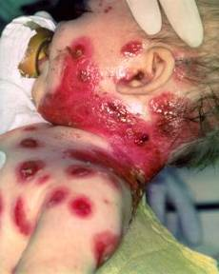
Varicella
(Chickenpox)
© Copyright American Academy of Pediatrics
ACIP recommends 2 doses of Varicella Vaccine
Dose 1 @ 12 months through 15 months of age
Dose 2 @ 4 through 6 years of age*
Those 13 years of age or older without evidence of immunity should receive 2 doses separated by 4 to 8 weeks.
*Second dose can be administered at an earlier age provided the interval between the first and second dose is at least 3 months.
MMWR, June 22, 2007, Vol 56, #RR-04
Notes:
Slide shows a child with typical varicella rash and infant with secondary bacterial infected varicella lesions, probably due to staph or strep
Chicken pox or varicella is caused by the varicella zoster virus
Prior to licensure of varicella vaccine approximately 100 previously healthy children died from chicken pox each year
Newborns are in the highest risk group if maternal rash is 5 days before or 2 days after delivery
Adults are 25 times more likely to die than children
Varicella Vaccine:
Live attenuated virus vaccine licensed in Japan and Korea in 1988, and in U.S. in 1995
One dose of vaccine is 85% effective; two doses provide nearly 88-98% efficacy.
Breakthrough chicken pox may occur in individuals who have received the vaccine
All cases of breakthrough chicken pox have been mild
Vaccine may be effective in preventing illness if given within 3 days and possibly up to 5 days after exposure.
Children who were up-to-date with one dose of varicella vaccine prior to starting school may not have received the second dose, so should receive it as soon as possible.
Reference: Prevention of Varicella - Recommendations of the Advisory Committee on Immunization
Practices (ACIP) MMWR (2007);56(No. RR-4):23

Slide 19
Acceptable Evidence of
Varicella Immunity
Written documentation of age-appropriate vaccination
Laboratory evidence of immunity or laboratory confirmation of varicella disease
U.S.-born before 1980*
Healthcare provider diagnosis or verification of varicella disease
History of herpes zoster based on healthcare provider diagnosis.
* Birth year immunity criterion does not apply to healthcare personnel or pregnant women
MMWR 2007;56(RR-4); 16-17

Slide 20
ACIP Recommendations for use of
MMRV (ProQuad®)
Licensed for ages 12 months through 12 years
Dose 1 at ages 12 through 47 months
Either MMR and varicella vaccines or MMRV vaccine can be used.
Providers who are considering administering MMRV should discuss the benefits and risks of both vaccination options with the parent or caregiver, since MMRV can lead to 1 extra febrile seizure for every 2300-2600 vaccinations.
Unless the parent or caregiver expresses a preference for MMRV vaccine, CDC recommends that MMR vaccine and varicella vaccines should be administered for the first dose in this age group.
Dose 1 or 2 given at ages 48 months and older
MMRV vaccine generally is preferred over separate injections of its equivalent component vaccines (i.e., MMR and varicella vaccines).
MMWR, May 7, 2010, Vol 59, #RR03
Notes:
Dose 1 at Ages 12 through 47 Months
For the first dose of measles, mumps, rubella, and varicella vaccines at ages 12 through 47 months, either MMR and varicella vaccines or MMRV vaccine can be used. Providers who are considering administering MMRV vaccine should discuss the benefits and risks of both vaccination options with the parents or caregivers. Compared with use of MMR and varicella vaccines at the same visit, use of MMRV vaccine results in one fewer injection but is associated with a higher risk for fever and febrile seizures 5 through 12 days after the first dose among children aged 12 through 23 months* (about one extra febrile seizure for every 2,300–2,600 MMRV vaccine doses). Use of MMR and varicella vaccines avoids this increased risk for fever and febrile seizures following MMRV vaccine. Providers who face barriers to clearly communicating these benefits and risks for any reason (e.g., language barriers) should administer MMR and varicella vaccines.
Dose 1 at Ages 48 Months and Older and Dose 2 at any Age
For the first dose of measles, mumps, rubella, and varicella vaccines at ages 48 months and older and for dose 2 at any age (15 months through 12 years), use of MMRV vaccine generally is preferred over separate injections of its equivalent component vaccines (i.e., MMR and varicella vaccines). Considerations should include provider assessment†, patient preference, and the potential for adverse events.
Of note, the routinely recommended ages for measles, mumps, rubella and varicella vaccination continue to be 12 through 15 months of age for dose 1 and 4 through 6 years of age for dose 2.
Other MMRV Vaccine-related Guidance
New precaution for MMRV Vaccine Use
A personal or family (i.e., sibling, parent) history of seizures is a precaution for MMRV vaccination. Studies suggest that children who have a personal or family history of febrile seizures or family history of epilepsy are at increased risk for febrile seizures compared with children who do not have such histories. Children with a personal or family history of seizures generally should be vaccinated with MMR and varicella vaccines because the risks of using MMRV vaccine in this group of children generally outweigh the benefit of MMRV vaccine.
CDC has developed materials to help with the implementation of the updated recommendations for use of MMRV vaccine:
www.cdc.gov/vaccines/vpd-vac/combo-vaccines/mmrv/vacopt.htm
* The 47 month cut-off was chosen on the basis of the epidemiology of febrile seizures: first febrile seizures are uncommon after age 4 years, approximately 94% of febrile seizures occur in children aged less than 4 years.
† Provider assessment should include the number of injections, vaccine availability, likelihood of improved coverage, likelihood of patient return, and storage and cost consideration.

Slide 21
Pneumococcal Conjugate Vaccine for Children (PCV13)
ACIP recommends PCV13 for:
  All children 2 through 59 months of age
  Children 60 through 71 months who have underlying medical conditions that increase their risk of pneumococcal disease or complications and have not previously received PCV13
  Children and adolescents aged 6 through 18 years with:
    immunocompromising conditions
    functional or anatomic asplenia
    CSF leaks or cochlear implants,
    solid organ transplants or chronic renal failure
    who have not previously received PCV13
MMWR, December 10, 2010, Vo1 59, #RR-11 MMWR, June 28, 2013, Vol 62, #25
Notes:
The number of doses of PCV13 recommended will depend on the age of the child and the number of doses of PCV7 given previously. Practitioners should refer to the detailed ACIP recommendations/guidelines for each child.
*Particularly cyanotic congenital heart disease and cardiac failure
† Including asthma if treated with prolonged high-dose oral corticosteroids
§ Includes B- (humoral) or T-lymphocyte deficiency; complement deficiencies, particularly C1, C2, C3, and C4 deficiency; and phagocytic disorders (excluding chronic granulomatous disease)
EPIC 2017

Slide 22
Pneumococcal Polysaccharide Vaccine for Children (PPSV23)
ACIP recommends PPSV23 for children 2 years and older with:
Underlying medical conditions:
  Sickle cell disease, functional or anatomic asplenia, immunocompromising conditions
  These children should receive a second dose of vaccine 5 years after the first dose of PPSV23
Immunocompetent children with chronic illness:
  heart disease, chronic lung disease, diabetes mellitus, CSF leaks, or cochlear implant
Administer ≥8 weeks after last indicated dose of PCV13
MMWR, December 10, 2010, Vo1 59, #RR-11

Slide 23

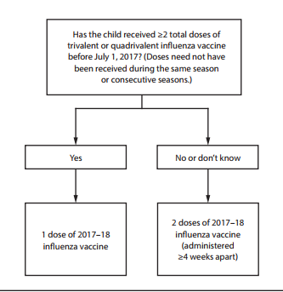
FDA Recommended Influenza Antigens
for 2017-2018 Season in the U.S.
Trivalent Vaccines (IIV3):
A/Michigan/45/2015 (H1N1) (NEW)
  A/Hong Kong/4801/2014 (H3N2)-like virus B/Brisbane/60/2008-like virus
Quadrivalent Vaccines (IIV4) also include:
B/Phuket/3073/2013-like virus
ACIP recommends annual influenza vaccine for all persons 6 months of age and older who do not have contraindications.
Recommendations and Reports Vol. 66 / No. 2
MMWR / August 25, 2017
Notes:
The Food and Drug Administration's Vaccines and Related Biologics Advisory Committee (VRBPAC) endorsed the WHO-recommended vaccine viruses for use in all U.S. seasonal flu vaccines for the 2017-2018 flu season.
Centers for Disease Control and Prevention, National Center for Immunization and Respiratory Diseases (NCIRD)

Slide 24
Influenza Vaccines for 2017-2018 Season
≥ 6 months | ≥ 3 years | ≥ 4 years | ≥ 5 years | ≥ 18 years | ≥ 65 years
Fluzone (IIV4) 6-35 mos—0.25 ml dose | Fluarix (IIV4) | Fluvirin (IIV3) | Afluria (IIV3) | FluBlok (RIV3 & RIV4) ** | Fluzone High-Dose (IIV3)
FluLaval (IIV4) 6 mos. and older--- 0.5 ml dose |  | Flucelvax (ccIIV4)* |  | Afluria (IIV4) | Fluad (aIIV3)
 |  |  |  | Fluzone Intradermal (IIV4) Ages 18-64 yrs.
*Cell-cultured **Recombinant
Ref: Centers for Disease Control and Prevention, National Center for Immunization and Respiratory Diseases (NCIRD). https://www.cdc.gov/mmwr/volumes/66/rr/rr6602a1.htm
Notes:
Flu vaccines for 2017-2018.
Changes in red on the table:
Afluria now licensed for persons 5 yrs. and older
FluBlok comes as trivalent and quadrivalent
Afluria has a vaccine licensed just for those 18 yrs. and older
Dosage note:
Fluzone for 6-35 mo. old children-----0.25 ml
FluLaval for 6 mo. and older children---0.5 ml

Slide 25
Live, Attenuated Influenza Vaccine (LAIV4)
  FluMist® MedImmune (Nasal Spray)
  licensed for healthy persons 2 through 49 years of age
ACIP recommendation
Due to poor effectiveness in past 3 seasons and concerns regarding the effectiveness against A(H1N1) viruses:
LAIV4 should not be used in the 2017-2018 season.
Currently only IIV provides protection against influenza and should be used for all persons
6 months and older who do not have contraindications.
MMWR 66(2); 1-24, August 25, 2017
Notes:
Studies demonstrated that LAIV did not work in the 2013-'14 influenza season when the primary strain was the 2009 pandemic influenza A(H1N1) strain, in 2014-'15 when the primary circulating strain was a drifted A(H3N2) virus, or the 2015-'16 season when the primary circulating strain was again the 2009 pandemic influenza A(H1N1) strain. With knowledge that LAIV had no protective benefit during the past three influenza seasons, ACIP does not recommend its use in the upcoming 2017-'18 influenza season.
The AAP Committee on Infectious Diseases and the Board of Directors all had reached the same conclusion about not using LAIV for the upcoming influenza season.

Slide 26
Influenza Vaccination of Persons with a History of Egg Allergy
Persons with a history of egg allergy who have had only hives after exposure to eggs should receive influenza vaccine.
Persons who report having had reactions to eggs such as angioedema, respiratory distress, lightheadedness, or recurrent emesis; or who required epinephrine or another emergency medical intervention may receive influenza vaccine. Vaccine should be administered in a medical setting supervised by a healthcare provider who is able to recognize and manage severe allergic conditions.
A previous severe allergic reaction to influenza vaccine is a contraindication to future receipt of the vaccine.
Recommendations and Reports Vol. 65 / No. 5 MMWR / August 26, 2016
Notes:
Recent studies with IIV and LAIV have indicated that a severe allergic reaction to egg-based influenza vaccine in a person with an egg allergy is very unlikely. Numerous studies have looked at egg-allergic patients receiving IIV3, LAIV in which mild allergic reactions occur and no anaphylactic reaction occurrences.
For the 2016-17 influenza season the ACIP has recommended If a person has a history of egg allergy and only experiences mild symptoms such as hives they can receive the flu vaccine. If they have experienced any other symptoms (angioedema, resp. distress) the flu vaccine should be administered in an appropriate medical setting and supervised by a health care provider who can manage emergent situation. If a patient has suffered a previous severe allergic reaction after receipt of the flu vaccine it is a contraindication and should not be administered.
Reference: MMWR. Prevention and Control of Seasonal Influenza with Vaccines Recommendations of the Advisory Committee on Immunization Practices-United, 2016-17 Influenza Season. August 26, 2016, Vol. 65; No. 5
EPIC 2017

Slide 27
Hepatitis A Vaccine for Children
ACIP recommends 2 doses of hepatitis A vaccine for:
All children 12 through 23 months of age
(Separate the 2 doses by 6 to 18 months)
Any child or adolescent 2 through 18 years, who has not previously received the vaccine, can receive the vaccine at subsequent visits.
      Caretakers who will have contact with adoptees from countries with high rates of hepatitis A if contact will be within 60 days of arrival in U.S. The first dose of the 2-dose series should be given as soon as adoption is planned.
MMWR, May 19, 2006, Vol 55, #RR-07
Notes:
In October 2005 the ACIP voted to approve the following recommendations for Hepatitis A Vaccination of Children:
All children should receive hepatitis A vaccine at 1 year of age (i.e., 12 through 23 months). Vaccination should be completed according to the recommended schedules and integrated into the routine childhood and adolescent vaccination schedule. Children who are not vaccinated by 2 years of age can be vaccinated at subsequent visits. Catch-up vaccination of unvaccinated children aged 2 through 18 years can be considered if immunity to hepatitis A is desired.
References:
1. Prevention of Hepatitis A Through Active or Passive Immunization - Recommendations of the Advisory Committee on Immunization Practices (ACIP) MMWR Vol. 55/No. RR-7 May 19, 2006
2. Notice To Readers: FDA Approval of VAQTA® (Hepatitis A Vaccine, Inactivated) for Children Aged >1 Year MMWR 54(40);1026 October 14, 2005
3. Notice to Readers: FDA Approval of Havrix® (Hepatitis A Vaccine, Inactivated) for Persons Aged 1--18 Years MMWR 54(48);1235-1236 December 9, 2005

Slide 28
Hepatitis B
Transmission:
1. Percutaneous or mucosal exposure to blood or body fluids including contaminated surfaces, or exposure by sexual contact
2. Perinatal infection from HBsAg + mother
ACIP recommends hepatitis B vaccine for:
All newborns , to be administered “within 24 hours” of birth, using single antigen vaccine; Dose 2 at 1-2 mos. of age and Dose 3 at 6-18 mos. of age.
All children and adolescents less than 19 years of age who did not complete the series as an infant.
MMWR, December 23, 2005, Vol 54, #RR16, MMWR, December 8, 2006, Vol 55, #RR16 , MMWR, December 22, 2011 Vol 60 , #50 Recommended Immunization Schedule for Persons Age 0 Through 18 Years, United States, 2017
Notes:
Incubation period from time of infection to onset of symptoms is 45 to 160 days (average, 90 days)
Approximately 10% of acute hepatitis B infections progress to chronic Hepatitis B infection.
90% of infants and 30-50% of children 1-5 years of age with acute hepatitis B infection become carriers
Many with chronic infection are asymptomatic. Chronic infection may progress to cirrhosis, liver failure & hepatocellular carcinoma
Timing for Doses 2 and 3 of infant series added to 1st bullet.
All pregnant women should be tested routinely for HBsAg
90% of healthy adults & 95% of infants, children & adolescents develop adequate antibody response after a complete series
If no antibody response after 6 doses, person is a non-responder and is susceptible to hepatitis B
Booster doses NOT recommended for any age group
References:
1. A Comprehensive Immunization Strategy to Eliminate Transmission of Hepatitis B Virus Infection in the United States. Recommendations of the Advisory Committee on Immunization Practices (ACIP) Part 1: Immunization of Infants, Children and Adolescents MMWR Vol. 54/ No. RR-16 December 23, 2005
2. A Comprehensive Immunization Strategy to Eliminate Transmission of Hepatitis B Virus Infection in the United States. Recommendations of the Advisory Committee on Immunization Practices (ACIP) Part 2: Immunization of Adults MMWR Vol. 55/ No. RR-16 December 8, 2006

Slide 29
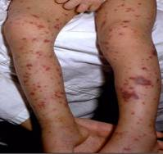
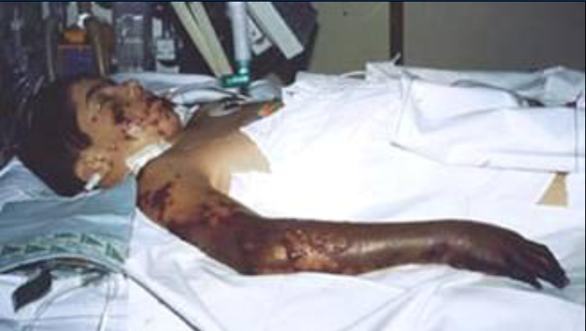
Meningococcal Disease
(caused by N. meningitidis)
Meningitis
~50% of cases 9-10% fatality rate
Meningococcemia
5%-20% of cases Up to 40% fatality rate
Rash
Vascular damage
Disseminated intravascular coagulation
Multi-organ failure
Shock
Death can occur in 24 hours
Photo courtesy CDC: Dr. Brodsky & Mr. Gust
11-19% of survivors have permanent sequelae
Ref: 1. Epidemiology and Prevention of Vaccine-Preventable Diseases. 13th Edition, 2015.
2. AAP Red Book 2015
Notes:
The most common clinical presentations of meningococcal disease are meningitis and meningococcemia.
Neisseria meningitides contains 13 serogroups, the most common being A, B, C,
W-135, and Y.
About 5-10% of adults are asymptomatic nasopharyngeal carriers of this organism.
Individuals with meningococcemia may die within 24 hours of the onset of symptoms even with prompt treatment with appropriate antimicrobials and supportive care in an intensive care unit.
Reference: 1. Epidemiology and Prevention of Vaccine-Preventable Diseases, 13th edition. 2015 HHS, CDC.
2. AAP Redbook 2015
3. Meningococcal Disease. About the Disease. http://www.cdc.gov/meningococcal/about/index.html

Slide 30
Meningococcal Conjugate Vaccine (MCV4)
(Men A,C,Y, W-135)
Menactra™ licensed for 9 mos. through 55 years
Menveo® licensed for ages 2 mos. through 55 years
ACIP recommends:
  First dose at age 11 or 12 years and a booster dose at 16 years.
  If first dose is at 13-15 years, give booster dose 5 years after the first dose or sooner, but after age 16 if entering college or technical school.
  If first dose is received ≥ 16 years of age, a 2nd dose is not needed.
  Persons aged 21 years or younger attending school or college should have documentation of one dose of MVC4 not more than 5 years before enrollment.
MMWR, March 22, 2013, Vol 62, #RR02
Notes:
Recommendation for Routine Vaccination of Persons Aged 11 Through 18 Years
After a booster dose of meningococcal conjugate vaccine, antibody titers are higher than after the first dose and are expected to protect adolescents through the period of increased risk through age 21 years. Persons who receive their first dose of meningococcal conjugate vaccine at or after age 16 years do not need a booster dose. Routine vaccination of healthy persons who are not at increased risk for exposure to N. meningitidis is not recommended after age 21 years.
CDC Guidance for Transition to an Adolescent Booster Dose
Some schools, colleges, and universities have policies requiring vaccination against meningococcal disease as a condition of enrollment. For ease of program implementation, persons aged 21 years or younger should have documentation of receipt of a dose of meningococcal conjugate vaccine not more than 5 years before enrollment. If the primary dose was administered before the 16th birthday, a booster dose should be administered before enrollment in college. The booster dose can be administered anytime after the 16th birthday to ensure that the booster is provided. The minimum interval between doses of meningococcal conjugate vaccine is 8 weeks.
No data are available on the interchangeability of vaccine products. Whenever feasible, the same brand of vaccine should be used for all doses of the vaccination series. If vaccination providers do not know or have available the type of vaccine product previously administered, any product should be used to continue or complete the series.
Recommendations for Adults 56 years and older
MPSV4 is the only licensed meningococcal vaccine for adults aged ≥56 years and is immunogenic in older adults. For adults who have received MenACWY previously, limited data demonstrate a higher antibody response after a subsequent dose of MenACWY compared with a subsequent dose of MPSV4. For meningococcal vaccine-naïve persons aged ≥56 years who anticipate requiring a single dose of meningococcal vaccine (e.g., travelers and persons at risk as a result of a community outbreak), MPSV4 is preferred. For persons now aged ≥56 years who were vaccinated previously with MenACWY and are recommended for revaccination or for whom multiple doses are anticipated (e.g., persons with asplenia and microbiologists), MenACWY is preferred.
Ref. 1. Prevention and Control of Meningococcal Disease - Recommendations of the Advisory Committee on Immunization Practices (ACIP) MMWR / March 22, 2013 / Vol. 62 / No. 2
2. Recommendation of the ACIP for Use of Quadrivalent Meningococcal Conjugate Vaccine (MenACWY-D) Among Children Aged 9 Through 23 Months at Increased Risk for Invasive Meningococcal Disease MMWR; October 14, 2011 / 60(40);1391-1392

Slide 31
Meningococcal Vaccines for High Risk
Persons 6 weeks – 55 years
Menveo® (Men A,C,Y, W-135) licensed for ages 2 mos. through 55 years
Menactra^{™ (}(Men A,C,Y, W-135) licensed for 9 mos. through 55 years
Recommended for persons 6 weeks through 55 years:
human immunodeficiency virus (HIV)
complement component deficiency
functional or anatomic asplenia (sickle cell disease)
microbiologists exposed to isolates of N. meningitidis
part of a community outbreak due to vaccine serogroups
persons traveling internationally to regions with endemic meningococcal disease
For details on doses and schedule refer to the current Immunization Schedule
MMWR, June 20, 2014, Vol 63 #24 MMWR, March 22, 2013, Vol 62, #RR02 MMWR, November 4, 2016, Vol 65 #43
Notes:
June 2016, ACIP recommended routine use of meningococcal conjugate vaccine for persons ages >2 months with human immunodeficiency virus infection. The majority of meningococcal disease among HIV-infected persons is caused by these four serogroups.
The same vaccine product should be used for all doses. ACIP recommends HIC-infected infants 2 through 23 months should receive MenACWY-CRM (Menveo). HIV-infected children < 2 years should not receive MenACWY-D(Menactra) due to immune interference with PCV13.
Reference:
MMWR, November 4, 2016, Vol 65(43).

Slide 32
Serogroup B Meningococcal Vaccine
Bexsero® licensed for ages 10 through 25 years (2 dose)
Trumenba® licensed for ages 10 through 25 years (2 or 3 dose)
ACIP recommends serogroup B meningococcal vaccine for:
Persons with persistent complement component deficiencies
Persons with anatomic or functional asplenia
Microbiologists routinely exposed to isolates of Neisseria meningitidis
Persons identified to be at increased risk because of a serogroup B meningococcal disease outbreak
The 2 vaccine products are not interchangeable.
(Category B – Permissive recommendation)#
A Men B vaccine series may be administered to adolescents and young adults 16 through 23 years of age to provide short-term protection against most strains of Men B. Preferred age is 16-18 years.
MMWR; June 12, 2015 ,Vol. 64 #22; 608-611
# MMWR; October 23, 2015, Vol .64 #41; 1171-1176
Notes:
“MenB vaccine should be administered as either a 2-dose series of MenB-4C or a 3-dose series of MenB-FHbp. The same vaccine product should be used for all doses.“
On February 26, 2015 the ACIP approved for MenB vaccines be recommended for the use among persons aged >10 years at increased risk for serogroup B meningococcal disease. This recommendation was designated a Category A (recommended for all persons in the age-based risk factor group).
The ACIP determined that insufficient evidence existed to routinely recommend that all adolescents be vaccinated with MenB vaccines. ACIP agreed that the information provided would allow each individual health care professional to use clinical decision making when recommending the vaccine. A Category B recommendation was made. MenB vaccine series may be administered to young adults 16-23 years of age to provide short-term protection against most strains of MenB.
References:
MMWR; October 23, 2015, Vol .64 #41; 1171-1176.
MMWR: June 12, 2015, Vol. 64 #22; 608-611.

Slide 33
Serogroup B Meningococcal
Vaccine Administration
Bexsero® licensed for ages 10 through 25 years (2 dose)
Trumenba® licensed for ages 10 through 25 years (2 dose or 3 dose)
MenB-FHbp (Trumenba®)
  2 dose schedule – administered at 0, 6 months
  Given to healthy adolescents who are not at increased risk for meningococcal disease
  3 dose schedule – administered at 0, 1-2, 6 months
  Given to persons at increased risk for meningococcal disease and for use during serogroup B outbreaks
MenB-4C (Bexsero®)
  2 dose schedule – 0, 1-2 months

Slide 34
Meningococcal Vaccine Updates
The following vaccines have been discontinued:
MENHIBRIX® (Men C&Y + Hib) licensed for ages 6 weeks through 18 months
MENOMUNE® (A/C/Y/W-135) licensed for use in persons 2 years of age and older.
Notes:
EPIC 2017

Slide 35
Rotavirus Vaccines
RotaTeq® (Merck) and Rotarix® (GSK)
RotaTeq®: 3 doses; ages 2, 4, 6 months
Rotarix®: 2 doses; ages 2 and 4 months
ACIP recommends:
2-3 doses depending on brand
Administer either vaccine as directed below:
  Minimum age for first dose: 6 weeks
  Maximum age for first dose: 14 weeks 6 days
  Minimum interval between doses: 4 weeks
  Maximum age for last dose: 8 months 0 days
If any dose is Rotateq®, 3 doses are required
Use RotaTeq® if allergy to latex
MMWR, February 6, 2009, Vol 58, #RR-02
Notes:
The routine use of Rotavirus vaccine has resulted in a dramatic decrease in hospitalizations for the management of dehydration. In the developing world the use of the vaccine has dramatically reduced deaths from rotavirus infection.
Rotateq® (Merck & Co) is a live, oral pentavalent vaccine that contains 5 live reassortant rotaviruses. (G1, G2, G3 and G4.) It is referred to as RV5 rotavirus vaccine.
Ref: Rotateq® Prescribing Information December 2009
Rotarix® (GSK) is a live, oral, monovalent attenuated rotavirus vaccine. It is referred to as RV1 rotavirus vaccine. Ref: Rotarix® Prescribing Information October 2008
ACIP does not express a preference for RV5 or RV1.
Interchangeability of Rotavirus Vaccines
ACIP recommends that the rotavirus vaccine series be completed with the same product whenever possible. However, vaccination should not be deferred if the product used for previous doses is not available or is unknown. In this situation, the provider should continue or complete the series with the product available. If any dose in the series was RV5 or the product is unknown for any dose in the series, a total of three doses of rotavirus vaccine should be given.
Contraindications
Latex rubber is contained in the RV1 oral applicator, so infants with a severe (anaphylactic) allergy to latex should not receive RV1. The RV5 dosing tube is latex-free.
A virus (or parts of a virus) called porcine circovirus is present in both vaccines. There is no evidence that this virus is a safety risk or causes illness in humans².
Some studies have shown a small increase in cases of intussusception within one week after the first dose of rotavirus vaccine. The estimated risk is 1 case per 100,000 infants receiving the vaccine². However, the benefits of the vaccine outweigh the risk. Rotavirus vaccination is now contraindicated for 1) infants with a history of severe allergic reaction (e.g., anaphylaxis) after a previous dose of rotavirus vaccine or exposure to a vaccine component, 2) infants diagnosed with severe combined immunodeficiency (SCID), and 3) infants with a history of intussusception.
Reference: 1. Prevention of Rotavirus Gastroenteritis Among Infants and Children - Recommendations of the Advisory Committee on Immunization Practices (ACIP) MMWR; February 6, 2009 / 58(RR02);1-25
2. Rotavirus Vaccine Information Statement 08/26/2013
3. MMWR, October 21, 2011 / 60(41);1427-1427

Slide 36
Types of Human Papilloma Virus (HPV)
(More Than 150 Types Identified)
Mucosal/Genital
~40 types
Cutaneous
High risk types
16, 18, 31, 33, 45, 52, 58
(and others)
Low risk types
6, 11 and others
Cervical cancer
Anogenital cancer
Oropharyngeal Cancer
Cancer precursors
Low grade cervical disease
Genital Warts
Laryngeal Papillomas
Low grade cervical disease
Skin warts
Hands and Feet
Ref: 1.Epidemiology and Prevention of Vaccine Preventable Diseases 13th Edition, 2015
2. Red Book – AAP 2015 Report of the Committee on Infectious Diseases
3. MMWR, August 29, 2014, RR Vol. 63, No. 5

Slide 37
HPV Vaccines
Gardasil 9® (9vHPV) HPV types 6, 11, 16, 18, 31, 33, 45, 52, 58
(CERVARIX™ & GARDASIL 4® are no longer available
in the U.S. as of December, 2016)
ACIP recommends HPV vaccine starting at age 11 or 12 years for:
All females through 26 years of age
All males through 21 years of age
Men 22 through 26 years who have sex with men or have an immunocompromising condition.
All other males 22 through 26 years.
Series can be completed with 9vHPV if started with 2v or 4v.
MMWR, March 27, 2015, Vo1 64, No. 11
MMWR, December 16, 2016, Vol 65, No. 49
Notes:
Recommendations for Use of HPV Vaccines
ACIP recommends that routine HPV vaccination be initiated at age 11 or 12 years. The vaccination series can be started beginning at age 9 years.
† Vaccination is also recommended through age 26 years for men who have sex with men and for immunocompromised persons (including those with HIV infection) if not vaccinated previously.
As of December 2016, 2vHPV and 4vHPV are no longer available in the United States. No ACIP recommendation for routine additional vaccination with Gardasil 9 for persons who have completed a 3-dose vaccination series with other HPV vaccines.
References:
2017 Supplement to Epidemiology and Prevention of Vaccine-Preventable Diseases, 13th Edition (the Pink Book)
MMWR, December 16, 2016, Vol 65, No. 49

Slide 38
2 Dose Schedule:
HPV vaccine initiated between 9-14 years can be given in two doses: 0, 6-12 months.
(If the 2nd dose is administered at least 5 months after 1st dose, it can be counted).
3 Dose Schedule:
HPV vaccine initiated after the 15th birthday or certain immunocompromising conditions should be vaccinated with the 3 dose schedule: 0, 1-2, 6 months
(Dose 2 should be given at least 1 to 2 months after first dose (1 month minimum); Dose 3 should be given at least 6 months after the first dose
(minimum of 3 months between dose 2 and 3)
ACIP Recommendations and Schedule
Reference: 2017 Supplement to Epidemiology and Prevention of Vaccine-Preventable Diseases, 13th Edition (the Pink Book)
Notes:
The ACIP meeting October 2016, approved the recommendation for a 2 dose vaccination schedule for HPV. The 2 dose schedule is only for adolescents that initiate the vaccine before the 15th birthday. If one-dose of the vaccine is administered before the 15th birthday and they turn 15 before receiving their 2nd dose, the two dose series can still be applied.
References:
2017 Supplement to Epidemiology and Prevention of Vaccine-Preventable Diseases, 13th Edition (the Pink Book)
EPIC 2017

Slide 39
Top 5 reasons for not vaccinating daughter, among parents with no intention to vaccinate their child against HPV
** Did not know much about HPV or HPV vaccine.
CDC. Human papillomavirus vaccination coverage among adolescents, 2007-2013. Postlicensure vaccine safety monitoring, 2006-2014-U.S.
Notes:
This slide shows the responses that parents gave when asked why they would not be getting the HPV vaccine for their daughter in the next year.
Three reasons that parents provided—lack of knowledge, not needed, and not sexually active—all demonstrate a lack of understanding on the part of the parent, especially why it is important to vaccinate at ages 11 or 12. Parents need to be told that HPV vaccine is cancer prevention and that it must be given prior to exposure.
Safety concerns can be alleviated by sharing the tremendous amount of data before and after the vaccine was licensed that demonstrate that HPV vaccine is safe.
Some of the reasons that encouraged parents to accept HPV immunization included 1) family history of cervical cancer of HPV infection 2) family and community support 3) education on HPV vaccine 4) healthcare provider access to an immunization registry. Healthcare provider recommendation was the strongest predictor of HPV vaccine initiation.
Encourage Parents To Immunize a Pre-teen or Adolescent
Try saying:
Your child needs three shots today that will prevent tetanus, diphtheria, whooping cough, and one type of meningitis and protect him/her from many cancers caused by HPV.
HPV vaccine produces a better immune response in preteens than it does in older teens and young women. I strongly believe in the importance of this cancer-preventing vaccine.
Reference:
1. Bernstein, H. DO, Bocchini, J. MD. Pediatrics: The Need to Optimize Adolescent Immunization, March 2017; Vol 139, No. 3.

Slide 40
Estimated Vaccination Coverage Among
Adolescents Aged 13 – 17 Years - 2016
National Immunization Survey-Teen (NIS-Teen), United States, 2016. MMWR/August 25. 2017/ Vol.66/No. 33
Notes:
For 2016 coverage rates among adolescents aged 13-17 in the U.S. increased slightly for all vaccines indicated. GA rates are at or above the national average.
Even with these gains HPV vaccination coverage remained lower that MenACWY and Tdap coverage rates which give the indication that providers are continuing to miss opportunities for HPV vaccination.
Reference:
National Immunization Survey-Teen (NIS-Teen), United States, 2016. MMWR/August 25. 2017/ Vol.66/No. 33

Slide 41
Reasons to Immunize Against HPV at 11-12 Years of Age
Higher antibody level attained when given to pre-teens rather than to older adolescents or women
At this age, more likely to be administered before onset of sexual activity
HPV can be transmitted by other skin-to-skin contact, not just sexual intercourse
There is no link between vaccine and riskier sexual behavior.
Even those who abstain from sex until marriage can be infected by their marital partner
Individuals need to complete the series for full protection
This is an anti-cancer vaccine
Presentation by Anne Schuchat, MD, RADM US Public Health Service, Assistant Surgeon General, Director National Center for Immunization and Respiratory Diseases at Immunize Georgia Conference, Atlanta, GA September 11, 2014
Gable, J., Eder, J., Noonan, K. and Feemstar, K. Increasing HPV Vaccination Rates Among Adolescents: Challenges and Opportunities. PolicyLab: The Children’s Hospital of Philadelphia, 2016.
Notes:
Providers are less likely to recommend the HPV vaccine to their younger adolescent patients. They may be more comfortable reserving their recommendation for older teens, rather than for 11- and 12-year-olds. Providing clinicians with information about vaccine safety and efficacy to share with parents may increase endorsement of current HPV vaccine recommendations. ​
​
HPV vaccine should be recommended the same way other vaccines (Tdap, influenza and meningococcal) are recommended.​
Provide information about giving vaccine at a young age to increase immune response and protect before sexual activity begins​
​
Reference: Gable, J.,Eder, J., Noonan, K. and Feemstar, K. Increasing HPV Vaccination Rates Among Adolescents: Challenges and Opportunities. PolicyLab: The Children’s Hospital of Philadelphia, 2016.​

Slide 42
Improve HPV Immunization Rates in Your Practice
RECOMMEND HPV Vaccine along with Tdap and meningococcal vaccine
Stress Cancer Prevention
Give Vaccine Prior to Potential Exposure to the Virus
Address Safety Concerns
Text, phone and/or Email patient/family as a reminder to complete HPV series
Remember this is part of routine adolescent care

Slide 43

Critical Elements for
Immunization Services
Celebrating 16 years

Slide 44
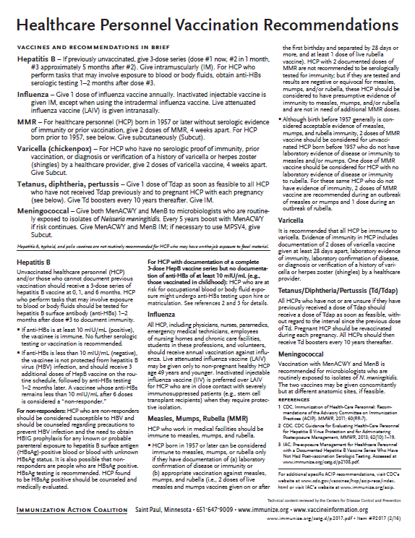
Recommended Healthcare Personnel Vaccinations
Hepatitis B
Influenza
Measles, Mumps, Rubella (MMR)
Varicella (Chickenpox)
Tetanus, Diphtheria, Pertussis (Tdap)
Meningococcal (recommended for microbiologists who are routinely exposed to isolates of N. meningitidis).
Are YOU up to date?
Available at www.immunize.org, P#2017
Notes:
Un-immunized HCP
Un-immunized healthcare workers are at risk of infecting patients, family members and community contacts
Immunized HCP
Protect patients from VPD’s
Help offices avoid potential liability cases. (The practice can be liable if an unimmunized HCP becomes infected with a vaccine preventable disease and infects a patient.)
Maintain productivity
Reduce illness and illness-related absenteeism
Evidence of Immunity to MMR
Documented administration of two doses of measles and mumps vaccine and one dose of rubella vaccine OR
Laboratory evidence of immunity or laboratory confirmation of disease (measles, mumps and rubella) OR
Born before 1957 (measles, mumps and rubella)
Because of their contact with patients or infective material from patients, many HCP are at risk for exposure to (and possible transmission of) vaccine-preventable diseases. Employers and HCP have a shared responsibility to prevent occupationally acquired infections and avoid causing harm to patients by taking reasonable precautions to prevent transmission of vaccine-preventable diseases.
Optimal use of recommended vaccines helps maintain immunity and safeguard HCP from infection, thereby helping protect patients from becoming infected. The recommendations for vaccination of HCP are presented in two categories: 1) those diseases for which routine vaccination or documentation of immunity is recommended for HCP because of risks to HCP in their work settings and, should HCP become infected, to the patients they serve and 2) those diseases for which vaccination of HCP might be indicated in certain circumstances. Vaccines recommended in the first category are hepatitis B, seasonal influenza, measles, mumps, and rubella, pertussis, and varicella vaccines. Vaccines in the second category are meningococcal, typhoid, and polio vaccines.
1. General Recommendations on Immunization, Recommendations of the Advisory Committee on Immunization Practices (ACIP). MMWR (RR-2); January 28, 2011
MMWR; November 25, 2011 / 60(RR07);1-45

Slide 45
PRE-EXPOSURE EVALUATION FOR HEALTH-CARE PERSONNEL
PREVIOUSLY VACCINATED WITH COMPLETE, ≥3-DOSES OF HEP B VACCINE
SERIES WHO HAVE NOT HAD POSTVACCINATION SEROLOGIC TESTING
Measure antibody to hepatitis B surface antigen (anti-HBs) anti-HBs ≥10 mIU/mL
Below adequate level
anti-HBs ≥10mIU/mL
1 dose of HepB vaccine,
4-6 wks.--- serologic testing
No Action for
Hepatitis B prophylaxis
(regardless of source patient hepatitis B surface antigen status)
Below adequate level
At or above adequate level
2 more doses of HepB vaccine,
4-6 wks.--- serologic testing
Vaccinated HCP whose anti-HBs remains <10 mIU/mL after revaccination (i.e., after receiving a total of 6 doses) should be tested for HBsAg and anti-HBc to determine infection status.
Below adequate level
At or above adequate level
HCP need to receive hepatitis B evaluation for all exposures
MMWR, December 20, 2013, Vol 62. RR # 10
Notes:
Postvaccination Serologic Testing
Testing unvaccinated HCP for HBV infection is not generally indicated for persons being evaluated for hepatitis B protection because of occupational risk.
Prevaccination serologic testing is indicated for:
all persons born in geographic regions with HBsAg prevalence of ≥2% (e.g., much of Eastern Europe, Asia, Africa, the Middle East, and the Pacific Islands)
certain indigenous populations from countries with overall low HBV endemicity (<2%)
persons with behavioral exposures to HBV (e.g., men who have sex with men and past or current injection drug users)
persons receiving cytotoxic or immunosuppressive therapy
persons with liver disease of unknown etiology.
Testing HCP at risk for HBV infection should consist of a serologic assay for HBsAg, in addition to either anti-HBc or anti-HBs. For unvaccinated HCP at risk for previous HBV infection, blood should be drawn for testing before the first dose of vaccine is administered.
HCP who have written documentation of a complete, ≥3-dose HepB vaccine series and subsequent postvaccination anti-HBs ≥10 mIU/mL are considered hepatitis B immune. Immunocompetent persons have long-term protection against HBV and do not need further periodic testing to assess anti-HBs levels.
All HCP recently vaccinated or recently completing HepB vaccination who are at risk for occupational blood or body fluid exposure should undergo anti-HBs testing. Anti-HBs testing should be performed 1–2 months after administration of the last dose of the vaccine series when possible. HCP with documentation of a complete ≥3-dose HepB vaccine series but no documentation of anti-HBs ≥10 mIU/mL who are at risk for occupational blood or body fluid exposure might undergo anti-HBs testing upon hire or matriculation. Testing should use a quantitative method that allows detection of the protective concentration of anti-HBs (≥10 mIU/mL) (e.g., enzyme-linked immunosorbent assay [ELISA]).
Completely vaccinated HCP with anti-HBs ≥10 mIU/mL are considered hepatitis B immune. Immunocompetent persons have long-term protection and do not need further periodic testing to assess anti-HBs levels.
Completely vaccinated HCP with anti-HBs <10 mIU/mL should receive an additional dose of HepB vaccine, followed by anti-HBs testing 1–2 months later. HCP whose anti-HBs remains <10 mIU/mL should receive 2 additional
vaccine doses (usually 6 doses total), followed by repeat anti-HBs testing 1–2 months after the last dose. Alternatively, it might be more practical for very recently vaccinated HCP with anti-HBs <10 mIU/mL to receive 3 consecutive additional doses of HepB vaccine (usually 6 doses total), followed by anti-HBs testing 1–2 months after the last dose.
References: 1. General Recommendations on Immunization, Recommendations of the Advisory Committee on Immunization Practices (ACIP). MMWR (RR-2); January 28, 2011
2. Immunization of Health-Care Personnel: Recommendations of ACIP MMWR; November 25, 2011 / 60(RR07);1-45
3. CDC Guidance for Evaluating Health-Care Personnel for Hepatitis B Virus Protection and for Administering Postexposure Management (Recommendations and Reports / Vol. 62 / No. 10 December 20, 2013)
Ref: CDC Guidance for Evaluating Health-Care Personnel for Hepatitis B Virus Protection and for Administering Post Exposure Management MMWR Recommendations and Reports /Vol. 62/No. 10 December 20, 2013

Slide 46
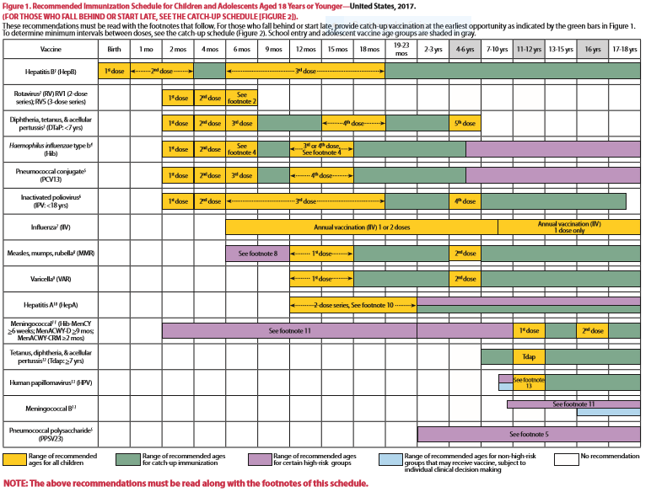
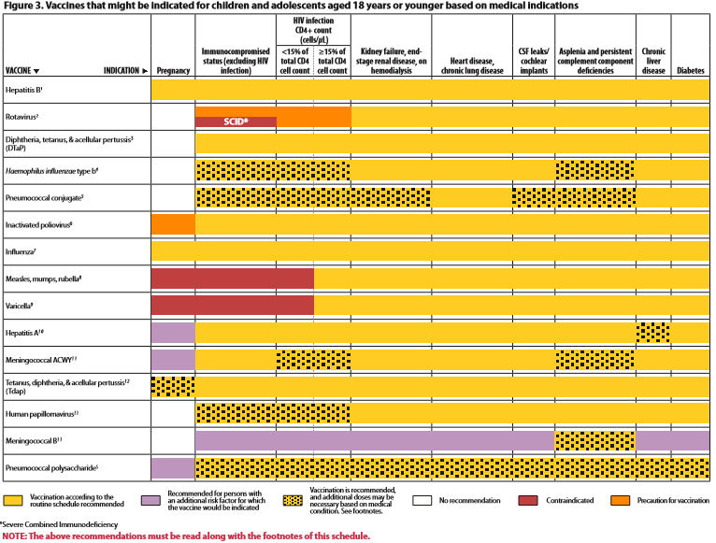
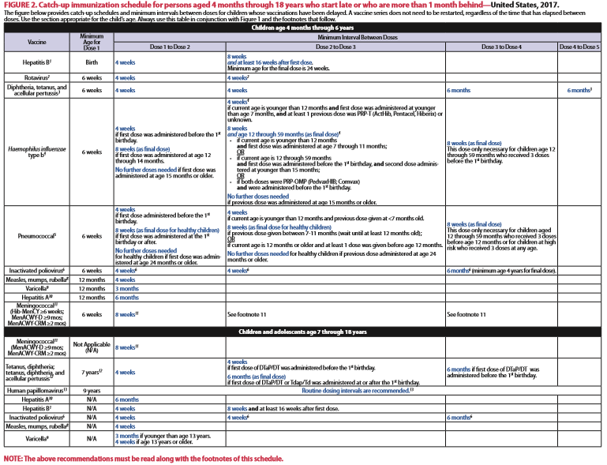
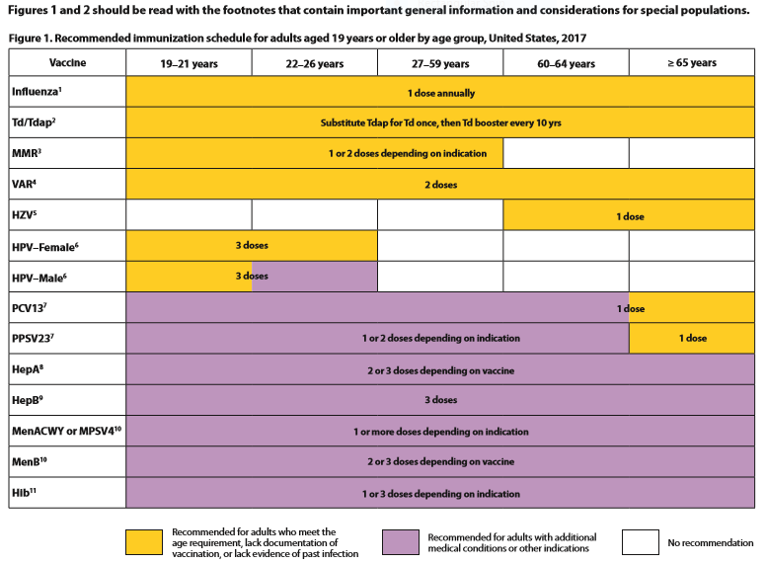
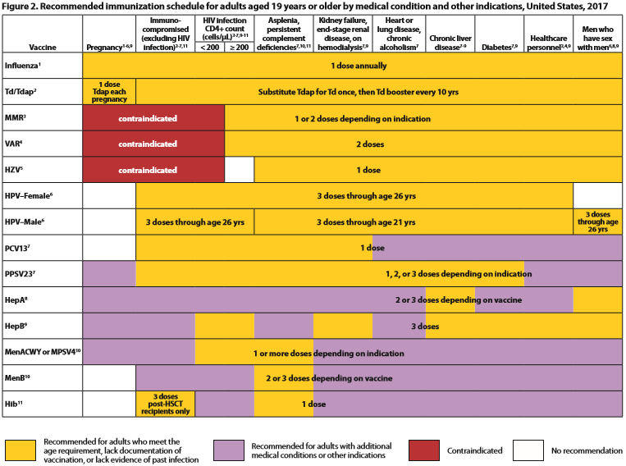
2017 Immunization Schedules
All staff must use the same immunization schedule
Five Schedules:
  Children & Adolescent
0 through 18 years
  Children & Adolescent
based on medical indications
  Catch-up schedule for
ages 4 months -18 years
  Adult 19 years and older
  Adult based on medical
  and other indications
READ THE FOOTNOTES
http://www.cdc.gov/vaccines/schedules/hcp/child-adolescent.html
http://www.cdc.gov/vaccines/schedules/hcp/adult.html
MMWR, February 7, 2017, Vol. 66
Notes:
2017 Childhood/Adolescent Immunization Schedule changes
A new figure, Figure 3 "Vaccines that might be indicated for children and adolescents aged 18 years or younger based on medical indications", has been added. This figure: Demonstrates most children with medical conditions can (and should) be vaccinated according to the routine child/adolescent immunization schedule. The diphtheria and tetanus toxoids and acellular pertussis vaccine (DTaP) footnote was revised to more clearly present recommendations following an inadvertently early administered fourth dose of DTaP. The tetanus and diphtheria toxoids and acellular pertussis vaccine (Tdap) footnote has been updated to reflect the recommendation for preferential vaccination of pregnant adolescents early during gestational weeks 27 through 36. The Hepatitis B vaccine (HepB) footnote was revised to reflect that the birth dose of HepB should be administered within 24 hours of birth. The Haemophilus influenzae type b vaccine (Hib) footnote, Comvax was removed from the routine vaccination portion of footnote. This vaccine has been removed from the market, and all available doses have expired. Additionally, Hiberix has been added to the list of vaccines that may be used for the primary vaccination series. A blue bar was added to the schedule for human papillomavirus vaccine (HPV) for children aged 9–10 years, indicating that persons in this age group may be vaccinated (even in the absence of a high-risk condition).
The footnote for HPV vaccine has been updated to include the new 2-dose schedule for persons initiating the HPV vaccination series before age 15 years. Live attenuated influenza vaccine (LAIV) has been removed from the influenza row of the schedule. Meningococcal: The 16-year age column of the schedule has been separated from the 17–18-year age column to highlight the need for a meningococcal conjugate vaccine booster dose at age 16 years. The meningococcal vaccines footnote has been updated to include recommendations for meningococcal vaccination of children with human immunodeficiency virus (HIV) infection and to reflect recommendations for the use of a 2-dose Trumenba (meningococcal B vaccine) schedule. The pneumococcal vaccine footnote, references to 7-valent pneumococcal conjugate vaccine (PCV7) have been removed. All healthy children who may have received PCV7 as part of a primary series have now aged out of the recommendation for pneumococcal vaccine.
2017 Adult Immunization Schedule changes
Influenza: LAIV should not be used during the 2016–2017 influenza season. Adults with a history of egg allergy info updatedHepatitis B: Adults with chronic liver disease, including, but not limited to, hepatitis C virus infection, cirrhosis, fatty liver disease, alcoholic liver disease, autoimmune hepatitis, and an alanine aminotransferase (ALT) or aspartate aminotransferase (AST) level greater than twice the upper limit of normal should receive a HepB series. HPV: Adult females through age 26 years and adult males through age 21 years who have not received any HPV vaccine should receive a 3-dose series of HPV vaccine at 0, 1–2, and 6 months. If an Adult received 1 dose prior to their 15th birthday they are eligible to complete the series with one additional dose. Meningococcal: Adults with asplenia receiving Men ACWY/Men B. HIV and Meningococcal for adults. HCP and Meningococcal administration. Men B for healthy young adults/2-dose admin.
Reference: MMWR, February 7, 2017, Vol. 6

Slide 47
Indications
Recommendations
Requirements
Indication
  Information about the appropriate use of the vaccine
Recommendation
  ACIP statement that broadens and further delineates the Indication found in the package insert
  Basis for standards for best practice
Requirement
  Mandate by a state that a particular vaccine must be administered and documented before entrance to child care and/or school
Notes:
EXAMPLES OF AN INDICATION
ADACEL vaccine is indicated for active booster immunization for the prevention of tetanus, diphtheria and pertussis as a single dose in persons 11 through 64 years of age.
EXAMPLE OF A RECOMMENDATION
Recommendations by ACIP for the routine administration of vaccines. May include other information and guidance on epidemiology of the disease, appropriate timing, dosage, contraindications to the vaccine and guidance for use in special populations.
EXAMPLE OF VACCINE REQUIREMENTS FOR ENTRY INTO CHILD CARE FACILITIES IN GEORGIA
Consistent with the Recommended Childhood and Adolescent Immunization Schedule
Children are required to be age appropriately immunized against each of these diseases: Hepatitis B, Diphtheria, Tetanus, Pertussis, Polio, Hib, Pneumococcus, Measles, Mumps, Rubella, Varicella, Hepatitis A, and meningococcal disease.

Slide 48


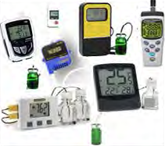
Updated Vaccine Storage and
Handling Recommendations
Use stand-alone refrigerator and stand-alone
freezer units. If combined, use only refrigerator part.
Do not store any vaccine in a dormitory-style or
bar-style combined refrigerator/freezer unit.
Use a bio-safe glycol-encased probe
or a similar temperature buffered probe.
Use digital data loggers.
Do not store ANYTHING ELSE in refrigerator.
Review vaccine expiration dates and rotate
vaccine stock weekly.
*Data loggers will be required for VFC January 2018*
Ref: Vaccine Storage and Handling Toolkit, June 2016
Notes:
It is estimated that 17-37% of immunization providers expose vaccines to improper storage temperatures. More commonly, refrigerators are kept too cold rather than too warm. The potency of vaccines stored at incorrect temperatures may be irreversibly reduced. A physical change in the vaccine may not be apparent.
Visit http://www.cdc.gov/vaccines/recs/storage/default.htm to view and print:
-Vaccine Storage and Handling Toolkit
-Vaccine Storage and Handling Guide
-Interim Storage and Handling Guidance
Remember: if you find temperatures out of range, TAKE ACTION, DO SOMETHING ABOUT IT!

Slide 49
Maintaining Appropriate
Vaccine Storage & Handling
Assign a primary and alternate vaccine coordinator.
Store all vaccines as recommended by manufacturer and IN ORIGINAL PACKAGING.
Monitor and record temperatures of refrigerator and freezer twice daily.
Maintain temperature log records for 3 years.
Take immediate action for all out-of-range temps.
Implement a vaccine emergency system.
If it is necessary to transport vaccine, do NOT use dry ice.
Ref: Vaccine Storage and Handling Toolkit, June 2016
Notes:
Remember: if you find temperatures out of range, TAKE ACTION, DO SOMETHING ABOUT IT!
The June 2016 toolkit reflects an adjustment to the Fahrenheit temperature range for storing refrigerated vaccines. The new recommended range is between 36 and 46 degrees F (previously between 35 and 46 degrees F).

Slide 50
Check Expiration Date of Vaccines and Diluents
Vaccine Expiration Date is 12/10/17
Use through December 10, 2017
Do NOT use on or after December 11, 2017.
Vaccine Expiration Date is 12/17
Use through December 31, 2017
Do NOT use on or after January 1, 2018.
12/17
12/10/17
Note: Some multidose vials have a specified time frame for use once the vial is entered with a needle. This may vary from the expiration date printed on the vial.
Notes:
Ref: Vaccine Storage and Handling Toolkit, June, 2016.

Slide 51
General Best Practice Guidelines for Immunization
(formerly General Recommendations on Immunization)
Timing and Spacing
Contraindications and Precautions
Prevention and Management of Adverse Reactions
Vaccine Administration
Storage and Handling of Immunobiologics
Altered Immunocompetence
Special Situations
Vaccination Records
Vaccination Programs
Vaccine Information Sources
NEW
Kroger AT, Duchin J, Vázquez M. General Best Practice Guidelines for Immunization. Best Practices Guidance of the Advisory Committee on Immunization Practices (ACIP). [www.cdc.gov/vaccines/hcp/acip-recs/general-recs/downloads/general-recs.pdf].
Notes:
Specific administration guidelines have been established for each vaccine. Minimum age and intervals for vaccines are set by manufacturers during clinical trials; too young an age or too close together may alter effectiveness of a vaccine.
There is a 4-day grace period – vaccines given during the 4-day window before the recommended age/interval may be counted as valid. It is suggested that MMR and Varicella, not be given before one year of age. GRITS tables have been set up to calculate this correctly when a vaccine history is entered.
The updated version is entitled General Best Practice Guidelines for Immunization. It will not be available to order but can be accessed on the ACIP Recommendations pg. or downloaded. The bullets list the chapters in the document.
EPIC 2017

Slide 52
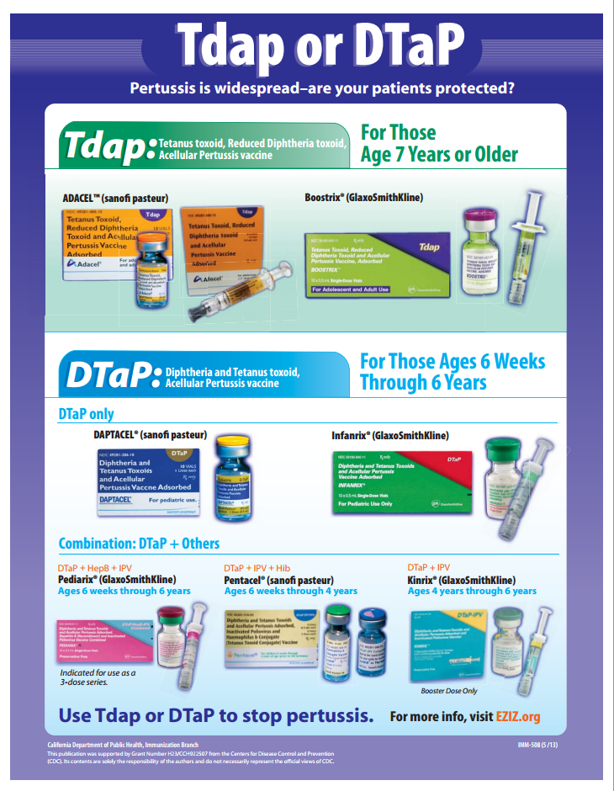
Check the vial 3 times!

Slide 53
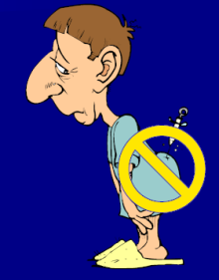
The 7 Rights of Vaccine Administration
Right Patient
Right Vaccine or Diluent
Right Time*
Right Dosage
Right Route, Needle Length, Technique
Right Site for route indicated
Right Documentation
* Correct age, appropriate interval, and administer before vaccine or diluent expires
Ref: Epidemiology and Prevention of Vaccine-Preventable Diseases. 13th Edition, 2015.
Notes:
Be sure to check package insert for correct route, correct sites for the route and correct needle length.
Much of this information is available in the ACIP General Recommendations document.
*Make a chart of this information for use in your office*. Or have a VACS FACS available in your office.
Ref: General Recommendations on Immunization MMWR 2011; 60 (No. RR-2) Jan 28, 2011
REMINDER:
Vaccines should never be given in the gluteus muscle
If it is discovered that Hepatitis B, rabies, or HPV vaccine has been given there, all such doses must be repeated at appropriate sites.

Slide 54
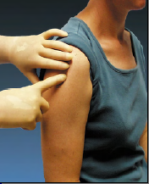
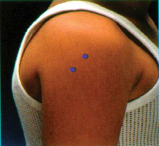
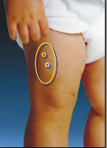
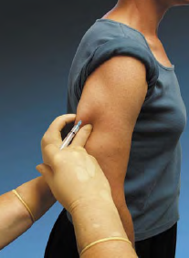
Sites for Vaccine Administration
Intramuscular (IM)
  DTaP, Tdap, Hib, Td, Hep A, Hep B, PCV13, IIV, MCV4, HPV
Subcutaneous (SQ, SC, or sub-Q)
  MMR, MMRV, Varicella, MPSV4, Herpes Zoster
Either intramuscular or subcutaneous
  IPV, PPSV23
Intranasal
LAIV
Orally (PO)
Rotavirus
Notes:
Be sure to check package insert for correct route and then make a chart for use in your office.

Slide 55
Immunization Administration Practices
The CDC has identified improper use of syringes, needles and medication vials during procedures performed by healthcare personnel, such as administering injections. These improper practices have resulted in:
Transmission of bloodborne viruses (HCV, HBV, HIV)
Referral of providers to licensing boards for disciplinary action
Malpractice suits filed by patients
Never administer medications from the same syringe to more than one patient, even if the needle has been changed.
DO NOT ENTER a vial with a used syringe or needle.
Ref: 1.Epidemiology and Prevention of Vaccine Preventable Diseases 13th Edition, 2015
2. CDC, NCEZIZ, DHQP. Injection Safety Information for Providers: www.cdc.gov/injectionsafety/providers.html
Notes:
EPIC 2017

Slide 56
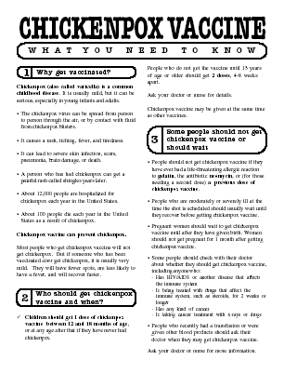
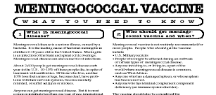
Always Document…
Accept only written documentation of prior immunizations
Provide VIS prior to administration of vaccine
After vaccine administration, document:
  Publication date of VIS & date VIS given
  Date, site, route, antigen(s), manufacturer, lot #
  Person administering vaccine, practice name and address
  Vaccine refusals with a signed “Refusal to Vaccinate Form”
  GA law does not require signed consent for immunizations
Notes:
Vaccine Information Sheets
VIS required by law for each vaccine given and each time that vaccine is given. The most current VIS must be used. For VIS statements in English and many other languages: www.immunize.org; www.cdc.gov/vaccines/ or call the National Immunization Program Information Hotline at 800-CDC-INFO (800-232-2522).
VIS can be provided at the same time or prior to allow time for questions and educate the parent/client about the vaccine.
Document all information listed on slide. Information will also be helpful if a specific lot of vaccine is recalled in the future.
Refusal to consent for an immunization should be documented for liability purposes and chart completeness. There is no way to document this in GRITS.
Georgia recognizes only medical and religious exemptions.
Medical exemptions must be documented in GRITS and be re-evaluated every year.
Georgia law does not require signed consent for immunization. Patients, parents or legal guardians may verbally consent to immunization. However, some practices may require written consent for all medical care.

Slide 57

A ‘Birth to Death’ Immunization Registry
Providers administering vaccines in Georgia must provide appropriate information to GRITS.
GRITS personnel can work with your EHR/EMR vendor to create an interface between your system and GRITS that will drastically decrease data entry time for your practice.
Contact the GRITS Training Coordinator at (404) 463-0807 or e-mail : dph-immreg@dph.ga.gov
Notes:
In 2004, House Bill 1526 was passed making the Georgia Immunization Registry a birth to death registry mandating that providers of immunizations in Georgia report those immunizations into the registry database. Immunization data may now be shared by all providers of immunizations to Georgians of any age, and to schools, daycares, colleges and universities, and long term care facilities. The patient (age 18 or older) or parent or legal guardian may OPT-OUT of the registry.
Contact GRITS to enroll: 1-888-223-8644
Benefits of GRITS include: accurate immunization records, inventory tracking, reduction in missed opportunities or over-immunization, generation of school entrance forms/college immunization forms, reminder/recall notices for parents, assistance in generating reporting of immunizations to HEDIS/COCASA, and elimination of phone calls to providers for immunization records. The GRITS program is web-based. New users to the system will have to attend a training session and receive a password. UNIFIED FONT SIZES OF WHOLE PAGE
Advantages of a statewide registry are as follows:
Benefits to the Community
Enhance the overall health status by facilitating identification of inadequately immunized segments of the population
Decrease occurrence of over-immunization due to inability to locate past records
Assist in issuing reminders to patients for pending and overdue immunizations
Benefits to Healthcare Providers
Reduce staff time needed to obtain complete immunization history of patients
Provide printouts of school certificates
Provide vaccine information and simplify complex and dynamic immunization schedules
Streamline vaccine inventory process
Generate HEDIS and other reports
Reinforce the concept of a medical home
Benefits to Public Health Officials
Provide an accurate measure of immunization rates for districts, counties, and the state
Allow Georgia healthcare providers to update and exchange immunization information about their patients in a confidential manner
Facilitate community outreach programs
The Georgia Code 31-12-3.1, which took affect July 1, 1996 and House Bill 1526, which took affect July 1, 2004 states:
Any person who administers a vaccine or vaccines licensed for use by the United States Food and Drug Administration to a person shall, for each such vaccination, provide to the department such data as are deemed by the department to be necessary and appropriate for purposes of the vaccination registry established pursuant to subsection (a) of this Code section…
At the present time the mandatory use of GRITS is not being strictly enforced but will be sometime in the future.

Slide 58
Exemptions From
School/Day Care Requirements
Medical Exemption O.C.G.A. §20-2-771(d)
Used when a physical disability or medical
condition contraindicates a particular vaccine.
Requires an annual review.
The medical exemption is documented in GRITS.
Religious Exemption O.C.G.A. §20-2-771(e)
Parent or guardian must be directed to http://dph.georgia.gov/immunization-section to obtain an Affidavit of Religious Objection to Immunization form.
This form must be signed and notarized and provided to the school.
Must be kept on file at school/facility in lieu of an
immunization certificate.
Affidavit does not expire.
Georgia does not have a philosophical exemption
Notes:
Medical exemptions should be entered in GRITS and will be listed on the immunization certificate. Medical exemptions must be reviewed on an annual basis.
Georgia now has an Affidavit of Religious Objection to Immunization form that must be filled out for if the parent is refusing immunizations due to a religious exemption.
The form lists all vaccines that are required for admittance into childcare facilities or schools in Georgia. It confirms the safety of vaccines. The form also states that risks if a child is not vaccinated such as, contracting vaccine preventable diseases and spreading them to others. Lastly the form mentions the exclusion of the child from childcare or school during an epidemic or outbreak of a vaccine preventable disease.
The form must be signed and notarized. It does not expire and must be kept on file at the school or childcare facility.

Slide 59
Vaccine Adverse Events
Local
- pain, swelling, redness at injection site
- common with inactivated vaccines
- usually mild and self-limited
Systemic
- fever, malaise, headache
- nonspecific symptoms
- may be unrelated to vaccine
Allergic
- anaphylaxis
- serious but rare
Ref: Epidemiology and Prevention of Vaccine-Preventable Diseases. 13th Edition, 2015
Notes:
The most common type of adverse reactions are local reactions, such as pain, swelling, and redness at the site of injection, occurring within a few hours of the injection and are usually mild and self-limited. These may occur with up to 80% of vaccine doses, depending on the type of vaccine. They are most common with inactivated vaccines, particularly those that contain an adjuvant (DTaP). On rare occasions, local reactions may be very exaggerated or severe. These are often referred to as hypersensitivity reactions, although they are not allergic, as the term implies. These reactions are also known as Arthus reactions, and are most commonly seen with tetanus and diphtheria toxoids. Arthus reactions are believed to be due to very high titers of antibody, usually caused by too many doses of toxoid.
Systemic adverse reactions are more generalized events and include fever, malaise, myalgia (muscle pain), headache, loss of appetite, and others. These symptoms are common and nonspecific; they may occur because of the vaccine or may be caused by something unrelated to the vaccine, like a concurrent viral infection, stress, or excessive alcohol consumption. Systemic adverse reactions were relatively frequent with DTP vaccine, which contained a whole-cell pertussis component. However, comparison of the frequency of systemic adverse events among vaccine and placebo recipients shows they are less common with inactivated vaccines currently in use, including acellular pertussis vaccine. Systemic adverse reactions that follow live attenuated vaccines, such as fever or rash, represent symptoms produced from viral replication and are similar to a mild form of the natural disease. Systemic adverse reactions following live vaccines are usually mild, and occur 7–21 days after the vaccine was given (i.e., after an incubation period of the vaccine virus). LAIV replicates in the mucous membranes of the nose and throat, not in the lung. As a result, LAIV may cause upper respiratory symptoms (like a cold) but not influenza-like symptoms.
An anaphylactic (allergic) reaction may be caused by the vaccine antigen itself or some other component of the vaccine, such as cell culture material, stabilizer, preservative, or antibiotic used to inhibit bacterial growth. Severe allergic reactions may be life-threatening. Fortunately, they are rare, occurring at a rate of less than one in half a million doses. The risk of an allergic reaction can be minimized by good screening prior to vaccination. All providers who administer vaccines must have an emergency protocol and supplies to treat anaphylaxis.
Reference: Epidemiology and Prevention of Vaccine-Preventable Diseases, 13th edition. May 2015 HHS, CDC.

Slide 60
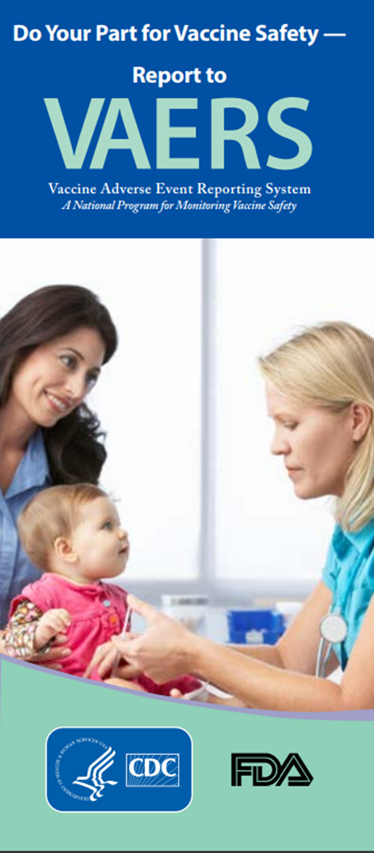
Monitoring Vaccine Safety
NEW
VAERS
Option 1 - Report Online to VAERS (Preferred)
Submit a VAERS report online. The report must be completed online and submitted in one sitting and cannot be saved and returned to at a later time. Your information will be erased if you are inactive for 20 minutes; you will receive a warning after 15 minutes.
Option 2 - Report using a Writable PDF Form
Download the Writable PDF Form to a computer. Complete the VAERS report offline if you do not have time to complete it all at once. Return to this page to upload the completed Writable PDF form by clicking here.
If you need further assistance with reporting to VAERS, please email info@VAERS.org or call 1-800-822-7967.
FDA and Vaccine Data Link Safety Project
VERP: VACCINE ERROR REPORTING SYSTEM
  On line reporting at http://verp.ismp.org/
  Report even if no adverse events associated with incident
  Will help identify sources of errors to help develop prevention strategies
Notes:
Nothing is 100% risk free. Most reactions to vaccines are mild with very small risk of severe allergic reactions (anaphylaxis).
Systems in place to monitor safety include the FDA (pre and post licensure monitoring) and the Vaccine Safety Datalink (VSD) Project. This large project links 4 HMO's at 10 sites with the CDC to monitor adverse events possibly caused by vaccines.
FDA monitors vaccines for safety before issuing licenses - very stringent licensing involving laboratory and human testing; vaccine safety is also monitored after licensure to ensure each vaccine lot is effective and pure. Vaccine manufacturers also do post-licensure monitoring.
The Institute of Medicine reviews research related to vaccine safety and publishes a report periodically.
VAERS
Updated system. Two options for reporting are outlined in the gray box.
Passive reporting system to monitor vaccine adverse events established by the National Childhood Vaccine Injury Act 1986
Mandates patients/ parents are educated about risk of vaccines and compensated for any injury caused by vaccine.
Emphasize there is no penalty for reporting an “adverse event”. The healthcare provider is only reporting that a specific event occurred after administration of a specific vaccine and is not claiming that the event was caused by the vaccine.
VERP – There is relatively little data available on why vaccine administration errors occur. The Institute for Safe Medication Practice (ISMP) has launched a national patient safety reporting program to capture the unique causes and consequences of vaccine –related errors. The ISMP National Vaccine Error Reporting Program (ISMP VERP) allows healthcare practitioners to report errors and near misses in confidence.
Sources of Vaccine Safety Information:
www.cdc.gov/vaccines/pubs/vis/default.htm www.cdc.gov/vaccinesafety/
www.idsociety.org www.vaccinesafety.edu
www.acponline.org www.aap.org
www.aafp.org www.immunize.org
www.vaccine.chop.edu www.vaers.hhs.gov
www.immunizationinfo.org
EPIC 2017

Slide 61

Why do we miss opportunities to immunize?
Physician or patient unaware of the need
Visits for mild illness, injury, or follow-up
Need for multiple vaccines
Invalid contraindications
Inappropriate clinic policies
Reimbursement deficiencies
Notes:
The CDC definition of a missed opportunity is, “A health care encounter in which a person is eligible to receive vaccination but is not vaccinated completely.” (Epidemiology and Prevention of Vaccine-Preventable Diseases, 13th edition. 2015 HHS, CDC. )
Missing an opportunity to immunize may leave you vulnerable to a lawsuit. Patients who developed vaccine-preventable disease after failing to be immunized (missed opportunities) have filed lawsuits. [see Needletips (1), 1,1994]
To avoid missed opportunities:
Vaccination records: Keep accurate immunization records in a prominent location in the chart so immunization status can be easily checked at each visit.
Mild illness/injury visits/follow-up visits: The CDC recommends immunization with all vaccines for patients even those with low-grade fever, mild diarrhea, mild ear infections, mild acute illness, or upper respiratory infections. There is no evidence of increased risk of adverse events associated with immunizations during the course of a minor illness. The decision to defer immunizations results in a missed opportunity. The procedure for assessing immunization status and giving immunizations at follow-up and sick/injury visits may require more time, necessitating change in your office practice.
Multiple vaccinations per visit: More than one vaccine can be administered at one time. There is no limit to the number of vaccines that can be given at one visit.
Know the schedules: Post the current schedule and keep staff updated on any changes.
Know Contraindications: Be aware of the true/valid contraindications, precautions and invalid contraindications. There are few truly valid contraindications to vaccine administration.
Adolescents: Adolescents are a large and healthy part of our population who seek medical care infrequently. Immunization status needs to be assessed at each visit.
Adults: Some adults who are healthy may be seen infrequently. Other adults may have multiple medical problems. Immunization status of all adults needs to be assessed at each visit.
Some barriers to be overcome regarding adolescents include:
Parents may be unaware that there are now more vaccines recommended for adolescents
Infrequent medical encounters for adolescent preventive medical services leaves fewer opportunities to immunize
Lack of awareness by both physicians and parents that VFC provides recommended vaccines free for the uninsured and underinsured (in Georgia) through age 18. SPACING ADJUSTED
Obtaining parental consent for vaccines is a challenge
Failure to vaccinate during sports physicals
Lack of reminder/recall systems for adolescents
Studies have shown that eliminating missed opportunities can help to increase vaccination coverage by 20 percent.

Slide 62
Invalid Contraindications to Vaccine
Mild illness or injury
Antibiotic therapy
Disease exposure or convalescence
Pregnancy or immunosuppression in household
Family history of an adverse event to a vaccine
Breastfeeding
Prematurity
Allergies to products not in vaccine
Need for TB skin testing
Need for multiple vaccines
Ref: General Recommendations on Immunization - MMWR January 28, 2011, Vol 60 # RR02)
Notes:
ANTIBIOTIC THERAPY
Antibiotics do not have an effect on the immune response to a vaccine. [Exception: The growth of the live Ty21, a strain of typhoid vaccine, is inhibited in vitro by various antibacterial agents. Some antibacterial agents may interfere with efficacy of Ty21 vaccine. CDC Yellow Book (Health Information for Travelers) recommends delaying vaccine >72 hours after any antibacterial agent. The Typhoid VIS recommends a delay of >24 hours.]
DISEASE EXPOSURE OR CONVALESCENCE
There is no evidence that either disease exposure or convalescence will affect the response to a vaccine or increase the likelihood of an adverse event.
PREGNANCY OR IMMUNOSUPPRESSION IN THE HOUSEHOLD OR BREASTFEEDING
Most vaccines, including live vaccines (MMR, varicella, and yellow fever) can be given to infants or children with pregnant or immunosuppressed household contacts, as well as to breast-feeding infants. Breastfeeding does not decrease the response to routine childhood vaccines and does not extend or improve passive immunity to vaccine-preventable disease provided by maternal antibody.
PREMATURE BIRTH
Vaccines should be started on schedule based on the child's chronological age. Studies demonstrate that decreased seroconversion rates might occur among certain premature infants with low birth weights (i.e., <2,000 grams) after administration of hepatitis B vaccine at birth. However, by one month chronological age, all premature infants, regardless of initial birthweight or gestational age are as likely to respond as adequately as older and larger infants.
NEED OR REQUIREMENT FOR TUBERCULOSIS SKIN TEST (PPD)
All vaccines, including MMR, can be given on the same day as a TB skin test, or any time after a TB skin test is applied. MMR vaccine may decrease the response to a TB skin test, potentially causing a false negative response in someone who actually has an infection with tuberculosis. If MMR has been given and one or more days have elapsed, in most situations it is recommended to wait 4-6 weeks before giving a routine TB skin test. No information on the effect of varicella vaccine on a TB skin test is available. It is prudent to apply rules for spacing measles vaccine and TB skin testing to varicella vaccine."
ADMINISTERING VACCINES TO HOUSEHOLD MEMBERS OF IMMUNOCOMPROMISED PATIENTS
Immunocompetent individuals who live in a household with immunocompromised patients can safely receive inactivated vaccines. They may also receive live virus vaccines such as MMR, varicella, rotavirus, zoster, yellow fever, and oral typhoid vaccines if indicated. LAIV should be avoided in some instances. (See Footnote 3).
1. General Recommendations on Immunization, Recommendations of the Advisory Committee on Immunization Practices (ACIP). MMWR 2011; 60 (No. RR-2) January 28, 2011
2. Epidemiology and Prevention of Vaccine-Preventable Diseases, 13th edition 2015. HHS, CDC. (Pink Book).
3. IDSA Guidelines, “2013 IDSA Clinical Practice Guideline for Vaccination of the Immunocompromised Host,” Clinical Infectious Diseases Advance Access published December 4, 2013

Slide 63
Vaccine Risk Perception
Many parents of young children are not familiar with vaccine-preventable diseases and perceive the risks of vaccines outweigh the benefits
Concerns
  Immune system overload
  Children get too many shots at one visit
  Vaccines have side effects (adverse reactions)
  Immunity from the disease is better than immunity from a vaccine (ie. chicken pox)
  Vaccines cause autism
Notes:
Vaccine Concerns
-One quarter of parents mistakenly believe that vaccines weaken the immune system.
-One quarter of parents believe that children get more immunizations than are good for them.
-On the plus side, the child's health care provider is seen as the most important source for immunization information. (Gellin, B., et.al. "Do parents understand immunizations? A national telephone survey." Pediatrics, 106(5); 1097-1102).
Answers to common concerns about vaccines
Vaccines do not weaken the immune system (we give a small antigen load even at peak times/ages in the vaccine schedule)
Natural immunity is not better than vaccines (ex: shingles in those who have had chicken pox natural illness)
Vaccine-preventable diseases are serious illnesses with the possibility of complications and even death
Well controlled studies during the past 10 years have failed to show any association between MMR vaccine or thimerosal and autism. However, many anti-vaccine groups continue to promote the association of autism and MMR vaccine and the dangers of thimerosal.
For more information about these topics (and others of concern to parents/patients) visit http://www.cdc.gov/vaccinesafety/

Slide 64
Response to Vaccine Safety Concerns
Vaccines are among the most thoroughly tested and safest things we put into our bodies
Refusing a vaccine means taking the risks of the disease and of spreading the disease to others
“Natural immunity” (from disease) may come with complications, permanent damage, or death
In Georgia, an unimmunized student may be prohibited from attending school during an epidemic*
Consistent reproducible research has shown that autism is NOT caused by:
— Thimerosal
— Multiple vaccines at one time
— MMR vaccine
* State of Georgia -Rules of Department of Human Services: Public Health 290-5-4-.07
Notes:
Studies have found no link between autism and MMR vaccine.
The Story of Dr. Andrew Wakefield and MMR – Autism Link
Original “study”, published in UK medical journal, Lancet, in 1998, proposing MMR - autism link was based on 12 children.
This resulted in decreased use of MMR vaccine and outbreaks of measles in the United Kingdom.
A press investigation revealed that Dr. Wakefield had falsified patient data and relied on laboratory reports that he had been warned were incorrect.
Larger studies, done later by other researchers, failed to establish any link between MMR and autism.
In 2010 Dr. Wakefield was found guilty of “serious professional misconduct” and his medical license was revoked.
The editors of Lancet took the unusual step of retracting his article from the scientific literature on the grounds that it was the product of dishonest and irresponsible research.

Slide 65
Talking with Parents about Vaccines
Start conversations early (prenatal visits)
Use language and examples parents can understand
Give written information (VIS) prior to the immunization visit
Provide your recommendations
Draw upon your experiences as a health care provider
Solicit and welcome questions
Recognize that some parents may be more interested in discussing vaccines than others
Adapted from Glen Nowak, PhD. CDC

Slide 66
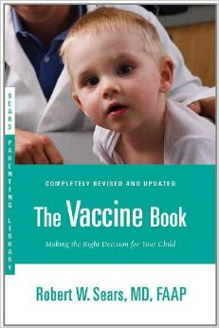
Vaccine Schedules Varying From ACIP/AAP/AAFP Recommendations
Dr. Bob’s Selective Vaccine Schedule
Dr. Bob’s Alternative Vaccine Schedule
Parent/caretaker refuses all vaccines
Alternate or delayed schedules have
not been tested
No studies to prove they are safer
If any of these Alternate Schedules are requested, the health care provider and staff must spend additional time educating the parent/caretaker about the appropriate use of vaccines.
Notes:
Quote from:
The Problem With Dr Bob's Alternative Vaccine Schedule*
“For parents who are worried about vaccines, Sears offers 2 alternative schedules. One, titled “Dr Bob’s Selective Vaccine Schedule,” is for parents who want to decline or to delay vaccines. Children whose parents choose this schedule might not be receiving the measles, mumps, rubella, varicella, and hepatitis A vaccines and will not be receiving the polio and influenza vaccines or a booster dose of pertussis vaccine. The other schedule, titled “Dr Bob’s Alternative Vaccine Schedule,” is written for parents who worry that children are receiving too many vaccines too early. Children whose parents choose this schedule will not be receiving the influenza vaccine until 5 years of age (which is unfortunate, given that tens of thousands of children 4 years of age are hospitalized with complications resulting from influenza every year),(³⁴) will not be receiving the hepatitis B vaccine until 2.5 years of age, will not be receiving measles vaccine until 3 years of age, and, to space out vaccines so that children do not receive 2 shots at 1 visit, will be visiting the doctor for vaccines at 2, 3, 4, 5, 6, 7, 9, 12, 15, 18, 21, and 24 months and 2, 2.5, 3, 3.5, 4, 5, and 6 years of age. Increasing the number of vaccines, the number of office visits, and the ages at which vaccines are administered will likely decrease immunization rates. In addition to the logistic problem of requiring so many office visits, Sears’ recommendation might have another negative consequence; recent outbreaks of measles showed that several children acquired the disease while waiting in their pediatricians’ offices.⁽⁷⁾
At the heart of the problem with Sears’ schedules is the fact that, at the very least, they will increase the time during which children are susceptible to vaccine-preventable diseases. If more parents insist on Sears’ vaccine schedules, then fewer children will be protected, with the inevitable consequence of continued or worsening outbreaks of vaccine-preventable diseases. In an effort to protect children from harm, Sears’ book will likely put more in harm’s way.”
*Paul A. Offit and Charlotte A. Moser Pediatrics 2009;123;e164-e169
http://www.pediatrics.org/cgi/content/full/123/1/e164
Ref. 7. Centers for Disease Control and Prevention. Measles: United States, January-July 2008. MMWR Morb Mortal Wkly Rep. 2008; 57(33):893–896
Ref. 34. Poehling KA, Edwards KM, Weinberg GA, et al. The underrecognized burden of influenza in young children. NEngl J Med. 2006;355(1):31–40; PEDIATRICS

Slide 67




Anti-Vaccine Movement
Promotes the idea that there is less evidence of disease today and immunizations are no longer needed
Sends confusing & conflicting information
Uses stories, personal statements, and books to play on the emotional side of concerned parents
Encourage parents/patients to:
  Get the facts
  Consider the source
  Discuss their concerns with you
Notes:
Anti-vaccine issues have been around since the early 1800's.
Most patients/parents haven't seen the diseases so are more concerned about vaccine risk
Media portrays tragedies with emotional appeal
Web sites with anti-immunization information are plentiful with little scientifically-based vaccine information
Address any concerns and questions your patients may have
We are living in a “world of information”, however, more information does not always mean a better informed consumer. The “anti” groups often report on personal stories of “tragedy”, with pain and suffering instead of using available information based on sound research. As health care providers we must be aware of the anti-immunization information in order to answer the questions presented by parents/patients. We need to provide information about immunizations in terms understandable by a non-medical person in order to educate the public about the reduction of vaccine preventable diseases due to the currently available vaccines.
Anti-Vaccine web sites:
This is just a small list of the many sites available on the internet for anti-vaccine promotion. Please be sure to check some of these locations so that you are aware of the type on information that can be obtained from these sites.
http://www.thinktwice.com/global.htm
http://www.gval.com/
http://www.nvic.org
For “Evaluating Information on the Web”
go to http://www.immunizationinfo.org/parents/evaluating-information-web

Slide 68










Resources for Factual & Responsible Vaccine Information
Notes:
These are sources for scientific and credible information
See information sheet in participant packet
http://www.cdc.gov/vaccines/vac-gen/safety/default.htm
www.idsociety.org/Immunization/
www.who.int
www.gaaap.org
www.aap.org
www.cispimmunize.org
www.aafp.org
www.acponline.org
www.immunize.org/resources This site is a good resource for healthcare providers and for information written specifically for patient and parents.
www.immunizationinfo.org
www.nfid.org Great resources for immunization for healthcare professionals; Webinars
www.pkids.org (support and counseling for children with infectious diseases)
www.vaccine.org

Slide 69
Important Office Practices
Use reminders on medical records and notify patients when vaccines are needed
Use of automatic text-messaging systems to remind patients of needed or scheduled appointments
Recall patients when vaccine is available after a shortage
Assess your immunization rates using CoCASA¹ to improve patient care, HEDIS² scores, and identify problem areas
Use current codes for vaccines and vaccine administration
1. Comprehensive Clinic Assessment Software Application
2. Health Plan Employer Data and Information Set®
Notes:
Reminders and Recall
For providers: A reminder communicating to the health care provider that a patient needs an immunization can be as simple as a chart clip, “sticky note” on the immunization record/ patient record, or a flag on the electronic medical record
For patients: A reminder is a message notifying a patient/parent of an upcoming appointment and/or a need for an immunization
A recall is a message notifying a patient that they are past due for an appointment and/or immunization
These can be automated or manual, computerized, telephonic, or written
If one member of a family is scheduled for an appointment, be sure and check all family member records for up to date immunizations and send reminder home at that time!
Reference: General Recommendations on Immunization, Recommendations of the Advisory Committee on Immunization Practices (ACIP). MMWR 60(RR-2); January 28, 2011
Dentists and veterinarians do a much better job with reminders and recalls than physicians

Slide 70

Stay Current!
Sign up for listserv sites which provide timely information pertinent to your practice www.immunize.org/resources/emailnews.asp
  AAP Newsletter
  CDC immunization websites (32 in all)
  CHOP Parents Pack Newsletter
  IAC Express, Needle Tips
  Websites specific to particular vaccines

Slide 71


Improve Access to Immunizations in Your Practice
Immunization only visits
Walk-ins for immunizations
Implement standing orders
Early, extended, or weekend hours
Mass vaccination clinics
NEW
High Immunization rates begin with a team designed plan!

Slide 72
Questions?
Check out these links for more immunization information and resources!
National Immunization Program
E-mail ► NIPInfo@cdc.gov
Hotline 800.CDC.INFO
Website http://www.cdc.gov/vaccines
Georgia Immunization Program
E-mail DPH-Immunization@dph.ga.gov
Hotline 404-657-3158
Website http://dph.georgia.gov/immunization-section
Immunization Action Coalition
E-mail admin@immunize.org
Phone 651.647.9009
Website www.immunize.org
Notes:
With a second click of the mouse presenters can highlight NIPInfo@cdc.gov, an Email site that can provide answers to specific questions about immunizations. Experts from the CDC will respond to questions Monday through Fridays in 24 to 48 hours or sooner. It is not a practical source of information if the practitioner has a patient in an exam room waiting for an immunization. However, it a great source for information you can not find in the Pink Book or on the CDC web site.

Slide 73
Test Your Knowledge!
EPIC 2017

Slide 74
Test Your Knowledge!
Four month old Lucas was given Tdap instead of DTaP.
What should be done?

Slide 75
Test Your Knowledge!
Four month old Lucas was given Tdap instead of DTaP.
What should be done?
If Tdap was inadvertently given to a child under age 7 years, it should not be counted as either the first, second, or third dose of DTaP. The dose should be repeated with DTaP. Continue vaccinating on schedule. If the dose of Tdap was administered for the fourth or fifth DTaP dose, the Tdap dose can be counted as valid. Please remind your staff to always check the vaccine vial at least 3 times before administering any vaccine.
IAC Ask the Experts - Reviewed July 2014

Slide 76
Five-year-old Tonia received her second MMR a week ago.
How long should she wait before receiving live varicella zoster vaccine?
Test Your Knowledge!

Slide 77
Five-year-old Tonia received her second MMR a week ago.
How long should she wait before receiving live Varicella zoster vaccine?
Test Your Knowledge!
Live vaccines can be administered simultaneously with another live vaccine (for example, MMR, varicella), but if not given at the same time, ACIP recommends waiting four weeks before administering the second live vaccine
IAC Ask the Experts - Reviewed January 2014

Slide 78
Test Your Knowledge!
Logan is an 8 year old boy who has never had DTaP vaccine. His mother was hesitant to immunize him when he was younger. Now she is willing to have him immunized.
What vaccine would you use to immunize him against diphtheria, tetanus and pertussis?

Slide 79
Test Your Knowledge!
Logan is an 8 year old boy who has never had DTaP vaccine. His mother was hesitant to immunize him when he was younger. Now she is willing to have him immunized.
What vaccine would you use to immunize him against diphtheria, tetanus and pertussis?
Logan should receive the following:
Tdap
Td 4 weeks after Tdap
Td 6 months after previous Td
Ref: Updated Recommendations for Use of Tetanus Toxoid, Reduced Diphtheria Toxoid and Acellular Pertussis (Tdap) Vaccine from the Advisory Committee on Immunization Practices, 2010 MMWR January 14, 2011 / 60(01);13-15

Slide 80
Test Your Knowledge!
Emily is 12 years old and comes to your office for a physical exam. Her immunizations were up-to-date when she started kindergarten.
What vaccines do you recommend for her?

Slide 81
Test Your Knowledge!
Emily is 12 years old and comes to your office for a physical exam. Her immunizations were up-to-date when she started kindergarten.
What vaccines do you recommend for her?
Tdap, Meningococcal Conjugate, HPV, possibly a 2nd varicella, hepatitis A
Influenza vaccine (in the fall)
Ref: Child and Adolescent Immunization Schedule
Notes:
.

Slide 82
Simon received MPSV4 at 5 years of age for international travel and a dose of MCV4 at age 11.
Does he need a booster dose of MCV4 vaccine at age 16?
Test Your Knowledge!

Slide 83
Simon received MPSV4 at 5 years of age for international travel and a dose of MCV4 at age 11.
Does he need a booster dose of MCV4 vaccine at age 16?
Test Your Knowledge!
Yes. Any meningococcal vaccination given prior to the tenth birthday (either with MCV4 or MPSV4) does NOT count toward routinely recommended doses.
IAC Ask the Experts - Reviewed September 2013

Slide 84
Test Your Knowledge!
Ethan is 17 years old. After his second DTP vaccine at 4 months of age he cried persistently for 4 hours, had a fever of 104°F, and developed a severe local reaction at the injection site.
His pediatrician subsequently administered DT at 6 months, 18 months and 5 years of age. He received Td when he was 12 years old.
With this history of a severe reaction to pertussis vaccine, should he receive Tdap?

Slide 85
Test Your Knowledge!
Ethan is 17 years old. After his second DTP vaccine at 4 months of age he cried persistently for 4 hours, had a fever of 104°F, and developed a severe local reaction at the injection site.
His pediatrician subsequently administered DT at 6 months, 18 months and 5 years of age. He received Td when he was 12 years old.
With this history of a severe reaction to pertussis vaccine, should he receive Tdap?
Yes, administer Tdap. These adverse reactions in infancy are not contraindications or precautions for Tdap vaccination in adolescents.
Ref: Preventing Tetanus, Diphtheria, and Pertussis Among Adolescents: Use of Tetanus Toxoid, Reduced Diphtheria Toxoid and Acellular Pertussis Vaccines MMWR Recommendations and Reports March 24, 2006 / Vol. 55 / No. RR-3

Slide 86
Test Your Knowledge!
Dakota is an 18 year girl who will be starting her first year of college in August. She had her first dose of HPV vaccine on April 5 and her second dose on May 8. She will not be coming home again until late November.
Should you give her the third dose of HPV vaccine before she leaves home in mid August?

Slide 87
Test Your Knowledge!
Dakota is an 18 year girl who will be starting her first year of college in August. She had her first dose of HPV vaccine on April 5 and her second dose on May 8. She will not be coming home again until late November.
Should you give her the third dose of HPV vaccine before she leaves home in mid August?
No! The minimum interval between the second and third doses of vaccine is 12 weeks. The minimum interval between the first and third doses is 24 weeks.
Ref: Imunization Action Coalition – Ask the Experts April 2012

Slide 88
Test Your Knowledge!
Varicella vaccine and MMR vaccine were administered to a 12 month old child. Before the child left the office the nurse noticed that the MMR vaccine expired at the end of the previous month (2 days ago).
What action should you take?

Slide 89
Test Your Knowledge!
Varicella vaccine and MMR vaccine were administered to a 12 month old child. Before the child left the office the nurse noticed that the MMR vaccine expired at the end of the previous month (2 days ago).
What action should you take?
The dose must be repeated. Because MMR is a live virus vaccine you must wait at least 4 weeks after the expired dose was given before repeating the vaccine. If the expired dose was an inactivated vaccine, the dose should be repeated as soon as possible.
Ref: Immunization Action Coalition - Ask the Experts IAC Express - Issue number 789: April 6, 2009

Slide 90
Test Your Knowledge!
Your office has a large supply of vaccine and space in the refrigerator is always an issue. Since the vaccines can not be stored in the vegetable drawers, the “vaccine manager” removed the bins and is storing some of the vaccines in the space occupied by the drawers.
Is this storage space appropriate?

Slide 91
Test Your Knowledge!
Your office has a large supply of vaccine and space in the refrigerator is always an issue. Since the vaccines can not be stored in the vegetable drawers, the “vaccine manager” removed the bins and is storing some of the vaccines in the space occupied by the drawers.
Is this storage space appropriate?
No! The area is commonly closer to the motor of the refrigerator and temperature may be less stable.
Ref: Immunization Action Coalition – Item #P3036 4/11
Notes:
Vaccines should not be stored in vegetable bins or the space occupied by vegetable bins because this area is commonly closer to the motor of the unit and temperatures may be less stable. The experts recommend that you remove the vegetable bins and put bottles of water in that space to help maintain a constant temperature in your refrigerator. Vaccines should be placed in the center of the refrigerator, away from the walls and floor of the unit in open containers so air can circulate around the vaccines. You also do not want the top shelf in the refrigerator too close to the vents that come from the freezer because this can expose your vaccines to freezing temperatures.
Reference: Ask the Experts (Immunization Action Coalition)

