Slide 1
WebCenter Training: The Coding Step
June 2018

Slide 2

Welcome

Slide 3

Purpose of Training
Code an invoice to an account
Code an invoice to a project

Slide 4
WebCenter Process
Paper, Non-PO Invoices
Invoice Scanned
Capture
WFR
Coding
EBS
Email, Non-PO Invoices
WFR
Coding
EBS
*PO Invoices skip the Coding Step.

Slide 5

Exceptions
Something is wrong
with the invoice and
a designated party is assigned to fix the
issue.

Slide 6
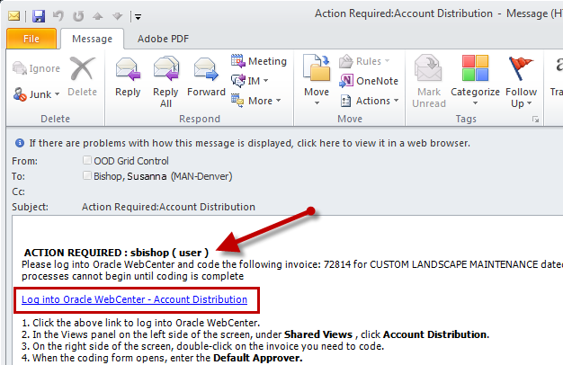
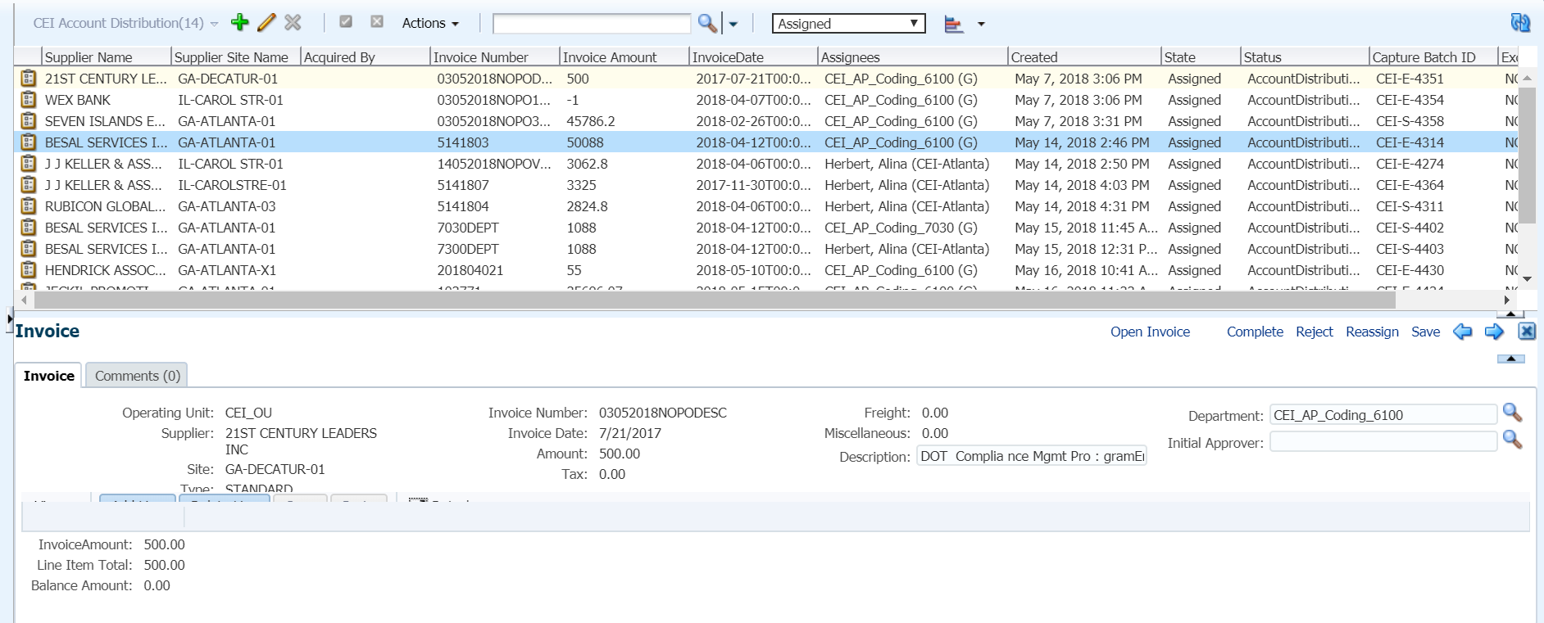
Coding Basics
1
2
Follow the 6 Steps
3

Slide 7
The 6 Steps
1
View the Invoice
2
Verify Information
3
Enter Initial Approver
4
Complete Description
5
Code to an Account or Project
6
Complete

Slide 8

Other Considerations

Slide 9

Questions & Answers

