Slide 1


Slide 2
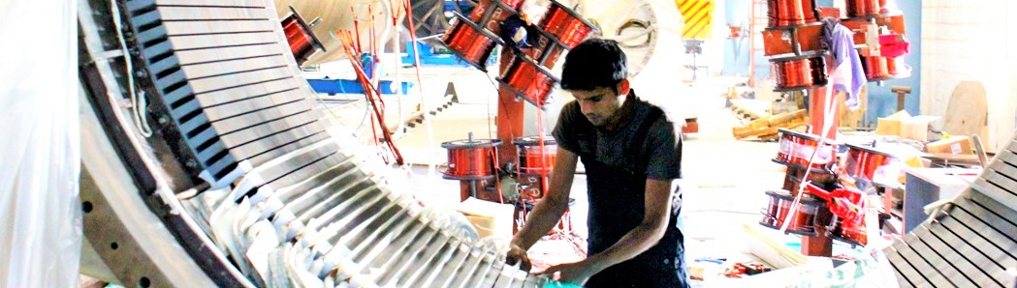
Business
Wind Turbine OEM
BOO & BOOT of Wind energy projects
‘Off grid - Distributed wind’ energy projects
JV manufacturing and technology licensing

Slide 3
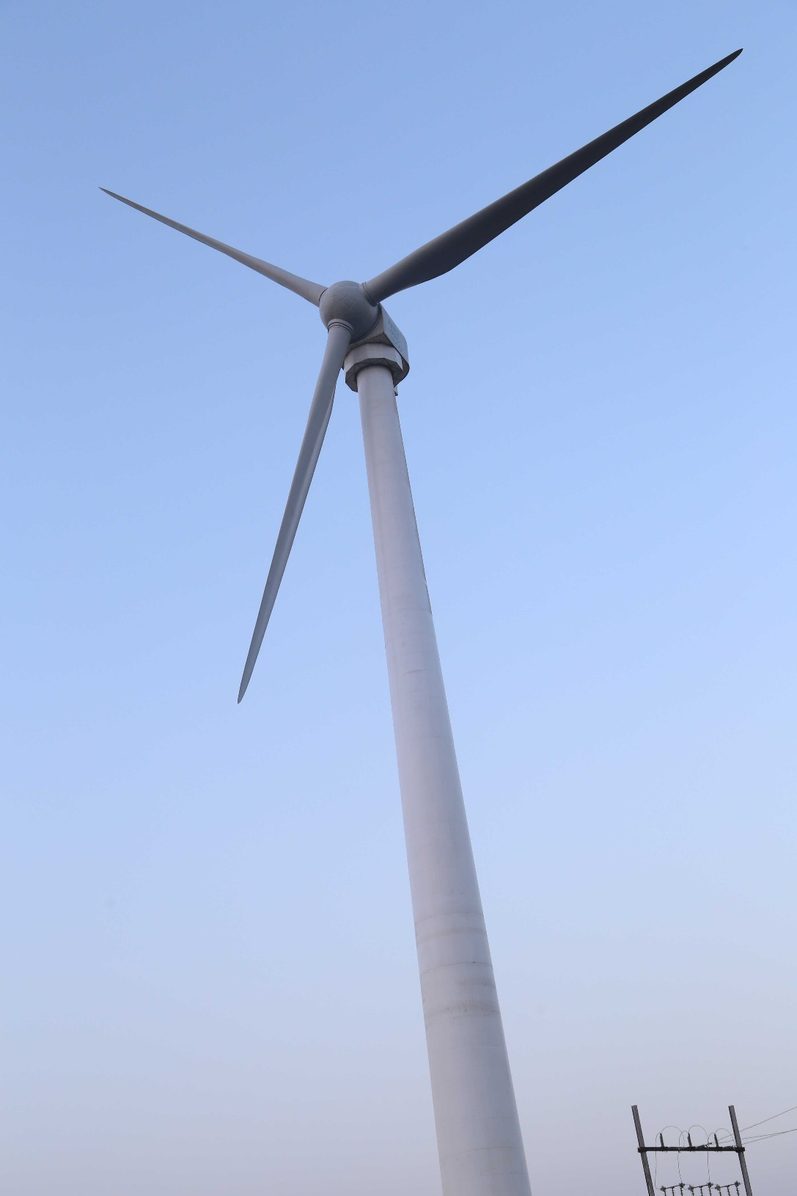
The Turbine
1MW ‘Ex-55’ Model
Direct Drive - No Gearbox
Permanent Magnet Generator
Full Convertor
Hub Height:60/105 mtr
Class: II B
Rotor Dia:55 mtr
Hot/Cold Regions
Low noise levels

Slide 4
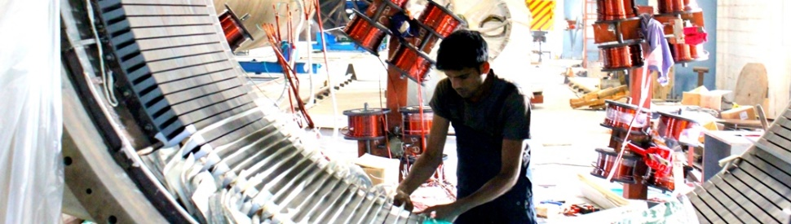
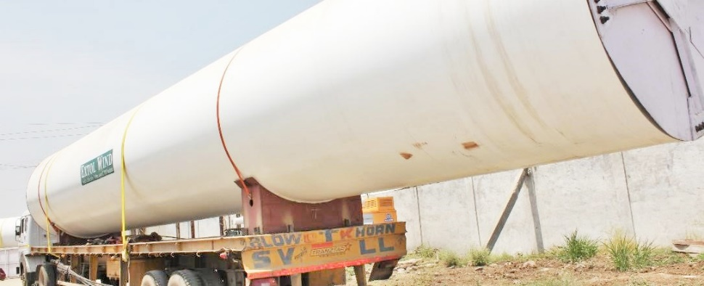
The Company
Promoted by professional from top institutions (IIM, MIT) with rich industry experience
Part of large business house, Extol Group of Companies
10 Years track record of excellence
Proprietary technology of 1 MW and 2.5 MW
Company Standing
  Group owned assets worth $380 M
  Soft Asset-technology and design worth $1B

Slide 5
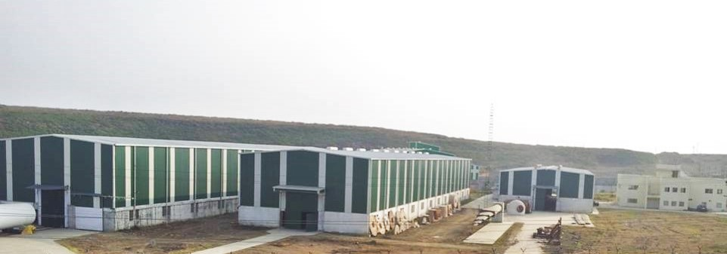
World Class
Manufacturing Facility

Slide 6
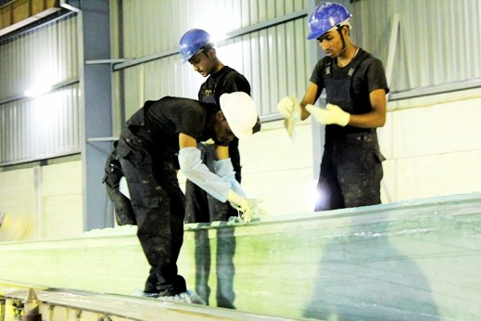
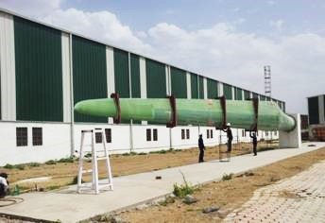
Status
1 MW model under serial production
2.5 MW model under certification
Export orders..\..\3E-EXTOL PURCHASE ORDER.11.03.2015.pdf
GL 2010 Design Approval, Type expected soon
Wind energy projects under construction in India & North America

Slide 7
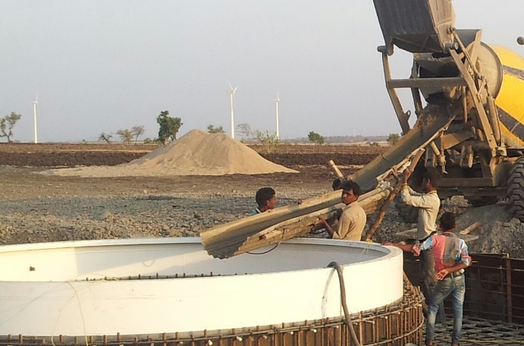
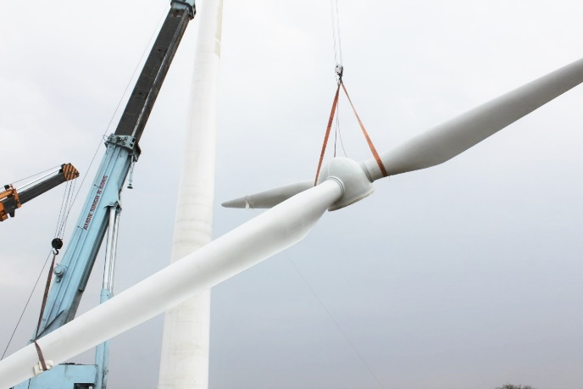
Energy Projects- India
Government PPA backed Wind energy project in India
Pipe line of wind energy project in multiple states (Dewas, Ratlam, Jaisalmer, Pratapgrah, Dhule)
India : PPA, Approvals and grid infrastructure in place at Ratlam, MP
Ph-1 of 5MW underway, PhII-15MW, PhIII-15MW
Assured returns with highest PPA rates of Rs. 5.92/ unit+GBI
BIB Final\drawings for DPR\PPA Agreement scan copy 15 jan 15.pdf

Slide 8
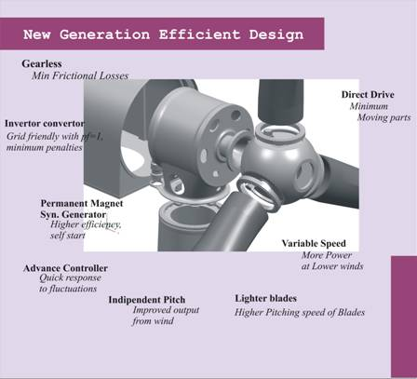
Design
Highly efficient gearless (direct drive) technology platrform
Certification as per Germanaisher LLyod(GL), Germany
Lightest in the class
Permanent magnet generator for improved generation
Combination profile blades for better performance in low wind
Minimalist design- Eliminates number of parts that reduces cost and maintenance
Highest hub height in 1 MW, to tap low wind sites

Slide 9
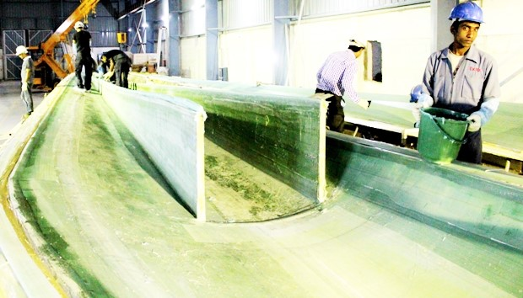
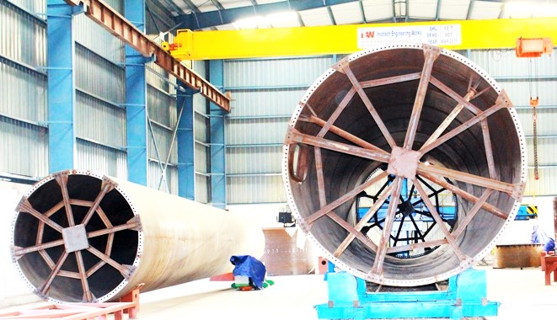
Manufacturing
In-house manufacturing of components including -
Dust/snow resistant Epoxy Blades
Permanent Magnet Generator
Tower, Nacelle, Spinner Cover, Controller
Global Supply chain includes leaders in components manufacturing
ISO & GL approved for process quality

Slide 10
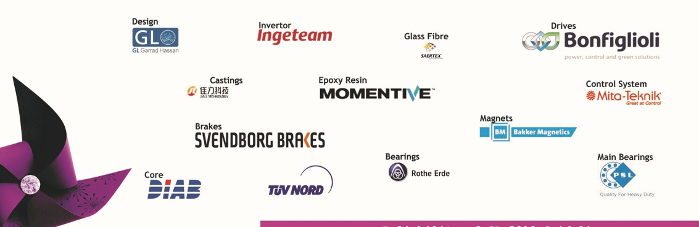
Quality
  Global supply chain of world’s leading component manufacturers
  Momentive, Germany
  Bonfigloli, Italy
  MitaTecnik, Denmark
  Rotherde, Germany
  Ingeteam, Spain
  Bakker Magnetic, Netherlands

Slide 11
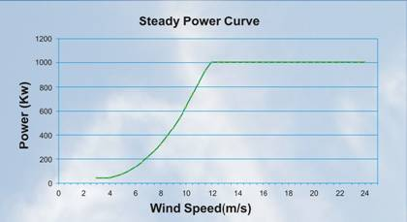
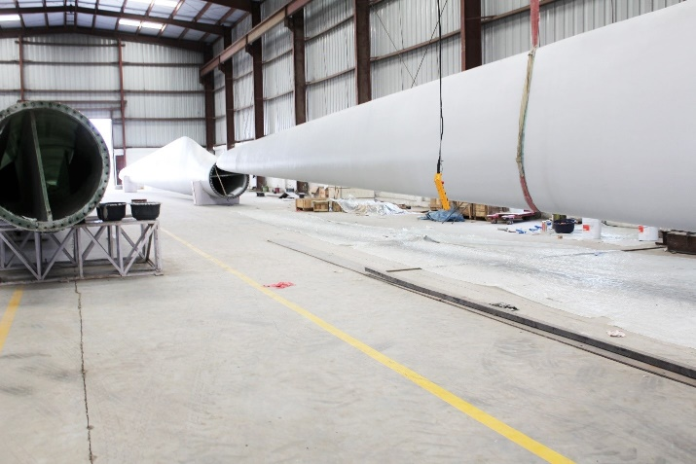
Performance
‘Variable speed’ design gives more power at given speed
‘Gearless design’ limits losses
‘Self start’ adds to generation
‘Full converter’ improves power quality and saves utility deductions
Reducing number of moving parts reduces maintenance and down time
Combination profile blades with high strength-light weight epoxy fiber delivers more power
Higher hub height increases generation

Slide 12
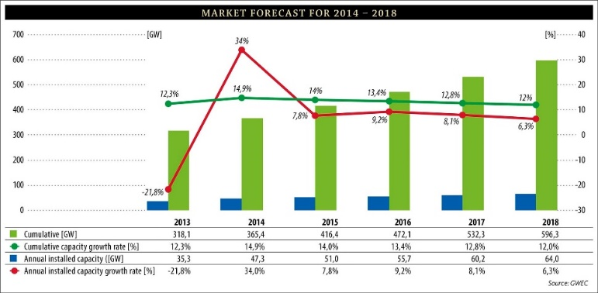
Industry Players
Source:GWEC
OEMs- Global
  Vestas
  GE
  Gamesa
  Siemens#
  Gold Wind#
Technology Companies
  AMSC
  Vensys
  Xyron (Extol Wind)
OEMs- India
  Suzlon
  Wind World*
  Gamesa
  Regen*#
  Inox*
  Kenersys*
Source:MNRE, India
*Franchise Technology
# Direct drive technology

Slide 13
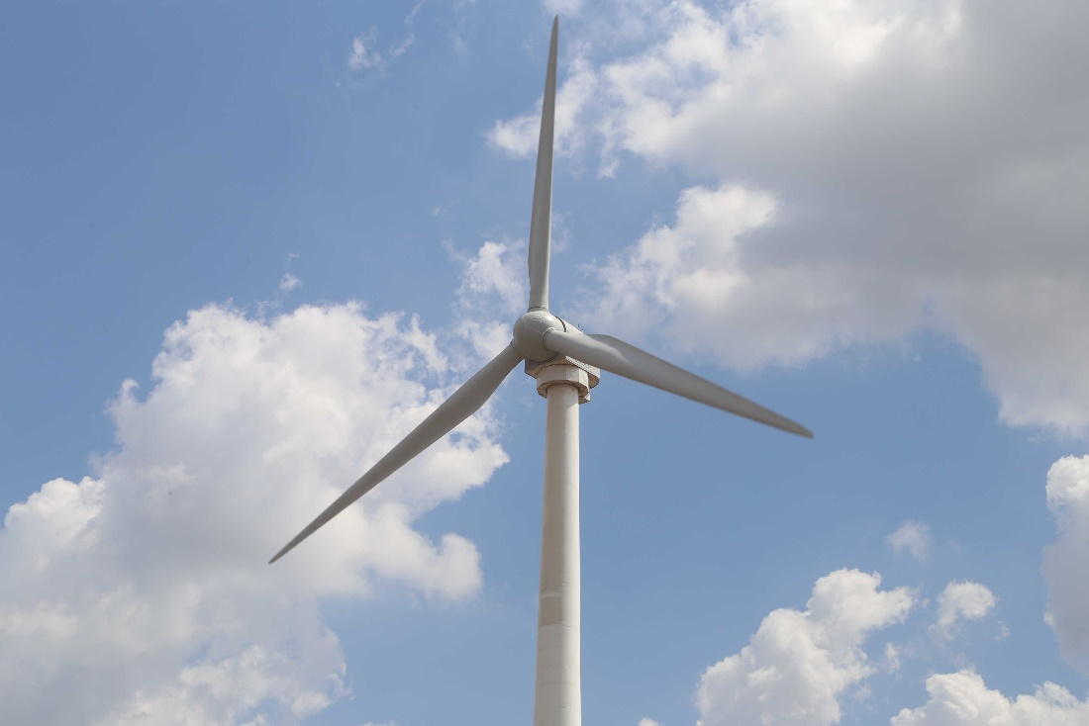
Gearless technology- Comparison
S.NO | COMPONENT | GEARED TURBINES | EXTOL WIND
01 | Gear Box | Huge Gear Box Approximately 40 T | Completely eliminated
02 | Gear Box Oil | More than 2000 Lit. | No Oil
03 | Oil Filter | 2 Nos. | N.A.
04 | Noise levels from mechanical movement | High | Low
05 | Oil circulation Pump | 1 No. | N.A.
06 | Oil Pipe-line & fitting | Required | N.A.
07 | Heat exchangers | Required | N.A.
08 | Radiator fan etc.. | Required | N.A.
09 | Cooling control system | Required | N.A.
10 | Generator cooling system | Required | Natural draft cooling
11 | Flexible coupling to absorb vibration | Required | N.A.
12 | Large size Nacelle | Required | Small Nacelle
13 | Entry to the nacelle (Ease of Repair) | Cumbersome | Easy

Slide 14
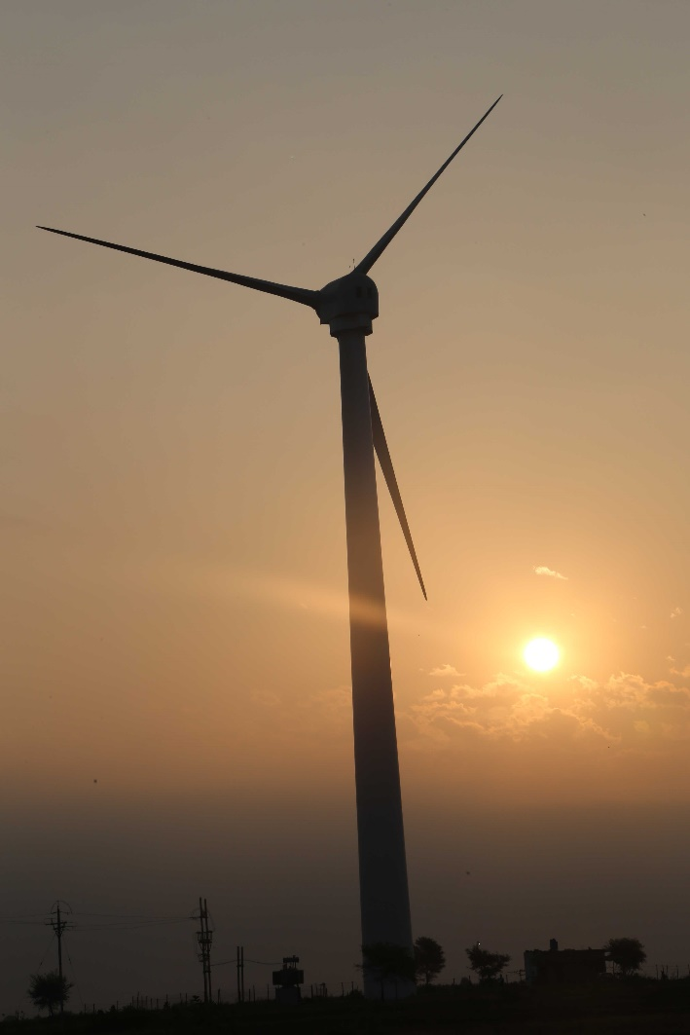
1 MW Installation- The Impact
2500000 (2.5 M Kwh) units of energy per Annum.
Electricity generation to power 5000 homes.
62 million units of generation in 25 years.
Saves environment of 90000 tons of Co2 (carbon di-oxide) emission.
Saves environment of poisonous SoX ,NoX & mercury pollution.
Saves river & water environment of 25,000 tons of ash.
Saves mining damage to sub strata of 46500 tons of coal (cause of deforestation and earth quakes)
Saves ozone layer depletion & global warming.
Saves road transportation congestion of 6 million truck-km.
Saves 2M ltr diesel in transport of coal.
Saves foreign exchange on diesel import costing $ 1.6 million .

Slide 15

www.extolwind.com
Email: ab@extolwind.com
Pictures ..\website

