Slide 1
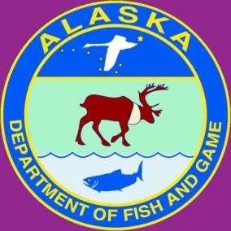
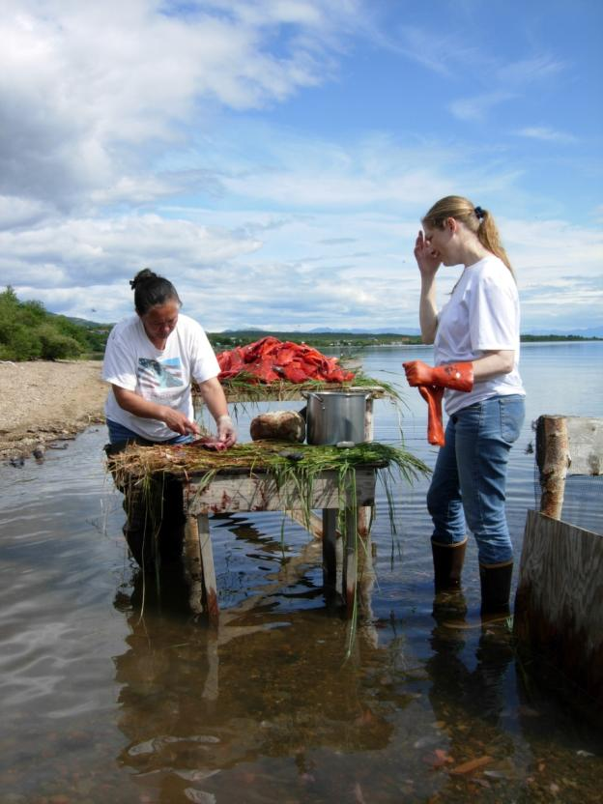
Learning Together:
The Collaborative Research Program of the Division of Subsistence
Jim Simon, Ph.D.
Division of Subsistence,
AK Department of Fish & Game
Arctic Waterways Safety Committee Workshop
Anchorage, AK
December 10-11, 2015
Learning about subsistence fishing, Nondalton
Notes:
My name is Jim Simon. I have been working as an anthropologist in the Arctic for the past 25 years. My current job is serving as the regional supervisor for the ADF&G’s Division of Subsistence for Arctic, Interior, and Western Alaska, a position I’ve held for the past 13 years. Most of this presentation focuses on the Subsistence Division’s collaborative research program, but I will also briefly review the Arctic Marine Mammal research program in the Division of Wildlife Conservation which follows very similar research protocols as the Subsistence Division.

Slide 2
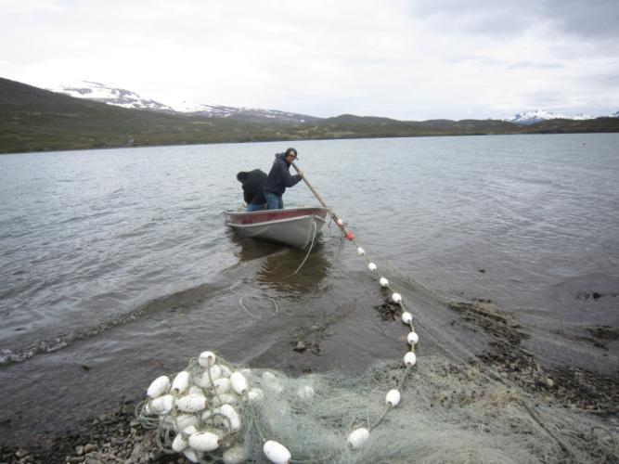
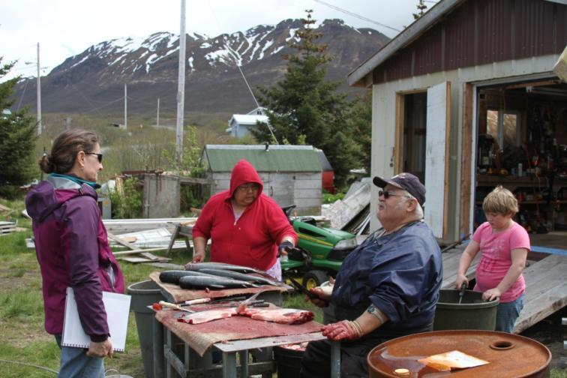
Division of Subsistence: Responsibilities
Alaska Statute 16.05.094 lists “duties”
Research and data compilation
Data reporting and education
Application of study findings
Subsistence fishing and processing,
Chignik Lake
Notes:
The Alaska Legislature directs the Division of Subsistence to compile existing data and conduct studies with subsistence users on all aspects of the role of fish and wildlife in the lives of Alaska residents and make such information available to the public, agencies, and regulators. I apologize for the pictures in this presentation that come from throughout Alaska instead of only the Arctic region.

Slide 3
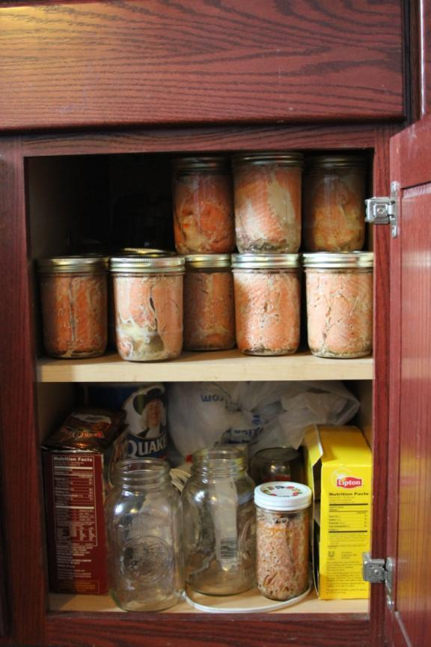
Types of research projects
Goal: “holistic” understanding of mixed economy and way of life
Community “baseline” studies (focus on one year)
Special topic research
Local and Traditional Knowledge
Harvest monitoring (multi-year)
Most projects are partnerships
Guided by ethical principles
Notes:
The Division of Subsistence conducts a variety of types of research working with Alaska residents directly. Virtually all of our research projects are conducted in partnership with local tribal governments consistent with Arctic social sciences research ethical principles.
Community consultation is key to the Subsistence Division’s research program. Our research works with people, so we do not have equipment in Arctic marine waterways that affects fish and wildlife. Most of our work takes place in people’s homes or camps and we sometimes are able to participate directly with subsistence users in hunting, fishing, and trapping activities. Our research typically takes place in the winter when people are more likely to be at home and to reduce the impact on people’s time during important subsistence activities.

Slide 4
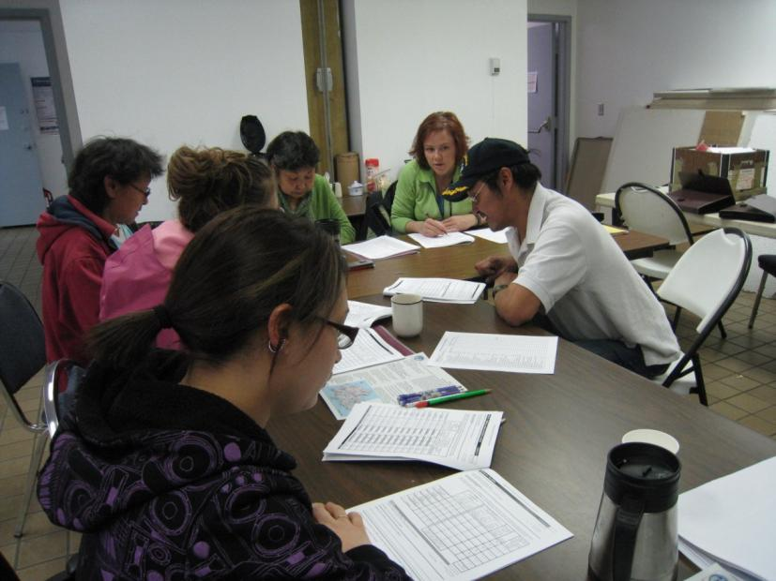
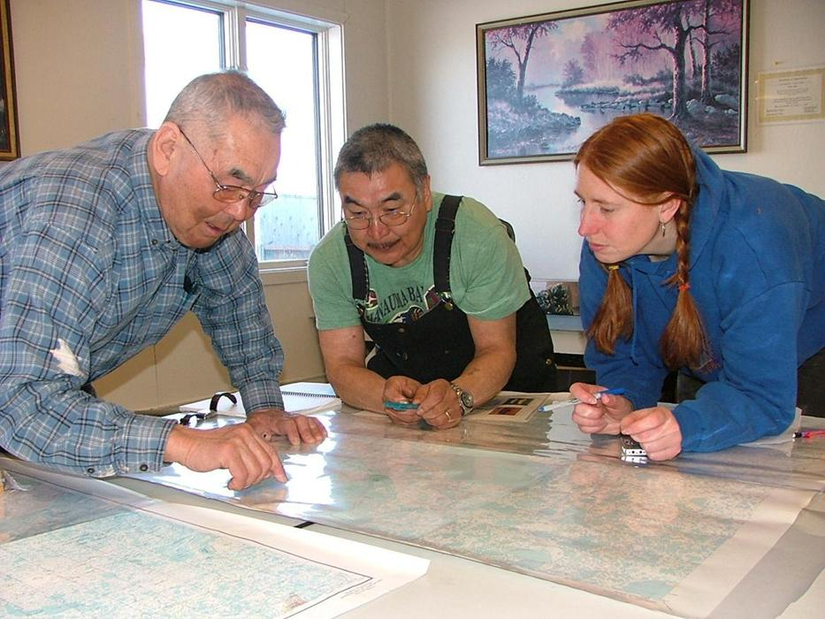
Ethical Principles
Alaska Federation of Natives: http://ankn.uaf.edu/IKS/afnguide.html
National Science Foundation: http://www.nsf.gov/geo/plr/arctic/conduct.jsp
State confidentiality statute: AS 16.05.815
Informed consent
Anonymous & Voluntary participation
Community approval & review
Study findings provided to communities
Notes:
In conducting our research, the Division of Subsistence follows the ethical research principles adopted in 1993 by the Alaska Federation of Natives and the Principles for the Conduct of Research in the Arctic adopted by the National Science Foundation’s Office of Polar Programs. In addition, the division protects the confidentiality and anonymity of subject matter experts participating in our research projects. We do not conduct research in cases where the community does not support their participation in the project. After a community approves the research project proposed, the Division of Subsistence attempts to incorporate local concerns into the research design of the project and does not release research results until after a community review meeting of the preliminary data. Individual household participation in the research is voluntary and consistent with principles of informed consent. The division remains committed to providing research findings back to the community that incorporates community review comments in the final reports. We also strive to provide summary letter reports to each community household in participating research communities.

Slide 5
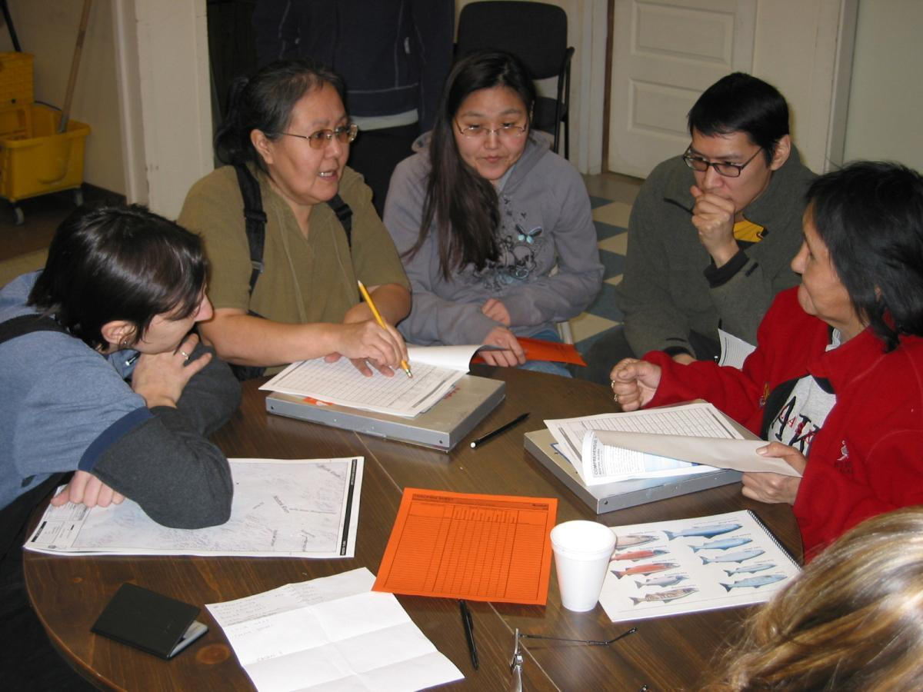
Methods: Local assistant training in Noatak
Notes:
In addition to tribal consultation to support collaborative research on subsistence, the Division of Subsistence hires and trains local research assistants in each community where we conduct research so that local community members are directly involved in data collection, as this results in better data and ensures community members fully understand the research being conducted.

Slide 6
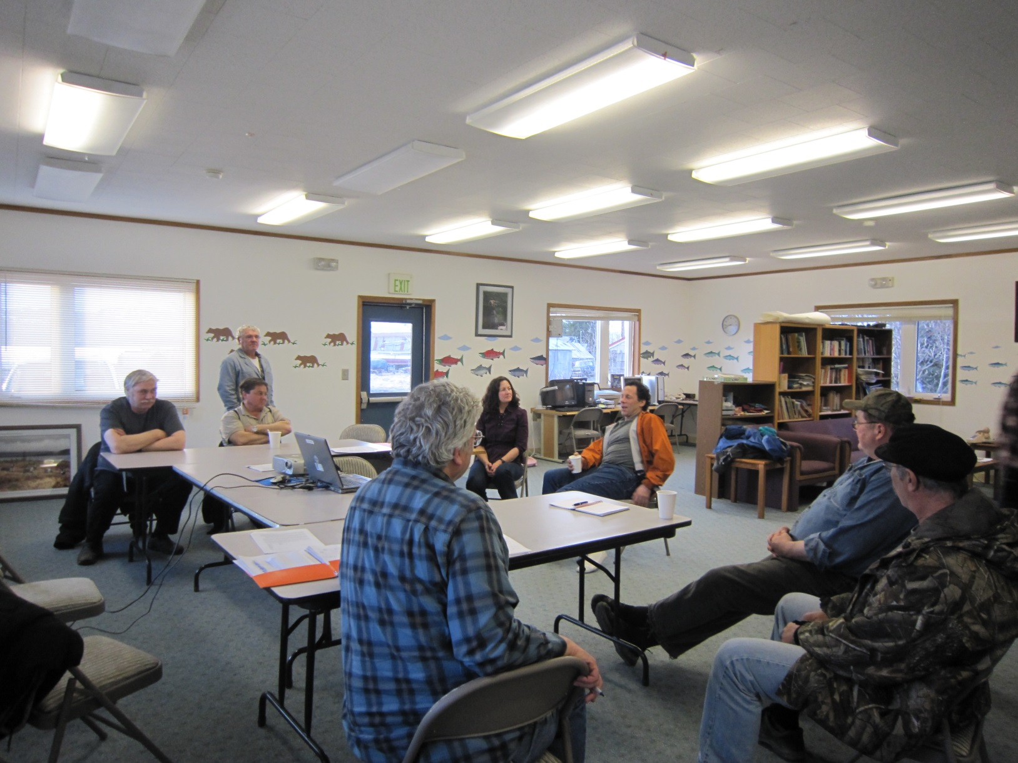
Methods: Project Review Meeting in Chignik Lake
Notes:
Once preliminary data results are developed, the Division of Subsistence then takes those draft data back to the community and holds a meeting with the tribal council and other interested community members to review the preliminary research findings and evaluate the results. Comments received during these community data review meetings are then considered and included in the final research report. This process helps to ensure that subsistence users themselves have a direct role in helping to interpret research findings as they are the real experts on subsistence harvest and use activities.

Slide 7
Community Subsistence Information System or “CSIS”
Online at http://www.adfg.alaska.gov/sb/CSIS/
Searchable by resource, area, or community
Export data into Excel file
Data in CSIS for over 75% of rural places
Number of data sets in CSIS = ~440 (community/year combinations)
Notes:
ADF&G Division of Subsistence research results are typically made available to the public through the on-line Community Subsistence Information System, otherwise called the CSIS. Members of the public can search this database of more than 400 community data sets by resource, area, or community. All of our more than 400 technical reports are also available on the Division of Subsistence website.

Slide 8
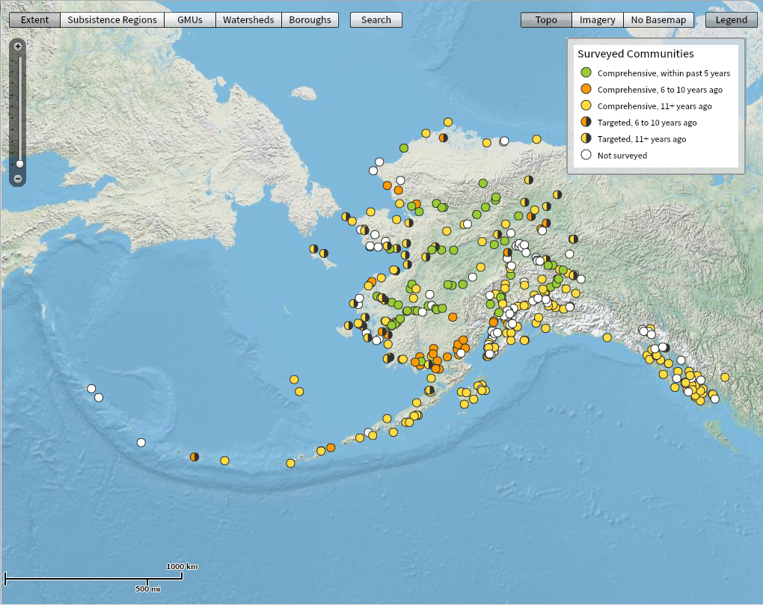
Community Subsistence Information System
Notes:
Here is a map of representing the data found within the CSIS. The white dots represent communities for which we have not conducted research, although it is important to note that a number of these communities have recently participated in Subsistence Division research since this map was created.

Slide 9
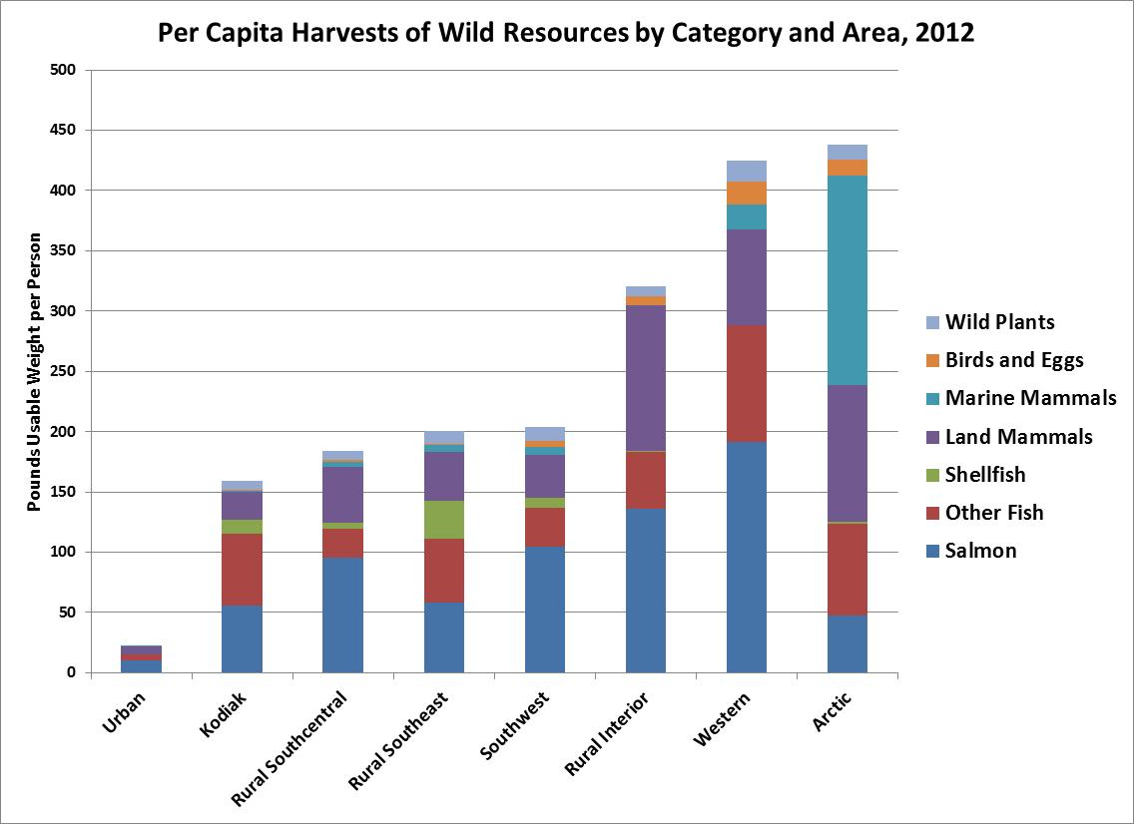
Notes:
The Division of Subsistence also regularly models statewide subsistence harvests to assist the public, agencies, and regulators to better understand the role of wild foods in the mixed subsistence and cash economies of Alaskan places. You’ll note here that on average residents of Arctic and Western Alaska harvest more than 400 pounds of wild foods per person each year. The different colors in this columnar graph represent different resource categories. Please note especially the blue part of the Arctic column on the far right, above the purple land mammals, which represents marine mammals that is probably of most concern to this group. More detailed information can be found the Subsistence Division’s website.

Slide 10
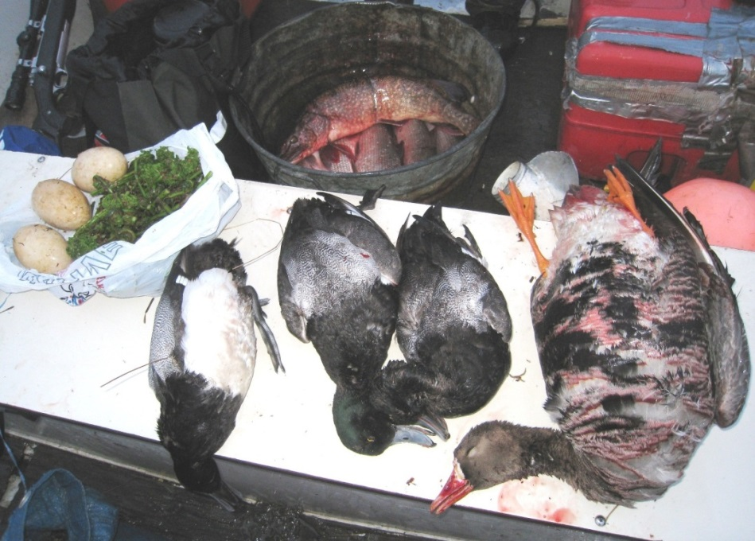
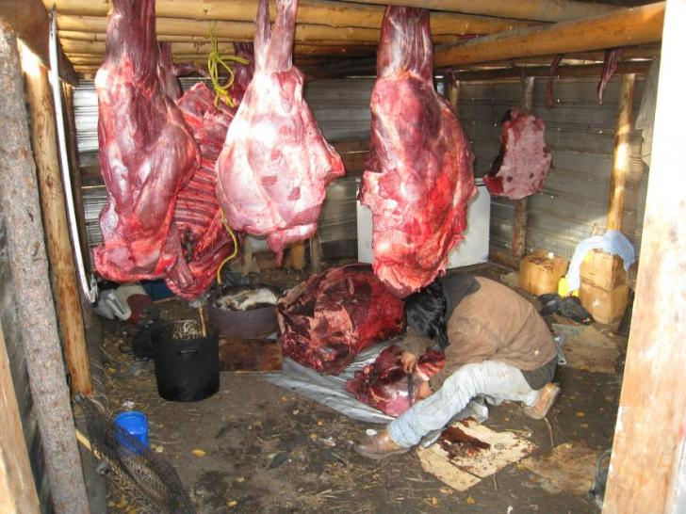
For more information
Jim Simon, 459-7317 or james.simon@alaska.gov
Website: http://www.adfg.alaska.gov/index.cfm?adfg=subsistence.main
CSIS: http://www.adfg.alaska.gov/sb/CSIS/
Phone: 907-465-4147
Mailing and e-mail
Notes:
For more information, please feel free to contact me directly, consult our website for access to Technical Papers of research results, or consult the CSIS to learn more about the subsistence information available by area, resource, or community.

Slide 11
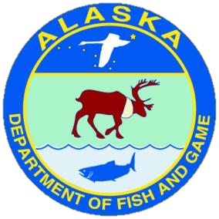
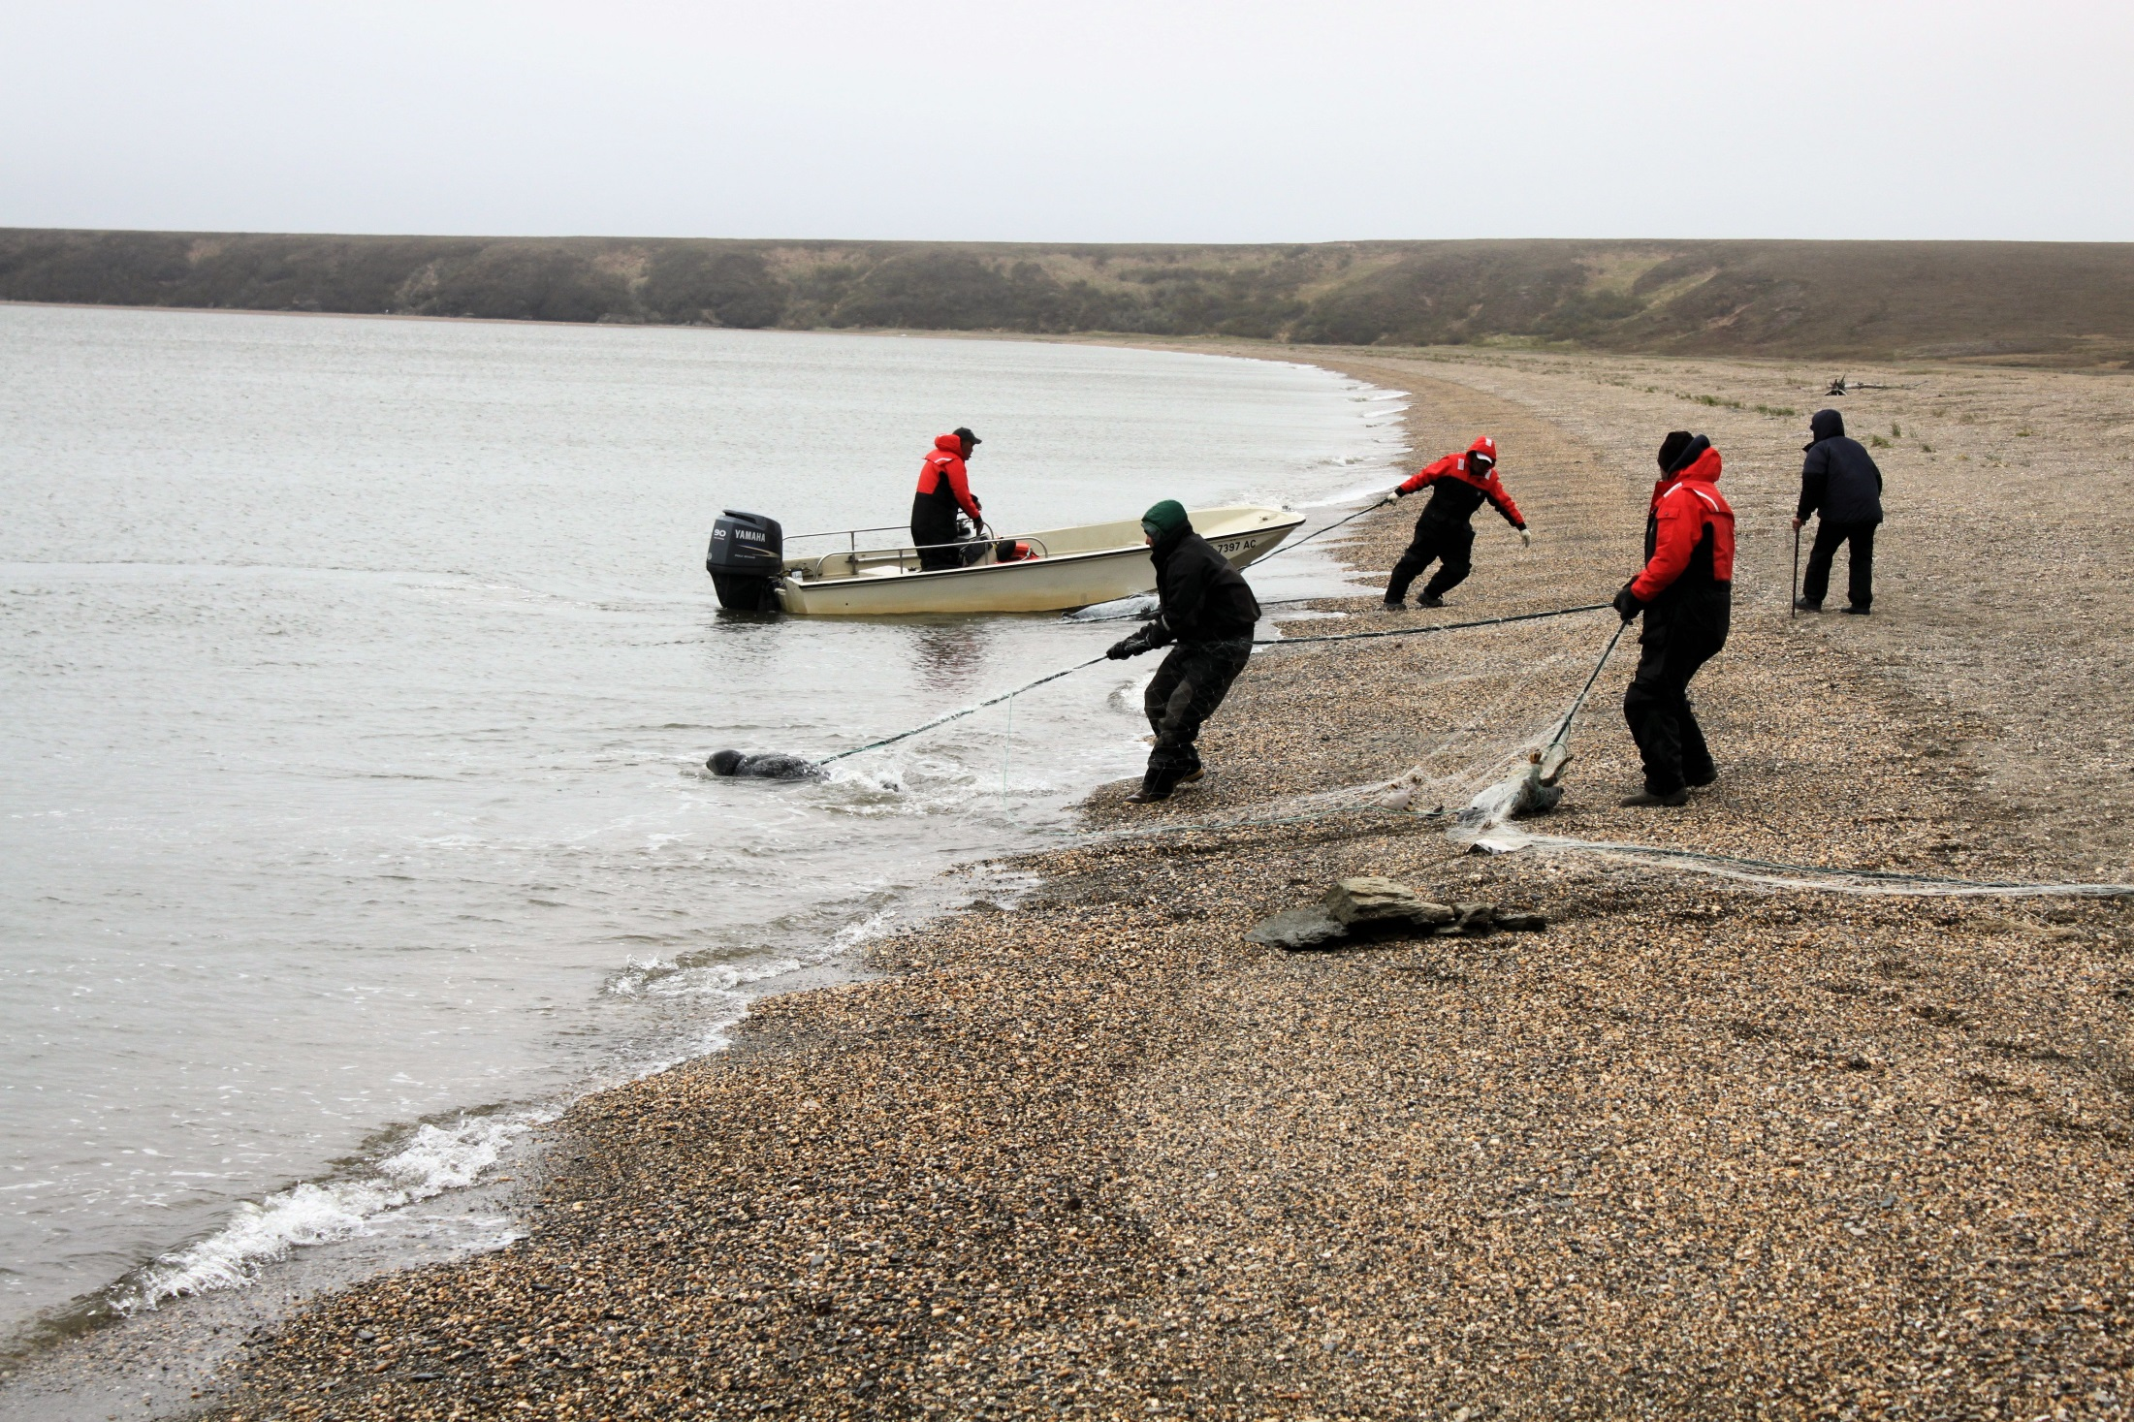
Hunters and biologists work together on all
marine mammal research projects within the
Arctic Marine Mammal Program
On the water projects include: Satellite tagging of bowhead, gray, and beluga whales, ringed and bearded seals, and walrus.
Notes:
Finally, the ADF&G Division of Wildlife Conservation’s Arctic Marine Mammal Program consults with Alaska Native Organizations such as the Alaska Eskimo Whaling Commission, Ice Seal Committee, and Eskimo Walrus Commission to identify research priorities and then consult with individual tribal councils to obtain research approval and then work directly with local marine mammal hunters. Similar to the Division of Subsistence, the Arctic Marine Mammal research program does not have their own equipment and vessels working in Arctic marine waters, but accompany subsistence hunters during their subsistence hunting activities from April through October in local boats to deploy satellite tags on bowhead whales, gray and white whales, ringed and bearded seals, as well as walrus.

