Slide 1
Sfi group inc.
www.sfigroupinc.com

Slide 2
New luxury Hotel
Location – Yakima WA
Floors – 20
Rooms – 201
24 Hr. Room service.
Restaurant.
Day SPA.
Convenience & Gift shop.
Wine tasting bar.
Luxury car services.
Starbucks (pending)
Fitness center.
Indoor Pool, Hot tub, and Sauna.
Planned open date 2019-2020
Complimentary airport shuttle

Slide 3
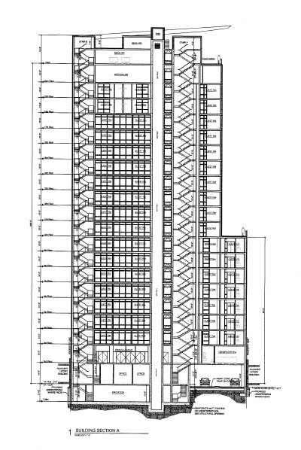
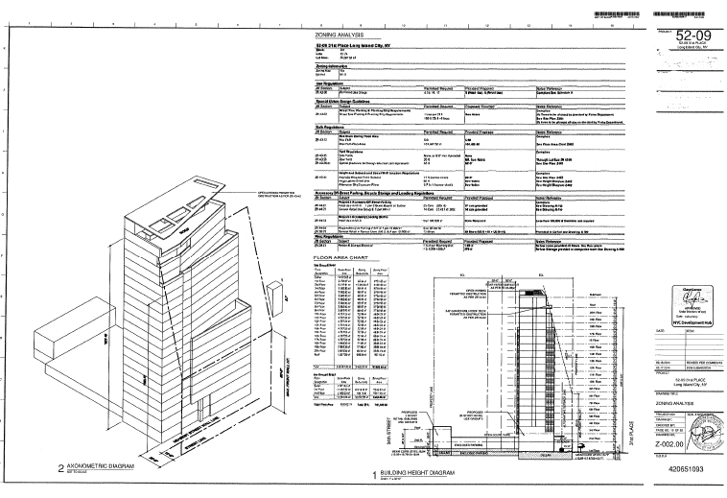

Slide 4
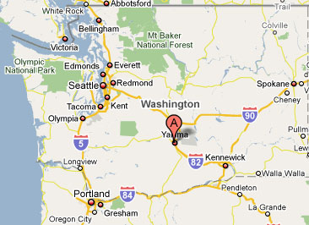
Location: Yakima WA
Set in a region rich in variety and diversity, Yakima is a perfect day trip for getting outdoors or to enjoy the bountiful agriculture the city has to offer.
Visitors are enticed by the geographical change to a more sunny climate relative to the rest of Washington state bosting 300 days of sunshine.
Yakima is situated in Yakima Valley, which is noted for being one of the best apple-producing areas in the world and for producing three-quarters of the nation's hops.
It’s also known as one of Washington's viticulture areas and features some of the region’s most delightful wines, as it sits at the same latitude as the great wine-producing regions of France.

Slide 5
Restaurant
Dinning Ambiance
On the Menu

Slide 6
Hotel Day SPA & Salon
Services
Massage
Body Treatments
Facial
Pedicure & Manicure
Relaxation Journey
Professional Makeup & Hair

Slide 7
Hotel shop
The hotel gift shop will sell local products, Memorabilia, Washington State Wines, Beer, and Convenience items everything from Sunblock to Toothbrushes anything that a traveler might need.

Slide 8
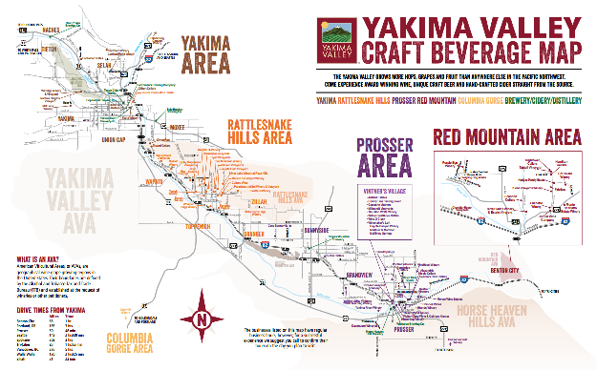
The Hotel will host a dedicated wine lounge with tasting bar that promotes Yakima Valley & Washington State wines. A minimal cork service fee will allow customers to sample any bottle we sell. We will negotiate directly with wineries to promote their wines in exchange for steep discounted or free bottles to sample for our customers. Washington State has over 100 wineries.

Slide 9
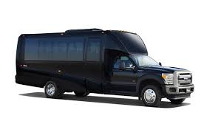
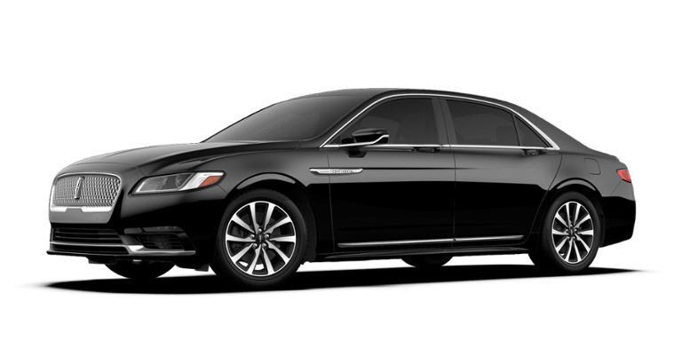
Hotel Car & Shuttle Services.
The Hotel will offer a luxury wine tour service. The will transport customers to select local wineries or around town for a minimum price and or an hourly fee.
The hotel will offer a curtesy shuttle service to an from the Airport and Apple Tree Golf course.
Town car services will also be available for customers who wish to visit Yakima’s other many destinations. For minimum fee or mileage rate.

Slide 10
Hotel value
Appraisal at completion $65 million
75 – 100 new jobs
Hundreds of supporting jobs during construction.
First and only 4 star high rise hotel in Yakima WA.
The Hotel will capitalize on an existing hospitality market that exceeds $300 Million dollars locally.

Slide 11
Current Location & Planned Hotel

Slide 12
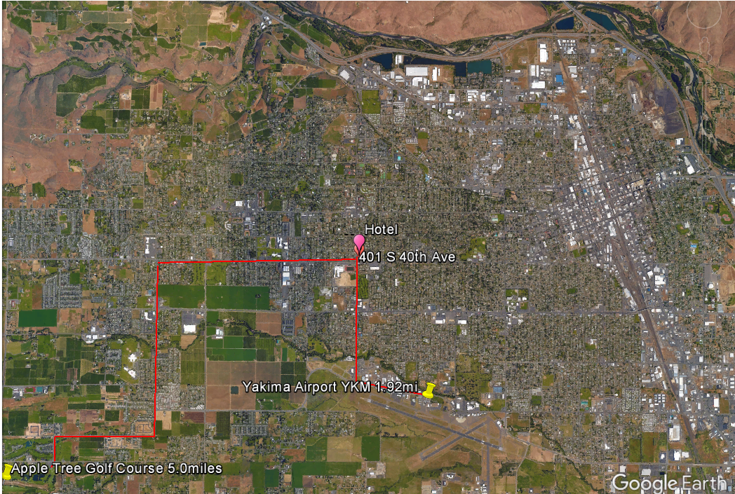

Slide 13
Destination Apple Tree Golf Course www.appletreeresort.com

Slide 14
The Request
$100 Million sale of equity
Security offered: common shares.
Use of funds:
To be built 20 floor, 201 room Hotel in Yakima WA.
Additional locations planned in WA, OR, & CA.
Zebulon Way CEO
zebulonway@sfigroupinc.com
877-628-2282

Slide 15
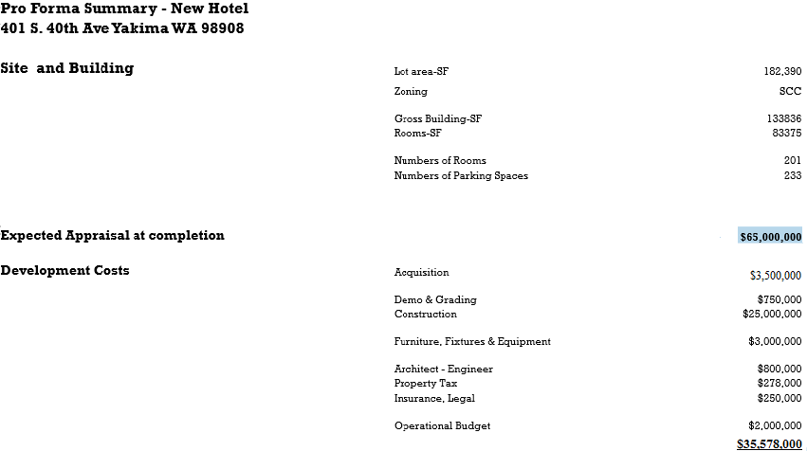

Slide 16
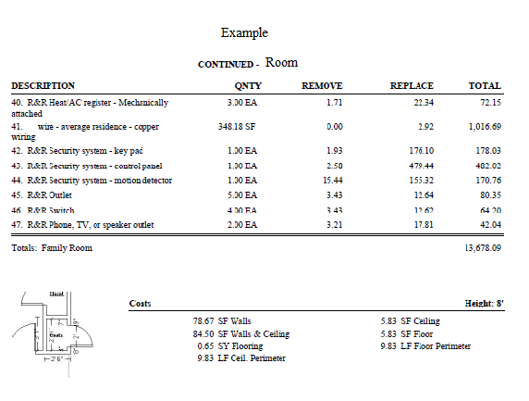
Hotel Pricing & project planning
Xactimate software also helps us build project schedules and time allowance's to schedule project time frames.
We use Xactimate estimating software that is updated monthly with the most current cost of materials and labor to industry standard pricing.
This powerful software provides us with the ability to accurately estimate the cost of any project or task to the inch, including allowances for waste or minimum charges.
We will use this software along with a completed and approved architecturally designed building plan, to build a complete, detailed, and accurate pricing picture, allowing us to confidently know what pricing is accurate.

Slide 17
strategy
We plan to build luxury Hotels in key markets that are currently underserviced in-order to corner the markets in select locations.
It is our goal to become a leader in the Hospitality Industry by offering consistent service and value in a hospitality brand that our customers can rely on.

Slide 18
Goal's
Short term goal’s:
Sell $100 mil. in common shares
Acquire new location
Build our flagship Hotel
Open for service by 2019
Exceed 75% occupancy
Plan additional locations
Long term goal’s:
2nd round of capital target $10 billion PPM. by 2020.
Use funds to acquire a top competitor.
Reorganize assets, focus on maximizing Profits and Efficiency.
Issue new IPO for SFI GROUP INC. target $20 to $25 billion dollar market cap. by 2021

Slide 19
Contact information
Zebulon Way CEO
Office:877-628-2282
Email: zebulonway@sfigroupinc.com
www.sfigroupinc.com

