Slide 1
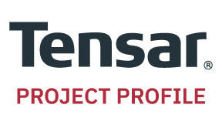
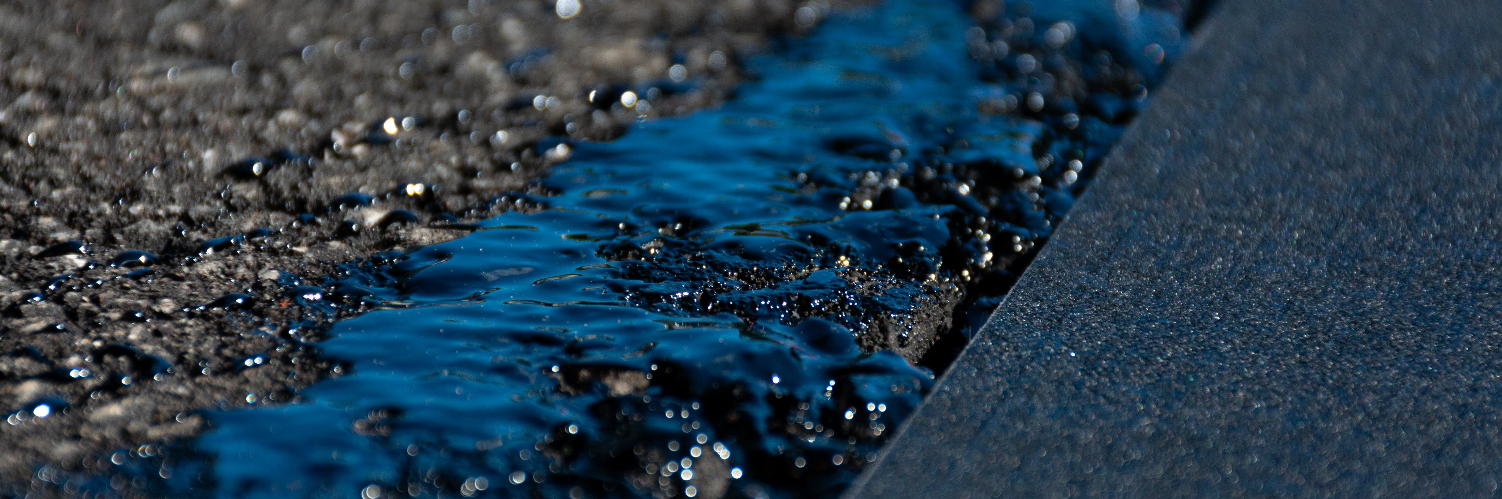


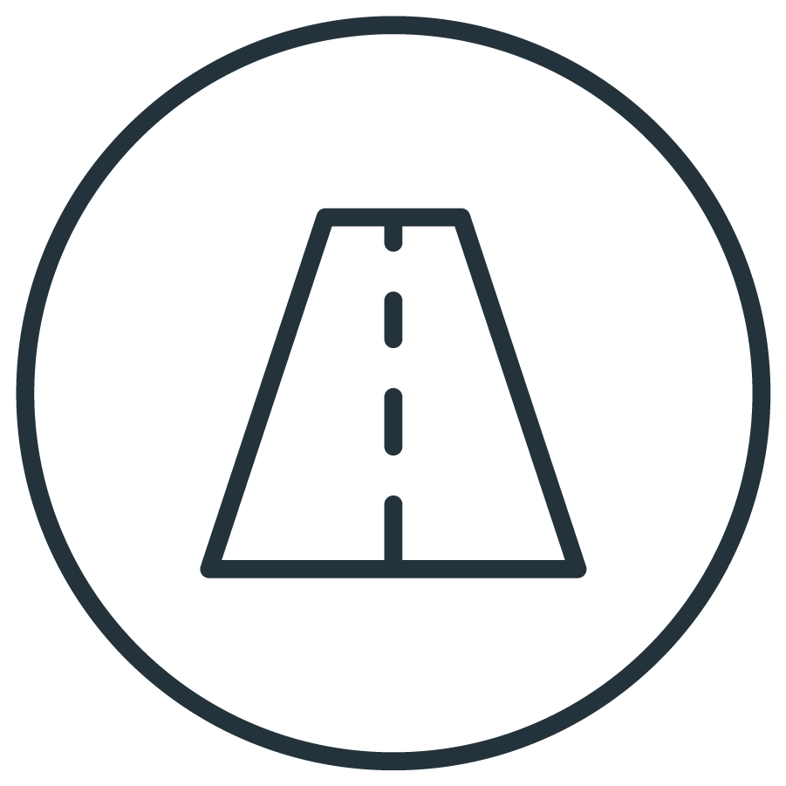


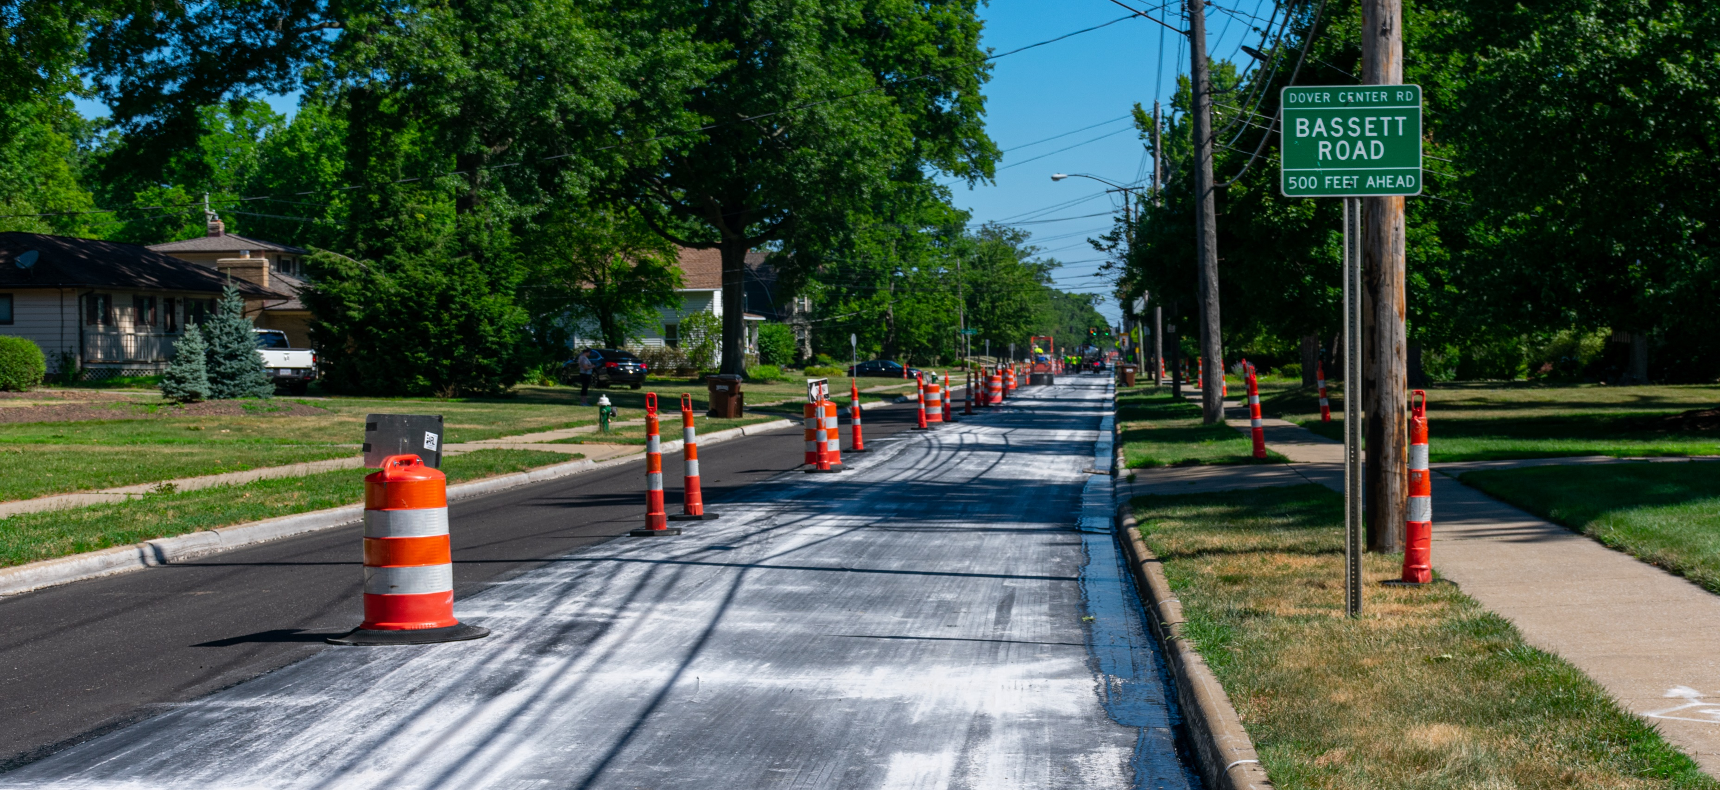
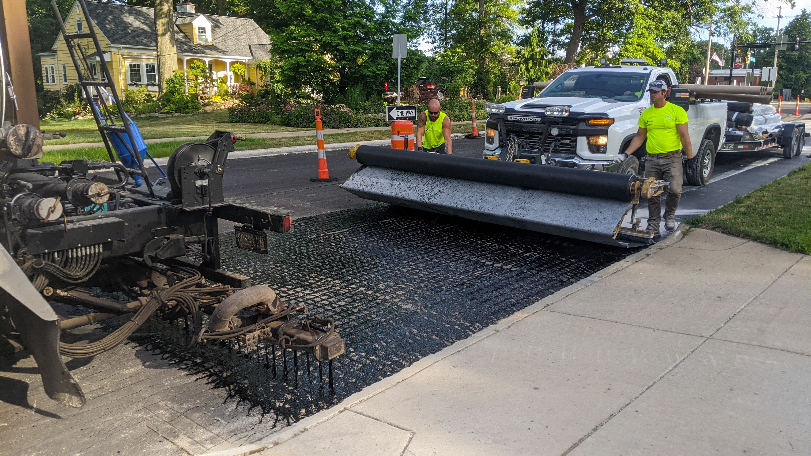
For roads that beat the winter freeze, design with GlasPave®.
Dover Center Road
Westlake, OH
CLIENT’S CHALLENGE
The City of Westlake routinely seeks to extend the life of their pavements. Freeze-thaw cycles and repeated trafficking result in unsightly cracking that threatens the structural integrity of city streets. In the past, GlasPave® has helped Westlake get the most out of their roads, and it was again an appropriate fit for the resurfacing of Dover Center Road.
TENSAR SOLUTION
3 inches of road surface milling was followed by chip sealing of the milled surface. A 1.5 inch lift of leveling course asphalt was placed next, followed by the installation of the GP25 GlasPave®, and finally the 1.5 inch surface lift of asphalt. The resulting road is better equipped to handle both the elements and trafficking, which saves money and resources in the long-term maintenance cycle of the road.
City of Westlake
Owner
Asphalt Fabrics
Specialty Installer
Specialized Construction
Contractor
Installation: 2022
Product: GP25 GlasPave®
Distributed By:

