Slide 1
Three-Player Kuhn Poker with Logic
Robert Timothy Panoff & Carolina Uribe-Gosselin
Artificial Intelligence – Fall 2017 – Sam Ganzfried
School of Computing & Information Sciences

Slide 2
Extensive-Form Game Tree using Gambit
An extensive-form game tree essentially is a diagram that shows every possible outcome based off an action.

Slide 3
Extensive-Form Game Tree using Gambit

Slide 4
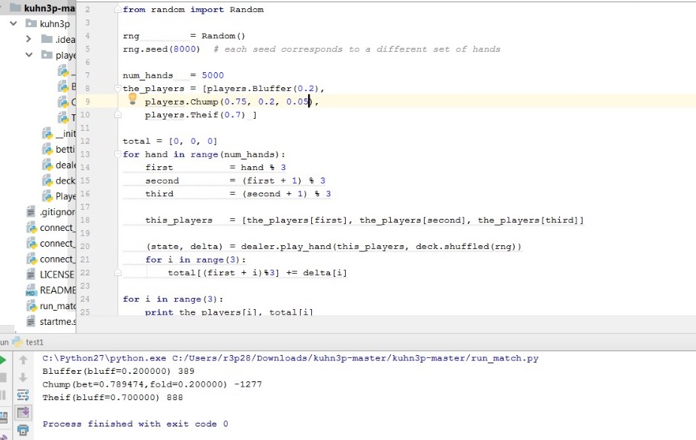
Results

Slide 5
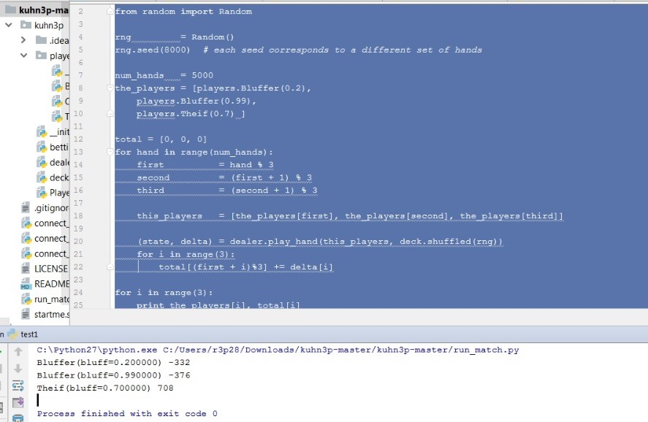
Results

