Slide 1
2016 Lifesharing Conference
Resources to Supplement Lifesharing During Life Changes
Presented by Rita Mandik, and Kathy Trumbore, MSW
KenCrest Services Lifesharing

Slide 3
Life stages:
Prenatal/Infancy
Early Childhood
School Age
Transition
Adulthood
Aging

Slide 4
Life Domains:
Daily life and employment
Community Living
Safety and Security
Healthy Living
Social and Spirituality
Citizenship and Advocacy

Slide 5
Important Questions:
What are other people my age doing, and what accommodations do I need to have similar life experiences?
Am I learning to create community connections and social capital?
How could adaptations assist me in living the life I want?
Am I learning how to access and integrate a variety of different types of support?

Slide 6
Do you feel empowered to ask questions, and support me to ask questions?
Do you have someone to talk to about your feelings and concerns, so that you don’t feel alone?
Are you helping me to create a vision for my own life?
How are you encouraging self-determination at all ages, stages and aspects of my life?
Are you always keeping an eye to the future or to the next stages of my life, and helping me to learn to do the same?

Slide 8
What is Assistive Technology?
An assistive techology device is “any item, piece of equipment, or product system, whether acquire commercially, modified, or customize, that is used to increase, maintain, or improve functional capabilities of individuals with disabilities”
~ PA Initiative on Assistive Technology

Slide 9
Examples:

Slide 10
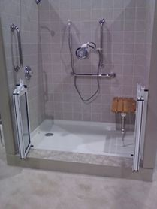
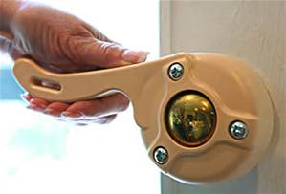

Slide 11
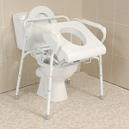

Slide 12
UTILIZE YOUR TEAM!!!

Slide 13
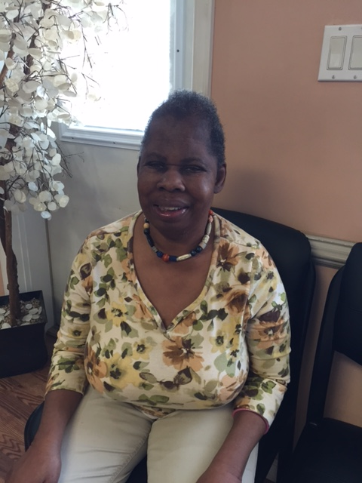
Anna’s Story

Slide 14
Resources:
www.lifecoursetools.com/planning
Mofamilytofamily.org
www.aging.pa.gov/local-resources/pa-link
https://ici.umn.edu/products/impact/231/
Wrightstuff.biz
AGING AND DISABILITY RESOURCE CENTER
TOLL FREE HELPLINE:
1-800-753-8827

Slide 16
Building Supports Into Your Budget
Creative Supports Require Creative Budgets

Slide 17
Where to start?
In order to get the most out of a budget to meet the needs of an individual you need to understand the basics.
Consolidated Waiver
Residential Habilitation

Slide 18
Waiver Funding
Medicare- entitlement program- pay into it and you are entitled to get something out of it. (SSDI)
Medicaid- needs based. You need to meet the qualifications to obtain this. (SSI)
Waiver funding is from Medicaid which is needs based
Consolidated Waiver(2176)
Notes:
Medicaid- reason why you can’t double bill while in hospital
Consolidated- needs have to be met PFDSW- $30,000 cap and this can’t be used for LS

Slide 19
Did you know…..
All waiver funding is split between federal and state dollars?
Federal is: %52.01
State is: %47.99

Slide 20
Residential Habilitation (bundled/ per diem services)

Slide 21
Residential Habilitation is Daily Billing
This service is authorized as a day unit. A day is defined as a period of a minimum of 12 hours of non-continuous care rendered by a residential habilitation provider within a 24-hour period beginning at 12:00am and ending at 11:59pm. The exception to this rule, effective July 1, 2015, occurs when an individual is admitted to a hospital or nursing facility. When this occurs the residential habilitation provider may not bill for the day the individual is admitted regardless of how many hours of care the residential habilitation provider has rendered during the 24-hour period. When an individual is discharged from a hospital or nursing facility the residential habilitation provider may bill for the discharge day of service regardless of how many hours of care the residential habilitation provider has rendered during the 24-hour period.
Substitute care is considered to be in program as money is being paid for a service.

Slide 22
HCBS? No Sweat!!!
All residential habilitation settings in which Residential Habilitation services are provided must be integrated and dispersed in the community in noncontiguous locations, and may not be located on campus settings.
Separate from any other ODP funded residential hab settings
Dispersed in the community
Located in the community surrounded by the general public
Requires approval

Slide 23
Residential Habilitation? Family Living? Don’t you mean Lifesharing?!?!?

Slide 24
Not Able to Use Some Discreet Services

Slide 25
Lifesharing Discreet Eligible Services
Why are they important to you?
Home and Community habilitation- in place of a day program (8am-5pm)
Home modifications
Vehicle modifications
Nursing

Slide 26
So What is Allowed?

Slide 27
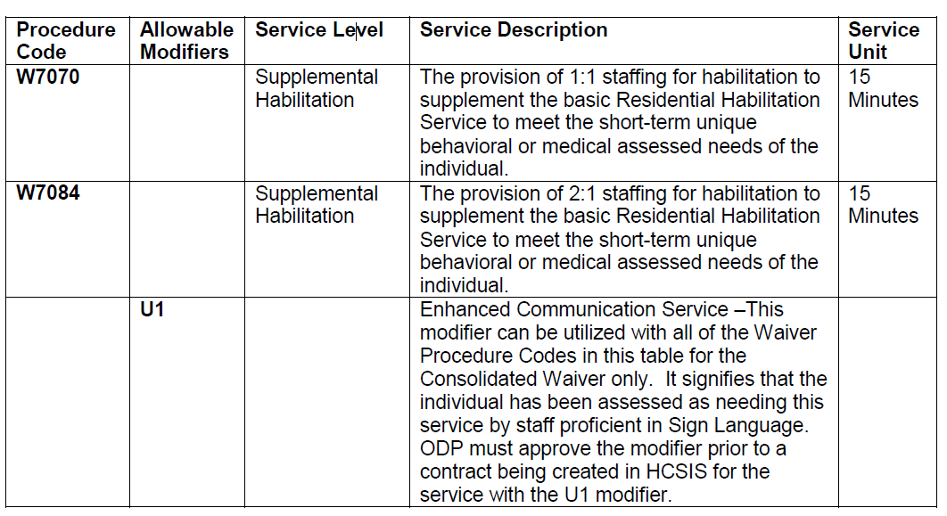
Supplemental Habilitation- Unit based (Licensed Only)

Slide 28
Additional Individualized Staffing- Unit Based (Licensed only)

Slide 29
Critical Revision?

Slide 30
Home and Community Habilitation as a day program
By the way….Anything can be habilitation!!!!

Slide 31
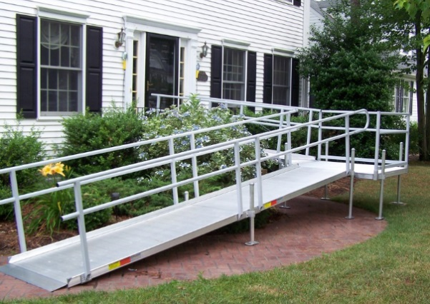
Home Modifications

Slide 32
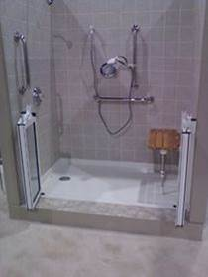
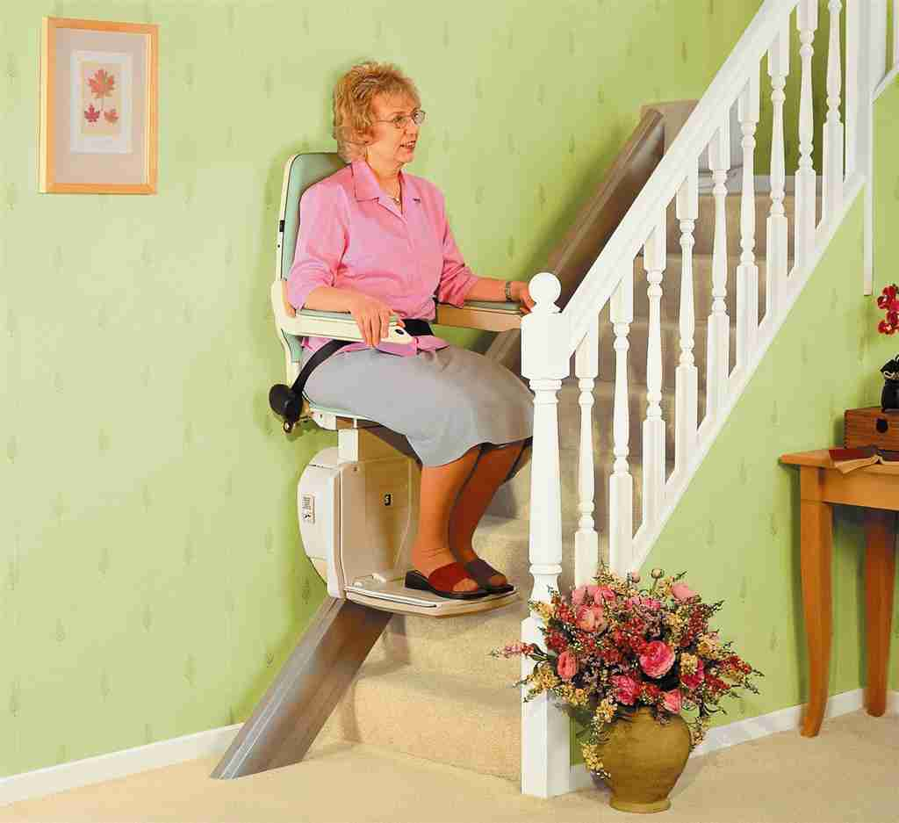
Home Modifications

Slide 33
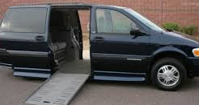
Vehicle Modifications

Slide 34
Nursing Services

Slide 35
Service Requirements (must be RN or LPN)

Slide 36
High Cost Budget….What?
Ideas you can use it for?????
Increased medical need
Increased behavioral need
Increased transportation
Benjamin and Harry Settlements
for adaptations
Be prepared with information……………………

Slide 38
What Does the Future Hold?
Rate Setting
Service Definitions
Autism
Natural families

Slide 39
Resources
Service Definitions
http://www.dhs.state.pa.us/cs/groups/webcontent/documents/document/c_179843.pdf
Chapter 6500- licensing regulations
http://www.pacode.com/secure/data/055/chapter6500/chap6500toc.html
Chapter 51- Waiver regulations
http://www.pacode.com/secure/data/055/chapter51/chap51toc.html

Slide 40
Websites That Are Your Friends
https://www.myodp.org/
www.palifesharing.com
http://pic.odpconsulting.net/provider information center)
http://www.dhs.state.pa.us/provider/longtermcareservices/index.htm
http://www.dhs.pa.gov/provider/intellectualdisabilities/resourcesfordevelopmentalprogramsprovidersadministrativeentitiesaesandsupportscoordinationorganizationsscos/

